Slide 1
A Student’s Identity within Education
Catholic Education Interns from the University of Notre Dame
The Sixth Annual School Leaders’ and Educators’ Conference
Hotel Alexander, Bardejov Spa
4 - 5 November 2022

Slide 2
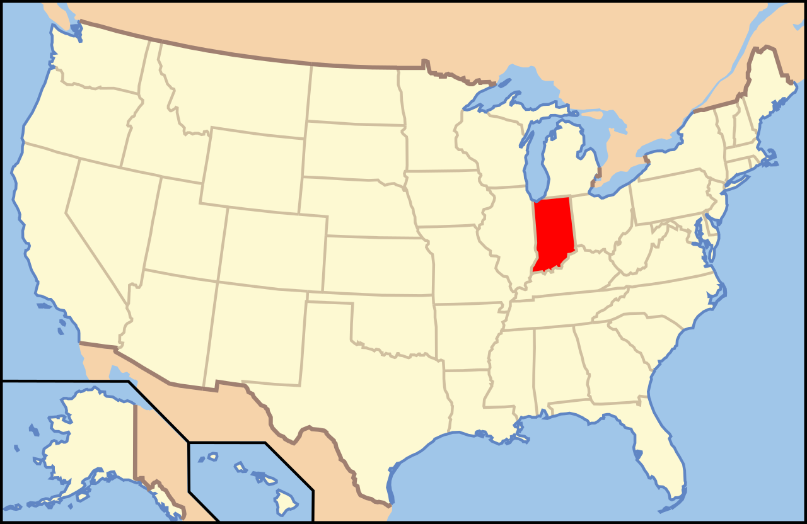
Who we are and our mission
Notes:
Mission: Bring awareness to the importance of identification
A student’s social and academic success can be measured by their perceived identity within the course work being taught. Identification is defined by having a sense of belonging in a school and valuing the school-related outcomes. The opposite, dis-identification, often leads to a path of downward mobility where students learn to feel unappreciated and unvalued.

Slide 3
Why does where we come from matter?
Formation of identity
Where we come from plays a major role in our identity and who we are.
Perspective and perception
Our background influences how we actively participate in our experiences and learning
Nuance in the classroom
Classrooms are full of students with diverse backgrounds and therefore unique identities
Notes:
Thoughts on the importance of background in the formation of identity
Stephanie Ona and _____
Why does where we come from matter? It’s a pretty straightforward question, I think.
Where we come from plays a major role in our identity and who we are as a person.
Everything from the country we call home, our native language and the community with which we speak it. Our family dynamics, childhood friendships and relationships. Our religion and community of faith. Our schooling, teachers, and peers. All contribute to who we are as individuals.
But our life doesn’t passively happen to us and form us like the squares of a quilt. We actively interact and influence our experiences and learning to create a quilted piece unique to us.
Each square, each stitch, each fold of the garment that is our life shapes our identity. And as we grow and change, so does our quilt.
Your classrooms are full of students decked out in customized quilts that represent the intersectionality of their identity and background. You as teachers, though it may not always be in your pay grade, are tasked with honoring the identities of your students through schooling.
Why? Because from the ages of 4-18 students spend more hours awake in school with you than they do at home. Because schools function as a microcosm of their immediate society, preparing students with the tools that not only foster their intellectual growth, but also social, emotional, and behavioral learning so that they can effectively engage and contribute to their community.
Ain't nothing more impactful in a community than people who are confident and content in their identity and their capabilities. So is it imperative that administrators and teachers enrich students with a curriculum that fosters that confidence of self.
Who we are, where we come from, how we identify influences how we receive and perceive the world and in turn affects how the world receives and perceives us.
As I mentioned before, schools serve as a microcosm of society and in American society, the American curriculum, though it is not standardized, is outdated and as a consequence exclusionary of millions of identities.
A scan on the literature and history curriculum alone revealed a tendency for American schools to teach from a straight white male perspective. History books often dilute or exclude othered experiences or reduce a non white male identity to a moment in time (land acquisition from natives, suffrage movement, civil rights).
And while this curriculum structure may not be deliberate, the general comfortability of what has always been enables complacency of pedagogy.
This complacency acts in direct conflict with individual identity as it damages students’ quilted pieces: smearing with dirt and tearing at the seams of some patches of a students identity that isn’t encouraged by the curriculum.
In short, where we come from matters because the diversity of our experience allows for nuance in our learning.

Slide 4
Encouraging Identity
Conscious Inclusivity in Class Materials
Ensuring use of measures of diversity
Children will be more confident in themselves and their identity when it is represented in maths word problems, books, etc
Children will feel more comfortable with their teacher if they feel an effort is being made to include them
Allowing Open Conversations
Children will learn to value their unique background and experiences, and learn from the perspectives of others
Students can improve their empathy, communication skills, and sensitivity to others’ views, interests, and needs
Create a Safe and Supportive Environment
If students present a lack of comprehension, provide the help necessary without judgement or disappointment
Meet with students privately to remove potential peer-related stress and communicate confidence in their ability
Notes:
How to encourage student involvement in school
Using multiple perspectives and representations in materials
saachi and caroline

Slide 5
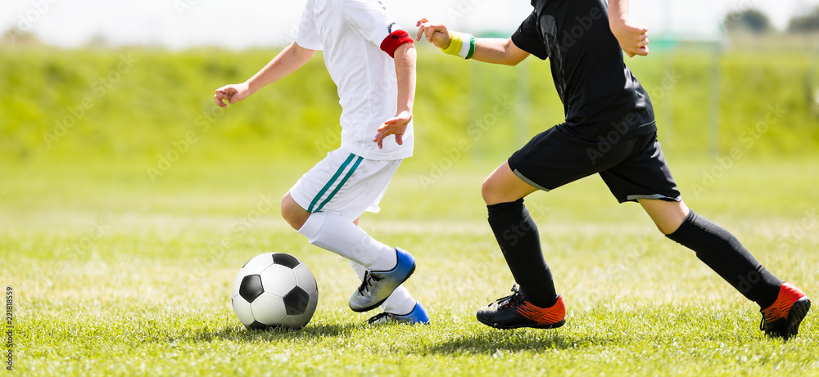
Identification vs Disidentification
Identification: Students relating to and identifying with the school and feeling that their voices are being heard
If a student can’t find ways to identify with the school, it is difficult for them to see the importance of learning.
How to aid in identification?
Inspiring students to identify with and take pride in their school
Emphasis on participation and class discussion
Listening to student feedback, from surveys and individual meetings with students
This feedback will aid in the creation of clubs, extracurricular activities, and study groups that the students want to be a part of.
Notes:
If a student can’t find ways to identify w/ school…
This lack of ability to see importance of learning will negatively impact their academic success along with behaviour at school. Instead of aligning their goals with the goals of the school, they would drift aimlessly through each course and academic year.
Necessity to inspire the students to feel like they are working on something very important: their own education … and that this aligns with the school’s value
In school, I felt like I could identify more with a class when the teacher was personable and inspired me; I consequently worked harder. An example of this was my high school spanish class, as I worked harder I began to identify more with the school and take pride in being a part of it
Example: at St Thomas More, the student body is very diverse. The teachers do a great job of including everyone in class discussions
I’ll do the blue
ON PARTICIPATION/ CLASS DISCUSSION: through constructive conversation, all students’ can feel that they are able to express their identity by participating.
FEEDBACK: surveys and feedback give us a way to hear from students things they might not have wanted to say in person (anonymously). Gives us a look into student’s minds
ABOUT CLUBS
Own examples: in my high school, I did not identify with or feel interested in a lot of the academic after school activities; however sports really stimulated me and kept me active. I found my school identity thru participation in sports. This in turn led me to working better in school so I could remain in sports
You could add ur own exp here as well
Throughout my life I felt disidentification because as a Korean Immigrant, I had to assimilate to white culture, but through sports and activities, I found a common ground with others and made friends. This increased my mental health and allowed me to help others who were going through the same experience.
Transition after talking about creation of clubs to the next presenters.
Increased disidentification can lead to students not seeing the importance of school and learning
Increased identification can lead to overall improvement of student mood and even grades eventually
Young and james

Slide 6
Improving Identification
Encourage Student Involvement
In-School Activities
Service, Physical Education, Art, Music, Field Trips, Assemblies, Career Day, etc.
Helps students discover their passions, make friends, connect with community members
Extracurricular Activities
Service, Sports, Arts, Academic competitions and challenges
Gives every student the opportunity to express themselves outside of the classroom
Prioritize funding and equally supporting these programs
Encourage parental involvement where possible
Incentivize staff and teacher leadership in extracurricular activities
In sum: offering good programs for student involvement helps kids enjoy school, grow as well-rounded individuals, and be proud of who they are
Notes:
How to encourage student involvement in activities
How to encourage teacher involvement in relationship building
Libby and John

Slide 7
Role of faith in schools
What is the Role of Faith?
Intertwined with mission of schools: intellectual knowledge, but also emphasis on emotional and effective learning
Provides an atmosphere that allows students to feel safe and heard
Creates community of fellow students who share the same values
It reaffirms the faith life of students outside of school
Adds culture of compassion to the school
Why is it important?
Helps fulfill Catholic distinctiveness in practice
Education of the whole person
Moral Principles
Education of all
Encourages the formation of identity
Notes:
How does faith and even catholic school missions help encourage the formation of identity
natalie, john d, erin

Slide 8
Wrap up
Schools function as a microcosm of their immediate society
Prepare students with the tools that foster their intellectual growth, and social, emotional, and behavioral learning
Effective engagement and contribution to their community
Encouraging Identity
Students learn to value their unique background and experiences while learning from others
If a student can’t find ways to identify with the school, it is difficult for them to see the importance of learning.
Encourage student involvement in-class and through extracurriculars
Intertwined with mission of Catholic schools: intellectual knowledge, but also emphasis on emotional and effective learning
Encourages the formation of identity
Notes:
Tyler and Olivia

Slide 9
Thank you!
The Sixth Annual School Leaders’ and Educators’ Conference
Hotel Alexander, Bardejov Spa
4 - 5 November 2022

