Slide 1
Working Together on Pedagogy
Practical strategies to create and develop a culture of collaboration and innovation for teaching and learning.
Helen Jordan​
Assistant Headteacher
Blessed Hugh Faringdon Catholic School
Better Together – teacher, school and systems’ collaboration to secure educational improvement
The Sixth Annual School Leaders’ and Educators’ Conference

Slide 2
agenda
Introduction​: the challenge
Motivation
Relevance
Active participation
Collaboration
Practical Strategies to develop culture
Impact and Outcomes
​

Slide 3
The Challenge
Motivation:
the prospect of making a difference in pupils’ lives motivates 92% of teachers (LKMco & Pearson 2015)
BUT
Only 38% of teachers surveyed in October 2018 agreed that ‘time and resources allocated to professional development are used in ways that enhance teachers’ instructional capabilities’. (Teachertapp, 2018)
AND
Substantially fewer classroom teachers (29%) agreed with this statement compared to headteachers (73%). (Teachertapp, 2018)
Notes:
Christopher Day “Teachers’ Worlds and Work: Understanding Complexity, Building Quality” Routledge 2017
‘Why Teach?’ LKMco and Pearson. 2015
What Teachers Tapped This Week #56 - 22nd October 2018 - Teacher Tapp

Slide 4
The Challenge
Relevance
Mid-career teachers vs Early Career Teachers
Barriers to effective Professional Development
Requirement for more specialized Professional Development
Outcome noticeable in 2018 OECD Teaching & Learning International Survey (OECD TALIS 2018)
Notes:
Jim Knight “Unmistakable Impact: A Partnership Approach for Dramatically Improving Instruction” Corwin Press 2010
TALIS - The OECD Teaching and Learning International Survey - OECD

Slide 5
The Challenge
Active Participation
Teachers’ autonomy and their perceived influence over their professional development goal setting is the area most associated with higher job satisfaction and a greater intention to stay in teaching. (NFER & Teacher Development Trust, 2020 )
Professional development activities should:
Be designed around individual teachers’ existing experience, knowledge and needs
Be relevant to the context and day-to-day experiences of teachers and their schools
Notes:
NFER & Teacher Development Trust, 2020 - “Teacher autonomy: how does it relate to job satisfaction and retention?”

Slide 6
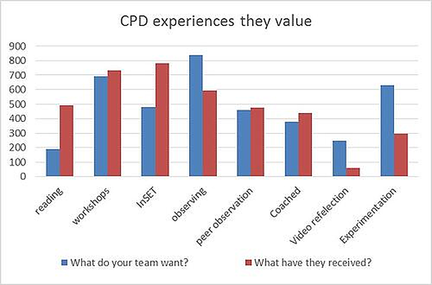
What do teachers want? (Irisconnect.com 2022)
Notes:
Effective Teacher CPD: How To Enable Career-long Learning (irisconnect.com)

Slide 7
Notes:
Bruce Joyce and Beverley Showers, 2002, Designing Training and Peer Coaching: Our needs for learning, VA, USA, ASCD

Slide 8
The Challenge
Collaboration
1 in 5 teachers don’t feel that they work in a collaborative culture
[OECD Tallis 2018]
Notes:
TALIS - The OECD Teaching and Learning International Survey - OECD

Slide 9
Practical strategies
At Blessed Hugh Faringdon Catholic School

Slide 10
Teaching & Learning Working party
Working lunch provided
Meet once per half-term ( 6 times per year)
Agenda is the planning, implementation and review of school-wide T&L strategies and innovations
Membership by invitation on annual review. Recommendations from middle leaders and/or nominations from peers (teacher innovation award)

Slide 11
Teacher innovation award
Monthly Award, nominations open to all
Decided on popular vote
Announcement in staff briefing with small prize
(often followed-up with invitation to teachbrief)

Slide 12
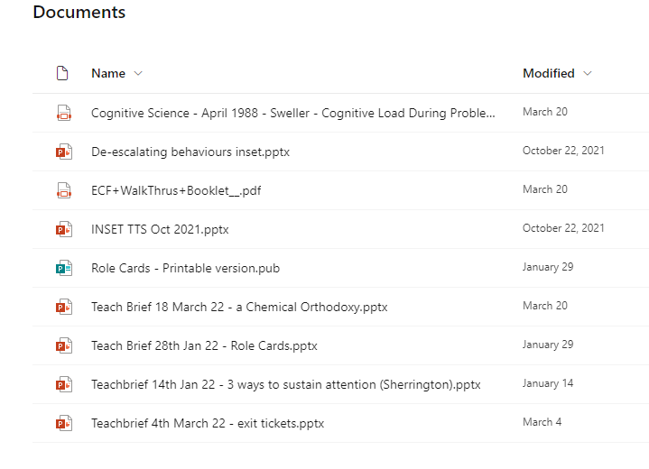
Teachbrief
Dedicated one briefing per fortnight to a 10-minute teachbrief presentation
A teacher/pair explain a technique they/their team are successfully implementing in their pedagogy
Resources are made available in sharepoint
Coordinated & calendared by SLT to create focus and cohesion

Slide 13
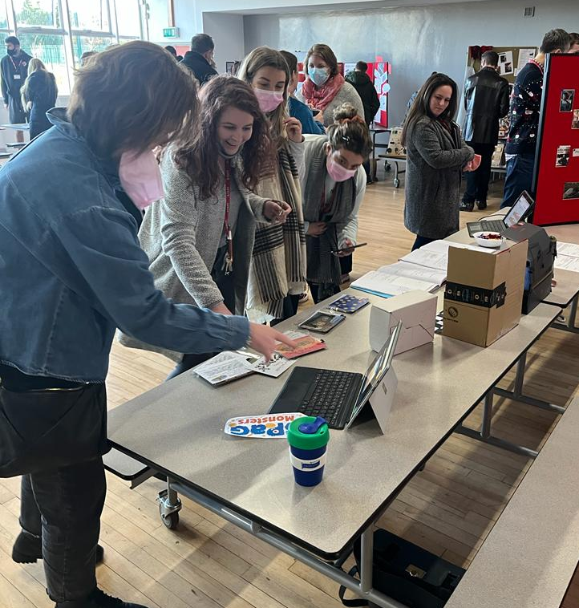
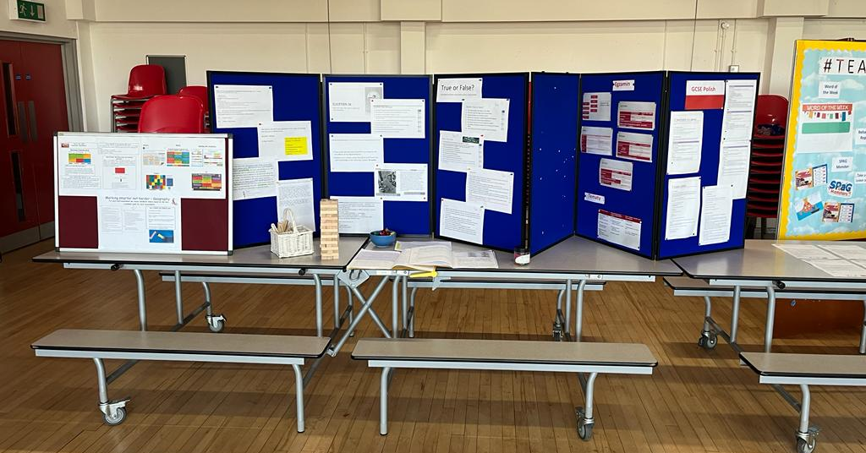
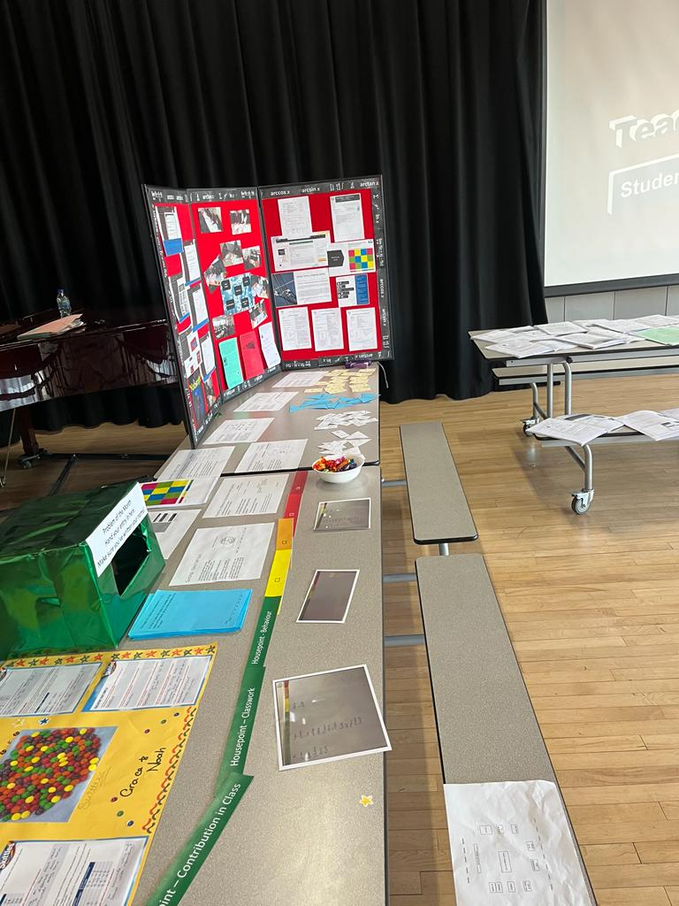
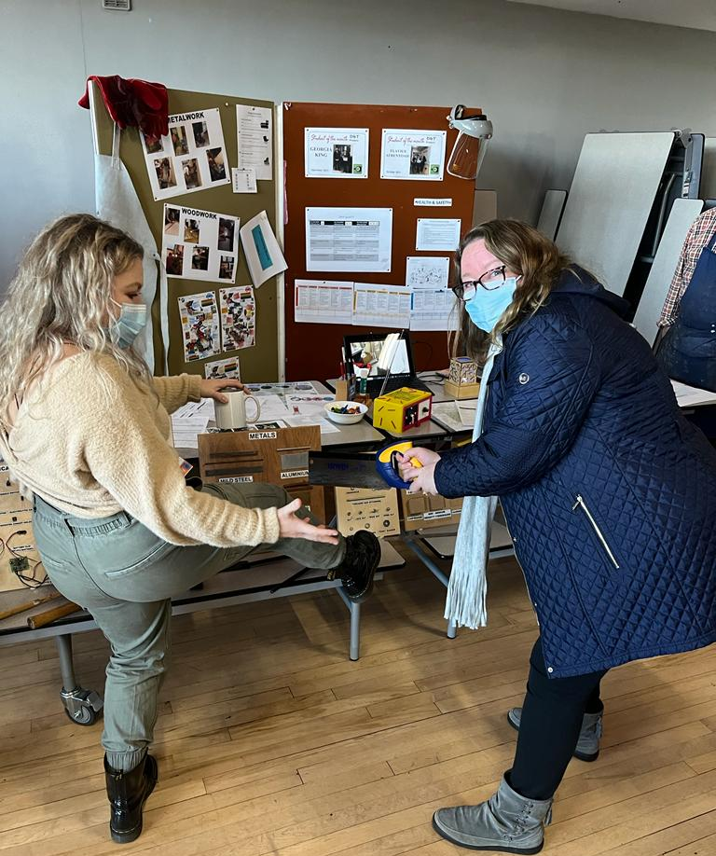
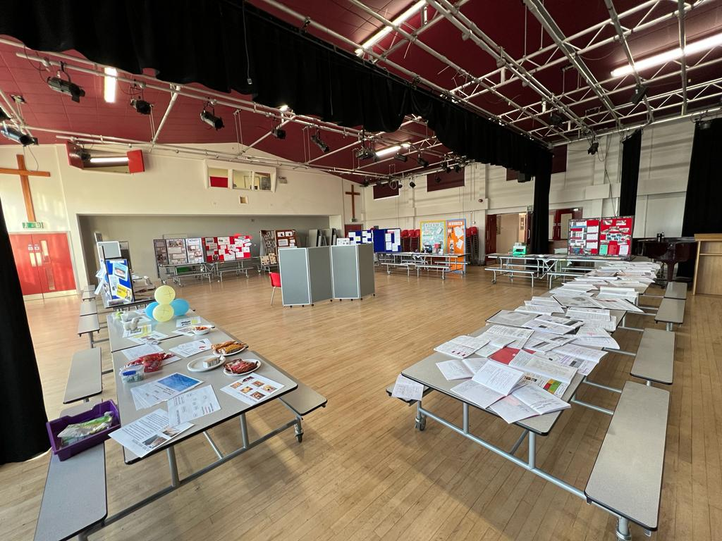
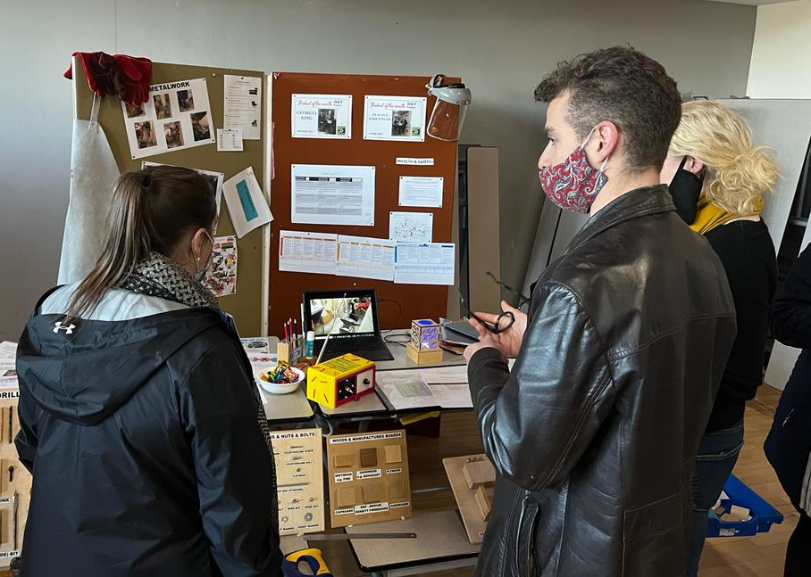
#Teachfest 2021
The Professional Development session on in
December ‘21 took the form of a
‘marketplace’ for subject teams to
share good practice & new resources,
to help each other and SHOW OFF what we had been working on this past year
Stalls could display resources, demonstrations of practice in action (via videos), even examples of students’ work where applicable.
Colleagues were able to
browse and ‘shop’ for resources,
discuss strategies on show and
sign up for peer observation
drop-ins if they want to find
out more.
There was voting and prizes
for the best stalls!

Slide 14
Peer-led Training
Lead teachers are chosen from across the range of subjects (in discussion with line managers and leadership).
Not necessarily subject leaders, an opportunity for any colleagues with a specific skill to lead.
Prepare a session individually or in pairs, working with Teaching & Learning leadership

Slide 15
Needs-based professional development
Teaching and Learning CPD Session - 12th March 2021 (office.com)

Slide 16
Peer observations
Optional Sign-up
Colleagues asked to identify at least one area they would be happy to demonstrate and one area they want to observe
List of preferences published to all staff who signed up so they can ‘match’ with another teacher and arrange to visit their lesson(s) when mutually convenient
Feedback sheet issued to all involved at the end of term to gather evidence of impact and suggestions for improvement

Slide 17
An environment for growth
Staff Room lending library
‘Sharing Good practice’ noticeboard with praise ‘post-it’ notes
Leads to ideas for ‘Innovation Award’ nominations… and the positive cycle continues!

Slide 18
Impact and outcomes
Student Outcomes across all stages
Observable improvement in classroom practice
Increased engagement with professional qualifications
The ‘non-measurables’
Discussions around teaching and learning
Attitudes towards challenge and innovation
Staff wellbeing and confidence

