Slide 1
how Is, The Brand Called You, viewed In A Competitive Marketplace?

Slide 2
Please watch the two Videos, and Read the two articles prior to the Seminar

Slide 3
Two short videos for your review:
https://www.youtube.com/watch?reload=9&v=CrNqADYHiXI
https://www.youtube.com/watch?v=Alqt7pIbp_o

Slide 4
Two short articles for you to read:
https://www.skillsyouneed.com/ps/personal-swot-analysis.html
https://www.fastcompany.com/28905/brand-called-you

Slide 5

What is YOUR BRAND?
What is YOUR BRAND?
How do you stand out in a competitive workplace and does BRAND YOU, meet the wants, needs and desires of the modern work force?

Slide 6
What is a Brand?
CORPORATE
Personal
The American Marketing Association defines a brand as “A name, term, design, symbol, or any other feature that identifies one seller's good or service as distinct from those of other sellers.
Personal branding is the practice of marketing people and their careers as brands. It is an ongoing process of developing and maintaining a reputation and impression of an individual, group, or organization

Slide 7
What is your brand?
How do you stand out in a competitive workplace and does BRAND YOU, meet the wants, needs and desires of the modern work force?
Question # 1
What does business success look like to you?
a)
b)
c)

Slide 8
What is your brand?
How do you stand out in a competitive workplace and does BRAND YOU, meet the wants, needs and desires of the modern work force?
Question # 2
What three skills are needed, and valued by employers in the 21st century work environment?
a)
b)
c)

Slide 9
“Everyone has a chance to learn, improve, and build up their skills.”
The twelve 21st Century skills are:
Critical thinking
Creativity / Problem Solving
Collaboration
Communication
Information literacy
Media literacy
Technology literacy
Flexibility
Leadership
Initiative
Productivity / Time Management
Social skills

Slide 10
What is your brand?
How do you stand out in a competitive workplace and does BRAND YOU, meet the wants, needs and desires of the modern work force?
Question # 3
What does personal success look like to you?
a)
b)
c)

Slide 11
“ Everyone has a chance to stand out.”
Question # 4
Is your view of business success aligned with your view of personal success?
(Is it just about how much money you earn
or; the title you have?)

Slide 12
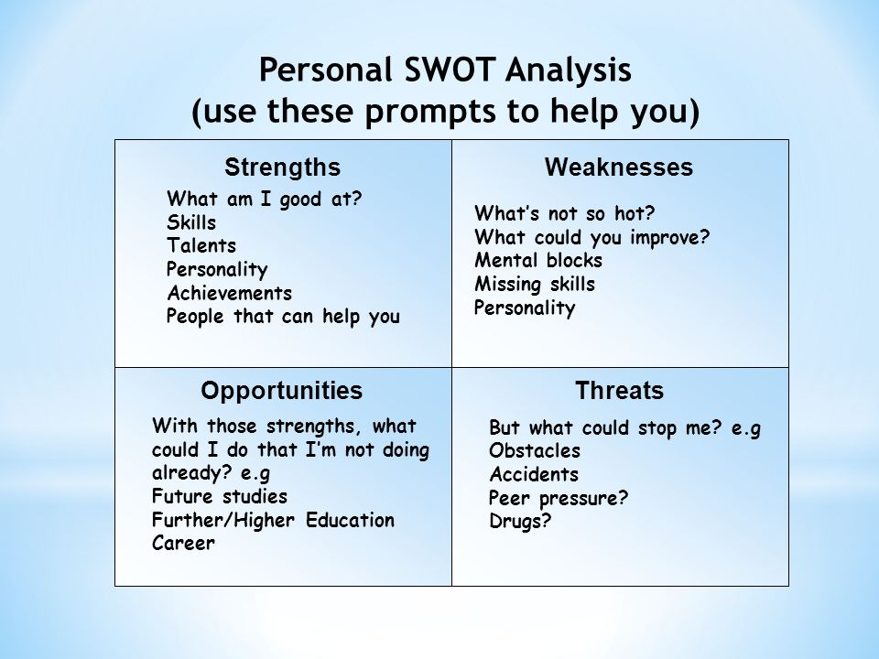

At its core, your brand is your reputation; how people think of you.
Everyone has a brand, but not everyone’s personal brand is developed to be a strength.

Slide 13
What is YOUR BRAND?
What is YOUR BRAND?
How do you stand out in a competitive workplace and does BRAND YOU, meet the wants, needs and desires of the modern work force?

Slide 14
Your SWOT of YOU
STRENGTHS
Weakness
1) 5)
2) 6)
3) 7)
4) 8)
1) 5)
2) 6)
3) 7)
4) 8)

Slide 15
Your SWOT of YOU
Opportunities
THREATS
1) 5)
2) 6)
3) 7)
4) 8)
1) 5)
2) 6)
3) 7)
4) 8)

Slide 16
The Great Pause = The Great Accelerator

Slide 17
What is YOUR BRAND?
What is YOUR BRAND?
How do you stand out in a competitive workplace and does BRAND YOU, meet the wants, needs and desires of the modern work force?

Slide 18
FOR YOUR CONSIDERATION
Widespread social distancing puts remote work in the spotlight.
How do you convey confidence in The BRAND called YOU via ZOOM?
Never say, ” I work hard”….. You prove it by your actions.
Certifications vs Internships?
Can you solve my problem?
Life-Long Learning is Necessary, because the marketplace keeps changing.
Stay current in adding value to your organization, or someone else will
Networking
Active engagement vs passive engagement
Get comfortable with the “ask”
https://www.business.com/articles/remote-worker-skills/

Slide 19





The GREAT PAUSE has Forced all workers to change and add skills

Slide 20
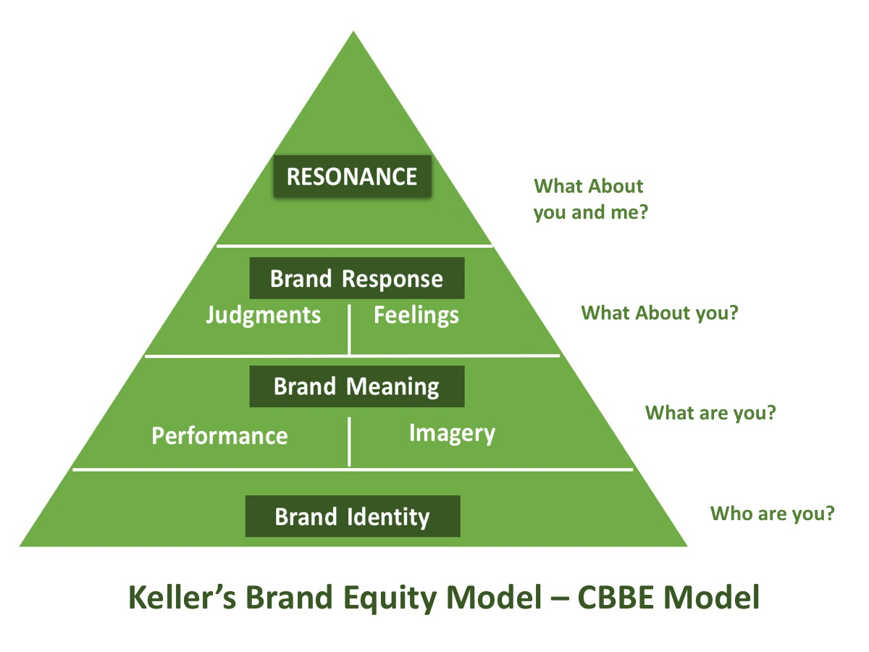
Brand Considerations

Slide 21
Personal Brand Tools
LinkedIn Profile
  Club Leadership Positions
  Volunteer Work
  Facebook ?????
Start Building up your connections- now!
Personal Website or Blog
https://www.theladders.com/career-advice/5-ways-to-improve-your-linkedin-profile-in-10-minutes-or-less-2

Slide 22
Change is painful, however, Irrelevance is WORSE

Slide 23
What is YOUR BRAND?
What is YOUR BRAND?
How do you stand out in a competitive workplace and does BRAND YOU, meet the wants, needs and desires of the modern work force?

Slide 24


Slide 25
What is YOUR BRAND?
What is YOUR BRAND?
How do you stand out in a competitive workplace and does BRAND YOU, meet the wants, needs and desires of the modern work force?

Slide 26
Student Veteran Career Guide
Military Service to Civilian Professional

Slide 27
Navigating a Military to Civilian Career Change
When deciding on a civilian career, evaluate:
Work with a Wasserman Coach
What aspects of your military tasks and skills would you like in a civilian position?
What aspects of your military tasks and skills would you prefer NOT to perform in a civilian position?
What industries and/or job functions include those tasks and skills that you would like to continue?
You can work with a coach at the Wasserman Center to identify careers of interest and learn how to translate your military experience into civilian success.
The first step is to identify your specific role and contribution to your unit/squadron/platoon and recognizing your value add.

Slide 28
the military is often a “we” organization, however in the civilian sector you must also identify the “I” in your experiences
1) What transferable skills do you feel you obtained in your military career and how can you translate it to show your value as an employee?
2) Identify collateral duties, leadership and/or training responsibilities.
3)Throughout your military experience, what key knowledge, accomplishments, skills, and experiences would you say are most valuable?
4) Spend time determining how you want to speak about those skills and accomplishments.

Slide 29
Building your professional network is a key component to civilian success.
Identify contacts through :
Family, and friends,
LinkedIn,
Student Veteran Clubs,
NYU Alumni Network,
Personal veteran networks,
NYU professors
Classmates
Volunteer Experiences
Networking provides opportunities to identify contacts within various industries that could lead to potential job opportunities.
One of the first steps in your transition should be to BUILD YOUR NETWORK.

Slide 30
Resume Tips: Transform Your Resume from Military Experience to Civilian Success
1) Show off your military background – if you were in combat, focus on your transferable skills and highlight your key responsibilities (For example, if you were Infantry discuss your communications, team building, and project management skills).
2) Highlight your track record of accomplishments – promotions and advanced responsibilities, collateral duties, and ribbons/awards/medals.
3)Always assume hiring managers are not familiar with military jargon so avoid using acronyms.
4) Do not use your military email address (johnsmith@navy.mil) on your resume, ensure that you include your NYU email address or other email source.
5) Identify all relevant training and certificates received in the service that would support your new career

Slide 31
Military Experience to Civilian Success
6) If your security clearance is still active, it is recommended to include this in your resume, as it may be an attribute to government, state, or private employers that require this.
Please note that after one-year of exiting the service or not utilizing your clearance it becomes inactive.
7) For veterans with more than 10 years of experience or who have performed numerous positions, highlight the positions that are most relevant to the career you are interested in pursuing.
In addition, position titles should reflect your MOS/job title not military rank *(utilize ONET Online for civilian translations)

Slide 32
What is YOUR BRAND?
What is YOUR BRAND?
How do you stand out in a competitive workplace and does BRAND YOU, meet the wants, needs and desires of the modern work force?

Slide 33
Make an Appoint with a Wasserman Career Coach
We want to help you!
www.nyu.edu/careerdevelopment

Slide 34
Key Transferable Skills
The next slide are a few examples of key transferable skills to highlight in your resume.
This is only a small representation of the skills gained in the military.
To identify transferable skills, visit ONET Online www.onetonline.org/crosswalk or
Military.com Skills Translator www.military.com/veteran-jobs/skills-translator
Make an appointment with a Career Coach at The Wasserman Center: www.nyu.edu/careerdevelopment
Make an Appointment at The Wasserman Career Center

Slide 35
Key Transferable Skills
Leadership
Project Management
Training/Development
Strategic Planning
Public Communications
Emergency Response
Global Affairs
Operations/Risk Management
Logistics/Supply Chain
Team Building
Quality Assurance/Control
Inventory Management
Make an appointment with a Career Coach at The Wasserman Center: www.nyu.edu/careerdevelopment

Slide 36
Networking & Job Search Resources
1) Wasserman Center
Log on to Handshake to learn more about our career resources and events and to schedule a one-on-one appointment with a Career Coach.
2) Google
Google search "jobs for veterans" and enter your MOS code to find civilian jobs that match your skills. Free job training resources are available at www.google.com/grow/veterans.
The next six slides are additional resources to help you.
It can over whelming, to navigate this process, so why not schedule an appointment with a Wasserman Career Coach to assist you in this process.
www.nyu.edu/careerdevelopment

Slide 37
Networking & Job Search Resources
3) LinkedIn ( two slides)
Veterans receive a 1-year free Premium account by visiting https://veterans.linkedin.com through ID.me.
LinkedIn Groups can help you to gain networks, find veteran specific job postings, and gain mentors. Find below a small sample of the military groups on LinkedIn (there are roughly 600 groups for veterans). To search for others, use the search box and select Groups.
US Military Veterans Network
The Value of a Veteran
Military-to-Civilian Transitioners
The next six slides are additional resources to help you.
It can over whelming, to navigate this process, so why not schedule an appointment with a Wasserman Career Coach to assist you in this process.
www.nyu.edu/careerdevelopment

Slide 38
Networking & Job Search Resources
4) LinkedIn (con’t)
LinkedIn Learning’s library of 13,000 courses can help you gain the skills you need to prep for interviews and build your ideal career. Here are some recommended courses:
LinkedIn for Veterans
Finding Your Purpose after Active Duty
Translating Your Military Skills to Civilian Workplace
The next six slides are additional resources to help you.
It can over whelming, to navigate this process, so why not schedule an appointment with a Wasserman Career Coach to assist you in this process.
www.nyu.edu/careerdevelopment

Slide 39
Networking & Job Search Resources
5) Twitter
Provides veteran with networking and job search opportunities, here are a few veteran twitter groups to consider.
@IdealMilHire @RecruitMilitary
@USJFCOM @Greenjobs4vets
6) Job Search Websites
VetJobs.com Troops to Teachers
MilitaryHire.com G.I. Jobs
National Veterans Foundation HireVeterans.com
The next six slides are additional resources to help you.
It can over whelming, to navigate this process, so why not schedule an appointment with a Wasserman Career Coach to assist you in this process.
www.nyu.edu/careerdevelopment

Slide 40
Networking & Job Search Resources
7) Veteran Service Organizations ( two slides):
Student Veterans of America American Legion
USO Iraq and Afghanistan Veterans of America
American Corporate Partners Four Block Foundation
The Mission Continues Veterans of Foreign Wars
Hire Heroes USA U.S. Department of Veteran Affairs
The next six slides are additional resources to help you.
It can over whelming, to navigate this process, so why not schedule an appointment with a Wasserman Career Coach to assist you in this process.
www.nyu.edu/careerdevelopment

Slide 41
Networking & Job Search Resources
7) Veteran Service Organizations:(con’t)
American Legion
USO Iraq and Afghanistan Veterans of America
American Corporate Partners Four Block Foundation
The Mission Continues Veterans of Foreign Wars
Hire Heroes USA U.S. Department of Veteran Affairs
Onward to Opportunity
The next six slides are additional resources to help you.
It can over whelming, to navigate this process, so why not schedule an appointment with a Wasserman Career Coach to assist you in this process.
www.nyu.edu/careerdevelopment

Slide 42
What is YOUR BRAND?
What is YOUR BRAND?
How do you stand out in a competitive workplace and does BRAND YOU, meet the wants, needs and desires of the modern work force?

Slide 43
Make an Appoint with a Wasserman Career Coach
We want to help you!
www.nyu.edu/careerdevelopment

