Slide 1
SITE ARCHITECTURE
SUPERGIRLLS

Slide 2
ECOMMERCE PRESENCE exercise

Slide 3
ECOMMERCE PRESENCE exercise
Vision
Mission Statement
Target Audience
MarketSpace
Strategic Analysis
Internet Marketing Matrix
Timeline
Big Sexy Vision to create a big sister network for young collegiate women to empower networking and connection in the reailworld
Inspire + empower college women to launch by providing tools to help them navigate the complex waters of life after college
Collegiate women sophomores/juniors/seniors undergraduate women who are overwhelmed with life after college
college campuses
College women + parents
More to come
website
blog
instagram
facebook for parents
campus ambassadors
podcast - internet radio
broadcast community am radio
nov wk 4, dec wk 1: finalize web design
dec wk 2: launch radio and website (basic)
mar wk 1: intern deadline
jan wk 1: launch online course
sept wk 1:launch #1 sister series book
feb wk 1: launch ecommerce site
Budget
Site: $1000
Radio Show $10000/6 months
Marketing: TBD, INSTA
Interns
june-aug: intern program

Slide 4
ECOMMERCE PRESENCE Timeline

Slide 5
SITE BLUEPRINT - TEMPLATE
SUPERGIRLLS: empowering college girls to launch!
about
connect
write
shop
speak
community
blog
coaching
radio show
about the sister series
meet the sisters
product catalog
DIY tshirt program
girl power shop - selling with your sisters
keynote value prop
videos/podcast
learn
course info

Slide 6
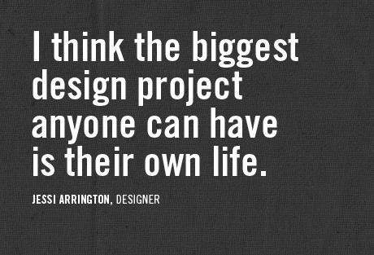
SITE BLUEPRINT – ABOUT US PAGES
What is SuperGirlls?
SG is a platform and movement created to empower + inspire collegiate women to launch
Meet the founder
Designed by a college professor and recovering fashionista -- Jeanne McPhillips discovered that life after 7th avenue was all about empowering + mentoring her younger sisters to discover their own power to achieve greatness and conquer the world!
Team SuperGirlls
SuperGirlls Radio
The Hero Whispers podcast and live radio curates mentors to inspire and inform our collegiate about life after college
SuperGirlls U
discover your superpower
learn killer networking skills
don't be a starving artist!
design your own life
The "Sister Series "
How to become a best selling author while you are still in school
Be part of the SuperGirlls Book Series
Meet our collegiate sisters
Join the brand heroes

Slide 7
SYSTEMS ANALYSIS FOR SITE DEV: template

Slide 8
SYSTEMS ANALYSIS FOR SITE DEV
Business Objective
Speak – Motivational Speaker Gigs
Write – Book Platform
Functionality
Host video, dynamic text + images, forms
Cart, dynamic text+ images
Info Requirements
Video content, text, images
Connect – Mentor Community
Shop – Girl Power Shop
Learn – SuperGirlls U
About SG - Brand Story
CMS, link to social
Cart, Product Catalog
Course site – content hosted
Dynamic text+ images
Credit card processing, book content, testimonials, reviews
Directory of mentors, images, text
Cc process, ship info, product info
Text+ images, video
Video, text, images

