Slide 1
Queen Bee
BeeHarmony.org
Ed Erwin

Slide 2
Queen Bee
a. Know and be able to describe a queen cell, supersedure cell and swarm cell
b. Know and be able to tell the difference between them.
c. Know and be able to describe indications of a “failing queen”, “queen-right” and “queen-less”
Queen-right: having a queen in the hive
d. Know and be able to describe at least one method of Queen rearing.

Slide 3
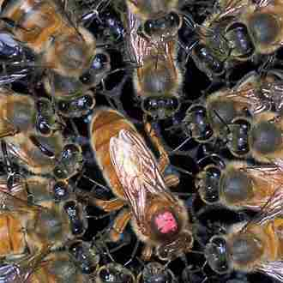
Queen Bee
Adult, mated female that lives in a honey bee colony.
She is usually the mother of most, if not all, of the bees in the beehive.
Queens are developed from larvae selected by worker bees.
The primary function of a queen bee is to serve as the reproducer.
Notes:
The term queen bee is typically used to refer to an adult, mated female (gyne) that lives in a honey bee colony or hive; she is usually the mother of most, if not all, of the bees in the beehive.[1] Queens are developed from larvae selected by worker bees and specially fed in order to become sexually mature. There is normally only one adult, mated queen in a hive, in which case the bees will usually follow and fiercely protect her.
The primary function of a queen bee is to serve as the reproducer. A well-mated and well-fed queen of quality stock can lay about 1,500 eggs per day during the spring build-up—more than her own body weight in eggs every day. She is continuously surrounded by worker bees who meet her every need, giving her food and disposing of her waste. The attendant workers also collect and then distribute queen mandibular pheromone, a pheromone that inhibits the workers from starting queen cells.[12]
The queen bee is able to control the sex of the eggs she lays. The queen lays a fertilized (female) or unfertilized (male) egg according to the width of the cell. Drones are raised in cells that are significantly larger than the cells used for workers. The queen fertilizes the egg by selectively releasing sperm from her spermatheca as the egg passes through her oviduct.

Slide 4
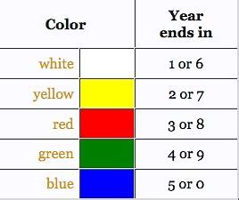
International Queen Marking Guide

Slide 5
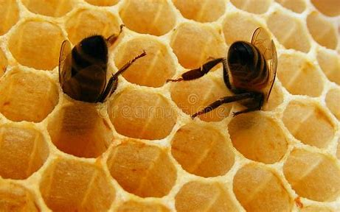
What is a Cell?
The term “cell” is used to describe any type of closed space created from wax by bees.
A “comb” is simply a series of interconnected cells that are used to store honey and pollen and to protect developing brood.
Notes:
What is a Cell?
To understand the difference between a supersedure cell and a swarm cell, it is helpful to understand the terms and the function these cells serve in the hive. In its most general form, the term “cell” is used to describe any type of closed space created from wax by bees. Using this basic definition, a comb is simply a series of interconnected cells that are used to store honey and pollen and to protect developing brood.

Slide 6
Types of Queen Cells
Swarm Cells,
Supersedure Cells
Emergency Cells
Each kind of queen cell is constructed for a different reason.
Notes:
https://carolinahoneybees.com/queen-cells/#:~:text=Honey%20bees%20build%203%20types%20of%20queen%20cells%3A,learns%20to%20discern%20the%20difference%20between%20each%20kind.
3 Types of Queen Cells
Honey bees build 3 types of queen cells: Swarm cells, Supersedure Cells and Emergency Cells.
Each kind of queen cell is constructed for a different reason. A wise beekeeper learns to discern the difference between each kind.

Slide 7
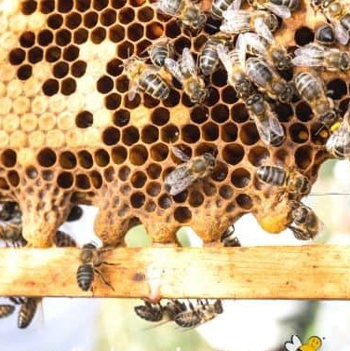
Where are “Swarm” Queen Cells Located?
Primarily found on the bottom of frames and others will be scattered on the face of the comb.
Queen Cells
They can be located anywhere in the brood nest area.
Capped Brood
Notes:
Where are Queen Cells Located?
The number of the queen cells present and their location tell the story of the hive’s status. They can be present anywhere in the brood nest area.
Sometimes cells are found primarily on the bottom of frames and others will be scattered on the face of the comb. The hive normally produces more than 1 cell at a time.

Slide 8
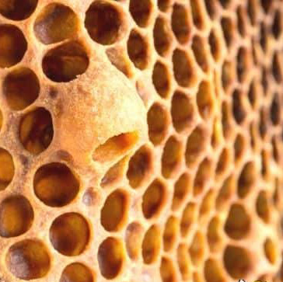
Queen Cups
Dome-shaped cups intended to contain an egg for a future queen.
If the cup contains and egg and white liquid, the cup is in the process of developing a future queen and potential swarming.
Notes:
Queen Cups
Queen cups are wax dome-shaped cups intended to contain an egg for a future queen. Beekeepers should be on the lookout for queen cups during hive inspections, as they send an important message, potentially signaling imminent swarm intentions.
If you see queen cups with an egg, white liquid and where the comb has been drawn out to form a queen cell, then you should pay attention. This queen cup has been "acknowledged" and is in the process of being developing into a future queen, a sign of potential swarming.

Slide 9
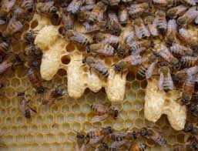
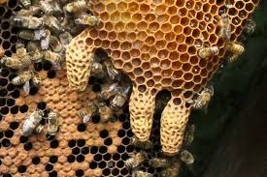
What do Queen Cells Look Like
Resemble peanuts on the frame of comb.
Queen Cells
Because the queen bee is larger (longer) than workers, cells have to be bigger.
Worker Cells
Notes:
What do Queen Cells Look Like?
Because the queen bee is larger (longer) than workers, cells have to be bigger. She can not develop in a normal, small worker cell.
These specially designed “queen cells” resemble peanuts on the frame of comb. Regardless of the types of queen cell – they all look the same and hold a developing queen honey bee.

Slide 10
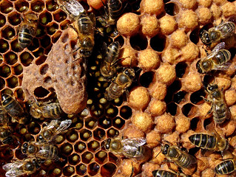
Drone Cells Often Confused as Queen Cells
Drone cells are a bit longer than worker bee cells.
Drone cells protrude from the surface of the comb a bit more.
Drone Cell
Queen cells are peanut shaped and hang down from the comb.
Queen Cell
Notes:
Drone Cells Often Confused as Queen Cells
Don’t be fooled by another type of cell. Drone bee cells are sometimes confused for queen cells by new beekeepers.
Drone brood is reared in cells that are slightly larger than worker cells. However, because drones are a bit longer, drone cells protrude from the surface of the comb a bit more.
They are however distinctly different than large peanut shaped queen cells that hang down from the comb.

Slide 11
arrhenotokous parthenogenesis
Has a grandfather but no father.
Drones

Slide 12
What is a Swarm Cell?
Swarm cells produce a new queen to take the place of the queen preparing to leave the hive (prior to swarming).
The bees produce many swarm cells, usually along the margins of the comb, and the strongest of these new queens take over the production of new brood for the colony.
Notes:
What is a Swarm Cell?
By contrast, swarm cells produce a new queen to take the place of the one preparing to leave the hive. Typically, the bees produce many swarm cells and the strongest of these new queens take over the production of new brood for the colony.
Most beekeepers report seeing three or more swarm cells of variable age in their hives. Unlike supersedure cells, bees typically create swarm cells along the margins of the comb when the colony is preparing to swarm.
To recap, a swarm cell is when there is an overabundance of bees in the hive and they need to swarm to create more room. The old queen leaves with part of the hive to find a new home. The new queen from the swarm cell stays to look over the rest of the hive. A supersedure cell is where the current queen is not doing her part in the hive and therefore the hive creates a new queen to take, or supersede, her place.
Don’t be surprised if you see more than one queen cell in a hive. For all queen cell types, bees can make up to ten to ensure a healthy queen is born.

Slide 13
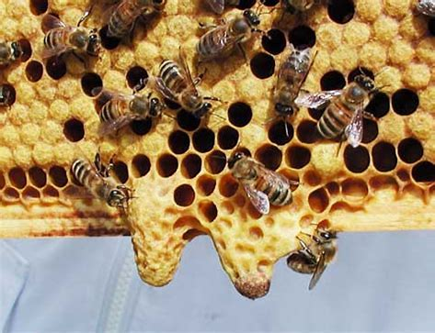
Swarm Cells Produced By the Colony
Usually produced in the Spring.
Called swarm cells because their construction is part of swarm preparations.
Swarming is a natural occurrence for bees.
Notes:
Swarm Cells Produced By the Colony
A strong honey bee colony is likely to produce swarm queen cells in the Spring. But, it can happen at any time during the warm months.
Honey bee swarming is a natural occurrence for bees. It is reproduction on the colony level.
When a colony swarms, a queen (usually the old one) and about half the population of bees leave. They will travel to a new location that has been selected by scout bees. Here, a new hive will be established.
But what about the bees left in the original location? Surely, they need a queen too! Yes, they do.
Before the swarm leaves, numerous queen cells are constructed. These are called swarm cells because their construction is part of swarm preparations.
Once the developing queen larva are mature and ready to emerge, the swarm leaves.
In the next day or so, a new queen will emerge from one of the cells. She kills the other queens still trapped inside and becomes the leader of the colony.

Slide 14
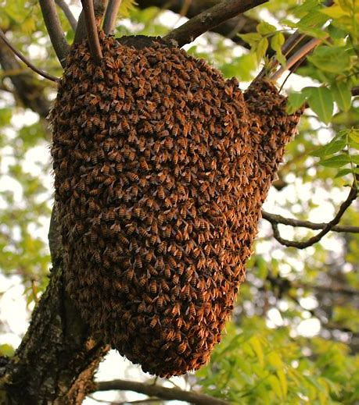
Why Do Bees Make “Swarm” Queen Cells?
The bees have determined that the colony is too large for their current hive.
In this situation, a portion of the bees will prepare to leave the hive with the existing queen.
They search for a new location in a migration known as swarming.
Notes:
In the second case, the bees have determined that the colony is too large for their current hive. In this situation, a portion of the bees will prepare to leave the hive with the existing queen. Together, they search for a new location in a migration known as swarming.

Slide 15
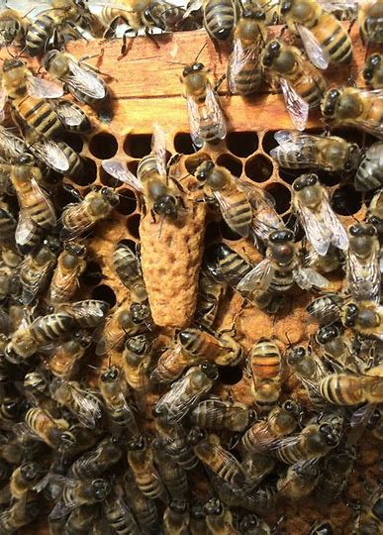
What is a Supersedure Cell?
The new queen that emerges from the cell will take over from, or supersede, the old queen.
The colony creates several supersedure cells at the same time. In most cases, the first one to emerge will become the new queen.
Notes:
What is a Supersedure Cell?
When a colony is raising a new queen to replace the aging, ill or missing queen, they produce supersedure cells. The new queen that emerges from the cell will take over from, or supersede, the old queen. To boost the odds of producing a healthy new queen, the colony creates several supersedure cells at the same time. In most cases, the first one to emerge will become the new queen.
Beekeepers usually find supersedure cells on the comb face, extending out from the surface and hanging downwards. With most varieties of honey bees, the colony will produce between one and three supersedure cells at one time.

Slide 16
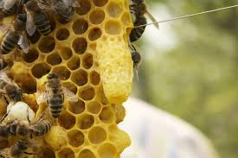
Why Do Bees Make “Supersedure” Queen Cells?
The existing queen is not producing enough brood to keep the colony viable, because….
Queen is aging or ill.
She has run out of genetic material needed to fertilize her eggs.
Notes:
Why Do Bees Make Queen Cells?
However, when beekeepers talk about cells, they are typically referring to queen cells. As the name implies, queen cells are where larva develop and mature into new queens. They are typically around one inch long, have rough surface texture, and are shaped like a peanut shell. Colonies usually produce new queens for one of two distinct reasons.
In the first case, the existing queen is not producing enough brood to keep the colony viable. This can happen when the queen is aging or ill, has run out of genetic material needed to fertilize her eggs, or has died. To keep up the colony numbers, the bees produce a new queen to take over the responsibility of laying eggs.
In the second case, the bees have determined that the colony is too large for their current hive. In this situation, a portion of the bees will prepare to leave the hive with the existing queen. Together, they search for a new location in a migration known as swarming.

Slide 17
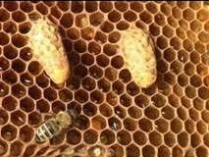
Supersedure Queen Cells
Produced when the colony needs to replace their current queen.
When a queen bee shows a decline in egg laying, the colony will make plans to replace her.
Fewer cells 3- 4. Usually found on the face of the comb, not the bottom.
Notes:
Supersedure Queen Cells
Another type of queen cell is called a supersedure cell. These queen cells are produced when the colony needs to replace their current queen.
Honey bee queens don’t live forever. And more importantly, they contain a finite number of eggs and/or semen to fertilize those eggs.
When a queen bee shows a decline in egg laying, the colony will make plans to replace her.
Supersedure cells can be anywhere in the brood nest area. But, you will most often find them on the face of the comb – not the bottom.
And, you will find fewer supersedure queen cells – maybe 3 or 4 instead of 6 or more than is common for swarm cells.

Slide 18
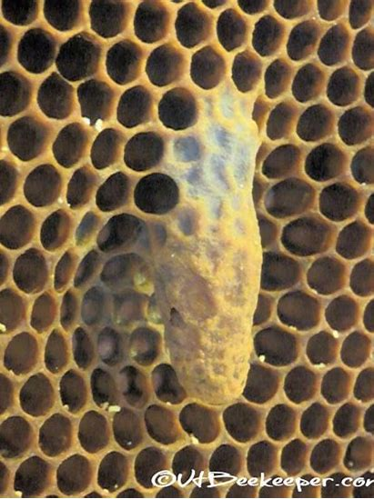
What to do with Supersedure Queen Cells
Trust the bees and let them replace their queen if they want to.
Check back in a couple of weeks to insure that queen replacement was successful, and the colony has fresh brood. Or…
Buy a new queen for the hive. Kill the old queen and tear down any queen cells before introducing a new queen.
Notes:
What to do with Supersedure Queen Cells
If you find several queen cells higher up on the face of the frames. This is probably not a sign of a future swarm. This often signals that the colony has a problem with their current queen.
If the present queen bee is failing in egg laying or pheromone production, the colony will replace her. In most cases, trust the bees and let them replace their queen if they want to.
Check back in a couple of weeks to insure that queen replacement was successful and the colony has fresh brood.
Letting the bees rear a new queen from queen cells does introduce local genetics into the hive. However, you run the risk of an inferior queen being produced.
If you want to try a queen with different genetics, this is a good time to buy a new queen for the hive. Kill the old queen and tear down any queen cells before introducing a new queen.
This is especially good advice in the case of emergency queen cells. Finding just a couple of cells in odd places on the comb may indicate that the colony in in crisis.
They are working with what they have but may not have the best larvae to produce a new queen. Giving them a mated queen is a good choice because they will have new worker bees sooner.

Slide 19
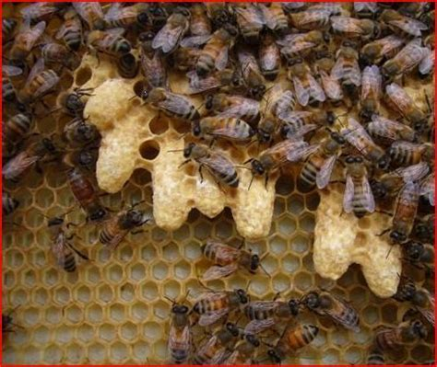
Emergency Queen Cell
The Queen Bee has died.
The bees will make multiple cells along the face of the brood area.
They are located across a frame with the bees desperate too get a new queen.

Slide 20
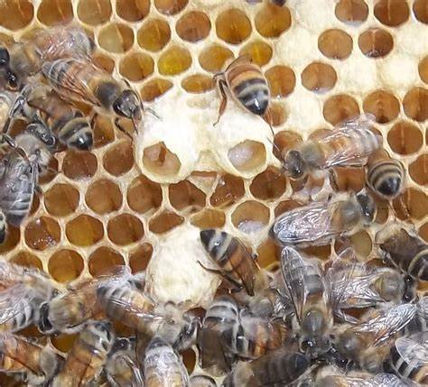
Open Queen Cells
Open queen cells occur during the larval stage.
A look inside reveals a growing larva floating in a bed of brood food.
The quality and quantity of food (royal jelly) in this cell that is responsible for queen development.
Notes:
Open Queen Cells
Open queen cells occur during the larval stage of the developing queen. Worker bees build out the cell along the face of the comb.
Or, if the cell is being produced in a queen cup at the bottom, you notice the cell is being elongated.
A queen bee can not fit in a normal brood cell. She must have more room. Therefore, the open queen cell will be noticeable on the face of the comb or at the bottom of a frame.
A look inside reveals a growing larva floating in a bed of brood food. It is the quality and quantity of food in this cell that is responsible for queen development.
Any worker larva has the capability to become a reproductive queen if she is fed copious amounts of nutritious food very early in life.

Slide 21
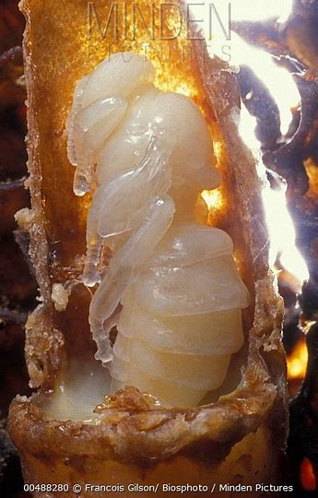
Capped Queen Bee Cells
When the queen finishes her larval development stage, the workers cap the end of the cell with wax.
Inside the queen larva enters the pupal stage, she spins a cocoon and completes the transformation into an adult bee.
Notes:
Capped Queen Bee Cells
The queen cells become a long structure that resembles a peanut. Large queen cells are hard to miss.
As the developing queen finishes her larval development stage, she is finished eating. Workers cap the end of the cell with wax.
Inside the queen larva enters the pupal stage, she spins a cocoon and completes the transformation into an adult bee.

Slide 22
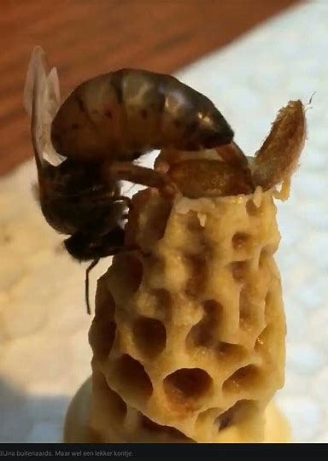
What Does a Capped Queen Cell Mean?
The life cycle of a queen honey bee from egg to adult is 16 days.
Most colonies will cap the queen cell on day 8 (this can be earlier).
Sometimes, it is difficult to tell if the colony has already swarmed, so use care if you cut out cells.
Notes:
What Does a Capped Queen Cell Mean?
The life cycle of a queen honey bee from egg to adult is 16 days. Most colonies will cap the queen cell on day 8 (this can be earlier).
Expecting an adult queen to emerge on day 16, a capped cell has about 8 days left – at most. When we see a capped cell, we don’t know when it was capped.
Has the colony already swarmed and taken the old queen with them? Sometimes, it is difficult to tell. Don’t cut out those queen cells until you verify that she is still in the hive.
When I see partially constructed queen cells and none are capped, I may decide to close the hive and consider how I want to proceed.
The hive may be split into 2 if it is primed to swarm – or I may let the bees continue if I think it is a supersedure issue.
When you are a beekeeper, it is sometimes hard to decide what to do. No choice is guaranteed to be the best one.

Slide 23
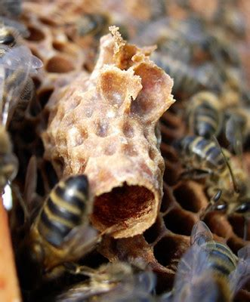
Emerged Queen Cells
Around day 16, a fully formed adult queen will emerge from her cell.
Her first order of business is to seek out any other developing queens and sting them to death.
Survival of the fittest can be an ugly business sometimes.
Notes:
Emerged Queen Cells
Around day 16, a fully formed adult queen will emerge from her cell. Her first order of business is to seek out any other developing queens and sting them to death.
Survival of the fitest can be an ugly business sometimes. Often beekeepers know that a queen has emerged from a cell when they find the end of the capped cell opened.
The queen bee is not ready to take over the colony just yet. She will need to mature for several days and then take her mating flights.
After mating with drone honey bees, she can return to the hive to begin her life’s work – laying eggs.

Slide 24
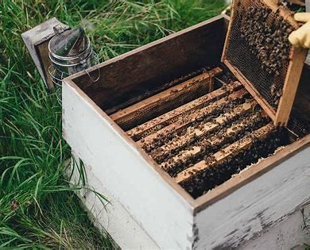
Using Extra Queen Cells
If a colony is strong with many queen cells, you can move the frame with some of the queen cells to a new box.
Add a few frames of bees, brood, honey and pollen from other hives.
Let this new split raise one of the queen cells into a new queen bee.
Notes:
Using Extra Queen Cells
If you have the resources, you can use excess queen cells to start a new hive. If colony A is strong with many queen cells, you can move the frame with some of the queen cells to a new box.
Then add a few frames of bees, brood, honey and pollen from other hives. Let this new split raise one of the queen cells into a new queen bee.
If you have a very large colony with numerous queen cells, you may even split it into 3 smaller hives. But don’t “spread your bees too thin”, or you will end up with several weak colonies.
Be aware if you take too many resources from your main colonies, you may miss the honey flow for the season.
As I tell students in my Online Beekeeping Class, being a good beekeeper is about balance – you have to work with the natural tendencies of the honey bee.

Slide 25
What Queen Cells Tell Us
It is thought that larger queen cells produce queen of better quality, because:
the belief that a strong colony with a large population has more workers to feed developing queens.
During an inspection, the largest ones should always be considered the best to keep.
Notes:
What Pictures of Queen Cells Tell Us
In general, it is thought that larger queen cells produce queen of better quality. This is due to the belief that a strong colony with a large population has more workers to feed developing queens.
When the beekeeper is deciding what to do with queen cells found during an inspection, the largest ones should always be considered the best to keep.
Finding a queen cell, or several, that are torn open on the side is and indication that the colony has reared a new queen. The torn cells are evidence of her killing her rivals.

Slide 26
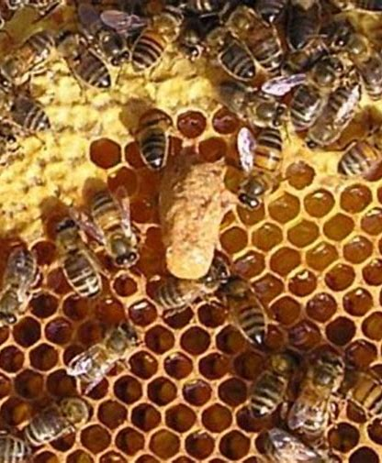
Forced Supersedure
Supersedure may be forced by clipping off one of the queen's middle or posterior legs.
This makes her unable to properly place her eggs at the bottom of the brood cell.
The workers detect this and then rear replacement queens.
Emergency queens are usually smaller and less prolific than normal queens.
Notes:
Supersedure
Capped swarm queen cells
As the queen ages her pheromone output diminishes. A queen bee that becomes old, or is diseased or failing, is replaced by the workers in a procedure known as "supersedure".
Supersedure may be forced by a beekeeper, for example by clipping off one of the queen's middle or posterior legs. This makes her unable to properly place her eggs at the bottom of the brood cell; the workers detect this and then rear replacement queens. When a new queen becomes available, the workers kill the reigning queen by "balling" her, clustering tightly around her. Death through balling is accomplished by surrounding the queen bee and raising her body temperature, causing her to overheat and die. Balling is often a problem for beekeepers attempting to introduce a replacement queen.
If a queen suddenly dies, the workers will attempt to create an "emergency queen" by selecting several brood cells where a larva has just emerged which are then flooded with royal jelly. The worker bees then build larger queen cells over the normal-sized worker cells which protrude vertically from the face of the brood comb. Emergency queens are usually smaller and less prolific than normal queens.

Slide 27
Queen rearing
The easiest method of raising a new queen is to move a ripe queen cell from a busy colony into a nuc or mating box stocked with nurse bees and brood.
This is usually the first type of queen rearing a new beekeeper tries and it is both fun and effective.
Notes:
Queen rearing is the process by which beekeepers raise queen bees from young fertilized worker bee larvae. The most commonly used method is known as the Doolittle method.[16] In the Doolittle method, the beekeeper grafts larvae, which are 24 hours or less of age, into a bar of queen cell cups. The queen cell cups are placed inside of a cell-building colony.[17] A cell-building colony is a strong, well-fed, queenless colony that feeds the larva royal jelly and develops the larvae into queen bees.[18]
After approximately 10 days, the queen cells are transferred from the cell building colony to small mating nuclei colonies, which are placed inside of mating yards. The queen cells hatch inside of the mating nuclei. After approximately 7–10 days, the virgin queens take their mating flights, mate with 10–20 drone bees, and return to their mating nuclei as mated queen bees.[17]
Queen rearing can be practiced on a small scale by hobbyist or sideline beekeepers raising a small amount of queens for their own use, or can be practiced on a larger, commercial scale by companies that produce queen bees for sale to the public. As of 2017, the cost of a queen honeybee ranges from $25 to $32.[19]
Beekeepers can also utilize alternative methods of queen rearing. Examples are the Jenter kit, walk-away split, Cloake board, and artificial insemination.

Slide 28
arrhenotokous parthenogenesis
Parthenogenesis is a form of reproduction in which an egg can develop into an embryo without being fertilized by a sperm.
Parthenogenesis is derived from the Greek word for “virgin birth.”

Slide 29
Questions & Comments

