Slide 1
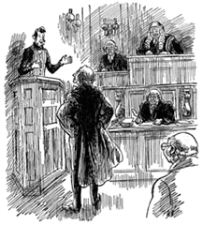
The Expert Expert Witness: Testifying In Court and Coping with Aggressive Cross-Examination Presented at: Association of Family and Conciliation Courts March 29, 2019 Houston, Texas
Stanley L. Brodsky, Ph.D.
biminip@gmail.com

Slide 2
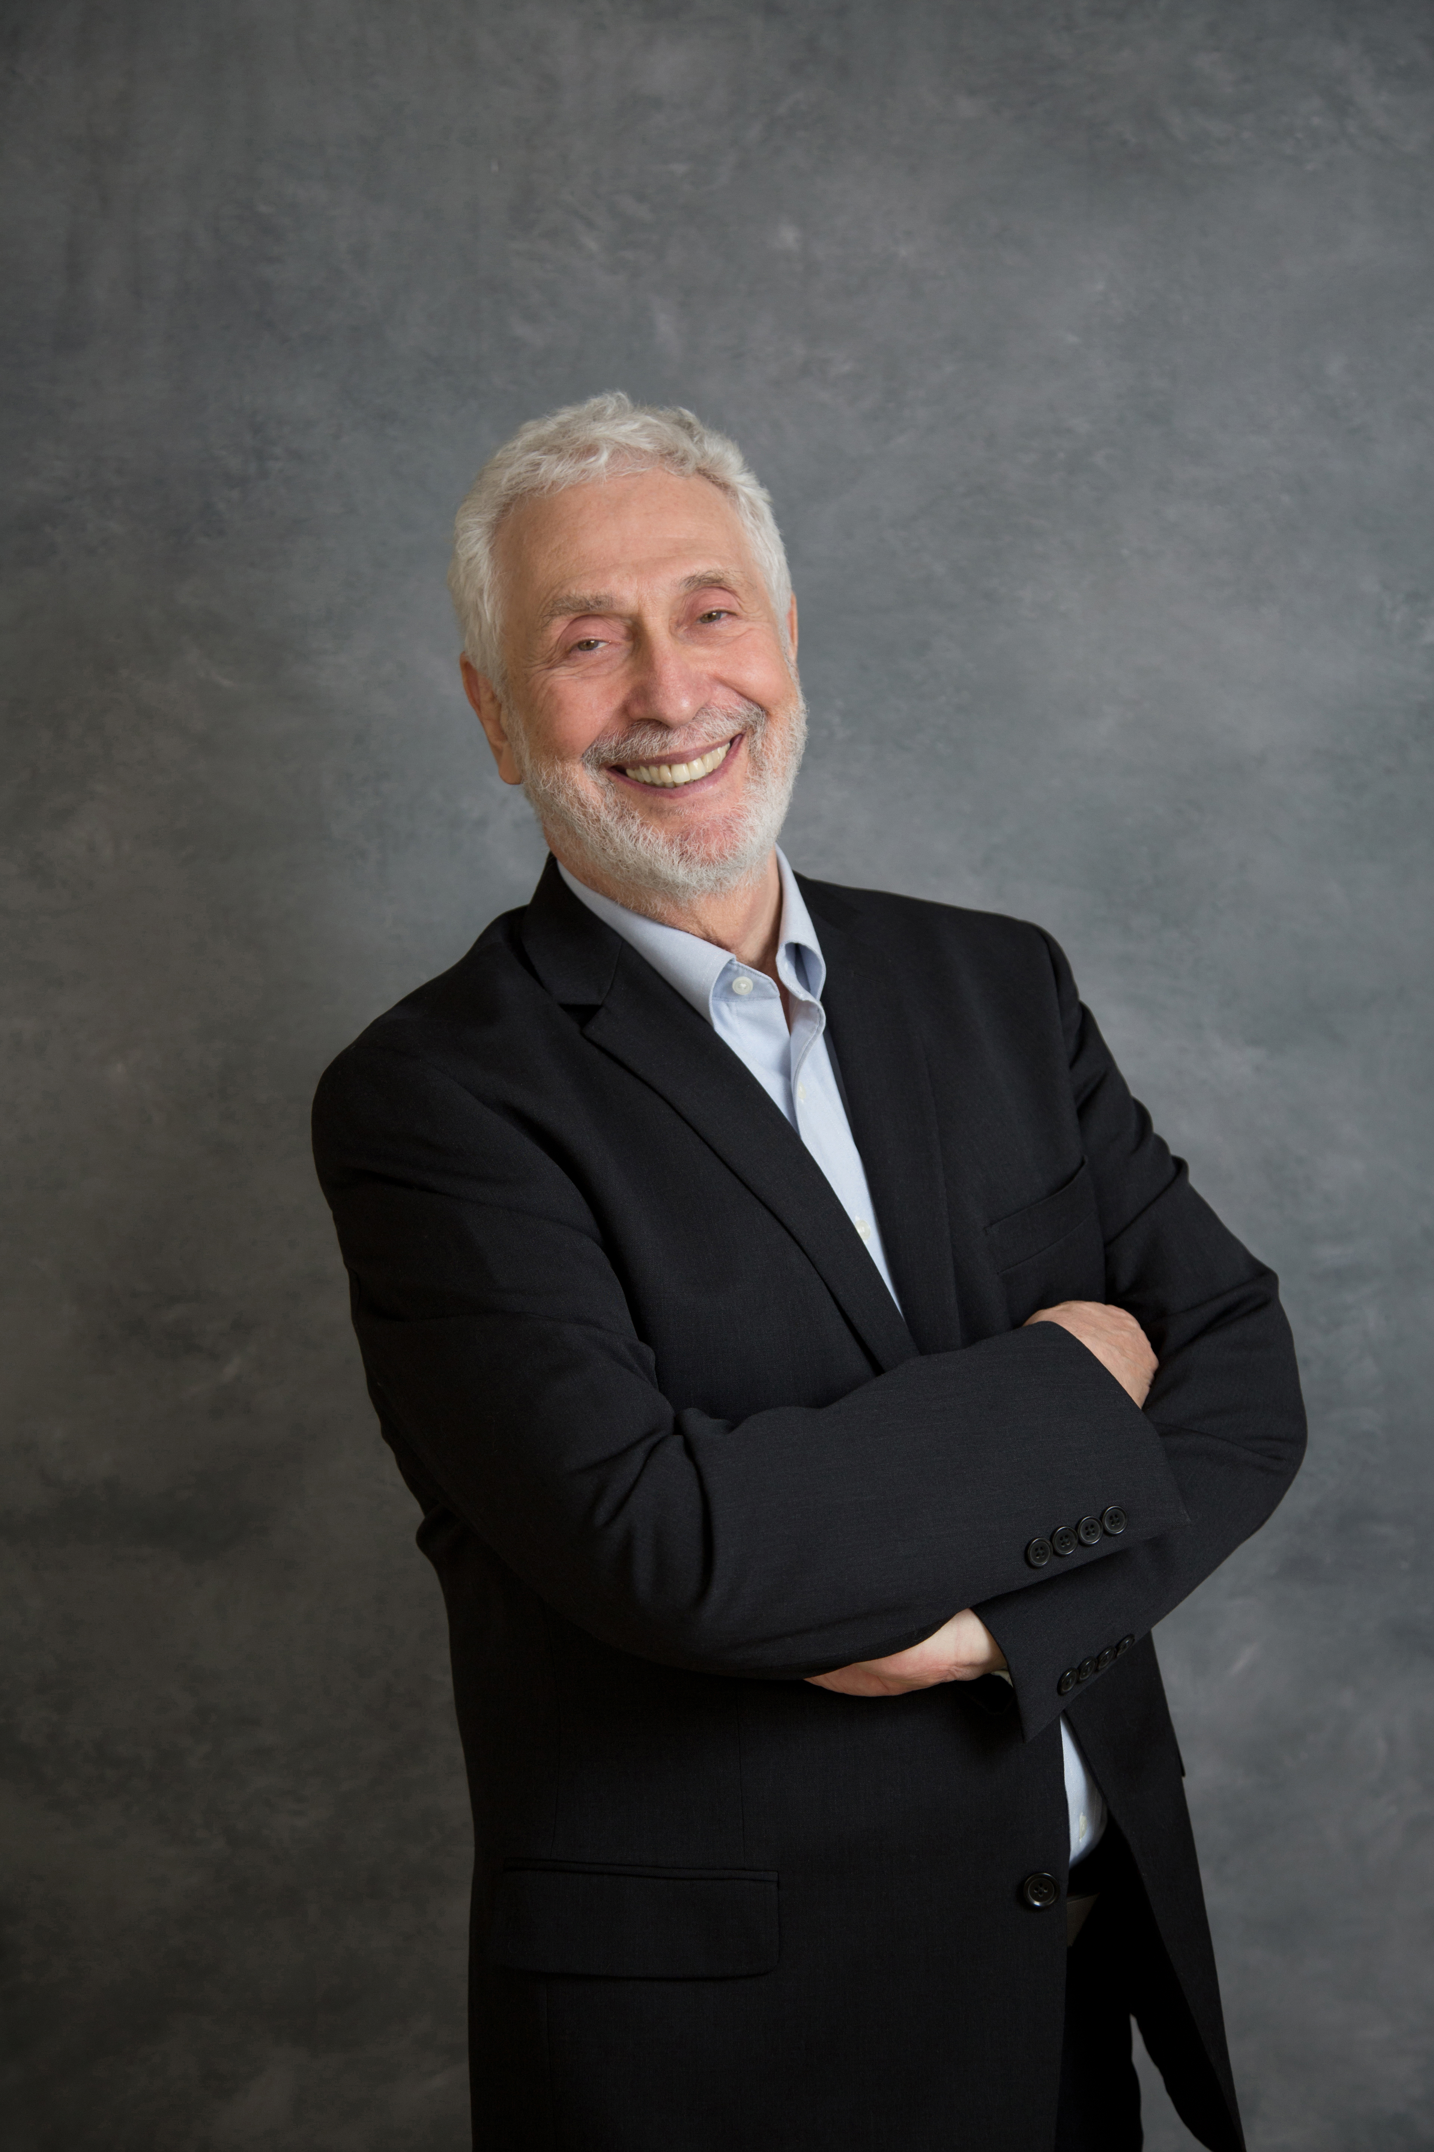
We start with tough X-E Questions
Questions You Should Be Able to Answer at End of Workshop

Slide 3
Contact Information
If you need to follow-up
Stan Brodsky
(205) 887-1436
biminip@gmail.com
No need to take notes. These slides will be provided later.

Slide 4
Goal: Preparation for Worst Case Scenarios
Worst Case Scenarios
Conducted by courtroom-skilled, case-prepared attorneys
These attorneys know how to challenge witnesses
They bring out problems in the experts’ work or uncertainties in their testimony:
EXAMPLE: “Don’t all evaluations have some findings that do not support the conclusions as strongly as others?” (Yes). “Please describe those findings from your own evaluation.”

Slide 5
More About Worst Case Scenarios
Where they came from
Scenarios drawn from workshops
Scenarios drawn from my experience
Themes in the literature
Selected for generalizability
See how you manage them

Slide 6
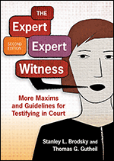
Some References
Brodsky, S.L. & Gutheil, T. (2016). The Expert Expert Witness: More Maxims and Guidelines for Testifying in Court, Second Edition. Washington, DC: American Psychological Association Books.

Slide 7
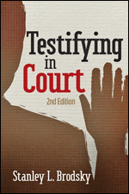
Brodsky, S.L. (2013). Testifying in Court: Second Edition. Washington, DC: American Psychological Association Books.

Slide 8
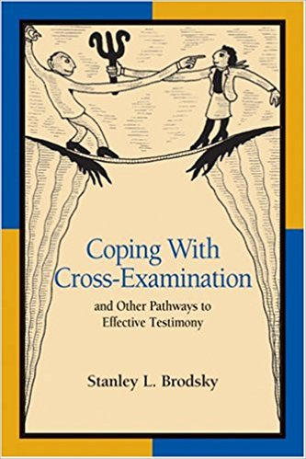
Brodsky, S.L. (2004). Coping with Cross-Examination and Other Pathways to Effective Testimony. Washington, DC: American Psychological Association Books.

Slide 9
More References
Brodsky, S.L. & Wilson, J.K. (2016). Worst expert testimony ever. Psychological injury and law, 9(3), 272-274. . DOI 10.1007/s12207-016-9261-7
Brodsky, S.L., Dvoskin, J.A., & Neal, T.M.S. (2017). Temptations for the expert witness. Journal of the American Academy of Psychiatry and Law, 45, 460-463.
Gutheil, T.G. & Dattilo, F.M. (2008). Practical approaches to forensic mental health testimony. Philadelphia: Lippincott Williams & Wilkins.
Brodsky, S.L. (2011).Therapy with coerced and reluctant clients. Washington, DC: American Psychological Association.

Slide 10
Our Objectives Today: 1-3
1. Learn the process of testifying
2. Understand more choices & constructs during cross-examination & depositions
3. Apply techniques that cut across specialties, cases, and tasks

Slide 11
Our Objectives: 4-6
4. Prepare you to leave courtrooms with more knowledge of transactions on the stand
5. For you to feel more comfortable and satisfied about your testimony
More able to integrate who you are and what you have to say with the demands of the court

Slide 12
Positive Outcome of Demonstrations
Objective to avoid trauma in the workshop.
But, my objective is to arouse some anxiety.
• No demonstration should end without presentation by you or me of successful responses.
•If I have not demonstrated successful responses, demand them!

Slide 13
The Push-Pull
A martial arts principle: Begins with attorney having aggressive tone or demeaning issue with factual basis.
When in agreement, witness moves in the same direction as the question, instead of resisting
A shift in ownership. The topic becomes owned by the witness.
Nondefensiveness of the push-pull promotes credibility

Slide 14
Push-Pull Examples
Requires practice to master the push-pull
Good push-pulls often begin with
“Oh, yes” or
“That is most certainly so” or
“Much more than most people would think”

Slide 15
The Admit- Deny 1: The Admit
Always follows a question in which complex issues are presented overly simply
Admit deny consists of two parts: admitting the part that is true and denying part that is untrue
Reply begins with a dependent clause, using words like “although” and “while.”
Thus, admit-deny might begin with this phrase:
“Although there is a great deal of information I did not have . . . “

Slide 16
Four Additional “Admit” Openings
Insofar as . . .
Insomuch as . . .
Even though . . .
Despite . . .

Slide 17
Admit-Deny 2: The Deny
• The second part of the sentence is a powerful denial of the parts that are untrue. The deny statement might be completed with:
• “. . . the information I do have is clear, consistent and compelling in pointing to my conclusions.”
Admit-deny responses require practice. The deny needs to be stated much more strongly and emphatically than the admit part.

Slide 18
ANSWER “YES OR NO”
Attorneys are entitled to ask that you answer questions with a simple “yes or no”
If there is a simple yes or no reply, by all means answer that way. Don’t be evasive. Say yes or no.
The second “Rule of Three” - no more than three yes answers or no answers in a row. Change wording.

Slide 19
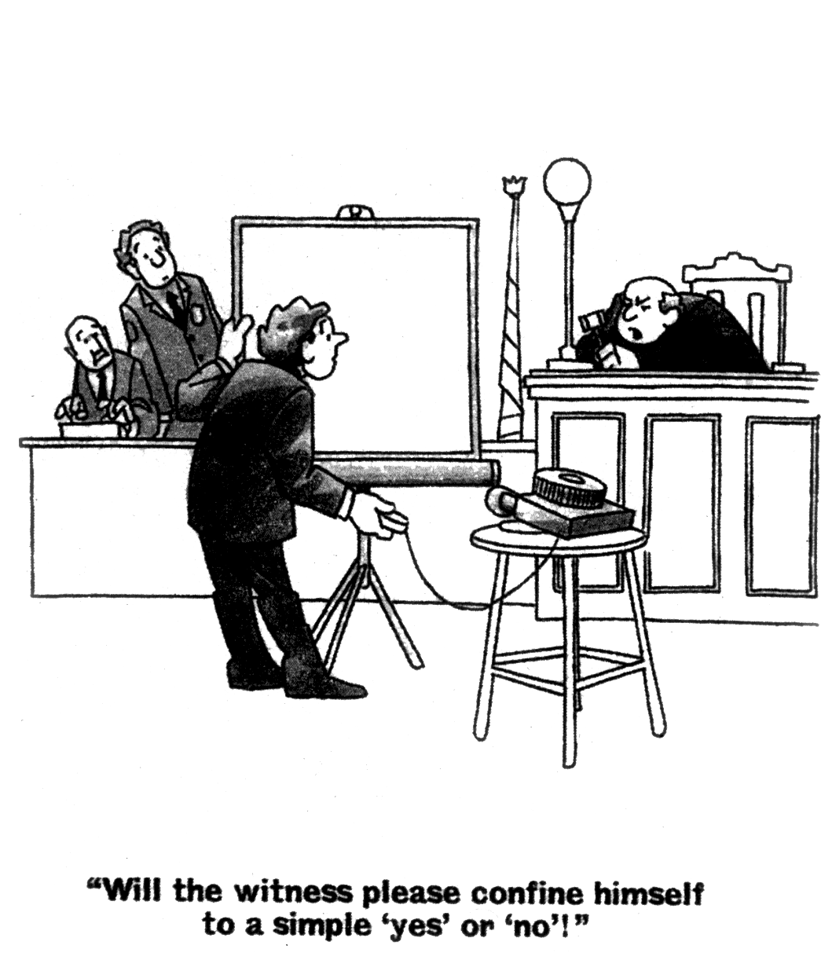

Slide 20
Pass as Option Is Always Present
“Pass” is an always available participant option
No obligation to respond in role-playing
Vicarious learning may occur from watching others
“Pass” as response will never be questioned or pursued
Still, please join in and participate in role-playing if you are comfortable doing so

Slide 21
My Responsibilities
To present principles that apply broadly
To give you a menu of choices: but no mandates. These will be techniques you may wish to try.
Humor: In workshop, not testimony
Also – I will not get through all of my slides. That is part of my plan.

Slide 22
Testifying at its best
Validates personal mastery & professional poise
• Public presentation of professional self: A rare event
• Managing tough scrutiny from intelligent questioners
• Effectiveness in a land of foreign concepts & procedures
• Intellectual challenge of quick thinking & mental agility

Slide 23
Testimony at Its Worst
At its worst, testimony can leave the expert feeling worthless and abused, and resolving never again to be in the courtroom voluntarily.
• Feelings of helplessness and inadequacy.
Disillusionment with the process.
Anger at the cross-examination.
Frustration about one’s performance.

Slide 24
Routine Testimony
Routine court testimony is unremarkable and not challenging
Uneventful & predictable
Not the focus of this workshop

Slide 25
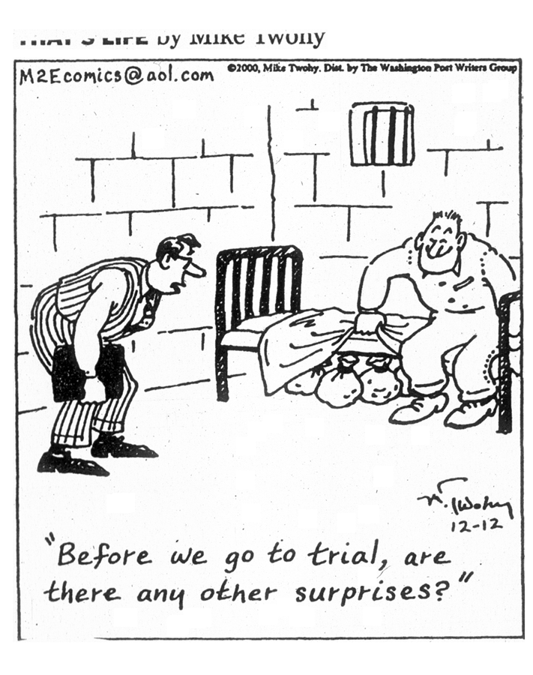
There are almost always surprises when testifying
Notes:
NO SURPRISES

Slide 26
SURPRISES: 2 Examples. Singing and Swooping Attorneys
After attorney says the witness is playing a game, he sings, "Once in a while he won’t call,
but It's all in the game.” (Tommy Edwards song, 1958)
(Many a tear has to fall, but it’s all in the game. All In the wonderful game that we know as love) https://www.youtube.com/watch?v=akbfXUA08OY
Attorney shifts position between each cross-examination question. Droops over the podium, then swoops towards the back of the courtroom, then forward to the podium, bent at the waist and knees, his body forming a stylized letter Z. It was captivating to watch.

Slide 27
Worst Case Scenario #1
“I had been given thousands of documents to read (I actually read them all). During cross, the lawyer asked why I had not addressed the impact on the examinee of his mother sleeping with her other son.” (In all of these documents mentioned in only 1 sentence).
“The lawyer then spent at least 30 minutes browbeating me on my position regarding children sleeping with their parents and the effect on siblings”
This is a classic battle for power & control. Try out answers. [from assertiveness training: While I appreciate your concern about the nature of the family bed, . . . ]

Slide 28
Worst cases: # 2, 3, 4 To Faint, To Cry, To Blank Out
Rare event: man who had panic attack and fainted on the stand
Woman who cried without visible emotion
Greatest fear: blanking out
Solutions:
Habituate to courtroom.
Gain an implicit ally.
Request break for personal reasons.

Slide 29
Preparing for Court
Two essential issues cut across all testimony
1. What do you know?
2. How do you know what you know? (the methodology issue)

Slide 30
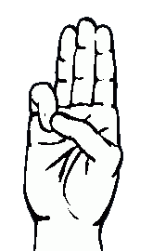
The Nature of Preparation
Techniques are no substitute for preparation.
Be prepared -- The Boy Scouts’ and Girl Scouts’ Credo. Spoken while holding up middle 3 fingers of the right hand

Slide 31
Be Prepared (Tom Lehrer, 1953)
Be prepared! That's the Boy Scout's marching song,
Be prepared! As through life you march along.
Be prepared to hold your liquor pretty well,
Don't write naughty words on walls if you can't spell.

Slide 32
Be Prepared - Tom Lehrer (continued)
Be prepared! And be careful not to do
Your good deeds when there's no one watching you.
If you're looking for adventure of a new and different kind,
And you come across a Girl Scout who is similarly inclined,
Don't be nervous, don't be flustered, don't be scared. Be prepared!
http://www.youtube.com/watch?v=fSwjuz_-yao

Slide 33
To Prepare
Review facts of case so they are fresh
Knowledge base: The first rule of three
This rule is: Learn in detail three studies directly relevant to your methods or tasks

Slide 34
Preparation Queries: Try Them
Is it important to stay current in your field?
Describe all of the books & articles you have read in the last year? How about in The Journal of Child Custody? In Parenting? In Journal of Marriage and Family? In Journal of Clinical Psychology? In Law & Human Behavior?
What scholarly books have you read in the last month? When? What chapters were in it?

Slide 35
Preparation Queries 2
Would you be surprised to see 5,050 entries in PsycINFO for ”child custody?” Or 8,322 entries in PsycINFO for “forensic evaluation?”
About how many have you actually read?
How many of the 11,651 articles for the WAIS have you read? Or how many of the 7,413 on parenting skills have you read?
(Search results as of 03/25/2019)

Slide 36
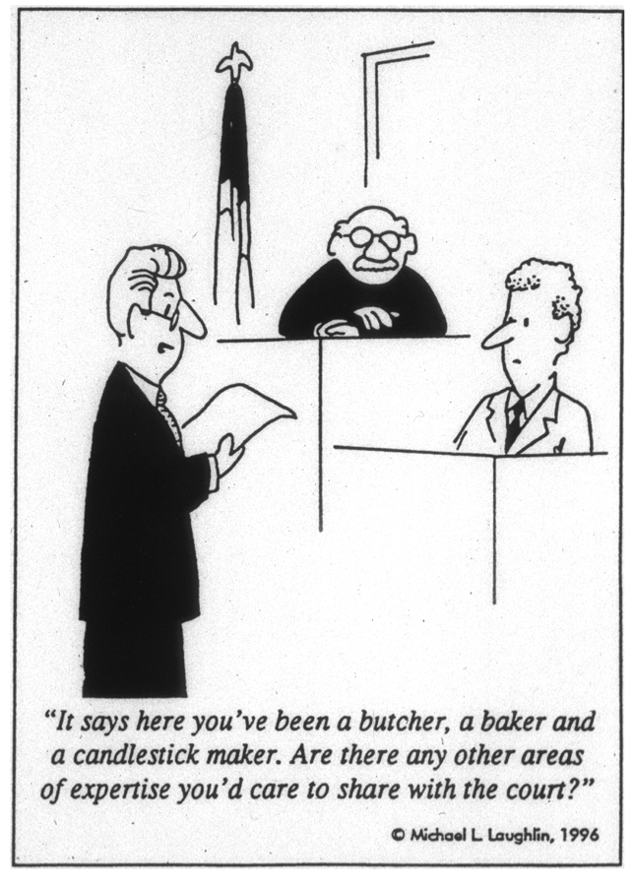
Prepare To Discuss Areas of Expertise

Slide 37
Experts Who Bring Authentic Self into Courtroom
The case for authenticity – easier on you and can be convincing.
BUT suppose you’re authentically very funny?
Remember Otto’s Law “Nobody is as funny as they think they are.”
Use only context congruent humor.
Or suppose you are authentically feisty and argumentative?

Slide 38
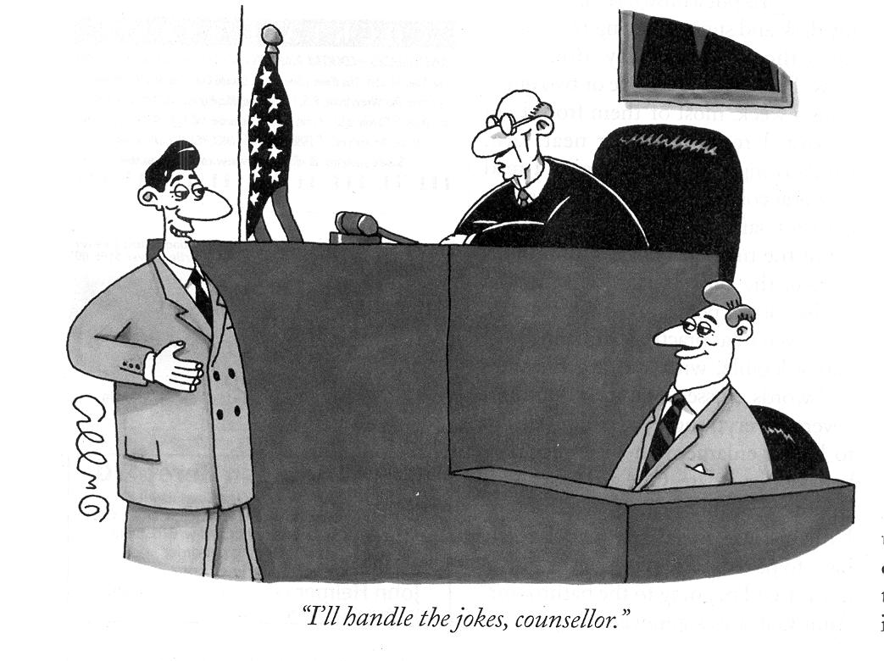
The Humor Hazard: Use Humor Rarely - Never Be Flip
“I’ll handle the jokes, counselor”

Slide 39
Feisty and Argumentative Experts
Dr. Emmanuel Tanay wrote about his testimony experiences in his book, American Legal Injustice
He was feisty by nature:
“When I finally took the stand, prosecutor Brue interrupted my direct testimony every few minutes. She jumped up, screaming, and threw her hands in the air, and the judge tolerated her outrageous behavior. When I asked her to lower her voice, the judge intervened: “She has a naturally high-pitched voice.” I said she was obviously screaming at me. “You are in Detroit, Doctor,” the judge said, implying that I did not appreciate cultural differences between blacks and whites . . . . later the judge ruled my testimony was to be stricken” (P. 22-23).
Hazard is losing likeability and seeming narcissistic

Slide 40
Narcissistic Experts
Believe it is all about them.
Focus on their success.
A transitory state from being on the stand.
Gutheil & Simon (2005): A sense of grandiosity; they believe they are in control and that testifying affirms how special and exceptional they are. This “leads the vulnerable expert to shape, slant, or distort testimony to win approval from the retaining attorney or to ‘win’ at any cost.”

Slide 41
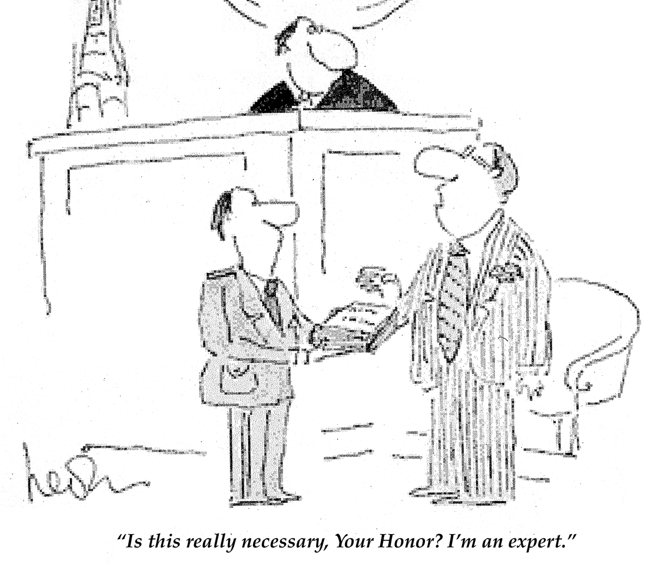
“Is this really necessary, Your Honor? I’m an expert.”

Slide 42
It’s Not About You – Dvoskin 2016 (Narcissism on the Witness Stand)
When you walk into court in your fancy new suit
And you think you're as cool as the night
When you snap at the lawyer who questions your point
When you dare him to stand up and fight
When you're sure that you know that your side ought to win
And that God is for sure on your team
You might stop for a moment and think of this song
Because things are not just what they seem
It's not about you
It's not about you
They may call you an expert and kneel at your feet
But believe me it's not about you

Slide 43
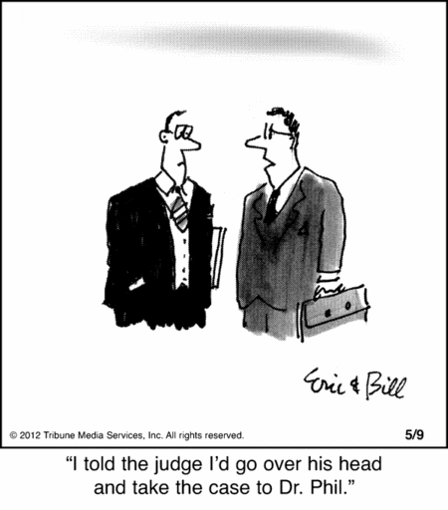
Experts Who Think They Know Best
The Humility
Conundrum
“Do you consider yourself to be
Be more intelligent than
most people?
•Confidence vs
humility

Slide 44
Learning To Say “I Don’t Know”
Good attorneys will always find something we do not know.
Honesty and the oath.
How one says I Don’t Know.
What follows the I Don’t Know statement is important.

Slide 45
The Art of Saying “I Don’t Know”
Saying “I don’t know” is natural cure for perceived narcissism (much as the bite of tsetse fly is a natural cure for insomnia).
Best said with confidence.
Stated in such a manner that it is clear it is truly okay with you that do not know.
Sometimes the best answer is, “nobody keeps track of that information in those terms.”

Slide 46
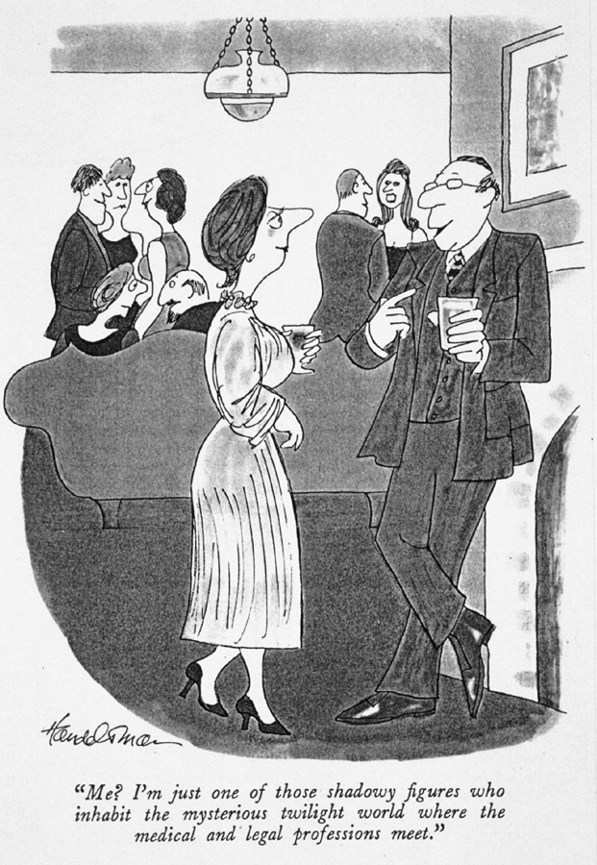
Narcissistic Self-Presentation*
“Me? I’m just one of those shadowy figures who inhabit the mysterious twilight world where the medical and legal professions meet.”
*As opposed to Kiwis, who understate skills and worth.

Slide 47
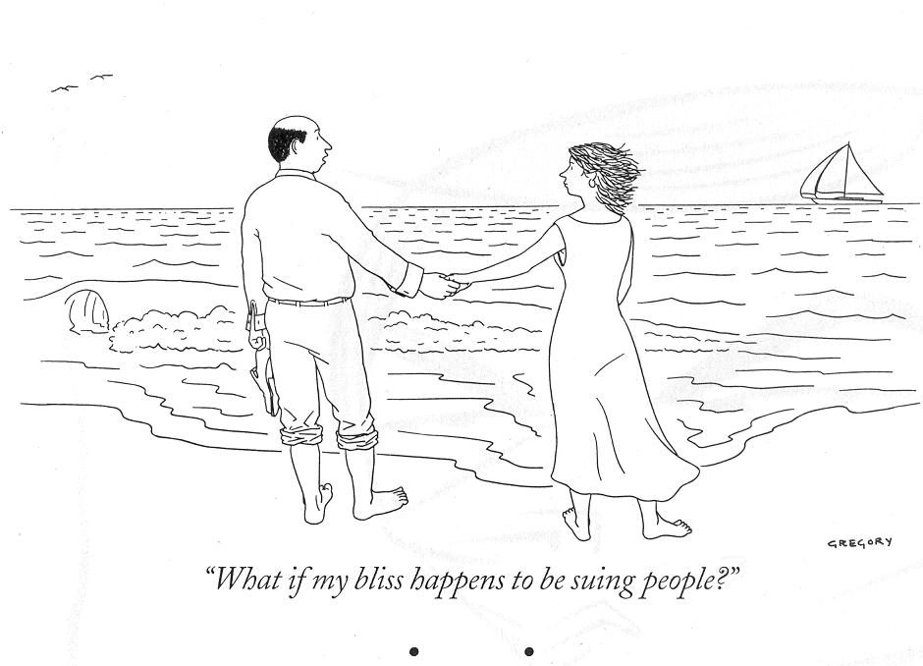
Attorneys Who Bully and Attack
“What if my bliss happens to be suing people?”

Slide 48
Bullying Attorneys
Strategies for dealing with bullying:
Pace
Breath
Control

Slide 49
Does Contentiousness in Court Generalize?

Slide 50
Power and Control on the Stand
Struggles for power and control
Attorneys seek positions of power and dominance over witnesses during X-E.
Attorneys seek to control substance and process of the examination.
Witnesses, in turn, seek to be powerful and to stay in control of self and of testimony.

Slide 51
Ultimate Attorney Control: When there is nobody to whom to reply
“You have testified that your opinion is based on reasonable scientific certainty, but it is true, isn’t it, that your opinion is neither scientific nor certain, Doctor! Thank you. No more questions.
And the attorney walked away from the podium.

Slide 52
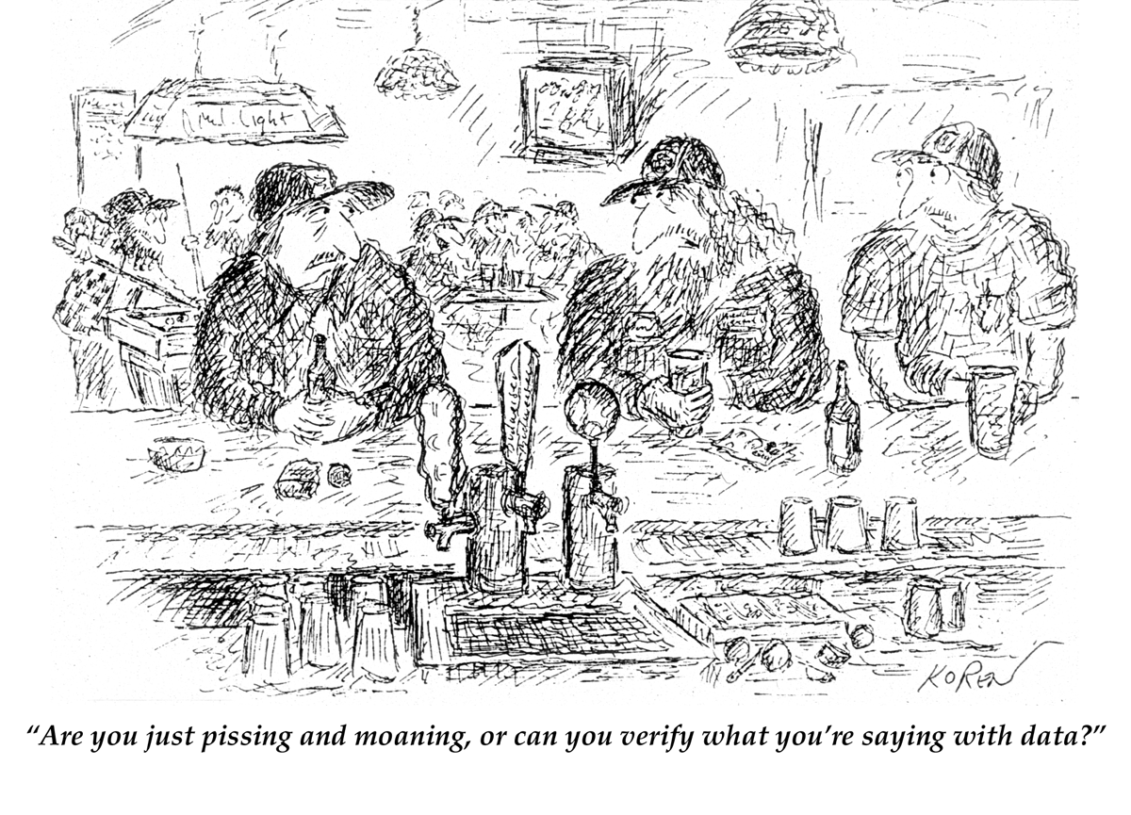
“Are you just pissing and moaning, or can you verify what you are saying with data?”

Slide 53
Worst Case Scenarios #5 & #6: Asked about a book or report
5. “While testifying about an evaluation that involved sexual abuse, I was asked about a book that had something to do with allegations of sexual abuse. Once I said I had not read it, the attorney battered me over and over for not knowing of this book or reading this book.”
6. “The attorney went on for 6 hours about why I had not read and used the psychiatrist’s report on this examinee.”

Slide 54
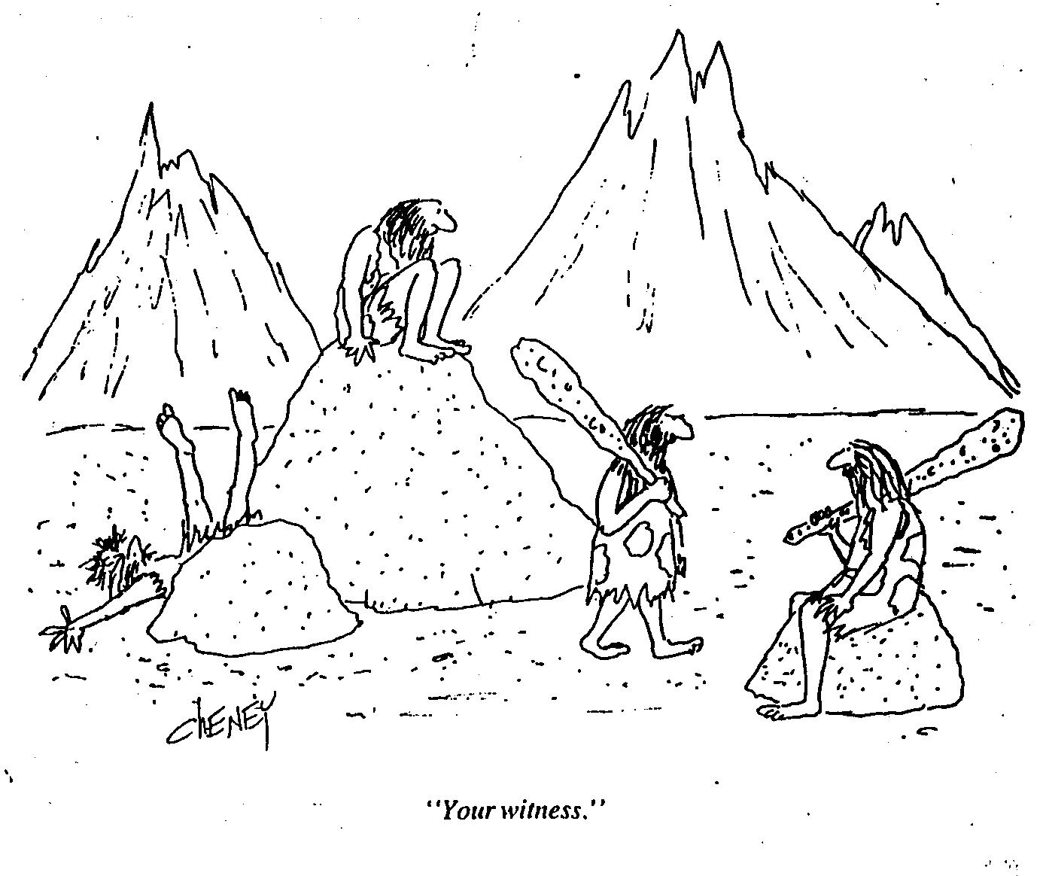
“Your witness.”

Slide 55
Answers to Worse Case #5 & #6
#5. Nobody has read everything
#6. It is only my interviews, my assessment, and my conclusions on which I have drawn.

Slide 56
The 4 Components of Credibility
Confidence
Likeability
Honesty (trustworthiness)
Knowledge
Notes:
Griffin, M.P., Brodsky, S.L., Blackwood, H., Abboud, B. & Flanagan, C. Bradsell. (2005, March) The Development of Credibility Scales for Witness Research. Paper presented at the meeting of the American Psychology-Law Society, LaJolla, CA.

Slide 57
Confidence
People believe individuals who are confident
When not confident, act paradoxically
The hazard of too much of a good thing: the arrogance of absolute certainty

Slide 58
Research on Witness Confidence
Cramer, 2006: studied 319 college students on confidence and expert witness credibility.
Low Confidence: Quivering tone of voice, absence of fluency in speech, vacillating pace of speech
Medium Confidence: Moderate and stable tone of voice, clarity in speech, moderately paced speech, willingness to acknowledge a degree of certainty
High Confidence: Loud and strong tone of voice, assertive speech and mannerisms, rapidly paced speech, unqualified statements (“I am certain”), good posture, fluency in speech.

Slide 59
Witness Confidence & Credibility
Low confidence Mid confidence High confidence

Slide 60
Findings
Confidence a significant main effect for credibility
Inverted V curve: Credibility rises with medium confidence and then falls off
High confidence still yields more credibility than low confidence

Slide 61
Worst Case Scenario #7
“During 5-hours of testimony, two other people were taking notes feverishly and passing messages to the attorney. During a break the court reporter told me that one was a lawyer and the other a psychologist hired to observe and critique. This made me very uncomfortable.”
Principle: When not confident, show confident behaviors and affect will follow.

Slide 62
Likeability
Some experts become unpleasant on the stand
Best testimony by experts maintains a fundamental niceness and likeability
People believe individuals they like
Likeability is related to ratings of trustworthiness, especially among women.
Brodsky, S.L. et al (2009). Credibility in the Courtroom: How Likeable Should an Expert Witness Be? Journal of the American Academy of Psychiatry & Law 37, 525-532

Slide 63
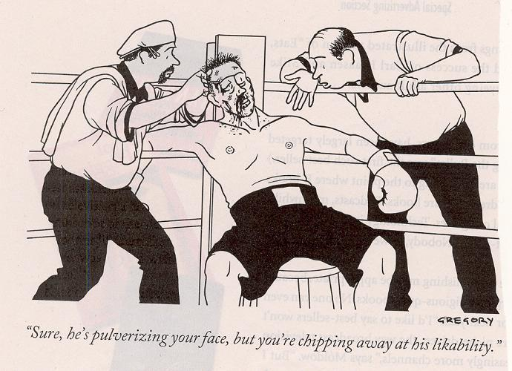
Likeability
People believe individuals they like
“Sure, he’s pulverizing your face, but you’re chipping away at his likeability.”

Slide 64
Trustworthiness (honesty)
• People believe witnesses they trust
• Trustworthiness is compromised by refusal to acknowledge problems
• Trustworthiness is compromised by defensiveness
• Defensiveness is a common response
Larson & Brodsky, BSL, 2014: Assertiveness versus defensiveness. doi.org/10.1002/bsl.2016

Slide 65
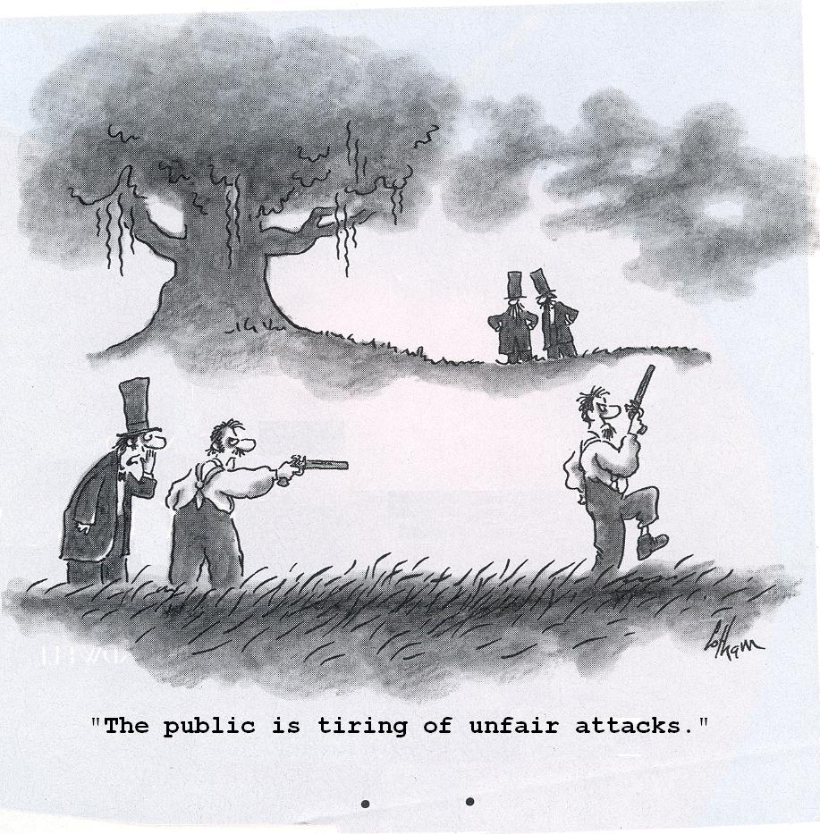
“The public is tiring of unfair attacks.”

Slide 66
Knowledge

Slide 67
Research on Knowledge and Expert Testimony
Differences in Expert Witness Knowledge: Do Mock Jurors Notice and Does It Matter?
J Am Acad Psychiatry & Law 43:69-81 (2015)
Caroline Parrott, Tess Neal, Jennifer Wilson, & Stanley L. Brodsky
155 college students, 2x2 design high/low knowledge, male/female witness
Knowledge defined as : substantive content and clarity of testimony, credentials, relevant experience, self-proclaimed expertise, assertiveness, and familiarity with the case

Slide 68
Findings
No difference in capital sentencing.
Low knowledge associated with higher likability.
Too much self- assertion of knowledge may have turned off mock jurors.
Ceiling effect on expertise.
Still: high knowledge is responsible thing to acquire. But deliver it in doses that can be swallowed.

Slide 69
Meeting With Counsel
Clarifying scheduling: When, where, ongoing notice of times
Going over qualifying questions
Agreement about issues you will be asked to cover
Draft by attorney or by you of direct examination questions
And if the attorney declines to meet with you?

Slide 70
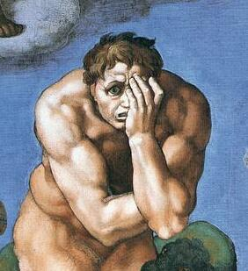
Handling Anxiety about Testifying
Testimony anxiety is normative in infrequent or new witnesses
Overprepare:
Action is the natural antidote for anxiety

Slide 71
Anxiety Reduction
Familiarization with and habituation to the courtroom
Observations before testimony (if rule is waived)
Speaking aloud
Fit and place in the witness stand

Slide 72
Anxiety Reduction- 2
Known and proven methods
Do not try new personal or chemical methods
•The Rumpelstiltskin Principle:
Know names of all of the participants
•Parallel forms of address can then follow:
“Dr. Smith, would you please explain . . . .”
“Mr. Moore, it is routine practice to . . . “

Slide 73
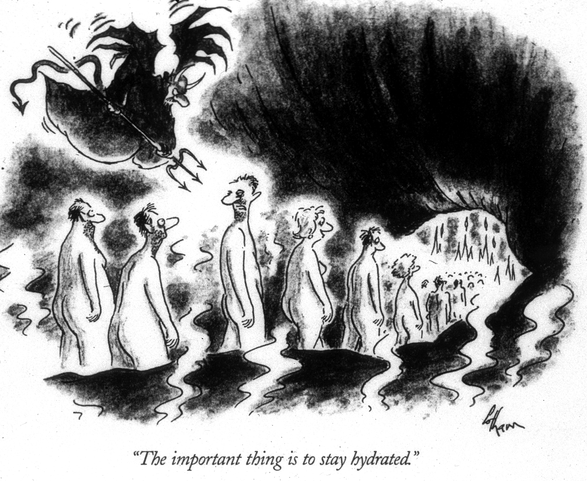
And stay hydrated

Slide 74
Breath control
Avoid shallow and quick breathing
Breathe in before answer
Deep breathing = emotional power
Pay attention to breath

Slide 75
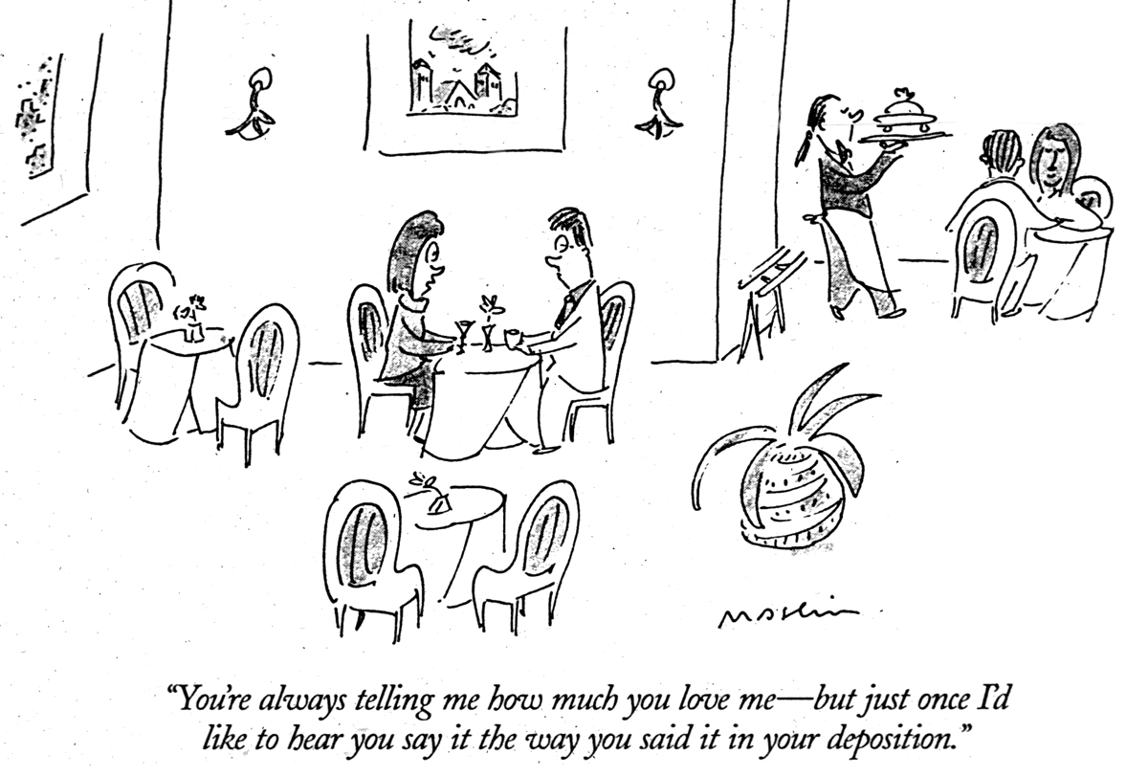
“You’re always telling me how much you love me. – but just once I’d like to hear you say it the way you said it in your deposition”

Slide 76
Judges
Always the trier of law (may be trier of fact)
Longevity, power, elections, active vs passive
May ask questions of witnesses
Widely varying degrees of control & interest
Affiliating with witnesses
May actively control witnesses

Slide 77
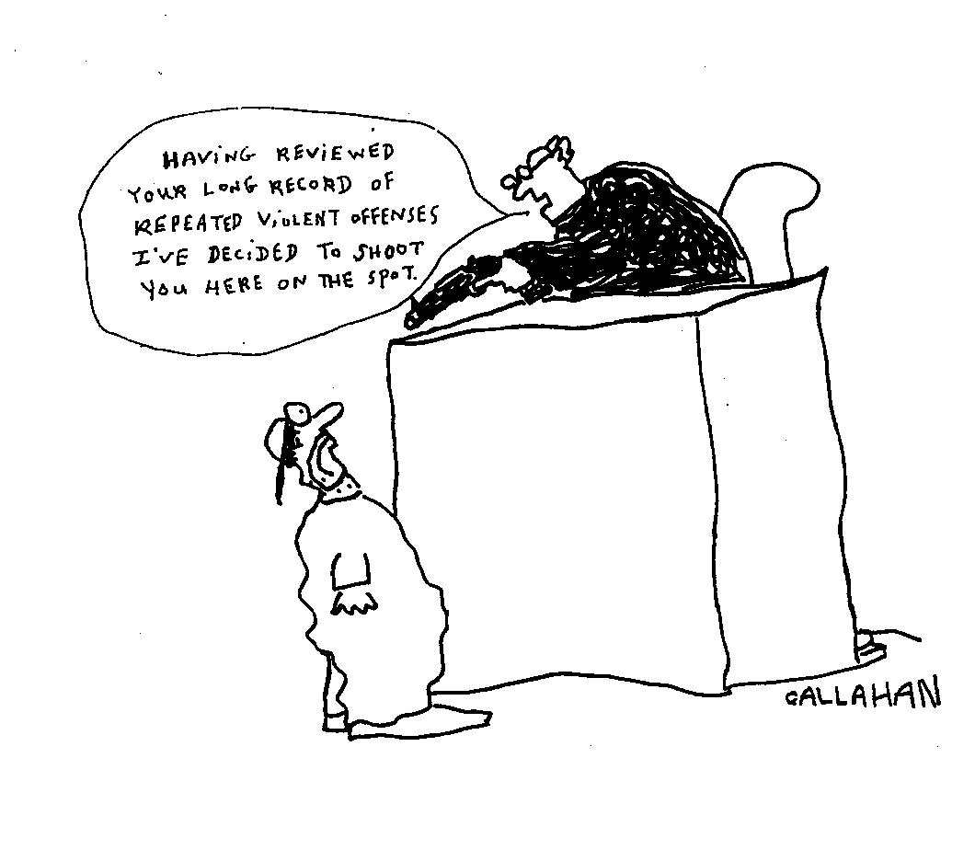
Arbitrary Judges

Slide 78
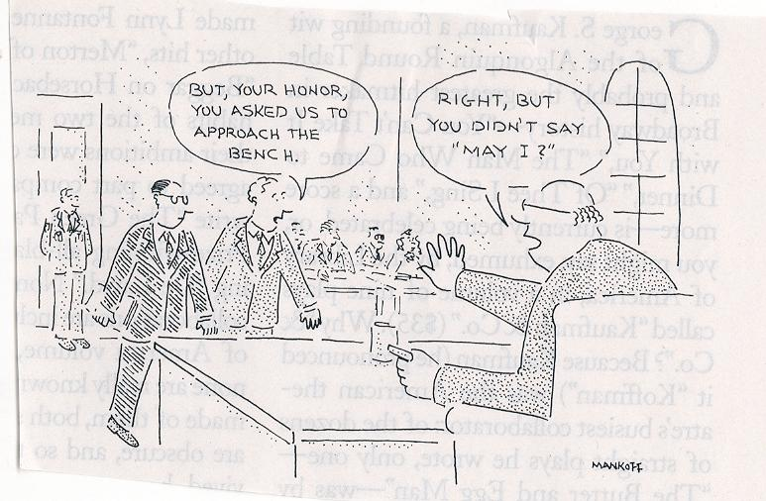
But, your honor, you asked us to approach the bench.
Right, but you didn’t say “May I?”

Slide 79
Eye Contact with the Judge

Slide 80
Connecting With The Judge
Asking the judge questions when at a loss
Scanning with eye contact all courtroom parties, including the judge
Worst experiences with judges: when they cross-examine or ignore: Brushed-off testimony
Best experiences with judges: Informed, just-right active, extend themselves to insure things go right

Slide 81
Treating Expert Witnesses
They testify about what they have seen and heard in their roles as therapists or other direct service roles.
Do not have to go beyond the limits of their observations
Privilege is owned by client and waived
Felt conflicts between helping roles and being an objective witness

Slide 82
Examples of Treating Expert Witnesses
•Psychotherapists testifying about their clients who are in child custody litigation or facing criminal charges
•Child abuse or Protective Service Workers who have been helping abusive partners or abused children or partners
•Drug or alcohol treatment program personnel

Slide 83
Principles of Testimony for Treating Expert Witnesses
Awareness of dual role.
•Resist pull to offer forensic-evaluative testimony if primary role is as therapist
•Accept possibility of contamination of subsequent treatment role

Slide 84
Evaluating Expert Witnesses
• Retained for the purpose of assessment
Distinct roles – Treator is helper; Evaluator is not clinician, needs full informed consent (Shuman, Connell)
• Client is retaining attorney (never the evaluee). Never call the evaluee your client. Confuses roles.
Plaintiff or defendant is the evaluee and is not a patient no matter what s/he requests or says.

Slide 85
Direct Examination: Introduction
Know path to witness stand
Primacy effects: Approach with poise and confidence, no matter how you feel. Affect follows behavior.
Identification of witness to court reporter (business card)
Some experts use Powerpoint slides to convey visual content: Pros and Cons

Slide 86
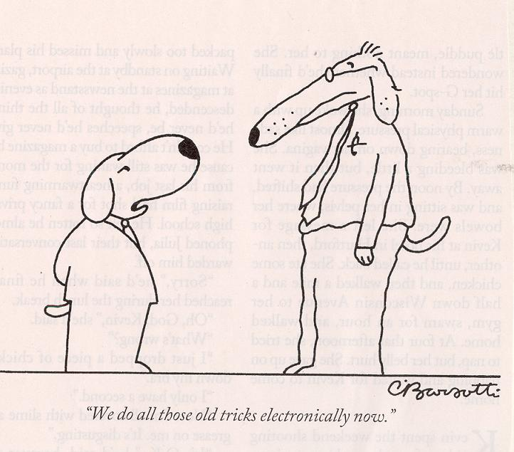
“We do all those old tricks electronically now.”

Slide 87
Walking to the Witness Stand
• Intellectuals often lead with their heads.
• The performance begins here: Testimony as performance art.
• Primacy & recency effects.

Slide 88
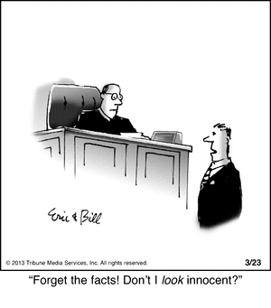
First Impressions

Slide 89
Direct Examination: Questions
• Experts: nature, time, & place of examination, methodology, findings, conclusions, opinion
• Open-ended questions should be asked by attorney followed by narrative answers by witness
• Direct examination testimony tells a story
• Narratives that promote cognitive processing by audience: Heilbrun research e.g., MR & cloak of competence

Slide 90
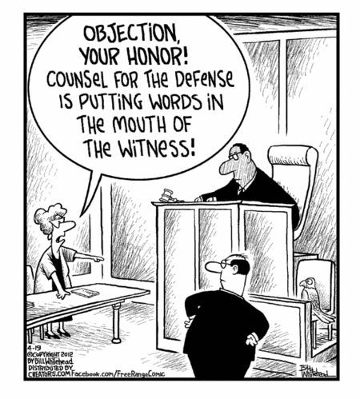
Counsel Putting Words in Our Mouths

Slide 91
Words in Our Mouth
Scott Bresler U Cincinnati – Examinee who spoke only through hand puppet
TV Show Family Tree – Bea Chadwick speaking only through “Monk”
Attorneys ask, ”Wouldn’t it be fair to say. . .?”
(Followed by their statement of our findings)

Slide 92
Micromomentary & Nonverbal Behaviors
Fraction of second, mm of movement
Slight tightening of lips
Transient hint of anger or tension
Whole body movements, leans, and postures, which are least likely to be amenable to training
Degree of asymmetry
Pitch of voice and voice stress
Excessive smiling

Slide 93
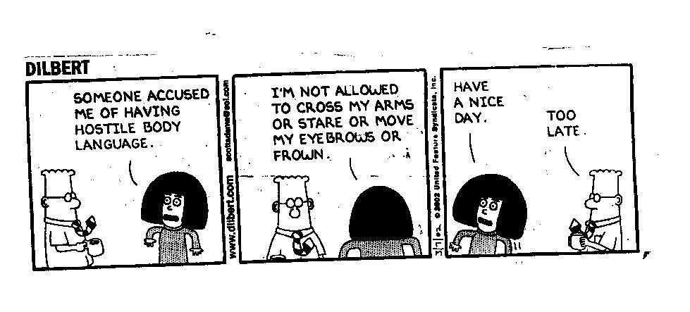

Slide 94
Nonverbal communication by attorneys
I once watched an attorney stick out tongue at opposing counsel

Slide 95
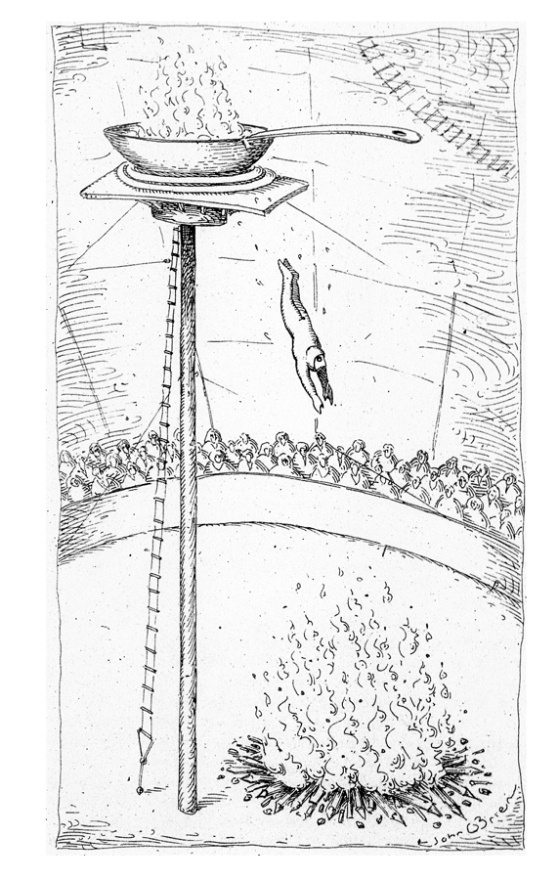
A nonverbal commentary on testimony

Slide 96
General Principles of Testimony
Take your time
Speak audibly
Avoid empty fillers
Speak rationally
Speak to audience – eye contact: How much, to whom?
Avoid jargon

Slide 97
What Experts Fear The Most
Going blank on the stand
After that, Not knowing detailed information about procedures or tests such as development or reliability or norms
Being embarrassed
Missing something

Slide 98
Challenges to Qualifications
Less often if court-appointed
Less often if qualifications better than “opposing” expert
Challenges to education: BA in chemistry? Graduate courses in assessing sex offenders (or other specific aspects of case)
Best handled in direct – but often not
There is always something we have not learned in schooling

Slide 99
Challenges to Experience
As much common sense as empirical
All experts have a first time testifying
Little experience – sign of not being a hired gun or bought witness
The Faust – Brodsky brouhahas
Clinical-therapeutic experience is highly valued by jurors. Almost everyone thinks experience matters
Spengler et al The meta-analysis of clinical judgment project. – low relation between experience and diagnostic accuracy (in The Counseling Psychologist, doi.org/10.1177/0011000006295149)

Slide 100
Challenges To Experience
You relied to some extent upon your experience in coming to your conclusions, isn’t that correct?
Doesn’t the weight of scientific research show that experience does not help mental health professionals to be more accurate in their evaluations?
While it may be your impression that experienced clinicians are accurate, the question is about the scientific literature. Are you familiar with that literature?

Slide 101
Experience: Answers
In common sense terms, acknowledge the limitations of experience.
Remember, there are people who keep doing the same things over again, without learning more.
Feedback and study shape learning, rather than experience by itself.

Slide 102
Weaknesses In Credentials
Don’t all professionals have further training they wish they could get?
In your own case, what further education and training do you wish you had received?
What does it mean to be board-certified [or a fellow, or promoted] in your field? Aren’t these the highest recognitions of competence and achievement in your profession?”
And you have not be so recognized for your achievements and competence, isn’t that so?

Slide 103
Credentials: Answers
Give thoughtful, fully accurate answers. Don’t fudge.
Place credential gaps in context of jobs or tasks.
There is always something we are not. Relax

Slide 104
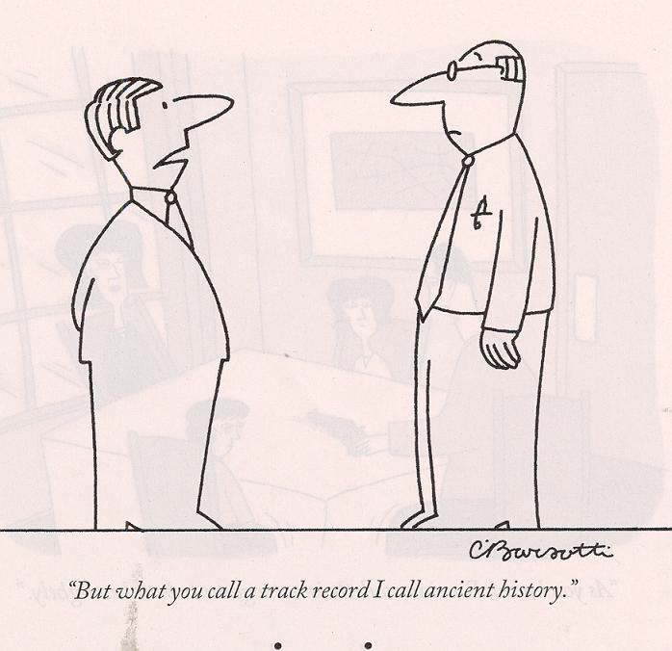
“But what you call a track record I call ancient history.”

Slide 105
Challenges to Technique
Address techniques of uncertain validity
Limitation of methods – All have limitations (What are the major weaknesses in the use of the Parenting Stress Index?)
A different story when attorney is specialized and knows more than expert (rare)
Another expert feeds X-E questions to be asked.
Many questions not substantive – just designed to reduce credibility of the witness.

Slide 106
General Aspersions
Attorneys may ask questions about everything expert has not done: There are always things we have not done.
They may ask, “This is all based on Ms. Grimaldi’s self-report to you” “Yes.” (alternatives?)
Sometimes silly & petty X-E questions. Answer calmly and seriously -- (no matter how great the temptation to laugh or ridicule)

Slide 107
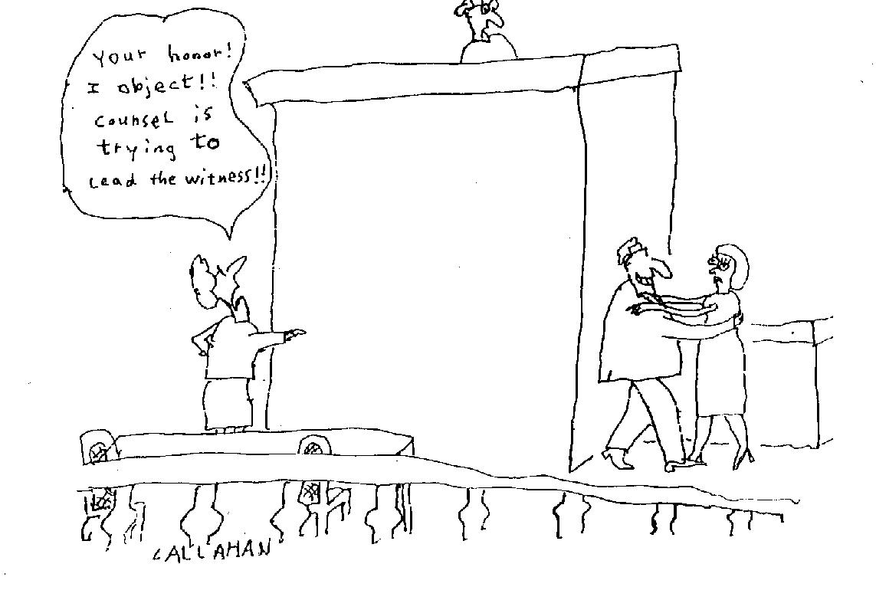
Your honor, I object! Counsel is trying to lead the witness!!

Slide 108
YES OR NO: 2
Sometimes the yes or no answer is demanded inappropriately. Do not give in. Instead, say:
“There is no simple yes or no answer to that question.”
Some witnesses turn to the judge and state
“Your honor, it would be professionally irresponsible to try to give a yes or no answer to that question.”
“To answer yes or no would violate the oath I have taken to tell the whole truth”

Slide 109
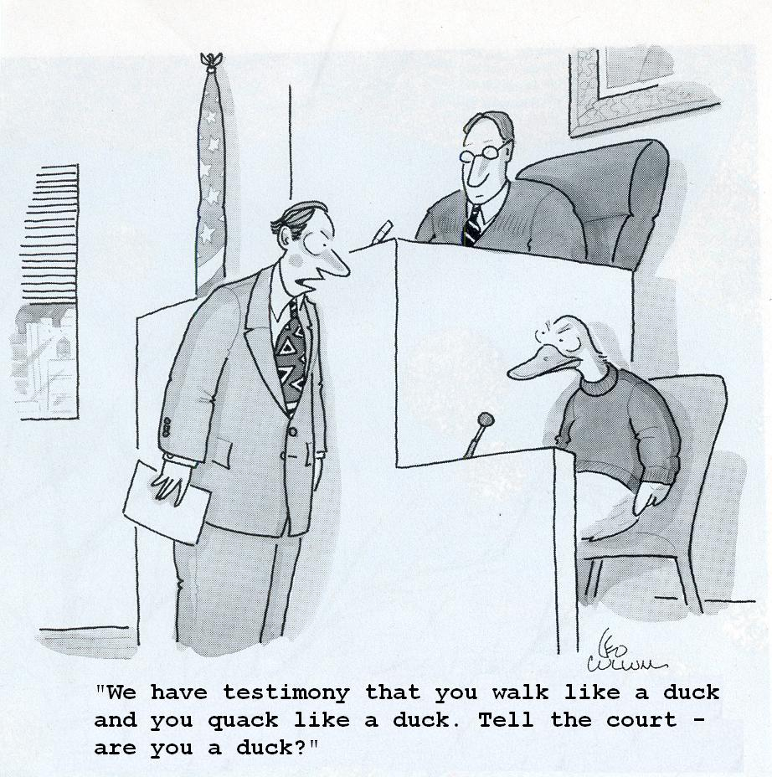
What Push-Pull would you use?
“We have testimony that you walk like a duck and you quack
like a duck. Tell the court -- are you a duck?” (the answer?)

Slide 110
Learned Treatises
Admitted if expert has relied on it
Or accepts book or study or person as authority
Accept only if truly, thoroughly familiar w it
Be cautious about quickly accepting even if person is famous psychologist (including Nobel Prize winner Daniel Kahneman?)

Slide 111
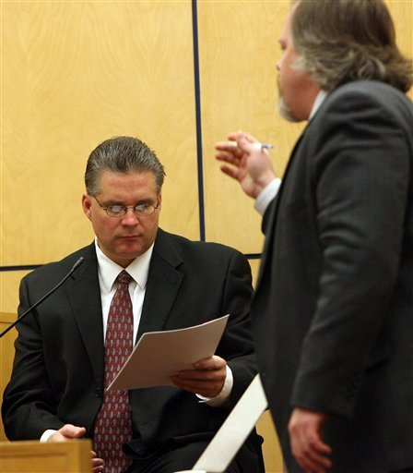
Learned Treatise in Cross-Examination
Doctor, Would you accept
Dr. Phillip Zimbardo as an
authority on the effects of
imprisonment?
If not him, who would you fully
accept as an authority?
Are you the national authority?

Slide 112
Prior Writings or Testimony
Attorneys collect transcripts of testimony by certain experts – often out of context
What if inconsistent with current testimony?
Professional writings
Listservs, Facebook
Case descriptions of pending trials
My story of leaving my body during sidebars, and “my mind was elsewhere”

Slide 113
Pace Control: Four rules
Attorneys attempt to control pace
To control your own pace:
1. Correct shallow and anxious breathing
- Breathe in deeply. Respond on out-breath. Slows pace, promotes power in answers (already noted)
2. Some answers require thought. Stop talking. Take time to think.
3. Think with visible actions. Hands, head positions, posture, body movement.
4. Then respond with clarity and strength

Slide 114
ELICITED VANITY
• Attorneys sometimes engage in outrageous flattery . In cross-examination or during depositions, ingratiating questions can take on a challenging or threatening quality.
• “You consider yourself a very careful observer of human behavior, don’t you?”
“With all the achievements on your resume, do you have an exceptionally high level of expertise in your field?”

Slide 115
Elicited Vanity: Answers. 1
Such questions have potential for bringing out self-promotion and arrogance.
Avoid elicited bragging
Matter-of-fact modesty
Do not be an expert on your expertise

Slide 116
ELICITED VANITY: ANSWERS 2
Address the tactic. You might respond:
“Prideful statements are unbecoming in professional work. My training and background that I testified about earlier accurately represent what I have done.”
Feel free to say “I don't know” or
“others would have to reach such conclusions”
Maintain a quiet, unimposing, and centered self-confidence in replying to such questions. The manner becomes the message.

Slide 117
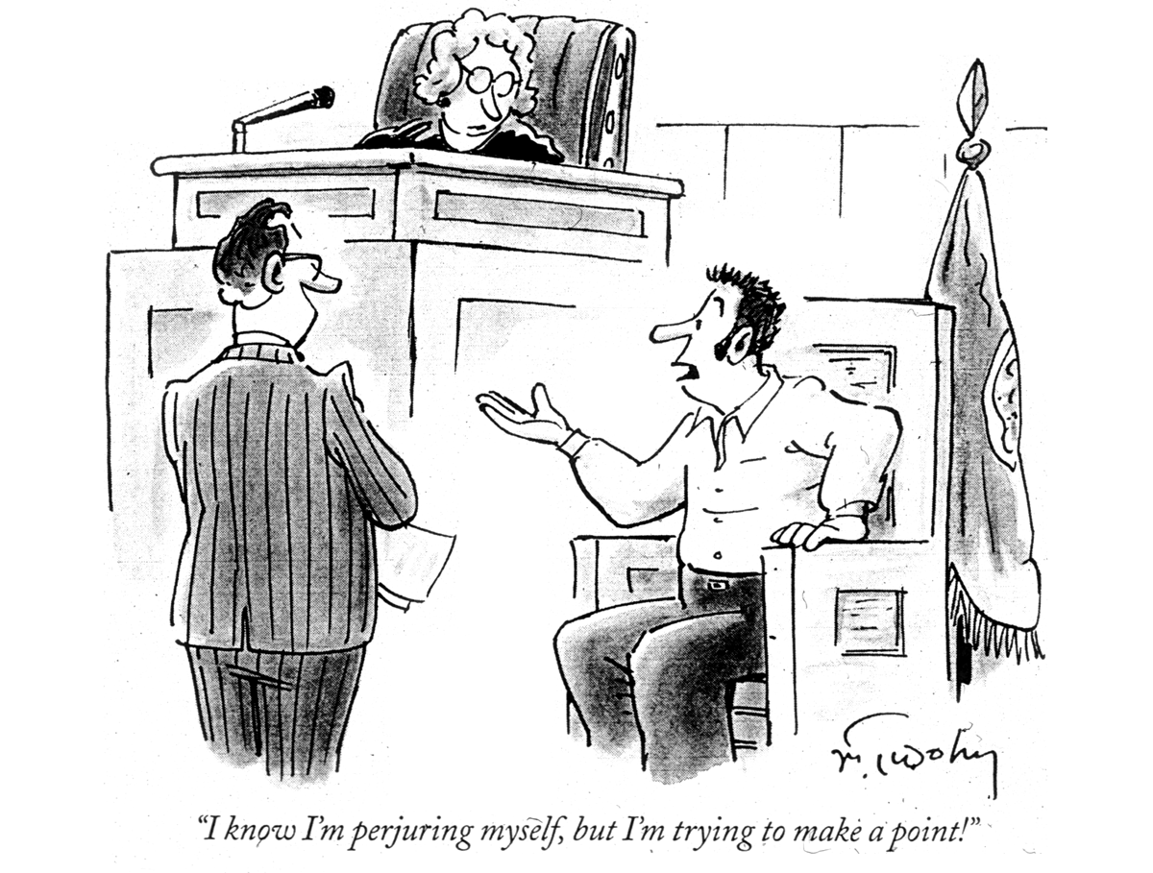

Slide 118
More Worst Case Scenarios: Gender and Personal Questions
“During a trial, the attorney asked personal information such as my home address and my current medications”
“Attorney asked me under oath what kinds of pain medications I’d been on during the evaluation and had they impaired my ability to function as an evaluator”

Slide 119
Worst Case Scenario: Personal Questions
“I was asked over and over about my personal life. Do I have kids? how many? I wouldn't respond.
The attorney then tried to go around it in an indirect way. Do you work part time? Why do you work part-time? What kind of car do you drive?”

Slide 120
Hypothetical Questions
A legitimate path for attorneys - the court is entitled to know your answer
Hypothetical questions usually have many elements
• Indicate possibility & probability
• One expert: ”Are you asking me to guess?”
• Note: My article in IJLP (2012) with Titcomb, Sams, Dickson, & Benda on Hypothetical constructs, hypothetical questions and the expert witness.

Slide 121
Hypotheticals: Answers 1-3 (of specialized interest)
1. The Simple Acquiescence to the hypothetical question. In this response, the expert replies with an unadorned and unexplained, “Yes.” The advantage of this reply is that there is no element of defensiveness.
2. The Qualified Agreement. In this reply, the expert adds a qualifier to the yes. It may consist of, “Yes. That is possible,” or the more careful, “Yes, that is hypothetically possible.” The expert is acquiescing, but is digging in a little.
3. The Elaborately Qualified Agreement. The expert describes the conditions under which s/he would agree, or the limitations on the scope of the agreement. This expert might state, “Yes, that is possible, but not probable,” or “Assuming that every one of your possible statements is accurate,only then would I agree.”

Slide 122
Hypotheticals: Answers 4-6
4. The Ambiguously Evasive Response. This reply avoids a definite answer. The expert states that it’s not clear that there is a yes or no answer, because of the uncertainties involved about the elements of the hypothetical question.
5. The Assertively Evasive Response. In this instance, the expert takes issue with the specifics of the hypothetical question, replying that the posited components may not be true, and it would be going against the factual understanding of the issues.
6. The Stubborn and Resistant Response. The expert presents a strong no. The disagreement may be in reply to some piece of the question or in reaction to the bottom line conclusion of the hypothetical question.

Slide 123
Empathic Evaluators “Did you have good rapport with Mr. Jones?”
Task is objective evaluation, to help the court, not to help the evaluee. Should one be empathic? (Shuman, E&B 1993) In 2010 BSL w/ Zervopoulos, Shuman declared objectivity vs empathy is a false dilemma
Brodsky, S.L. & Wilson, J.K. (2012). Empathy in Forensic Evaluations: A Systematic Reconsideration. Behavioral Sciences and the Law. Online publication, DOI: 10.1002/bsl.2042
Too little or too much empathy?

Slide 124
Reports and Your Own Records
•When you write reports, know that you may be held accountable for all entries
No duplicate and “held in reserve” sets of records
Precision and care in writing
•Check and double check accuracy
Commit essential aspects to memory so your testimony is not drowned in your searching through records

Slide 125
AFTER YOUR TESTIMONY: 1
• Do not assume the legal opinion is a direct reflection of your effectiveness. It is a common error.
• Step down with confidence
Read something else you should have known for this case
Get feedback from courtroom participants

Slide 126
Supplemental Content
These last slides are intended to supplement material I have presented
Some of it is drawn from Brodsky & Gutheil (2016)

Slide 127
Actual “Bad” Aspects of Expert’s Life
Accusation of child abuse by divorcing spouse
(no charges, issue dismissed, but raised in X-E)
Lying about disciplinary action by board
Arrest for marijuana use or public intoxication.
Foreclosures, bad checks, persistent pursuit for unfounded charges (AT&T for years w G)
Ease of PI searching public records – many of us have done something wrong at ST
Consent decree with lawsuit, licensing board (B/C insurance company)

Slide 128
Apologies
A1. “I apologize, but I do not know the frequency of bipolar disorders in young adults.”
A2. “I don’t know.”
The Maxim:
Experts who apologize or acknowledge regret over errors are less effective. Simple statements without the overlay of apologies are more straightforward and credible ways of responding.

Slide 129
Clinical vs Actuarial Testimony
Krauss, Daniel A. & Sales, Bruce D.(2001). The Effects of Clinical & scientific Expert Testimony, PPPL, 7, 267-310.
Krauss,DA& Lee, D.H.(2003) International Journal of Law & Psychiatry, 26, 113-137.
•Jurors more influenced by clinical opinion than by actuarial expert testimony (N=208 U AZ students)
•Differences remain even after effective X-E and after deliberations
Your task: Identify what expert has done right and wrong

Slide 130
Arbitrary Pigeonholes
On a scale of 1 to 10, with 10 being the highest, how fully did your evaluation cover the defendant’s life, personality, and functioning?
Do the best you can at estimating how fully you have come to understand Mr. D.

Slide 131
Asked and Answered
“Doctor, is this word, written in your own handwriting, on page four of your notes, the word ‘malingering?’ ”
“Yes,” she acknowledged, “but it was . . .”
At this point the judge cut off her answer with a quick, authoritative statement:
“Asked and answered.”
The Maxim
When the court limits what you can explain, neither panic nor become angry or defensive; rather, testify as confidently and accurately as you can within these constraints.

Slide 132
Directed Feedback
Forensic evaluator was visibly fearful of saying the wrong thing. During the cross-examination, he paused for perhaps five seconds before responding to each question, looking down, as if the right answer would manifest itself from the invisible ether. The only times he did speak right away, he asked (and asked and asked), “Would you please rephrase the question?”
The Maxim:
It is difficult to reshape your pattern of responses to challenging questions on your own. Part of becoming an expert expert calls for getting and using directed feedback on your testimony from knowledgeable observers.

Slide 133
Expert Witness as Master Teacher
1. Dynamic communication. - charismatic and captivating.
2. Styles of relating on the stand that involve the audience.
3. Clear communication “most of the time”
4. Authenticity about who you are as a professional.
The Maxim
Part of being a great witness is to be a great teacher on the witness stand, and being a great teacher is the result of concerted effort

Slide 134
Reframing what was asked
Q. “Doesn’t the fact that Mr. F. has held the same job successfully for 15 years suggest that he is not intellectually disabled?”
A. “When you suggest that someone with intellectually disability is unable to hold a job for 15 years, you demean the abilities and lives of all people who are intellectually disabled.”
The Maxim:
Without trying too hard or doing it too much, look for opportunities to nudge the frame of reference in questions to a compelling and cogent view that offers a teaching lesson.

Slide 135
Gender-Intrusive Questions
Larson & Brodsky: Women experts, compared to men, were perceived as less confident, trustworthy, likable, believable, and credible than the male experts. However, in reaction in gender intrusive questions, mock jurors subsequently rated both men and women higher on these desirable traits.
The Maxim
In the difficult moments in which women are patronized on the witness stand, they may gain control by restating their status as doctors without being strident and within the context of the questioning. When subjected to gender-intrusive attacks, their best responses will usually be assertive.

Slide 136
Holy Mackerel, Man! (actual expert answers)
“That is immaterial and irrelevant.”
“You asked me that question earlier.”
“What did I just say? Holy Mackerel, man!”
“Object to form.”
The Maxim:
Leave the legal observations to the attorneys; they have the right and authority to make objections. And never engage in insulting or demeaning behaviors on the stand, no matter how clever or witty you think you are being.

Slide 137
Personal Attacks: Overview
Heated attacks in custody cases and defense expert witness in sexual abuse charges
You would have few secrets.
Foolish sounding statements from prior trials may surface
Nobody lives a spotless life
Underweger (Hollifield) death threats, attys spitting on hand, accused of pedophilia
Personal attacks when nothing else there
Maintain composure & poise and do not attack back

Slide 138
Internet Vulnerabilities
Joel Dvoskin* Some list members, including some lurkers, are attorneys, and literally anyone can access the archives any time they want. This is not a hypothetical concern; I have been cross-examined about PsyLaw postings before, but luckily, they weren't mine.
Asking the list for case-related consultation strikes me as a dangerous practice. First, anything we post could be raised during cross-examination, including posts that suggest that we don't have the requisite expertise to testify about a particular matter in court. Second, if we provide much case-specific information, it will often be easy to deduce the case in question.
This raises concerns about confidentiality, privacy, and could perhaps implicate attorney-client privilege. On the other hand, if we keep the question extremely vague, we run the risk of getting advice that is misguided in regard to the instant case.
*Nov. 18, 2015 psylaw-L

Slide 139
When I want to seek consultation on a case, I usually call someone I know to be a relevant expert, and offer to pay them for their time. I don't do it very often, as it is my practice to turn down cases for which I believe I lack the appropriate expertise.
Occasionally, there is a specific issue that I want to explore with a leading expert to make sure that there isn't some emerging line of research or knowledge that I ought to know about.
Finally, even if we ask for help on a closed or private listserve, we may be required to produce in court any and all correspondence (including emails) that relate to the case, in which case the consultant's email will be read in open court, whether they intended it or not. My strong advice is to seek case consultation from a widely respected expert, on the telephone.
The Maxim: Never put anything online that is highly private, possibly confidential, or personal.

Slide 140
Recording of Assessments
Routinely with children
Attorneys and experts often avoid it
Clay Shealy et al survey research: 160 forensic psychologists, 59% thought 3rd party might negatively affect results, 33% thought it might be positive
Uncle Carroll Brodsky and his story
Fisher and Brodsky book: Share everything

Slide 141
Silent Treatments
High grade silences communicate
You answer and the attorney just waits
It can be elegant move by attorney
Do not let silences by attorneys intimidate you
Use silences yourself. Next utterance should be very good b/c everyone will be listening

Slide 142
Thank you, Thank you, Thank You
Appropriate expressions of appreciation are always in order in the courtroom.
But do not slip into meta-testimony

Slide 143
Leading Questions
Avoid as expert being puppet-like
Wouldn’t you say getting Bs in high school math is inconsistent with a diagnosis of ID?
The Wouldn’t You Agree trap
Simple truths & listen with care

Slide 144
Otto, DeMier & Boccaccini (2014) Identifying the referral question
Scope: Report should be not more or less than needed to answer referral question
Up to 25% of experts address other legal issues

Slide 145
Other Quality Issues
My observations in consulting
Essential elements often missing from forensic reports
Robinson and Acklin review of 210 CST reports:
3/4ths received rating of inadequate
“pervasive mediocrity with respect to quality”

Slide 146
Language Problems in Reports
Many reports are poorly written
Jargon: psychotic-like symptomatology
Caution about Allness terms
Utilized vs used, verbalized vs said
Examinee admitted, denied
Verbatim statements communicate powerfully
Change reports on request if in error– but document changes

Slide 147
Insinuations of Bias
Responding to bought witness accusations –
What do you intend to do with all that money?
Isn’t it possible to be influenced unconsciously in an opinion by being paid a huge amount of money?
“Could your $400 an hour include time spent going to the bathroom in the courthouse?”
The bend over backwards response
Do not argue

Slide 148
Source for Examining Reports
These excerpts are drawn from Forensic Mental Health Assessment: A Casebook. NY: Oxford University Press (2002) By Kirk Heilbrun, Geoffrey Marczyk, & David DeMatteo.
The book is made up of reports by experts with commentary.
Topics cover the entire range of forensic psychology work.
Following slides are excerpted from this book

Slide 149
Joseph Dokes’ morality
“he has no apparent moral context to motivate himself to ameliorate the behaviors that have restricted his freedom.”
Q. I am just an ole country lawyer, and don’t know about your fancy pantsy language, but I want to be clear. Mr. Dokes just doesn’t give a damn, isn’t that right?”

Slide 150
JT: CST & Examiner Effects
“ the defendant (showed) profound indifference to discussing with this examiner the nature and desirability of possible plea agreements that could hypothetically be offered in his case.”
Q. Does his indifference to talking with you necessarily reflect incompetence? Did you observe him talking to his lawyer about pleas?
Why should he be anything but indifferent in talking to you? Now please define narcissism. Can psychologists have narcissism?

Slide 151
JT Dx Schizophrenic: A contradiction?
“ . . . The defendant provided a detailed and chronologically organized account of his behavior at the time of the alleged offenses and he indicated a willingness to disclose and discuss the same information with his attorney, whom he described as ‘a nice young guy . . . I like him.’”
Q. You have written that JT is schizophrenic. Isn’t such mental organization inconsistent with schizophrenia?

Slide 152
An Ethical Issue?
Much published forensic psychologist had me over for dinner when I was in his city.
I looked over his impressive collection of psychology books, including 1st editions of books by Wm James, Freud, Perls, Titchener, Wundt, Wechsler, all autographed by the authors.
I commented on the autographs. He blushed and said, in confidence, he had signed them himself with their names. “It is an affectation,”* he explained.
Any reporting duty?
Suppose he was selling them?
*A mannerism or habit that is assumed rather than natural, especially to impress others

Slide 153
Warmth & Perceived Credibility
From Witness Research Lab
Warmth accounted for much more of credibility judgments than did competence
The hired gun hypothesis

Slide 154
Clarity
The ability to convey technical information non-technically
Categorical messages better than quantitative
20% of people with these results vs one out of every 5 individuals with these results
Marc Boccaccini and I were blown away by a medical expert’s testimony for defense in a child murder trial (expert said injury was due to bicycle accident). Astonished at result when I spoke to jurors afterwards.
Jorge Varela – Jurors had trouble understanding low risk Static 99R results

Slide 155
Clinical Knowledge
Note use of clinical
Krauss and Sales studies of clinical versus actuarial testimony (insert)
Data on reliability, validity, turn off jurors
DeMier – case in which psychodynamic explanation apparently alienated jurors. Why?
But Specialty Guidelines call for scientific foundations.

Slide 156
Certainty
When certain too much is offputting
Better credibility if ultimate legal opinion is avoided
Curvilinear relationship
Better too much confidence than too little

