Slide 1

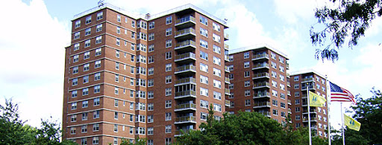
Cooperators United for Reform
Monthly Meeting
Sunday, March 1, 2026
Hosted by: Jean Hall
Welcome!
We will begin Shortly!

Slide 2

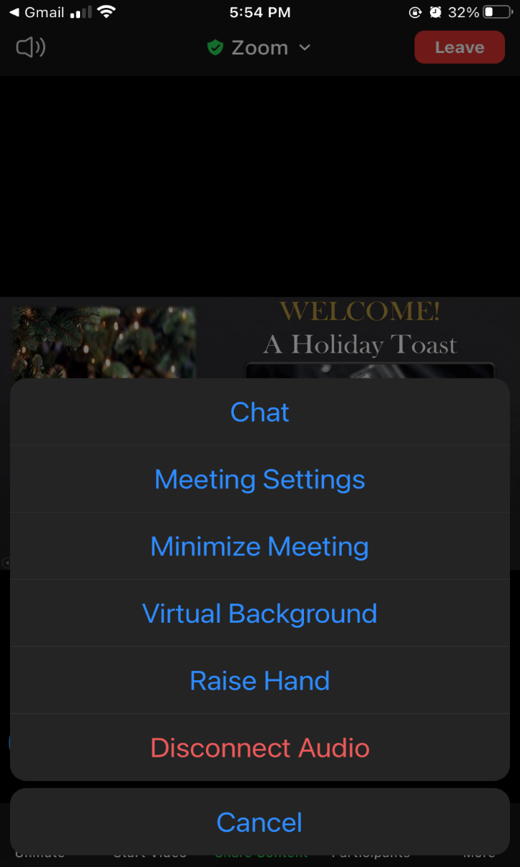


Zoom Mobile Access
Cooperators United for Reform
Type your answer in chat

Slide 3

Mission Statement
As shareholders of Rochdale Village Inc., we recognize the need for community involvement. Therefore, we are committed to being informed and taking an active role in the decisions that impact our quality of life. We value each other’s experiences, abilities, and different points of view. Together we will work to elect qualified directors and for the overall good of our community.
Cooperators United for Reform

Slide 4
Meeting and Dues
We meet on the first Sunday of each month normally at 3:30PM.Since COVID-19 in 2020 we have been meeting via Zoom. It is time for us to begin in-person meetings. I will work with the keyholders of building 1 to have our first Sunday date. I anticipate we will begin either April or May. Will also explore if I can hold hybrid for those you wish not to come out.
Our yearly dues are $60.00. We use the proceeds for administrative materials, printing, monthly meeting expenses, birthday, get well and sympathy cards/expressions.
We also want to raise funds to support qualified candidates running for the Board of Directors. You can cash app $JHallCU4R or Zelle Me.
Cooperators United for Reform

Slide 5

Agenda
Report on Legislator’s Weekend in Albany NY
State of our Finances
Hot Topics
Open!
This is a meeting where your VOICES will be heard!
Cooperators United for Reform

Slide 6
Current Events in our Nation
On February 28, 2026, the Trump Administration along with Israel bombed Iran in a military operation.
This action was taken based on claims of “imminent threats” despite negotiations that were to resume tomorrow. No Congressional authority, lack of ongoing plans for the region, and no true explanation to the American public.
148 Iran children were killed in the attack. What threat did they pose to either the United States or Isreal?
Trump wants a Noble Peace Prize – yet his administration has attacked/bombed the following: Iran, Venezuela, Somalia, Iraq, Nigeria, Latin America and the Caribbean.
His actions are risking regional destabilization, civilian casualties, escalation risks, and damaging US relations with our allies.

Slide 7
Elections / Mid-Term Elections
The election season has begun. In New York, our 32nd Assembly – the seat is open as Assemblywoman Vivan Cook will not seek re-election after 35 years of service.
Note: Rochdale Village Board of Directors does not endorse candidates. We will provide a forum for all candidates to share their platforms as perspective candidate once the petition cycle ends.
Note: Supporters seeking petitions should not be ringing doorbells – rather they can obtain signatures in the lobbies, outside of our buildings, and in our mall areas.
I am encouraging everyone to VOTE!
As the mid-term elections draw near there is a fear that the Trump administration will try to maneuver to not allow the elections of as a 17-page memo is being circulated in Congress to give Trump the authority to declare a national state of emergency and take over the elections.
If your VOTE did not matter, they would not be trying to silence it!

Slide 8
Chancellor Kamar H Samuels Stands Tall!
During the February 10, 2026, Community Education Council (CEC) District 3 meeting, Hunter College associate professor and district parent Allyson Friedman was caught on a live mic making the following remarks while a Black eighth‑grade student was speaking about saving her school from closure:
“They’re too dumb to know they’re in a bad school.”
“Apparently, Martin Luther King said it, like, ‘If you train a Black person well enough, they’ll know to use the back, you don’t have to tell them anymore.’”
District 3 represents the Upper West side, Morning Side Heights, Manhattan Valley and parts of West Harlem.

Slide 9
The Chancellor’s Response
Let me be clear: Anti-Black racism has no place in NYCPS – not in our classrooms, our community spaces, or anywhere in our city. The comment was a vile and reckless attack on a young person speaking her truth to power.
And most of all, I want to acknowledge the Community Action School and the brave student who spoke in the CEC meeting. We are providing support to her and her school community. No student should have to experience what she did.
To be confronted by such hateful and demeaning words is especially painful for me as a parent. I want to say to her what I would say to my own kids: She is brilliant. She has infinite potential. And any attempt to dimmish that potential will not stand while I am Chancellor.
New York City Public Schools does not tolerate racism or discrimination of any kind period. We take these matters very seriously, and the superintendent, as well as our Office of Family and Community Empowerment, are responding to this incident comprehensively.
Citywide and Community Education Councils are independent bodies, and their meetings are expected to be respectful spaces for students, families, and staff.

Slide 10
Chancellor’s Response Con’t
What happened at the meeting was a complete violation of those expectations, and we are providing support to the district to repair the harm done.
You have my word that behavior like what we saw at the District 3 CEC meeting will not be tolerated. We can and must do better.
We need to equip our staff to have courageous conversations focused on shifting attitudes and interrupting prejudice, addressing controversial issues, and coalition building.
The teacher has been placed on leave by Hunter College. Hunter College opened an investigation under its conduct and nondiscrimination policies, reviewing whether her actions violated university standards.
Education is another tool used against us: What we must do is teach our own; ensure that we provide supplemental platforms to teach our children our history. And most important we must teach them “Critical Thought.”

Slide 11
Legislator’s Weekend in Albany, NY
Lawmakers and advocates used the weekend to spotlight urgent policy needs, especially around:
Education funding
Affordable housing
Sentencing reform and incarceration costs
Racial wealth gap and loss of Black homeownership
Assemblymember Michaelle Solages, chair of the Caucus, emphasized that New York spends over $3billion in incarceration instead of prevention, calling for a shift toward community investments.
The weekend marked the 100th anniversary of Black History Month and the 55th year of the Caucus. Leaders connected today’s fight to the Caucus’s origins in 1966 when Black and Puerto Rican lawmakers started the “midnight walk” to demand power in Albany.

Slide 12
Caucus Weekend is intentionally held in the middle of the state budget process, giving legislators of color and their constituents a unified platform to push for changes before negotiations finalize. Assembly Member Latrice Walker highlighted that the timing is strategic for shaping the counter-offer to the governor’s budget.
The weekend included a youth summit featuring Gen Z rapper Cash Cobain, signaling a push to involve younger voices in policy conversations.
New York City Mayor Zohran Mamdani returned to Albany for a mayor’s forum alongside other mayors, moderated by Attorney General Letitia James.
The weekend featured:
82 policy workshops
A scholarship gala
Recognition of Black trailblazers
Advocacy gatherings drawing people from across the state

Slide 13
State of our Finances
We are still facing significant financial challenges as we enter the end of our fiscal year – 2026 on March 31, 2026.
We enter FY-27 on 4/1/26 thru 3/31/27. There is no carrying charge increase scheduled for FY-27 – remembers it ends 3/31/27. However, we must be on-point as we address our revenues.
We will begin preparing for the next two-year fiscal budget during FY-27 with preliminary projections end of May/June 2026.
Immediate Concerns: Collections – during the month of November 2025 (first month of carrying charge increase – we were short by approx. $500,000) December 2025 we were again short by $500,000. That is 1 million dollars in two months is equal to at least a 1.5% carrying charge increase. We cannot afford that level of non-payments.
Therefore, this is an area that I have asked management to report out to the board and shareholders every month.

Slide 14
The Board has asked management to aggressively peruse those not paying and increase the number of evictions as required.
The Board has asked management to go after commercial tenants as well for non-payments.
Current Budget – We will need to make adjustments as our budget has been thrown out of wack by the level of spending on snow removal this year. In January we spent $155,000 on the first snowstorm. We spent $546,00 for the second storm. Both total $702,000. For the storm that just hit we are estimating an additional $650,000.
We budgeted $800,000 in the budget; actual expenses are $1.3 million. Therefore, we are approximately $552,126 over budget.
Funding – where can we get money!!!!!
Federal – Congressman Meeks – Note: On Friday, 2/27/26 we received notification of funding opportunities available for Community Funding Project – the due date for submission is 3/6/26 at 5:00PM.

Slide 15
State Funding:
NY Senate: Senator James Sanders has indicated he has allocated 2million dollars – we are searching for those funds.
NY Assembly: Assemblywoman Vivian Cook pledged 30 million to Rochdale – 5 million to operations and 25 million to capital work. We are trying to find out when these monies will be received.
City Funding:
City: It is anticipated that ongoing conversations will be held with City and Agency officials to address the water bill interest charges.
It is difficult because shareholders want action now, but the process of obtaining funding also requires the ability to effectively advocate on behalf of the community. That is the role of the elected Board of Directors. Therefore, it is important that as a community we speak as one voice. If we are not unified, we hurt the community as a whole.

Slide 16
Hot topics / Calendar
Mon. 2 Mar., 9:00 AM
Congressman Meek’s Clergy & Community Breakfast – Monday March 2nd at 9AM – Robert Ross Johnson Family Life Center
Tue. 3 Mar. 2026
United States Postal Service Presents – Muhammad Ali Memorial Stam Unveiling – Tuesday March 3, 2026, from 10:00AM – 2PM Robert Johnson Family Life Center. Keynote Speaker – Congressman Meeks
Tue. 2026 – 3 Mar. 2026
Commercial Services Committee Meeting via Zoom – Tuesday – March 3, 2026, 7PM
Wed. 4 Mar. 2026, 10:00 AM
Senior Citizens Committee Meeting – Wednesday March 4, 2026, at 10AM – Grand Ballroom
Thu. 5 Mar. 2026, 7:00 PM
Community Center Committee Meeting – Thursday March 5, 2026, at 7PM – Club Lounge
Sun. 8 Mar. 2026
Daylight Savings Time begins

Slide 17
Public Safety & Parking Committee– Thursday, March 12, 2026, Club Lounge at 7PM
Maintenance & Environ Conservation Committee – Thursday March 19, 2026, at 7PM – Club Lounge
Friday, March 20, 2026 – Welcome Spring!!
Sunday March 22, 2026, from 3PM to 6PM – Women’s History Month Celebration – Community Relations Committee & Senator Sander’s office – Grand Ballroom
Monday, March 23, 2026, at 7PM – Board Meeting via Zoom!!!
Wednesday, March 25th Budget & Finance Committee Meeting – 7PM – Rooms 11/12/13

Slide 18
Celebrating Women’s History Month
2026 Theme – Leading the Change: Women Shaping a Sustainable Future.
This year’s theme is aimed at expanding our understanding of sustainability beyond just the environmental concerns. It encompasses financial sustainability, community resilience, leadership succession and intergenerational equity.
Goals and Objectives include:
Honor – celebrate the diverse contributions of women
Educate – Raise awareness about the important historical and contemporary roles of women
Inspire, Connect, and Envision – Women Power throughout our Nation!

Slide 19

Questions?
Cooperators United for Reform

Slide 20


Cooperators United for Reform

