Slide 1
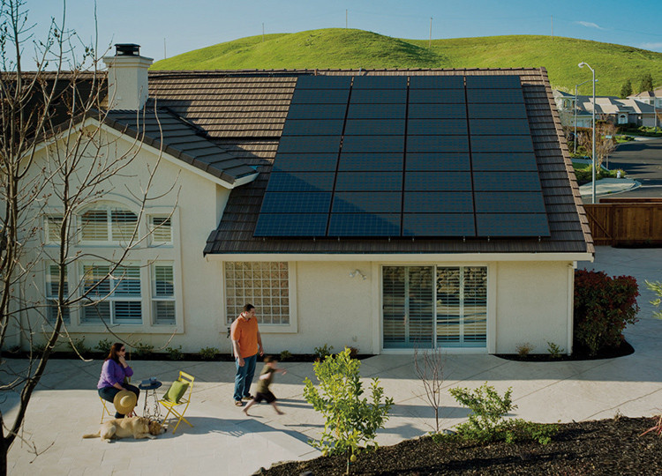

IS YOUR HOME RIGHT FOR SOLAR?

Slide 2

MYTHS HOMEOWNER’S SIDE
I don’t know who to trust…
Solar is
too expensive
We don’t get enough sun where I live
I’m going to move
in the next 20 years
The technology is improving too fast, I’ll just wait
Should I lease or own?

Slide 3

OUR MAIN SOURCE OF ENERGY COMES FROM DIRTY ENERGY
Coal, Oil, Gas, etc.
NEARLY 8,000 OPERATIONAL POWER PLANTS IN US ALONE

Slide 4


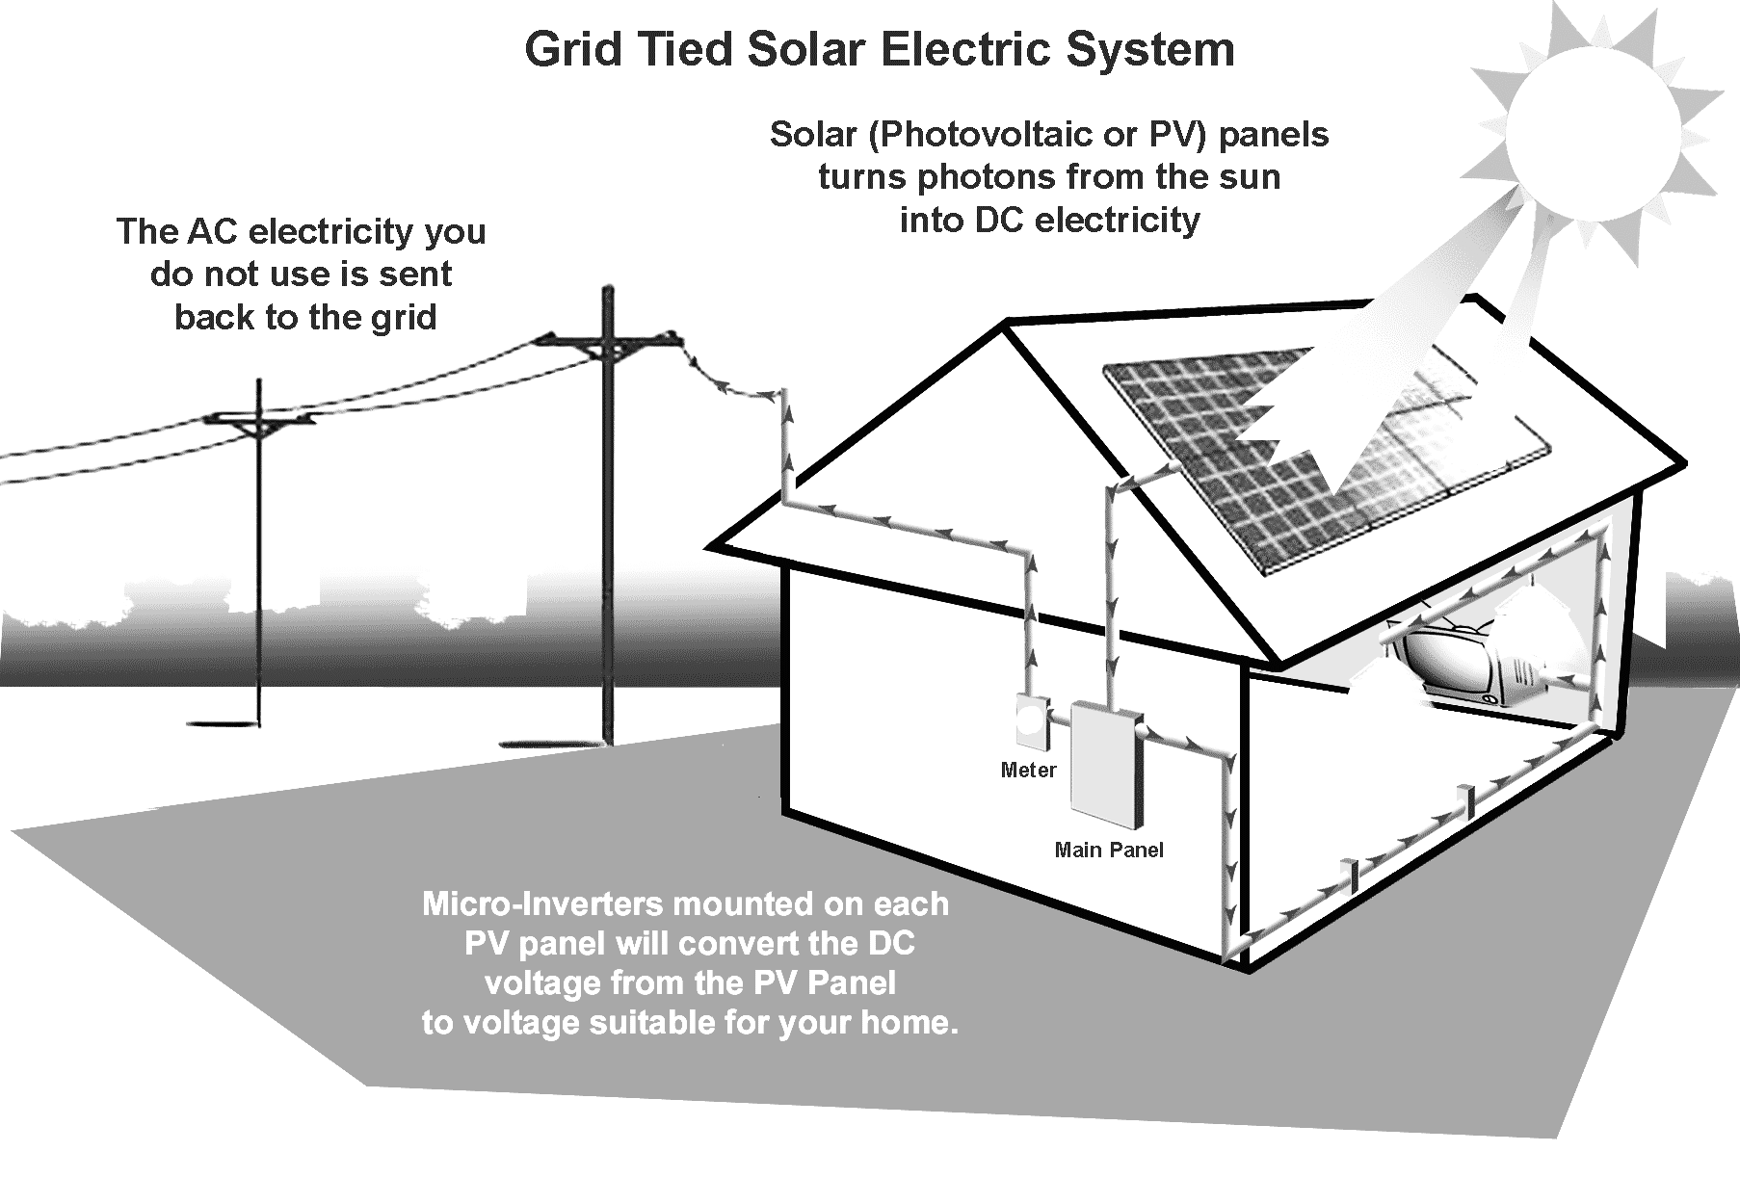
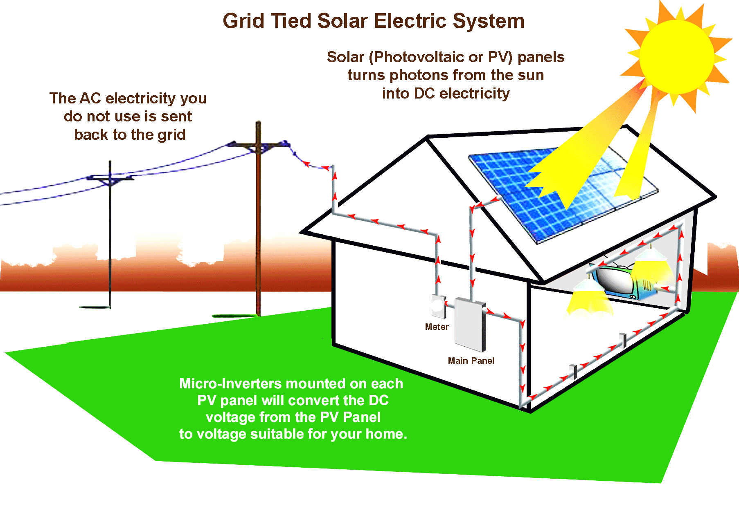
HOW DOES SUNSHINE BECOME
SOLAR ENERGY?
Solar Panels capture energy from the Sun and channel it to an inverter, where it’s converted to AC electricity to power your home.

Slide 5
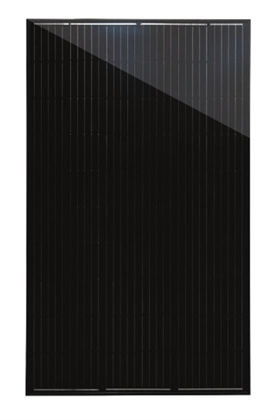
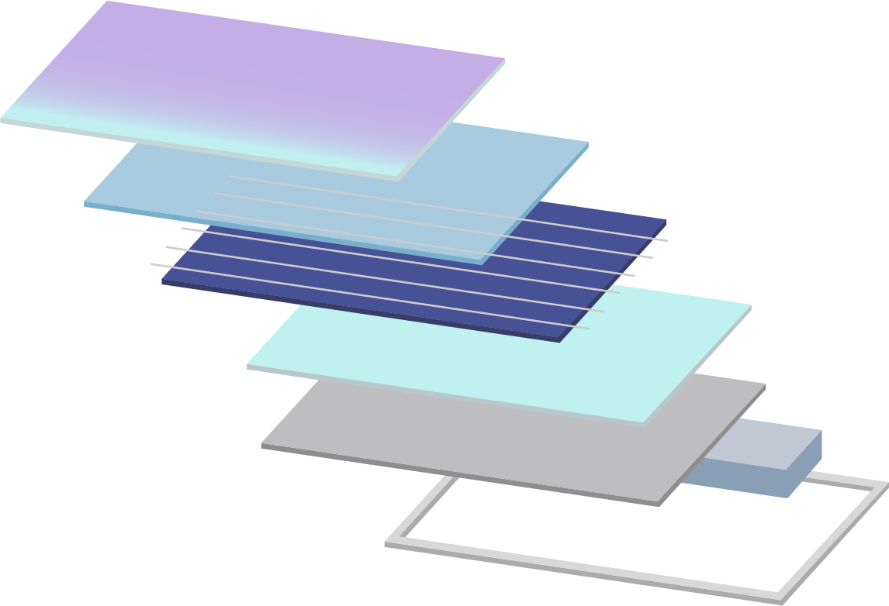
MANY CELLS ARE THEN TURNED
INTO A PANEL
Glass
Encapsulant
Crystalline Cells
Encapsulant
Back Sheet
Junction Box
Frame

Slide 6
MORE THAN ONE PANEL FORMS A SOLAR ARRAY
WE DESIGN THIS ARRAY TO REPLACE THE ENERGY YOU ARE RENTING FROM THE UTILITY…

Slide 7
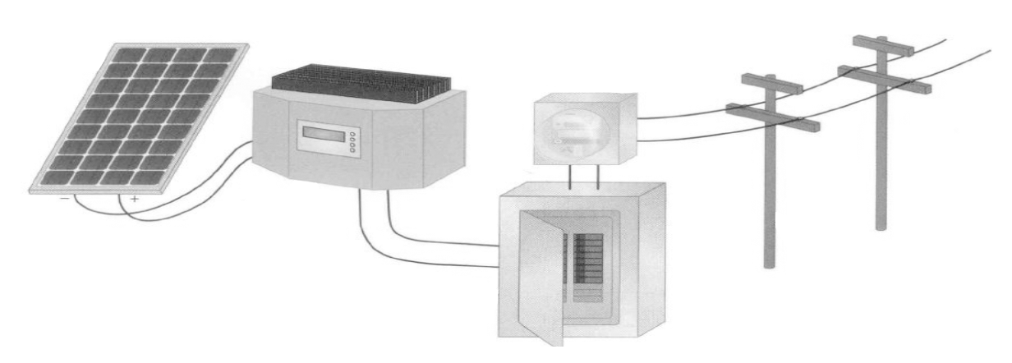
SOLAR (PHOTOVOLTAIC) SYSTEM COMPONENTS
PV Array refers to all system components
»
Panels
»
Inverters
»
Wiring
»
Racking and / or Railing Systems (not shown)
Electricity Meter
Utility Grid
Array
Interactive Inverter
AC Power Distribution Panel

Slide 8
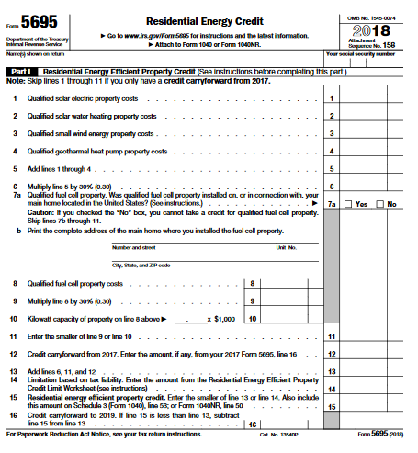
Federal Tax Credit for Solar Energy
Installing alternative energy equipment in your home can qualify you for a credit equal to 30% of your total cost. The credit is available through the end of 2019.
The credit is only available for improvements you make to your residence. This can apply to a second residence as well.
As a credit, you take the amount directly off your tax payment, rather than as a deduction from your taxable income. Other than the cost of the system, there's no limit to the dollar amount of the credit.

Slide 9

NEW LAWS BEING PASSED THAT REQUIRE SOLAR

Slide 10

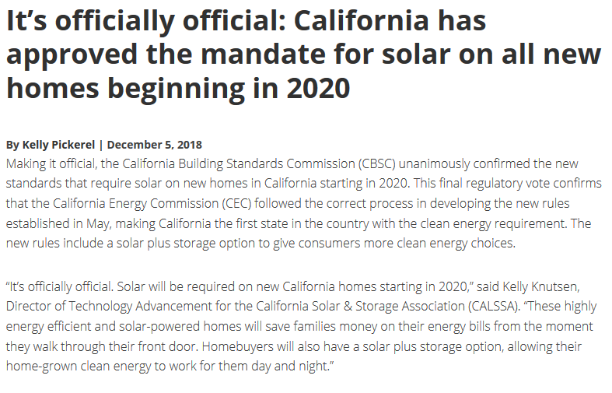

Slide 11
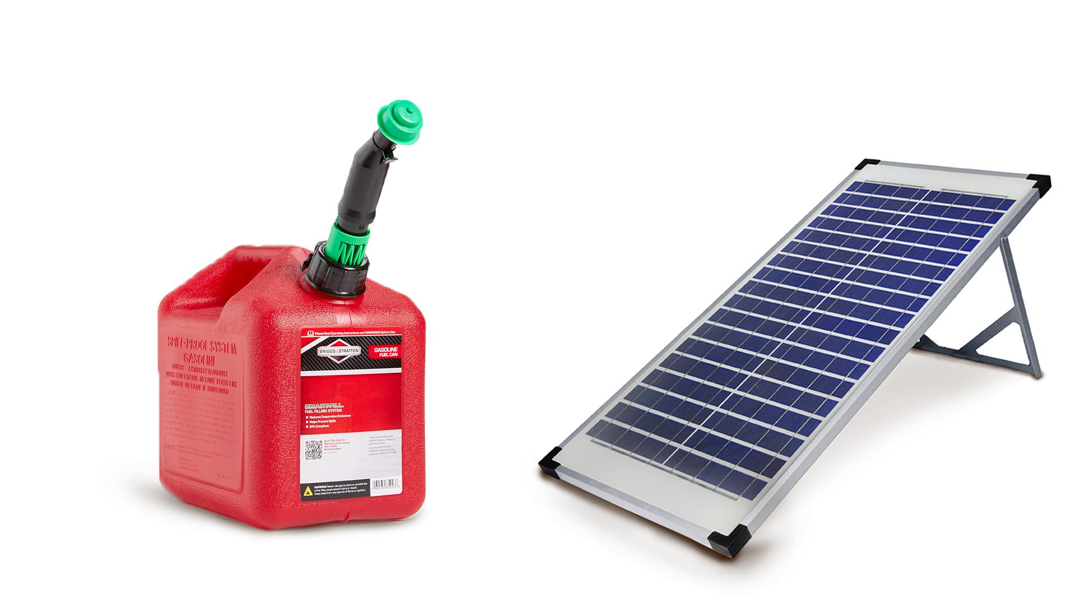
PRICE OF GAS VS KWH OF ENERGY

Slide 12

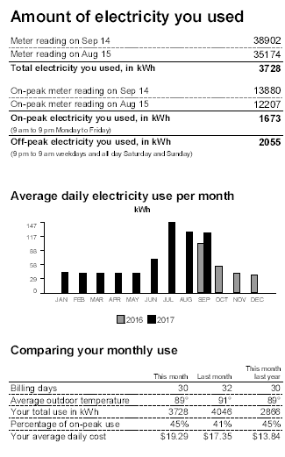
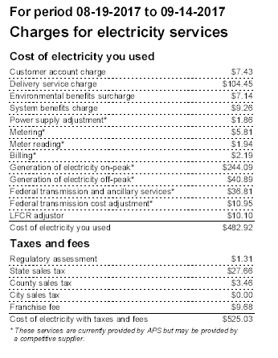
DO YOU DO PAPER OF ON-LINE BILLING?
Price per KWH
$525.03 / 3728 KWH
$0.1408

Slide 13
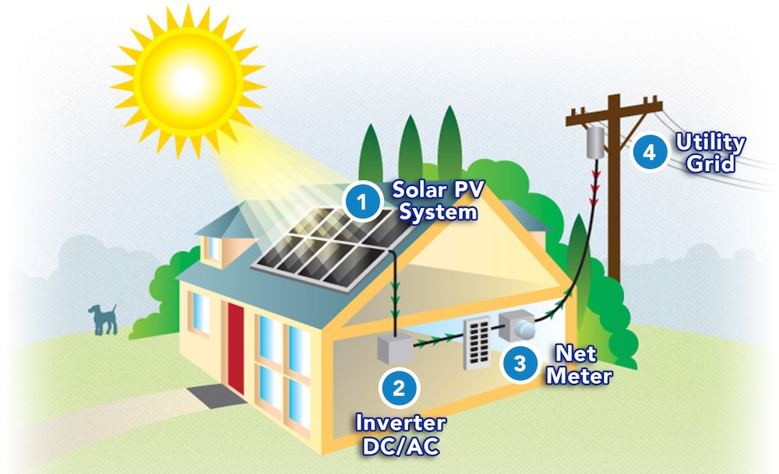
GRID TIED SOLAR ELECTRIC SYSTEM
Power is only generated during daylight hours when demand is low
Most of your power is needed at night, when there is no sun out
The solar system is connected to the grid; it acts as a giant battery
  The grid receives the excess energy produced during the daylight hours
  You pull energy from the grid during the night when there is no sun
The power company credits you for electricity you put on, and then deducts the credits at night when you draw.
They bill you each month for the difference

Slide 14
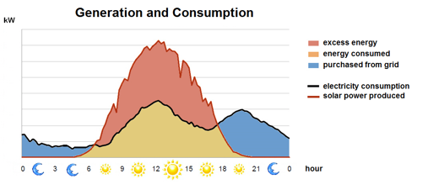
GENERATION AND CONSUMPTION

Slide 15

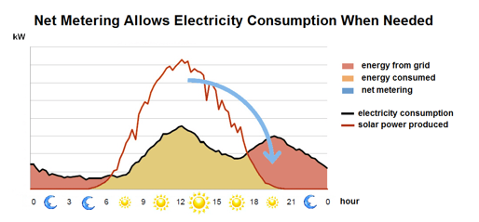
NET METERING ALLOWS CONSUMPTION
WHEN NEEDED

Slide 16
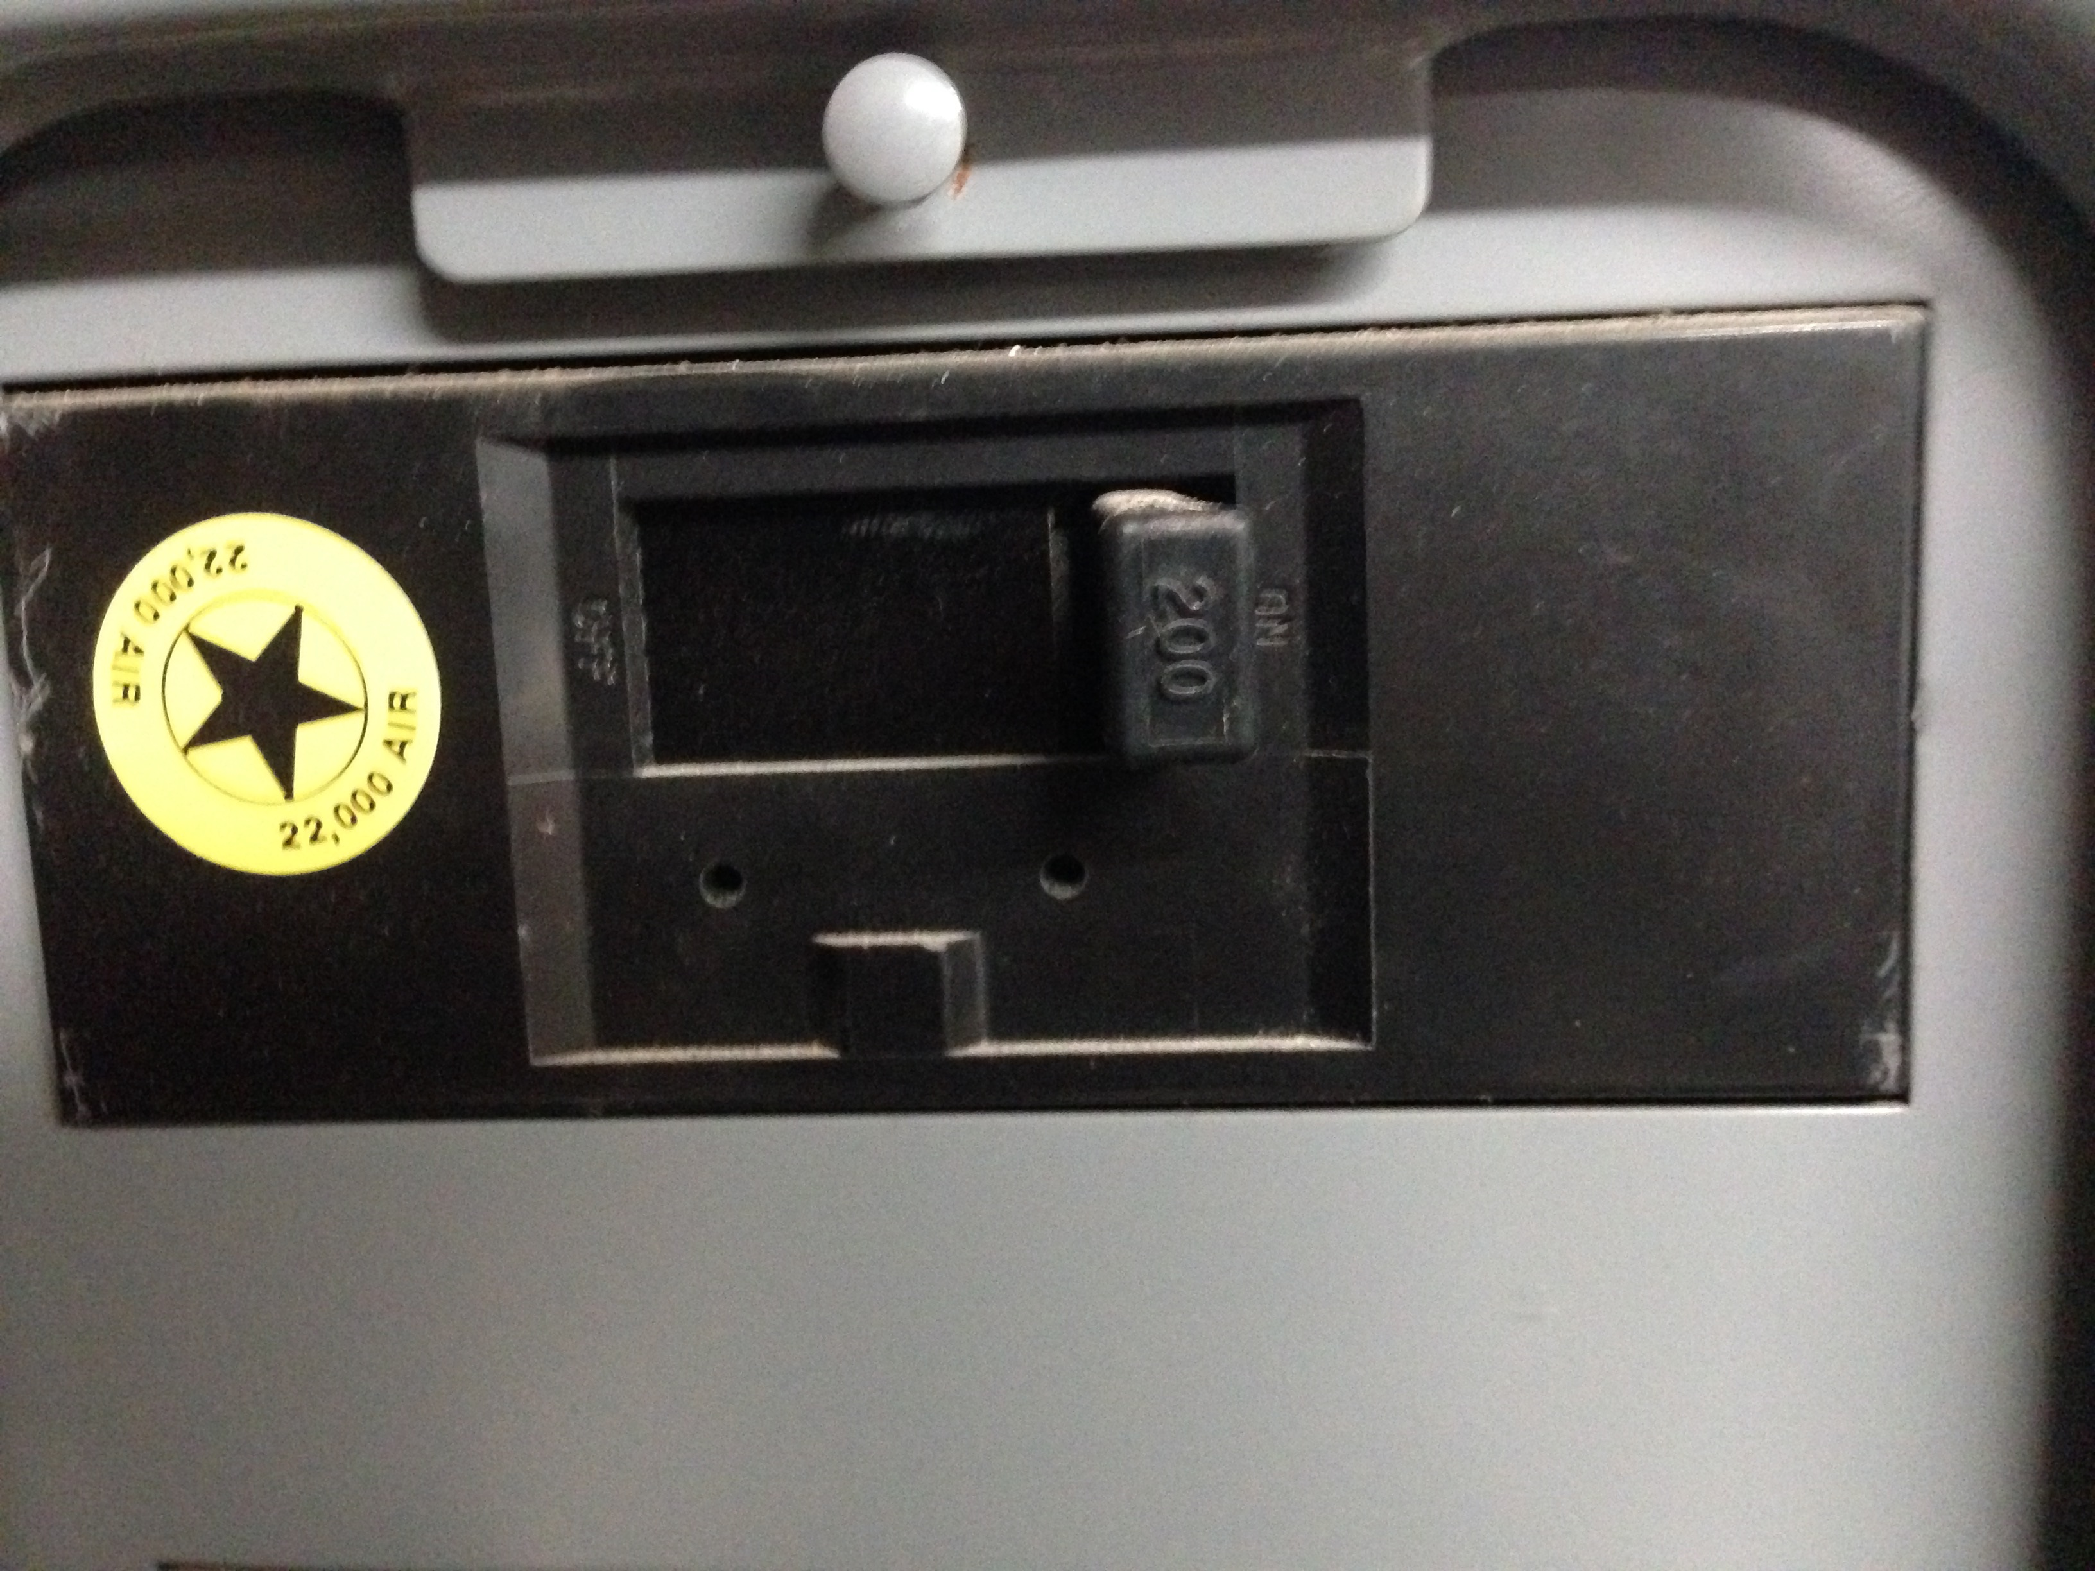
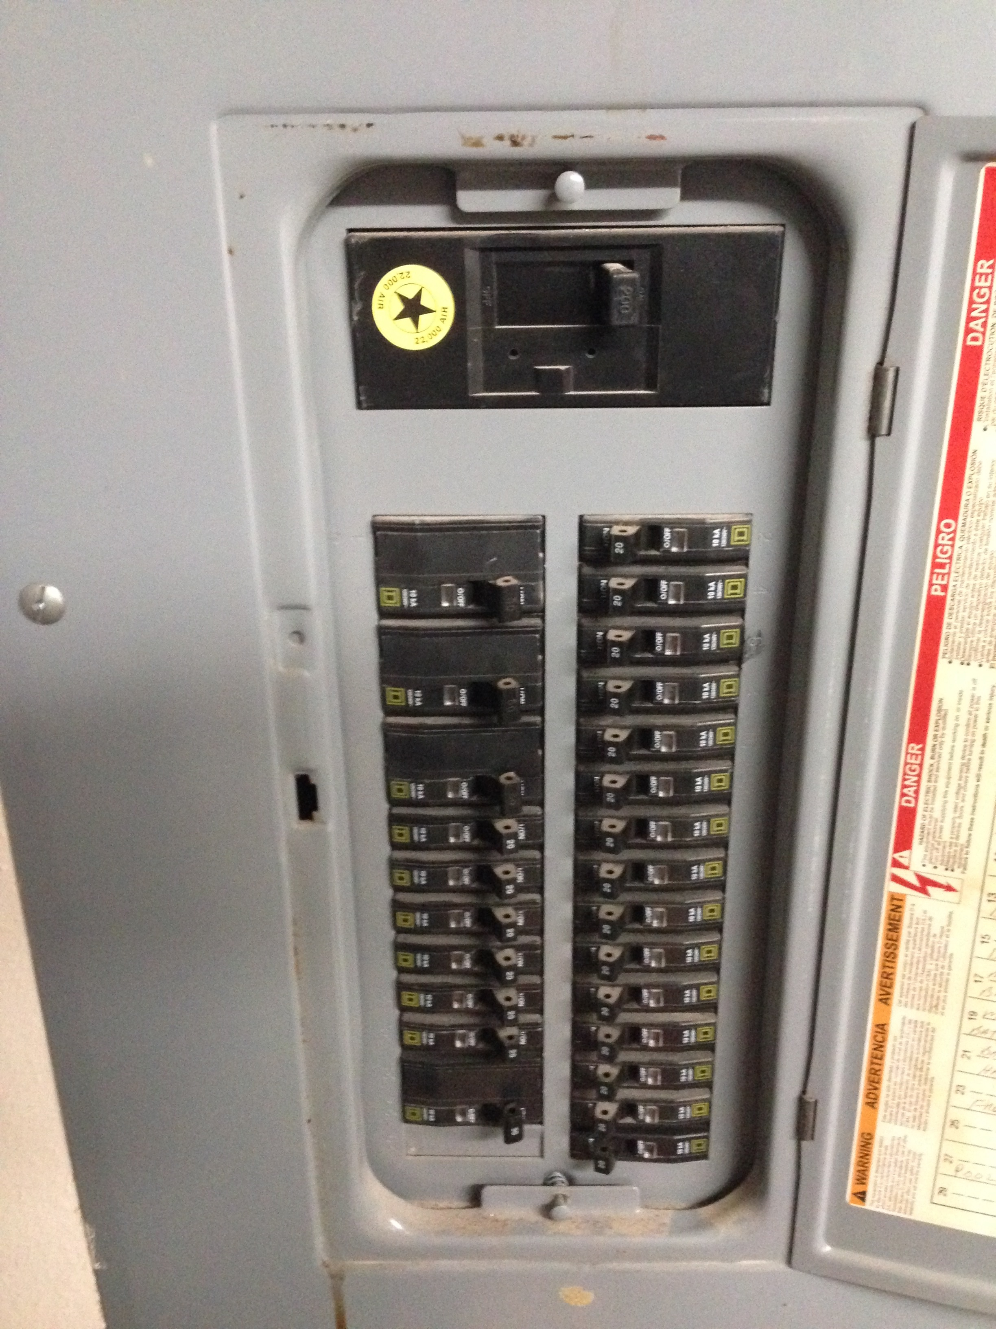
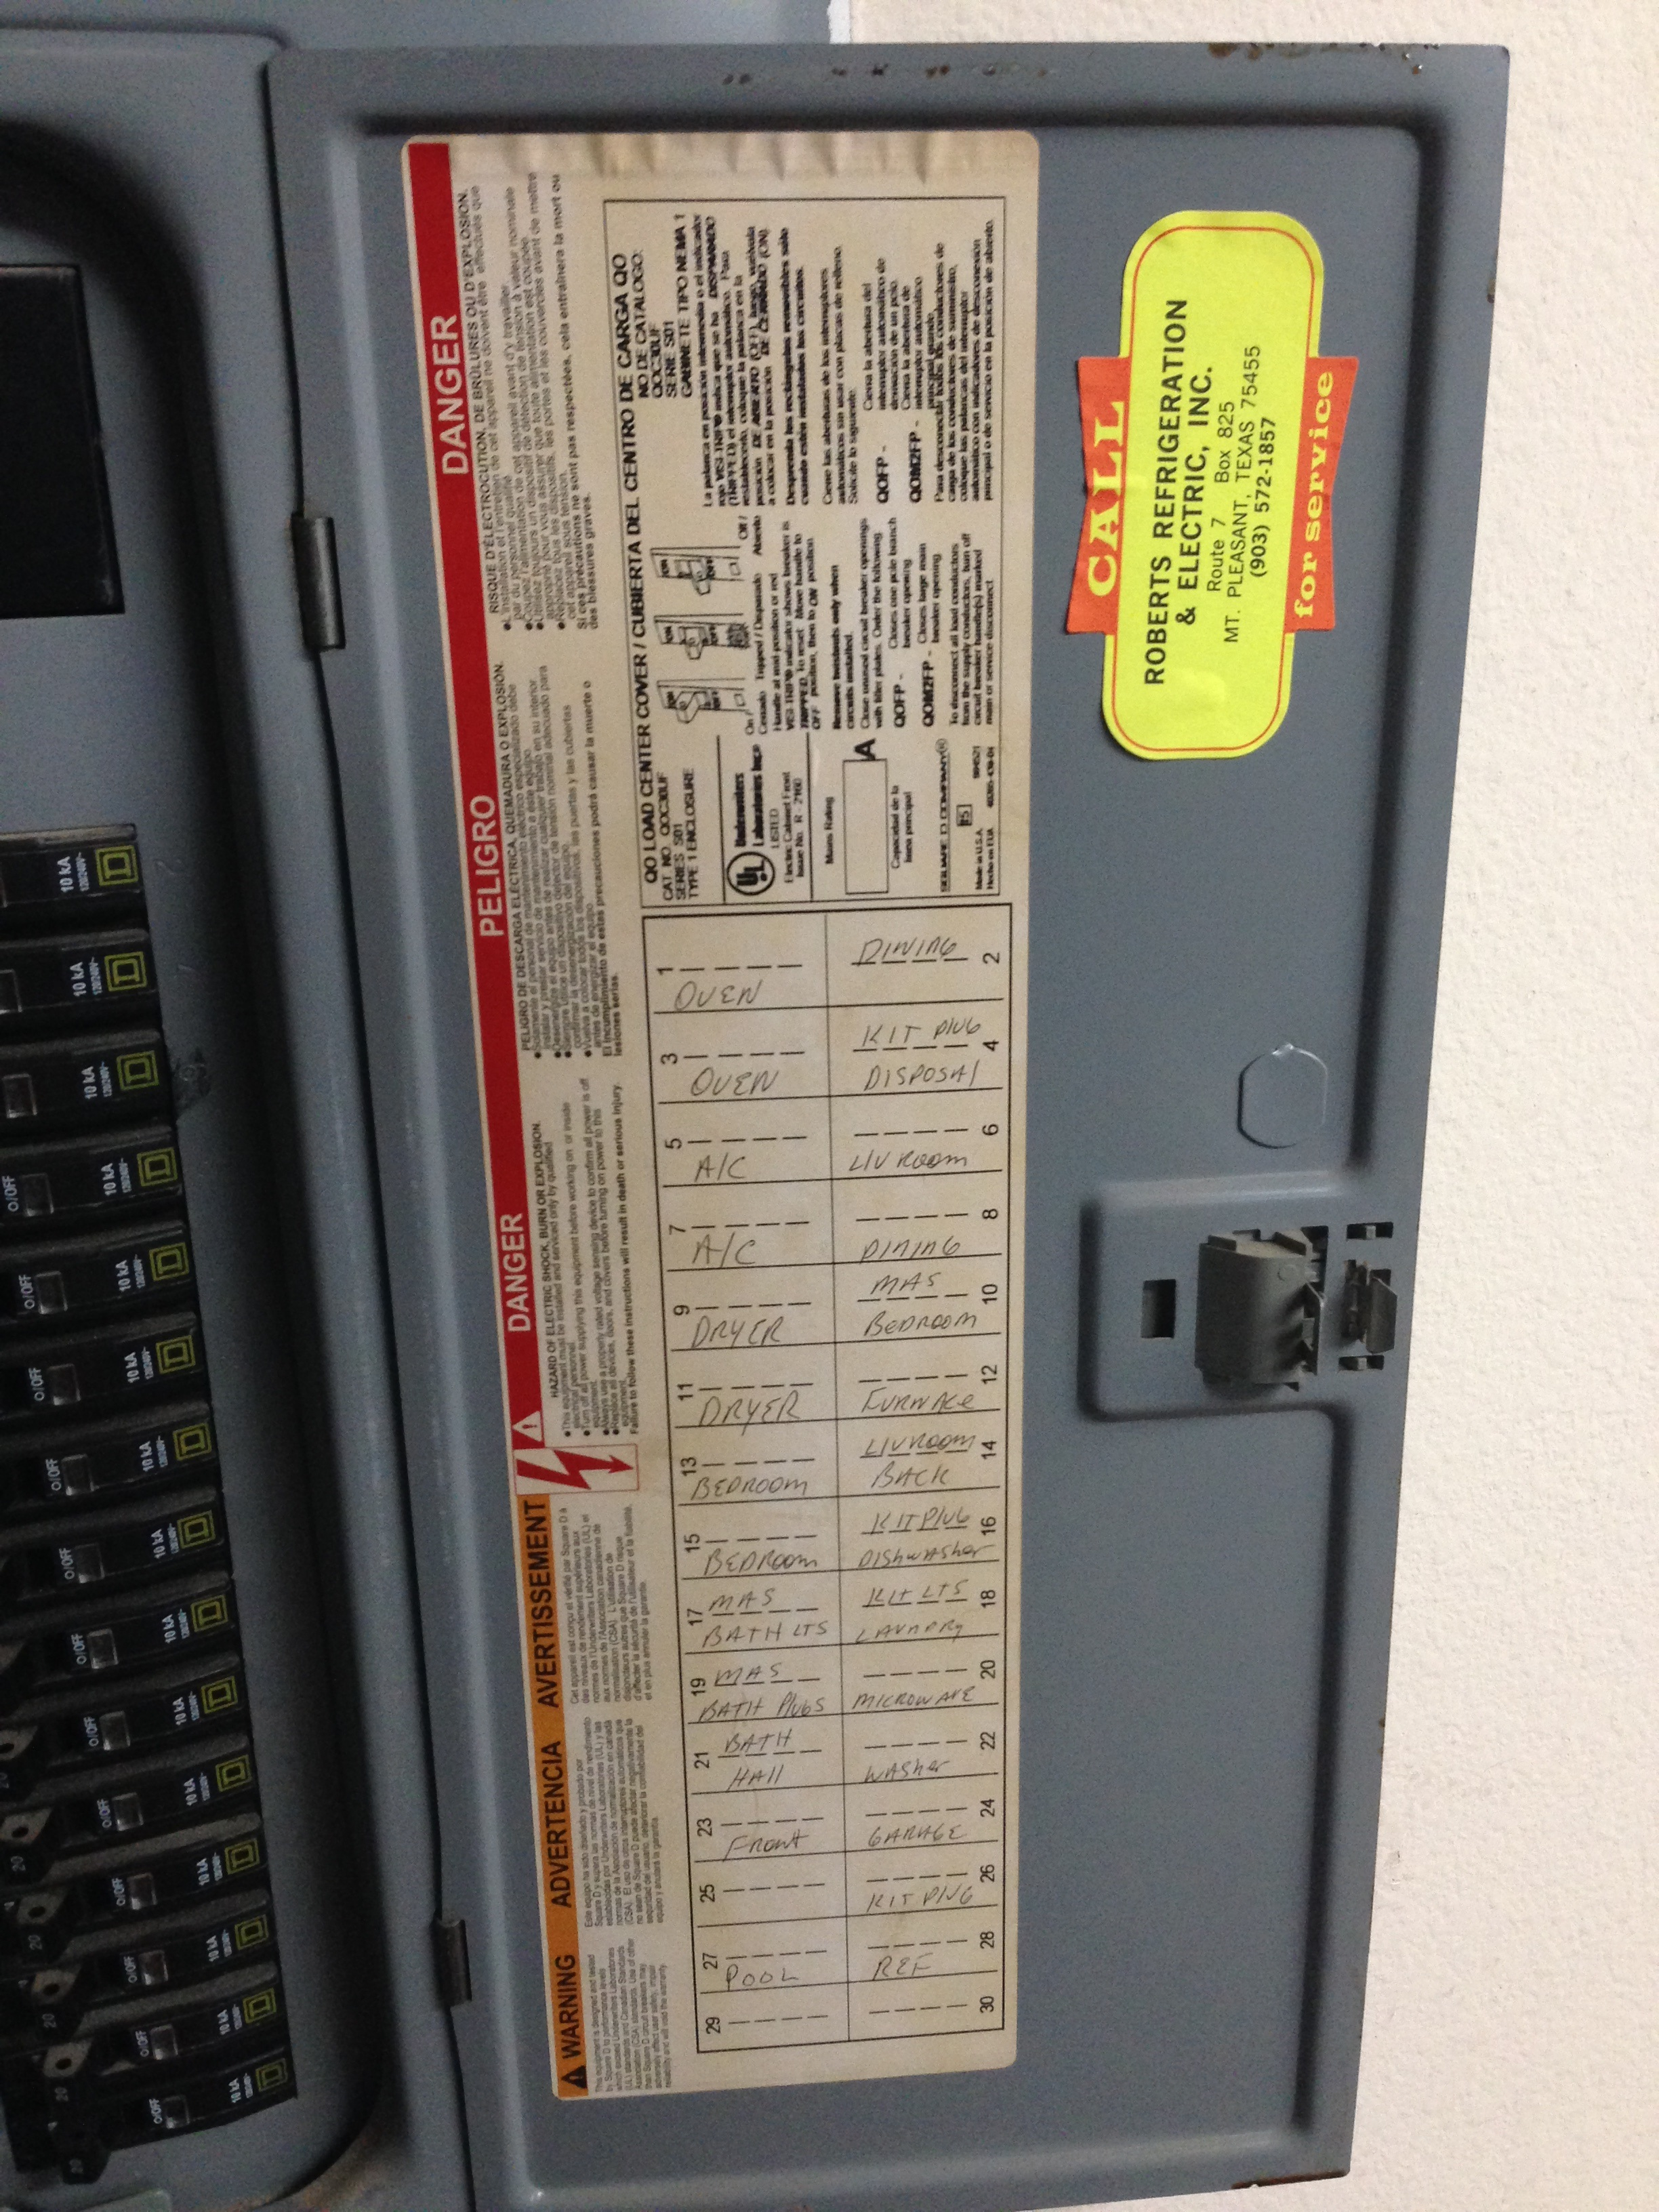
LET’S TAKE A LOOK AT THE
RATING OF YOUR PANEL
GENERALLY, SOLAR REQUIRES A 2OO AMP PANEL

Slide 17
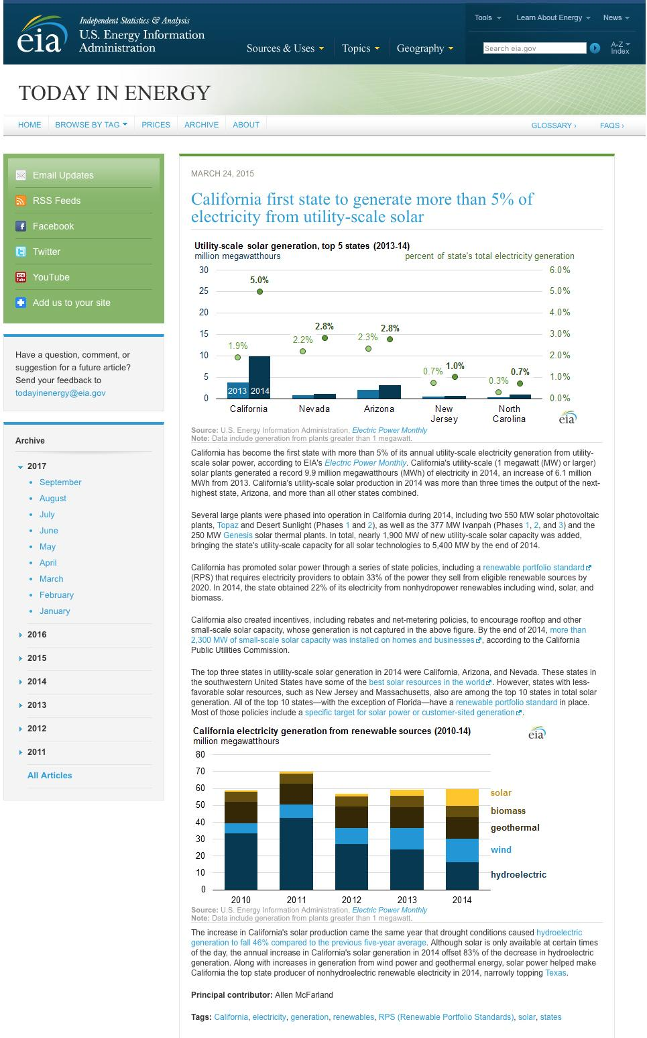
SOLAR ELIGIBITY
Cost of Energy
Credit
Roofing
Shading

Slide 18
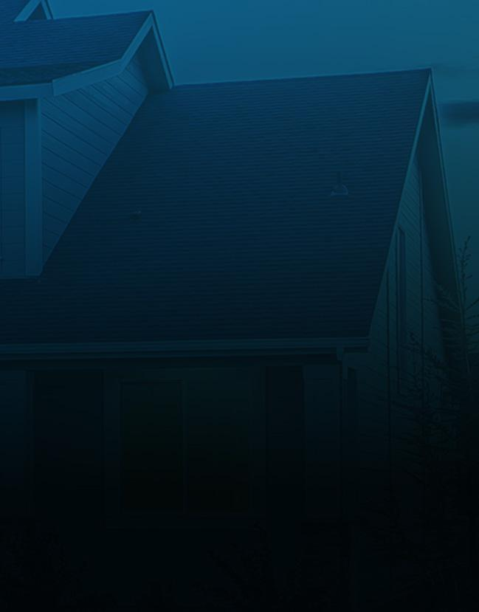
ROOF ASSESSMENT
Look at the roof and check for the following...
1.
Roof orientation, size and shape
2.
Roof
Quality
3.
Tree on the south facing side
Is it the right direction?
Is there enough space for panels on the south side?
Are the shingles intact or do they look old and ratty?
Are there trees that could create shade on the roof?
Proximity of trees to the home?

Slide 19
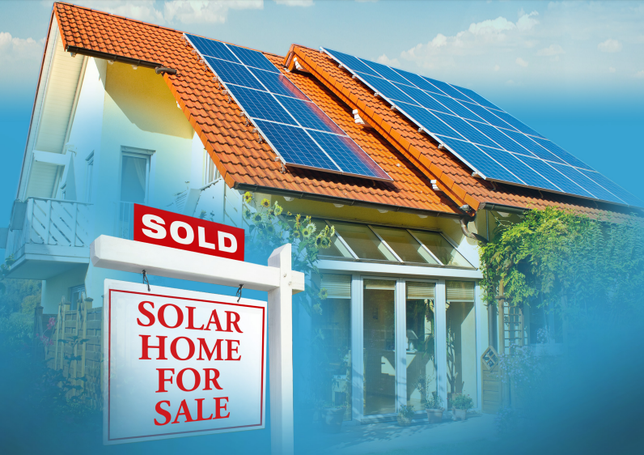
WHAT
IF I SELL MY HOME?

Slide 20
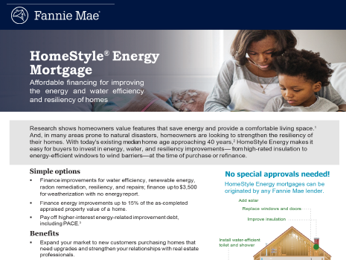

Slide 21
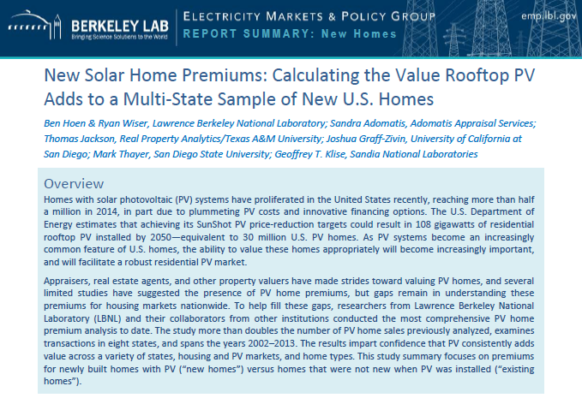

Slide 22
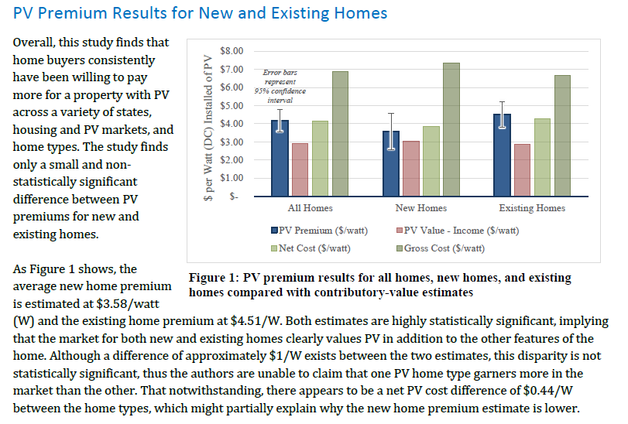

Slide 23
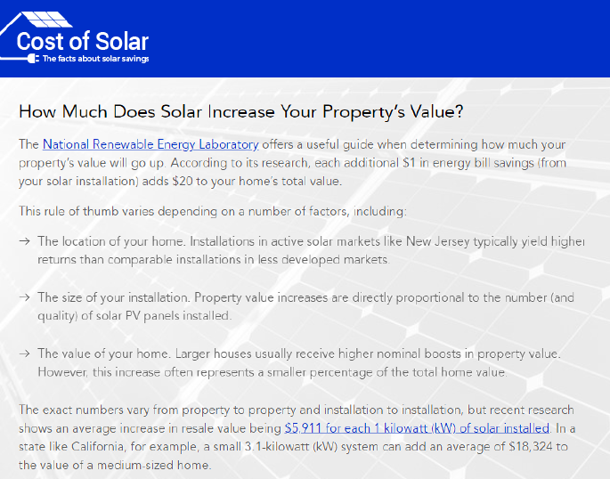

Slide 24
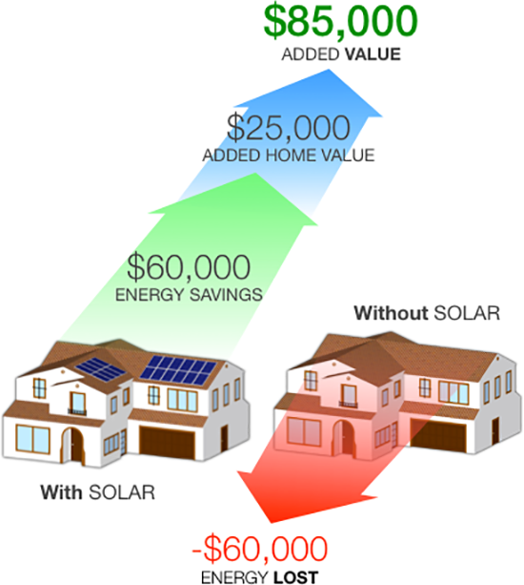
How is the
Valuation Determined?
Asset:
Liability:

Slide 25
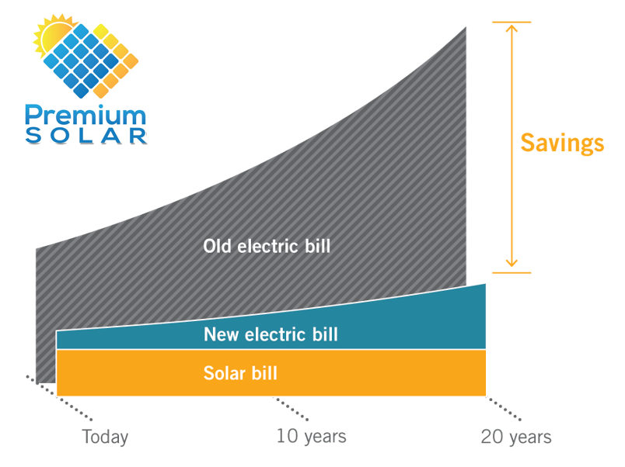


Slide 26
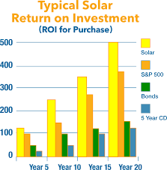
Asset versus a
Liability

Slide 27

NREL Study Finds Solar Homes Sold 20% Faster and for 17% More.

Slide 28

Homes with Solar Sell Faster
Homes with lower electricity bills also sell faster, spending less time on the market.
According to the U.S. Department of Energy’s Office of Energy Efficiency & Renewable Energy, a home with solar panels will sell twice as fast as a home without solar panels.

Slide 29

Homes with Solar Sell Faster
Homes with lower electricity bills also sell faster, spending less time on the market.
The website for the U.S. Department of Housing and Urban Development states that energy saving improvements increase the potential resale value of your home and help it sell more quickly because they
“make your house more affordable to more people”,
“attract attention in a competitive market”,
and are
“improvements which will actually save money.”

Slide 30
Your Options…
Stick with your current electricity provider
          Unpredictable rates
      Adds no value to your home
Go Solar
          Zero Out of Pocket Option
          Long Term Savings
          Control & Predictability
      Adds Value to Your Home

Slide 31
WHAT HAPPENS NEXT?
SUBMIT YOUR ELECTRIC BILL AND SET AN APPOINTMENT
REVIEW PROPOSAL
REVIEW & SIGN INSTALLATION AGREEMENT
SOLAR INSTALLER SITE VISIT
RESIDENTIAL SOLAR PERMIT
SOLAR INSTALLATION
UTILITY INSPECTION
TURN ON SOLAR & START SAVING!

