Slide 1
An Alternative Option to Improving the Coastal Resiliency of Chippechaug Trail
11/26/24
MIFD Road Protection Sub-Committee

Slide 2
Presentation Topics
Overview of erosion issue
Original concepts considered
Creation of an alternative concept option: sloped rock wall
Design engineer selection
Proposed design
Projected cost
Next steps on alternative option
Update on Plan A “Living Shoreline”

Slide 3
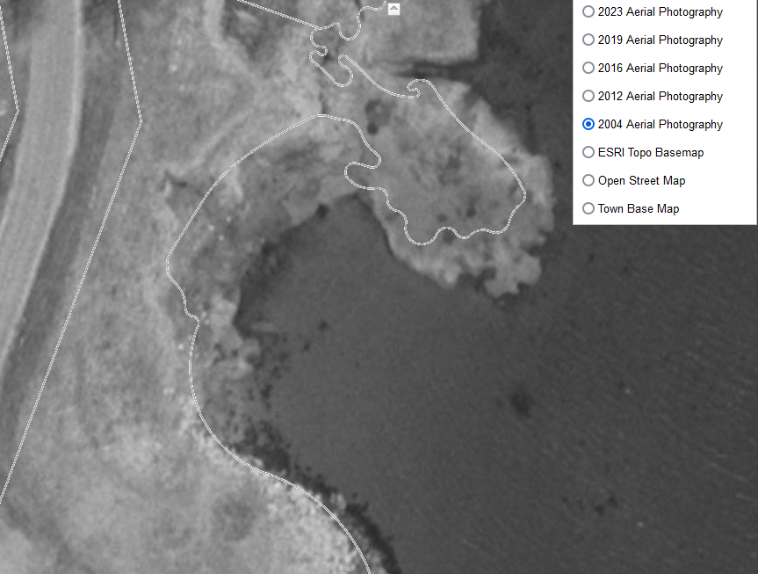
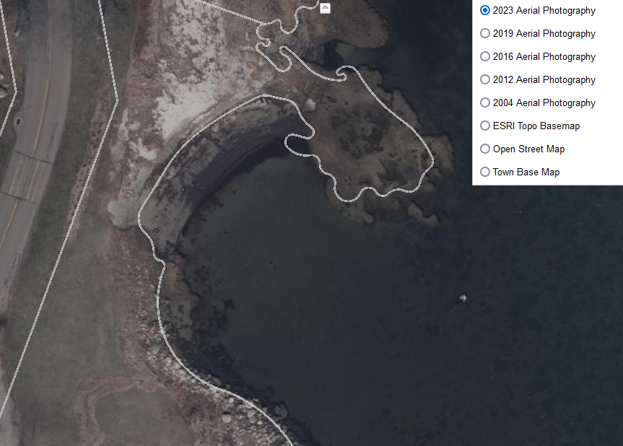
Recent Erosion North of Allyn’s Alley

Slide 4
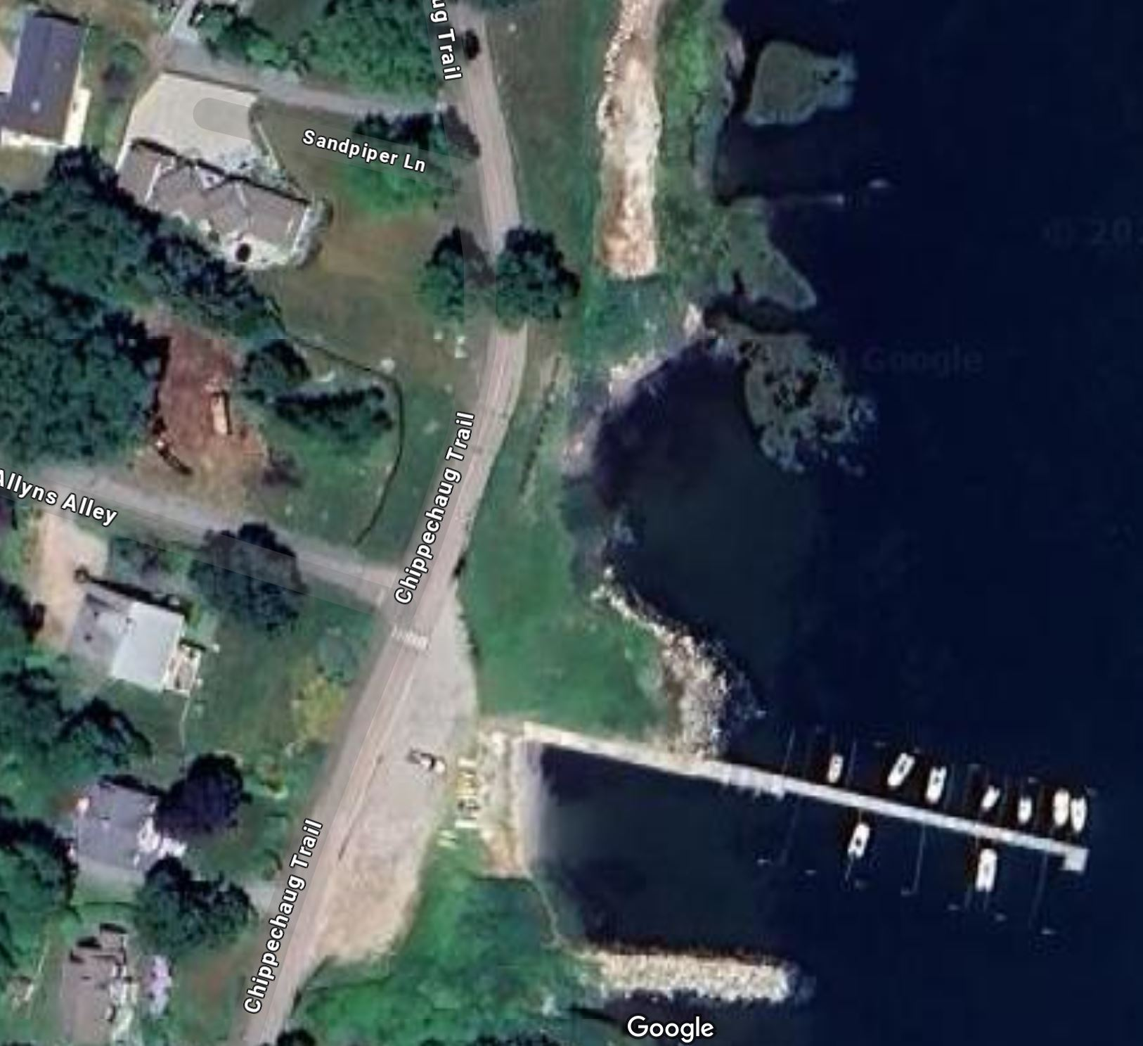
East Side of the Road North of Allyn’s Alley
Conclusion: Sloped Rock Walls work!!
Living shoreline protection without rocks
Issue: Regulators no longer allow them to be installed within CJA (there are exceptions)
Massive erosion
Sloped rock wall installed in the 1960s
No erosion

Slide 5
Resiliency Options Originally Considered
Elevate the existing road
  Very expensive and disruptive
  Effective long-term solution for erosion and sea level rise
Permanently relocate main thruway onto Old South Rd and Allyn’s Alley
  Expensive and disruptive
  Deed restrictions and neighbor concerns
  Effective long-term solution for erosion and sea level rise
Create a shoreline barrier to prevent or slow down further erosion (Living Shoreline Project)
  Limited historical data to 10 years on effectiveness,
  High cost ($350,000 to $600,000)
  Not a solution if sea level rise continues
  Preferred method by DEEP
  Grant funding available to fund up to 75% of cost

Slide 6
Living Shoreline Option Was Selected
Problems arose
  Challenges with creating a design that meets MICO concerns.
    Use of shipped-in fill would not be approved due to concerns over it compromising Allyn’s Alley marina.
  Living shoreline projects have required 3 components: fill, plantings, and rocks
  Grant funding available for living shoreline projects, but now funding in question without all 3 components,
  Unclear DEEP responses as to whether no-fill living shoreline design would be approved
  Issues of ownership of in-water components: littoral rights, liability, maintenance
In spring of 2024, the living shoreline project seemed like it was in jeopardy and unlikely to happen.
The MIFD Board asked the Task Force to keep pushing on the Living Shoreline option, but an alternative solution was clearly needed in case the issues could not be resolved.

Slide 7
A Project Group Was Formed
Scott Parry - MIFD
Jeff Miceli - MIFD
Tom Giola - MIFD
Bob Domurat - MIPOA
Lou Allen - MICO
Kevin Miller - Advisor
Develop an alternative approach
  Could be located within MIPOA owned property
  Would not require a DEEP permit (Outside Coastal Jurisdiction area)
  More palatable to MICO
  With a more proven record of success in shoreline road protection

Slide 8
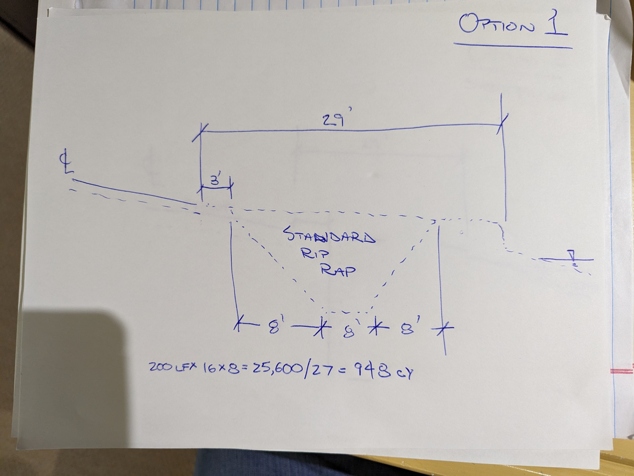
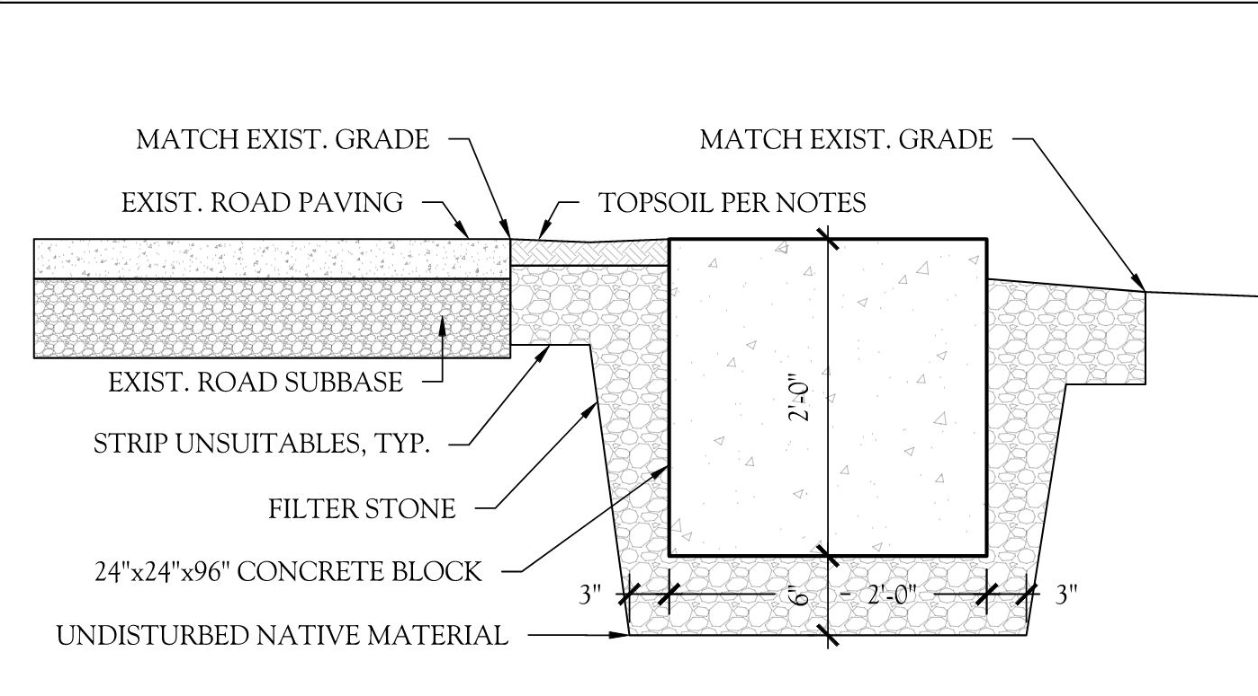
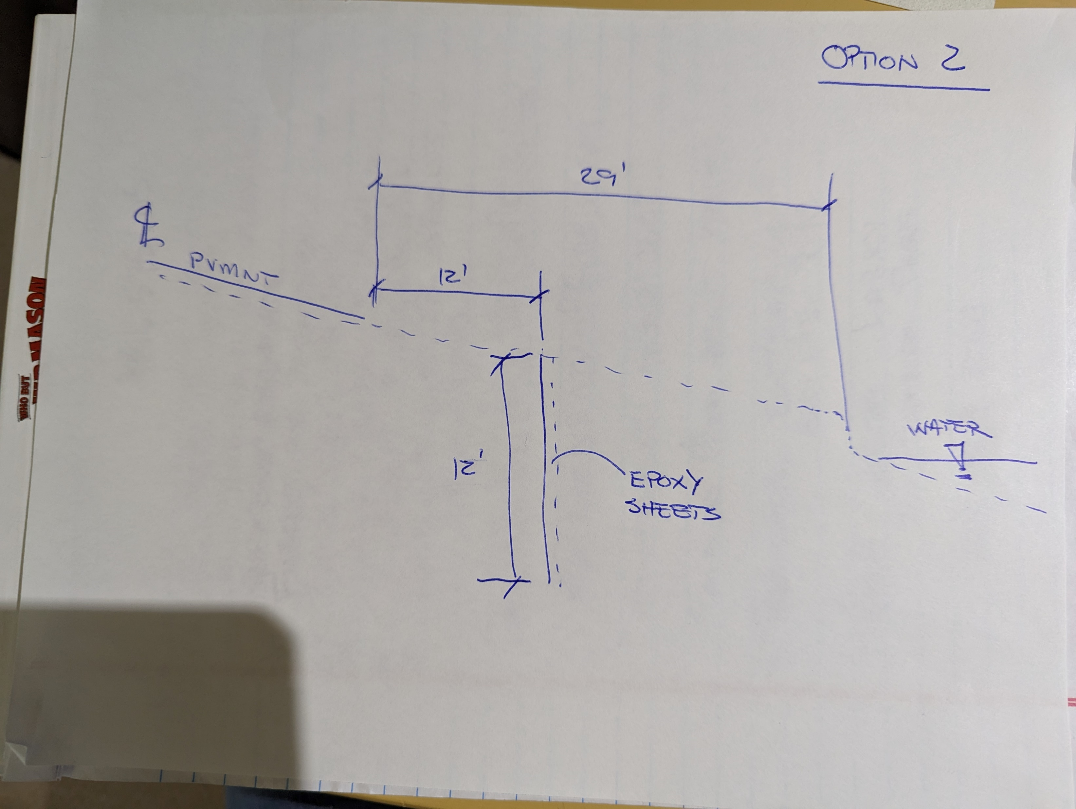
Alternative Options Created that Met Criteria
Sloped Rock Wall (Riprap)
Buried Concrete Blocks
Buried Sheet Metal Barrier

Slide 9
Engineering Search to Create Design Concepts
Contacted 10 different local firms
Received 3 proposals
CLA From Norwich Selected

Slide 10
Progress To Date
Geotechnical Investigation: surveys, test holes, etc
Concept designs created
Sloped Rock Wall design selected by MIFD Board
Preliminary budgets created to help with decisions
Met with Town Staff for comments and permitting concerns
Verbal agreements with MICO for construction access

Slide 11
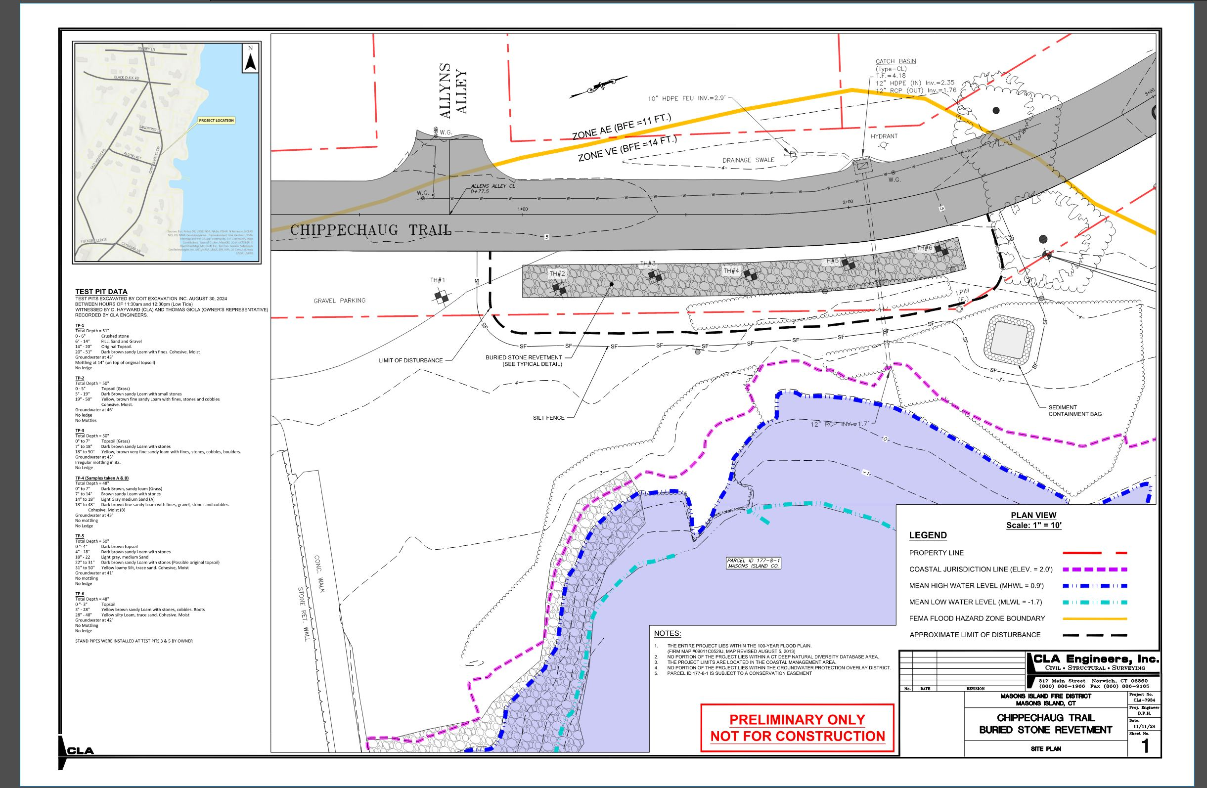
Chosen Design Plan View – Sloped Rock Wall

Slide 12
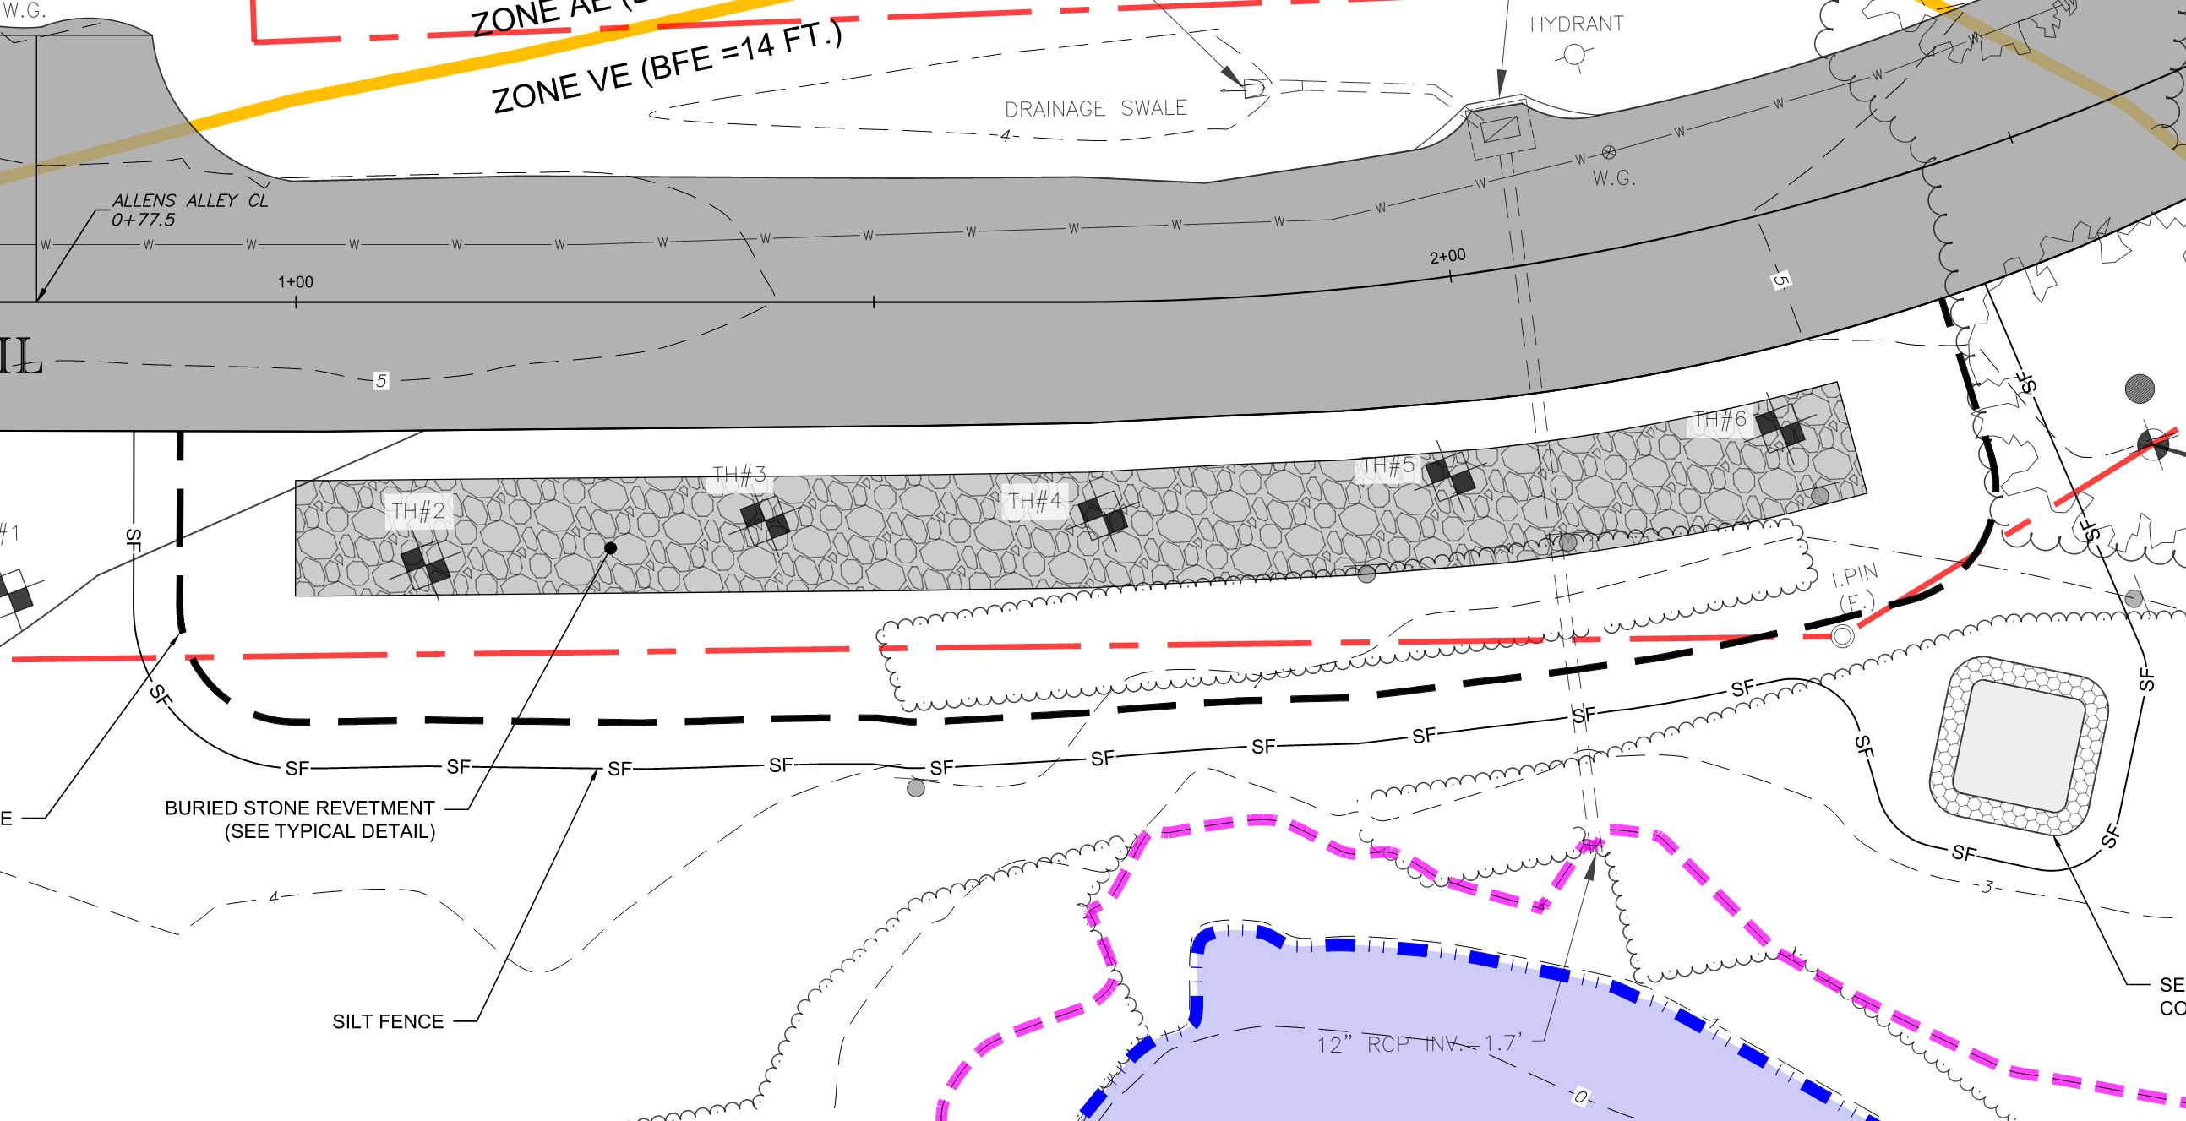
Enlarged Plan View
N >
Chippechaug Trail
Construction Area

Slide 13
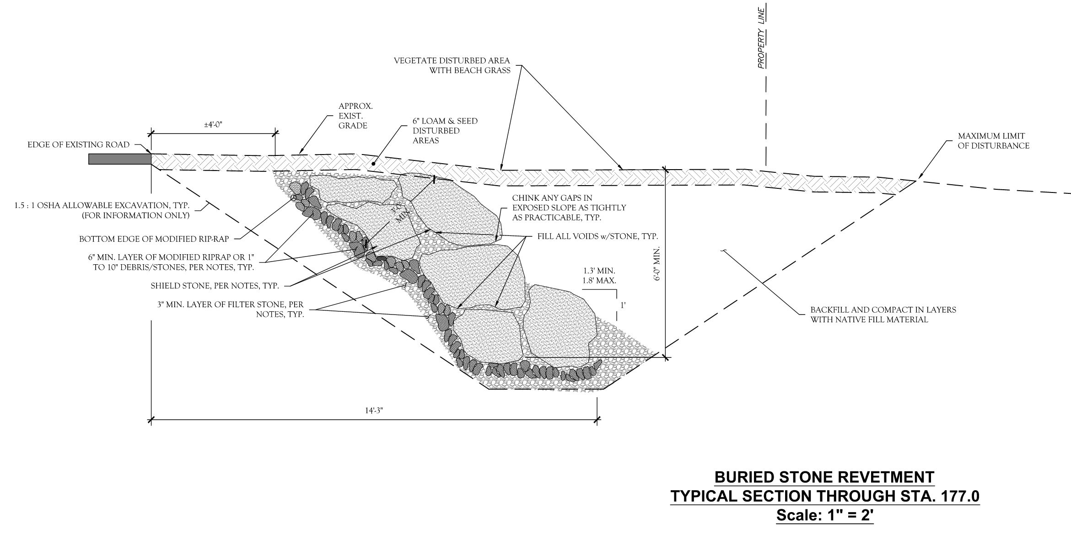
Enlarged Cross Section

Slide 14
Advantages of Sloped Rock Wall Design
Rocks work!
  Most-often used method to protect water-front properties, roads and other transportation infrastructure
    Examples: Causeway to Masons Island and Enders Island, Amtrak train lines, Taylor Swift home, Breakwaters in Stonington
  Causeways have lasted through hurricanes and survived for over 100 years
Outside of Coastal Jurisdiction Area
  Do not need DEEP or Army Corp of Engineers approvals
No need for littoral rights or liability guarantees with MICO
Wall would be built on land already owned by MIPOA
Less Expensive
  Costs likely to be in the $200,000 - $250,000 range
Disadvantages:
  Does not stop erosion until erosion is within 10’ of road
  Does not address sea level rise
  Likely no grant funding available to help defray cost

Slide 15
Projected Cost
Engineering designs, test holes, permit fee = $20,000 (already spent)
MICO Land Use Fee (access & excavation rights): $5,000
Construction (4 estimates based on initial design)
  Coit = $95,000
  Machnick = $124,000
  Camputaro = $225,000
  Chirenza = $268,000
  Average Cost = $177,000
25% construction contingency fee = $44,000
Legal Fees = $2,000
Addl design fees = $3,000
Total Projected Cost = $250,000

Slide 16
Next Steps and Schedule
Complete Final Design
Apply for Planning and Zoning Permit
Complete MICO land use agreement
Complete Bid Documents
Request/Receive Bid Proposals
Board Meeting: Approve Project and Select Vendor
Special Meeting of Taxpayers to approve budget
Construction

Slide 17
Potential Options to Move Forward
Approve and move forward with Sloped Rock Wall only (2025)
Approve and move forward with Living Shoreline only (2026/2027)
Do both: Sloped Rock Wall in 2025, Living Shoreline in 2026/2027
Do both: Living Shoreline in 2026/2027, sloped rock wall in future (wait and see if Living Shoreline is effective)
Do neither: simply repair the road if/when it is damaged by a storm(s)
  $15,000 to $50,000 rough estimate depending on extent of damage for each time it has to be repaired
  Possible that a Sloped Rock Wall would be recommended to be built at the same time as a road replacement if it is completely washed out in a storm

Slide 18
Living Shoreline Project Overview and Update
DEEP greenlights a pilot plan of just Rocks & Plants per MICO's request (a No-Fill design)
Engineers finalized plan of rocks and plants
Next:
GZA to submit pilot plan permit applications with MIPOA as the applicant
Acquire a letter of permission to DEEP from landowner (MICO)
Negotiate agreement with MICO for access rights, littoral rights and assumption of liability
Permit review period of 12-18 months
Seek construction grant funds in 2025 or 2026 cycle
Construction of pilot plan project 2026 or 2027

