Slide 1
Mr. Jesse Woods
A Royal History!

Slide 2
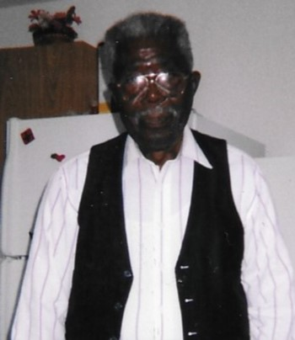
Mr. Jesse Woods

Slide 3
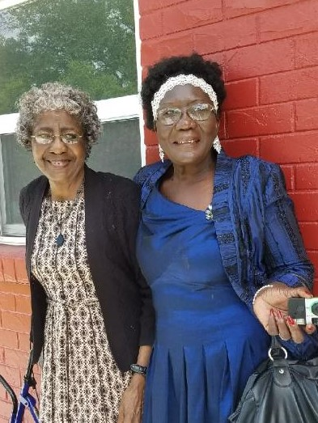
Mr. Jesse Woods’
Daughters

Slide 4
Left: Sister Anna Mae Streater

Slide 5
Right: Minister Elnora Woods

Slide 6
Sister Jacqueline Holmes, Deceased

Slide 7
Mr. Jesse Woods’ Sister:
Mother Bertha Lewis

Slide 8
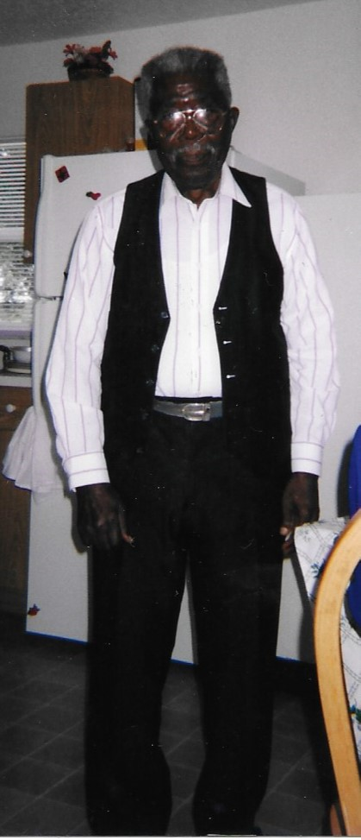
Mr. Jesse Woods

Slide 9
Executive Producer:
Community Of Royal, Inc.

Slide 10
Producer:
Young
Performing
Artists (YPAs), Inc.
www.youngperformingartists.org

Slide 11
“But he knoweth the way that I take: when he hath tried me, I shall come forth as gold.” Job 23: 10
Mr. Jesse Woods

