Slide 1




Colorado Opioid Safety Collaborative
ED Opioid Pilot 2017
ED Nurse education series

Slide 2

Colorado Opioid Safety Collaborative
What is the Colorado Opioid Safety Collaborative?
Partnership between:
Colorado Hospital Association
Colorado Chapter of the American College of Emergency Physicians
Telligen – QIN/QIO
  Colorado’s Quality Improvement Network/Quality Improvement Organization
Colorado Emergency Nurses Association
Many others who care about the opioid epidemic gripping our nation!
Notes:
ENA is crucial partner in supporting this work , as nurses are frontline in managing patient pain.
Evidence based approach to care.
Represent ALL ER nurses

Slide 3
Why are we participating?
Pain is the most common reason for admission into the Emergency Department
Colorado is at the center of the US opioid epidemic with the 12th highest rate of misuse and abuse of prescription opioids across all 50 states
4/10 Colorado adults admit to misuse of prescription medication: primarily pain killers
Overdoses: 2/3 from pharmaceuticals to 1/3 from heroin
Emergency Departments are in a strong position to reduce opioid use in a population at high risk for misuse and abuse through alternative pain management strategies
Notes:
Recent study identified that addiction can begin I 3 days of using opioids
If used for one month, can become life long issue.

Slide 4
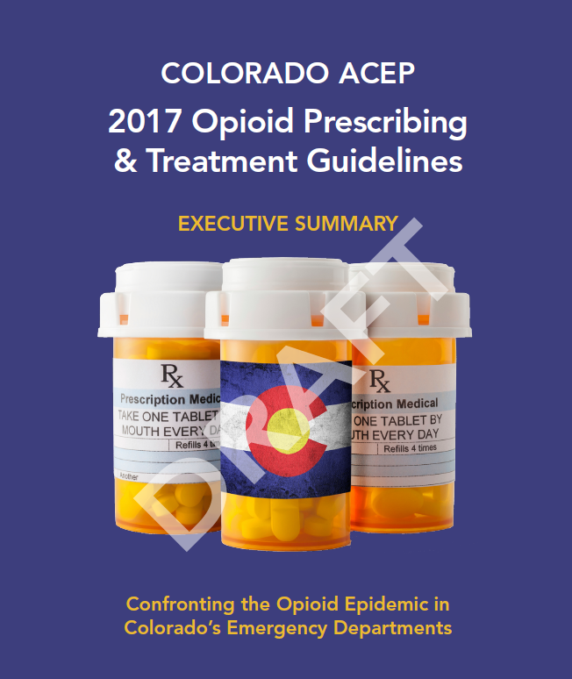
What are we hoping to accomplish?
Pilot Objective:
Reduce administration of opioid medications by Emergency Department providers through implementation of the Colorado ACEP Emergency Department Opioid Guideline
Specific Aim:
Reduce Emergency Department opioid administration by 15 percent
Notes:
Began October 2016 @ Swedish Hospital
Collect data until October 2017 @ pilot hospitals
Will go Colorado wide to all hospitals in 2018

Slide 5
Who is participating in the pilot?
Swedish Medical Center
Boulder Community Health
Sedgewick County Health Center
Gunnison Valley Health
Sky Ridge Medical Center
Yampa Valley Medical Center
Poudre Valley Hospital
  UCHealth Emergency Room – Harmony
Medical Center of the Rockies
  UCHealth – Greeley Emergency and Surgery Center
Notes:
Pilot group represent diverse emergency department; testing administration of program in many types of ED’s.

Slide 6
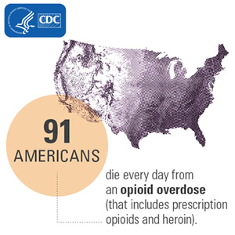
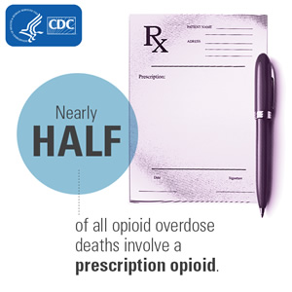
Background

Slide 7
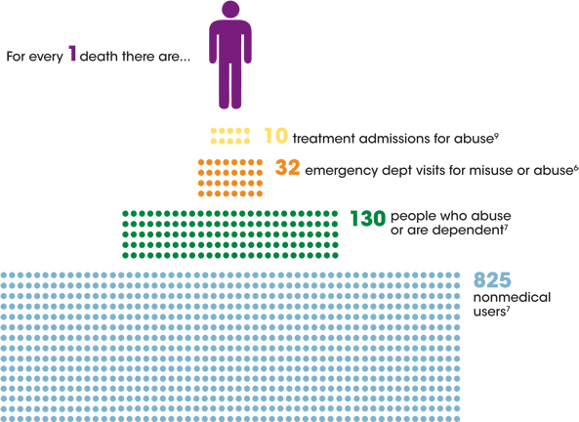

Slide 8
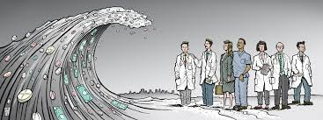
Alternatives To Opioids
Multi-modal non-opiate approach to analgesia for specific conditions
Goals: To utilize non-opiate approaches as first line therapy and educate our patients
  Discuss realistic pain management goals with patients
  Discuss addiction potential and side effects with using opiates
  Opiates will be second line treatment
  Opiates can be given as rescue medication
LaPietra A. ALTOSM Program.
Notes:
Highlight each bullet point – start conversation with patient early.
Stress use of multiple methods to manage pain versus simply restricting opioids .

Slide 9
CERTA Approach
Channels/Enzymes/Receptors Targeted Analgesia
Shift from a symptom based approach to a mechanistic approach
Targeted, patient-focused analgesic approach = combinations of non-opioid analgesics = less opioids
Results in
  Greater analgesia
  Reduced doses of each medication
  Fewer side effects
  Shorter length of stay
http://www.propofology.com/infographs/certa-concept-of-analgesia
Notes:
Based on improved understanding of the neurobiological aspect of pain
Part of the multi-modal analgesia strategy
Synergistic combinations act on different target sites
Specifically sedation!

Slide 10
Examples
Channels:
  Sodium (Lidocaine)
  Calcium (Gabapentin)
Enzymes:
  COX 1,2,3 (NSAIDS)
Receptors:
  MOP/DOP/KOP (Opioids)
  NMDA (Ketamine/Magnesium)
  GABA(Gabapentin/Valproate)
  5HT1-4(Haloperidol/Ondansetron/Metoclopramide)
  D1-2(Haloperidol/Prochlorperazine)
http://www.propofology.com/infographs/certa-concept-of-analgesia
Notes:
Care pathways targeting different receptors for better pain mangement

Slide 11
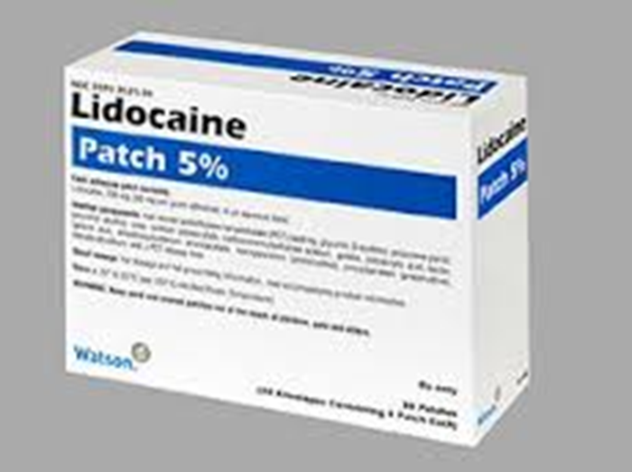
Lidocaine
Action: Acts on central and peripheral voltage dependent sodium channels, G protein-coupled receptors, and NMDA receptors
Uses: Musculoskeletal pain, migraines
Route: Topically, IV, Trigger point injections
Dose:
  Patch 5% : 1-3 patches , remove after 12 hours
  IV: 1.5 mg/kg given over 10 minutes (MAX 200 mg)
**At low IV doses, lidocaine is generally benign
Caution: Monitor patients with a cardiac history
Notes:
Note:
Lidoderm 5% patch is prescription only BUT
Lidocaine 4% is OTC and more affordable ( Box of 10/ about $5.00 )
Lidocaine is toxic at 4 mg/kg- this dose is 1.5 mg/kg and can last up to 24 hours

Slide 12
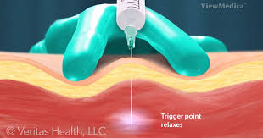
Trigger Point Injections
Notes:
RN encouraged to partner with MD to identify and support pain management options, ie; with migraine patient.

Slide 13
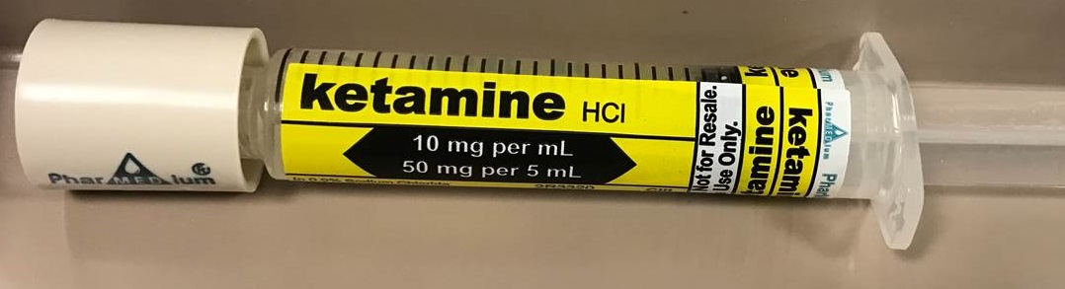
Ketamine
Action: Antagonizes NMDA receptors; reduces hyperalgesia and opioid tolerance
Uses: MSK pain, joint dislocations, fractures
Route: IV or intranasally
Dose: Analgesia= 0.2 mg/kg slow IVP over 3-5 minutes (use 50 mg/5 mL dilute product – see below)
          0.1 mg/kg/hr continuous infusion
          Suitable for inpatient units
      Intranasal: 50 mg (use 100 mg/1 mL product)
Benign in low doses
Cautions : Do not use in PTSD
Notes:
Ketamine has narrow therapeutic index.
Effect lasts several hours – may continue into inpatient units
Must be given slowly; over 5-8 minutes- Options: via syringe pump, Add ease from pharmacy, buretrol- what are your facilities resources?
Add other nursing interventions to support effect: manage environment, dim lights, reduce stimuli , warm blankets, etc.
Dissociative effect of Ketamine can trigger PTSD flashbacks.

Slide 14
Other Options
Ketorolac (Toradol)
  15 mg for everyone
    No difference in pain reduction with 30 mg vs 15 mg
  Great for many pain indications including musculoskeletal/pelvic pain and renal colic
Haloperidol(Haldol)
  Low dose (2.5 mg IV)
  Great for nausea, especially cannabinoid induced hyperemesis
Dicyclomine (Bentyl)
  MOA: antispasmodic and anticholinergic agent that acts to alleviate smooth muscle spasms in the GI tract
  20 mg/kg PO or IM (IM only!!!)
  Great for abdominal pain (think cramps)
Notes:
Toredol= No increased benefit with 30 mg, so dose is 15 mg for all.
Haldol amy cause extrapyramidal symptoms, prolonged QT.
*** Potential Med Error *** Dicyclomine (Bentyl) IV may cause thrombosis, thrombophlebitis, injection site reaction

Slide 15
ED Pain Pathways

Slide 16
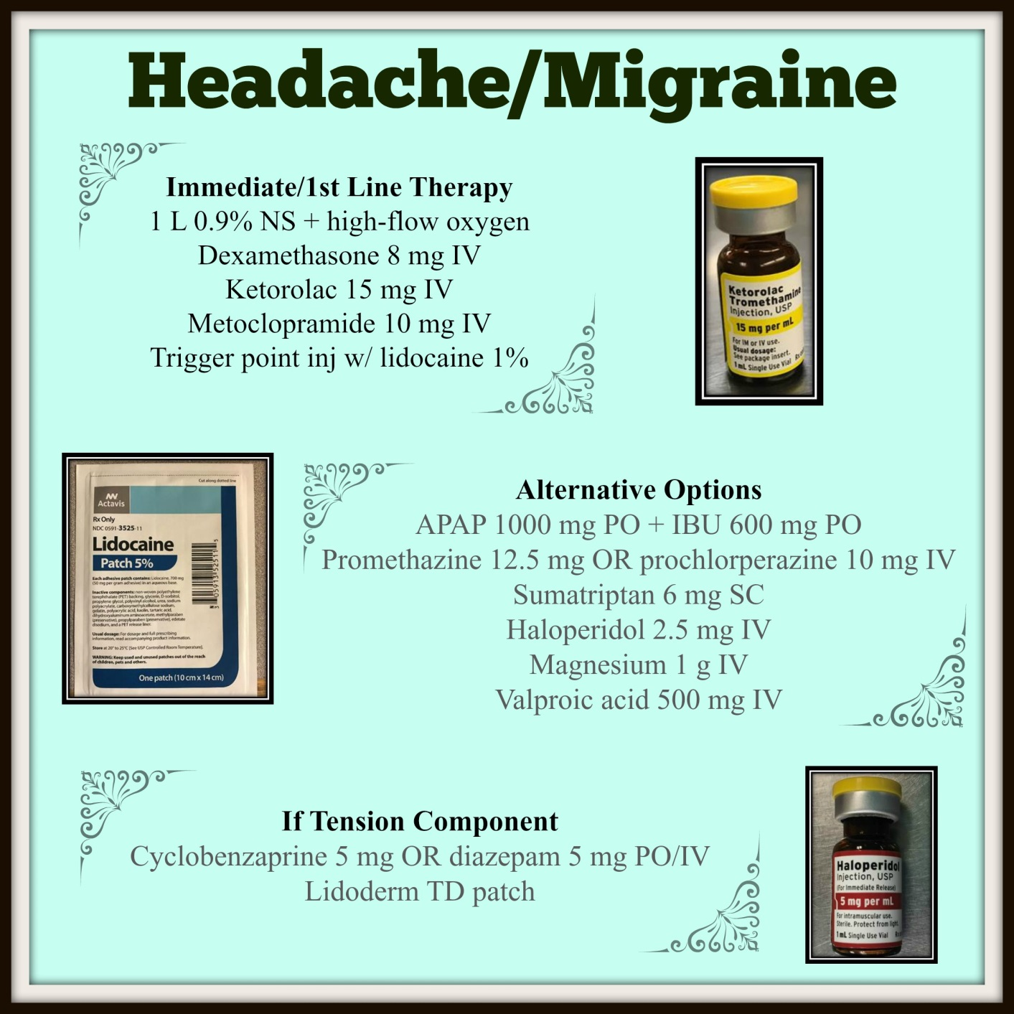
Notes:
Knowledge Points on Less Common Medications
Valproic Acid (Depakene) for HA
Thought to inhibit neuronal firing, thus reducing intracerebral vasodilation as a source of pain
GABA potentiation actions may reduce neuronal inflammation
Magnesium for HA
Decreases release of pain modulating substances in the brain (e.g. Substance P and Glutamate)
Reduces cortical spreading depression, brain signaling related to aura and migraine related sensory changes

Slide 17
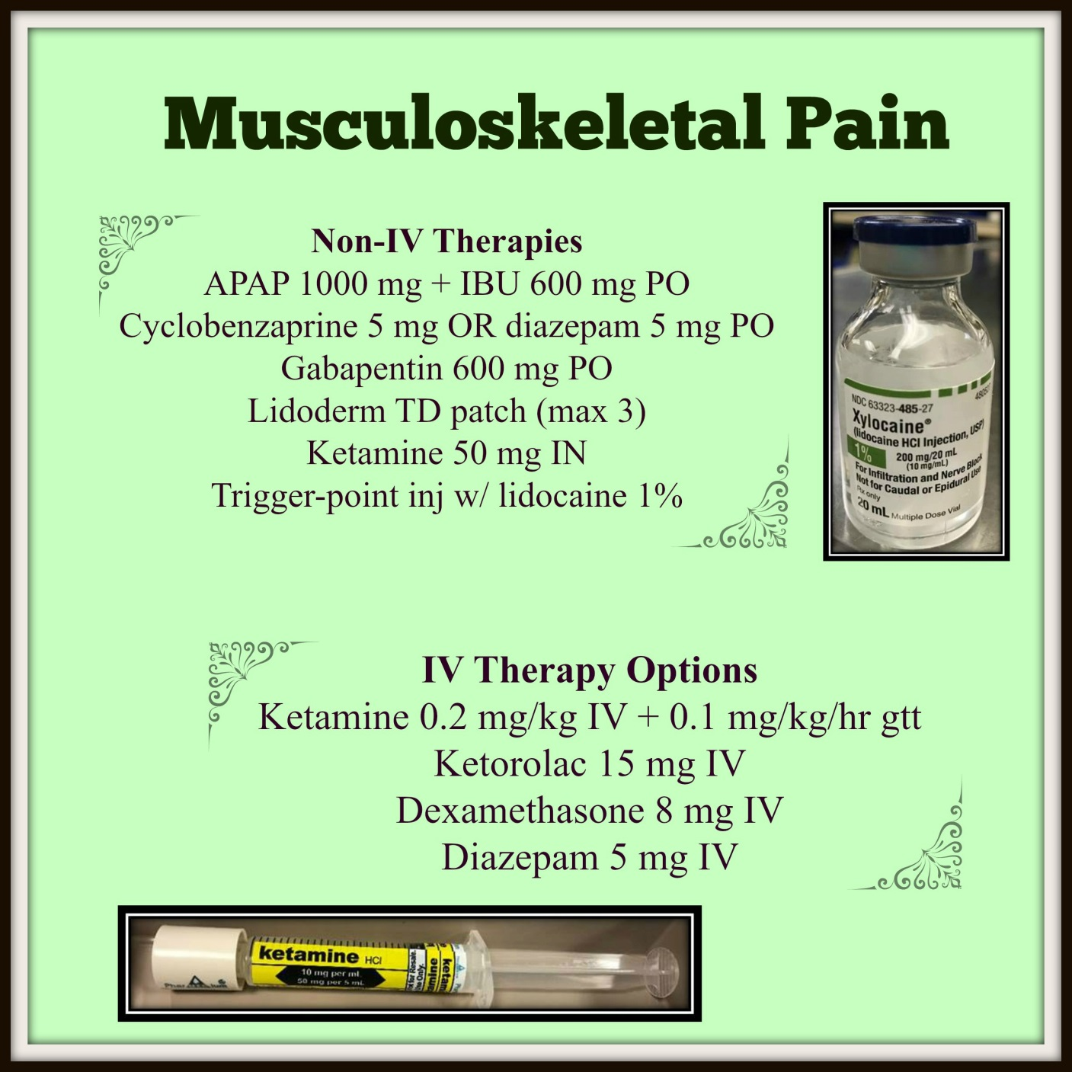
Notes:
Cyclobenzaprine= Flexeril
Diazepam= Valium
Gabapentin = Neurontin
Ketorolac= Toredol

Slide 18
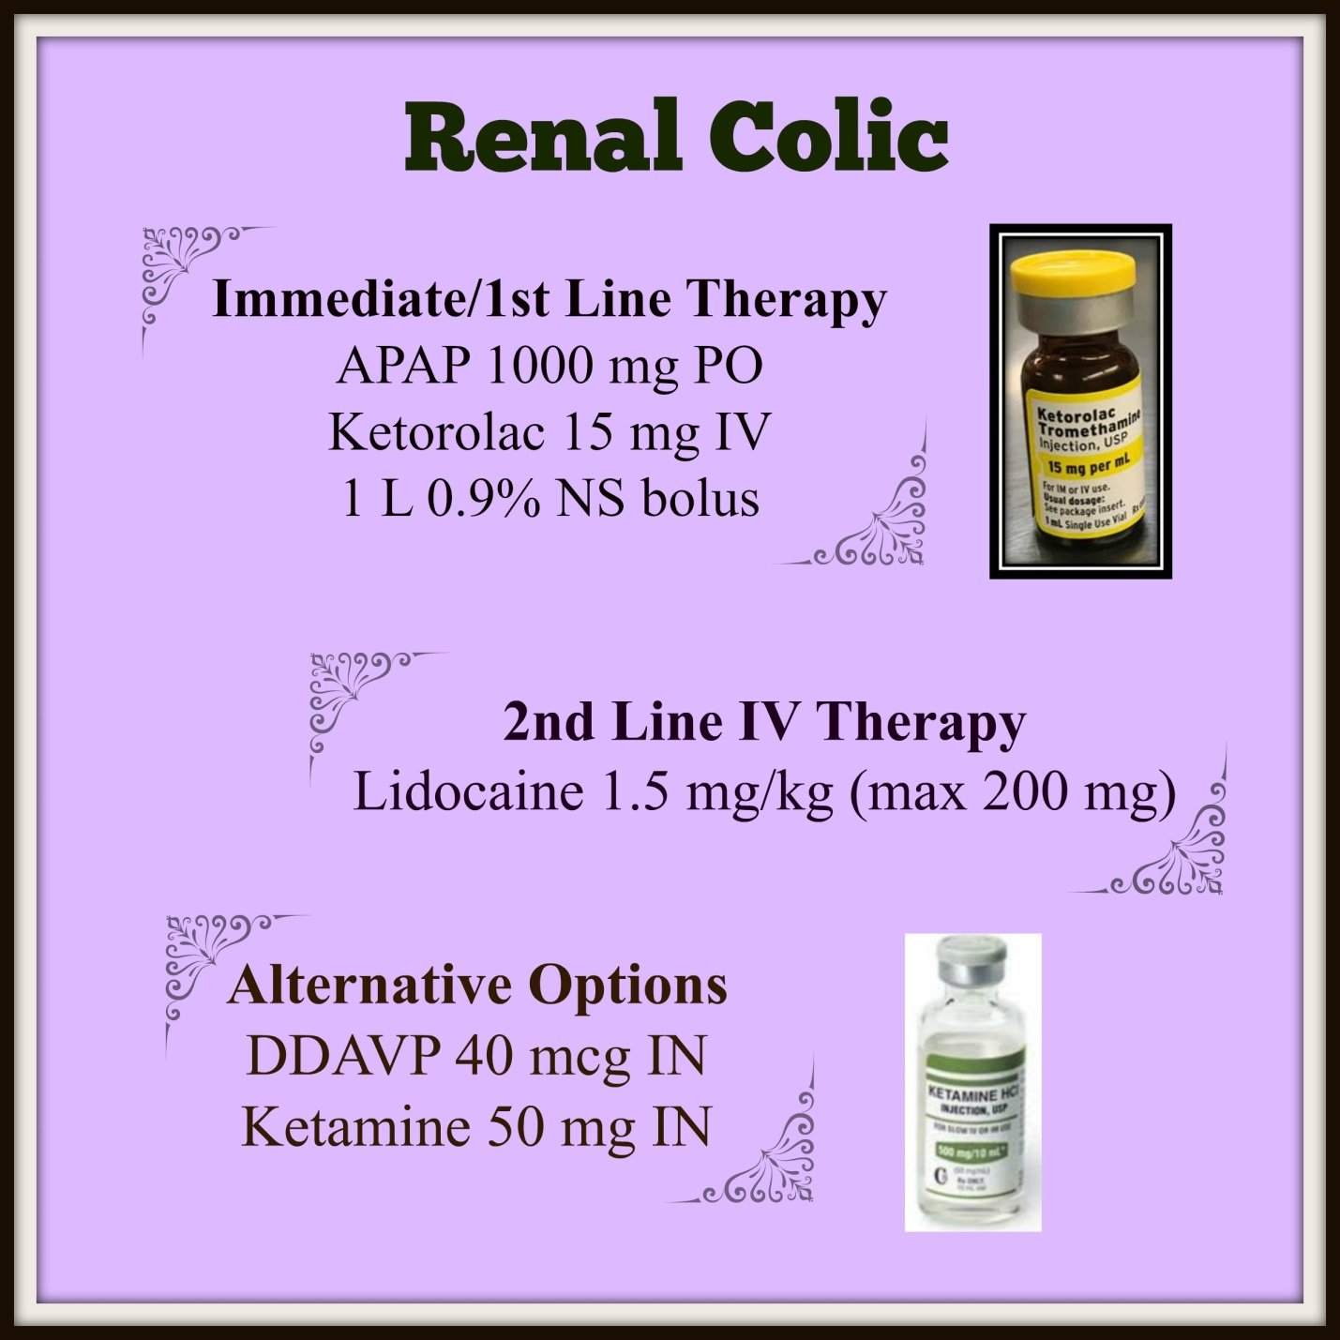
Notes:
Knowledge Points on Less Common Medications
Valproic Acid (Depakene) for HA
Thought to inhibit neuronal firing, thus reducing intracerebral vasodilation as a source of pain
GABA potentiation actions may reduce neuronal inflammation
Magnesium for HA
Decreases release of pain modulating substances in the brain (e.g. Substance P and Glutamate)
Reduces cortical spreading depression, brain signaling related to aura and migraine related sensory changes

Slide 19
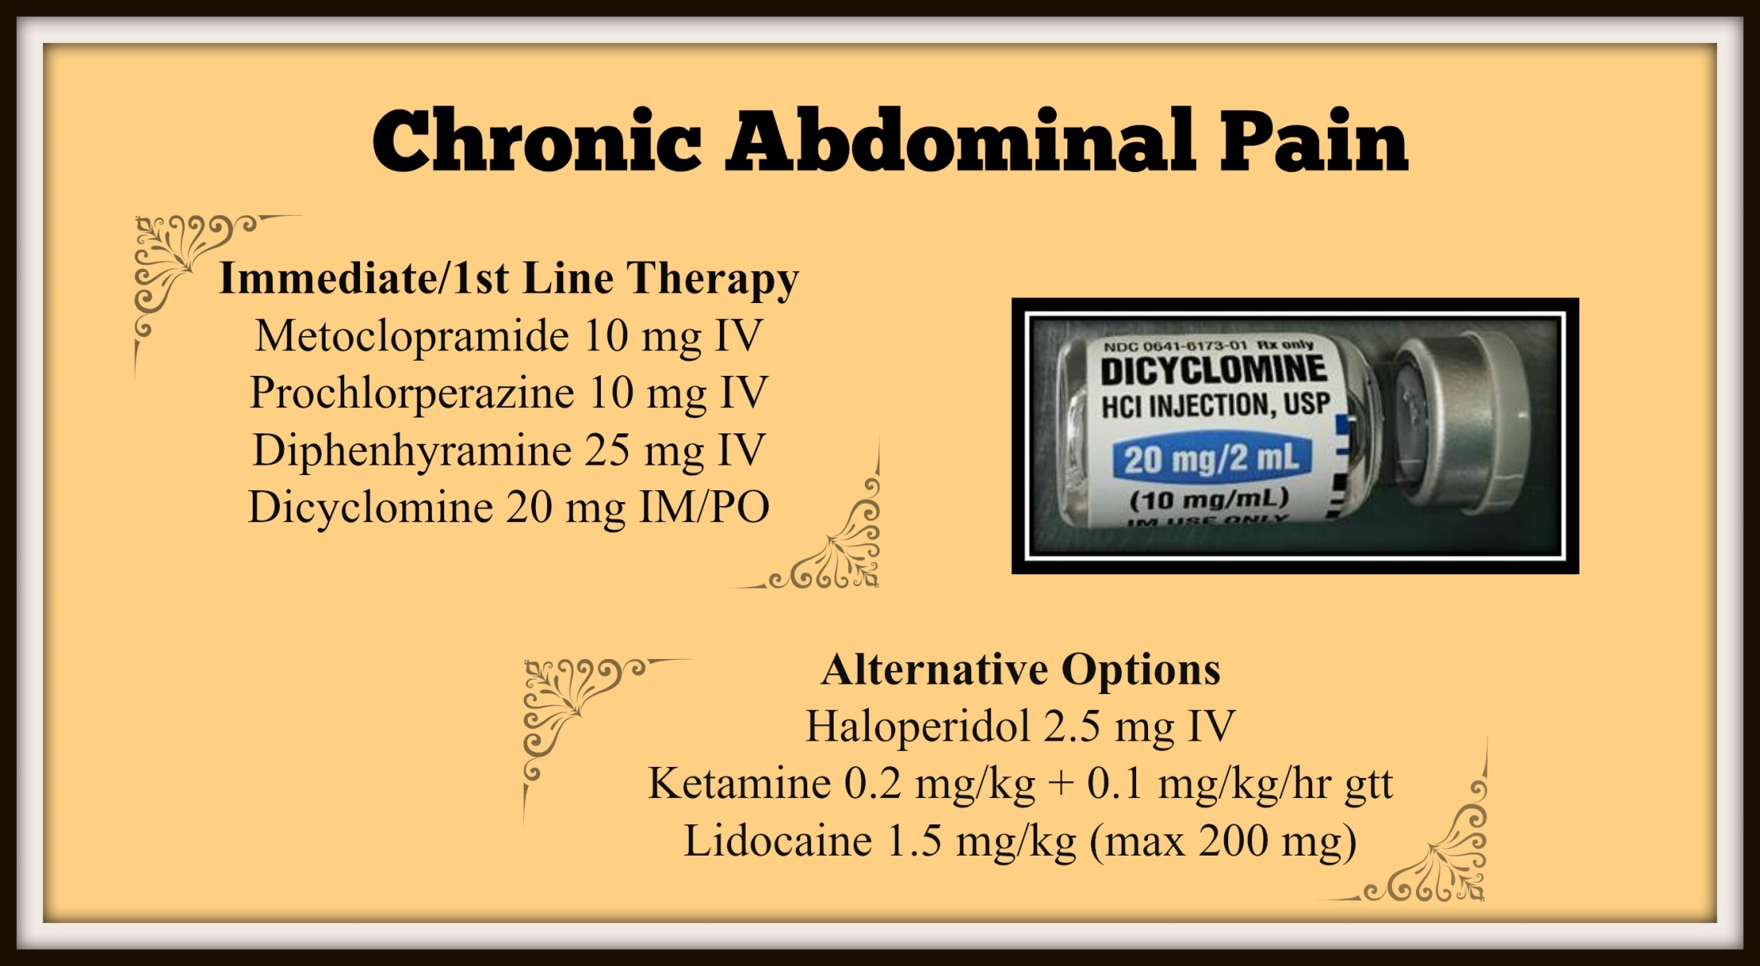

Slide 20
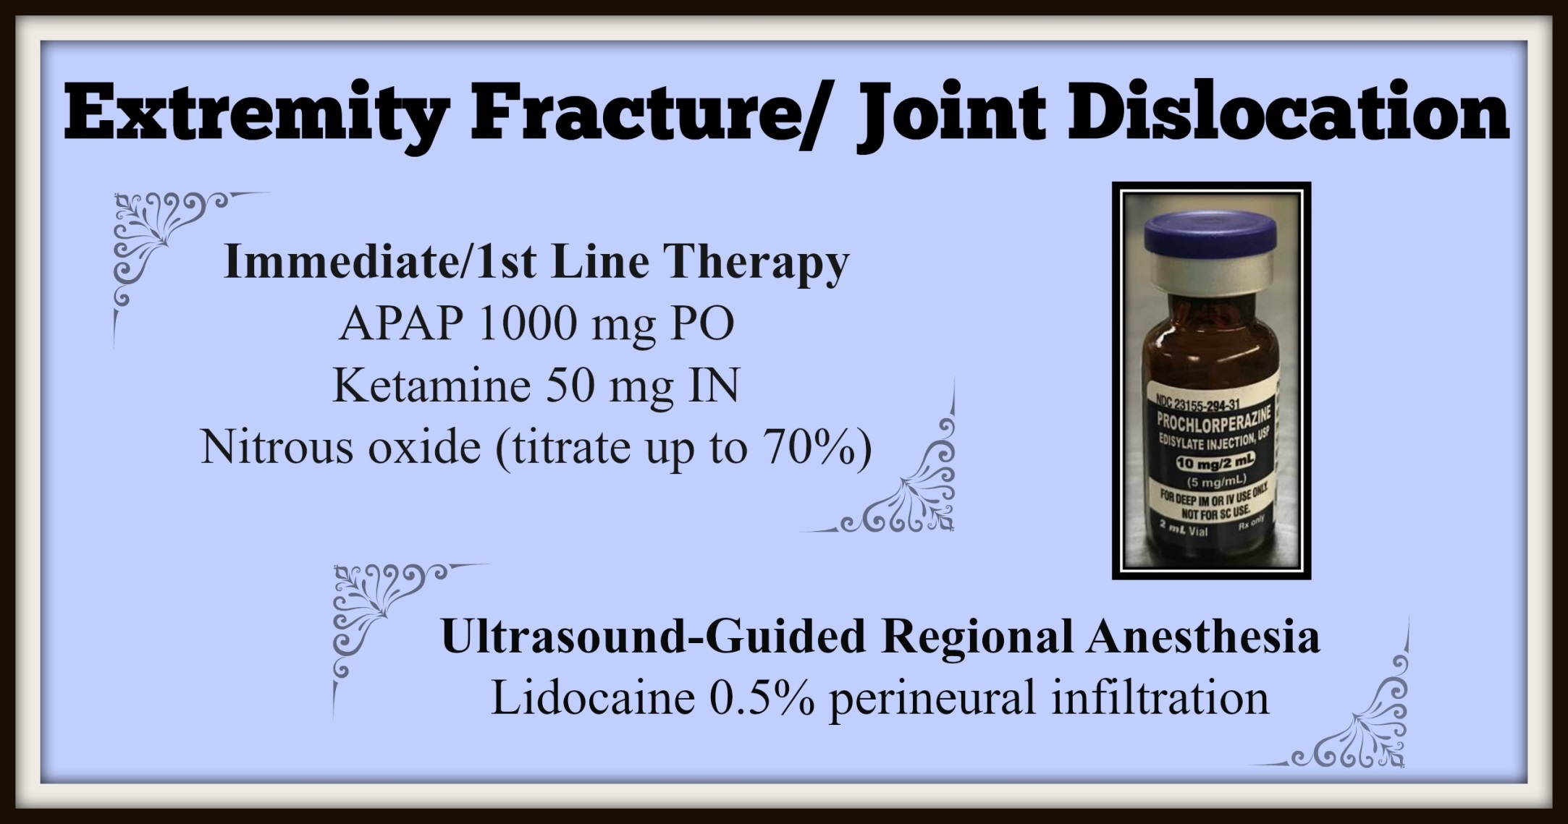
Notes:
Patient /Family Education important regarding safety features of Nitrous

Slide 21
What Can Nursing Do?

Slide 22
Education
Why do we need this project?
  Colorado has the 12th highest rate of misuse and abuse of opioids
  Pain is the most common reason to visit the ED
  Vicodin/Norco has been the #1 prescribed medication for the last 6 years
  4/5 new heroin users report using prescription opioids first
  There are safer and more efficacious medications with fewer side effects

Slide 23
Education
Nursing education
  Learn about the new multimodal, opioid-free pain management pathways
  Work with physicians to limit the use of opioids
  Be proactive with patient and family concerns
    Begin conversation regarding best practices to manage pain
    Manage pain management expectations
    Provide educational resources
    Talk about realistic pain goal
    Scripting regarding “control” of pain versus “relief” of pain
    Promote “increasing comfort”
Patient education
  Educate patients and families on how to use the pain assessment tools
  Provide non-pharmacologic alternatives to medication

Slide 24
Pain assessment
Assess patient prior to administration of any pain intervention
  Standardized Pain Assessment tools
  Use scripting that medication will help “control your pain” and improve your comfort
Reassessment within a reasonable time frame
  Standardized Pain Assessment tools
  If pain is not “controlled” suggest alternatives
Notes:
Reframe to “how can we improve your comfort?”

Slide 25
Who Else is Involved?

Slide 26
Project champions
ED Nursing
  Director, charge RNs, staff
ED Physicians
  Director, staff
Hospital Leadership
  CNO, CMO, CEO
Other Support
  IT
  Pharmacy

Slide 27
Policy changes
Procedural Sedation
  Ketamine dosing – must clearly define analgesia vs sedation doses
    < 0.25 mg/kg slow IVP = analgesia
    >/= 1 mg/kg slow IVP = sedation = “timeout”
High-risk Medication Administration
  Lidocaine administration
    1.5 mg/kg bolus + 1-2 mg/kg/hr drip x 24 hrs max = floor
    Cardiac lidocaine = CCU
  Ketamine administration
    < 0.25 mg/kg slow IVP + 0.1 mg/kg/hr x 48 hrs max = floor
    1-2 mg/kg + 5-30 mg/hr = CCU

Slide 28
Pharmacy/IT SUPPORT
Education
  Nurses, physicians, pharmacists
CPOE
  Creation of pain treatment order set
    Split by indication
  Create order strings for unique entries – clearly label “for pain”
    Lidocaine
    Ketamine
Smart Pumps
  Addition of new medications – clearly label “for pain”
    Lidocaine
      Bolus = 1.5 mg/kg in 100 mL NS over 10 min
      Gtt = 2 g/250 mL D5W premix bag max 2 mg/kg/hr
    Ketamine
      Bolus = 50 mg/5 mL prefilled syringe entry to infuse over 5-10 min
      Gtt = 100 mg/50 mL NS max 0.1 mg/kg/hr

Slide 29
Data collection
Primary outcome = change in ED opioid use pre- and post- implementation
  Measured in morphine dosing equivalents
  Per ED patient visit
Utilize EHR reports to gather doses administered of various opioids used in your ED
  Convert to morphine dosing equivalents
Patient volume data
Secondary outcome = patient satisfaction
  Press Ganey Scores
    Overall and for “pain control”
**All data organized by month

Slide 30

Support
How can CHA, CO ACEP, CO ENA and Swedish support YOUR hospital?
Numerous contacts from previous projects
Educational resources
Toolkit
Encouragement – YOU CAN DO THIS!!! Change your practice.
QUESTIONS???

Slide 31
