Slide 1


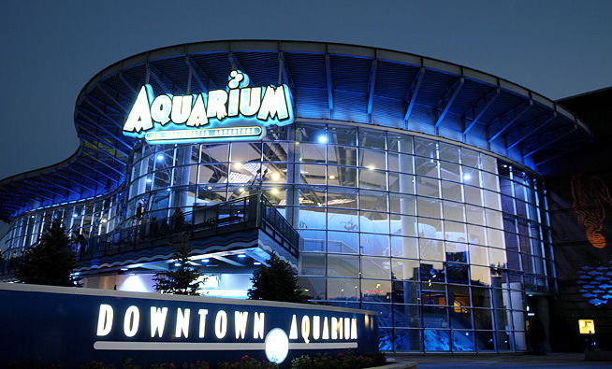

2019 Colorado ENA Education Conference
November 1st
7am-5pm
At the Denver Aquarium
Special vendor booths to visit.
Early bird pricing:
$50 for ENA members $100 Non-ENA members by Oct. 1st
After Oct. 1st: $75 for ENA members and $125 for Non-ENA members
Limited space so register early!
Register Here
find the link at ColoradoENA.org
Breakfast, lunch and snacks Included!
FREE PARKING!!
FREE Entrance
into exhibit
after conference
Multiple speakers and Free CEs
Special guest at lunch
Free T-shirt with registration
(Size subject to availability)
Questions? Email: conferenceplanning@coloradoena.org

