Slide 1
My Successful Year as a Membership Chair 2.0: How You Can Do it Too
Amy Boren, MS, BSN, RN, NREMT, CEN, CPEN, TCRN
AmyLouENA@gmail.com
Kristina (Tina) Larson, MSN, RN, CEN, CPEN, TCRN
Tinajlarson@hotmail.com
Notes:
Amy
NO DISCLOSURES ARE TO BE MADE ON PRESENTATION SLIDE DECKS.
Check link on slide 4
Log into ENA website prior

Slide 2
Focus Areas
Expiring Members
New Members
Current Members
Future Members
Students
Find a successor (not just a replacement)
Notes:
Amy

Slide 3
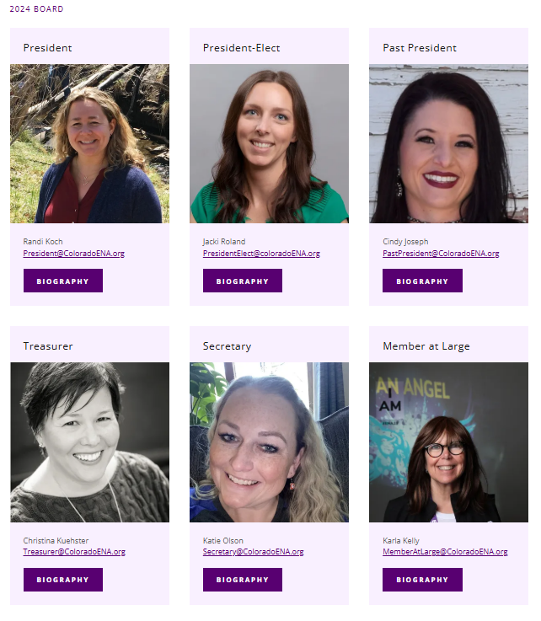
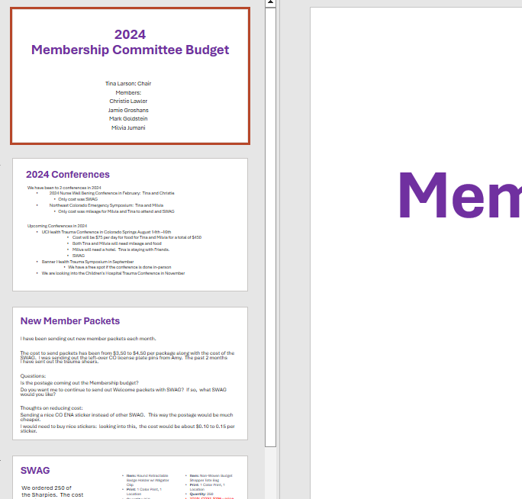
Engage with your State Board
Photo from Colorado ENA site. Retrieve 1/19/2025 from https://coloradoena.org/about
Notes:
Tina
Speak to board to enlist assistance with ideas, budget, SWAG, etc.
Presented to the board about budget re. conference costs, liaison t-shirts, and swag
My board was super supportive and said did say no at time, helping me to prioritize with my budget.

Slide 4
Pull reports
New member report
Expiring member report
Membership report (how many members do you have)
Recording-20250112_143607.webm
Notes:
Tina
Show in real time how to pull report.
report demonstration—live demo preferred but will also have a video if AV fails.

Slide 5
Expiring Members
Notes:
Tina

Slide 6
Email expiring members each month
Use Mail Merge in Word to create an email that includes their name
  Create a form letter in Word—update each time as needed
  Mailings—select recipients—choose your excel spread sheet (click: my table has headers and ok)
  Insert merge field —choose first name
  Preview Results
  Finish and Merge—email messages, fill in data. When you click ok, it will send in outlook
  https://youtu.be/_Efb_oMgxEs
Notes:
Tina
I don’t plan to show the video, but we can. I do plan to make this presentation available via QR code so they can watch the video at home.
There was a learning curve for me, the YouTube videos were helpful, I also reached out to Amy. If you need help reach out, our contact information is at the end of our presentation. Feel free to contact us at any time.

Slide 7
What should your email say
Please don’t go
Why they should stay
  Scholarships
  CEs
  Networking
  Publications
What is happening in your state
  Future meetings
  Future events or projects
Ask them to renew and provide a link
Notes:
Tina

Slide 8
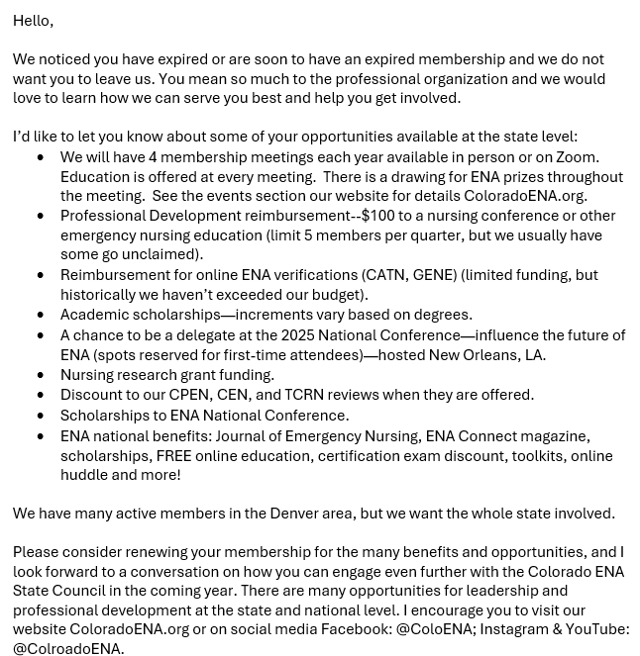
Notes:
Tina
Here is an example of what ours looks like; you can copy it as needed.
Just a quick glance at what our email looked like…It isn’t important to be able to read it
People did respond, which is great, even if it is just a few.

Slide 9
New Members
Notes:
Tina

Slide 10
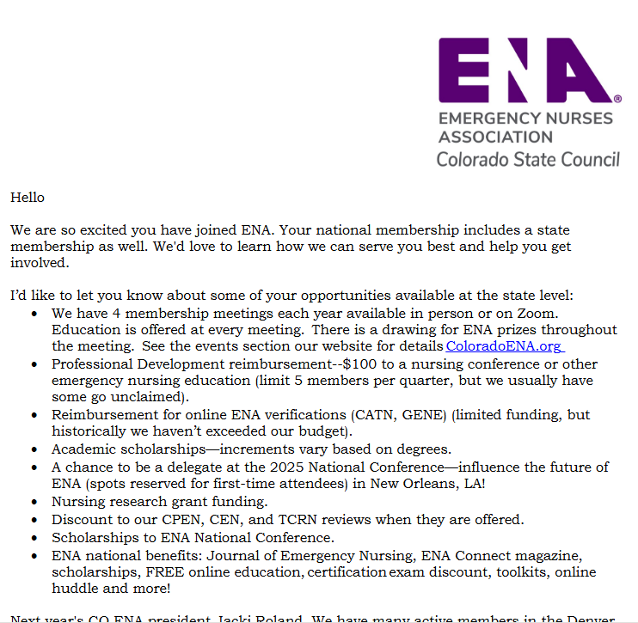
Welcome New Members
Send something in the mail or an email
Update Welcome letter each month (delete old information and add anything new)
Notes:
Tina
Figure out what works best in your state.
Benefits to each:
packages vs envelopes vs emails– budget
Think about making them stand out, maybe a purple envelope.
hand addressing – signing the letter
It was rewarding when people at conferences would tell me I got a letter or email from you.
emails get lost do get lost.

Slide 11
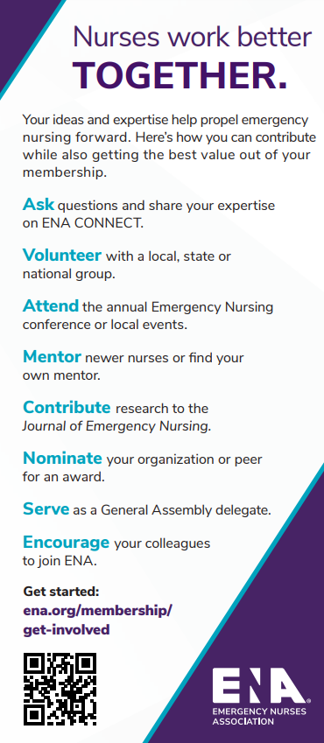
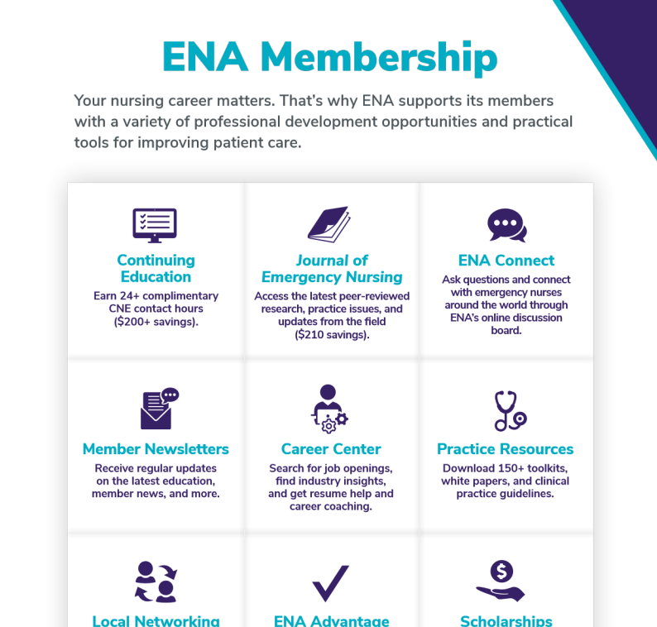
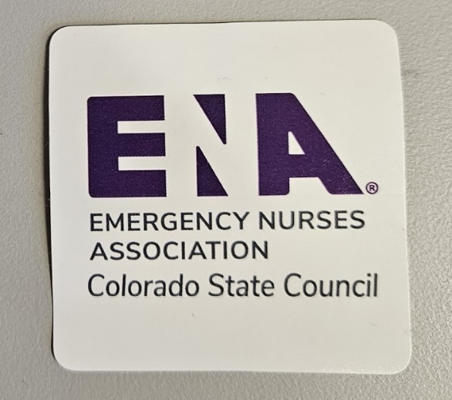
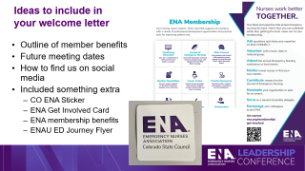
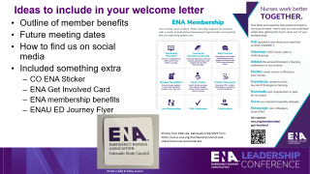
Ideas to include in your welcome letter
Outline of member benefits
Future meeting dates
How to find us on social media
Included something extra
  CO ENA Sticker
  ENA Get Involved Card
  ENA membership benefits
  ENAU ED Journey Flyer
Photos from ENA site. Retrieved 1/19/2025 from https://www.ena.org/membership/recruit-and-share/resources-and-materials
Photo credit Kristina Larson
Notes:
Tina
We included the CO ENA sticker and brochures from ENA – they are free

Slide 12
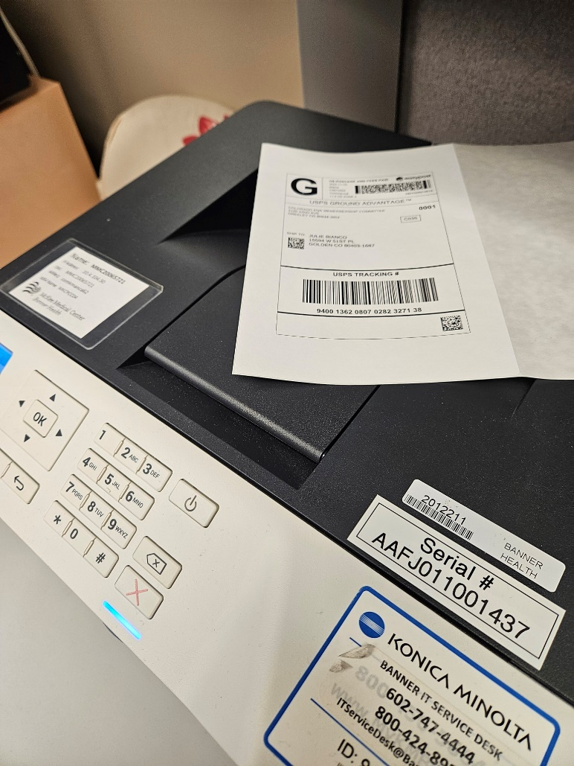
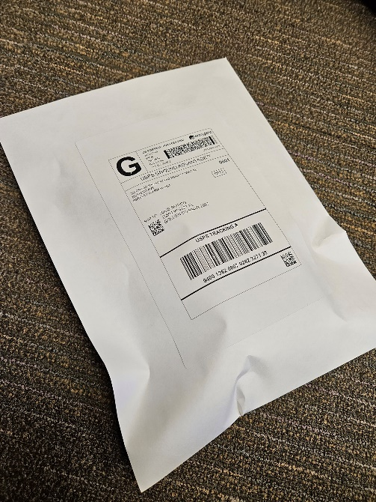
Mailing packages
  A food scale and a ruler come in handy—or you can weigh your standard package at the post office
  4x6 labels—2 per sheet
Photo Credit Kristina Larson
Notes:
Tina
You can choose to use USPS, UPS, Fedex. Pirate Ship
I did not know how to do a mass shipping. Amy taught me and it made it much less time consuming.

Slide 13
Current Members
Notes:
Amy

Slide 14
Highlight benefits and honor current members
ENA Members benefits Scholarship Professional reimbursement Conferences Delegate ENA Connect JEN CE | CO ENA Member benefits Annual CO Nurse Awards Excellence in Emergency Nursing Lifetime Achievement Inspire Nurse Leader Rising Star Nursing Education Annual Education Conference Quarterly meetings with virtual offerings Includes 1 CE Drawing for $100 to spend on the ENA Site Academic Scholarships CE Reimbursement
Notes:
Amy
We want to honor current members. Award winners are listed on the Colorado ENA webpage.

Slide 15
Future Members
Notes:
Amy

Slide 16


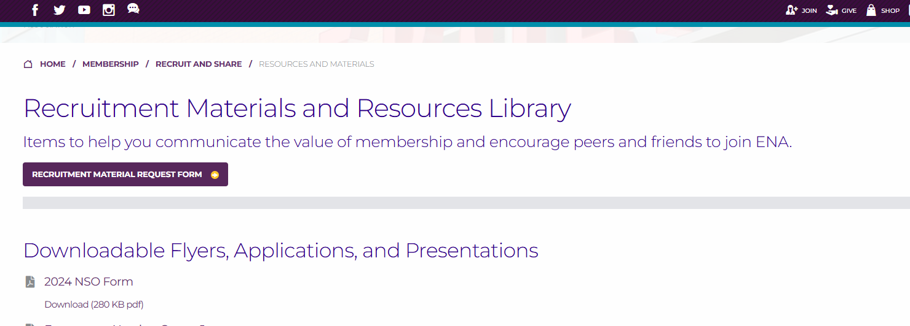
Recruiting New Members
We chose to attend 4 conferences and interact with members
  When possible, opted for venues that would waived or discounted the vender fee
  Our committee reimbursed committee members for expenses incurred because of attending (meals & mileage)
Swag
Raffle for tickets to the 2024 CO ENA
  Education Conference
Handouts from ENA
Photos from ENA site. Retrieved 1/19/2025 from https://www.ena.org/membership/recruit-and-share/resources-and-materials
Notes:
Amy
You can request ENA handouts from the recruitment material request form or there are downloadable flyers. ENA will also send stickers and magazines if requested.
Emergency nursing career journey
ENA get involved palm card
ENA membership application – I put a QR code on that goes directly to the ENA membership page
ENA membership brochure
Membership benefits fact sheet flyer
Mentoring program flyer
Reach out to the Foundation for handouts

Slide 17

Student Member Engagement
Nursing Student Organization
Packets from ENA
Swag
Raffle
RN mentor program through ENA
Photos from ENA site. Retrieved 1/19/2025 from https://www.ena.org/membership/recruit-and-share/resources-and-materials
Notes:
Amy
Highlight the student membership for only $25/year
We attended the Colorado Student Nurse Association Conference: COSNA.org
We obtained 23 new student memberships after the COSNA conference!

Slide 18
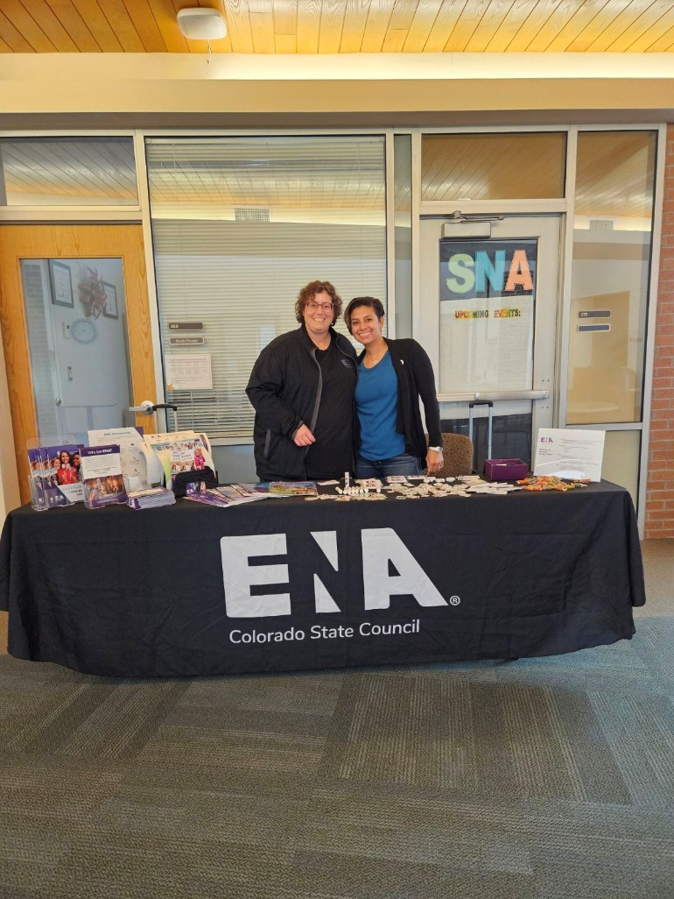
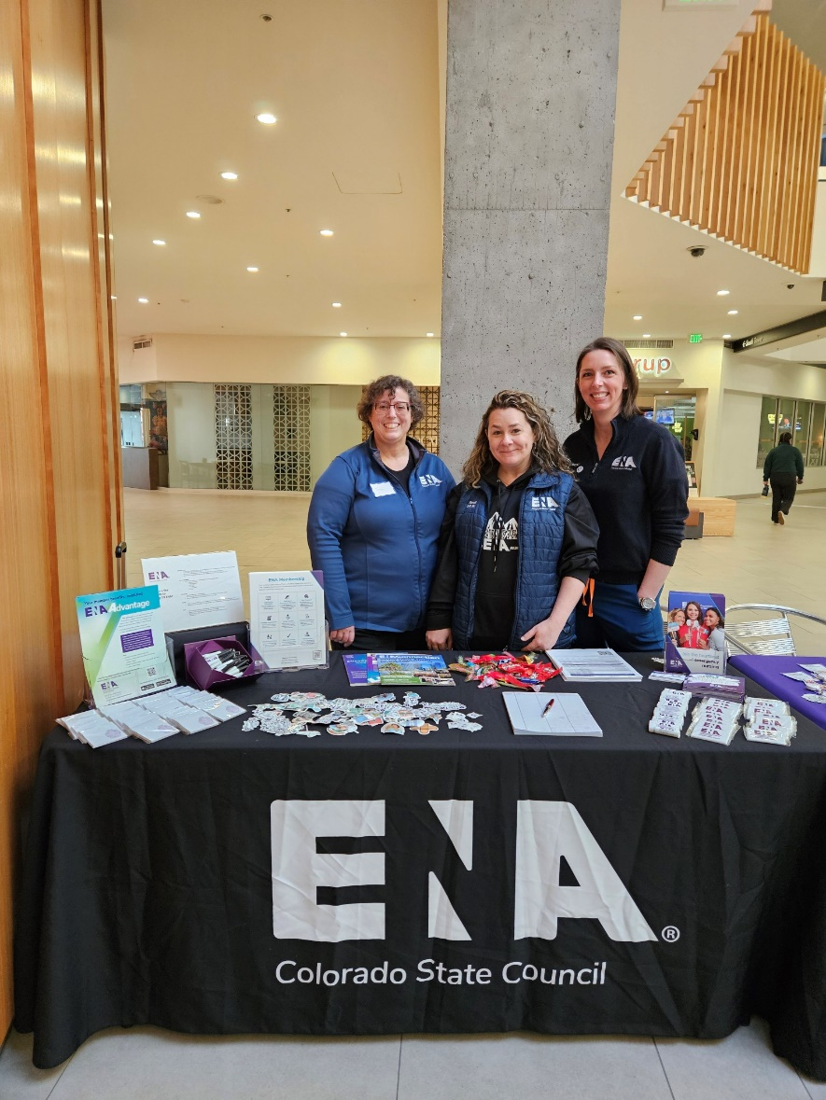
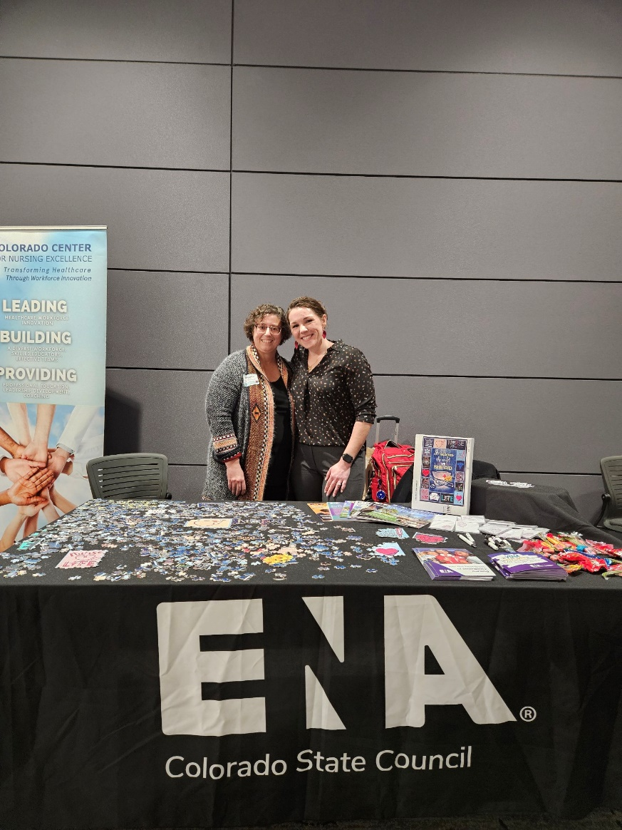
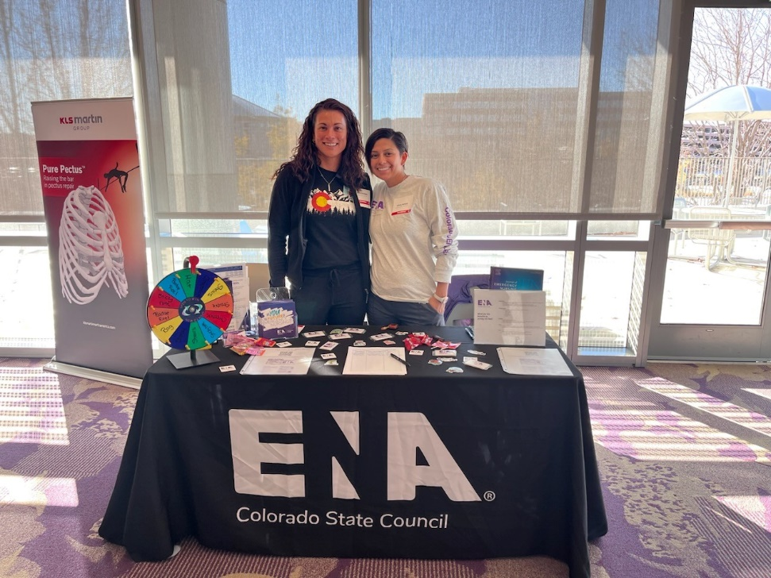
Photo credit Kristina Larson and Jamie Groshans
Notes:
Amy
Goal 4, went to 4.
We raffled off tickets to the 2024 CO ENA Education Conference
Colorado Student Nurse Association Conference: COSNA.org

Slide 19
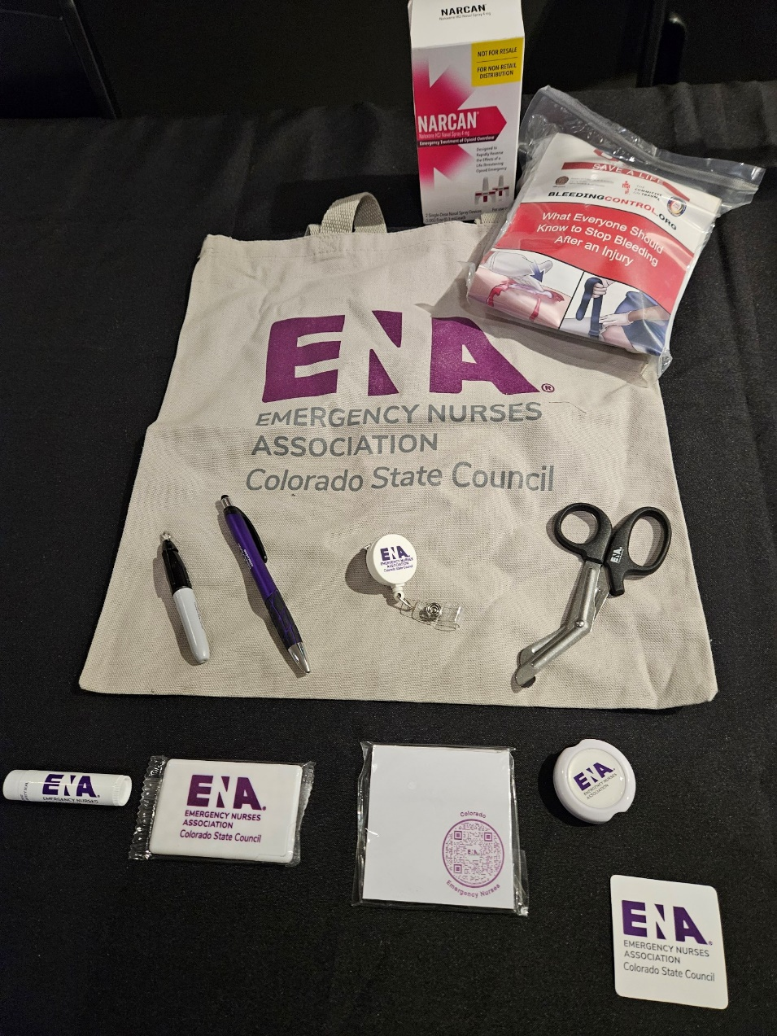
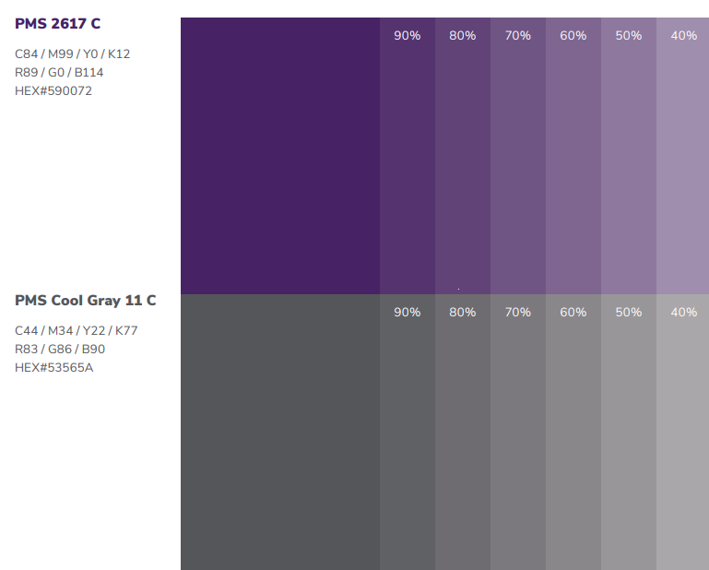
Notes on swag
Brand Center (under state and chapter leaders)
  Logos
  Colors
Photo credit Kristina Larson
ENA Brand Center. Retrieve 1/19/2025 at https://www.ena.org/membership/get-involved/state-and-chapter-leaders/ena-brand-center/guidelines
Notes:
Amy
https://www.ena.org/docs/default-source/state-and-chapter-leaders/brand-center/guidelines/ena_brand_guidelines.pdf?sfvrsn=e2b245b0_14
Everything Promo
Uprinting - stickers
Some of the companies charged an extra $50 to use the exact ENA colors. This was a one time charge, so for every other order we were able to receive the exact color.

Slide 20
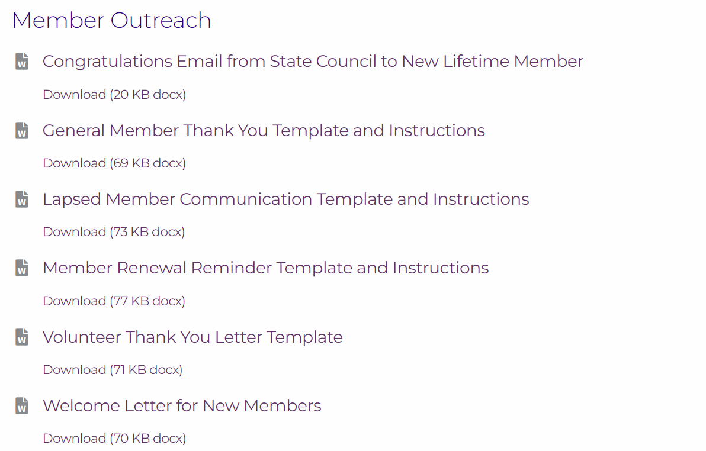
ENA Resources
Photos from ENA site. Retrieved 1/19/2025 from https://www.ena.org/membership/recruit-and-share/resources-and-materials
Notes:
Amy
https://www.ena.org/membership/get-involved/state-and-chapter-leader-area/ena-brand-center

Slide 21
Liaison Program
Notes:
Tina

Slide 22
Liaison Responsibilities
Read emails from CO ENA
Share information from the emails with co-workers (ex: meetings, conference, committee applications)
Attend at least one meeting per year (in person or on zoom)
Encourage staff to attend meetings—organize a carpool or watch party
Interact with us on Social Media if they have accounts
Notes:
Tina
You can build any liaison program that you want. This is what we did.

Slide 23
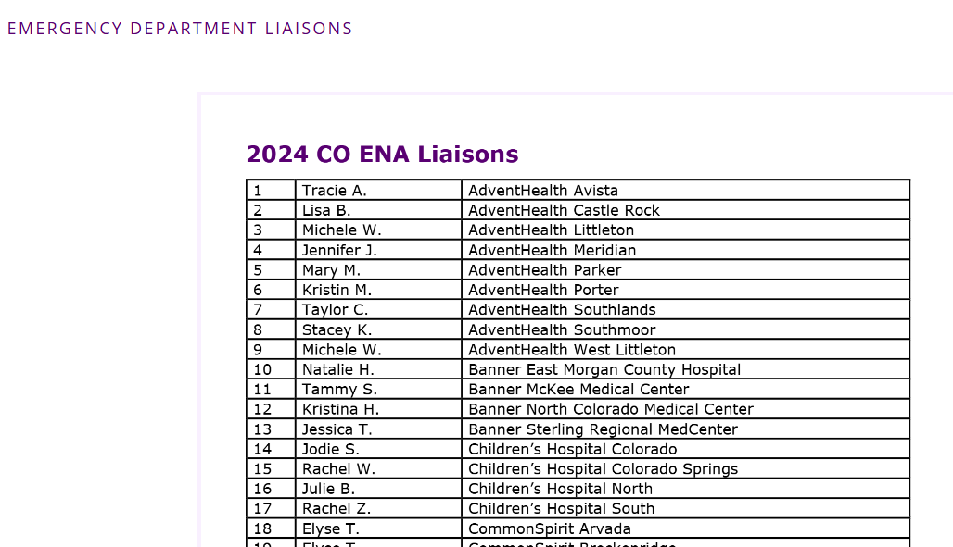
Liaison Benefits
Reimburse ½ of their annual membership
Delegate points to represent CO at General Assembly
Photo from Colorado ENA site. Retrieve 1/19/2025 from https://coloradoena.org/membership
Notes:
Tina
Fun and connection!

Slide 24
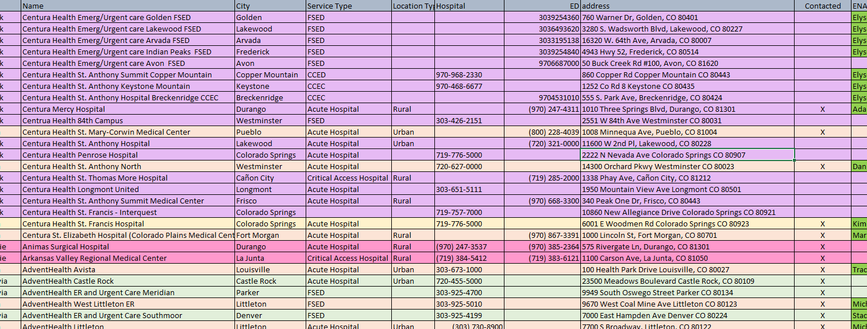
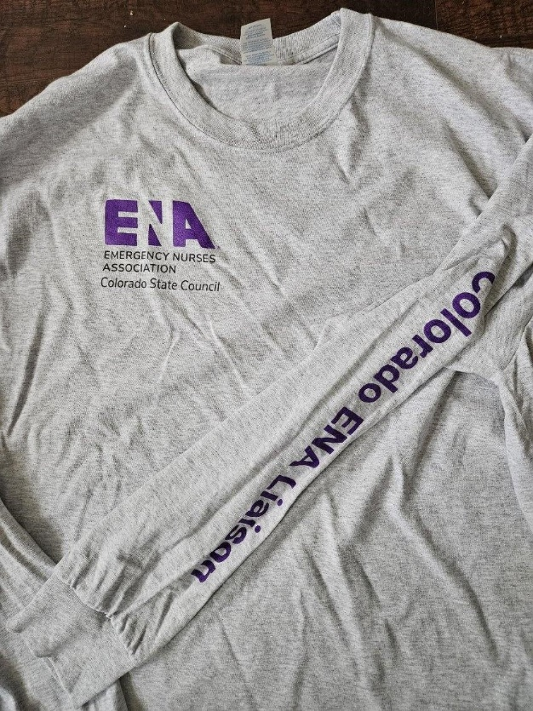
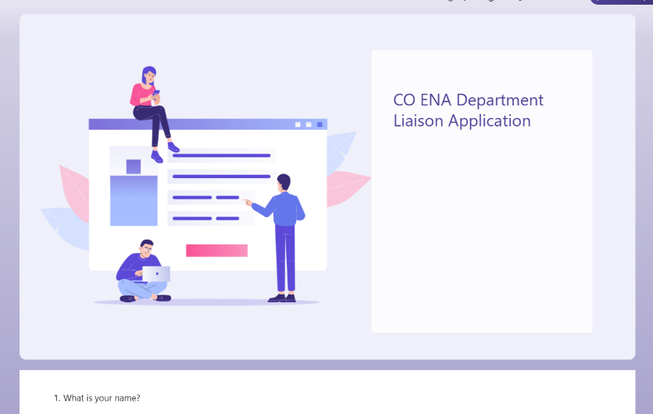
Growing the Liaison Program
Reached out to each CO hospital
Use Microsoft Forms to create an application
Make a contact list in outlook for ease of reaching out
Send emails out to all the Trauma Program managers in the state of Colorado
Give something special for the liaisons
Photo credit Kristina Larson
Notes:
Tina
Each person on the membership committee was assigned hospitals to call. We each made cold calls to the ED leaders. I color coded each person to make it easy to see.
Had scripting available
How do you get the list of hospitals in your state
The Microsoft form includes an attestation of what the liaison responsibilities are and an essay of why they would like this opportunity.
Emails were sent out regularly with information to send out to the liaison’s coworkers with CO member meeting details, events and opportunities, scholarship deadlines, etc.
As a thank you this year to our liaisons we sent out t-shirts to the current liaisons. On the back it says “ask me about Colorado ENA”. They have been a huge hit. These were sent with thank you cards from our CO ENA membership team.

Slide 25
Goals
Notes:
Tina
Have goals

Slide 26
Membership Committee 2024 Goals
  Attend at least 4 nursing conferences during 2024 with a CO ENA booth.
  CO ENA Liaisons: in 2023 we had 36 facility liaisons. Our goal is to increase this to 45.
  Current CO ENA membership is 1065. We will continue with our goal of 1300 for 2024.
  Contact all expiring CO ENA Members.
  Send all new CO ENA Members a welcome package.
Notes:
Tina
They can be whatever you choose.
We attended 4 conference in 2024, up from 2 in 2023
We went from 36 liaisons to 59 by the end of 2024
We did not meet our membership goal, we left 2023 with 1065 members and ended 2024 with 983
We did contact all expiring members each month and send out welcome letters to all new CO ENA members

Slide 27
Looking to 2025
Notes:
Tina
Feedback from the current CO ENA liaisons is “how do we engage and inspire our coworkers” – we had our first CO ENA liaison meeting on Monday.
We will continue with our lofty goal of 1300 CO ENA members for 2025.
We want to attend at least 5 Nursing Conferences in 2025
We want to have at least one member activity in 2025.
We also would like to increase our liaisons to 65 in 2025.

Slide 28
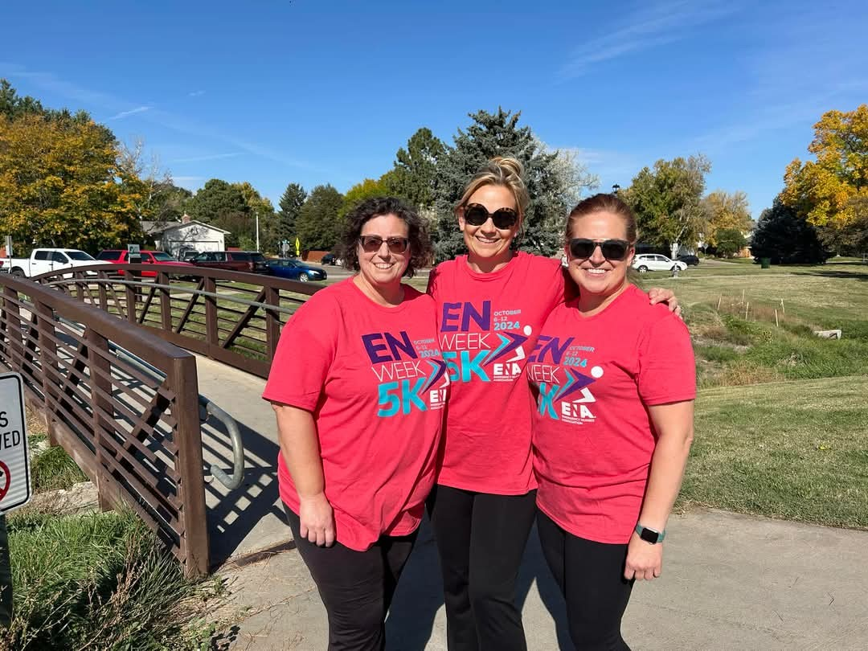
Find a successor
Photo credit Amy Boren
Notes:
Amy and Tina
We invited ENA liaisons to walk the ENA 5k with us. We had one taker!
I am honored to be Amy’s successor. I did not realize the amount of time and energy that she put into the roll of membership chair when I was a committee member. Even though it is lots of work, it is so rewarding. Reach out to us with any questions.

Slide 29
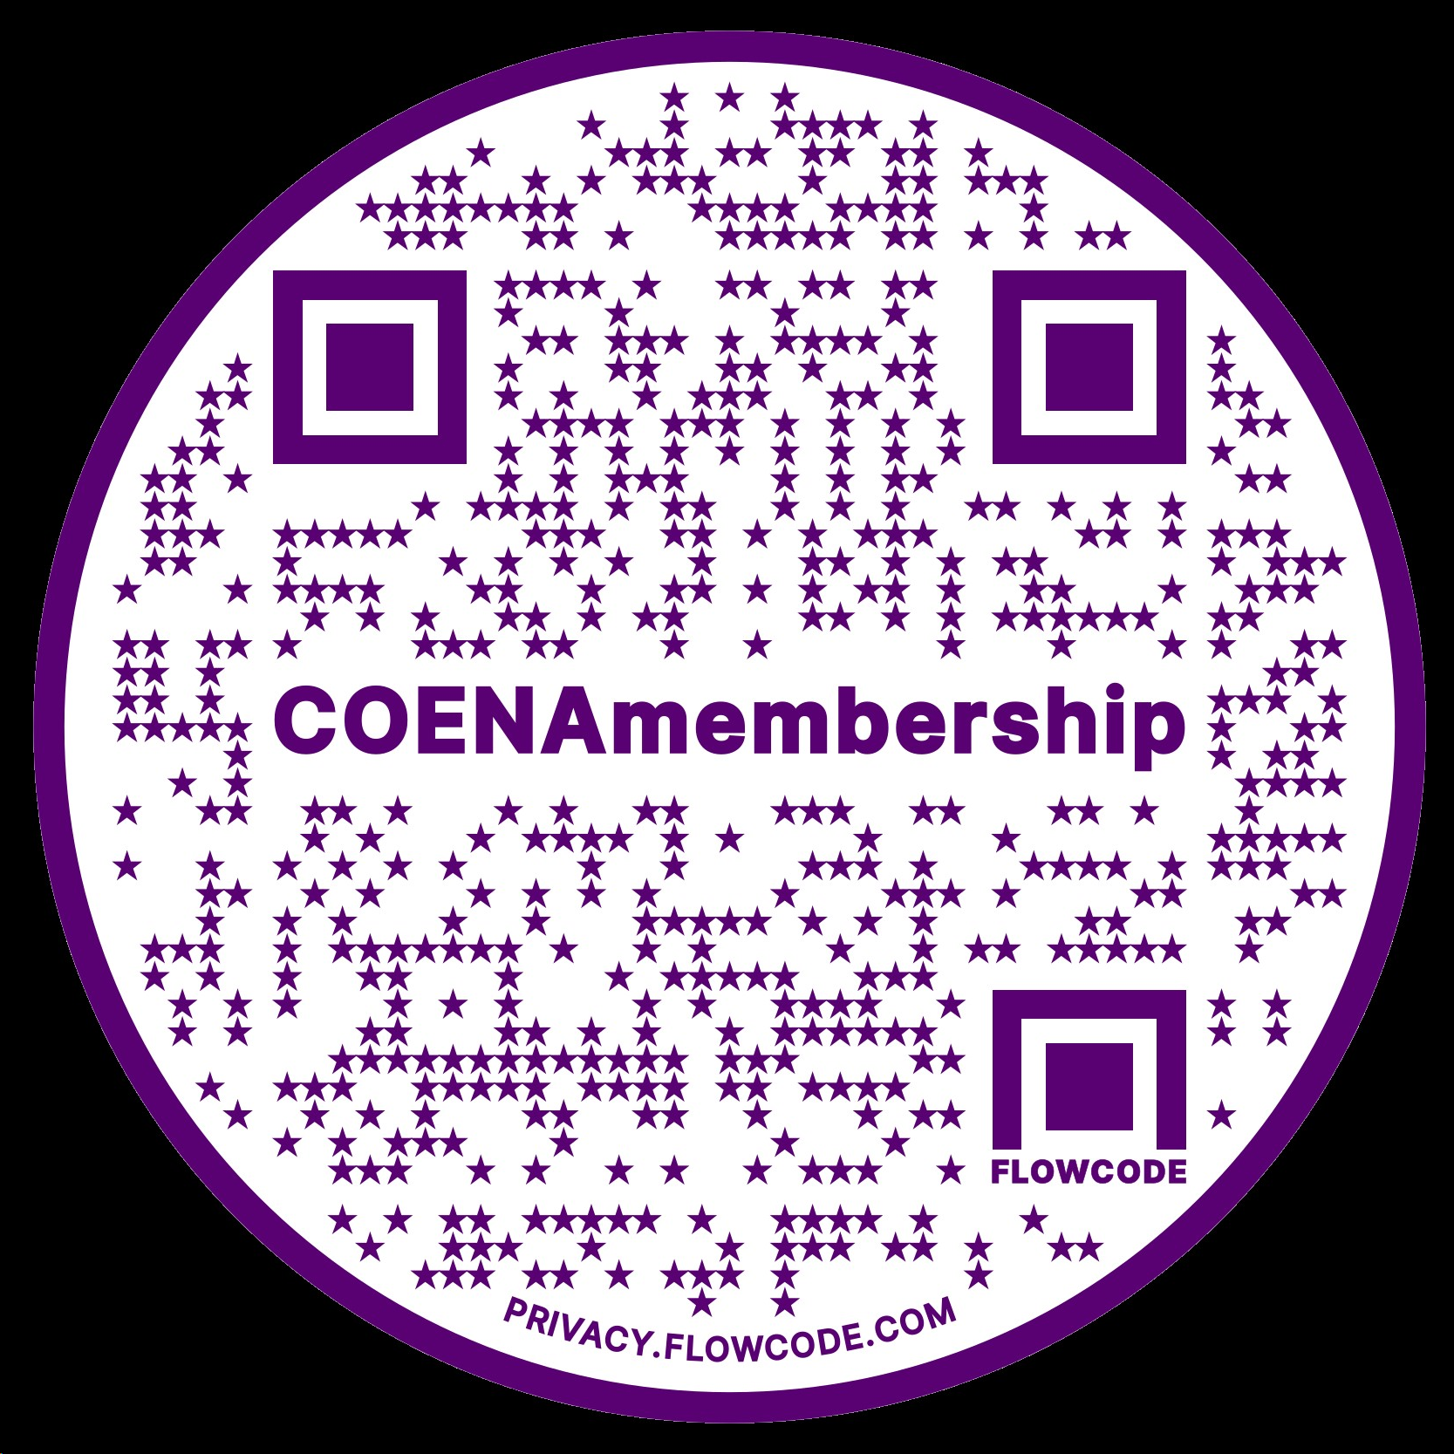
Email us at AmyLouENA@gmail.com, tinaj.larson@hotmail.com, or membership@coloradoena.org
Get the presentation and see our committee page
Notes:
Amy or Tina

Slide 30
References and Resources
Colorado Emergency Nurses Association (2025, January 19). Colorado ENA. https://coloradoena.org
Emergency Nurses Association (2025, January 19). Emergency nurses association. https://www.ena.org
https://youtu.be/_Efb_oMgxEs

