Slide 1
ENA Membership

Slide 3
Get Results
Complimentary CE - Members have exclusive FREE access to a library of 24+ CE courses on emergency nursing topics. New topics added monthly!
Discounted BCEN Fees - ENA members enjoy a $140 discount on CEN Exam fees for certification and re-certification
Subscription to JEN - Electronic and print subscription to the Journal of Emergency Nursing, ENA’s peer-reviewed research publication, included with membership
Practice Resources - access to evidence-based emergency nursing resources to help you stay committed to care
Exclusive Conference Rates - Receive members exclusive pricing on all ENA events, including the annual conference and the regional symposia series
Funds for your Future - apply to receive educational scholarships and research grants through the ENA Foundation
Preferred Pricing - members enjoy 20% discounts on ENA online education, products and merchandise including:
ENA’s CEN Online Review
Course in Advanced Trauma Nursing (CATN)
Geriatric Emergency Nursing Education (GENE

Slide 4
Get Connected, Get Involved
ENA CONNECT – Collaborate with your peers worldwide in an exclusive members-only online community
ENA Monthly Education and Membership Bulletins – Stay informed! Receive monthly e-newsletters on the latest ED news, educational products and courses, advocacy, networking and membership highlights
ENA Career Center - Thinking about a career move? We're here to help connect you with new opportunities both nationally and internationally
ENA Mentoring Program- Shape the future by sharing your expertise with other members or find guidance from peers to help you achieve your goals
States and Chapters- Network and interact with local colleagues as part of 180+ local state councils and chapters
Social Media- Stay up to date with news from the profession by following ENA’s social media channels
Volunteer Opportunities –Make a direct impact on the profession by volunteering for leadership and committee opportunities at the state and national level
ENA Connection- Members receive 12 issues of ENA’s member magazine featuring in-depth coverage of topical issues affecting you and the emergency nursing profession
Newsline - Weekly e-newsletter focused on health care news
EN411 Legislative Network – Get active in ENA’s advocacy efforts to start making a difference for all emergency nurses

Slide 5
COLORADO ENA Benefits
www.ColoradoENA.org ………………………………………………………………Documents/Budget planning
In addition to all of the National benefits,
there are additional benefits available to CO ENA members
2 Gifts per state meeting of $100
5 members per month can apply for reimbursement for ENA courses
5 members per quarter reimbursed up to $100 for CE courses
Colorado State Education Conference : 2023 date TBD
Scholarships to the National ENA Conference in San Diego, CA
AND, BSN, MSN, PhD Scholarships: Applications due June 1st

Slide 6
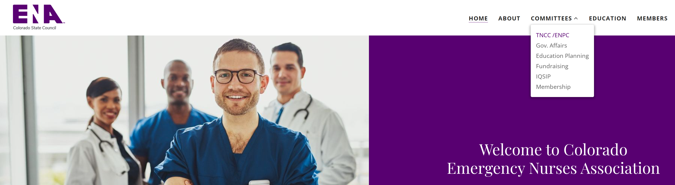
MEMBERSHIP GIVEAWAY
The 2023 TNCC / ENPC Committee is participating in a state membership drive
Eligibility: Any Colorado ENA member (Either a new member or renewing)
Who attends a TNCC or ENPC course prior to March 31st, 2023
You must submit an application to the
state committee (CKzeigler@me.com )
which includes:
Your ENA Course #
The name of your course director
Your new or current ENA member #
You must join prior to submitting an application.
Renewing members can contact ENA member services and have their award applied to their current membership.

Slide 7
National ENA
Membership
Colorado ENA
State Website

