Slide 1


2026年度中国煤科国际科技合作研究重点方向与关键时间节点
Research Priorities & Key Dates for CCTEG Supporting Research Project 2026

Slide 2
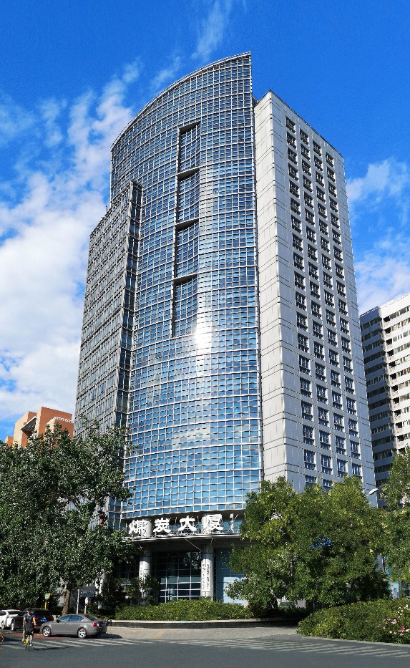
中国煤科始终秉承“开放共享、合作共赢”的理念，高度重视并持续推动煤炭领域的国际科技合作，积极融入全球创新网络。围绕煤炭安全绿色智能开发和清洁高效低碳利用，已与多所国际知名高校和研究机构开展科研项目合作20余项，推动了矿业行业发展与科技进步。
Adhering to the concept of "open sharing and win-win cooperation", China Coal Technology and Engineering Group (CCTEG) attaches great importance to and continuously promotes international Science & Technology Cooperation in the field of coal, and actively integrates into the global innovation network. Focusing on the safe, green and intelligent development and clean, efficient and low-carbon utilization of coal, CCTEG has carried out more than 20 scientific research projects with several internationally renowned universities and research institutes, which have contributed to the development of the industry and scientific and technological progress.

Slide 3
重点合作领域 （COOPERATION RESEARCH PRIORITIES）
1.煤矿智能开发方向 INTELLIGENT COAL MINE DEVELOPMENT
数字化工程设计 Digital Design
透明矿井 Geology
矿山数字化基础平台框架开发
→ Development of the Fundamental Framework for Mine Digitalization Platform
矿山数字模型逻辑及数据驱动
→ Logic and Data-Driven Mechanism of the Mine Digital Model
多源异构信息模型管理及应用
→ Management and Application of Multi-Source Heterogeneous Information Models
矿山数字模型仿真
→ Simulation of Mine Digital Models
地震低频信号处理及岩性解释 → Low-frequency seismic signal processing and lithology interpretation
长钻孔电磁法探测
→Long-hole electromagnetic detection
随钻地震孔巷联合 → Integrated while-drilling seismic and roadway exploration
近钻头钻孔轨迹测量与旋转导向钻进 → Near-bit borehole trajectory measurement and rotary steerable drilling
多源异构异质数据信息融合 → Multi-source heterogeneous data fusion
快速精准超前探测 → Rapid and accurate ahead-of-the-face detection

Slide 4
重点合作领域 （COOPERATION RESEARCH PRIORITIES）
1.煤矿智能开发方向 INTELLIGENT COAL MINE DEVELOPMENT
智慧大脑 Smart Control
智能装备 Intelligent Equipment
三维坐标定位通信融合位置服务和精确时钟同步授时基础网络构建 → Construction of a Fundamental Network for 3D Coordinate Positioning, Integrated Communication and Positioning Services, and Precise Clock Synchronization across the Entire Mine
基于矿用5G+工业物联网的煤矿泛在精确感知网络构建 → Development of a Ubiquitous and Precise Perception Network for Coal Mines Based on Mining 5G and the Industrial Internet of Things (IIoT)
低功耗、微型化多源协同智能无线传感 → Low-Power, Miniaturized, and Multi-Source Collaborative Intelligent Wireless Sensing
智慧煤矿多专业协同决策分析 → Multi-Disciplinary Collaborative Decision Analysis for Smart Mines
自动截割智能决策与控制 → Intelligent Decision-Making and Control for Automated Cutting
井下装备精确定位与导航 → Precise Positioning and Navigation of Underground Equipment
多场景机器人 → Multi-Scenario Robots
硬岩截割及耐磨材料 → Hard Rock Cutting and Wear-Resistant Materials
掘进导航技术 → Tunneling Navigation Technology
露天矿连续开采技术 → Continuous Mining Technology for Open-Pit Mines

Slide 5
重点合作领域 （COOPERATION RESEARCH PRIORITIES）
2. 煤炭绿色开发方向 GREEN COAL DEVELOPMENT
矿井建设 Mine Construction
低损害开发 Low-Impact Mining
建井无绳提升技术 → Ropeless Hoisting Technology for Shaft Construction
高效无滚动部件轴承新型破岩滚刀 → High-Efficiency Rock-Cutting Disc with Bearing-Free Design (Without Rolling Components)
低温水溶性载冷剂 → Low-Temperature Water-Soluble Refrigerant
超声波冻结壁智能探测技术 → Intelligent Ultrasonic Detection Technology for Frozen Walls
高浓度大倍线自流充填材料 → High-Concentration, High-Dilution-Ratio Self-Flow Backfilling Materials
煤系固废、城市固体垃圾采空区固化材料及工艺 → Solidification Materials and Processes for Goaf Areas Using Coal-Based Solid Waste and Municipal Solid Waste
高位坚硬覆岩水力压裂弱化技术 → Hydraulic Fracturing Weakening Technology for Hard Overlying Strata at High Levels
地表沉陷智能实时预警技术 → Intelligent Real-Time Early Warning Technology for Surface Subsidence

Slide 6
重点合作领域 （COOPERATION RESEARCH PRIORITIES）
2. 煤炭绿色开发方向 GREEN COAL DEVELOPMENT
煤层气开发利用 Coalbed Methane (CBM)
生态环保 Sustainability
智能矿山透明地层动态构建技术 Dynamic Construction Technology for Transparent Strata in Intelligent Mines
废弃（关闭）矿井煤层气赋存地质条件精准探测技术 Accurate Detection Technology of Coalbed Methane Geological Conditions in Abandoned (Closed) Mines
分散式煤层气资源储能技术 Distributed Coalbed Methane Resource Energy Storage
低浓度煤层气稳定燃烧技术 Stable Combustion Technology for Low-Concentration Coalbed Methane
生态脆弱矿区自修复技术 Self-rehabilitation Technology for Ecologically Fragile Mining Areas
高寒高海拔矿区土壤重构与植被恢复关键材料添加剂 Key Material Additives for Soil Reconstruction and Vegetation Restoration in High-Altitude, Cold Mining Areas
中短途距离管道输送煤浆制备技术 Coal Slurry Preparation Technology for Medium- and Short-Distance Pipeline Transport
煤浆流变特性测试技术 Rheological Property Testing Technology of Coal Slurry

Slide 7
重点合作领域 （COOPERATION RESEARCH PRIORITIES）
3. 煤矿安全保障方向 COAL MINE SAFETY ASSURANCE
安全防控 (Safety Warning & Control)
应急救援 (Emergency Rescue)
职业健康 (Wellbeing)
基于大数据的煤矿灾害预警指标体系及智能预警模型
Disaster Early Warning Indicator System and Model Based on Big Data
低自发热低卤环保型防灭火材料 Low-Self-Heating, Low-Halogen Environmentally Friendly Fire Prevention and Extinguishing Materials
钻机故障自动诊断 Automatic Diagnosis of Drilling Rig Faults
高性能智能钻具 High-Performance Intelligent Drilling Tools
机器人大功率本安动力驱动 High-Power Intrinsically Safe Drive for Robotics
透地通信 Through-the-Earth Communication
井下坍塌煤岩体快速钻进 Rapid Drilling Technology for Collapsed Underground Coal-Rock Masses
多维雷达生命探测 Multidimensional Radar Life Detection
煤矿应急救援用外骨骼助力 Exoskeleton Assistance for Coal Mine Emergency Rescue
矿井降尘水雾图像识别 Image Recognition Technology for Mine Dust Suppression by Water Mist
呼吸性粉尘浓度高精度传感 High-Precision Respiratory Dust Concentration Sensing
压风风筒快速自动连接 Rapid Automatic Connection of Compressed Air Ducts
露天矿山移动尘源高效控制 Efficient Control of Mobile Dust Sources in Open-Pit Mines

Slide 8
重点合作领域 （COOPERATION RESEARCH PRIORITIES）
4. 煤炭清洁低碳利用方向 CLEAN AND LOW-CARBON UTILIZATION OF COAL
煤炭加工与转化
(Coal Processing & Conversion)
污染物治理 (Pollutant Control)
碳减排与碳中和 (Decarbonization)
高精度在线灰分检测 High-Precision Online Ash Content Detection
选煤装备实时检测预警 Real-Time Monitoring and Early Warning for Coal Preparation Equipment
煤油共处理催化剂规模化制备 Scale-Up Preparation Technology for Co-Processing Catalysts of Coal and Oil
高盐有机物混凝与臭氧催化氧化 Coagulation and Ozone-Catalyzed Oxidation of High-Salinity Organics
烟气净化高效活性焦材料制备 Preparation of High-Efficiency Activated Carbon Materials for Flue Gas Purification
高性能矿井水除氟催化剂和工艺 High-Performance Catalysts and Processes for Fluoride Removal from Mine Water
膜污染物控制 Membrane Fouling Control
低浓度大风量VOCs治理 Treatment of Low-Concentration, High-Volume VOCs
膜电极构型关键CO2电还原电解池 Key CO2 Electroreduction Electrolyzers with Membrane Electrode Assembly
CO2长管道运输 Long-Distance CO2 Pipeline Transport
高效低能耗CO2吸收剂 High-Efficiency, Low-Energy CO2 Absorbents
燃烧前CO2湿法吸收先进捕集工艺 Advanced Pre-Combustion CO2 Capture via Wet Absorption
高性能低能耗的吸附剂/膜材料 High-Performance, Low-Energy Adsorbent/ Membrane Materials

Slide 9
重点合作领域 （COOPERATION RESEARCH PRIORITIES）
5. 转型升级方向 TRANSFORMATION AND UPGRADING
基于GIS/BIM/VR/AR的地下工程可视化建设 Visualization Construction of Underground Engineering Based on GIS/BIM/VR/AR
具备边端计算功能的数据采集与传输装备 Data Acquisition and Transmission Equipment with Edge Computing Capability
地下空间安全运维和结构设施韧性 Safety Operation & Maintenance and Structural Resilience of Underground Spaces
地热资源精准勘查与评价技术 Precise Exploration and Evaluation Technology for Geothermal Resources
煤-地热资源协同一体化开发 Integrated Co-Development of Coal and Geothermal Resources
地热+多能协同冷热联供技术 Geothermal and Multi-Energy Coordinated Heating and Cooling Supply Technology
CIM模型数据整合和渲染技术 CIM Model Data Integration and Rendering Technology
基于单光源多参光信号解调的城市构筑物安全检测 Urban Infrastructure Safety Inspection Based on Single-Light-Source Multi-Parameter Optical Signal Demodulation
空气及固定排放颗粒物高精度和高可靠性在线监测及自动标定 High-Precision, High-Reliability Online Monitoring and Automatic Calibration of Airborne and Stationary Particulate Matter
动静两用高精度远程构筑物形变监测技术与装备 High-Precision Remote Monitoring Technology and Equipment for Both Dynamic and Static Deformation of Structures

Slide 10
CCTEG 科技合作项目申请流程和关键时间节点
事项 | 日期 (估计)
发布科技合作需求 | 2025年10月14日
项目意向书递交截止 | 2025年10月31日
项目意向书审议结束 | 2025年11月7日
邀请提交项目申报书 | 2025年11月21日
项目申报书提交截止 | 2025年12月10日
项目申报书审议结束 | 2025年12月31日
项目申请书审议结果通知 | 2026年1月7日
项目合同的签署和项目的启动 | 2026年1月20日

Slide 11
CCTEG SUPPORTING RESEARCH PROJECT KEY DATES
Milestones | Date (estimated)
Call for Express of Interest(EOI) | 14 Oct 2025
Closing Date for EOI | 31 Oct 2025
Consideration of EOI by CCTEG Academic Committee | 07 Nov 2025
Invitations for Full Proposal | 21 Nov 2025
Close of Full Proposal of Project Application | 10 Dec 2025
Consideration of Full Proposal of Project Application | 31 Dec 2025
Notification of outcomes of Application | 07 Jan 2026
Execution of Project Contract and Project Commencement | 20 Jan 2026

Slide 12

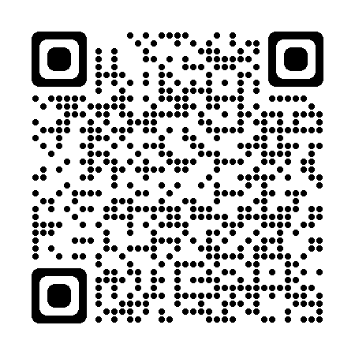
THANK YOU
谢谢
In case of any inquiry, please do not hesitate to contact us via:
Mr. Dai Shuangcheng Email: scdai@cctegamt.com
Dr.Zhao Liang Email: lzhao@cctegamt.com
如有任何疑问，请随时通过以下方式联系我们：
赵 良 邮箱: lzhao@cctegamt.com
代双成 邮箱: scdai@cctegamt.com
Website
LinkedIn

