Slide 1


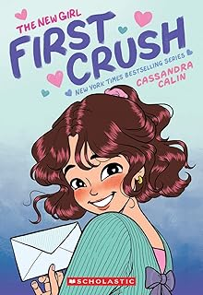

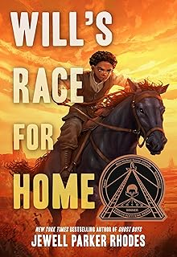
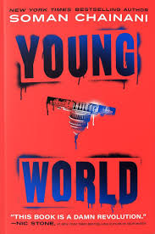
CHECK IT OUT! NEWSLETTER
MAY
EDITION
Highlighting Staff Recommendations from Picture Books to Teen Novels and Everything In-Between!
Perfect next read for fans of Guts by Raina Telgemeier. Lia's relationships -- with her friends, her crush, her mom, and even herself -- are all tested like never before.
The young dudes plan a trick shot show to raise money for the struggling neighborhood rec center where everyone plays basketball.
A thrilling adventure story about a son and his father who set out to win land during the Oklahoma Land Rush—if they can survive the journey. A Coretta Scott King Author Award winning book.
A renegade thriller, about a teenager elected President of the United States, sparking a global revolution of young leaders—until one of them is murdered and he’s the prime suspect.

