Slide 1
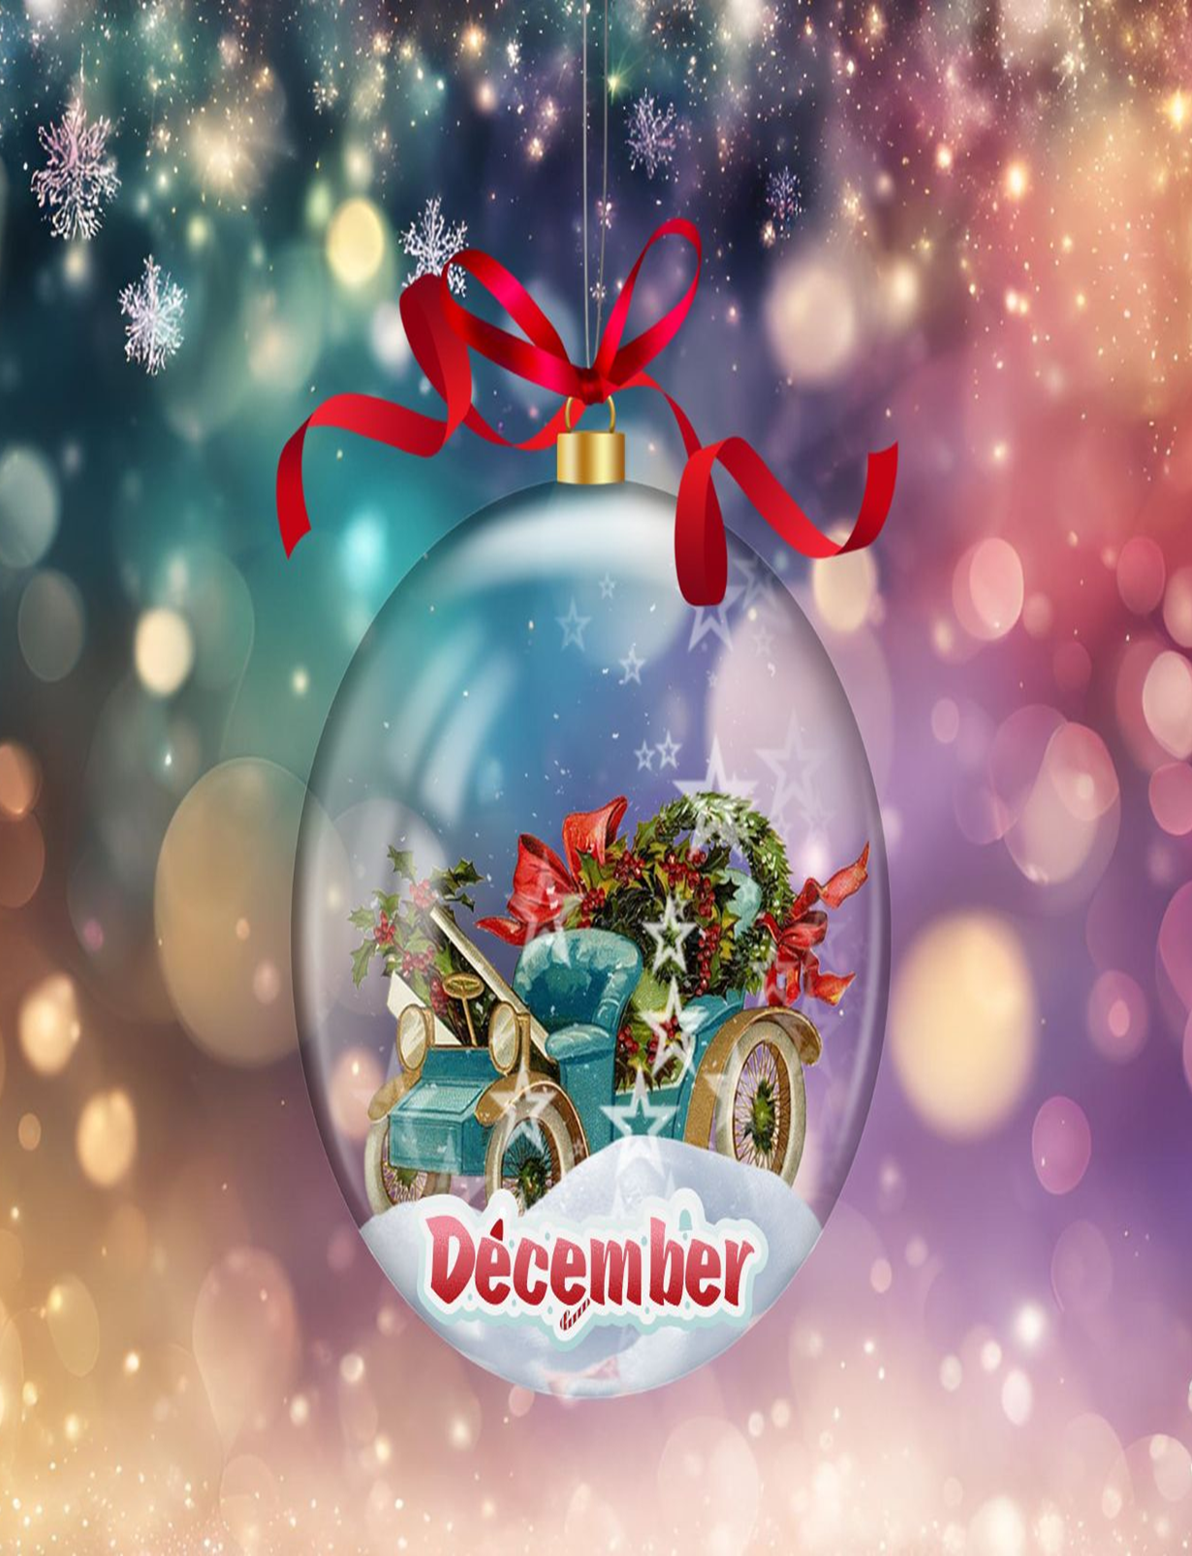

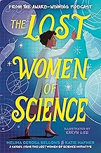
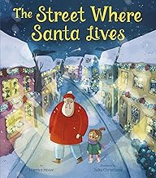
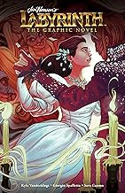
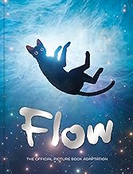
CHECK IT OUT! NEWSLETTER
DECEMBER
EDITION
Highlighting Staff Recommendations from Picture Books to Teen Novels and Everything In-Between!
From the popular Lost Women of Science podcast, comes an empowering collection that recognizes ten trailblazing female scientists whose lives and works have been lost to history...until now. Uncover the truth behind some of the world's greatest accomplishments—and the women who made it happen.
When the young narrator announces that Santa Claus has moved in next door, Mom, Dad, and big sister Liv are less than convinced. But it doesn't matter; the narrator is convinced. And the more she gets to know her new neighbor, the more certain she is that he is indeed Santa Claus
40th Anniversary of the film. Through dangers untold and hardships unnumbered, discover this brand new adaptation of Sarah’s surreal adventure through the twisting and changing paths to the castle beyond the Goblin City, determined to save her brother Toby from the Goblin King, Jareth
A stunning picture book adaptation of the Oscar-winning film that has enchanted audiences around the globe. When Cat’s home is submerged by a great flood, he finds refuge on a boat alongside an unlikely band of animal companions.

Slide 2
