Slide 1
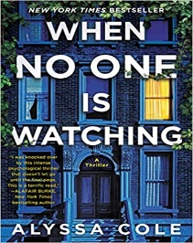
Sharon’s
Best Reads!
February Edition
Coming to the Library Company of Burlington in February
The Sanatorium : Sarah Pearse’s book is a roller coaster from start to finish! When Elin’s brother gets engaged how can she say no to a weekend away to celebrate! Unfortunately, the next morning his fiancée goes missing. Will they find Elin’s brother’s fiancée in time for a happy ending?
Finlay Donovan Is Killing It : by Elle Cosimano is the most humorous book I have checked out in a long time! Finlay is meeting with her agent about her next book and is overheard talking about murder! Unfortunately, this person thinks she is a hit man and wants to hire her for a real murder! Run don’t walk to check this book out!
Awesome Reads Available Now
When No One Is Watching : by Alyssa Cole is an excellent read! Sydney has lived in her neighborhood all her life and suddenly it seems like everyone is moving. Suddenly, neighbors are missing and condos are being built everywhere. Is this a coincidence? Check this out and see! While this book did not get very good reviews I thought it was an exciting, thought provoking read!
Kamala’s Way : by Dan Morain is a very interesting book! Whether you voted for Kamala or not this book is very thought provoking. This really makes you see how she was raised by her parent’s and the woman she is today. From her early days as a prosecutor to her later days as district attorney, her rise to Vice President has given young girls of color the courage to dream big!

