Slide 1
Sickness, Stress, and Staffing, Oh My!
Issues in Long-Term Care during COVID 2020
Arlene Morris, RN, MSN, EdD
April 9, 2021 | 12 PM

Slide 2
Declaration
I declare that I have no know conflicts of interest with any of the organizations or content mentioned in this presentation.

Slide 3
Overview:
The novel coronavirus experience in 2020 led to unprecedented situations across all healthcare settings. This presentation will include some of the issues faced in Alabama long-term care settings during 2020, lessons learned, and provide opportunity for discussion of implications for the future.

Slide 4
Objectives:
At the conclusion of this presentation, participants should be able to:
Relate emotional distress of residents, families and staff during isolation and loss
Discuss staffing concerns and modifications within long-term care settings
Consider strategies that could support the needs of residents, families, and staff

Slide 5
My background
BSN, MSN, EdD
Retired professor of nursing at Auburn University Montgomery
Certifications in gerontology
Certification in educational best practices for teaching older adults and their families or caregivers
Member of Central Alabama Aging Consortium Ombudsman Advisory Council

Slide 6
Alabama Area Alabama agencies on aging
Divided into regional areas (Montgomery is in the Central area)
Ombudsman: a salaried position to monitor and respond to concerns of older adults
Central Alabama Agency on Aging Ombudsmen Advisory Committee:
an invited volunteer position to meet quarterly to oversee and advise the activities and projects of the local ombudsmen
to serve as trained volunteer ombudsmen to visit local long-term care and assisted living facilities
Random, unannounced visits to monitor facility adherence to regulations
Random visits with residents to learn of any concerns

Slide 7
Alabama Nursing Home Association
This is the professional association of member long-term care facilities
Location: 4156 Carmichael Dr., Montgomery, AL
Phone: 334-271-6214
Katrina Magdon (email: kmagdon@anha.org)
John Matson

Slide 8
The problem identified
April 2020 ombudsmen committee, I became aware need during the COVID-19 epidemic:
Staff and residents episodically had high infection rates
Staff departures >>severe shortage of staff in LTC facilities
April 1, 2021 phone interview with Katrina Magdon, Alabama Nursing Home Assoc. in March 2021 to review problem and lessons learned

Slide 9
“LTC is not a priority”
Residents in LTC and assisted living facilities (ALFs) have
complex care needs
Multiple co-morbidities
Emotional and psych-social needs in addition to management of physical care needs

Slide 10
Personal protective equipment (PPE)
March 2020: National shortage of PPE
Prioritization of PPE to emergency and critical care staff in hospitals
May/June 2020 PPE available to LTC
Lack of personal protective equipment (PPE) that fit
Federal purchase of PPE but lacked quality (“gownslike wet tissue paper” and masks “like loose fitting panties”)
KN95 masks were on backorder
Therefore, COVID transmission from visitors or new admission>resident>staff; fewer staff>resident transfers

Slide 11
Occupational Safety and Health Administration (OSHA)
OSHA inspections followed staff deaths from COVID
Unable to determine where staff contracted COVID infection
Staff had to work extended shifts or 14 day periods to cover for staff absent for
+ COVID status
COVID exposure until negative testing (but still shedding virus)

Slide 12
STAFFING SHORTAGES
LTC and assisted living facility (ALF) staff often employed at two or more facilities to increase earnings:
RNs, LPNs
Social Workers,
Certified Nursing Assistants
Cleaning staff
Administrator challenges
ADPH required to declare primary place of employment and only work there
No regulation to prohibit
Ombudsmen & surveyor visits reduced due to potential COVID spread

Slide 13
“many staff resigned”
Staff deaths >>fear of remaining staff
School closures>>need to care of children now at home
Fear of infection
Fear of transmission to family members
Federal stimulus unemployment stipends were often the same or more than salary with less risk and provided ability to monitor children out of school

Slide 14
“No one to administer medications”
Traditional LPN role as “medication nurse”
Shortage of LPNs during COVID
Reduction in LPN education programs in AL
Creation of waiver for training at Alabama Community Colleges for Medication Assistants
Modeled after program in Nebraska & endorsed by over 30 states
One semester pharmacology and medication safety course
Alabama Board of Nursing oversees the community college teaching and clinical

Slide 15
Medication assistant, continued
Two separation Medication Adminstration Records (MARs):
Medication assistant passes routine medications
that “don’t require nurse oversight” (BP, lab value, sliding scale)
or any newly prescribed medication
LPN passes meds that require supervision or ”hands-on” nursing care

Slide 16
“No One to Meet the Actual personal Care Needs”
Creation of “Temporary Nurse Aide” training programs:
8 clock hours (vs. prior 75 clock hour requirement)
Recruited custodial, laundry, dietary staff from the LTC facility to be cross-trained
Recruited some nursing assistants from restaurants or manufacturing jobs (‘backbreaking labor’)
Can work up to 4 months without certification
However, federal stimulus and unemployment benefits were higher than TNA salary

Slide 17
“No one to clean or disinfect”
High rate of Custodian staff departures
National Guard mobilized as a “strike team”
Mission: to clean and disinfect
Outcome: sticky residue on all surfaces that were cleaned
Result: increased actual workload required to remove residue
Recommendation: strike team collaboration with facilities before any action

Slide 18
Infection Preventionist
Center for Medicare/Medicaid (CMS) 2019 regulations included life safety codes and survey procedures, including the role of infection preventionist for adherence to new rules
“Cohorting” rules and regulations (separate from hospital regulations)
Isolation required for COVID positive residents
Conflicted with required 30-day notice to relocate resident
Facilities created temporary plexiglass or vinyl shields

Slide 19
Patient transers from Hospital> LTC
Regulations: LTC could not admit a person discharged from hospital until assurance that the person’s status was “COVID negative”,
Backup of patients in hospitals prevented needed beds for new admissions
Created animosity between hospitals and LTC facilities
Then “COVID Unknown” accepted

Slide 20
Centers for Disease Control CENTERS FOR MEDICAID/MEDICARE SERVICES
New information regarding revised regulations sent daily to facilities
Ever-changing rules as more was learned regarding COVID best-practices
New regulations “to take effect immediately”: no time to for ANHA to communicate revisions to LTC facilites

Slide 21
Challenges to Help residents face Unknown
LTC or Assited Living Facility (ALF) is “Home”
Relationships with staff and other residents become like family
Relocation (‘moving’)>>grief over loss of connection with roommate, sense of place
Staff resignations due to increased threat of COVID risks>>further grief of loss of relationships
Actual family/friends’ visits prevented due to COVID risks
Developed severe loneliness, fear, depression

Slide 22
Lessons learned and positive interventions
VACCINATIONS:
75-90% of residents in Alabama LTC facilities received COVID vaccine in the initial rollout
50% of staff in Alabama LTC and ALF currently vaccinated, but rates increasing as more observe lack of detrimental vaccination effects
Each LTC had 3 onsite vaccination clinics

Slide 23
Lessons learned and positive interventions, continued
Quality PPE supply is increasingly available
Communication improving: Director of Nursing (DON), LPN,
Nursing assistant>nursing assistant peer communication
Continue use of quality mask even if vaccinated

Slide 24
Helping Residents keep connected
iPad & cell phone visits
Outdoor visits
Temperature check for all
Visitor sign-in with declaration of COVID-free status and declaration to notify facility if status changes

Slide 25
NEED to prepare for next outbreak:
Dire need for backup/relief nursing staff
Already oriented to facility
Willingness to work during Nov. to Jan spikes
Signing bonuses available
****Call Katrina for more information

Slide 26
Needs, continued:
Many organizations are focusing on providing resources to meet the need for teamwork and resilience
ANA
ASNA
Counseling groups
Bereavement groups
Respect the contribution of all members of the healthcare delivery team!

Slide 27
Needs, continued
All staff must maintain personal safety
Facility focus on methods to promote wellness, nutrition,
Organizations continue to support staff with meals or snacks
Individuals can write notes of appreciation to staff and take to administrator
Individuals can write notes of encouragement to residents (must leave unsealed to be reviewed prior to delivery by Ombudsman staff, who will then deliver)

Slide 28
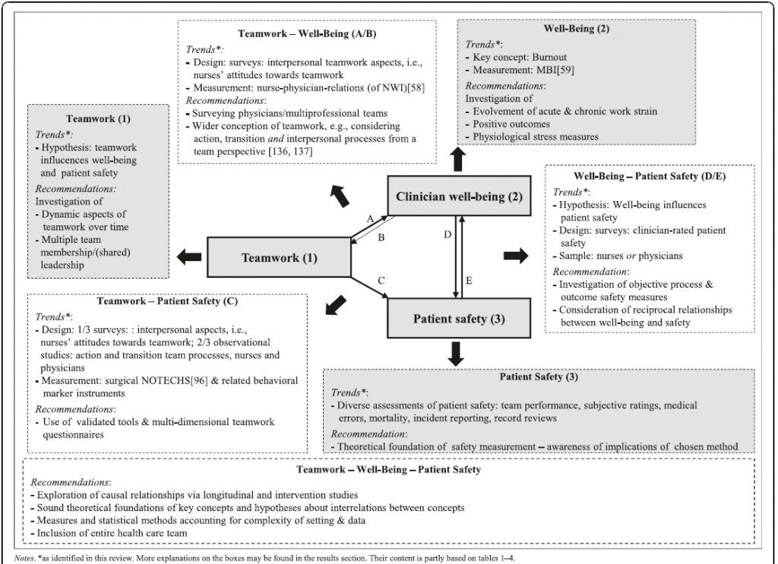
Notes:
Drawing from psychological theory and their findings, Welp and Manser developed an integrative framework that addresses these limitations and proposes mechanisms by which these concepts might be linked (see Figure 1) [1]. Although this framework applies only to hospital settings, it may provide a useful starting point for the development of frameworks in other settings.
Figure 1 | Integrative Framework of Teamwork, Clinician Occupational Well-Being, and Patient Safety in Hospital Settings | Source: Welp and Manser, “Integrating teamwork, clinician occupational well-being and patient safety—development of a conceptual framework based on a systematic review,” BMC Health Services Research. NOTES: Creative Commons license: http://creativecommons.org/licenses/by/4.0/

Slide 29
REFERENCES:
Alabama Nurses Association. Nurse to nurse (N2N) support program. www.alabamanurses.org
American Nurses Association. Resilience resources. www.nursingworld.org
Grafton, E., Gillespie, B., & Henderson, S. (2010). Resilience: The power within. Oncology Nursing Forum, 37, 698-705. doi: 10.1188/10.onf.698-705.
Oxford University Press (2016). Resilient. Retrieved from http://www.oxforddictionaries.com/definition/english/resilient
Shirer, P. (2015). Your relationships: Uniting in a common cause. In P. Shirer (Ed.), Fervent: A woman’s battle plan for serious, specific, and strategic prayer (pp. 169-181). Nashville, TN: B & H Publishing Group.

Slide 30
Thank you for this opportunity
Contact information:
Arlene H. Morris, RN, MSN, EdD
arlenehughesmorris@gmail.com

