Slide 1
Cultural Humility in Healthcare
Amy Morris, MPA, BSN, RN-BC, CTH
PrEP and STI Nurse Coordinator for
Medical Advocacy and Outreach

Slide 2
Nothing to Disclose

Slide 3
Learning Outcomes
Be able to define the difference between competency and humility
Be able to define implicit versus explicit bias
Be able to list at least 3 sources of self-awareness
Be able to identify strategies for engaging populations that you might define as “other”
Notes:
For over 20 years, I worked as a college-health nurse at Auburn University at Montgomery. In that time, I came into contact with students from many different cultures, ethnic groups and backgrounds, religions, socio-economic classes, and genders. I had to learn time and time again, to address each person as an individual, and not as a group. Currently, I work at Montgomery Advocacy and Outreach, in which I come into contact with a wide variety of people, all wanting and needing the same thing we all desire: to be accepted.

Slide 4
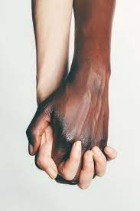
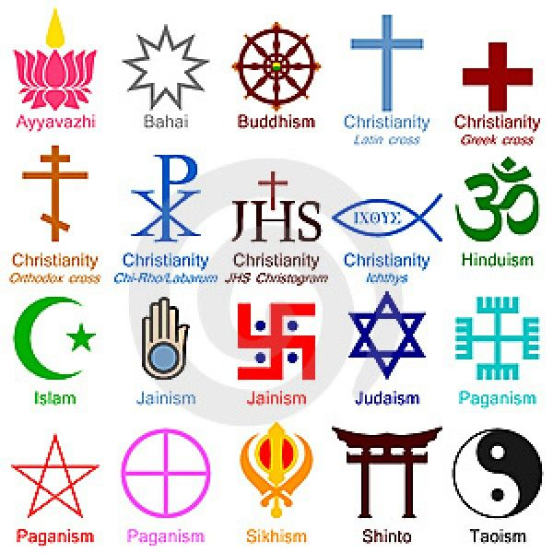
What makes us uncomfortable?
Notes:
Does a movie like “Brokeback Mountain” about a homosexual relationship make you uncomfortable? Do different religions? What about an interracial couple that happens to be gay? There are plenty of examples of movies and books that bring to us, the clash of cultures, opinions, and beliefs. The recent election comes readily to mind when we think about how different and how divisive even political beliefs can be.

Slide 5
Beliefs vs Reality
Notes:
Throughout our history, people have equated the witch to be evil, satanic and someone to be feared. A modern practicing witch, maybe your next door neighbor who just happens to relate their spirituality to nature. However, what is your first thought when you hear about someone from a different religion or even from another country?

Slide 6
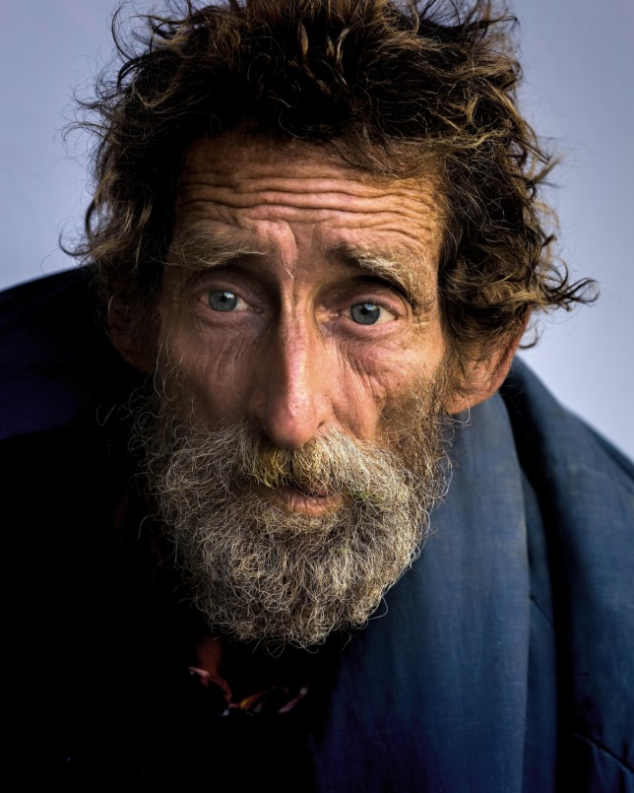
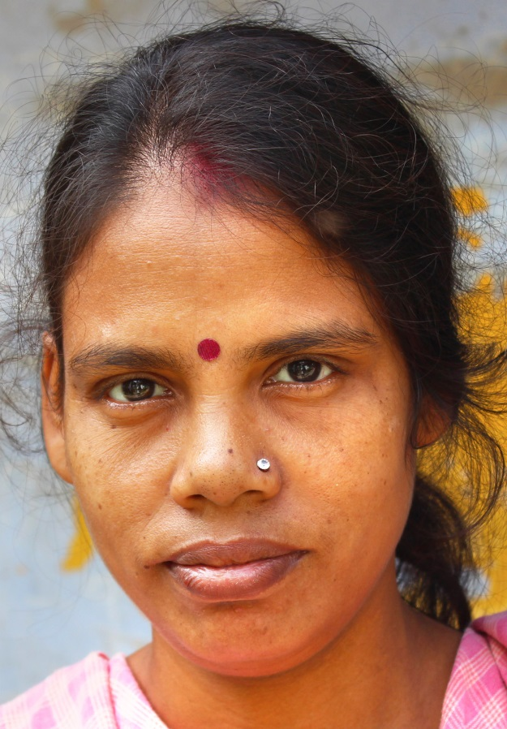
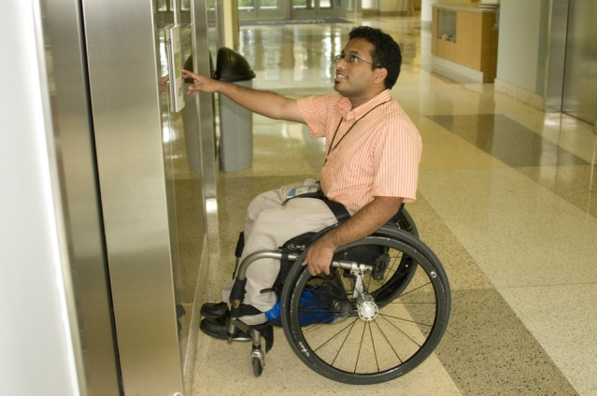
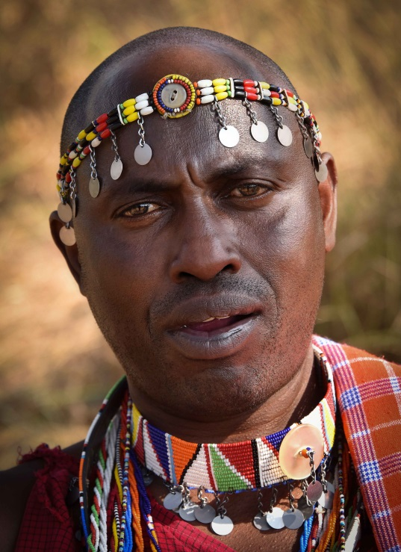
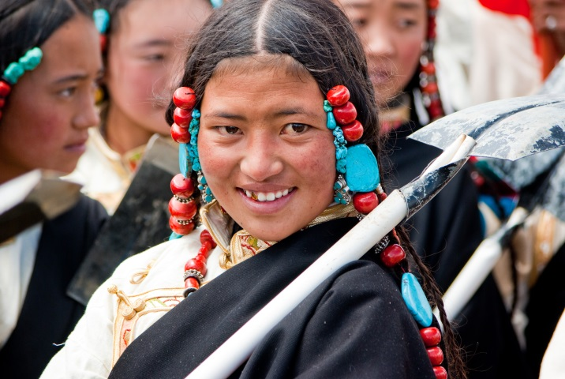
Notes:
Reflecting on these pictures for a moment. Who do you relate to the most? The homeless, the mentally ill, the disabled, another ethic group or race, or is it easier to relate to someone that looks and acts like you do?

Slide 7
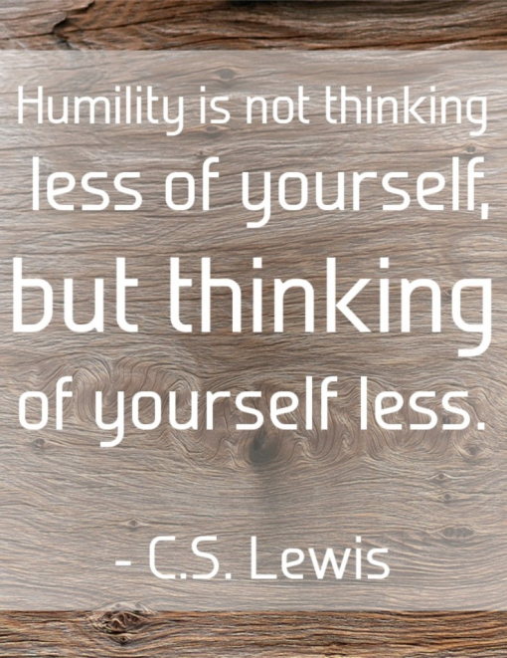
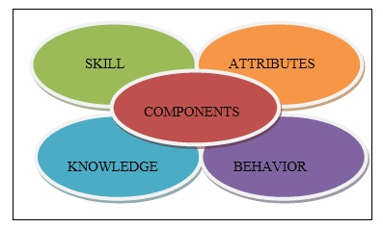
Definitions
Competency→
the ability to do something successfully or efficiently.
Humility→ modest or low view of one's own importance; humbleness.
Notes:
Cultural competence has been in the literature for at least 30 years and was a product of the social and political climate of the 1960s and 1970s when racial and ethnic populations, particularly in the US, began to demand respect and sensitivity. Cultural humility evolved out of this model because, competency did not embrace the patient as an individual, but continued to stereotype. Right away you can visualize a difference in the two approaches to culture. There are several models to address competency in different fields, not just healthcare. To be competent in a skill is to master it, while humility asks you to look beyond what you know, and acknowledge what you do not.

Slide 8
Competency vs Humility
Competence
Expert
Endpoint
Rigid
Hierarchy
Linear
Status Quo
Humility
Learner
Fluid
Flexible
Dynamic
Partnership
Evolving
Path to Equity
Notes:
The dichotomy of the two meanings is shown here.

Slide 9
Transcultural Nursing Society
Basic Transcultural Nursing Criteria (Initial Certification Five Years)
Hold a current, active, unrestricted RN license in a state or territory of the United States or the professional, legally recognized equivalent in another country.
Hold a diploma, an associate, or BSN degree from a program accredited by the Commission on the Collegiate of Nursing Education (CCNE) or the National League for Nursing Accrediting Commission (NLNAC) if school is in the US; or legally recognized equivalent in another country.
Currently employed in nursing, either full- or part-time, at the time of application.
Completed at least one course (didactic and/or clinical) in cultural diversity and promotion of cultural competence for a minimum of 3 credits (or equivalent 42 Contact Hours).
Completed 2400 hours of transcultural nursing practice as a registered nurse in an administrative, teaching, research, or clinical capacity, either full- or part-time during the five years prior to submitting your application.
Description of Practice
The CTN-B practices in diverse settings including primary care, acute care, community settings, rural/remote area nursing, and long-term care across the life span and is actively engaged in education (e.g. patient, staff, students, and colleagues), case management, clinical practice, consultation, research, and/or administration.
Notes:
As I indicated earlier, I worked on a college campus for over 20 years. I was fortunate to come into contact with all kinds of people. Sometimes, you think you have seen everything. We used to joke that we should write a book but no one would believe us. Or maybe my interest goes even deeper than that: For 2 summers, when I was about 11, I had the fortune to go to Mexico and stay with my grandparents. My grandfather was helping with a plant start up and thought this was a great opportunity for my sister and I. I was absolutely fascinated when we were out in the city and the marketplaces. I was a blond-headed child and people would come up to me and stroke my head. I was told that being blonde was a sign of good luck. Since that time, I have tried to read about different cultures and visualize what it means to be in a different place, or from a different background. I was head-over-heels in my transcultural nursing class because I thought it was all so interesting. But since that time, through life-experiences, I have come to believe that we can only treat patients and others in our lives as individuals not as a group.

Slide 10
Self-Awareness
Self-Concept: Perception of you
Thoughts: How do you think of you?
Feelings: Related to the thoughts of yourself, usually an external stimuli
Body: The body’s response to emotions
Emotions: Come from your mind
There are 5 elements to self-awareness
https://www.yourtrainingprovider.com/the-5-elements-of-self-awareness/
Notes:
Feelings versus emotion. A feeling is how you react to another person’s thoughts about you (cry, laugh) while emotions are deeper and can be projected as a positive or negative. Obviously its more complicated than that but some people you know can come across as happy, sad or depressed, angry, fearful, disgusted and unfortunately, our tone or body language can express those emotions . I have used the Pixar movie “Inside Out” to help people visualize their emotions.

Slide 11
Bias
Conscious or Explicit:
The known biases that we know that we have towards something or someone.
Ex: How you may feel towards the mentally ill, the elderly or another race or ethnic group?
Unconscious or Implicit
The stereotypes that we hold towards certain groups. Our mind unconsciously categorizes people (or things) into groups.
Ex: When in the position to hire someone, do you prefer tall over short, or blondes over brunettes?
https://implicit.harvard.edu/implicit/takeatest.html
Notes:
My Grandfather was in WWII and was stationed in the Pacific. Throughout his life he had a bias against the Japanese but not all people from Asia. The populations that we as healthcare workers come into contact with can be very broad. It is difficult to admit that we have bias but in fact, we all do. And these biases control our decision making processes. Sometimes, we are forced to look beyond ourselves and to use the phrase, “walk in another person’s shoes” to try to understand where someone is in relationship to you. They could be less educated, and you need to adjust your terminology to their level of understanding. English may be a second language and you need to use a translator. They may come from culture that uses alternative medicines or healthcare practices (herbs, acupuncture, massage) to heal the body and the mind. Are these situations “wrong” or do they make your job more difficult, or can you attempt to understand that each individual comes from a different background and has a vision of the world that is unlike yours?

Slide 12
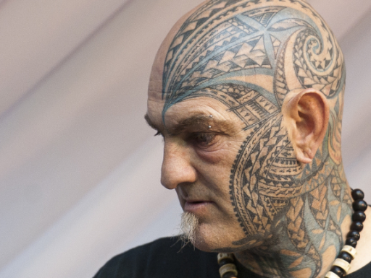
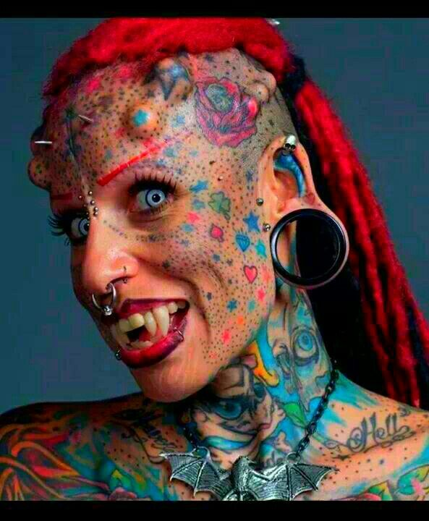
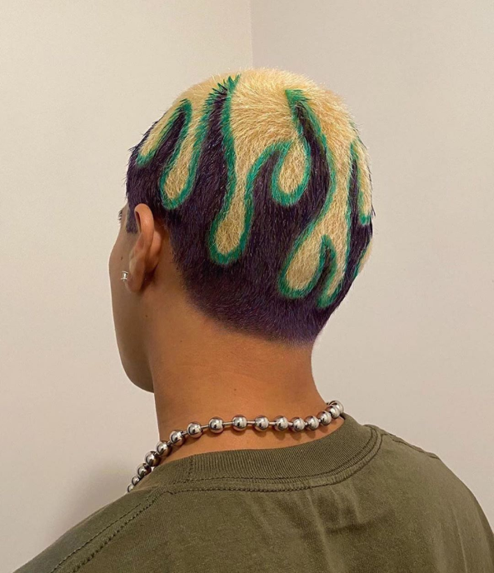
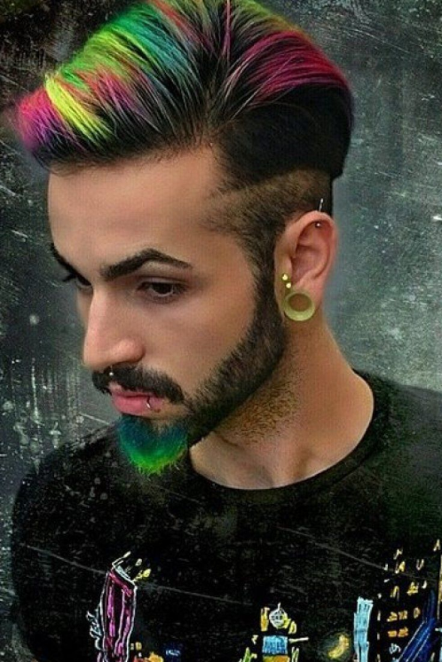
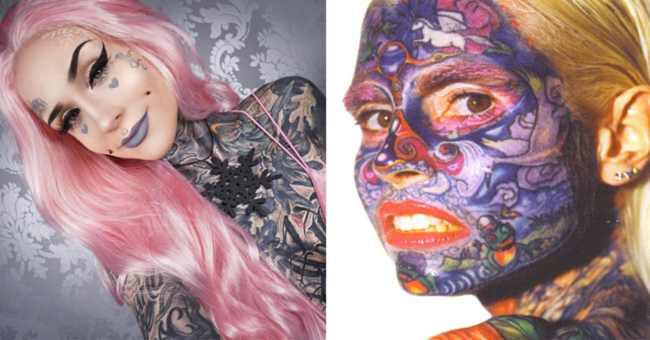
Notes:
Thoughts? They may not work in healthcare, but what is your gut-reaction when you look at these pictures?

Slide 13
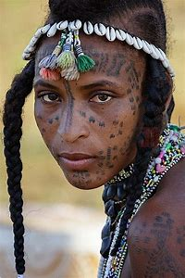
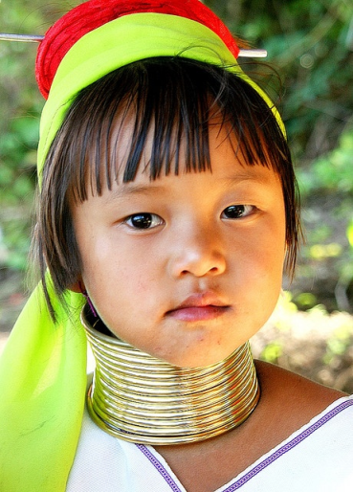
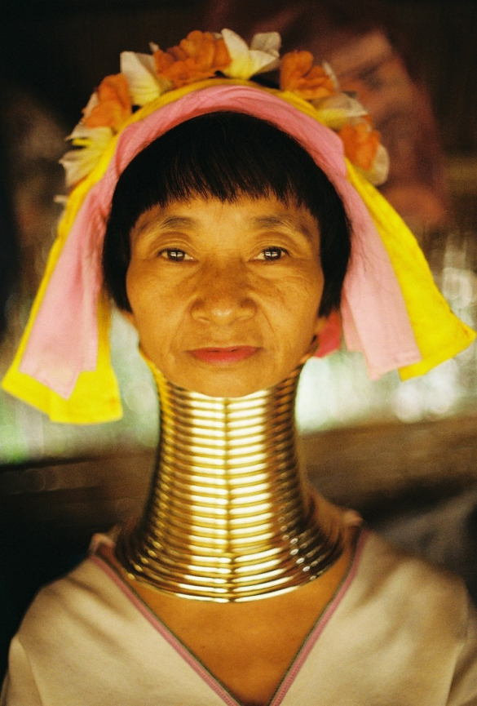
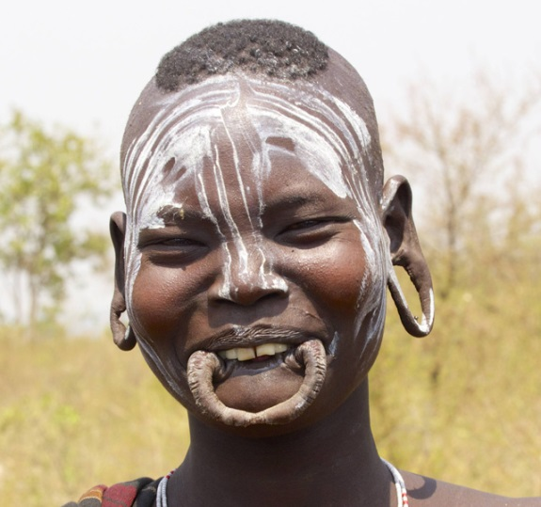
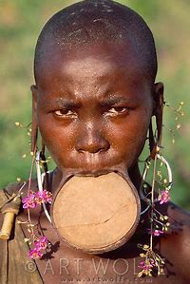
Notes:
Beauty is in the eye of the beholder. What makes one group’s beliefs, customs, or traditions, wrong? Because we do not have the same beliefs or ideas. Just as beauty is defined differently in other cultures, so is health and well-being. How do we come together? And what do we do when we collide? I want to express at this point that I am not promoting unhealthy or harmful healthcare practices like genital mutilation of women. In many societies, it should be addressed that women are perceived as less valuable and therefore, expendable. However, what I am saying is people may have a different perspective of health than you and it is our role to promote understanding.

Slide 14
Good Example of Cultural Divide
The story of a Hmong child with epilepsy and the Western (American) doctors who treated her.
Notes:
A quick synopsis of the book, without divulging too much information, but this is about a Hmong little girl named, Lia Lee, whose family moved from Laos to Northern California. She had a severe form of epilepsy . The healthcare community and the family were in constant conflict in how to care for this child. The family believed that she was spiritually gifted and did not want her to take medications as prescribed by physicians. They instead gave her herbal remedies, which was inconsistent with Western healthcare philosophy. Needless, to say, but this is a classic example of cultural miscommunication.

Slide 15
In Fiction
Notes:
The Poisonwood Bible. A story in which a Southern Baptist father, moves his family to the Belgian Congo as missionaries. House of Sand and Fog. I quote, “A dispute between a former colonel in the Iranian Air Force and an American woman over a foreclosed house illustrates how thinly veiled prejudices can escalate to unimaginable tragedy. Told through three distinct voices, this National Book Award finalist is a shockingly true portrait of the country we live in today.”

Slide 16
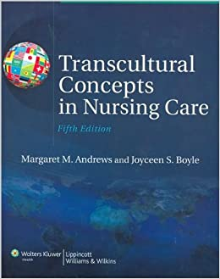
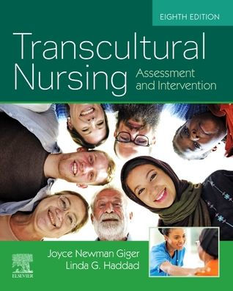
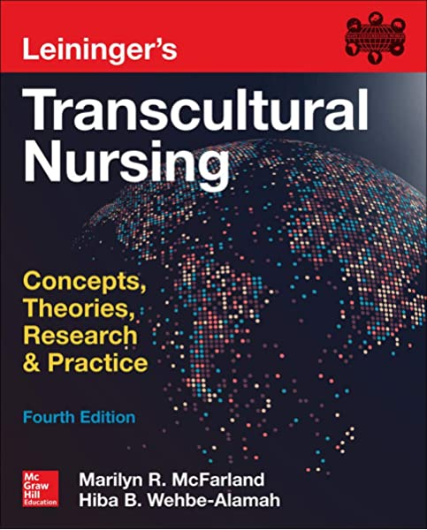
Notes:
At least one semester on transcultural nursing is taught in most nursing school and medical curriculums. But what did we really learn? That in the African-American community, the family tends to be matriarchal? That Asian cultures believe direct eye-contact is rude? Middle-Eastern women prefer a female provider while men prefer a male provider? That certain cultures are more present-time oriented rather than future oriented?

Slide 17
Literature Review
Campinha-Cacote, J. “Cultural Competemility: A Paradigm Shift in Cultural Competence versus Cultural Humility Debate.” The Online Journal of Issues in Nursing, Vol. 24, No.1.
Greene-Moton, E. and Minkler, M. “Cultural Competence or Cultural Humility: Moving Beyond the Debate.” Health Promotion Practice, January 2020, No. 1, p. 142-145.
Isaacson, M. Clarifying Concepts: “Cultural Humility or Competency.” Journal of Professional Nursing. May/June, 2014, Vol. 30, No. 3.
Moore de Peralto, et al. “It’s All About Trust and Respect: Cultural Humility in Mobile Health Clinic Services for Underserved Minor Populations.” Journal of Health Care for the Poor and Underserved, Vol. 30,
No. 3, p. 1103-1118.
Stubbe, D. “Practicing Cultural Competency and Cultural Humility in the Care of Diverse Patients.” Focus, Vol. 18, No. 1, Winter 2020.
Yeager, K. and Bauer-Wu, S. “Cultural Humility: Essential foundation for clinical researchers.” Applied Nursing Research. November, 2013.
Notes:
These are just a few of the references that are available not only in nursing, but throughout healthcare. And these are the resources that I used to prepare this presentation. I would like to point out that the Isaacson did a study, in which nursing students were asked to preform a pre-self-evaluation test on their cultural competency and the majority gave themselves high scores. They then had an immersion exercise in which they went to a Native American Reservation. Prior to going, they were asked to do a journal exercise on how they portrayed the this population. Many of them wrote that they saw the Native Americans, as lazy, alcoholic, and thought they should be grateful that they have “free” housing and healthcare. After their experience, the majority of them reflected that they truly did not know anything about this culture. They found that Native Americans were happy and not hateful or complaining; poor but generous with their wisdom and experiences. One student wrote, that it was intimidating to walk into the room and not be in the majority population. They preferred to stay out of the way, on the outside of the group. This student said, “It must be what minorities feel sometimes in my society.” That was a very powerful conclusion to come to. That is truly becoming self-aware. In the post-test on cultural competency, the students did not rate themselves as high has they had in the pre-test.

Slide 18
So? Let’s Put it Together
Do we strive for competence or humility or both?
How do we know our biases?
How do we become more self-aware?
What tools are available to us?
Notes:
In looking at the literature, some authors have proposed that we strive for a combination which they call, “Competemility,” or a blending of the two. Striving to know the basics or generalities but maintaining a holistic view of the patient/individual.
Learning our implicit biases and coming more self-aware takes practice and self-reflection. Mindfulness is a good tool for us to use as we communicate with our populations. Learning to be in the moment, and reflective-listening are tools we can utilize. Understanding that each person has their own story and though someone may seem put together and capable, inside they may struggling to make it through the next minute.
Are there tools out there that are accessible to providers in healthcare? Certainly!

Slide 19
Tools for your Tool Belt
Ethnic-Sensitive Inventory (ESI; Ho 1991, reproduced with permission)
Multiculturally Competent Service System Assessment Guide
Self-Assessment Checklist for Personnel Providing Services and Supports to Children and Youth With Special Health Needs and Their Families
Agency Cultural Competence Checklist—Revised Form (Dana 1998, reproduced with permission
Notes:
Many different self-assessment and cultural humility tests are available. The key is to remember that we all have bias and the trick is to have that self-awareness so you might be able to address these issues. Just making sure that you can approach the patient as an individual, rather than a group, is a positive step. And the willingness to be open to new ideas is helpful.

Slide 20
Strategies for Approaching Others
It’s okay to be uncomfortable.
It’s okay not to know.
It’s okay to ask.
You cannot achieve cultural-competency but you can strive for learning what it means.
Each individual is an expert, but only about themselves and their life.
This is a life-long process.
Notes:
By “Others” what do I mean? Based on the information I have provided here, Each of us is an other. We are all different, we are all from different backgrounds and we all have the same basic needs. I think, there has to be an understanding that to approach cultural humility is to recognize that there needs to be a redistribution of power, within the healthcare system and this is supported by the literature. In essence, people should be allowed to incorporate their culture and themselves, into their care plan and not to be “told” how they should eat, that they must follow a specific regimen, or that what they are doing is wrong, just because you do not share their experience or their beliefs.

Slide 21
Thank you!

