Slide 1
Guidelines for Healthcare Professionals Working with Individuals with Complex Communication Needs
In Partnership with
Mental Health America, the ALS Association Alabama Chapter
And
The Counseling Clinic

Slide 2
Lisa M. Bruening, M.S., CCC-SLP
The ALS Association Northern Ohio Chapter
Lisa@alsaohio.org
216-867-1262 (Mobile voice and text)

Slide 3
May is…
ALS Awareness Month
Mental Health Awareness Month
Better Speech and Hearing Month

Slide 4
Disclosures
I hold a Speech Pathologist License in the State of Ohio.
I maintain the American Speech Language Hearing Association Certificate of Clinical Competence and have met the supervision criteria.
I am employed at the ALS Association Northern Ohio Chapter.
I am not taking an honorarium from any of the communication devices, products or therapist recommended strategies
I am not being paid or receive an honorarium to present this information to you today.
I am not a certified counselor or mental health therapist.

Slide 5
Objectives and Goals
Describe 3 common demographics of persons with ALS/MND
List 3-4 impacts ALS/MND may have on communication skills
List 3-4 barriers to therapeutic relationship with a person with ALS/MND
Describe 3-4 strategies to support those with complex communication needs
Reminders, Checks and Balances
Patient autonomy and personal goals of care come first in all that we do, even the right to refuse treatment (informed refusal).
Professionals should be mindful of their own relationship to terminal illness / end of life.
Be aware that providing assistance to those with complex communication needs and serious illnesses can be exhausting- and rewarding, be sure to set boundaries

Slide 6
Acknowledgements
Many of the ideas in this presentation are based on nearly 20 years of working solely with those diagnosed with ALS and the countless number of colleagues, mentors, physician and nurses I have met along the way. I have made an attempt to acknowledge those within the field who have been helpful to me and to others where possible.
  Special thanks to: Alisa Brownlee, John Costello, Lisa Bardach, Amy Roman, Barbara Bennett Shadden, Katie Strong, Robin Pollens and so many more! Especially those wo are working to provide access to mental health services to those with communication impairments.
Many of the strategies and resources shared within this presentation are common within the field of speech and language pathology, but may feel foreign or cumbersome to those who do not regularly work with these materials. I encourage you to try them out, adapt them to your specific situation and client and listen to the people and families with whom you work- they will give you guidance. Hopefully, you will begin to feel more comfortable and see ways to adapt the materials and strategies to those you meet along the way.

Slide 7
“ Communication is the essence of human life.”
“That was probably the biggest hurt. She couldn't talk.”

Slide 8
Mini-review: What is ALS?
Amyotrophic lateral sclerosis is …
  Progressive neuromuscular disease (MND).
  Affects the motor neurons in voluntary muscle fibers.
  Results in poor muscular control, progressive weakness and ultimately paralysis
  Affects all voluntary muscle movement, including speech, swallowing and breathing.
  Only 2 medications are known to slow the progression, with minimal longevity.
  Average lifespan is 3-5 years after diagnosis without assisted breathing devices.
  There is no test for ALS but process of elimination of other possible conditions.
  Many people are significantly impaired when diagnosis is finally conferred.
There is no known cause, however some environmental factors and genetic causes are thought to be contributing risk factors.
More men than women are diagnosed with a mean age of mid 50’s, although there have been cases of ALS across the lifespan.
Only 25-30,000 Americans living with ALS in the US.

Slide 9
Baseline: Speech Changes and Terminology
Dysarthria: medical diagnosis of motor-speech disorder is characterized by slurred speech production cased by weakness and/or poor coordination of the muscles involved in speaking including the lips, tongue, jaw as well as the vocal and respiratory tracts.
Types of Dysarthria:
  Spastic Dysarthria indicated a strained and strangled (tight) vocal quality
  Flaccid Dysarthria indicated by weak, imprecise speech production, breathy vocal quality, and low volume
  Mixed Dysarthria: combination of both spastic and flaccid features listed above
Anarthria: medical diagnosis. Complete loss of speech
Locked-in and Total Locked In syndrome

Slide 10
Often disagreement in the research
There is often disagreement in the research about the full symptoms associated with a diagnosis of ALS, and surely, the diagnosis represents a large continuum.
The previous statements of “muscle movement only” has been a disservice to those living with ALS and their loved ones.
Caregivers often take the brunt of personality changes, cognitive, behavioral changes while professionals reinforce “motor only”
New literature is examining these issues under a new microscope
Resource:
Front. Neurol., 11 March 2019 | https://doi.org/10.3389/fneur.2019.00192
The Impact of Cognitive and Behavioral Symptoms on ALS Patients and Their Caregivers

Slide 11
Affect on Relationships and Caregivers
70% of people with ALS were noted to demonstrate increased self-centeredness and reduced interest for the feelings of others
  (Fisher F, Philpott A, Andrews SC, Maule R, Douglas J. Characterizing social communication changes in amyotrophic lateral sclerosis. Int J Lang Commun Disord. (2017) 52:137–42. doi: 10.1111/1460-6984.12267)

Slide 12
Barriers to Communication
Pseudobulbar affect (emotional lability),
Anarthria (speech loss),
Dysarthria (speech impairment),
Frontal Temporal- Lobe Dementia FTD (Cognitive-behavioral impairment), and
Paralysis
Other Barriers:
  Language deficits
  Executive Functioning Deficits (specifically shifting and working memory, also deficits in naming and verbal fluency, more notable in bulbar onset compared to limb onset)
  Social Cognition Deficits: the abilities to perceive, identify and understand, interpret or attribute social situations and other's cognitive and emotional states and to choose on that basis an appropriate reaction as well as poor ability to engage in perspective taking

Slide 13
Psychosocial Changes
Speech changes
Facial expression changes
Breathing changes
Swallowing Changes
Cognitive Changes
Behavioral and Emotional Changes
Family Role Changes
Identity Changes
Alertness and Readiness Changes (fatigue)
Control and Independence Changes
EVERYTHING changes

Slide 15
Useful Strategies to Improve Communication
Slow down rate of speech
Use full breath and speak only 3-4 words per breath (or less)
Use short sentences and make sure your listener follows along
Exaggerate mouth movements
Use a letter board to point to the first letter of a word (helps with pacing/slowing AND understanding)
Plan your day and energy levels, may not be able to communicate well the day AFTER a full clinic visit or family event
If your speech is clear but difficult to project, ask your SLP about hands-free voice amplification systems.
Listeners should confirm message either at each word level or phrase/sentence level.

Slide 16
HiTech, Notech, Rapid Access
YES!
ALL forms of communication!

Slide 17
Benefits of AAC
The reported findings make clear that enabling complex communication independent of a “translation” by caregivers/next-of-kin and thus patient autonomy is crucial for the preservation of psychological wellbeing of severely disabled patients.
Ozanne AO, Graneheim UH, Strang S. Finding meaning despite anxiety over life and death in amyotrophic lateral sclerosis patients. J Clin Nurs. (2013) 22:2141–9. doi: 10.1111/jocn.12071

Slide 19
Specific Suggestions and Strategies
Notes for the professional
Learn about the client’s desired communication “system”
BE HONEST when you do not understand the message!
Discuss appropriateness of including a communication helper who is familiar with client’s communication “system” (at least in the early sessions) until you feel more comfortable
Consult with a local speech language pathologist for recommendations or team intervention.
Remind yourself to slow down and allow the client time to think and to compose a response or spoken thought
Think about where you will sit as you will need to see both the client’s facial expressions AND the communication screen if using hi tech
Traditional thoughts of “resistant to therapy” or “poor compliance” may not fit the person living with ALS

Slide 20
Suggestions and Strategies (continued)
Notes for the professional
Give clear signals when changing topics of conversation
Be mindful of changes in muscle strength and muscle control can impair facial muscles and ability to modulate the volume and manner spoken words are produced. (i.e. flaccid face doesn’t mean disinterest or aloof)
DON’T GUESS or COMPLETE A MESSAGE without asking permission from the client if this is acceptable
Stay in the interaction while the client is composing the message
Likewise, when the device is speaking, make eye contact with the client who will be watching your facial expressions for reaction
Technology is unreliable; be prepared with a back up method

Slide 21
Suggestions and Strategies (continued)
Notes for the professional
Reasoning blocks… is it stubbornness, rigid thinking, inflexibility, or something more??
Pseudobulbar Affect or “normal” grief and emotion??
Consider developing specific communication boards and templates for common therapeutic strategies (reach out to a local AAC center or University program- students would welcome opportunities for real life experience)

Slide 22
Specific Guidelines
Preparing for meetings…
Dealing with breaks and delays in the conversation…
Dealing with limited message set (such as with picture or word boards)…
Be mindful of closed vs open question sets.
Be mindful of client’s cognition, language including comprehension, retention and recall. (Not always reliably noted in medical history)
Seeking additional information…
Managing privacy and confidentiality…
Ensuring client directed counselling (see Serious Illness Conversation Guide)
Ensuring accuracy and congruency…
Attending to client comfort…
Moving beyond the concrete and the “safe”..
AGAIN, managing ones own values and beliefs

Slide 23
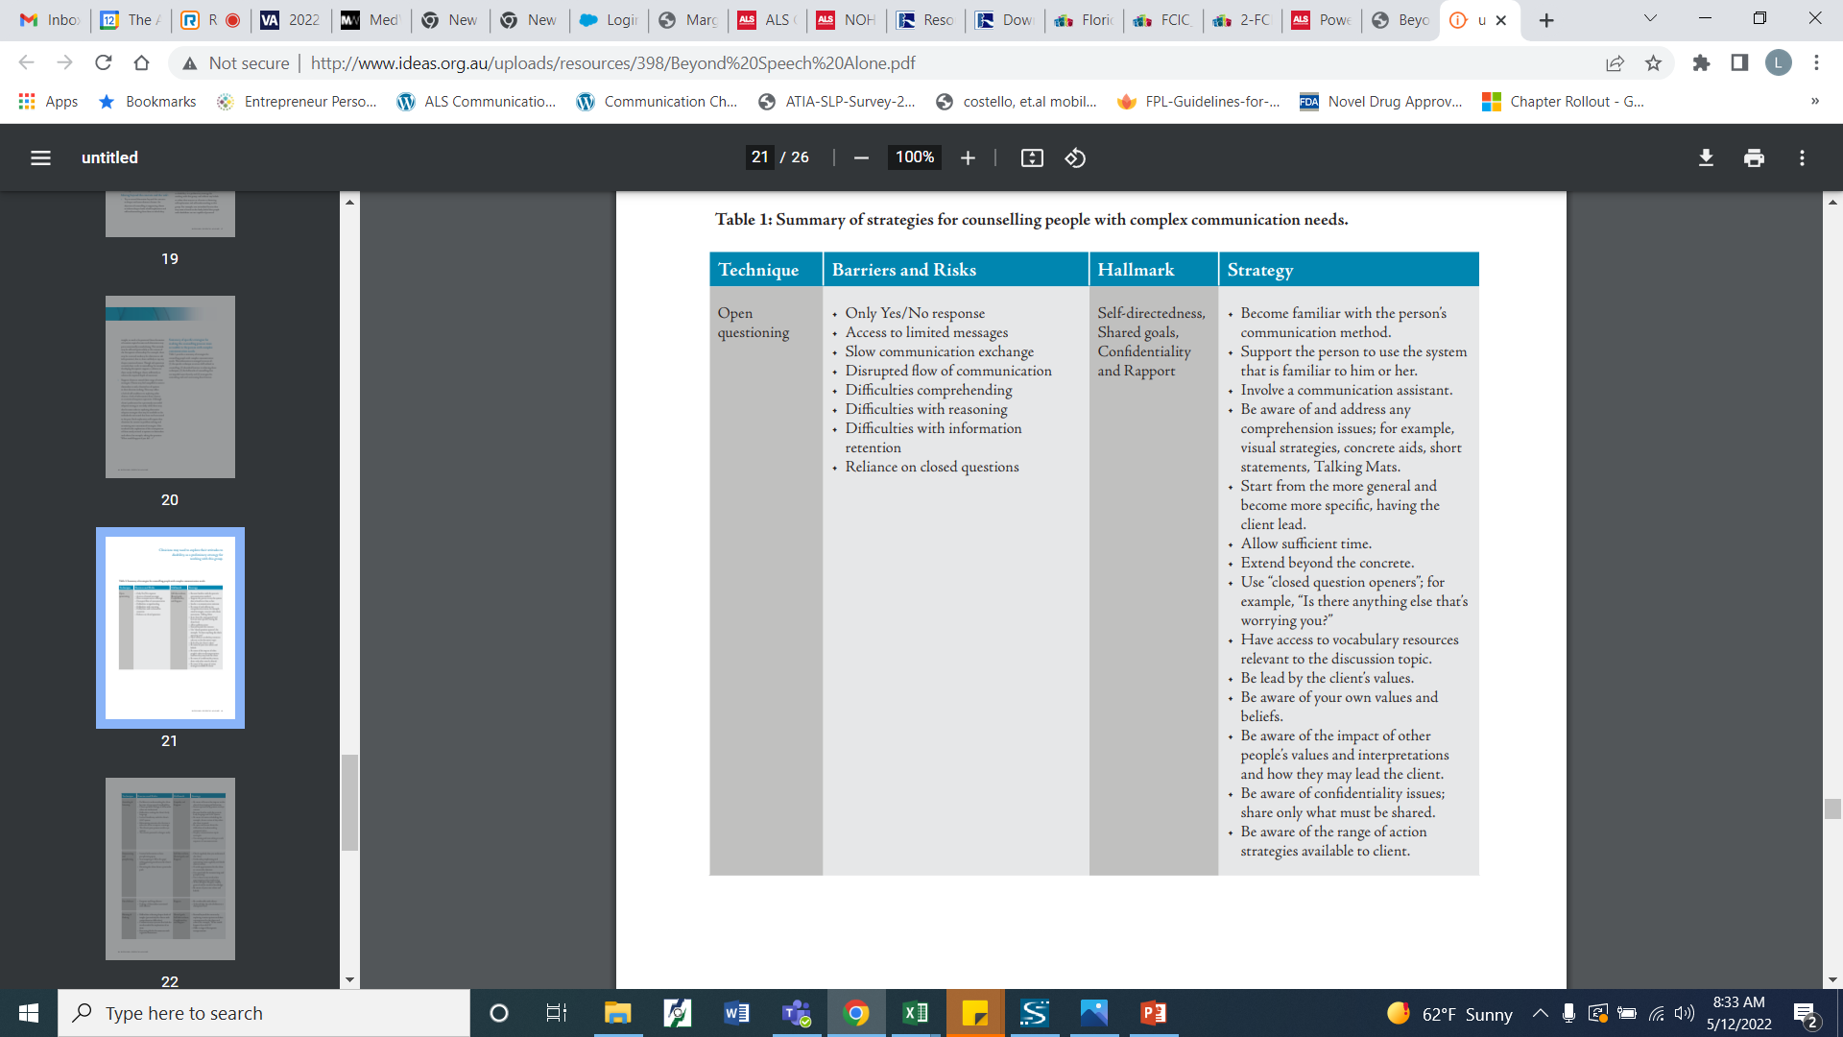
Beyond Speech Alone

Slide 24
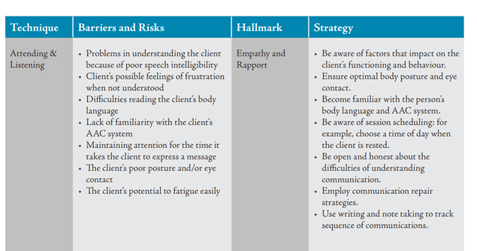
https://www.myalliedhealthspace.org/resources/beyond-speech-alone-guidelines-for-practitioners-providing-counselling-services-to-clients-with-disabilities-and-complex-communication-needs

Slide 25
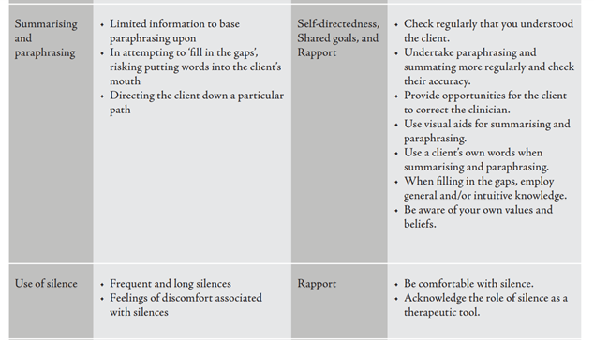

Slide 26
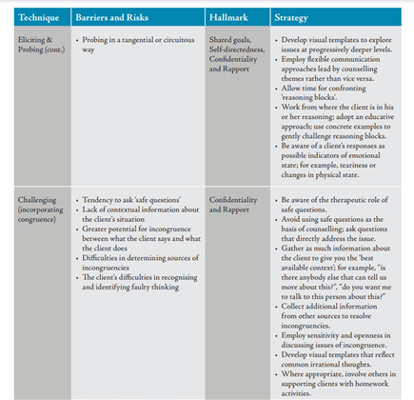

Slide 27
Types of Activities
Healthcare “report card” or “passport” modified for mental health
  https://flfcic.cbcs.usf.edu/docs/2-FCIC_My_Health_Report_Fillable-updated.pdf
  https://flfcic.cbcs.usf.edu/docs/FCIC_Health_Passport_Form_Typeable_English.pdf
Journaling
Workshop- assigning evaluation or therapy tasks ahead of time to allow the person to take needed time to use communication strategies to formulate response
Framework: Serious Illness Conversation Guide
“Fillable Forms” using Google Forms so persons with adapted access and SGD can complete (thought record, worry tree, worksheets)

Slide 28
Communication Boards
The ALS Association, Resources may vary by state
  Iowa: http://webia.alsa.org/site/DocServer/Low_Tech_AAC_Kit_Manual.pdf
AmyandPALS: many resources including how ALS affects speech and downloadable/printable communication resources. https://amyandpals.com/
A Talking Mat is a visual communication framework which supports people with communication difficulties to express their feelings and views. Talking Mats can be carried out in person using a physical mat and cards, or in a digital space https://www.talkingmats.com/
Innovative Speech: curated online list of links to communication boards that can be downloaded https://innovativespeech.com/comms-boards-download/
Eat Speak Think: curated online list of links to communication boards and resources https://eatspeakthink.com/free-low-tech-aac-for-adults/
Speakbook; Patrick’s Legacy download link
  https://acecentre.org.uk/projects/speakbook

Slide 29
References and Resource Links
https://amyandpals.com
  Amy Roman,M.S., CCC-SLP, is the Augmentative Communication Specialist at The Forbes Norris ALS Research and Treatment Center in San Francisco, California.
https://arc.phhp.ufl.edu/wordpress/files/2017/06/Living-with-ALS-_-Speech.pdf
  Alisa Brownlee, ATP, CAPS and Lisa M. Bruening, MS, CCC-SLP, The ALS Association Living with ALS Resource Guide #9
Beyond Speech Alone: Nick Hagiliassis, Mark DiMarco, Hrepsime Gulbenkoglu, Teresa Iacono, Joanne Watson
  A resource for practitioners providing counselling services to clients with disabilities and complex communication needs.

Slide 30
Videos
Simple communication options
  https://www.youtube.com/watch?v=O5mNNZEG_eU
Laser Pointer with simple communication boards
  https://youtu.be/Gyo03Kt5I54
Partner assisted scanning with a letterboard
  https://youtu.be/pLb6-Oi3uR0
  https://youtu.be/Y2UiP1DAej4
AE EYE OU low tech eye movement board
  https://youtu.be/T5eWUUKrfUg
Speak Book simple eye gaze speech book
  https://vimeo.com/25812980?utm_campaign=2470763&utm_source=affiliate&utm_channel=affiliate&cjevent=78efffaad1f111ec80f6050d0a82b820&clickid=78efffaad1f111ec80f6050d0a82b820

Slide 31
Articles
Bentley, B., & O'Connor, M. (2017). Counselling people with amyotrophic lateral sclerosis. Age, 30(49), 50-59.
Genuis, S. K., Luth, W., Campbell, S., Bubela, T., & Johnston, W. S. (2021). Communication About End of Life for Patients Living With Amyotrophic Lateral Sclerosis: A Scoping Review of the Empirical Evidence. Frontiers in neurology, 12, 683197. https://doi.org/10.3389/fneur.2021.683197
Linse, K, Aust, E., Joos, M, Hermann, A. (2018). Communication Matters—Pitfalls and Promise of Hightech Communication Devices in Palliative Care of Severely Physically Disabled Patients With Amyotrophic Lateral Sclerosis. Front. Neurol., 27 July 2018 https://doi.org/10.3389/fneur.2018.00603
Light J. “Communication is the essence of human life”: reflections on communicative competence. Augment Altern Commun. (1997) 13:61–70. doi: 10.1080/07434619712331277848

Slide 32
McKelvey M, Evans DL, Kawai N, Beukelman D. Communication styles of persons with ALS as recounted by surviving partners. Augment Altern Commun. (2012) 28:232–42. doi: 10.3109/07434618.2012.737023
Pérez AIG, Dapueto JJ. Case report of a computer-assisted psychotherapy of a patient with ALS. Int J Psychiatry Med. (2014) 48:229–33. doi: 10.2190/PM.48.3.g
Neudert C, Wasner M, Borasio GD. Individual quality of life is not correlated with health-related quality of life or physical function in patients with amyotrophic lateral sclerosis. J Palliat Med. (2004) 7:551–7. doi: 10.1089/jpm.2004.7.551
Keller J, Gorges M, Horn HT, Aho-Ozhan HE, Pinkhardt EH, Uttner I, et al. Eye-tracking controlled cognitive function tests in patients with amyotrophic lateral sclerosis: a controlled proof-of-principle study. J Neurol. (2015) 262:1918–26. doi: 10.1007/s00415-015-7795-3
Poletti B, Carelli L, Solca F, Lafronza A, Pedroli E, Faini A, et al. An eye-tracker controlled cognitive battery: overcoming verbal-motor limitations in ALS. J Neurol. (2017) 264:1136–45. doi: 10.1007/s00415-017-8506-z

Slide 33
Murphy J. “I prefer contact this close”: perceptions of AAC by people with motor neurone disease and their communication partners. Augment Altern Commun. (2009) 20:259–71. doi: 10.1080/07434610400005663
Serious Illness Conversation Guide: http://www.instituteforhumancaring.org/documents/Providers/Serious-Illness-Guide-old.pdf
  https://library.nshealth.ca/SeriousIllness/GOC

Slide 34
THANK YOU
Lisa M. Bruening, M.S., CCC-SLP
Lisa@alsaohio.org
216-867-1262

