Slide 1
Help FOR THE HELPER: Tools for transforming trauma
Dr. Moniaree Jones, Ed.D., MSN, RN, COI
Associate Professor
Samford University
Moffett & Sanders School of Nursing
College of Health Sciences

Slide 2
Course Objectives
Define Post Traumatic Stress Disorder and Discuss its implications for the healthcare worker, family, and community.
List categories of PTSD symptoms and their diagnostic criteria.
Explain Criteria for Assessment and diagnosis of PTSD.
Discuss treatment modalities for PTSD.

Slide 4
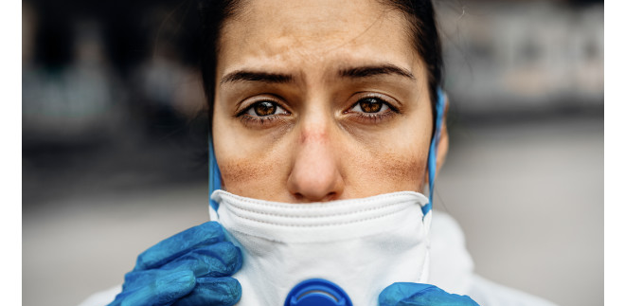

Slide 5
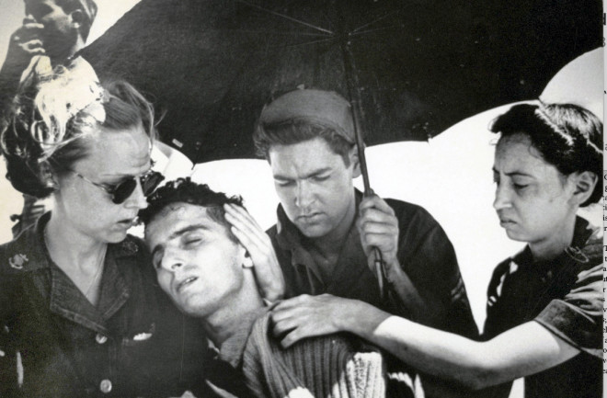
The Ignored History of Nurse PTSD
The Ignored History of Nurse PTSD
Military nurses in WWII experienced PTSD that was left untreated — and often denied altogether — driving many from the profession. Can we do better for today’s nurses and healthcare providers?
Military nurses in WWII experienced PTSD that was left untreated — and often denied altogether — driving many from the profession. Can we do better for today’s nurses?

Slide 6
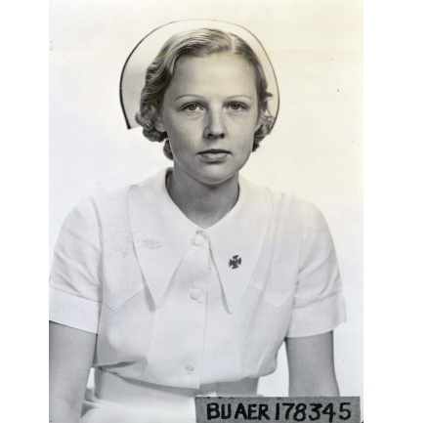
In February 1945, U.S. Navy nurse Dorothy Still was a prisoner of war in the Japanese-occupied Philippines. Along with 11 other Navy nurses, Nurse Still provided care for civilian inmates in a prison camp where food was scarce, and guards were brutal. Few inmates weighed more than 100 pounds, and most were dying from malnutrition.
On the night of Feb. 22, Nurse Still and the other inmates watched as their captors set up guns around the perimeter of the camp and turned the barrels inward. Other guards dug shallow graves. The inmates had long suspected the camp commander planned to massacre them all, and it seemed the rumors were coming true. Yet Nurse Still and another Navy nurse reported to the infirmary for the night shift. They had little medicine or food to offer their patients; comfort and kindness were all they had left to give.

Slide 7
The Navy nurses weren’t the only medical care providers taken prisoner during WWII. Sixty-six U.S. Army nurses as well as hundreds of physicians, pharmacists, and medical assistants were also held captive in the South Pacific. But at the end of the war, as the U.S. prepared to welcome home millions of men and women who served their country, mental health treatment was limited — and reserved for men. Nurses, it was assumed, did not suffer.
At the time, the U.S. military was the largest employer of nurses, and it had established an expected code of silence regarding how nurses responded to their own trauma. In 1947, an article in the American Journal of Psychiatry claimed a military hospital was a controlled environment that insulated nurses from the brutality of war. The study’s author claimed that nurses’ mental health needs were “less complex,” and that nursing fulfilled women by catering to their natural instinct to care for men: “They were supplying a service which gratified the passive needs of men. And which identified these women with the mother, the wife, or the sweetheart back home.”
Many nurses, including Nurse Still, responded to the lack of mental health treatment by leaving both the military and nursing. The late 1940s saw a shortage in nurses at time when hospital admissions rose by 26 percent. The shortage persisted until the late 1960s when wages began to increase. Many nurses, including Nurse Still, responded to the lack of mental health treatment by leaving both the military and nursing. The late 1940s saw a shortage in nurses at time when hospital admissions rose by 26 percent. The shortage persisted until the late 1960s when wages began to increase.

Slide 8
Nursing
The Applause has faded
The word “HERO” is no long used in commercials flooding the tv media
The thank you dinners and notes aren’t flooding the hospitals
COVID vaccine numbers are slowing, and cases are starting to rise. Americans are starting to remember what the world looked like before the pandemic
Nursing fighting on the front lines have been battling COVID 19 for over a year, but there is no end yet
Nurses have been holding the hands of others loved ones in a 60+ hour week, communicating via i-pads with families separated from their spouses, children, and family for weeks on end. All of this with no place to unwind and no breaks.
Help is being brought in by travel nurses who get bonuses and extra benefits while those at home get nothing
There is a shortage of nurses and there is no relief pool. There is no end in sight.
This is what only NURSES understand because unless you are a nurse you have no clue
There is an UNSPOKEN truth about Nurses, PTSD and the Pandemic.

Slide 9
What is PTSD (Post Traumatic Shock Disorder?
A psychiatric disorder that may occur in people who have experienced or witnessed a traumatic event such as a natural disaster, a serious accident, a terrorist act, war/combat, or rape or who have been threatened with death, sexual violence or serious injury.

Slide 10
Symptoms of PTSD
Re-experiencing type symptoms -such as recurring, involuntary and intrusive distressing memories, which can include flashbacks of the trauma, bad dreams and intrusive thoughts
Avoidance- Can include staying away from certain places or objects that are reminders of the traumatic event that can activate overwhelming symptoms
Cognitive and Mood Symptoms- Can include recall trouble, negative thoughts about one’s self. Out of body experiences and feeling the world is “not real” (derealization)
Arousal Symptoms- Hypervigilance such as intensely startled by stimuli that resembles the trauma, trouble sleeping, or outburst of anger.

Slide 11
Diagnosis
Symptoms of PTSD usually begin within 3 months after experiencing or exposure to a traumatic event. Occasionally symptoms may emerge years afterward. For a diagnosis of PTSD, symptoms must last more than 1 month. Symptoms of depression, anxiety or substance use that often accompanies the PTSD.

Slide 12
Trauma is a part of the Healthcare giver world
Nurses and others in healthcare bear witness to trauma often and the ability to stay resilient is a point of pride.
PTSD can look like burnout however it is not the same. PTSD is a diagnosable mental health disorder, and it requires a specific set of resources and treatment.
In the line of healthcare work, we see a lot. Our ability to stay resilient is not exactly a choice and we don’t often process what we have experienced because there is always another patient waiting. In the moment we are serving our patients, but when shift is over, there are real and serious consequences for our physical and mental health.

Slide 13
Today’s Mental Health World
What I know about the “Lived Experience”
My World- Academia/students/Anxiety/changes in student choices/stigma
According to the Journal of Psychiatric and Mental Health Nursing Review, nurses report experiencing contempt, ostracization, and even termination as a result of sharing their mental health experiences.
https://www.ncbi.nlm.nih.gov/pmc/articles/PMC7175897/
https://onlinelibrary.wiley.com/doi/abs/10.1046/j.1365-2850.2000.00258.x

Slide 14
I survived a traumatic event!

Slide 15
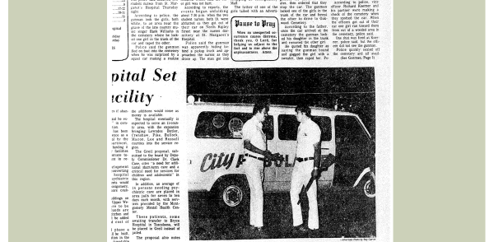

Slide 16
Burn-out vs. PTSD
Trauma and post-traumatic stress disorder are not as well understood as burnout, and they are also more stigmatized. PTSD has more lasting health consequences being extremely distressing and highly disruptive to quality of life both in and out of scrubs or a business suit.
BURNOUT- Emotional exhaustion due to chronic overwork
PTSD- Not really studied until the 1970’s and even now is a misconception experienced exclusively by those in the military. When in fact it could be a car accident, school shooting, act of violence, loss of life, body trauma, or other trauma.

Slide 17
PTSD
ED and ICU Nurses for example, bear witness to and experience trauma on a daily basis. They see trauma walk right through the front door and now the pandemic gives way to intubating patients who are swollen, lying prone for hours with no PPE or ventilators in stock. They are holding up personal phones and tablets so patients’ loved ones can say goodbye from a distance.
More than 140,000 Americans have died and almost 1000 of them have been healthcare workers.
A meta-analysis has shown that treating traumatized patients leads to PTSD symptoms in about 14.8% of physicians and the male physicians were more likely to exhibit symptoms than females (47.3% vs 20.4%.) (The European Journal of Psychiatry 2016(30:4)., Sandler, Rutkowska & Makara-Studzinska.

Slide 18
According to the national Alliance on Mental Health:
3.6 % of the adult population in the U.S. have been affected by PTSD (About 9 million people) and of those 30% have severe symptoms.
Research indicates that experiencing trauma can significantly alter the brain. While this condition is not preventable it is treatable. The first step is RECOGNITION.
Symptoms typically start 1-3 months after the traumatic event however, in some cases it will take years before symptoms begin to surface. Other disorders such as anxiety, depression, OCD, and personality disorder can also appear along side PTSD.
Https://www.nami.org/learn-more/mental-health-conditions/posttraumatic-stress-disorder

Slide 19
Symptoms
Hypervigilance:
The body is on survival mode. This is displayed by anxious and jumpy manifestations and feeling on edge and defensive. There is hyperarousal.
This is believed to be caused by chronic increase of dopaminergic and noradrenergic levels in the body. This condition puts a person on high alert even though there is no present danger. The trauma becomes deeply embedded into the brain and the hormone imbalance causes the body to act in defensive mode displaying problems such as:
Difficulty sleeping
Grouchy feelings
Depression
Detached and numb
No interest in activities (anhedonia)
Aggressive or violent acts
Trouble with affection
Problems in school
Trouble focusing
Being easily startled
Difficulty concentrating
Sense of guilt or shame
Self-destructive behaviors.

Slide 20
AVOIDANCE
PTSD individuals will go to extremes just so they will not be reminded of the terrifying experience. These include:
Staying away from places and objects that can be a reminder of the trauma
Not wanting to be around people who are reminders of the trauma
Avoiding thoughts and feelings about the traumatic incident
They need to avoid these reminders to alleviate unpleasant emotions and distressing anxiety that comes with it.
In some case the individual may completely disassociate from the traumatic event completely blocking it from their memories. They may prefer to stay home and not face the outside world.

Slide 21
Undiagnosed PTSD
The individual may feel anxious and depressed but not understand why they are feeling down. The anxiety and fear does not go away without proper treatment or care.
The trauma is real and heavy. Something deeper is going on. Is it exhaustion that will pass in a few days? Is it hypervigilance that follows you out of the unit, into your car, and all the way home.
Getting help is easier said than done due to the mental health stigma that is commonplace in the healthcare settings. There is a “don’t ask, don’t tell” attitude.
According to the Journal of Psychiatric and Mental Health Nursing Review, nurses report experiencing contempt, ostracization, and even termination as a result of sharing their mental health experiences. This needs to CHANGE!

Slide 22
Throughout the pandemic, nurses and other essential workers have been described as “heroes”. The Clap for Our Carers movement from the UK’s first lockdown, designed to help the public give public thanks to frontline pandemic workers, has been brought back for 2021 under the new title, Clap for Heroes.
But nurses are not heroes. They are technically expert professional carers with unique skills. Clapping is a poor substitute for allowing them the freedom to speak up about the concerns they may have about their own health and wellbeing and those they care for
https://theconversation.com/nurses-report-ptsd-symptoms-due-to-the-pandemic-heres-why-152935
Nursing Toolkit
https://www.nursingworld.org/~48e191/globalassets/foundation/the_ptsd_toolkit_for_nurses__assessment.99783.pdf

Slide 23
How is PTSD Treated?
The First Step is to Seek Help of a Professional.
Symptoms from the four core should be present for at least one month: (1) Intrusive thoughts (2) Avoidance (3) Alterations in cognition and mood) (4) Alterations in arousal and reactivity.
Specific treatment and treatment time can vary from person to person. Some may be able to successfully recover in just a few months of therapy, while others may need years and years to get better.
The therapist’s approach will depend on different factors including: the severity of the case, the age of the patient and the specific symptoms Therapy goals are to improve symptoms, teach healthy coping skills and to retore the patient’s self esteem.

Slide 24
Types of Therapy
Cognitive Behavioral Therapy- typically lasting 3-8 months that focuses on changing negative patterns of thinking with practical and goal-oriented approaches.
Prolonged Exposure- Addresses the avoidance problem in PTSD. While it may seem easier to avoid it is very unhealthy to avoid stressors because this does not help in building healthy coping strategies. Exposure focuses on desensitizing the person to the trauma. Methods may include writing, imagining, or visiting the place where the trauma happened. Gradual exposure is guided by a trained therapist over time.
Medications-The brain of the person works differently than someone who does not have trauma. Neurotransmitters may be impaired causing an unbalance of chemicals into their system. Hormones can also be irregular. Some common medications are:
Zoloft (Sertraline)
Prozac (Fluxetine)
Effexor (Venlafaxine)
Paxil (Paroxetine)

Slide 25
PTSD/REferences
It is not advisable to self-medicate and self-diagnose when dealing with this kind of problem. There are a lot of emotional, hormonal, and neurological factors at play. It is best left to the hands of a skilled professional.
Keep in mind that not everyone who experiences trauma develops PTSD. Some can naturally get over traumatic events by themselves, while others need years of therapy and medications to heal wounds.
https://theconversation.com/nurses-report-ptsd-symptoms-due-to-the-pandemic-heres-why-152935
https://www.nursingworld.org/~48e191/globalassets/foundation/the_ptsd_toolkit_for_nurses__assessment.99783.pdf
Https://www.nami.org/learn-more/mental-health-conditions/posttraumatic-stress-disorder
https://www.ncbi.nlm.nih.gov/pmc/articles/PMC7175897/
https://onlinelibrary.wiley.com/doi/abs/10.1046/j.1365-2850.2000.00258.x

