Slide 1
SUCCESSFUL LIVING CENTER “BRINGING GENERATIONS TOGETHER”
Alzheimer’s Adult Day Care Center
1902 Bullard St.
Montgomery, AL 36106
334-264-1790

Slide 2
WHAT IS INTERGENERATIONAL PROGRAMMING?
Intergenerational programs refer to social service programs that provide opportunities for different generations to come together to share experiences, knowledge, and skills that are mutually beneficial and foster positive long-term relationships.

Slide 3
Intergenerational Programming
Intergenerational programs:
intentionally unite the generations in ways that enrich participants’ lives
build on the positive resources that young and old have to offer each other and to their communities.
bring people of different generations together for ongoing, mutually beneficial, planned activities,
promote greater understanding and respect between generations
promote healthier lifestyle behaviors for both generations simultaneously, lowering health risks
greater sense of belonging and connectedness with others of different ages.

Slide 4
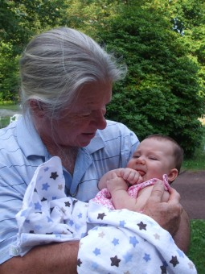
Benefits of Intergenerational Program Babies to Preschool
Children as young as 9 weeks to 13 months old demonstrate higher levels of interaction and cooperative play with an older adult when compared to children not involved in intergenerational program
Children in pre-school who are partnered with older volunteers show better socioemotional outcomes such as increased tolerance of others, increased empathy, less judgment, and greater social. Studies also document improved vocabulary and language ability (Heydon, 2017; Detmer et al., 2020; Femia et al., 2008).

Slide 5
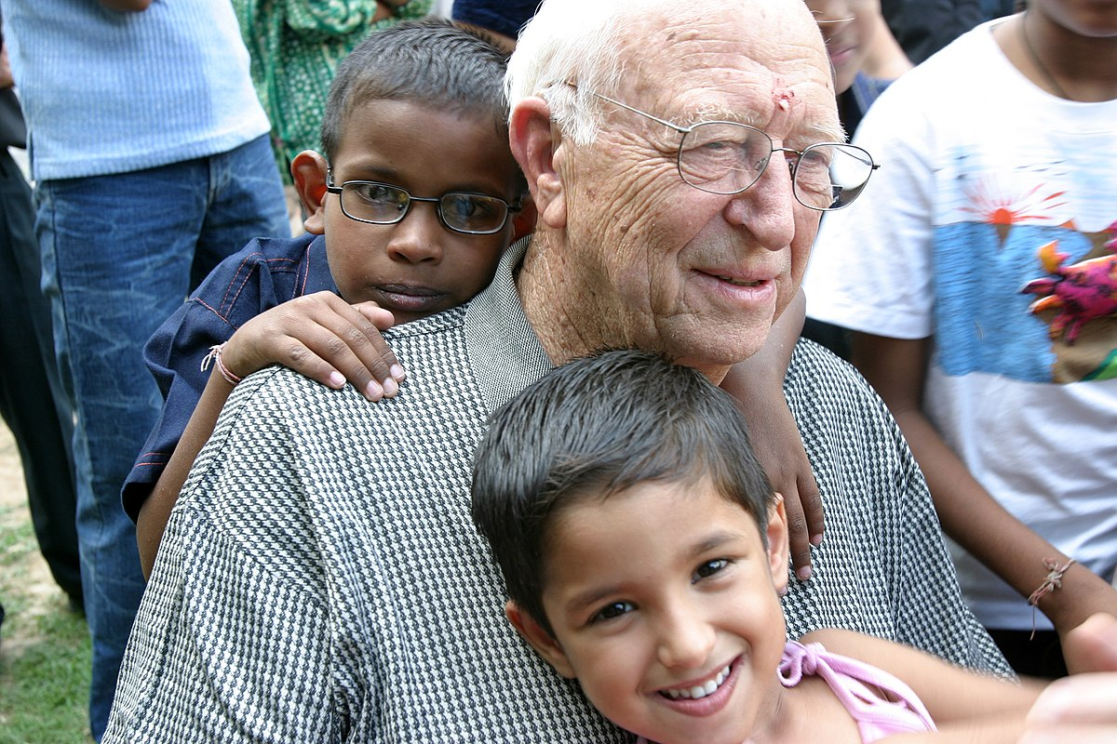
Benefits of Intergenerational Program Elementary
Students who are partnered with an older volunteer show enhanced learning, reading comprehension and improvement in writing abilities
Evidence also reveals improvements in task orientation, short-term memory , problem solving skills and accountability, as well as patience, sensitivity, compassion, respect, and empathy
Their mental health is also impacted with reduced anxiety and sadness, reduced stress, and improved mood changes.
When the program has a physical component, children have better awareness of healthier diets and nutrition, are more physically active, engage less with “screen time” (smart phones, gadgets, and TV) and show improvements with overall well-being.

Slide 6
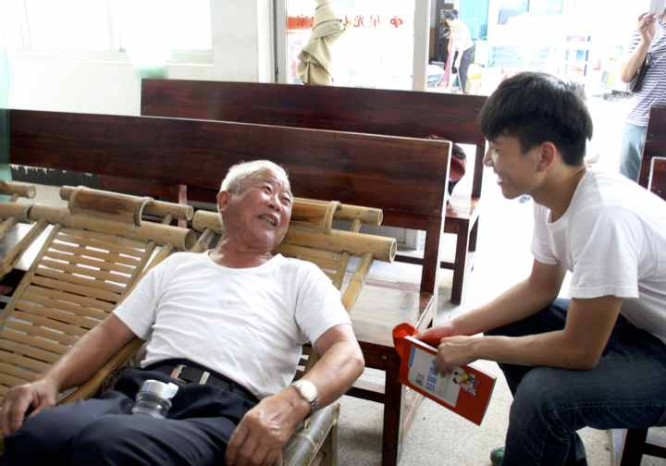
Benefits of Intergenerational Program Middle School
Students in middle school undergo rapid physical, socio-emotional, and moral development. When middle schoolers are partnered with an older adult, they show improvements in academic performance, family dynamics, improved peer relationships , decreased depressive symptoms, reduction in substance use and healthier eating habits.
Children supported by a non-family caring older adult also gain relationship skills, such as reasoning, problem solving, accountability, conflict resolution, and decreased bullying and victimization.
They also express clearer educational aspirations, occupational interests and goals.

Slide 7
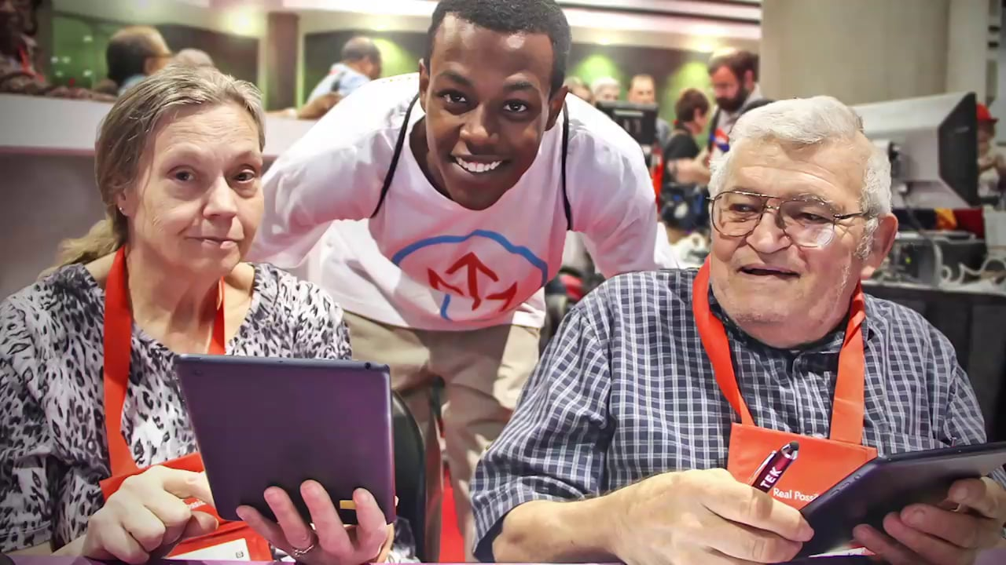
Benefits of Intergenerational Program Highschool
Teenagers experience improved sense of self and identity , self-confidence
They are more likely to feel empowered to make changes in their schools and neighborhoods.
Because of the socio-emotional exchange with an older adult, teenagers experience improvements with their emotions and mental health as well as their physical health.
This Photo by Unknown Author is licensed under CC BY-SA

Slide 8
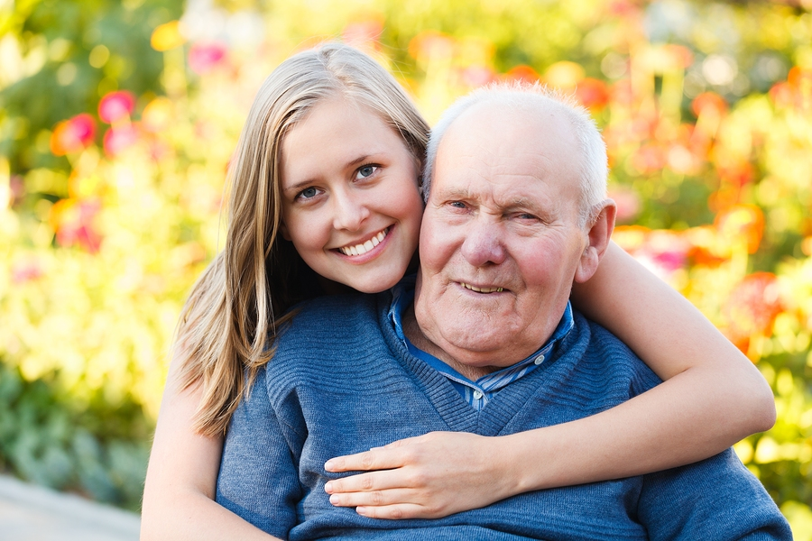
Benefits of Intergenerational Program Young Adult/College
The transition from adolescence to adulthood is a time when individuals focus on themselves to develop knowledge, skills, and self-understanding. They find where they belong in the world in terms of work and their personal relationships
Emerging adults who are partnered with older volunteers report improved civic engagement, entrepreneurial capabilities, and occupational skills.
They also express self-confidence, efficacy, and sense of self
Some even report they gain skills and knowledge in the realms of geriatrics and gerontology – the medical, psychological, and social aspects of aging.
This Photo by Unknown Author is licensed under CC BY-SA-NC

Slide 9
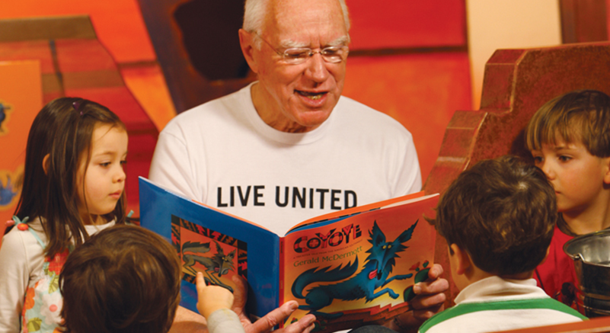
Benefits of Intergenerational Program Older Adults
Older volunteers in intergenerational programs report a stronger sense of community, decrease in social isolation, improvements in quality of life, greater life satisfaction, and a stronger sense of purpose, self-worth, self-esteem and empowerment
Research also shows that highly engaged volunteers, individuals who contribute more than 200 hours per year, experience improvements in cognitive functioning such as mental alertness, executive functioning, and even the structure of their brains show more volume and activity
There is a reduction of falls and frailty, an increase in strength, balance, and walking speed, and instrumental activities of daily living, that is, day-to-day tasks, such as preparing food, housekeeping, doing laundry. They report positive attitudes towards youth and feel they have more agency to address neighborhood problems

Slide 10
Intergenerational Activities

Slide 11
Intergenerational Activities-One Generation

Slide 12
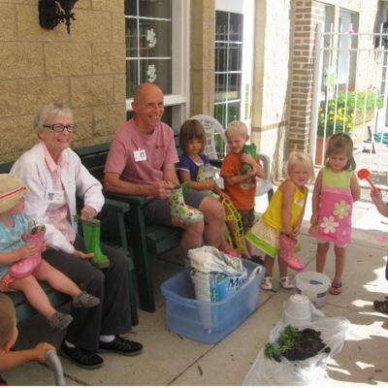
Intergenerational Activities

Slide 13
Intergenerational Activities

Slide 14
Intergenerational Activities

Slide 17
Intergenerational Activities

Slide 18
IT TAKES A VILLAGE OF GENERATIONS WORKING TOGETHER
This Photo by Unknown Author is licensed under CC BY-NC-ND
Notes:
Programs involving centenarians will likely become more popular as life expectancy continues to rise. A program in Chicago brings centenarians together with kindergarten students to count to 100 together (Little Brothers, 2020). They kindle their curiosity by answering questions about growing up and growing older – passing wisdom from one generation to the next
When young students have meaningful connections with grandparents and older neighbors or volunteers, they are likely to remain interested in aging and gerontology as they approach college and work.

Slide 19
This information was taken from the Generations United publication: Making the Case for Intergenerational programs www.gu.org

Slide 20
QUESTIONS??????

