Slide 1
Grief Throughout the Lifespan: Supporting Children and Youth in ALS
Mental Health America in Montgomery
Winter Symposium
February 11, 2022
Melinda S. Kavanaugh, PhD, LCSW
Associate Professor, Social work
Helen Bader School of Social Welfare

Slide 2

Grief: The Hardest Topic
It is OK to be sad
It is OK to not want to talk about this
It is OK to want to talk about this
It is OK to want to protect the child
It is OK to want to tell children everything
It is just OK – families need to know and understand

Slide 3
By the end of this presentation…..
Assess what children/youth know and anticipate about death and dying
Craft discussions by age group
Identify how grief manifests in children and youth
Understand anticipatory and complicated grief

Slide 4
Death and Dying

Slide 5
Research on talking about death and dying with children and youth
Talking with children and letting them express their feelings and grief helps them feel less anxious about death^{1,2}
Helps them process the loss of their parent ³.
Children benefit from clear information in order to feel comfortable in expressing their feelings and parents are the ideal ones to start and have the conversation. ^{4,5,6}
Everyone, including children, feels the loss - before the loss. The grief before the death – the anticipation

Slide 6
Youth view: Talking or NOT talking about death and dying (Kavanaugh, Noh and Studer, 2016)
“I think it makes [the parent] uncomfortable, which makes me uncomfortable.”
“Unless she brings it [discussion of death] up, like, I’m not ‘gonna’ bring it up....‘Cause I don’t wanna make her any sadder than she already is”
“I don’t know how to describe it. Kinda made me really upset because, yeah everybody’s gonna die, but like my mom is gonna die, like, more than likely way before the average person. And, like, I don’t know. Like, dealing every day, like, knowing that each day she’s, like, getting worse and worse . . . it just . . . I don’t know. It makes me . . . upset.”

Slide 7
what questions children and youth are asking and anticipating
What will the death look like?
Will my parent remain in the home?
Will I be there when he/she dies?
What will happen to me when they die?
What will the services or funeral look like?
Who will be there to support me?
Where will we live after my parent dies?

Slide 8
Helping the family respond
Prepare
While all children may not ask all these questions, be prepared - you never know.
Honest
Be honest—even if that means you are not sure, or if it is upsetting.
Tell
Encourage parents to tell them how they feel
Address
Encourage parents – if they don’t know, let the child know they will get the answer.
Difficult
This is just difficult for everyone – parents and children.

Slide 9
Suggestions by age group
These are suggestions
When working with families, they know their child best.
Always seek support from ALS organizations, child’s school, friends, family, clergy – whomever is a trusted source

Slide 10
Children ages 3-5
Allow questions and talk with child
Answer questions honestly and in simple words and terms
Use real terms, such as death or dead, not “sleeping” or “gone away.”
Provide structure and a normal schedule
Offer patience, explanations, and assurance
Resist punishment for acting out
Encourage physical activity and play to express feelings and expend energy
You may have to clarify that death is not contagious

Slide 11
Children 6-9
Provide reassurance
Respond to their needs and questions honestly and compassionately
Allow for creative play through art, stories, etc.
Encourage physical play as an outlet for grief and energy expression

Slide 12

Children 10-12
Give permission for expression of feelings.
Encourage child to ask questions and give honest answers
Avoid punishment, but offer encouragement, reassurance, compassion
Allow child to NOT be brave by giving them time to express emotions and worries
Ask if and how the child might like to be involved in the memorial services.

Slide 13
Children 13-19
Encourage
Encourage conversation and expression of grief; be honest
Allow
Allow child to have time to mourn; do not expect them to take over the adult role
Seek out
Seek out professional help, if needed, such as a school counselor, professional therapist, or clergy
Utilize
Utilize teen support group services
Provide
Provide opportunity for them to be with their friends – this is a critical time for them, and they rely on peers

Slide 14

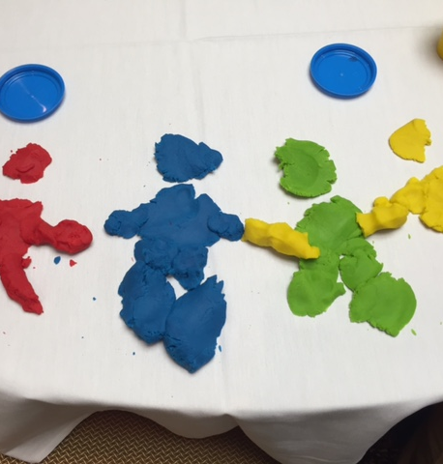
Activities with families - Memory boxes, art and activities
While you are talking about love, loss, death and dying – think of all the things that may be helpful when the loved dies.
What are the items or memories most associated?
Create art together
Find items that will remind the child of the person who died
Talk about the loved one – the child/youth needs the connection

Slide 15

Grief

Slide 16

What is grief?
Emotion – often overwhelming
Sadness from the loss of a loved one
Natural reaction to loss
The anticipation of the loss

Slide 17
Grief is real and felt in different ways, including with ALS
Grief can include all the losses associated with illness.
For the child or youth in a family with ALS, the loss of the relationship between parent and child.
The sense of “normalcy” is disrupted when the parent is diagnosed, but also when the disease progresses and things change.
Each time new symptoms, or a progression of a current symptom occurs, that is a loss for the person with ALS and for their child.
As each loss mounts, the relationship changes, leaving the child confused, sad and grieving.

Slide 18

Anticipatory grief
Before the loss - this is the normal mourning.
- acknowledgement of what the person will lose
- Feeling of impending loss
Does not make the eventual loss easier or harder – or affect how long someone grieves

Slide 19
The losses felt in ALS
Loss of playing a game with parent
Loss of walking down the street
Loss of parent driving them to game
Loss of parent holding their hand
The loss of their parents voice

Slide 20
Youth anticipatory grief
“[the machine] makes communication a lot harder . . .I think it's just that it isn't her voice. Because that's all you really want to hear. And all you hear is that . . . machine. My dad's old phone has my mom's voice message on it. And we call so we can listen to it.”

Slide 21
How to help children/youth with anticipatory grief
Anticipatory grief is normal. They may feel guilty, feeling bad about something that has changed or that they lost – while their parent is still alive.
Allow them to acknowledge the loss and how they feel
Encourage the youth to spend time with loved one – making new memories while acknowledging the changes
Everything will be OK is not always true. Let them talk, cry, be silent – most of all be supported.
Lastly - encourage them time to be - with friends, at school, on their own. Maintaining some sense of normalcy as a child/youth

Slide 22
What about Complicated grief?
Complicated grief is like being in an ongoing, heightened state of mourning that keeps you from healing.

Slide 23
How complicated grief can manifest in children and youth
Loss of interest in daily activities and events
Inability to sleep, loss of appetite, fear of being alone
Regression – or acting younger than they are
Excessively imitating the person who has died
Repeated statements of wanting to die to be with the person who has passed away
Avoiding peers and friends
Extreme change in school performance, or avoiding school

Slide 24
How to address complicated grief – and help your child move through the deepest part
Finding support often in School staff - teachers, social workers etc
Peer support groups
Children and youth are often helped by finding something meaningful and important they can do to help the family member or the disease advocacy in general.
Some youths join groups, while others become active in advocacy, education, and disease awareness.
Whatever they choose, allow the child or youth to express themselves and gain support is a crucial aspect of moving through grief and celebrating the person with ALS.

Slide 25
ALS specific Resources

Slide 26
Dealing with grief and students
Guide for school staff to support youth while living in a family with ALS
Notes:
The transition may be particularly difficult if the parent has progressed or was newly diagnosed over the summer, representing a change in their “normal” status.
Moreover, we know that nearly a third of all ALS families have youths in the family who assist in care and who may have engaged in numerous caregiving tasks over the summer.
Scaling back on the caregiving in order to go back to school can be a stress release, but also may be anxiety-producing with the youth wondering who will provide the care now that he or she is back in school. This can make the transition back to school more stressful.

Slide 27
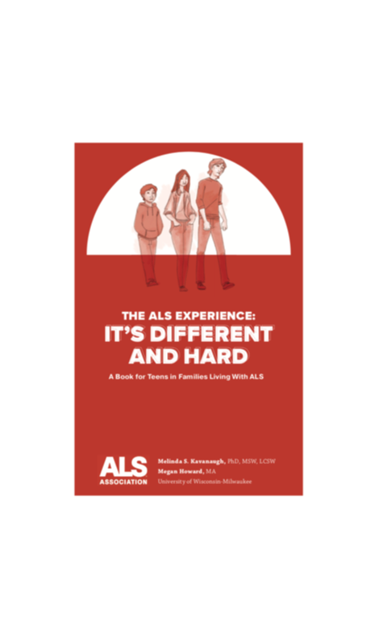


Books that use their own words

Slide 28

Final thoughts….
This truly is the hardest topic – for families but also for professionals
Know that there are no final answers, only support and guidance for children and youth in families with ALS
Youth are looking for that support – you can be that for them

Slide 29
Contact information
Melinda S. Kavanaugh, PhD, LCSW
Kavanaug@uwm.edu

