Slide 1
Supporting persons affected by ALS
An introduction for Mental health and Support professionals

Slide 2
Welcome
Thank you to our community partners and sponsors
Disclosures

Slide 3
Purpose of today’s symposium
Intention for today
Next steps
What to take away
If you only attend today
If you want to learn more and be a part of building this program

Slide 4
“Persons Affected by ALS”
Persons living with ALS (pALS)
Family Caregivers (cALS)
Spouses
Parents
Significant Others
Children
Adult Children
Siblings
ALS has a profound effect on the person living with the disease and everyone close to that person.

Slide 5
What is ALS?
https://youtu.be/mVG9Nk6voM8
Notes:
Basic overview – What is ALS?
Reminder that later in the program we will discuss resources, including what the ALS Association does and what we have available

Slide 6
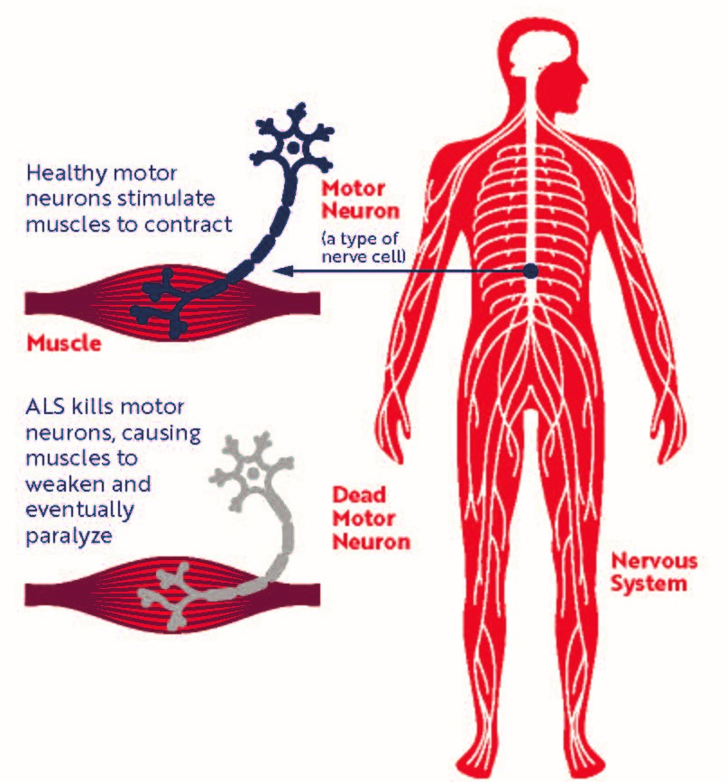
What is ALS?
Amyotrophic Lateral Sclerosis
ALS is an always fatal neurodegenerative disease in which a person’s brain loses connection with the muscles. Gradual onset of progressive muscle weakness is the most common initial symptom in ALS, and over time people with ALS lose their ability to walk, talk, eat, and eventually breathe.
Notes:
ALS stands for Amyotrophic Lateral Sclerosis
It is a fatal, neurodegenerative disease in which a person’s brain loses connection with the muscles.
Gradual onset of progressive muscle weakness is the most common initial symptom in ALS. Over time people with ALS lose their ability to walk, talk, eat, and eventually breathe.
ALS involves upper motor neurons, the nerves that go from the brain to the spinal cord, and lower motor neurons, the nerves that go from the spinal cord out to the muscles.
Sensory nerves are not affected, so people with ALS maintain the ability to feel, taste and smell. ALS also does not affect involuntary muscles such as the heart.

Slide 7
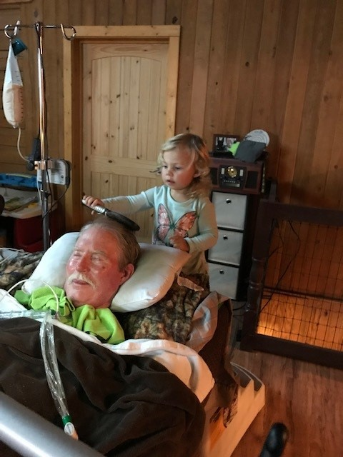
Incidence & Prevalence
Prevalence
Number of people who have a condition at or during a particular time period.
It is estimated that at least 16,000 Americans may be living with ALS at any given time.
Incidence
Number of people who develop a condition during a particular time period.
Approximately 5,000 people in the U.S. are diagnosed with ALS each year.
Notes:
While approximately 5,000 people are diagnosed with ALS every year, we estimate at least 16,000 Americans are living with ALS at any given time. This estimate may be low, as ALS is not a reportable disease.

Slide 8
ALS Symptoms
ALS is typically a disease that involves a gradual onset. The initial symptoms of ALS can be quite varied in different people. One person may have trouble grasping a pen or lifting a coffee cup, while another person may experience a change in vocal pitch when speaking.
The rate at which ALS progresses can be quite variable from one person to another. Although the mean survival time with ALS is three to five years, some people live five, 10 or more years. Symptoms can begin in the muscles that control speech and swallowing or in the hands, arms, legs or feet. Not all people with ALS experience the same symptoms or the same sequences or patterns of progression. However, progressive muscle weakness and paralysis are universally experienced.
Gradual onset of progressive muscle weakness – which is generally painless -- is the most common initial symptom in ALS. Other early symptoms vary but can include tripping, dropping things, abnormal fatigue of the arms and/or legs, slurred speech, muscle cramps and twitches, and/or uncontrollable periods of laughing or crying.
When the breathing muscles become affected, ultimately, people with the disease will need permanent ventilatory support to assist with breathing.
Since ALS attacks only motor neurons, the senses of sight, touch, hearing, taste and smell are not affected. For many people, muscles of the eyes and bladder are generally not affected.

Slide 9
diagnosis
ALS is a difficult disease to diagnose. There is no one test or procedure to ultimately establish the diagnosis of ALS. It is through a clinical examination and series of diagnostic tests, often ruling out other diseases that mimic ALS, that a diagnosis can be established. A comprehensive diagnostic workup includes most, if not all, of the following procedures:
Electrodiagnostic tests including electomyography (EMG) and nerve conduction velocity (NCV)
Blood and urine studies including high resolution serum protein electrophoresis, thyroid and parathyroid hormone levels and 24-hour urine collection for heavy metals
Spinal tap
X-rays, including magnetic resonance imaging (MRI)
Myelogram of cervical spine
Muscle and/or nerve biopsy
A thorough neurological examination
These tests are done at the discretion of the physician, usually based on the results of other diagnostic tests and the physical examination. There are several diseases that have some of the same symptoms as ALS, and most of these conditions are treatable. It is for this reason that The ALS Association recommends that a person diagnosed with ALS seek a second opinion from an ALS expert - someone who diagnoses and treats many ALS patients and has training in this medical specialty.

Slide 10
Stages of als
Once ALS starts, it almost always progresses, eventually taking away the ability to walk, dress, write, speak, swallow, and breathe, and shortening the life span. The onset of ALS often involves muscle weakness or stiffness as early symptoms. Progression of weakness, wasting, and paralysis of the muscles of the limbs and trunk, as well as those that control vital functions such as speech, swallowing, and breathing, generally follows.
How fast and in what order this occurs is very different from person to person. While the average survival time is three years, about 20 percent of people with ALS live five years, 10 percent will survive 10 years and 5 percent will live 20 years or longer.
Progression is not always a straight line in an individual, either. It is not uncommon to have periods lasting weeks to months where there is very little or no loss of function. There are even very rare examples in which there is significant improvement and recovery of lost function. These ALS "arrests" and "reversals" are, unfortunately, usually transient. Less than 1 percent of people with ALS will have significant improvement in function lasting 12 months or longer.

Slide 11
Changes in thinking and emotional lability
Around 50% of people with ALS will eventually experience some change in cognitive ability or behavior, with those changes ranging from minor symptoms to full-blown dementia.
Similar to how the physical symptoms of ALS can vary widely from one patient to the next, thinking and behavioral changes can take on many different forms.
About half of all people with ALS will never experience any cognitive symptoms. Some people may experience just one or two symptoms, while others might have many.
Changes in thinking and behavior can be caused by ALS, but they can also be the result of other factors that may or may not be related to the disease. For example, a lack of oxygen caused by ALS-induced breathing difficulties can impair thinking abilities. Symptoms can also sometimes be related to medication side effects, anxiety or depression issues, a lack of sleep, or a separate pre-existing neurological disease.
It is important to manage expectations. If your expectations of what someone can do exceeds their ability, it can be frustrating for both the person living with ALS and the caregiver.
Besides cognitive and behavioral changes, some people with ALS experience changes in how they process and display emotions. They may laugh or cry at inappropriate times, even when they don’t necessarily feel happy or sad. They may also feel emotions more intensely than normal, or find it difficult to “shut off” an emotion once they begin feeling it. These symptoms are referred to as “emotional lability” or “pseudobulbar affect.”
https://www.als.org/navigating-als/coping-with-als/changes-thinking-emotional-lability

Slide 12
Multidisciplinary care
Multidisciplinary Care brings together a team of health care professionals specially trained to address the needs of people living with ALS, allowing them to receive care from each discipline during a single visit. The care team typically includes a neurologist, physical therapist, occupational therapist, respiratory therapist, nurse, dietitian, speech language pathologist, social worker, mental health professional and an ALS Association Chapter liaison.
The ALS Association Alabama Chapter currently has relationships with four multidisciplinary clinics within our state:
The Certified Treatment Center of Excellence at Crestwood Medical Center in Huntsville
The Recognized Treatment Center at Alabama Neurology Associates in Birmingham
Affiliated Clinics:
The University of Alabama at Birmingham (UAB) ALS Clinic
The ALS Care Clinic at the Birmingham VA

Slide 13
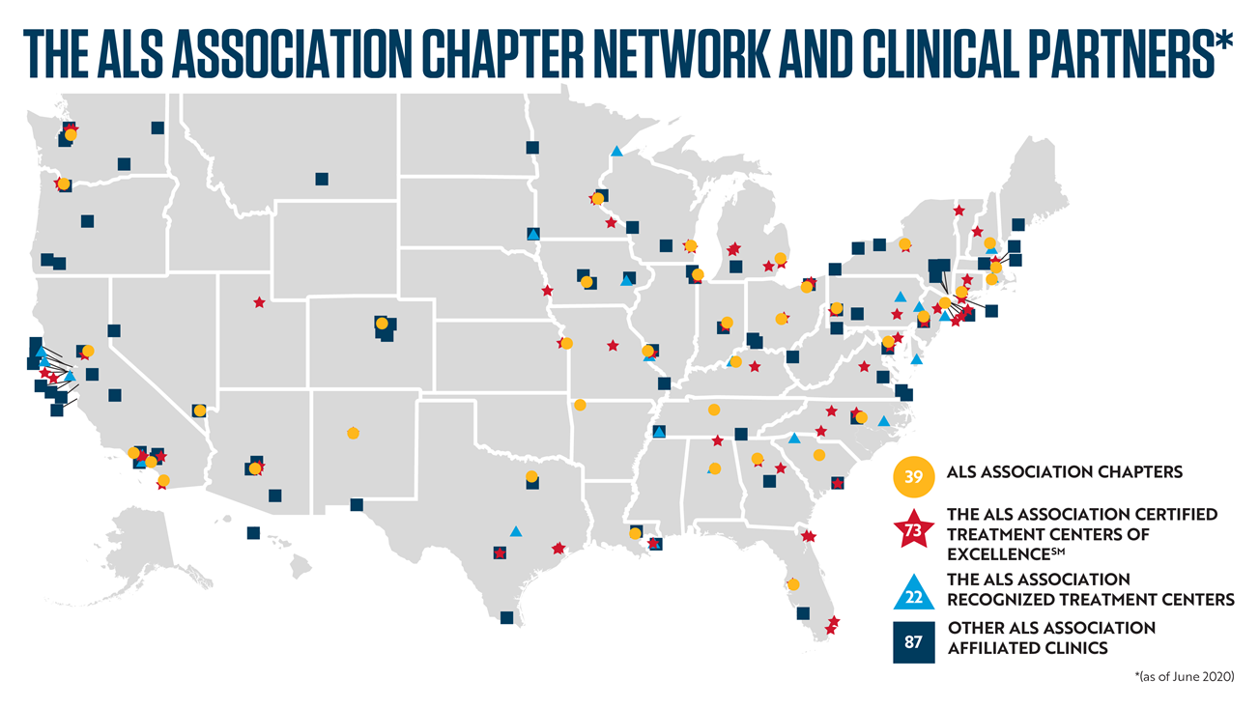
Clinics
Notes:
The ALS Association collaborates with some of the best ALS physicians and clinics across the United States to help ensure that people living with ALS have access to specialized care, based on best practices. The ALS Association’s Certified Treatment Centers of Excellence and Recognized Treatment Centers provide compassionate care in a supportive atmosphere with an emphasis on hope and quality of life.
To become certified as a Center of Excellence, each clinic must:
Adhere to The ALS Association’s clinical care and treatment standards, based on AAN Practice Parameters
Participate in ALS-related research
Successfully complete a comprehensive site review
The ALS Association Recognized Treatment Centers have the same high-quality approach to multidisciplinary care as Certified Treatment Centers of Excellence; however, they do not offer onsite ALS research.
It is important to note that other models of care are necessary to meet the needs of all people living with ALS. These affiliated clinics include, but are not limited to, neurology group practices and solo practitioners across the country. The ALS Association chapters may provide educational and other support to these practitioners and their patients in their local community. However, these models of care are not an official part of The ALS Association Certified Center Program.

Slide 15
FDA Approved Drugs
There are currently five drugs approved by the U.S. Food and Drug Administration to treat ALS (Radicava, Rilutek, Tiglutik, Exservan, and Nuedexta). Studies all over the world, many funded by The ALS Association, are ongoing to develop more treatments and a cure for ALS.
Radicava™ (edaravone)
The FDA approved Radicava™ in 2017, less than a year after Mitsubishi Tanabe Pharma America submitted a new drug application, making it the first new treatment specifically for ALS in 22 years. Learn more.
Rilutek (riluzole, now generic)
This was the first FDA-approved drug available to treat ALS — in 1995. It inhibits glutamate release and prolongs life approximately three months. Riluzole is the generic name of Rilutek.
Tiglutik (thickened riluzole)
The first and only thickened liquid form of riluzole, Tiglutik was approved by the FDA in September 2018. This formulation contrasts with the oral pill form of riluzole that has been on the market for ALS for more than 20 years. It is designed to avoid potential problems of crushing tablets. Learn more.
Exservan™ (riluzole oral film)
An oral film formulation of riluzole, Exservan was approved by the FDA in November 2019. This formulation contrasts with the oral pill form of riluzole that has been on the market for ALS for more than 20 years and developed for patients with severe swallowing difficulties. The oral film is placed on top of the patient’s tongue and dissolves bypassing the need to swallow a pill or liquid.
Nuedexta®
Indicated for the treatment of pseudobulbar affect (PBA), which is characterized by frequent, involuntary, and often sudden episodes of crying and/or laughing that are exaggerated and/or don’t match how you feel. PBA occurs secondary to a variety of otherwise unrelated neurologic conditions. Nuedexta® (dextromethorphan HBr and quinidine sulfate) was FDA-approved in 2011.

Slide 16
Therapies and care
There is not yet a cure for ALS, but there are ways to help mitigate and manage the symptoms.
Physical and Occupational Therapy
Physical therapy (PT) is the use of exercises and treatments to improve physical movement and overall mobility. Occupational therapy (OT) is similar but is focused on developing or maintaining the physical skills needed to perform everyday tasks. For example, a physical therapist might prescribe stretching exercises to limit discomfort and preserve range of motion or use pool therapy to help you walk and improve joint function. An occupational therapist may help you find new ways to brush your teeth or recommend equipment that can make your activities of daily living easier to perform.
Speech Therapy
For people living with ALS with bulbar symptoms, a speech-language pathologist can help with both speaking and swallowing difficulties. This may include finding devices to help you communicate as your speech becomes harder for others to understand.
Respiratory Therapy
A respiratory therapist can teach you new techniques for breathing and coughing, helping you keep your airway and lungs clear and healthy. When mechanical ventilators are needed, they can help you evaluate the options and choose the best ventilator for your needs.
Psychotherapy
It’s not unusual to feel depressed or anxious after being diagnosed with ALS. If you have difficulty coping with the mental and emotional side of ALS, a counselor or psychiatrist can help.
Medications
There are a number of medications that can help treat the various symptoms of ALS and new drugs are being developed all the time. Talk with your doctor or therapist to find out what is currently available and whether any such medications might be right for you.

Slide 17
Things als does not affect
Thoughts
The ability to reason
Hearing
Sight
Taste
Sensation & Touch
Opinions, Feelings, Beliefs
Awareness
Intelligence

Slide 18
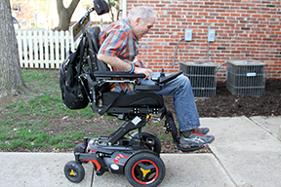
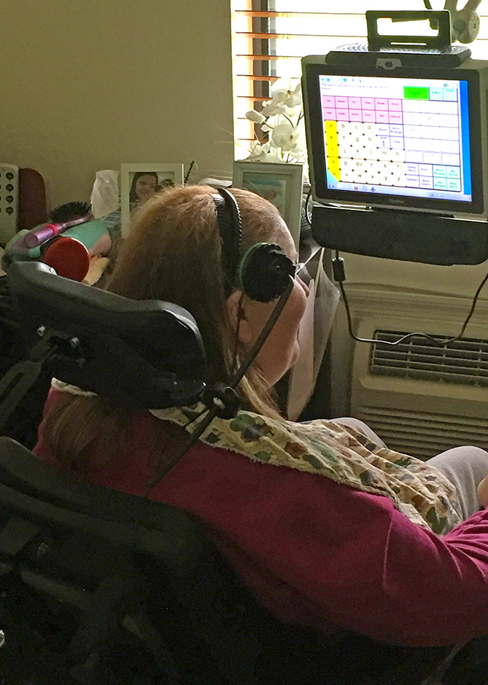
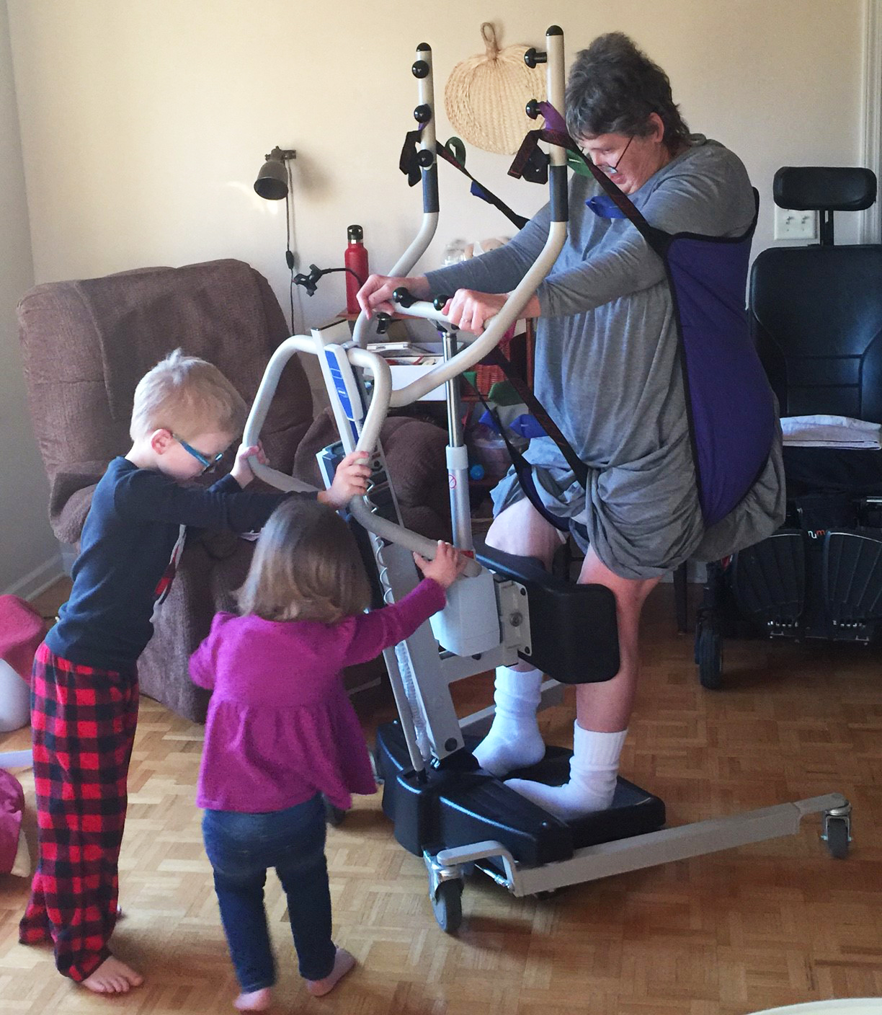
Commonly Required Equipment
Wheelchair, Manual and Power
Speech Generating Device
Respiratory Equipment
Equipment to Assist with Activities of Daily Living
Patient Lifts
Accessible Van
Ramps
Notes:
Many people living with ALS choose to stay at home as long as possible. To maintain safety and independence, people living with ALS require a variety of medical equipment throughout the course of the disease. And since ALS continues to progress over time, the needs continue to change. While it is best to plan ahead and have equipment ready before it is desperately needed, this can be a challenge due to availability, acceptance and things just changing so fast it is hard to keep up. Health insurance does not cover much of what is needed by someone who is living with ALS, so much of the equipment is paid for privately or comes from a loan program.
Manual wheelchairs are helpful early on in the disease, or to help with short transfers. Power wheelchairs are imperative for someone who is no longer able to walk due to leg weakness or decreased respiratory endurance. They also offer support of the upper body & head when they become weak. Power wheelchairs are generally covered by insurance, but the ramp to get it into the house and the van to transport it from place to place are not.
Speech Generating Devices are also generally covered by insurance, and offer a way for people to communicate when they have lost the ability to speak. SGDs can be accessed thorough touchscreen, a keyboard, specialized switches and buttons, or eye gaze, and can communicate with smart home technology to control the environment as well.
Respiratory equipment is also often covered by insurance. A suction machine helps with excess saliva when swallowing becomes challenging. A non-invasive ventilator helps push air in and force air out when the diaphragm starts to weaken. There are devices to help with coughing and airway clearance as well, and a patient may choose invasive ventilation to help them breathe when they are no longer able to do it themselves.
Equipment to maintain safety in the bathroom or to assist with dressing or eating is not typically covered by insurance, but is needed throughout the progression of the disease. Raising the height of a toilet makes it easier to get on/off, having a bench or chair to sit on in the shower conserves energy and decreases the chance of falls. A utensil that can be strapped to a hand lets someone keep eating even after losing grip strength. There is a wide variety of equipment available to help with daily tasks – if someone has a challenge, someone else has made a piece of equipment to help!
When standing becomes harder, patient lifts are a safe way for caregivers to move the person from one place to another, such as from their bed to wheelchair.
Ramps, home modifications to make room for a wheelchair or bathroom modifications, and wheelchair accessible vans are not covered by insurance but are commonly needed.

Slide 19
Potential barriers/challenges to seeking and receiving support
Communication difficulties
Pseudo Bulbar Affect (PBA)
Time/ Energy/ Overwhelmed
Frustration with healthcare system
Not wanting to have to explain ALS (again!)
Not sure where to go/ lack of resources and understanding

Slide 20
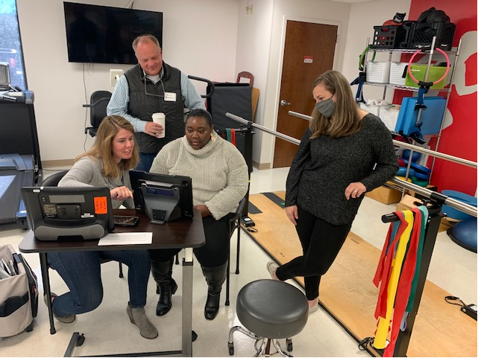
Tips for Communicating with People with Speech Impairments
Take as much time as necessary to communicate and be patient.
Concentrate and pay extra attention to help you understand what the individual is saying.
If you do not understand something the individual says, do not pretend that you do. Ask them to repeat what he or she said and then repeat it back.
Don’t attempt to help the person by finishing his or her sentences or reading over their shoulder while using a device. Let the person speak for himself or herself.
After trying to understand the person repeatedly, without success, ask the person if it is ok to communicate through an alternative method.
Ask questions if you are not sure about what to do. Don’t be afraid.

Slide 21
“Please tell them……”
“Try to be flexible and understand that my needs as a pALS and the needs of my caregiver are unique. We may need you to think outside the box and be available in different ways than you may be to more “typical” patients”
“Find out how I communicate and be patient with me so I have time to tell you what you need to know”
“I tried to talk to my therapist and use my speech device, but it took me so long to get across what I needed to say that there was not time to get to it. Most of the time I can tell that people are anxious for me to get it out more quickly, so I just say ‘never mind’ and let the thought or feeling go. It feels very frustrating and lonely to not be heard.”
“Time is very precious to us and we need professionals that are willing to be proactive in our care. By the time we receive a diagnosis of ALS – many of us have been experiencing symptoms for years have been sent from specialist to specialist and undergone tons of testing well before we got to you”
“The level of loneliness and isolation that comes with this disease is something I can’t even put into words. It feels like there is just no way anyone can understand what we are really going through”.
“I remember sitting in the room and the doctor telling me I had ALS, and then.. well, I guess I was in shock, and I don’t really remember very much of what was said after that. Many months later I feel like I am still trying to process that day, but I can’t. Things are happening so fast and there is so much to think about……”

Slide 22
Common themes
People Living with ALS
Emotional distress of losing physical function and threatened future
Keeping up with constant changes in symptoms
Feeling unsupported by the healthcare system
End of life concerns
Faith/ Existential Concerns
Sense of loss
Changes in identity, roles, and relationships
Pinto, C., Geraghty, A. W. A., Yardley, L., & Dennison, L. (2021). Emotional distress and well-being among people with motor neurone disease (MND) and their family caregivers: a qualitative interview study. BMJ Open, 11(8), e044724. https://doi.org/10.1136/bmjopen-2020-044724

Slide 23
Common themes
Family Caregivers
Emotional impact of the burden of the disease
Strain from caregiving tasks (and arranging for care)
Changes forced on their own lives (role changes)
Not having time for themselves (or to even process their feelings – survival mode)
Isolation (Feeling like the only one who understands)
Children in their lives
The always changing “new normal”
Pinto, C., Geraghty, A. W. A., Yardley, L., & Dennison, L. (2021). Emotional distress and well-being among people with motor neurone disease (MND) and their family caregivers: a qualitative interview study. BMJ Open, 11(8), e044724. https://doi.org/10.1136/bmjopen-2020-044724

Slide 24
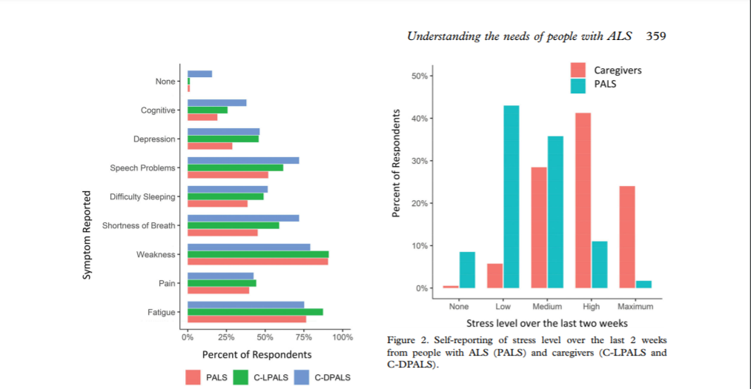
*Brizzi, K. T., Bridges, J. F. P., Yersak, J., Balas, C., Thakur, N., Galvin, M., Hardiman, O., Heatwole, C., Ravits, J., Simmons, Z., Bruijn, L., Chan, J., Bedlack, R., & Berry, J. D. (2020). Understanding the needs of people with ALS: a national survey of patients and caregivers. Amyotrophic Lateral Sclerosis & Frontotemporal Degeneration, 21(5–6), 355–363. https://doi.org/10.1080/21678421.2020.1760889

Slide 25
Supportive approaches
Hope, Control, Compassion (Pinto et. al)
Proactive Problem-Solving
Education
Focus on what you can do
Mindfulness and the power of the moment

Slide 26
References:
Brizzi, K. T., Bridges, J. F. P., Yersak, J., Balas, C., Thakur, N., Galvin, M., Hardiman, O., Heatwole, C., Ravits, J., Simmons, Z., Bruijn, L., Chan, J., Bedlack, R., & Berry, J. D. (2020). Understanding the needs of people with ALS: a national survey of patients and caregivers. Amyotrophic Lateral Sclerosis & Frontotemporal Degeneration, 21(5–6), 355–363. https://doi.org/10.1080/21678421.2020.1760889
Pinto, C., Geraghty, A. W. A., Yardley, L., & Dennison, L. (2021). Emotional distress and well-being among people with motor neurone disease (MND) and their family caregivers: a qualitative interview study. BMJ Open, 11(8), e044724. https://doi.org/10.1136/bmjopen-2020-044724
Weeks, K. R., Gould, R. L., Mcdermott, C., Lynch, J., Goldstein, L. H., Graham, C. D., McCracken, L., Serfaty, M., Howard, R., Al-Chalabi, A., White, D., Bradburn, M., Young, T., Cooper, C., Shaw, D. P. J., & Lawrence, V. (2019). Needs and preferences for psychological interventions of people with motor neuron disease. Amyotrophic Lateral Sclerosis & Frontotemporal Degeneration, 20(7/8), 521–531. https://doi.org/10.1080/21678421.2019.1621344
Sirois, F. M., Molnar, D. S., & Hirsch, J. K. (2015). Self-Compassion, Stress, and Coping in the Context of Chronic Illness. Self & Identity, 14(3), 334–347. https://doi.org/10.1080/15298868.2014.996249
Murphy, V., Felgoise, S. H., Walsh, S. M., & Simmons, Z. (2009). Problem solving skills predict quality of life and psychological morbidity in ALS caregivers. Amyotrophic Lateral Sclerosis, 10(3), 147–153. https://doi.org/10.1080/17482960802245007

Slide 27
References:
Cognitive Changes and Emotional Liability Article: https://www.als.org/navigating-als/coping-with-als/changes-thinking-emotional-lability (Retrieved 2/08/2022)
Turell W, Roc A, Pioro E, Howson A. Living With the Burden of Pseudobulbar Affect: A Qualitative Analysis of the Effects of Education on Patient Experience. J Patient Exp. 2020 Dec;7(6):1324-1330. doi: 10.1177/2374373519899597. Epub 2020 Mar 2. PMID: 33457582; PMCID: PMC7786644.

Slide 28
Please Look for our Post-Event Survey
https://www.surveymonkey.com/r/ALSMHFEB22

Slide 29
Questions and contact information
ALS Association Alabama Chapter Contact Information:
Main Office:
300 Cahaba Park Circle, Suite 209
Birmingham, AL 35242
800-664-1242
info@alsalabama.org
Director of Care Services and Public Policy:
Melissa Enfinger, MS
334-312-3328
melissa@alsalabama.org
National ALS Association
www.als.org

