Slide 1

RESOURCES
The ALS Association Alabama Chapter:
Melissa Enfinger, Director of Care Services and Public Policy
melissa@alsalabama.org
334-312-3328
https://www.als.org/alabama
800-664-1242
The ALS Association:
www.als.org

Slide 2
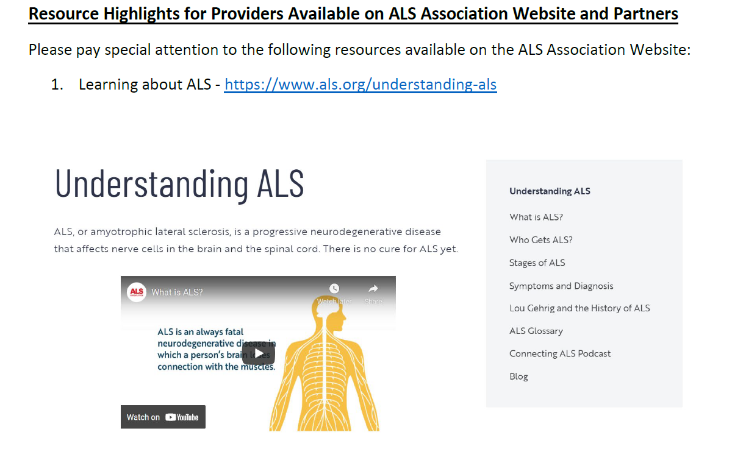

Slide 3
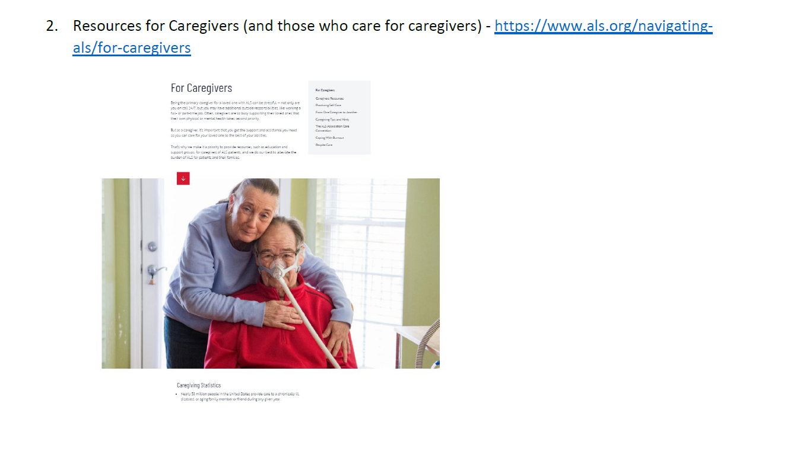

Slide 4
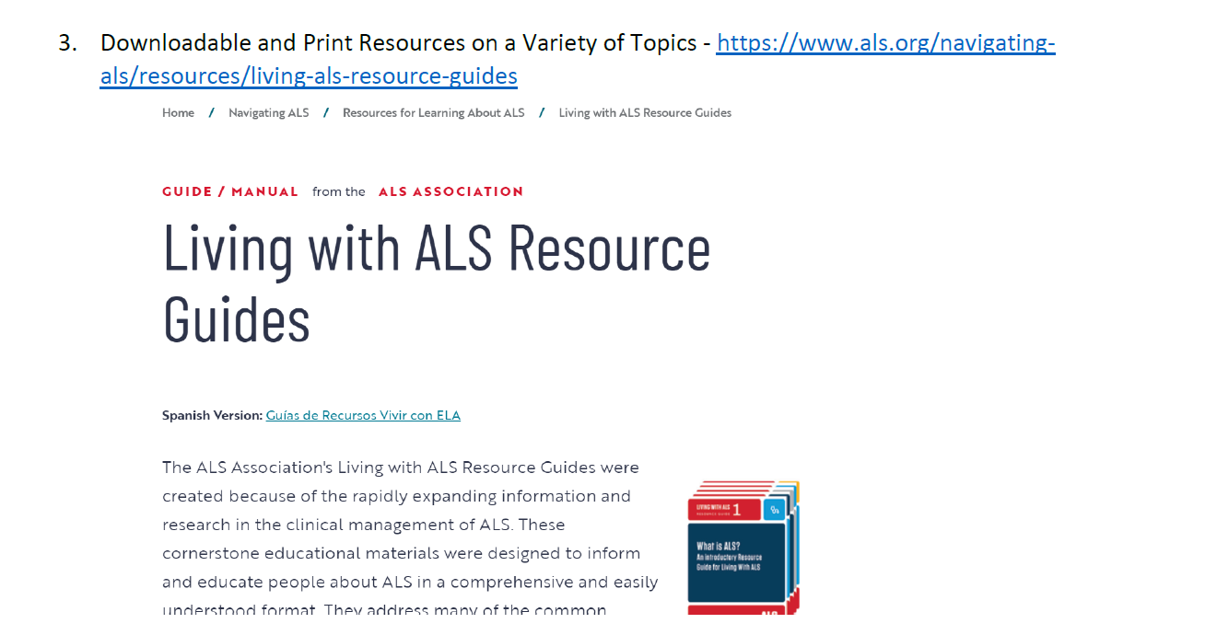

Slide 5
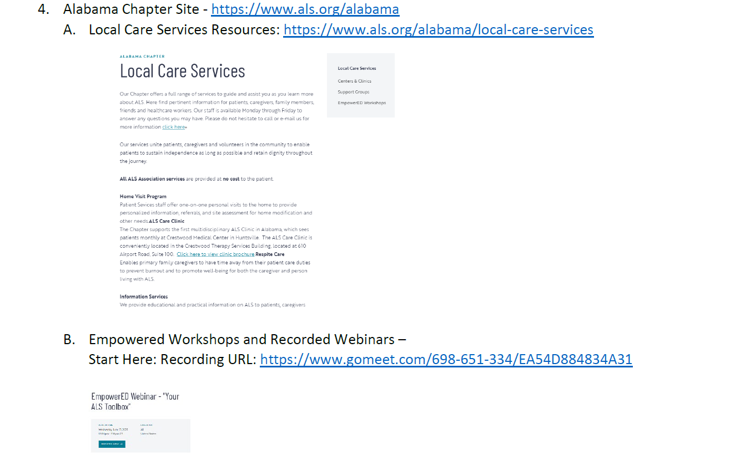

Slide 6


Slide 8


Slide 9



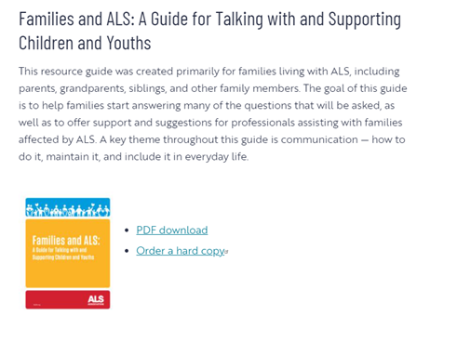

Slide 10
