Slide 1
FY21 Mental Health Update
Kimberly G. Boswell, Commissioner
Alabama Department of Mental Health
July 9, 2021

Slide 2
Did you know that it typically takes ten years from the first time someone has mental health concerns until they get a correct diagnosis and proper treatment? We can’t wait for that.

Slide 3
Alabama Crisis System Redesign
Crisis Diversion Centers | Rural Crisis Care | Stepping Up Initiative
Alabama Crisis System of Care
Reduce
Reduce hospital emergency department admissions and jail bookings due to behavioral health crisis.
Promote
Promote integrated services, regardless of diagnosis (mental health, substance use disorder or co-occurring intellectual disability)
Develop
Develop a regional approach to crisis care through planning and collaboration
Decrease
Decrease the rates of referral to expensive and restrictive inpatient care with extended lengths of stay.

Slide 4
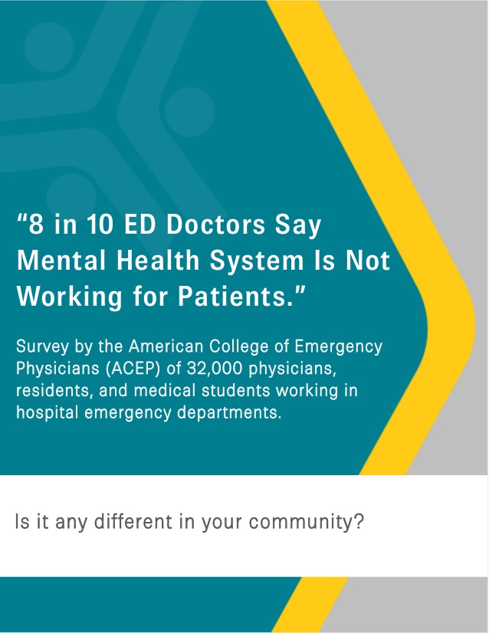
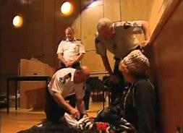
Question: What is driving our current crisis in mental health care and what are we going to do about it?

Slide 5
With the opening of the Alabama Insane Hospital in 1861, Alabama became a national leader in the moral treatment movement through the work of Dr. Peter Bryce. The facility would later be renamed in his honor.
State of the art treatment – moral treatment movement
Free from restraint
Free from warehousing in jails
Dignity of work
Foundation for the fields of psychiatry, psychology and social work
State of the art facility
Running water
Gas lighting
70-degree air-conditioning
Largest employer

Slide 6
Wyatt v. Stickney
By the late 1960’s, Bryce was overcrowded and warehousing 5,200 people with mental illness living in deplorable conditions.
A lawsuit was filed in 1970 when the Legislature cut funds earmarked for mental health resulting in Bryce Hospital firing over 100 employees.
The goals of the Wyatt case filed in October of 1970 included:
(1) establish a constitutional right to treatment on behalf of people with mental illness,
(2) a constitutional right to habilitation for people with mental retardation, and
(3) set minimum standards regarding safety, education, training, medication, nutrition, physical accommodations, staff/patient ratios, individualized treatment and aftercare.

Slide 7
With the settlement of the Wyatt case in 2003, Alabama returned to a place of national prominence as a model for treatment of individuals with mental illness and intellectual disabilities.
Thirty-three years later the case was settled in 2003. At the time it was the longest running lawsuit for mental health services in the United States
To quote Judge Myron Thompson -
“The enormity of what this case has accomplished cannot be overstated. The principles of humane treatment of people with mental illness and mental retardation embodied in this litigation have become a part of the fabric of law in this country and, indeed international law.”

Slide 8
2003 - 2018
2004 Three developmental centers were closed
2008 Discussions began about building a new Bryce Hospital
2009 Decision to build new Bryce at 268 acute care beds (over 500 additional acute care beds at the time)
2010 New Governor and new Commissioner
2010 Proration in the General Fund resulting in a $40 million cut to the ADMH budget
2010 Review of the Departments statutory responsibility to serve civilly committed patients (Stage 4)
2011 Closed the last developmental center – Partlow in Tuscaloosa
2012 Closed Searcy and Greil hospital
2014 Closed North Alabama Regional

Slide 9
Where we are now – internally – blockages in the system
268 beds for the civilly committed with 35% beds filled with forensic patients and 9 beds for the deaf unit that was moved when Greil Hospital closed
Increase in the number of individuals with mental illness and substance use disorders in emergency rooms and jails
ADMH crisis residential programs (civilly committed – Stage 4)with lengths of stay 6 months to a year.
Where we are now as a society - external
Despite medical advances and technological leaps, the average life span has declined for the third year in a row
Among epidemiologists, psychiatrist, public-health officials and social scientist, there is a growing consensus that the number one health crisis in America right now is not cancer, not obesity, not heart disease but loneliness
You can’t separate the mind/head from the body
Our social structures no longer encourage connections and relationships that support our mental health
COVID -19

Slide 10
CRISIS NOW Transforming Crisis Services In Alabama
FOUR CORE ELEMENTS FOR TRANSFORMING CRISIS SERVICES
CRISIS STABILIZATION PROGRAMS (Crisis Diversion Centers)
These programs offer short-term “sub-acute” care for individuals who need support and observation, but not ED holds or medical inpatient stay, at lower costs and without the overhead of hospital-based acute care.
24/7 MOBILE CRISIS (Rural Crisis Projects)
Mobile crisis offers outreach and support where people in crisis are. Programs should include contractually required response times and medical backup.
ESSENTIAL PRINCIPLES & PRACTICES (required for all components)
These must include a recovery orientation, trauma-informed care, significant use of peer staff, a commitment to Zero Suicide/Suicide Safer Care, strong commitments to safety for consumers and staff, and collaboration with law enforcement.
HIGH-TECH CRISIS CALL CENTERS (9-8-8 Study Commission)
These programs use technology for real-time coordination across a system of care and leverage big data for performance improvement and accountability across systems. At the same time, they provide high-touch support to individuals and families in crisis.

Slide 11
Crisis Diversion
Core Components of the Diversion Center
24/7/365 Access, Assessment, Linkage
Temporary Observation (23 hours)
Extended Observation (<7 days)
Collaboration with specialty providers
Intellectual/Developmental Disability, Deaf Services, Substance Use Disorder

Slide 12
RFP Core (Mandatory) Components
Community Collaborative
Crisis Focused Community Collaborative (i.e.,)
Law Enforcement
Hospitals/EDs
MH & SUD Providers
IDD Providers
Elected officials

Slide 13
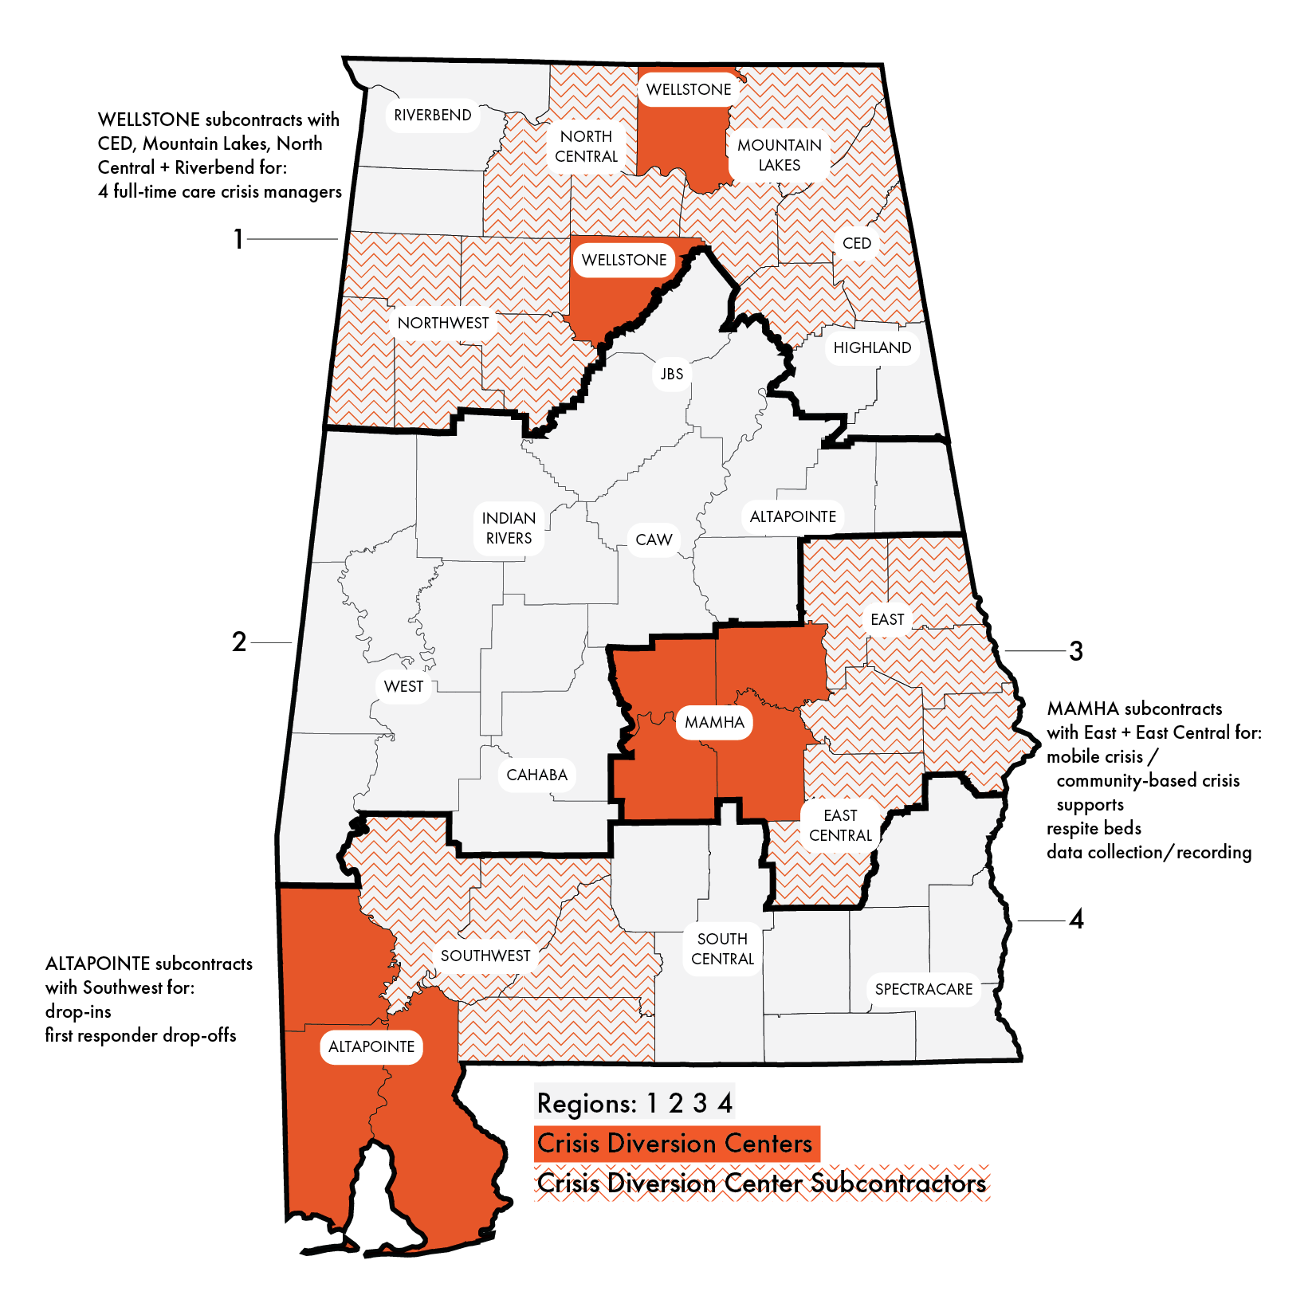
Crisis Diversion Center
FY21 Update: RFP Awards and Counties Served
Notes:
MAP with counties, regions, CMHCs, and Crisis Diversion Centers (3)

Slide 14
Rural CMHC Crisis Care Potential Components
Mobile Crisis
Expanded by each CMCH
24/7/365 Access
Co-Response
With law enforcement &/or EMS
Both on-site & virtual to maximize availability
Crisis Peer Support
Promotes recovery-oriented crisis care
Crisis Case Management
Targeting high-utilizers to reduce future crisis episodes
Call tracking Software
Improves data collection and benchmarking of crisis needs & care
Respite Options
Subacute beds to prevent escalation of crisis
Available 24/7/365

Slide 15
Rural CMHC 2020 Supplemental Appropriation
$2,500,000 to establish/expand crisis care in rural communities
5 CMHCs received $500,000 each:
Cahaba
Northwest Alabama
Southwest Alabama
Wellstone (Cullman)
West Alabama

Slide 16
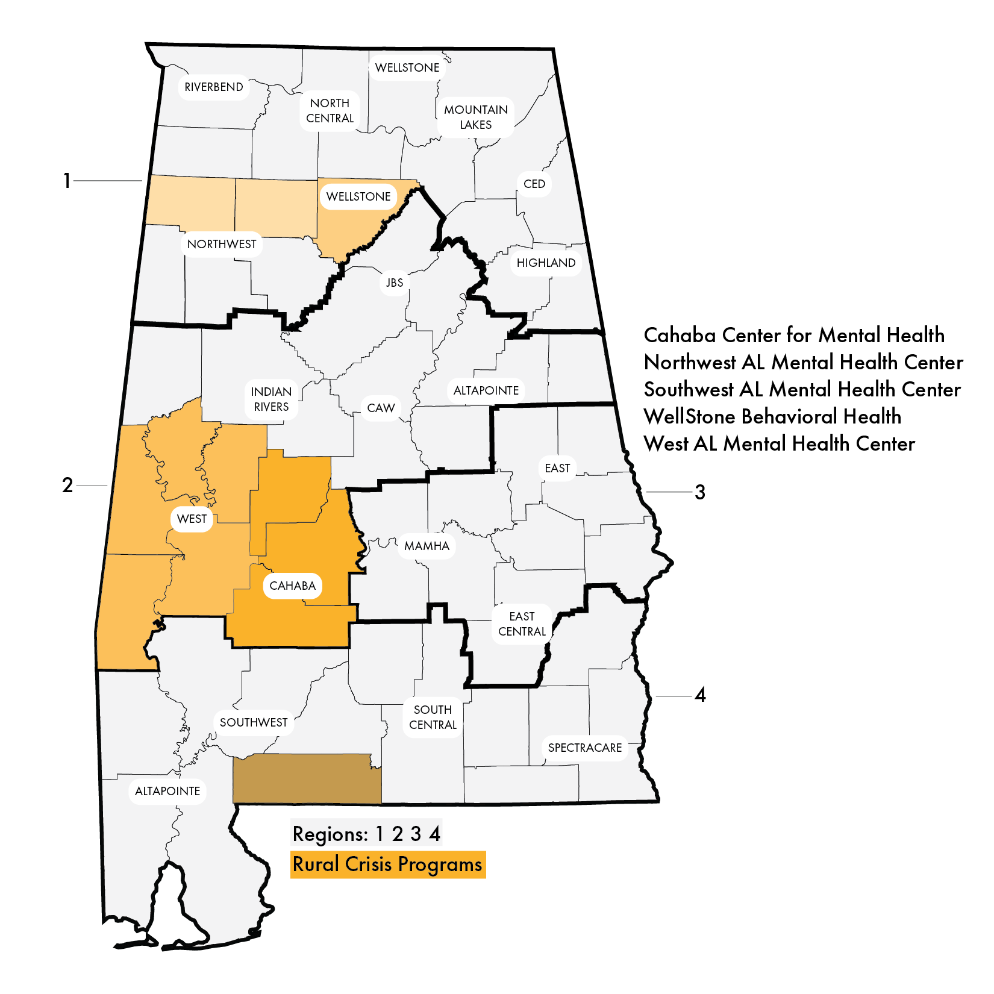
Rural Crisis Care
FY21 Update: Current Rural Crisis Programs
Notes:
MAP with counties, regions, CMHCs, and Crisis Diversion Centers (3) and Region 2 shaded and Rural Crisis Programs

Slide 17
Stepping Up is a national initiative focused on reducing the number of people with mental illness in jails.
What is Stepping Up?
The human toll of this problem—and its cost to taxpayers—is staggering. Jails spend two to three times more money on adults with mental illnesses that require intervention than on those without those needs, yet often do not see improvements to public safety or these individuals’ health.
Approximately 2 million times each year, people who have serious mental illnesses are admitted to jails across the nation. Almost three-quarters of these adults also have drug and alcohol use problems. Once incarcerated, individuals with mental illnesses tend to stay longer in jail and upon release are at a higher risk of returning to incarceration than those without these illnesses.

Slide 18
Required Program Elements
Policy Level
Pass a County-level Stepping Up Proclamation
Submit MOUs from identified community partners
Convene and facilitate a strong planning committee that includes membership from various sectors
Develop referral system with local jail and emergency rooms
Individual Level
Provide Case management
Conduct Crucial Conversations in local communities
Conduct Stepping Up “Month of Action” activities in May
Notes:
The purpose of the program is to provide case management services and establish sustainable system for implementing the Stepping Up framework
The keys to success are working on both the policy and the individual level to build collective impact, provide backbone agency coordination and keep the issue in the forefront in communities, build awareness, and educate the community and key stakeholders.
It is important to note that this program is not a one size fits all approach. The model is flexible to meet the needs of the individual counties.

Slide 19
Year 1 Outcomes (January – September 2019)
5,562 screened by Stepping Up in jails and EDs
1,732 screened positive for serious mental illness (SMI)
29% of inmates screened positive
55% of ED patients screened positive
100% of individuals that screened positive were referred to mental health treatment
Notes:
Each site implemented Stepping Up unique program to address county needs
A total of 5562 individuals were screened for SMI
5032 – inmates screened
530 – ER patients screened
A total of 1732 individuals screened positive for SMI
1443 inmates screened positive
289 ER patients screened positive
All clients that screen positive receive a referral to mental health treatment

Slide 20
Moving Forward
Bi-partisan group of legislators made Stepping Up Alabama a top priority in the 2020 Legislative Session
$1.8M has been allocated for FY2021
Expand to 28 counties in FY2021 and remaining 28 in FY2022 to expand Stepping Up services to all 67 counties
ADMH will also allocate one-year funding to sustain current successful implementations of the Stepping Up program
Notes:
ADMH utilized existing funding for $50,000 Case Management and T/TA services which limits the Stepping Up roll out to all counties, funding and support to assist counties that want to implement Stepping Up
Individual sites have implemented the Stepping Up Program well such that each individual booked in jail receive a screening (3 criteria)

Slide 22
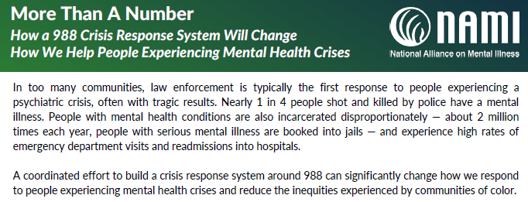
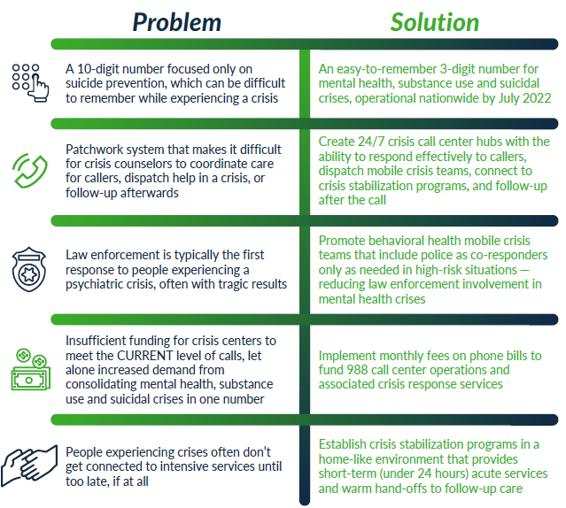
Why 9-8-8?

Slide 23
9-8-8: The Thread Connecting Alabama’s Crisis System of Care

Slide 24
Core Components of a Comprehensive Behavioral Health Crisis System

Slide 25
COVID-19 Crisis Information Line
ADMH and Alabama Emergency Management Agency offer crisis resources, help and information through regional providers, through one easy to access statewide Information Line, 1-888-442-1793.
Any individual, including but not limited to, children, older adults, individuals with disabilities, healthcare professionals, first responders, and administrators working on the frontlines who are experiencing stress or anxiety related to COVID-19, may call the Information Line.
The Information Line will connect individuals with appropriate staff and programs in their local communities to provide vital resources and services.

Slide 26
Alabama Family Central is a collaboration of state agencies and partners supporting
Alabama's families with resources, services and more to help raise
healthy, happy kids.
www.alabamafamilycentral.org
Alabama Family Central is a directory of important resources, found statewide.
The website makes finding child care, health services, family services
or education resources easy, with over 300 programs and
services to support children and families in our state.
Great Families Need Strong Partners.

