Slide 1


2-1-1: Bringing People and Services Together
Tasha Cooper
HandsOn River Region
2-1-1 Connects Alabama
tcooper@handsonriverregion.org

Slide 2
What is 2-1-1?
A free, easy to remember three-digit number
A 24-hour helpline which provides information and referral to health and human services for everyday needs and in times of crisis/disaster
Serves as a link for individuals wanting to “Give Help”

Slide 3
How to I connect to 2-1-1?
Dial 2-1-1 from anywhere in the U.S.
You will be prompted to your zip code to ensure you are connected to the correct regional 2-1-1 call center
Visit 211.org to find your local 2-1-1. Many 2-1-1 call centers offer web searches, text and chat features to connect to resources

Slide 4
Before 2-1-1

Slide 5
After 2-1-1

Slide 6
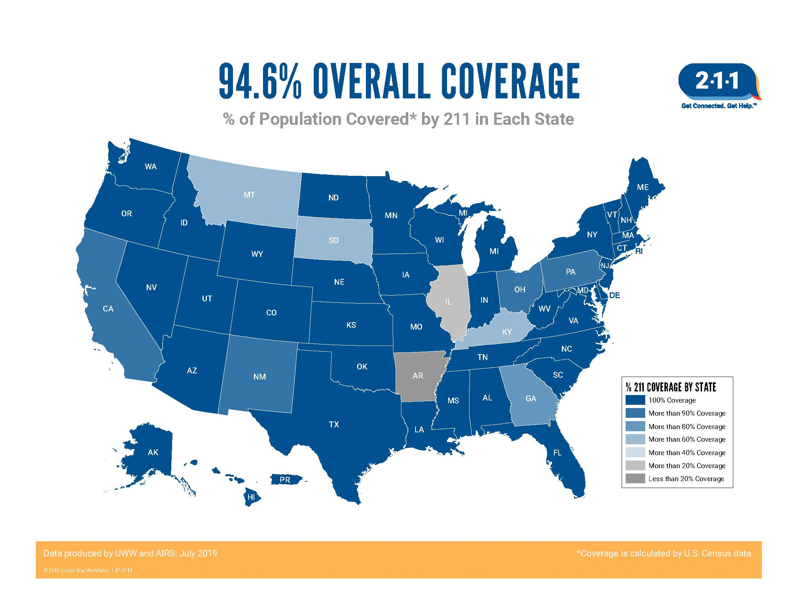

Slide 7
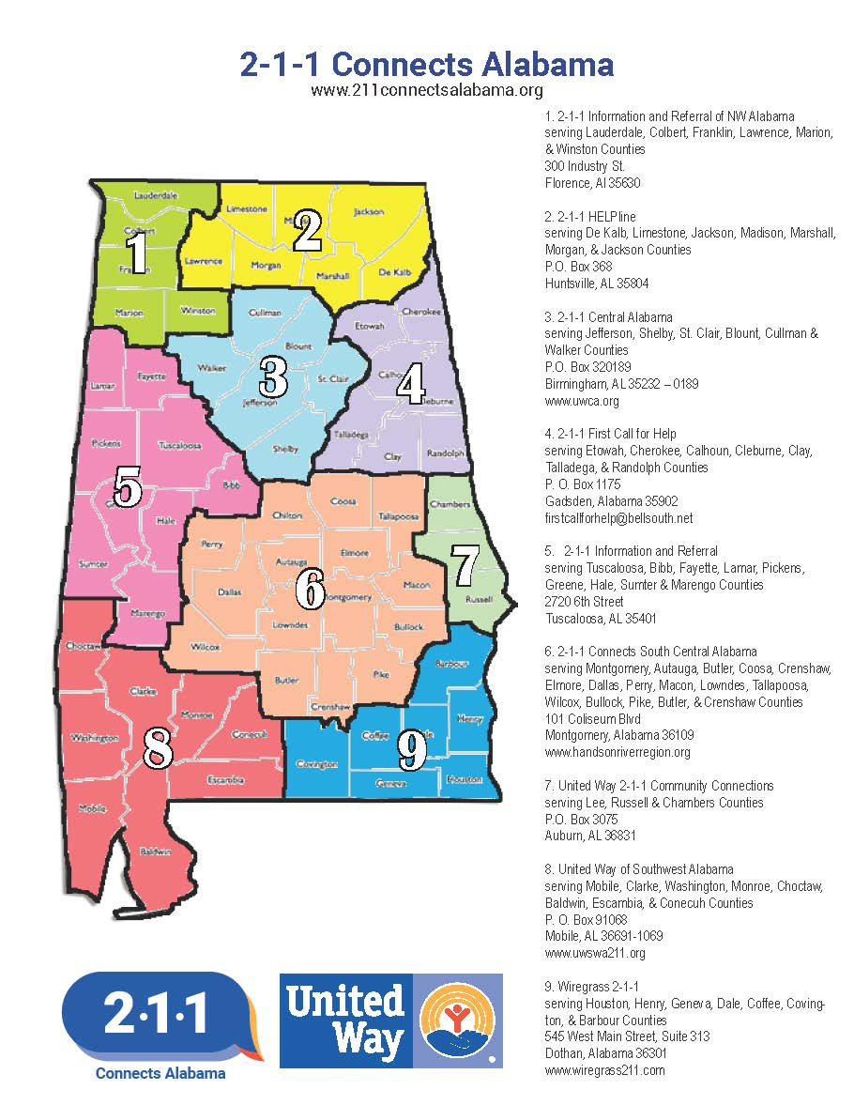
2-1-1 Connects Alabama is a network of nine call centers in the state of Alabama
Each call center is independently operated and managed
Uses a statewide database, iCarol, to access resources locally, regionally, and statewide
Although they are independent, call centers work together to cover call needs. In times of disaster, call centers utilize a Disaster Response Plan to coordinate services and maintain coverage across the state.

Slide 8
When you call 2-1-1, you’ll find information about:
Supplemental food and nutrition programs
Shelter and housing options and utilities assistance
Emergency information and disaster relief
Employment and education opportunities
Services for veterans
Health care, vaccination and health epidemic information
Addiction prevention and rehabilitation programs
Reentry help for ex-offenders
Support groups for individuals with mental illnesses or special needs
A safe, confidential path out of physical and/or emotional domestic abuse
Call 211 and speak with a live, highly trained service professional in your area from any cell phone or landline. All calls are private and confidential.
Call 2-1-1
Text 888-421-1266
Chat at 211connectsalabama.org

Slide 9
What happens on a call?
Information & Referral Specialists:
Asses, understand, and prioritize callers’ needs
Identify and offer appropriate resources
Help callers make informed decisions
Provide advocacy for those needing extra support
Follow-up with callers to identify gaps in service and measure effectiveness

Slide 10
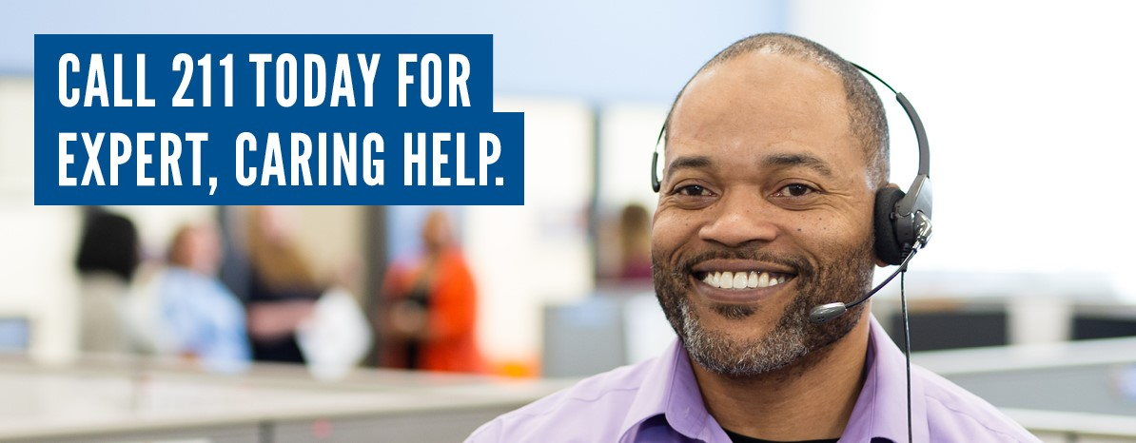
2-1-1: A Seamless System for Information
Call 2-1-1
or go to
211.org to
find help near you!

