Slide 1
15th Annual Homeowners Meeting
January 30, 2021
Abercrombie Woods
Property Owners Association
Joe Ello, President
Evelyn Ello, Vice President
Vic Pizzi, Secretary
Nicole Ello, Treasurer

Slide 2
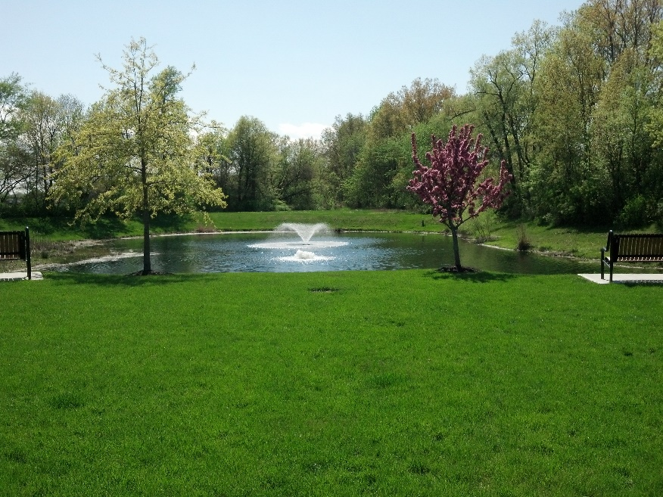
Today's Agenda:
Reading of Minutes from 2020 Meeting
Treasurer Report
Fountains for 4 & 5 Ponds
Budget for 2021
New Business
Subdivision Garage Sale Dates June 4 & 5, 2021; 2nd subdivision sale to be determined

Slide 3
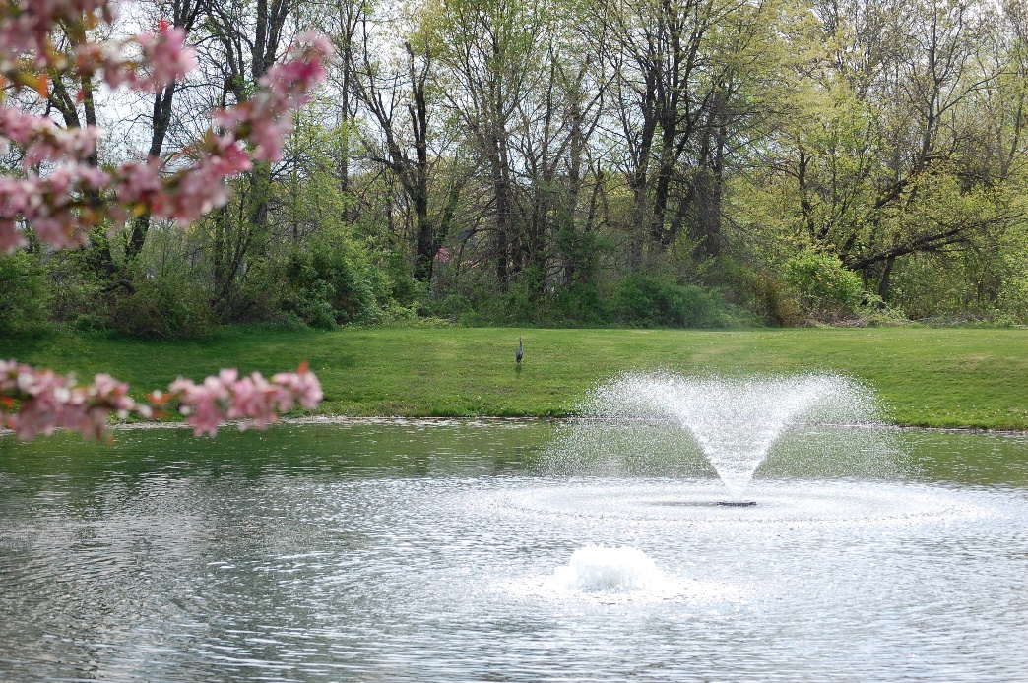
Abercrombie Woods
Property Owners Association, Inc.
Overview
Who We Are:
144 Lots with 15 acres of Commons Area including 5 Storm Water Retention Ponds.
Annual Potential Revenue 2021 is $35,712 @ $248 dues and 144 Lots
Total Revenue collected at Year end 12/31/20 $35,485.

Slide 4
Reading of Minutes
2020 14th Annual Meeting Jan 18, 2020 (next slide)
2nd Election Meeting Feb. 8, 2020 (Slide #6)

Slide 5
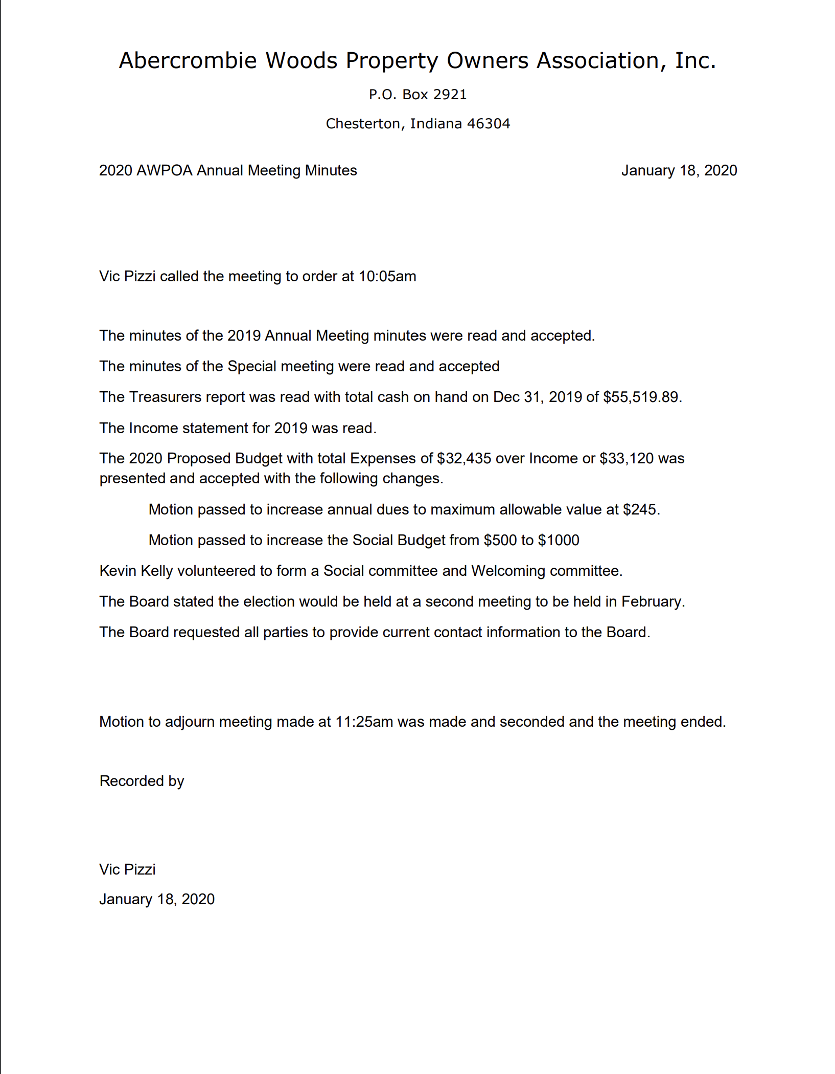

Slide 6
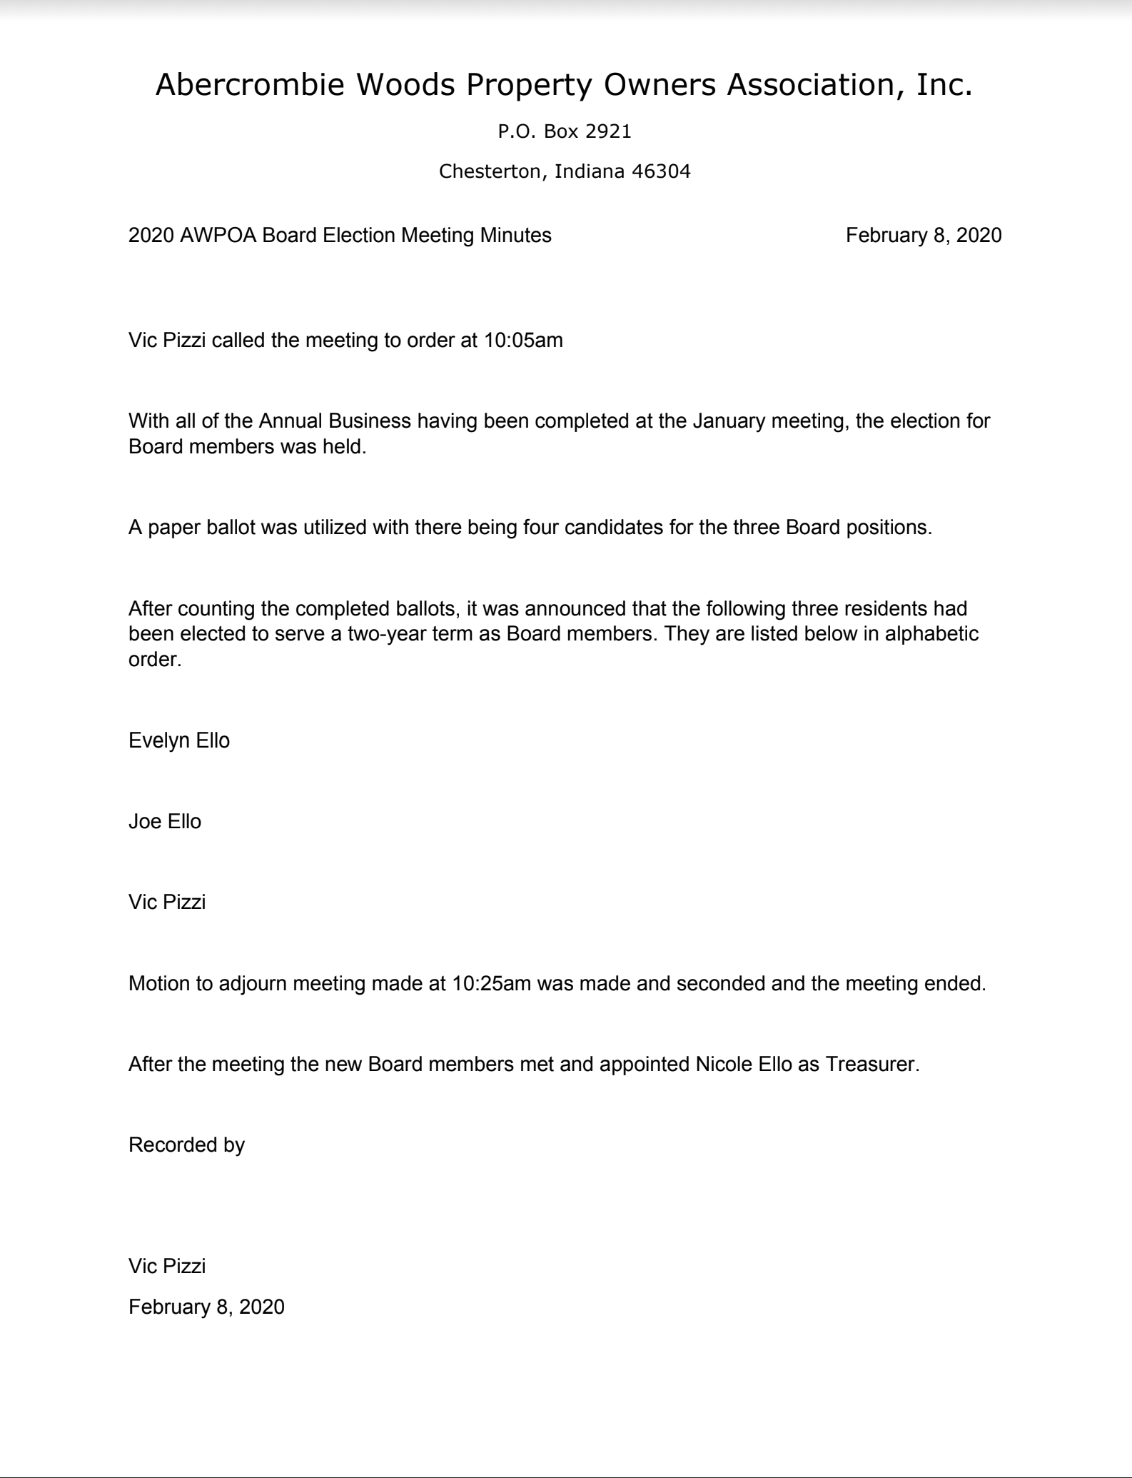

Slide 7
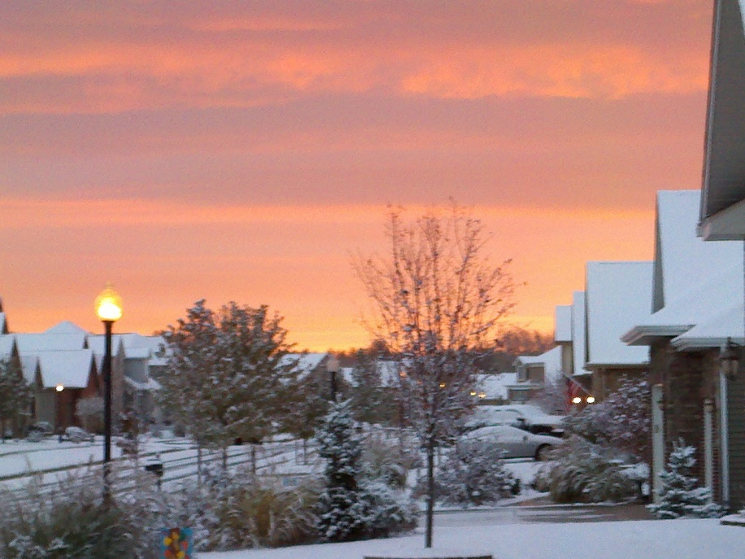
Treasurer Report
Bank Account
Financials
Budget

Slide 8
Bank Account Status
As of December 31, 2020
Current Checking Bank Balance $46,127.37
Current Working Capital Fund $7,930.08
Total Cash on Hand at 12/31/20 $54,057.45
Expected Operational Expenses until July 1, 2021 $16,575.
  Lawn Care (Mowing and Applications) $4,575.
  NIPSCO $1,500.
  Pond Maintenance $8,000.
  Annual Meeting Expenses $0.
  Insurance $2500
Total Operating Bank Balance at July 1 $37,482.45

Slide 9
Income Statement December 31, 2020
 |  | Actual |  | Budget
Income
INCOME-A/ASSESSMENT (includes Insurance check for property damage) |  | $41441.37 |  | (144 homes @ $245) $35,280.00
INCOME-RESERVE (Capital Reserve $444 + Insurance Discount $390.32 to be moved to Savings) |  | $834.32 |  | $0.00
Total Income |  | $40,496.05 |  | $35,280.00
Expenses
PROPERTY INSURANCE |  | $2499.00 |  | $3,000.00
LEGAL |  | $0.00 |  | $200.00
MAINTENANCE-LANDSCAPE/MOWING |  | $12,200.00 |  | $13,000.00
MAINTENANCE-POND TREATMENT |  | $8685.80 |  | $8,000.00
MAINTENANCE-FOUNTAIN REPAIRS (New lights & repair electrical on ponds 1-3 $4260.00. Install electric post w meters/permit for ponds 4 & 5 $2650.00) |  | $6,910.00 |  | $1,000.00
SUPPLIES |  | $287.83 |  | $200.00
POSTAGE |  | $480.40 |  | $350.00
ELECTRIC |  | $5571.97 |  | $6,000.00
MEETING EXPENSE |  | $200.00 |  | $150.00
BANKING |  | $65.00 |  | $120.00
TAX PREPARATION |  | $262.00 |  | $300.00
PROPERTY REPAIRS (Damaged roof on AWPOA Garage paid by insurance) |  | $5343.05 |  | $0.00
DOMAIN/WEB HOSTING |  | $83.88 |  | $125.00
SOCIAL COMMITTE |  | $15.00 |  | $1000.00
Total Expenses |  | $42,079.93 |  | $33,445.00
Net Income/(Loss) |  | ($1,583.88) |  | $1,835.00

Slide 10
2021-22 Proposed Budget
PROPERTY INSURANCE |  | $3,000.00
LEGAL |  | $200.00
MAINTENANCE-LANDSCAPE/MOWING (1x expense for tree/shrub removal *see quote) |  | $12,200.00 $2,160.00
MAINTENANCE-POND TREATMENT |  | $8,826.00
MAINTENANCE-FOUNTAIN REPAIRS (1x expense Purchase of Pond 4 & 5 fountains) |  | $1000.00 $7,000.00
SUPPLIES |  | $200.00
POSTAGE |  | $350.00
NIPSCO |  | $7,000.00
MEETING EXPENSE |  | $100.00
BANKING |  | $65.00
TAX PREPARATION |  | $260.00
PROPERTY TAXES |  | $0.00
DOMAIN/WEB HOSTING |  | $125.00
SOCIAL COMMITTE |  | $500.00
Total Expenses |  | $42,286.00
Expected Income |  | $35,712.00
Expected GAIN/(LOSS) |  | ($7,274.00)

Slide 11
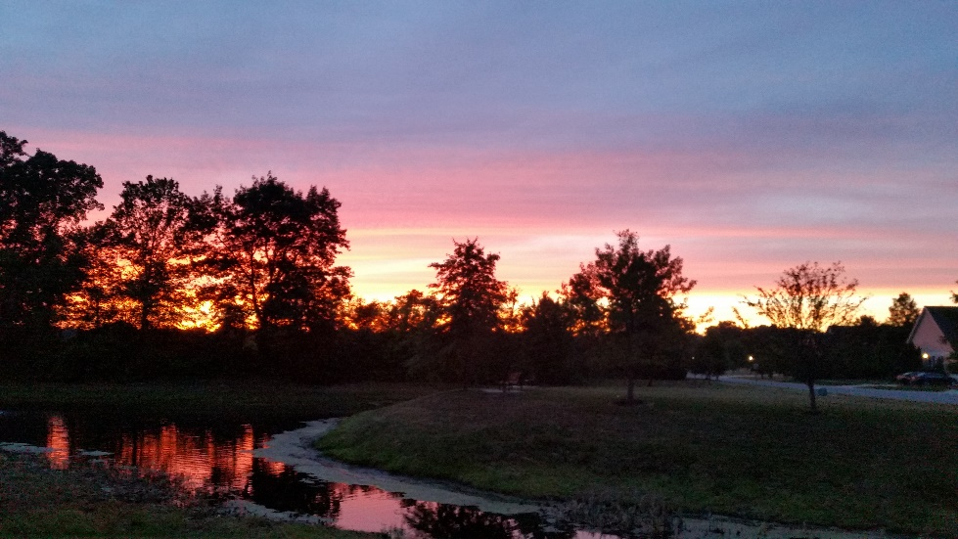
Association Vote on the
Proposed 2021 Budget
No Annual Meeting shall be adjourned until a budget is approved by the owners for the upcoming year.
Questions on the Budget
Vote on the Budget
In Favor – Yes/No

Slide 12
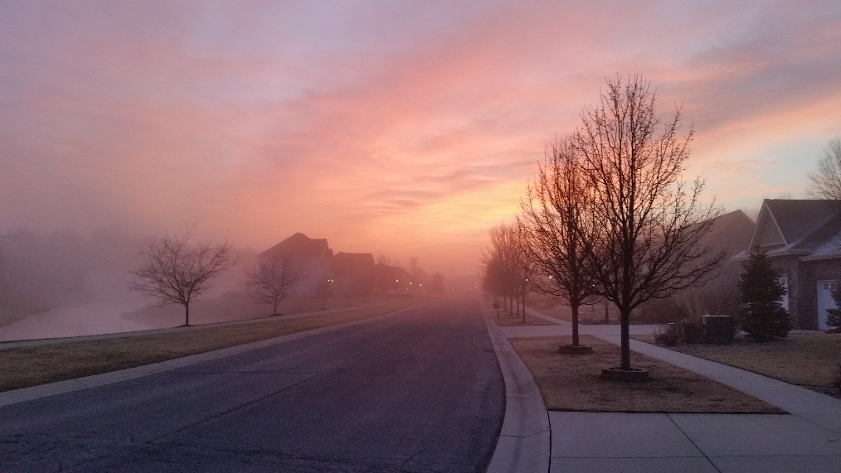
Status of 2020 Dues
Current Dues - $245 for Fiscal year ending June 30, 2021
As of December 31st, the total Dues still owed by 2 homeowners: $950 does not include Late Fees and Interest. (Update: did receive 1 of 2 in Jan with appropriate late fees and interest $1,173.68 received in Jan not included in previous slides)
AWPOA had to write-off $690.00 due to a bankruptcy resulting in loss of income.

Slide 13
2020 POA Dues
Dues for 2020 were $245
Cost of Living Adjustment for 2021 is 1.3% or approximately $3.18 per property.
New Dues for 2021 will be $248 with increase of $3 for COLA
Capital Reserve Fee $43 per at closing of homes sold
Invoices will be mailed on the June 1, 2021 with a July 31, 2021 Due Date
Late Fee WILL be assessed after July 31.
An 18% APR Interest charge may be added when account is 60 days past Due.
A Lien may be placed if the account becomes 90 days past due.

Slide 14
Rules and Restrictions
The Board can only enforce matters that relate to the Covenants, By-Laws and Guidelines to Property and Home Improvement.
Cannot enforce traffic problems, parking problems, barking dogs, dog messes or neighbor disputes.
The Board may adopt rules with or without meeting to cover any subject not specifically covered by the Covenants or By-Laws.
To change the Covenants or By-Laws would require a 2/3 vote by all homeowners.

Slide 15
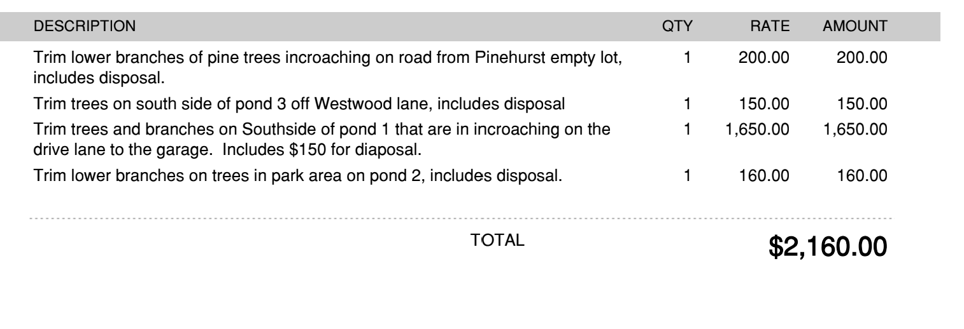
Landscaping
Hawkins Lawn Service is our grass cutting Contractor through 2021.
Below is the quote for additional services we requested from landscaping

Slide 16
PONDS
Lake & Pond Biologists LLC of Chesterton was the vendor for 2020 and has submitted new bid to continue services on all ponds.
Second bid received from Aquatic Control which includes all 5 ponds.

Slide 17
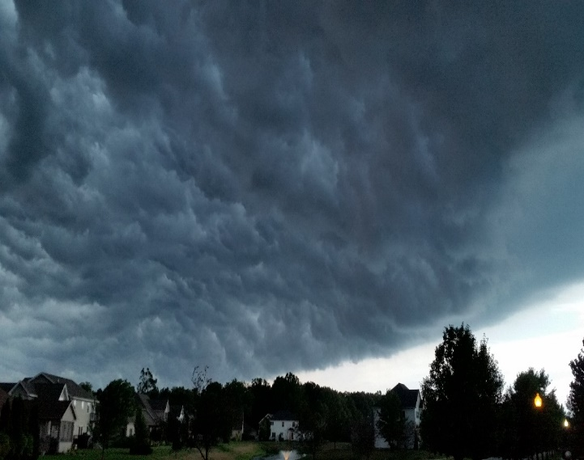
Your AWPOA Committees
Architectural Committee
  Pierre Lauzon
Neighborhood Directory
  Board of Directors
Social/Welcoming Committee
(Yard Sale)
  Kevin Kelly
Pond Committee
  Shaun Connelly
  Roger Case
We have had committee members move or step-down. We could use volunteers for all committees. We prefer at least 3 people per committee if possible…join us to help keep our community a great place to live!!
Please email board member if interested.

Slide 18
New Business
New Business may be brought before the meeting only upon written request submitted at least five (5) days prior to the date of the meeting; provided however, that such written request may be waived at the discretion of the Board of Directors.

Slide 19
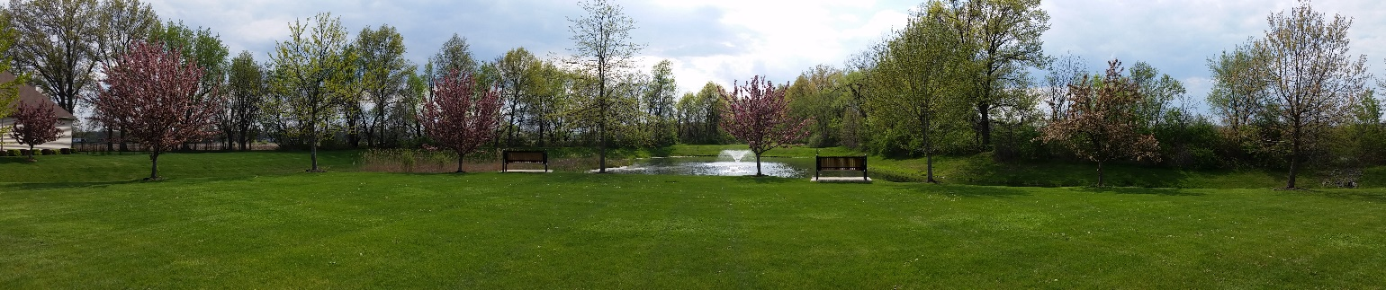
Adjournment
No Annual Meeting shall be adjourned until a budget is approved by the owners for the upcoming year.
These slides and minutes from this meeting will be posted on our Abercrombie Woods Web Site.

