Slide 1
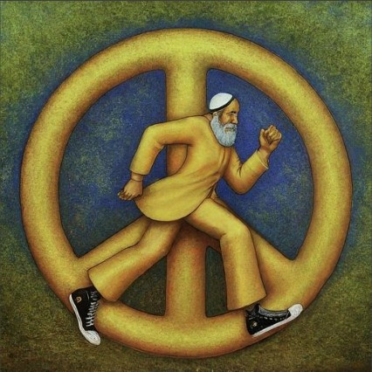
What is Project Aharon?
"Be of the disciples of Aaron, loving peace and pursuing peace"
Project Aharon is an advocacy and facilitation nonprofit whose mission is:
To institutionalize Shalom Strategies within our communal institutions for the pursuit of peace, unity, and conflict preparedness
To evolve cultural and institutional norms within Jewish communities to further prevent disaffiliation due to conflicts.
To help institutions adopt formalized introspection and continuous improvement in conflict preparedness.
To strengthen Jewish communal life by facilitating institutions through tools and resources for proactive conflict management, fostering a culture of peace and inclusive unity to prevent disaffiliation.
Project Aharon seeks a future where every synagogue:
Has a Shalom Strategy addressing conflicts
Sets aside time to introspect and review effectiveness
Drives down disaffiliation through continuous improvement

Slide 2
Who is Project Aharon for?
"The entire Jewish people are a single, perfect whole"
Project Aharon partners with lay and professional leaders of communal organizations such as synagogues, schools and other communal institutions.
People experience disagreements within their community. Ideally, these represent a healthy exchange of ideas, but they also have the potential to lead to conflicts.
Community leaders, professional and volunteer, bear the difficult responsibility of managing the conflicts and ensuing fallout. Through no fault of their own, they are unable to amicably resolve all conflicts owing to a lack of resources and/or relevant training. At the same time, members may lack the emotional, social, or political wherewithal to engage effectively. All too often, conflicts escalate, and others take sides. As a result, people may feel a lack of support, become distanced from the community, and in some cases leave their religion.
The number of people impacted, and to what degree, is not regularly measured; commonly discussed; or formally addressed by the majority of community organizations. Instead an ad-hoc, reactive approach is common when managing conflicts. To reduce interpersonal conflict, avoid losing social cohesion and increase healthy communal participation, we should better prepare groups, individuals, and leaders to become conflict resilient.

Slide 3
How does Project Aharon work?
Implementing Continuous Improvement in terms of a Shalom Strategy is an ongoing, cyclical process of introspection and adjustment with the goal of optimizing Shalom and addressing problems systemically.
"Every organization needs to be introspective, transparent, and honest with itself."
The standard business model of Continuous Improvement emphasizes incremental changes to eliminate waste and enhance efficiency. It’s core mechanics are:
Set Goals that are aligned to values and measurable where possible: e.g. Increase participation, Increase volunteer hours, Resolve z% of conflicts amicably.
Plan on how to achieve those goals: Most organizations do this either at the board or sub-committee level.
Collect Data while implementing Plans: e.g. headcounts at events, surveys, third party assessments, membership count, conflict counts, resolution %
Review Results periodically and adjust Plans as needed: Organizational introspection is a group activity which often works best when focusing on achievable, typically smaller improvements.
Repeat
A Shalom Strategy is more than a plan for peace, rather it is a thought out approach to optimizing completeness, wholeness, and universal flourishing. For a communal institution e.g. a synagogue, a Shalom Strategy might include core pillars like:
1. Shalom Bayit (Peace in the Home/Internal Harmony): Fostering a welcoming and supportive congregational environment.
2. Tikkun Olam (Peace through Justice/Repairing the World): Active pursuit of repairing the world and social justice.
3. Shalom L’Makom (Peace with the Divine/Spiritual Wholeness): Deepening spiritual connection and meaning through Jewish practice and learning.

Slide 4
How does Project Aharon work?
Here is an example of a Shalom Strategy (reuse it or fill in your own Pillars, Goals, Strategies and Initiatives)
"Vision without action is merely a dream. Action without vision just passes the time. Vision with action can change the world."
Pillar 1: Shalom Bayit
(Internal Harmony & Welcome)
Goal: Ensure every person feels welcomed, valued, and a true sense of belonging.
Pillar 2: Tikkun Olam
(Repairing the World)
Goal: Act as agents of justice and peace, actively working to repair the brokenness in the world.
Pillar 3: Shalom L'Makom
(Peace with the Divine/Spiritual Wholeness)
Goal: Provide diverse and meaningful opportunities for spiritual growth, learning, and connection to Jewish tradition.
Strategy Component | Key Initiatives
Radical Inclusivity (B'tzelem Elohim) | Welcoming Protocol: Implement a formal greeter program for all services and events. Train staff and volunteers to use name-tags and intentionally learn and use members' names.
 | Accessibility: Ensure physical, programmatic, and financial accessibility (e.g., "rise if you are able" language, clear policies for joining/affording membership, hearing assistance, and diverse service styles).
Community in Relationship (Kehillah Kedoshah) | Small Group Connections: Facilitate smaller gatherings (e.g., "Shalom @ Home" dinners, affinity groups) to foster deeper personal relationships outside of large services.
 | Hesed (Loving-kindness) Committee: Formalize a committee to provide support for members in times of need, celebration, illness, or mourning (e.g., meal delivery, rides, calls).
Conflict Resolution | A Culture of Grace: Establish clear, respectful, and confidential processes for addressing conflict and disagreement, emphasizing listening and mutual respect over winning an argument.
Strategy Component | Key Initiatives
Pursuit of Justice (Tzedek) | Social Action Projects: Organize regular, hands-on activities that address local needs (e.g., food drives, working with homeless shelters, environmental efforts).
 | Advocacy & Education: Educate the congregation on pressing social and ethical issues through a Jewish lens, encouraging informed action and advocacy within the community.
Interfaith & Community Bridge Building | Dialogues for Understanding: Host regular interfaith and cross-cultural dialogue events with neighboring religious and community groups to promote mutual respect and cooperation.
 | Community Partnerships: Formalize partnerships with local non-profits whose missions align with the synagogue's values of peace, equity, and well-being.
Support for Israel & the Jewish People (Ahavat Yisrael) | Balanced Education: Promote robust, thoughtful, and pluralistic educational programs about Israel and the global Jewish community that foster a deep connection while allowing for critical engagement.
Strategy Component | Key Initiatives
Meaningful Worship (Avodah) | Kavannah (Intention): Encourage deeper focus and devotion in prayer through pre-service reflections, diverse musical styles, and clear explanations of the liturgy.
 | Variety of Service Styles: Offer multiple prayer experiences (e.g., traditional, meditative, family-focused, musical) to meet the diverse spiritual needs of the congregation.
Lifelong Learning (Talmud Torah) | Core Curriculum: Develop a cohesive, multi-stage curriculum for all ages that connects Jewish texts and values (like Shalom) to modern life.
 | Adult Education: Offer high-quality adult learning opportunities in different formats (in-person, online, short-term, long-term) to cultivate intellectual and spiritual growth.
Personal Spiritual Development | Spiritual Mentorship: Create opportunities for members to connect with clergy or lay leaders for personalized spiritual guidance or deep textual study.
 | Rhythms of Rest: Encourage members to fully observe Shabbat and holidays as times for genuine rest, disconnection from stress, and re-connection with family and community.

Slide 5
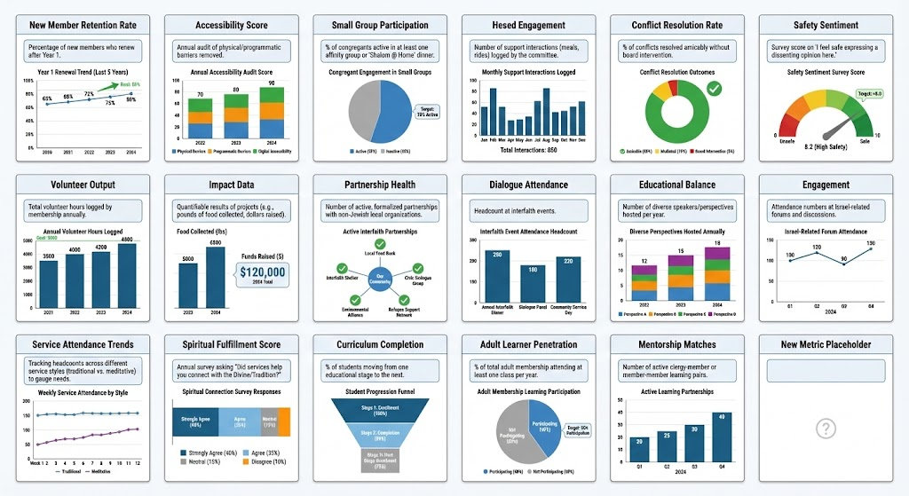
A Shalom Strategy’s effects are important
measures of what’s working and what’s not
"You can't improve what you don't measure"

Slide 6
When does Project Aharon get involved?
""
Initial conversations focus on advocacy and the normalization of continuously improving an organization's approach to growing peace
Facilitation is available upon request and on a case by case basis for institutions seeking assistance setting up Continuously Improving Shalom Strategies:
Consultation on how Continuous Improvement works and how to set it up
Conflict resolution frameworks / best practices
References to experts in the field and organizations with related offerings
* Please note Project Aharon does not engage/facilitate with specific conflicts, but rather offers a way to change the system those conflicts exist within
Registration may occur when an institution schedules dedicated time periodically for leaders to introspect. Joining the growing list of adopters helps to encourage others to consider the possibilities

