Slide 1

Clean Needle Exchange: Promoting Public Health and Social Justice in Nursing
Amber Soiland
NUR 336 ETHICS, LAW & POLICY
Mary Beth Johnson, DBe, MN, RNC
April 20, 2025

Slide 2

Topic: Clean Needle Exchange
Program Relevance to Provision 9: Nurses are responsible for promoting social justice, protecting public health, and shaping health policy.
Overview: This presentation will define clean needle exchange programs, explore the policy landscape, and propose a nursing-centered solution to expand NEPs nationwide.
(CDC, 2022)
(National Harm Reduction Coalition, 2023)

Slide 3

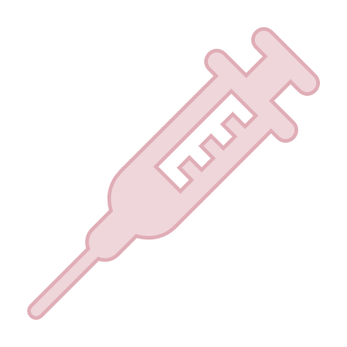
What Is a Clean Needle Exchange Program?
Community-based programs that provide access to sterile needles and safe disposal
Often they include education, referrals to treatment, HIV/HCV testing, and overdose prevention
(CDC, 2022)

Slide 4

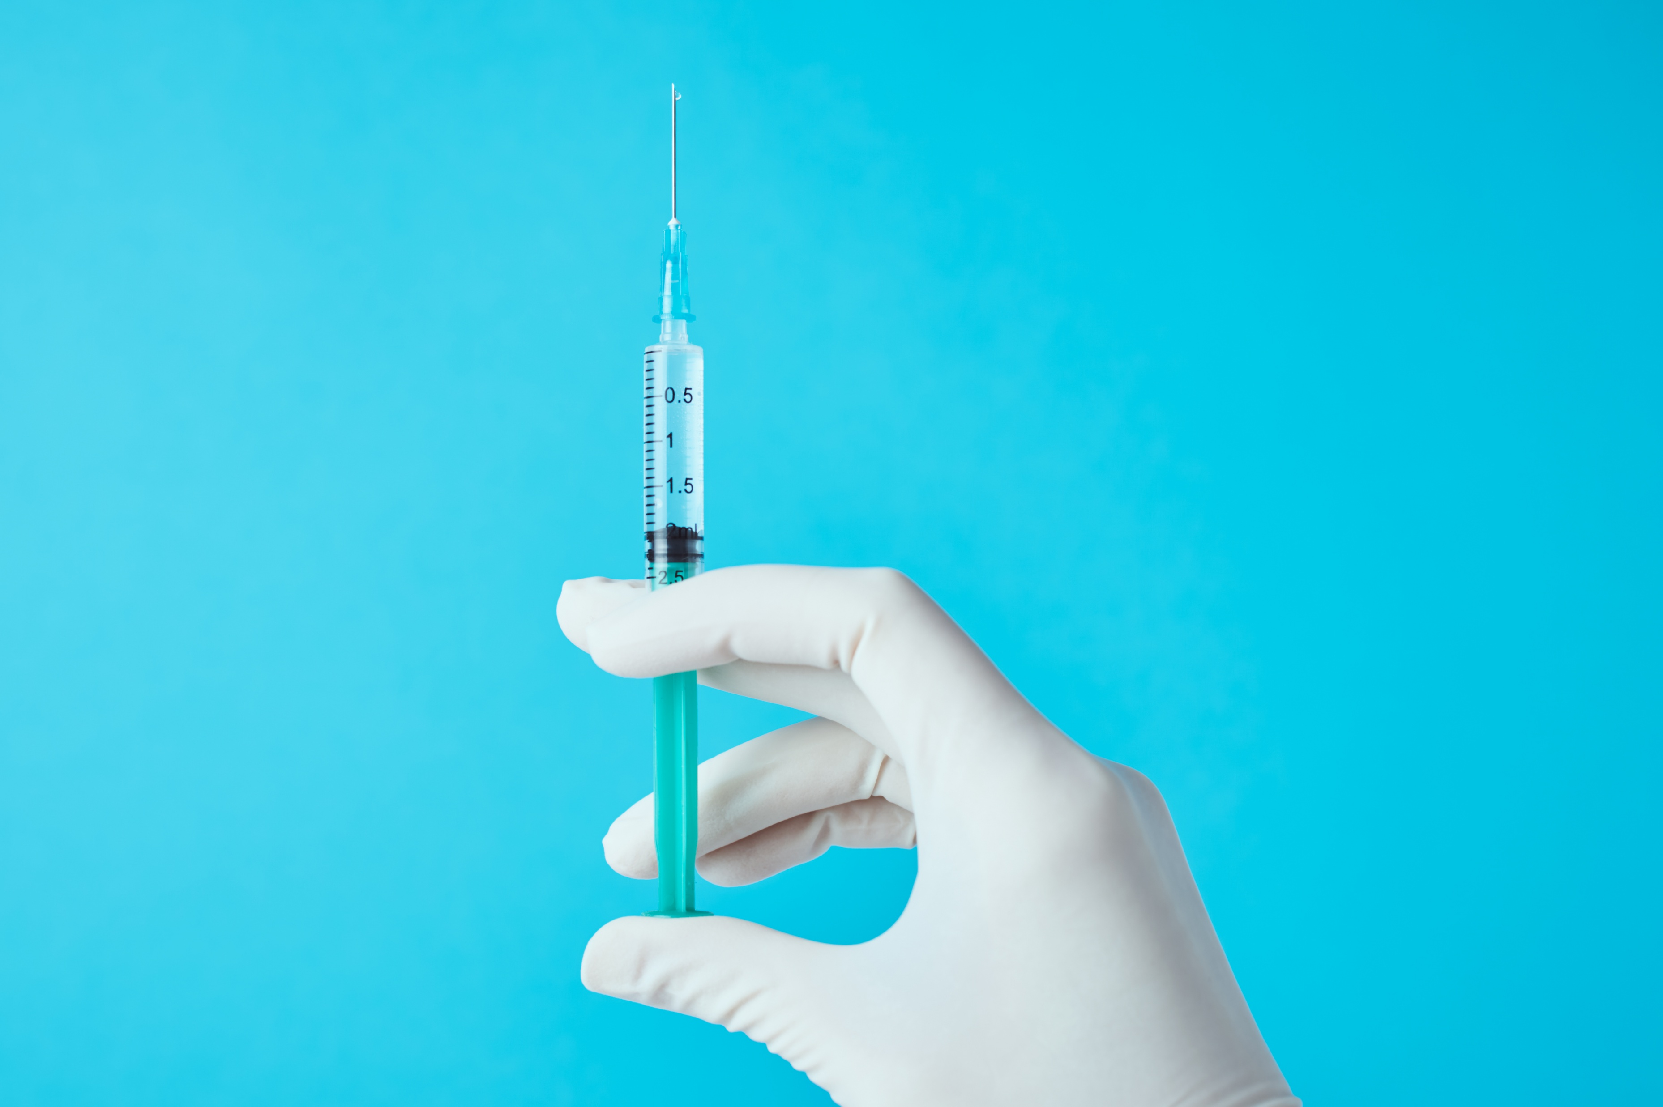
Why This Issue Matters
Over 2 million people in the U.S. inject drugs
Shared needles lead to higher transmission of HIV, Hepatitis B/C
NEPs reduce transmission, improve outcomes, and connect people to care (Des Jarlais et al., 2021)
(CDC, 2022)

Slide 5

Nursing’s Role in the Issue
Nurses educate, advocate, and reduce stigma
Nurses work in harm reduction clinics and public health roles
Provision 9 calls nurses to promote social justice and public good
(American Nurses Association [ANA], 2020)

Slide 6
History of the Issue
1980s: Needle exchange begins in response to HIV/AIDS
1988: Federal funding for NEPs banned
2009: Ban lifted, but inconsistently applied
Present: Only 38 states support NEPs legally
(Beletsky & Davis, 2020)

Slide 7

Past Attempts & Current State
Criminalization and abstinence-based strategies dominated
Stigma and politics often halted progress
Current NEPs are underfunded or localized
(Des Jarlais et al., 2021)

Slide 8
NAVIGATING Q&A SESSIONS
Know your material in advance
Anticipate common questions
Rehearse your responses
Maintaining composure during the Q&A session is essential for projecting confidence and authority. Consider the following tips for staying composed:
  Stay calm
  Actively listen
  Pause and reflect
  Maintain eye contact

Slide 9

Who Is Affected?
PWID (People Who Inject Drugs)
Unhoused individuals
LGBTQ+ youth, especially transgender people
Rural communities with limited healthcare

Slide 10

Social Determinants of Health
  Housing instability
  Access to healthcare
  Poverty and unemployment
  Discrimination and stigma

Slide 11

Proposed Solution
Federal and state funding to expand NEPs
Mobile outreach units in rural areas
Integration with public health departments and clinics

Slide 12

Cost & Practicality
Cost: ~$0.97 per clean syringe; ~$450,000/year for a full program
This Saves $7 for every $1 invested (CDC)Practical and scalable
(CDC, 2022)

Slide 13
Implementation Timeline
Phase 1: Launch pilot programs in underserved areas (6-12 months)
Phase 2: Scale up through state grants and health departments (1-3 years)

Slide 14

Collaborative Implementation
Public health departments
ANA and state nursing associations
Harm reduction coalitions
Community leaders and law enforcement
(National Harm Reduction Coalition, 2023)

Slide 15

My Own initiative
Rapid Harm Reductions
  www.TheRTI.org
  Insta and TikTok: @The_Rapid_CPR_Girl

Slide 16
Addressing Opposition
Misconception: NEPs encourage drug use
Response: Evidence shows NEPs reduce disease and increase access to treatment
Emphasize public safety and fiscal responsibility
(Beletsky & Davis, 2020)

Slide 17

Impact on Individuals
Reduces rates of HIV/HCV
Connects clients to recovery services and social support
Reduces hospital visits, improves health outcomes

Slide 18

Impact on Nursing
Upholds Provision 9: Integrity, values, advocacy
Expands nursing roles in public health
Enhances trust with marginalized communities
(ANA, 2020)

Slide 19

Case Study Example
San Francisco NEPs: 50% reduction in HIV among PWID in 10 years (Des Jarlais et al., 2021)
Nurses involved in outreach, education, and community trust-building

Slide 20

Call to Action
Nurses should advocate through ANA and legislative lobbying
Push for full federal repeal of NEP funding bans
Educate peers and patients on harm reduction
(ANA, 2020)

Slide 21


THANK YOU
NEPs are effective, ethical, and cost-saving
Nurses are key to advancing social justice in policy
Clean needle access saves lives and protects communities

Slide 22
References
Beletsky, L., & Davis, C. S. (2020). Harm reduction and the law. Health Affairs, 39(3), 429–435. https://doi.org/10.1377/hlthaff.2019.01450
Centers for Disease Control and Prevention. (2022). Syringe services programs (SSPs). https://www.cdc.gov/ssp/index.html
Des Jarlais, D. C., Nugent, A., Solberg, A., Feelemyer, J., & Mermin, J. (2021). Syringe service programs for persons who inject drugs in urban, suburban, and rural areas—United States, 2013–2017. Lancet Public Health, 6(1), e35–e44. https://doi.org/10.1016/S2468-2667(20)30276-3
National Harm Reduction Coalition. (2023). Principles of harm reduction. https://harmreduction.org/about-us/principles-of-harm-reduction/
American Nurses Association. (2020). The nurse’s role in addressing the opioid epidemic. https://www.nursingworld.org/~4ac077/globalassets/docs/ana/ana_opioidpositionstat ement_2020.pdf

