Slide 1

The Innovation Engine
Project Process and Good Record Keeping
Dr. Ralph K. Coppola, Founder & Executive Director

Slide 2

Examine the Challenge and identify what needs to be done:
Determine what the goals are and what you will need to do to win.
Look at the RWDC Scoring Rubric and see what the judges will be looking for and design your solution so that they conform to the RWDC Scoring Rubric in the order that they are provided. This helps make sure the judges will see all of your work and will not miss anything.

Slide 3
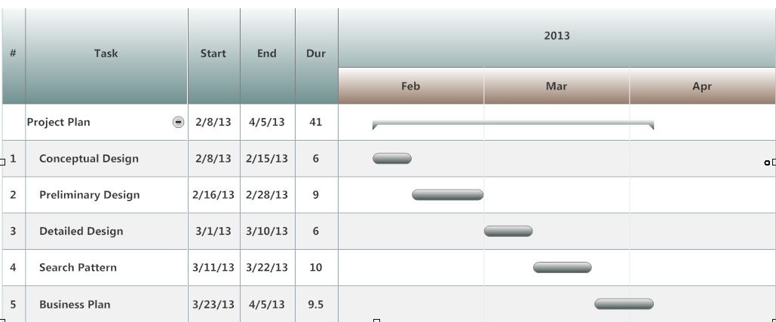
Establish a Timeline with Milestones
A timeline with milestones is key to your success. You may need to revise this timeline as your work progresses. The Project Manager should call regular team meetings (at least once a week) to review the progress that everyone has made on their tasks:
• Key events should be noted as milestones. These milestones, such as the due date for the submission of the Challenge Solution, should drive the dates for the other tasks.
• It is easy for time to rush by so be sure to create a timeline with specific tasks for each team member.
• If problems arise, they should be dealt with efficiently and effectively, and a revised timeline should be created with the plan to resolve the problem included.

Slide 4

Develop a Design Plan
To be successful you will need to have a plan for your work. This should include the following:
• Team members with expertise to address the Challenge in fields such as science, math, and design
• Mentors to supplement the expertise of your team
• Physical resources such as a place to meet and work, computers, and software loaded on the computers
• A strategy that includes the application of the design process and mathematical and scientific principles to the Challenge
• Preparation of your Challenge Solution submission

Slide 5


Develop and Use a Communication Plan
Strategize How to Communicate Your Challenge Solution
Keep in mind that a quality Challenge Solution is likely to require multiple drafts before it is polished and ready to submit. You need to plan for that part of the process.
The Challenge Submission should be designed so that reviewers will see that all of the review criteria in the Scoring Rubric are addressed.
Link the Communication Plan to Your Timeline
Make sure that you reserve enough time for writing your Challenge Solution. Be sure that key writing tasks and milestones are included in your timeline.

Slide 6
Communications Plan Continued
There are three products you will create as part of your Communications Plan:
Engineering Design Notebook (Submitted for Judging, it includes the details of your research)
Engineering Design Diary (Each team member will keep one. It is used to help build the Engineering Design Notebook and PowerPoint. It is NOT submitted or judged)
PowerPoint Presentation (Coveys a summary of the key elements of your research. Teams will present their PowerPoints to a panel of Judges)
Please Note: The Public Affairs/ Communications Plan is part of what is required as part of the Engineering Design Notebook and the PowerPoint Presentation. It is NOT a separate product.

Slide 7

Develop the Writing Team
Each team member should be part of the writing team.
Assign roles for the writing process and modify the plan based on the results of testing and redesigning your Challenge Solution.
You should appoint one person, perhaps your project communication specialist, as the lead on the writing task. This team member might be responsible for ensuring that everyone meets their writing task goals and for undertaking the editing of the final document.

Slide 8
Good Records Keeping is Vital for Success!!!
Engineering Design Diary – Each students keeps an Engineering Design Diary of ideas, solutions, plans, tasks and timelines. The key information from each student’s Engineering Design Diary is added Engineering Design Notebook.
Engineering Design Notebook – Detail the design process and the teams’ results. This is the submission that the judges will evaluate.

Slide 9


Engineering Design Diary
Keeping good records is part of good
science an engineering. Record:
Ideas
Solution options
Plans
Sketches of designs
References
Actions that need to be taken
Notes from meetings
Tests & analysis results
Plans
Tasks & Timelines

Slide 10
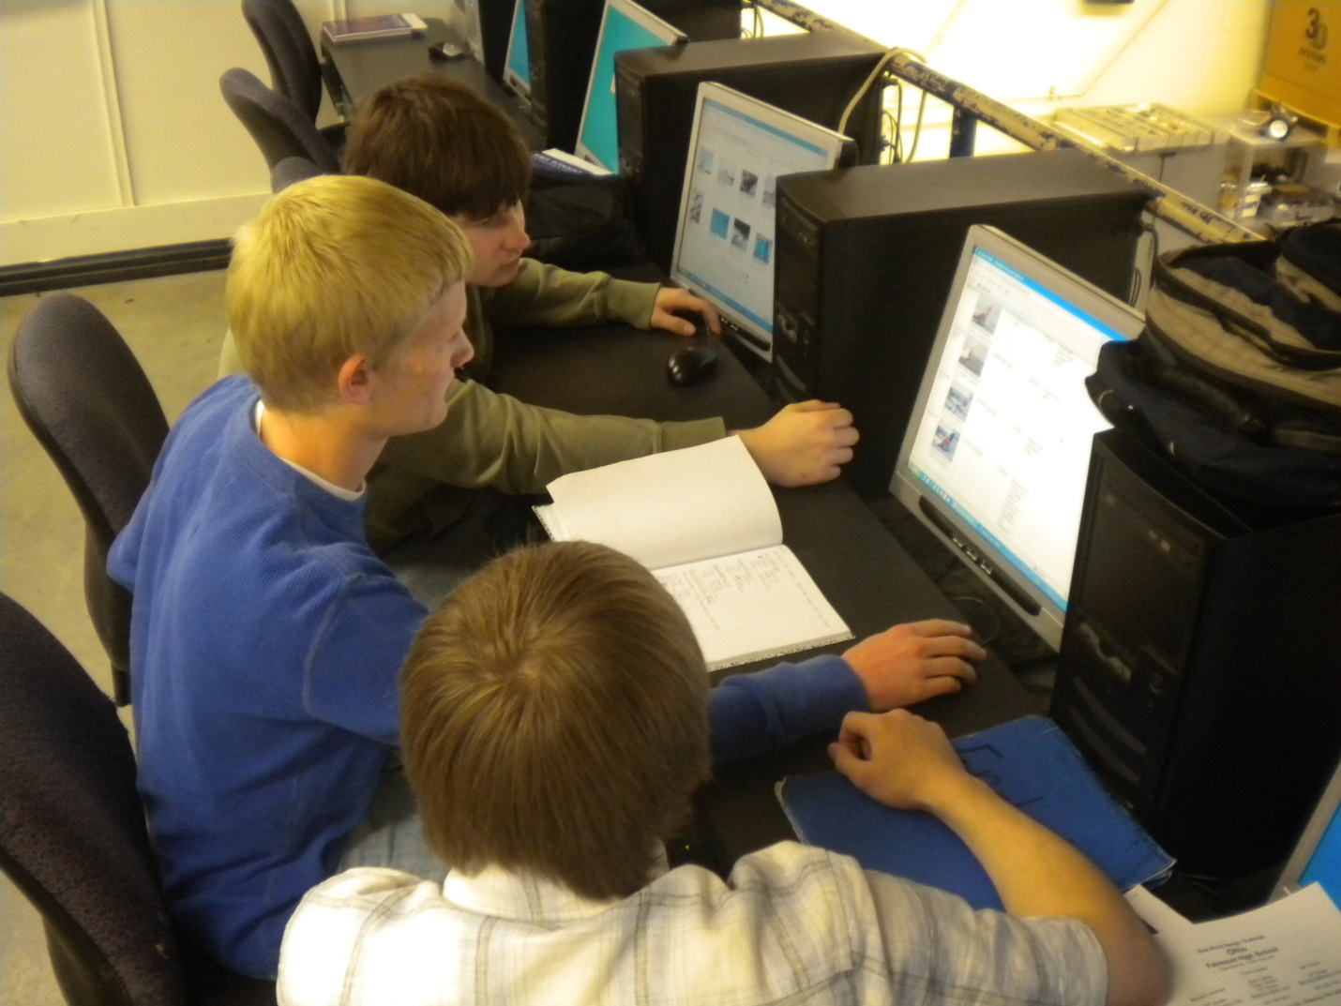
Engineering Design Diary Continued
Have regular meetings with your team to coordinate and share share ideas from your Engineering Design Diary
Keep notes at all meetings with dates, topics and action items.
Identify key information to include in your team Engineering Design Notebook.
Identify topics where you need Mentor support.
Keep track of questions and hypotheses.

Slide 11

Engineering Design Diary Continued
Record all analyses and results. From those results identify ways to enhance your design.
Identify all iterations on your design and detail all improvements.
Identify all tasks.
Keep a timeline of each task with milestones for each deliverable.
Identify critical paths for each task timeline identifying order and priority and how one task timeline connects to the others.

Slide 12
Engineering Design Notebook
Your Engineering Design Diary will contain information that you will include in Your Engineering Design Notebook.
The Engineering Design Notebook is what you submit for Judging.
It details the process of your research, analysis and work.
The structure follows the Scoring Rubric so the judges can easily find key information that will be evaluated. Review the Scoring Rubric carefully to following its paragraph order and details on what judges are looking for.
You will need to identify the key information that the judges need to learn about your results. The Engineering Design Notebook has been limited to 80 pages this year so take extra time to submit your best narrative in response to each Scoring Rubric element. Not all of your information can be included.

Slide 13
Engineering Design Notebook Continued
Your Engineering Design Notebook should contain evidence collected over time and should be presented in the form of a report.
It will be judged on the degree to which it demonstrates your team’s: Winning strategy, including a description of team members’ roles and a chronicle of the extent of collaboration among team members.
Level of innovation in addressing the Challenge process and the design solution.
Understanding of the engineering, science, and mathematics concepts underlying the problem and solution.
Demonstration of the use of the design process and skills in using design tools.

Slide 14

Engineering Design Notebook Continued
Evolution of the design (schematics) and decision/testing process leading to the solution proposed
Teamwork and collaboration
Networking and working effectively with RWDC mentors to supplement your teams’ needed expertise

Slide 15
Engineering Design Notebook Continued
Detail the design process and your team’s results.
Do not postpone work on your Engineering Design Notebook, but work on it throughout the challenge.
The narrative sections of your report need to include information allowing judges to verify your analysis and design viability. It will communicate an understanding of the mathematics supporting the results of the proposed design.
The data included will explain how the images in your proposed solution relate to the testing results obtained from the mathematical formulae used for analysis, and how you have modified your designs based on testing.
The narrative and graphic representations of your design should clearly communicate an analysis of how the proposed design works and why it works.

Slide 16

Submit Your Challenge Solution in the form of your Engineering Design Notebook
In the end, everything comes down to your submission. When you submit, make sure that:
• Your submission meets the guidelines
• You review the RWDC Scoring Rubric by which your submission will be judged
• Make sure you submission is a complete as you can make it.
• You submit on time!

Slide 17
PowerPoint Presentation
The PowerPoint Presentation is:
15 minute presentation given before a panel of judges at the International Event in Washington, DC.
10 Minutes of questions by a panel of judges.
It is a summary of the information provided in the Engineering Design Notebook.
It should include key concepts, processes, analyses, designs and conclusions, etc.
You should develop a strategy and plan to communicate your results clearly and with enough information to convey key concepts and ideas.
Remember your Engineering Design Notebook and your PowerPoint are two different products with two different purposes.
  Engineering Design Notebook includes all the details of your research.
  PowerPoint coveys a summary of the key elements of your research.
Since you only have 15 minutes you will NOT be able to present all of the information included in the Engineering Design Notebook.
It is important to EXPLAIN all key findings.
Practice presenting your PowerPoint to ensure each team member has a speaking role, you can answer questions the judges will ask, and that you can present the information in 15 minutes.

