Slide 1

The Innovation Engine
Design of a Business Plan
Mr. Jeffrey Coppola, RWDC

Slide 2

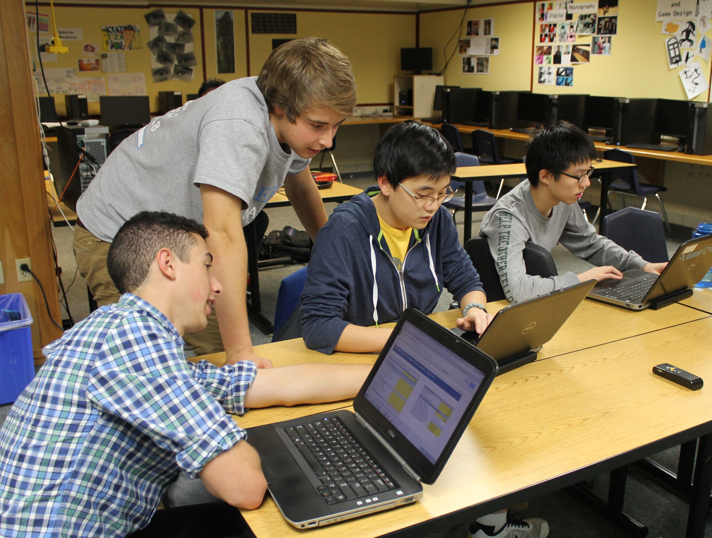
Introduction to business plan
What is a Business?
What is a Business Case?
What is a Slack Time?

Slide 3
What is a Business?
What is the purpose of a business?
  To make money
What are the 2 major types of business?
  Sell a Product
  Provide a Service
What are the 2 major strategies for business?
  Low-Cost provider
  Differentiator
Notes:
Answers:
1. Make a product or provide a service
2. Make money
3. Any example is fine
4. Low cost provider and Differentiator

Slide 4
Your business should only have 2 of the following characteristics.
Fast
Cheap
Good

Slide 5
What is a Business Case?
Provides the rationale for the development of a product or service.
  Why are you making a business?
Explains how the project will produce a Return on Investment (ROI)
  What is in it for me (for the person paying for it)?
Outlines the overall feasibility and risks.
  Can your plan work?
  What problems might prevent your plan from working?
Provides the overall scope, timeframe, and funding requirements
  How much will it cost? How long will it take? How will you get the money to start?

Slide 6
Key terms
Total Income (Revenue)- Money received for a good or service. This is all of the money that you receive.
Cost- Money required for equipment, time, space, or materials. This is the money you are spending to run your business.
  Fixed costs- Costs from things such as equipment or land that do not change with additional service or production of a product.
  Variable costs- Additional cost to make a product or perform an additional service.
Profit- The money you receive from revenue after paying for your fixed and variable costs.
  Profit=revenue-Cost

Slide 7
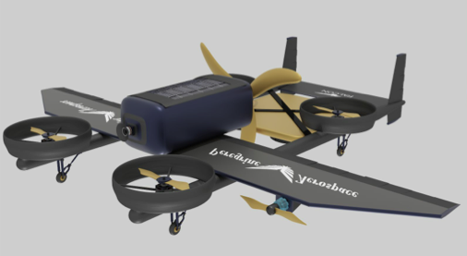

Key terms
  Return on Investment- What is in it for me? This is the benefit someone gets from giving money or some other resource for a good or service.
Break even point- This is the point in time where the profit made is equal to the amount of money you initially invested in your business.
Amortization- Method of accounting for your fixed and variable costs to figure out what your cost are for each flight.

Slide 8
Calculating Break Even Point
The Break Even Point is you have made enough money from daily profits to pay for your fixed costs initially invested in your project
Number of Days to Break Even = Fixed costs/ Profit (Net income) per day
Break even point may come after many or few days of deliveries depending how much your fixed costs are and how much your operating expenses are
You will hit a break even point as long as your design Makes a daily net income

Slide 9
Project planning
It is important to have a good plan for completing the challenge
Make sure not to forget to incorporate the business planning into your work
It is important to complete work on different areas of the competition at the same time
Planning with a Gant Chart could be more efficient than using something like a waterfall chart.
More valuable than the chart is understanding what your plan is and what tasks you need to complete to accomplish the mission and the project

Slide 10
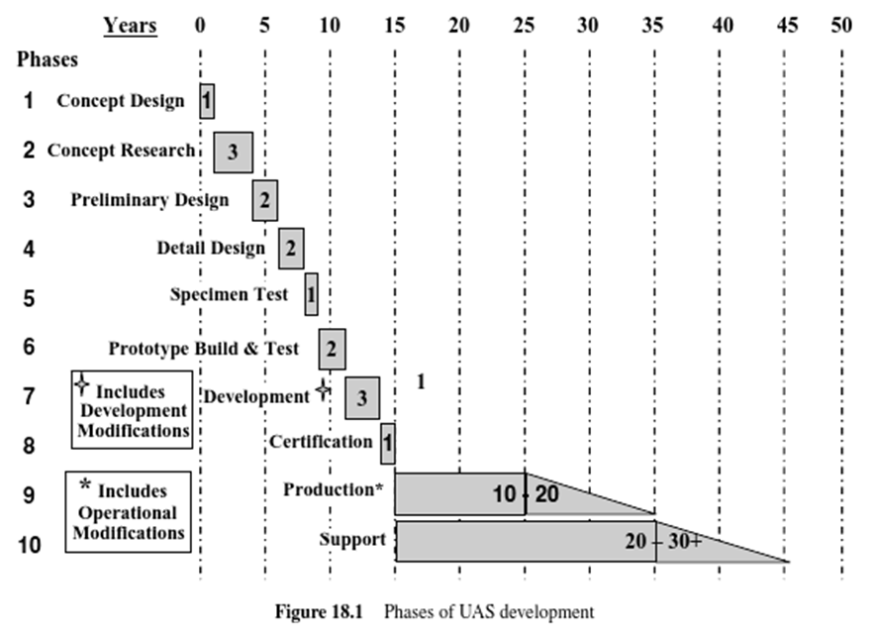
(Waterfall) Method
Good for linear tasks
Not much room to improve on task efficiency
Tasks are not easily done at the same time

Slide 11
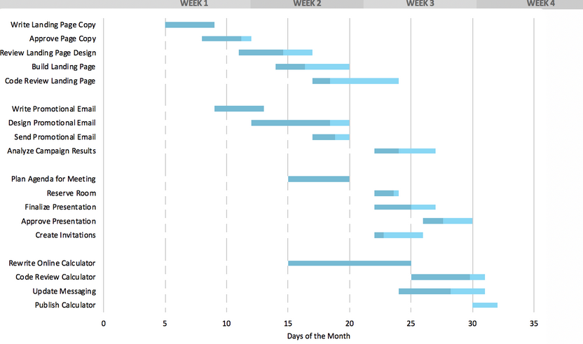
Gantt Chart
Tasks can be shown to occur at the same time
Shows the tasks easily from the start time to the finish time
Good for organizing a large project
Does not show detail on how tasks are related to each other well

Slide 12
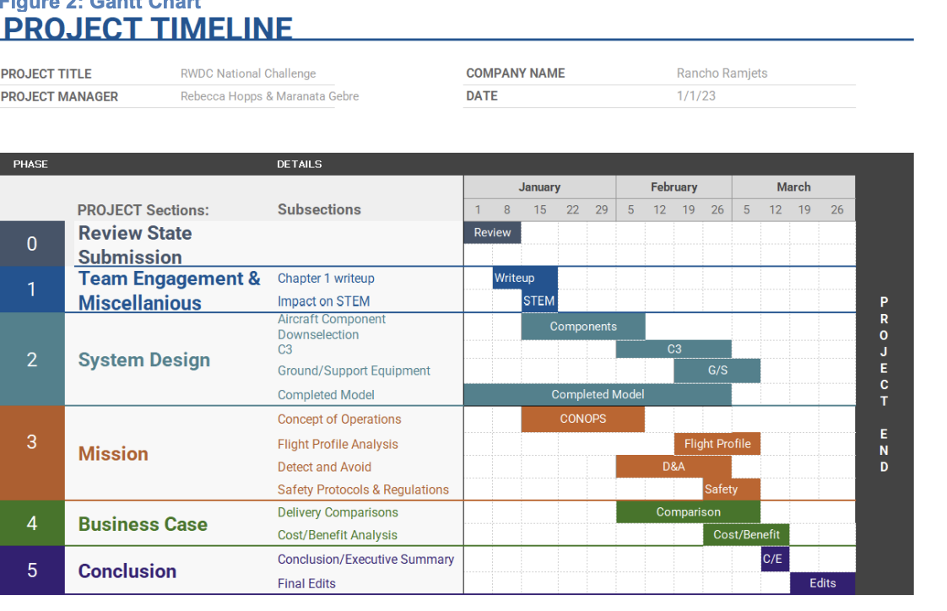
Gantt Chart

Slide 13
The Innovation Engine
15.2 Calculating Costs, Profits, and Slack Time
Mr. Jeffrey Coppola, RWDC

Slide 14
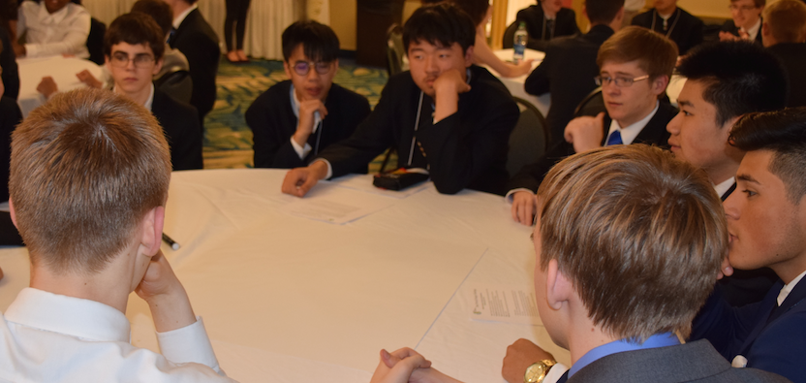
Calculating your Costs
Understand Fixed Costs
Calculate Variable Costs
Analyze your costs
  Look at the cost per delivery
  Look at your operating costs
  Decide if your design cost effective.

Slide 15
Fixed Costs
The cost required to design and assemble the entire system
  Initial systems costs.
  The cost of the components of the air vehicle
    Parts of the aircraft
  Components of the ground station
    GPS
    RC controls
  Support equipment
Fixed costs do not change once you have purchased your system.
Fixed Costs =Air Frame Costs + Sensor Costs + Command Control Communications Costs+ Support Equipment Costs

Slide 16
Variable (Operating) Costs
To find the variable cost for the day you must determine the following
How long will the aircraft be flying the mission
What are the fuel requirements for each flight
How much fuel will you need to fly each flight
Daily Fuel costs
Number of flight hours needed for the mission X Fuel consumption per hour
Daily Cost of Personnel
Total Personnel per hour cost

Slide 17
Variable (Operating) Costs Continued
The cost required to operate the vehicle
Variable Costs (operating costs) are the second component involved in calculating your costs.
The Variable Costs are costs for operating your system for a given day
Costs of operating your system
  Consumables- Fuel
  Operating costs = Cost of Fuel for each of the missions

Slide 18
Mission Performance Assessment
You can create a chart to evaluate the performance of your UAS in various areas. While the measurements for performance may be different for each area of performance you can give a 1-5 ranking for each variable based on the quality. You can then combine these scores to determine the overall quality of each design based on multiple measures of performance.
Rank 1-5, 5 being best.
High total = Desirable Market
Opportunity Characteristics | Pre Fire | During active fire | Post fire | Other Possible measure
Fuel used
Speed of flight
Ease of use
Costs
Other Variables
Total

Slide 19
Public Affairs/ Communications Plan
This year teams will need to have a Public Affairs/communications plan
The target audience will be a government agency who are unsure if UAS’s should be used for wildfire mitigation
Teams should explain the value of the support they are providing
The Audience may not have a technical background, will not have a background in wildfires and will have limited time to consider the proposal
This is NOT how your teams UAS communicates using C3 equipment

Slide 20
Public Affairs/ Communications Plan
Teams will need to have a plan that includes the following elements:
Public Relations Strategy Template.
  This will provide background on the importance of wildfires
  Explain difficulties getting support from the public for using a UAS to assist with supplies
  Groups who are in your target audience and how you plan to reach them
Media Products
  These are tools used to convey the message
    An infographic
    Social media posts

Slide 21
Strategic Communications Plan
Teams describes the strategy they have for their communications plan
What information was used to communicate
How is the information used important
  Did you give enough background on wildfire mitigation?
  Is it clear how your design can be useful
  Why is you design the best
  Is it cost effective?
  Will your communication plan be understood?
It will be important here to show the thought process for the communication plan

Slide 22
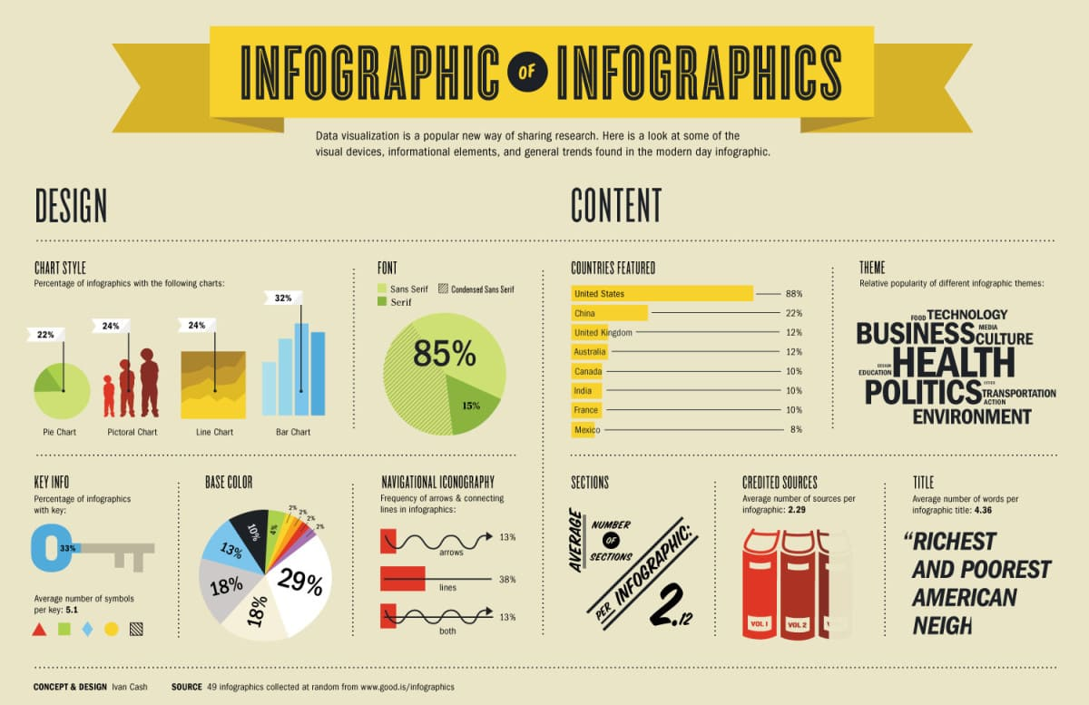
Infographics
Use images and pictures to describe a lot of information and concepts quickly

Slide 23
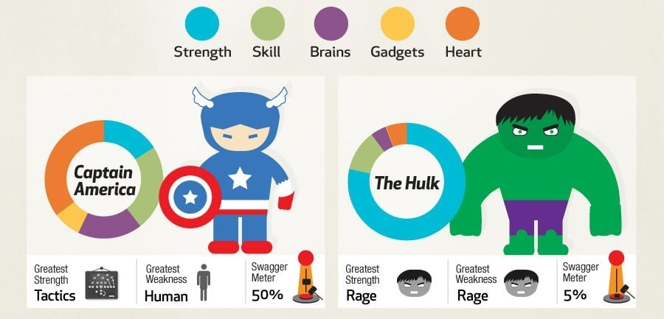
Infographics
Can organize information so that multiple variables can be assessed in a short amount of time

Slide 24
Infographics
Teams will need to include an infographic that explains their design
The infographic should be able to explain the importance of wildfire mitigation and how the UAS designed will be useful
Keep in mind the information on the infographic should be simple enough to be understood in a short amount of time
  If teams use the infographic in their presentations make sure to give enough time for judges to understand what is being communicated

Slide 25

Other Communication
The communication can be a very short written communication to include in the communication plan. It is like an elevator pitch (30-60 seconds) and may be used with the infographic to add some additional information.
Pitch to go with the infographic
It could be a social media post.
Should help anyone understand the infographic
Gives context to let people know what is being communicated

Slide 26
What is an Executive Summary?
Similar to an Abstract used in scientific research
  Gives an overview of everything in the entire paper in one page or less
  Should not be very technical
  Typically Written at the end
  May have some broad description of financial plan
  Make sure to include a brief description what the mission is or what the goal of your project
  Maximum of one page

Slide 27
What is an Executive Summary used for?
An Executive summary is used by high level Executives to briefly learn enough about a project to decide on it
Frequently in business it is used to determine if a company will move forward with a project
If the summary does not clearly explain what the mission is and how you plan to address, it with the results they will not move forward with it.
If the summary is approved the business may look at the additional details of the plan
People reading the summaries frequently do not have time to read every page of a report and sometimes even read about the project before the summary

Slide 28
Why is the Executive Summary important?
Will act as a tie breaker when teams scores are tied
Make sure to leave enough time to do a good job writing the executive summary at the end
Regularly the executive summary is used to determine what team moves on to the next level of the competition
This is the most difficult section of the paper because you need to give a lot of detail in very few words
Do Not Skip this section!

Slide 29
Questions?

