Slide 1

The Innovation Engine
Roles & Building a Team
Dr. Ralph K. Coppola, Founder & Executive Director

Slide 2
Team Roles
Teachers/Coach
Mentors
Project Manager (Student)
Systems & Test Engineer (Student)
Software Engineer (Student)
Project Scientist (Student)
Project Mathematician (Student)
Marketing & Communications (Student)

Slide 3

Who can be a Coach?
An RWDC coach can be a formal classroom teacher in any school or an adult advisor to an after school or informal learning program.
Although having specific expertise in engineering principles or a degree in a STEM-related field may be helpful, coaches are not required to have a technical background to participate.
Coaches can be, but are not limited to: technology education teachers, science teachers, math teachers or other teachers.

Slide 4
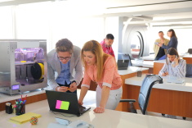
What role does the Coach play on a team?
The coach should act as a facilitator, advisor, and educator for the team.
Arrange access to computer-related resources and provide students with assistance with software.
Coordinate project activities with school academic activities.
Advise the team.

Slide 5

What does a Coach do?
Provide meeting space
Create a schedule of meetings
Attend and supervise all meetings
Obtain approval from school and permission from parents
Share the digital plane parts, training video, and other analysis tools provided to support the teams’ work
Provide access to resources for students
Seek support, and encourage students to seek support, from mentors

Slide 6
What Does a Coach Do? Continued
Offer guidance, lessons, or suggestions on basic fundamental principles in engineering, science, and math
Assist with defining the roles of team members
Assist with communication and connection between the team and its mentor(s)
Provide suggestions and constructive feedback on strategy and models
Travel with and chaperone team, if necessary, at events
Register team, access online forms and password- protected areas, and assist with final submission
Assist with final submission criteria: oversee student deadlines and ensure all submissions are made properly and timely.

Slide 7

Project Manager
Responsible for recruiting a winning team and leading strategy design. The Project Manager is responsible for the overall success of the product or program.
Responsible for managing the project plan and deliverables, ensuring that all project team members have the necessary resources required to complete the project, and reporting status for the team, tracking timeline and milestones, and quality.
Many times this individual plays additional roles in the project. The Project Manager leads the cross-functional team and is typically responsible for the development of the overall product, program or Engineering Design Notebook.
They often monitor several interrelated sub-project activities engaged in by team members.

Slide 8


Systems & Test Engineer
Defines the UAS, its modules, and interfaces. He or she has ultimate responsibility for ensuring the various parts of the UAS will work together as a whole when finally assembled.
Provides direction to the design team, manages interfaces, and participates in design reviews.
Responsible for testing prototypes of designs and pre- production products created by the design team.
Reviews test cases generated by the design team and collaborates with the design team during the testing phase.
Liaison with an engineering Mentor, assisting the team with the incorporation of engineering advice. This person may also be a project simulation engineer on the team.

Slide 9

Software Engineer
The Software Engineer is the expert in the authentic simulation and modeling tools, such as CAD.
The Software Engineer is responsible for simulation and modeling application interoperability, file compatibilities, and file transfer.

Slide 10

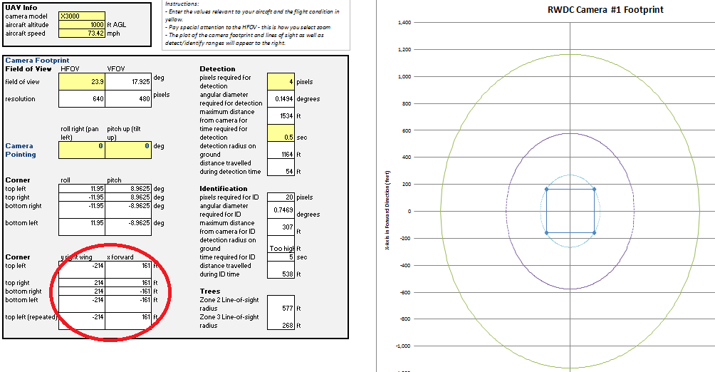
Project Scientist
The Project Scientist should have a background in physics or a related field.
This role will be responsible for the scientific integrity of the approach and for translating the scientific principles into the team’s engineering design.
This role is the liaison with a Science Mentor, assisting the team with the incorporation of scientific advice.

Slide 11




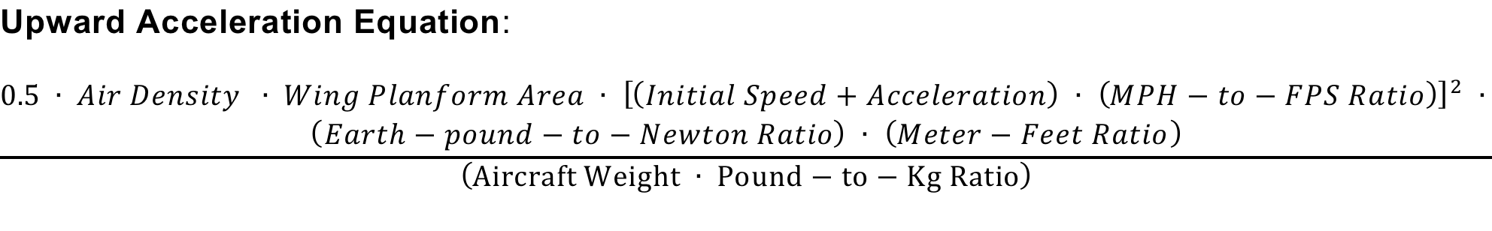
Project Mathematician
The Project Mathematician should have a background in mathematics, with a minimum of algebra and trigonometry.
Responsible for the mathematical integrity of the approach and for translating the mathematical principles and applications into the team’s engineering design.
Works with the Software Engineer on the mathematical analyses.

Slide 12
Marketing & Communications Specialist
Integrates ideas, approaches, and applications from the design team into written documents, videos, and presentations.
Coordinates and manages the development of the Engineering Design Notebook and PowerPoint Presentation.
Coordinates the management of the team’s material from the Engineering Design Diaries, and helps to ensure that the structure of the Engineering Design Notebook matches the requirements as represented in the Student, Teacher, Mentor Guide and the Scoring Rubric.
Responsible for managing the editing of all documents, particularly the Engineering Design Notebook and the PowerPoint Presentation.
Responsible for the team's brand. This person represents the team to the media and will work with the teacher/coach to coordinate event activities.

Slide 13

Mentor’s Roles
Mentors are professional scientists, engineers or mathematicians who will help you with the Challenge.
Each team may recruit a maximum of four mentors with expertise in science, mathematics, engineering, and aviation design.
Mentors may limit the number of teams they choose to assist and the amount of time they will devote to the mentorship process.
Accordingly, mentors will be available on a first come/first served basis.

Slide 14
Mentors Role
The Mentor is a subject matter expert that provides advice on science, math, and engineering principles and is a content resource for your team.
Presents STEM concepts to your team and gives you a chance to interact with real world engineers, scientists and mathematicians.
Stimulate creative thinking through assisting your team with the hands-on design of your project.
The Mentor is also the Teacher/Coach's advisor, assisting with knowledge of core principles processes, and knowledge of science, math, and engineering.
The Mentor should NOT solve the problem of the Challenge for the team.

