Slide 1

The Innovation Engine
Introduction to Unmanned Aerial System (UAS)
Introduction to Unmanned Aircraft Systems
(UASs)
Dr. Florian Hafner, Embry-Riddle Aeronautical University
Thanks to Dr. Florian Hafner, Dr. Brent A. Terwilliger & Dr. Robert Deters, Embry-Riddle Aeronautical University
Thanks to Dr. Brent A. Terwilliger & Dr. Robert Deters, Embry-Riddle Aeronautical University

Slide 2
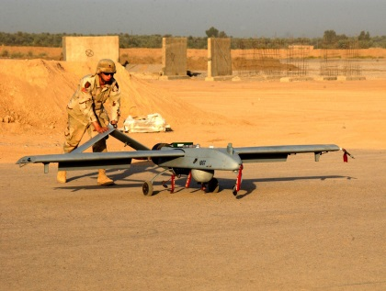
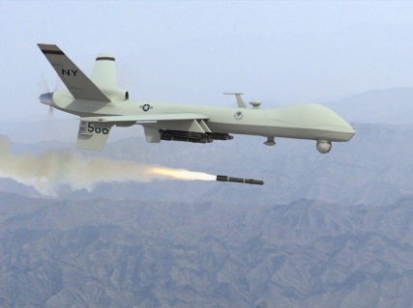
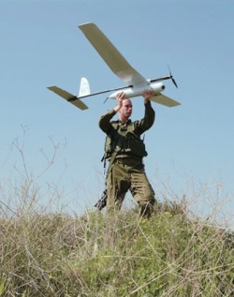
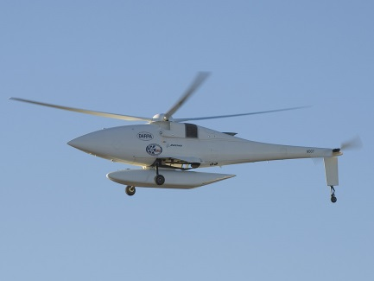
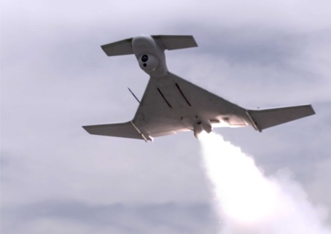
  UAS Definition
UAS -> aircraft without an operator or flight crew onboard
  Unmanned Aerial Vehicle (UAV; remote air vehicle element of UAS)
  Known also as Drone or Remotely Piloted Vehicle (RPV)
  Autonomously or remotely guided vehicle
  Used for military and civilian (and eventually commercial) tasks without risk to human operators/crew

Slide 3
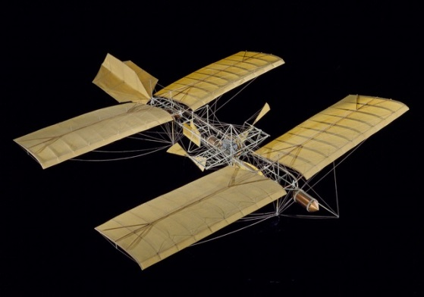
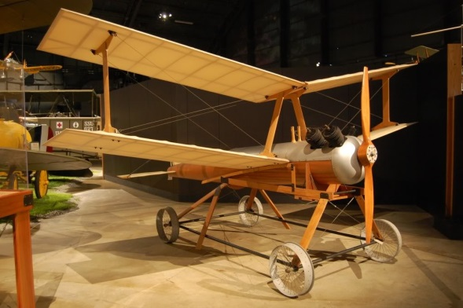
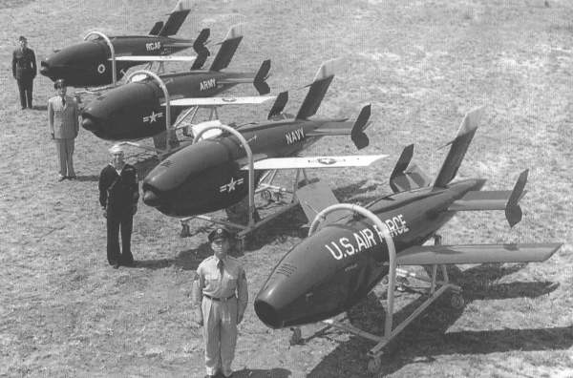
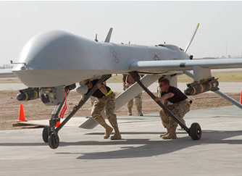
Former UAS Definition
History
  Early examples (1849-1940s)->research test beds, guided munitions, aerial targets, and reconnaissance
  Development increased during Cold War
  Development of small lightweight digital computers help create flight independence
  Desert Storm (1991) - first wide-scale employment of UAS (> 500 missions flown)
  By 2008 the US Department of Defense (DoD) had more than 6,000 UAVs (more than 230,000 hours)
Four Ds (previously known as 3 Ds):
  Dull – tasks that require persistence or repetition
  Dangerous – tasks that carry a high degree of risk
  Dirty – tasks that are carried out in hazardous environments
  Deep –tasks that are beyond the range/capability of manned platforms

Slide 4

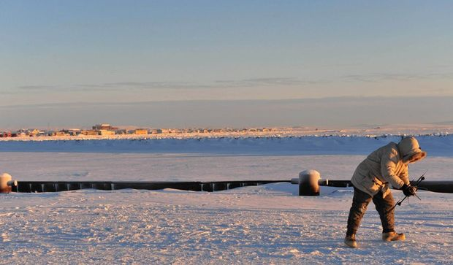
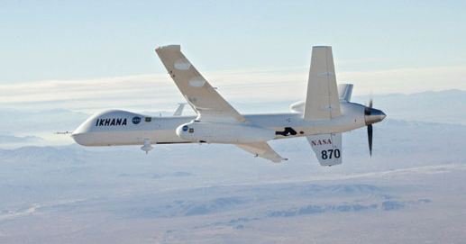
Now what are they used for?
Civilian/commercial uses
  Aerial photography/filming
  Agriculture
  Communications (relay) (Facebook/Google)
  Conservation/wildlife monitoring
  Damage assessment/infrastructure inspection
  Fire services and forestry support
  Law enforcement/security
  Search and rescue
  Weather
Military (in addition to civilian uses)
  Aerial targets
  Intelligence, surveillance, and reconnaissance (ISR)
  Enemy defense testing/interruption (jamming)
  Combat
  Ordinance destruction (mines and bombs)

Slide 5
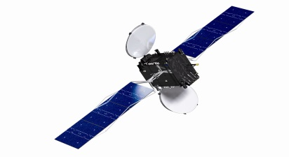
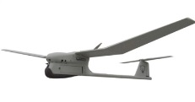
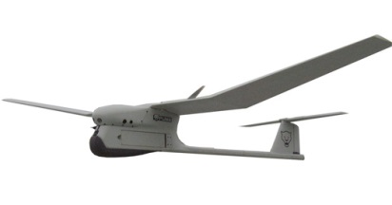
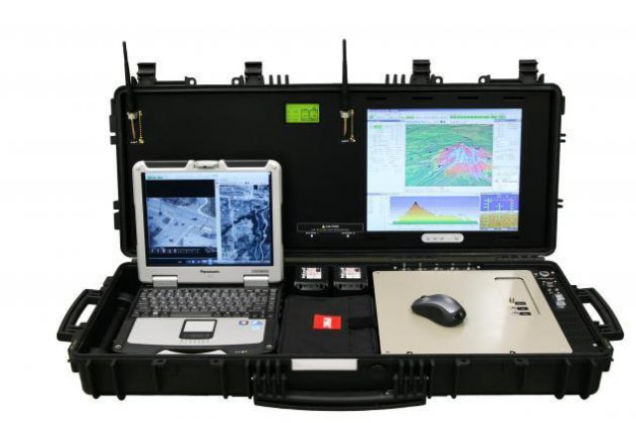
How They Generally Work
Satellite Communications System
Secondary UAV
Remote Vehicle Element/ Unmanned Aerial Vehicle (UAV)
Line of Sight Communications (telemetry, visual sensor, control)
Control commands (to UAV)
Telemetry and Video (from UAV)
Line of Sight -Telemetry and Video (from UAV)
Telemetry and Video (from UAV)
Line of Sight - Control commands (to UAV)
Sensor Field of View (FOV)
Personnel (in field)
Ground Control Station (GCS)

Slide 6

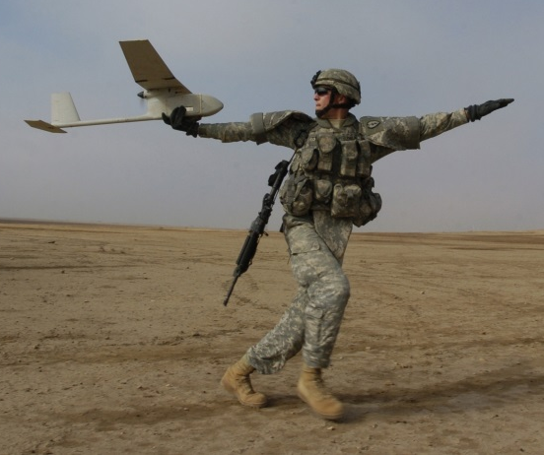

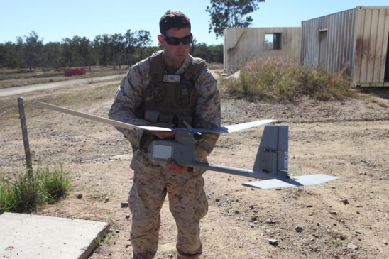
Launch
2
3
1
Brief
1
6
Debrief
1
Post Process
4
Execution
1
5
Recovery
Pre-planning
1
1
1

Slide 7
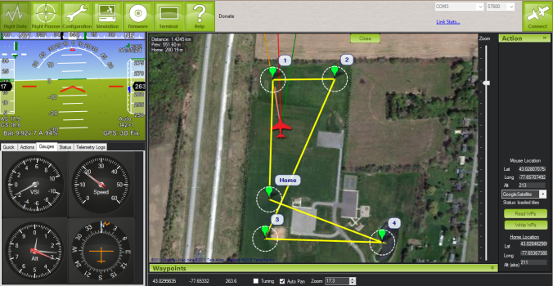
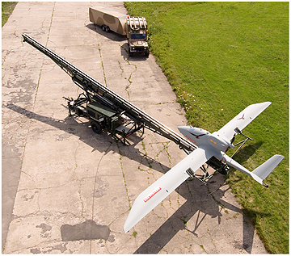
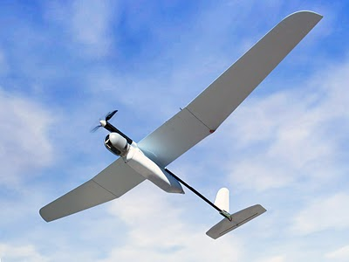
Mission Steps
Pre-planning (mission planning) –all the mission parameters and assets are considered
Briefing - crew review the parameters for operation of the mission
Launch –remote vehicle element is made airborne
  Handheld
  Launcher
  Conventional takeoff (from runway or unimproved surface)
Execution (operation) –the mission is performed, primary purpose of the system
Recovery –aircraft capture/landing occurs
  Controlled descent
  Shipboard
  Conventional landing (on runway or unimproved surface)
Debrief –when the results of the mission are examined and reported

Slide 8
Regulation, Certification, & Licensure
Due to the rapid evolution of UAS technology, regulations/policies are subject to continuous review and revision
In the US
  The FAA released regulation on the commercial use of UASs (see the small UAS rule Part 107)
  Delivery companies are obtaining certification for UAS deliveries through FAA Part 135
Regulations for Operations, Certifications, Registration, Insurance, etc. now exist in most countries

Slide 9
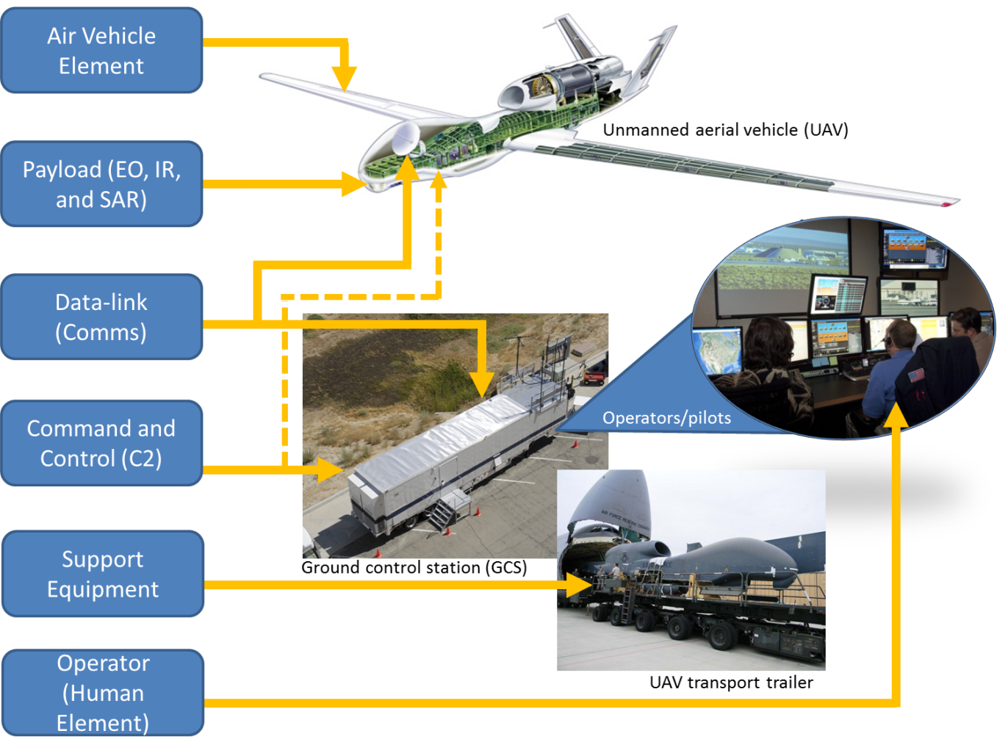
Subsystems

Slide 10
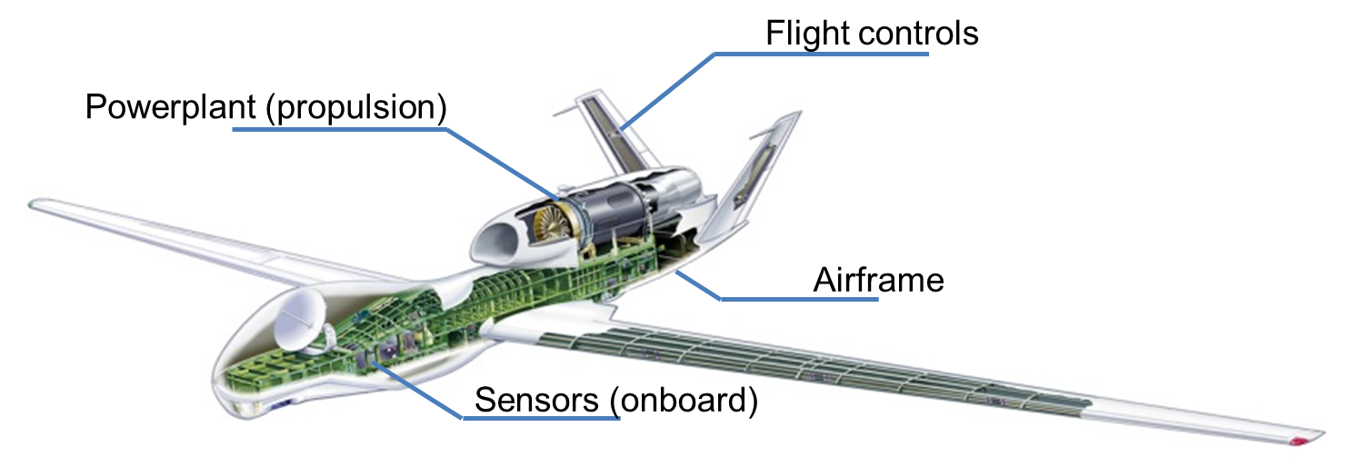
Air Vehicle Element
Air vehicle element (i.e., UAV) represents the remotely operated component
Aerodynamically similarly to manned airframes
Airframe structures can be lighter, (slower speeds component weight is less)
Systems on board – no direct human limitations
Primary elements include
  Airframe – the structural aspect of the vehicle
  Flight Controls – the actuators and control surfaces
  Power plant (propulsion) – the power and thrust generating mechanism of the aircraft
  Sensors (onboard) – the data measurement and capture devices

Slide 11
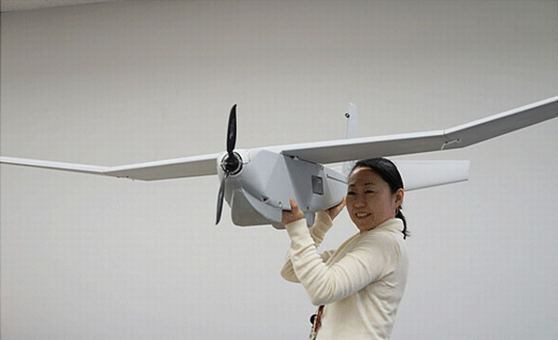
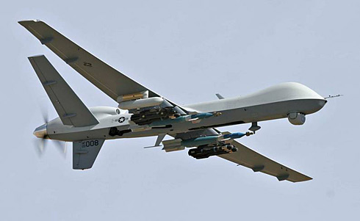
Air Vehicle Element – Airframe
HTOL/Fixed-wing Configurations
Advantages
  Long flight duration
  Higher altitude capability
Disadvantages
  Requires logistical support for launch and recovery
Typical types
  Tractor propeller – thrust generating propeller mounted on front of aircraft, ahead of motor (e.g., Puma UAV)
  Pusher propeller–thrust generating propeller mounted on rear of aircraft, behind motor (e.g., Predator/Reaper)

Slide 12
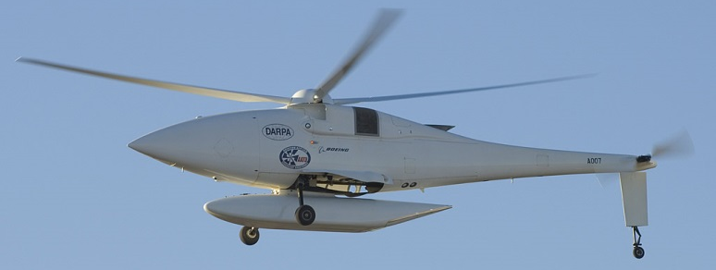
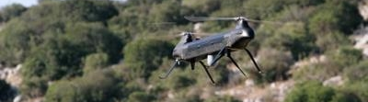
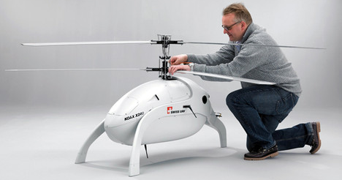
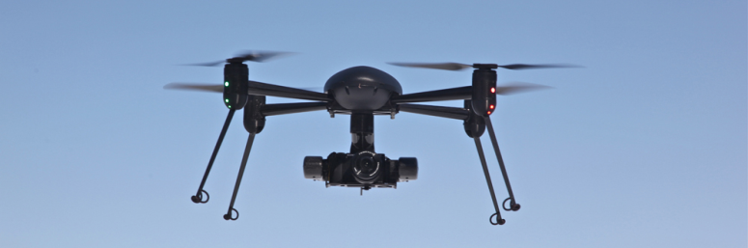
Air Vehicle Element – Airframe
VTOL/Rotary-wing Configurations
Advantages
  Small launch & recovery footprints
  Rapid deployment (covert)
  Capable of slower flight/hover
Disadvantages
  Slower max airspeed, reduced range, reduced operational altitude
Types
  Single main rotor: most recognizable configuration, reqs tail rotor
  Tandem rotor: two rotors, ratio of motor mass to lift increases strongly as size increases
  Coaxial rotor: two counter rotating rotors stacked in vertical (no tail rotor), increased mechanical complexity
  Quadrotor/multirotor: proportional control of motors, reqs use of extremely complicated control algorithms

Slide 13
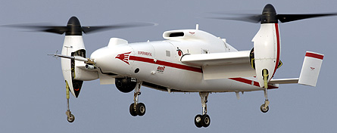
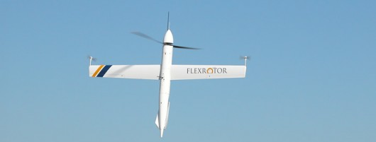
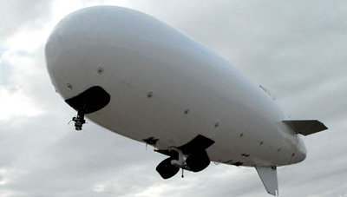
Air Vehicle Element – Airframe
Hybrid Configurations
Convertible rotor (VTOL-> HTOL; e.g., tiltrotor)
  Rotor mounted on each wing tip
  Rotors tilt forward or upwards to transition between configurations
Tilt-Wing-Body
  Entire aircraft transitions from vertical to horizontal flight
  Propulsion could be from a fixed rotor, cyclic/collective pitch mixing (CCPM), or ducted fan
Lighter than Air (e.g., dirigible)
  Lifting envelope contains gas that is lighter than air to provide lift
  Control is achieve through manipulation of control surfaces (horizontal/vertical stabilizers), gas in envelope, directional thrusters (ducted fans or fixed-rotors)

Slide 14
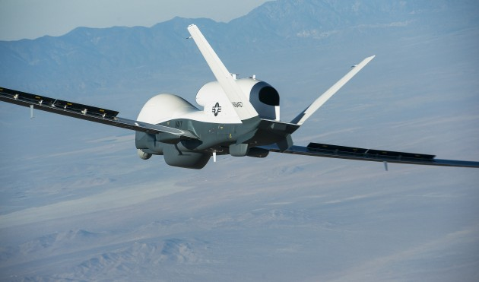
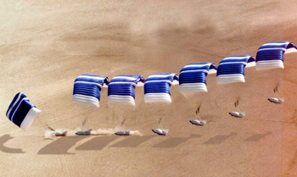
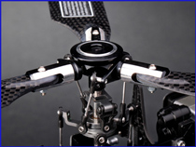
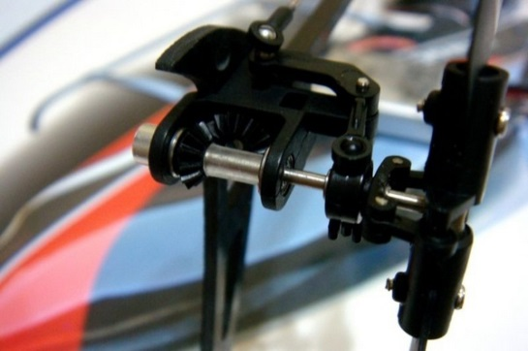
Air Vehicle Element – Flight Controls
Flight Controls
Contain linkages to rotors, controls surfaces, and powerplant(s)
Computers/control systems interfaced to both autopilot/data-link to ground control
Unmanned flight controls operate under same aerodynamic principles as manned counterparts; difference is how commands received and executed
  Comm system (via uplink) receives control commands (from control station)
  Flight control system (FCS) processes command(s) and executes
    Deflects control surface (e.g., elevator, rudder, ailerons, rotor)
    Moves sub-component (e.g., retracts gear or changes throttle)
    Changes power flow (e.g., power to electric motor)
    FCS can also include or be composed of an autopilot system

Slide 15
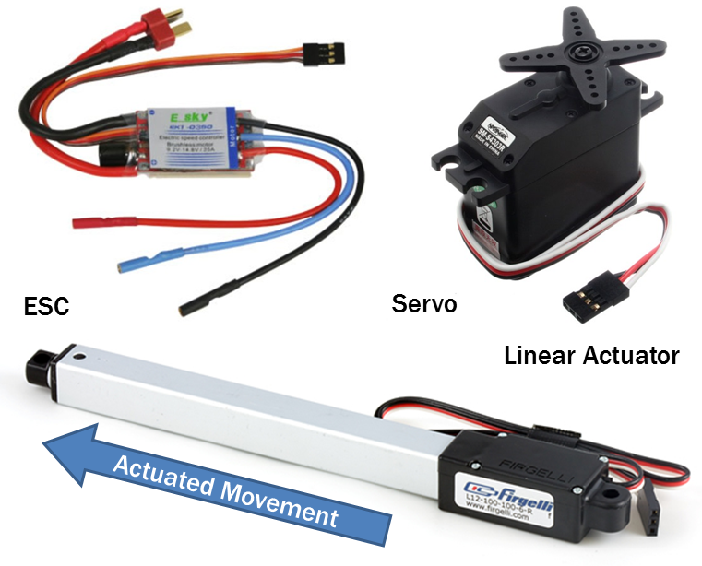
Air Vehicle Element – Flight Controls
Example Actuators/Controls
Servo –electric motor that performs proportional rotating movement about a central axis
Linear actuator (electric, hydraulic, or pneumatic) – provides linear (along a straight line) movement
Electronic speed control (ESC) – varies the speed and direction of an electric motor, typically controlled using a servo interface

Slide 16
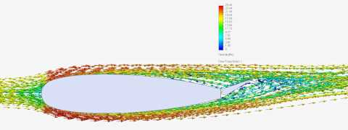
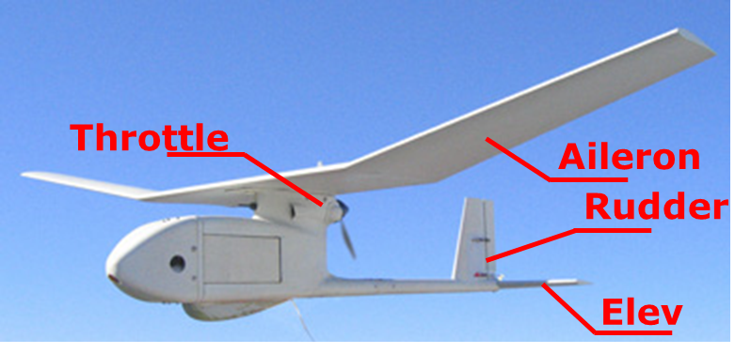
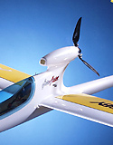
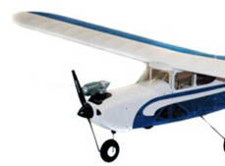
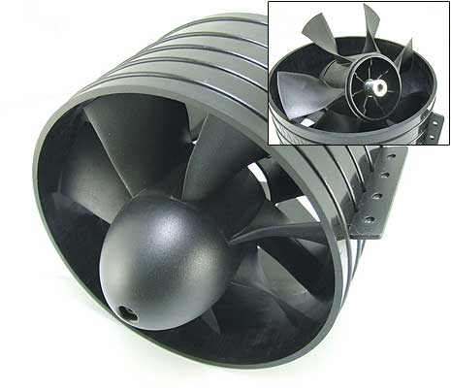
Air Vehicle Element – Flight Controls
HTOL/Fixed-wing Control Surfaces
Movement of air over flight control surfaces causes change in pitch, roll, and yaw of vehicle
  Elevator
  Aileron
  Rudder
  Flaps
Changing RPM of propulsion system increases or decreases thrust
  Propeller (tractor or pusher)
  Impeller (turbine/jet/ducted fan)
Pusher
Tractor
Impeller

Slide 17

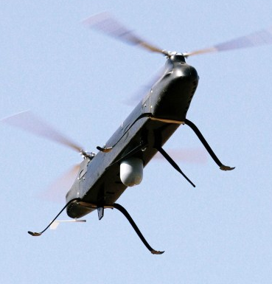
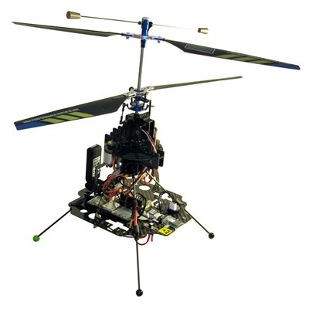
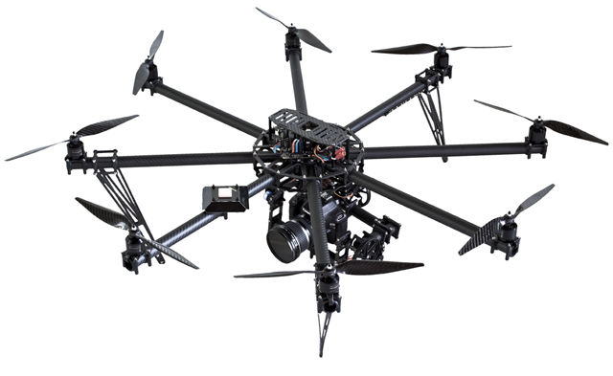
Air Vehicle Element – Flight Controls
VTOL/Rotary-wing Control Surfaces
Movement of air over rotors generates lift
  rotor pitch change
  RPM determines thrust
Control movement is accomplished by actuating the disc created by spinning rotors (pitch and roll), changing tail rotor RPM, or changing rotational speeds (co-axial, dual, and multi-rotor)
Multiple forms of rotors
  Conventional rotor (with tail rotor)
  Tandem (dual counter rotating blades, no tail rotor) - controls rotation through differential in two rotors
  Co-axial rotor (no tail rotor) – controls rotation through differential in two rotors
  Multi-rotor (e.g., quadcopter) - controls all movement (pitch, roll, and yaw) through differential in the multiple rotors
Conventional
Dual
Co-axial
Multi-rotor

Slide 18
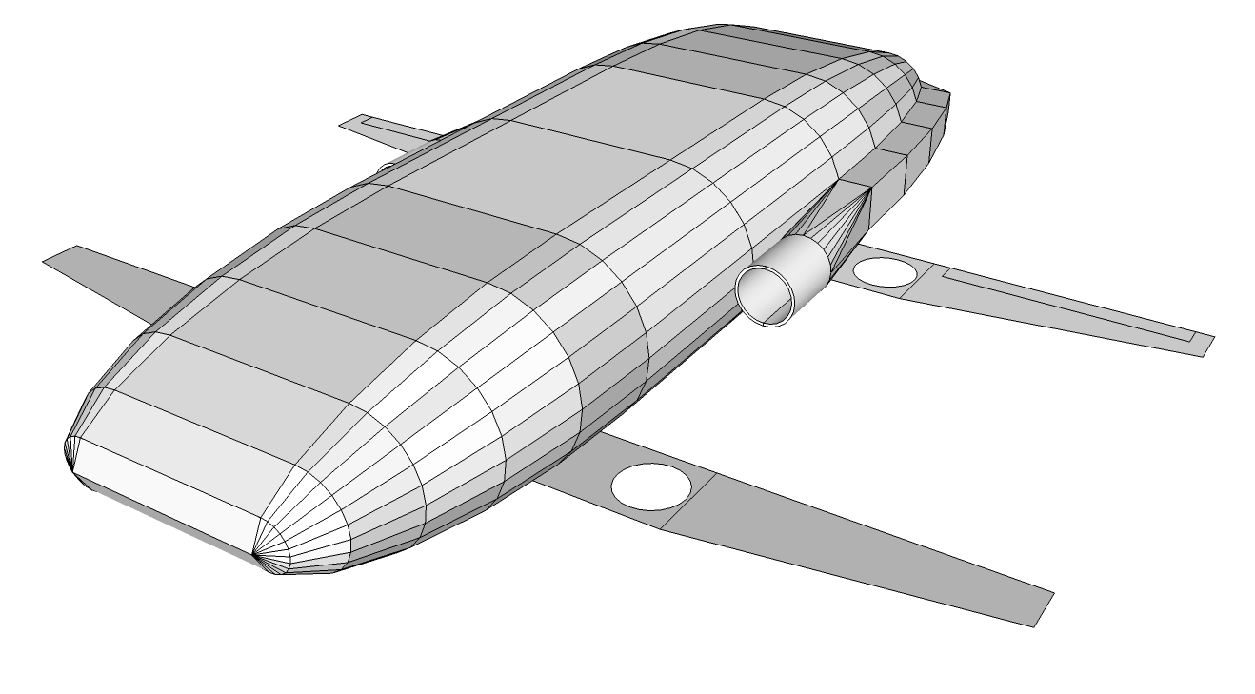
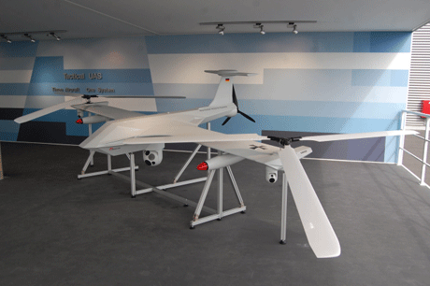
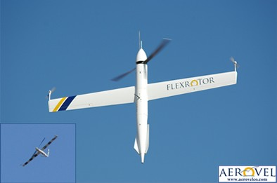
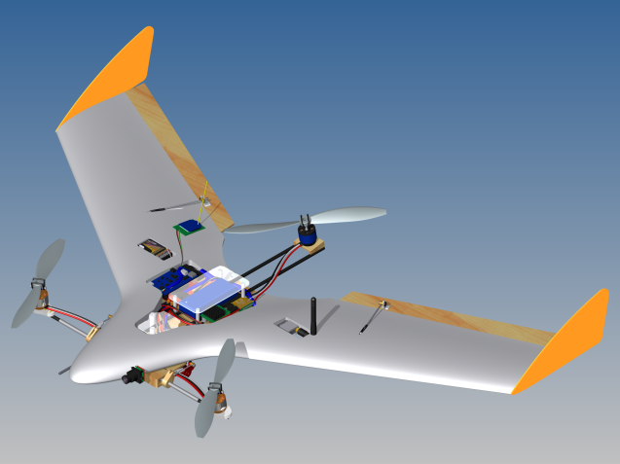
Air Vehicle Element – Flight Controls
Hybrid/Other Control Surfaces
Fixed-wing control surfaces
Rotary-wing control surfaces
Lighter-than-air (envelope)

Slide 19
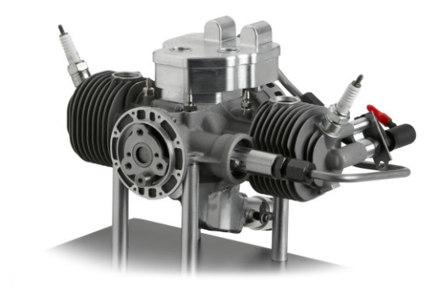
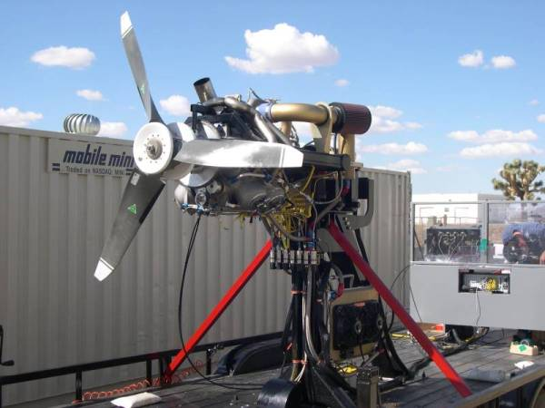

Air Vehicle Element – Power Plant
Power plant (propulsion source)
Developed/configured for lighter airframes/lower speeds
Propulsion systems that can operate at high altitudes are generally used for the larger vehicles, while smaller aircraft will use smaller more efficient power plants
Achievement of a small fuel load and maximized performance requires an efficient propulsion system and optimum airframe aerodynamics
Power plant or propulsion systems are used to
  Generate thrust to overcome lift-induced drag and gravity to maintain airspeed or achieve vertical flight
  Counteract torque in a rotor system
Power plant types
  Internal combustion (IC)
  Electric motor
  Hybrid (e.g., hydrogen)

Slide 20



Air Vehicle Element – Power Plant
Internal Combustion Power plants
Piston engines (typically used in RC airplanes)
  Two-stroke (two-cycle)/glow fuel engine
    Mixes lube and fuel
    ~Twice the power than four-stroke with greater fuel consumption
  Four-stroke
  Stepped piston
    Two differing diameter bores with base being larger
    Claimed lighter mass/power ratio (as two-stroke) and fuel efficiency (as four-stroke)
Rotary (Wankel)
  Low mass/power ratio with high rotational speed
  Requires a reduction gearbox and cooling equipment
  Low fuel consumption
Gas-turbine engines
  Quieter than piston
  Produce power at low mass/power ratio

Slide 21

Air Vehicle Element – Power Plant
Electric Motor Power plants
Brushed DC Motor
  Rotating set of armatures (electro magnets)
  Mechanical rotary switch reversed direction twice every cycle
  Advantages/limitations
    Low cost, simple , inexpensive control (ESC)
    Requires period maintenance, poor head dissipation, and brush arcing generates EMI noise
Brushless DC Motor
  External rotor (permanent magnet)
  Three coils activated in sequence
  Advantages/limitations
    Less maintenance, high efficiency, with high output power/size ratio (More power/longer runtime) and low EMI noise
    Higher cost, while control (ESC) is expensive, complex, and required for operation

Slide 22

Air Vehicle Element – Power Plant
Powerplant Fuels
IC Fuels (Requires support/flight line equipment)
  Diesel/residential heating oil, biodiesel, gasoline, gasohol, jet A (aviation fuel), liquefied petroleum gas (LPG), ethanol, methanol, nitro-methane
Electric
  Fuel cell/battery
    NiCad (nickel-cadmium, phasing out)
    NiMh (nickel metal-hydride, phasing out)
    Li-Poly (lithium-polymer)
    Li-Fe (lithium-ferrite phosphate)
    Li-S (lithium-sulfur)
  Requires use of ESC and charger
  Most have built in battery elimination circuitry (BEC)
  UBEC prevents grounding-> loss of all flight ctls. given system fault

Slide 23



Air Vehicle Element – Sensors (Onboard)
Sensors use variety of means to capture data about environment (e.g., state of specific component/the aircraft)
Sensors are Proprioceptive (i.e., internal to vehicle) or Exteroceptive (i.e., external)
The most common types of sensors:
  Position/location - used to determine the position, location, or orientation
  Force/tactile - used to determine the amount of physical contact or pressure (e.g., landing gear up/down, doors open/closed, or barometric pressure)
  Acceleration - used to determine the velocity changes rate
  Velocity - used to determine the positional change rate
  Note: When acceleration and velocity measurement is combined into a single device, it is referred to as an Inertial Measurement Unit (IMU), which is capable of improved orientation determination
Sensor data is output (from device)
  Analog – produces a voltage proportional to the measured quantity
  Digital – an encoded measurement value (e.g., binary)
Force Sensor
Atmospheric Pressure
Inertial Measurement Unit

Slide 24




Air Vehicle Element – Sensors
Sensor Perception can be divided into four categories based on purpose:
Navigation – provides guidance, navigation, & control (GN&C) functions to support path planning, dynamic re-planning, and to enable multiple agent communications and coordination
Mission sensing – provides information necessary to perform mission planning, scenario planning, assessment and understanding, multi-agent communication and coordination, and situational awareness
System health – provides capability to ascertain the state of the vehicle for fault detection, vehicle health management, failure anticipation, re-planning, and contingency management
Manipulation – provides capability to interact in a more detailed manner with the exterior environment to support improvised explosive device (IED) disposal, car inspection, logistics and materials handling

Slide 25



Payload
Payload is typically a Sensor or Sensor suite (series of sensors)
In remote sensing applications, the payload sensors are Exteroceptive
Typical payload sensors:
  CCD/CMOS camera (e.g., Daytime TV, color video) – digital imaging sensor
  Thermal (e.g., infrared [IR]) – sensor used to measure and image heat (i.e., thermal radiation)
  LiDAR – measures distance and contours of remote bodies (e.g., terrain) through use of reflected laser light
  Multispectral camera – all encompassing sensor for capturing image data across the electromagnetic spectrum (thermal, radar, etc…)

Slide 26

Communications
Communications: How do you get data to and from the aircraft?
Data to communicate:
  Command & control (C2; uplink) - control signals to aircraft (from ground control station)
  Telemetry data from aircraft (downlink; vehicle state and positioning)
  Sensor data from aircraft
Primary methods for communicating
  Line of sight (LOS) data link – radio frequency (RF), typically very high frequency (VHF)
  Beyond LOS (BLOS) – Satellite data link, typically high frequency (HF)

Slide 27

Communications
Typical UAS communication system is composed of:
  Antenna – direct/emit communications signal
  Transmitter (TX)- modulate and send data
  Receiver – receive and demodulate data
  Transceiver – a combination TX/RX capable of sending and receiving data simultaneously
  Multiplexer device to select one of several input signals, used in communications to switch between multiple inputs
Data going to the UAV is referred to as “uplink”
Data coming from the UAV is referred to as “downlink”

Slide 28


Communications
Decisions occur before and during flight
Frequencies are limited – unlicensed, licensed, civilian, military
Bandwidth –where to process data (onboard or on ground) must be determined
Operational range
  < 300 NM - LOS –RF communication, subject to radio horizon/ atmosphere
  > 300 NM or loss of signal - BLOS –operated using relay, subject to latency
  Radio Horizon –limits propagation of radio waves due to curvature of Earth and terrain

Slide 29





Communications
Typical types of antenna used with UAS:
  Quarter-wave – vertically erected omnidirectional radiating signal in all directions; power reduces rapidly with distance
  Yagi-uda – directional beam antenna, aimed at target
  Parabolic dish – reflects power from point source emitter out as a beam (width varies with size of dish)
  Lens antenna – focuses RF waves using dielectric material
  Phased array/patch – series of patches formed on dielectric substrate to create complex array
NOTE: Antenna tracking significantly improves performance of communications
Quarter-wave
Yagi-Uda
Lens Antenna
Patch
Parabolic Dish

Slide 30

Command and Control (C2)
To operate the aircraft effectively it is necessary to coordinate all elements (Control, Communications, and Air Vehicle)
How do you operate the aircraft effectively?

Slide 31


Command and Control (C2)
UAS are remotely or autonomously operated aircraft, without a human operator onboard the vehicle element
Teleoperation (manual control mode) – remotely controlled by an operator; referred to “as man in the loop”
Autonomous operation – system is programmed to fly in accordance with a set of pre-established or uploaded control parameters, while being supervised by an operator; referred to as “man ON the loop”

Slide 32
Command and Control (C2)
Autonomy is the ability for a system to execute its mission following a set of preprogrammed instructions without operator intervention
Full system autonomy is not consistent or likely with today's technology. However, as technology advances the line constantly moves further to the right.
Manual
Semi-Autonomous
Fully Autonomous
Operated completely by remote (manual) control with from takeoff
constant operator involvement to landing, no pilot intervention
Certain tasks have been delegated to the “System” to perform within user controllable parameters
The “System” controls everything

Slide 33



Command and Control (C2)
Autonomous operation requires
  Integrated Navigation (e.g., Global positioning system [GPS] or localization sensor system)
  Pre-programmed flight control routines (or Intelligence)
  Defined operating parameters that can be updated remotely
Control and Telemetry communication rate can be significantly less than with manually flown remote operation
Highly dependent on software and hardware to
  Perceive remote operating environment
  Determine most appropriate courses of action based on perception of environment
  Carry out (execute) best course of action

Slide 34

Command and Control (C2)
Teleoperation (manual control) requires
  Ability to see or see from the remote vehicle element (exocentric or egocentric view)
  Control link with low latency (little to no delay)
  Flight control inputs (e.g., yoke, stick, or cyclic; pedals, throttle)
  Mapping of flight controls to specific actuation responses on aircraft
  NOTE: Depiction of vehicle state (e.g., attitude/heading indications; not required) – significantly enhances operation
Operator/system performance is dependent on quality and quantity of presented data
Control/telemetry communication rate must be significantly greater than with autonomous operation

Slide 35
Command and Control (C2)
Many UAS support varying levels of autonomy (in addition to manual control)
  Improves performance/reduces boredom (autonomy->repetitive actions)
  Use of both serve as a redundant control method in case of malfunction
Ex. lost link - system might be lost if it is not able to re-establish a comm link; engages autonomous operation and performs one (or more) of the following:
  Proceed to a waypoint where signal strength is certain in order to reacquire connectivity
  Return to first waypoint and loiter or hover for a predetermined time in an attempt to require the signal and then returning to landing waypoint to land if this is unsuccessful
  Remain on current heading for a predetermined amount of time. During this time, any secondary means of communication can be attempted with the aircraft
  Climb to re-acquire link
  Orbit where link was lost; at this point the external pilot then takes over using remote control technology, which uses VHF LOS radio technology
  After specified duration, system automatically lands

Slide 36



Command and Control (C2)
Ground Control Station is the centralized ground facility that manages
  Flight Plans and Flight Information
  C2 Communications
  Payload Data Communications
  Backup Data Links
  Maintenance Support
Can be a simple setup or
something
a lot more elaborate

Slide 37



Support Equipment
Used to assist in UAS operation and maintenance in the field (flight line equipment)
Examples
  Launch/recovery systems (e.g., catapult or capture hook)
  Refueling/recharging system
  Trailers and cases for transport
  Internal combustion engine starters
  Operational enclosure (tent, trailer, etc.)

Slide 38
Questions?

