Slide 1

The Innovation Engine
Introduction to Unmanned Aerial System (UAS)
Forces of Flight
Aerodynamics & Performance
Dr. Florian Hafner, Embry-Riddle Aeronautical University
Thanks to Dr. Florian Hafner, Dr. Brent A. Terwilliger & Dr. Robert Deters, Embry-Riddle Aeronautical University
Thanks to Dr. Brent A. Terwilliger & Dr. Robert Deters, Embry-Riddle Aeronautical University

Slide 2
Topics
Four aircraft forces
Basic aerodynamics
Fixed-wing air vehicle range and endurance
Weight and balance
Rotorcraft

Slide 3
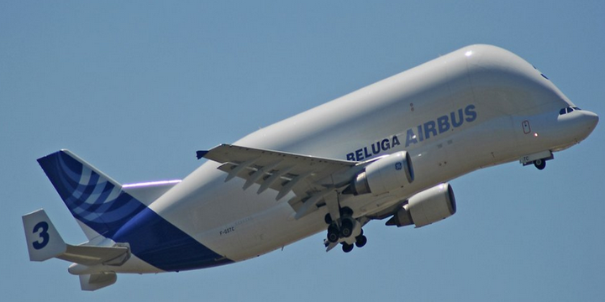
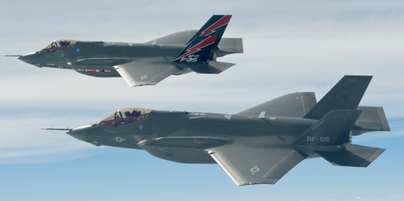
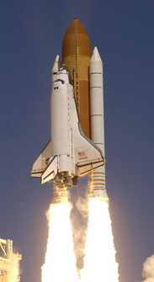
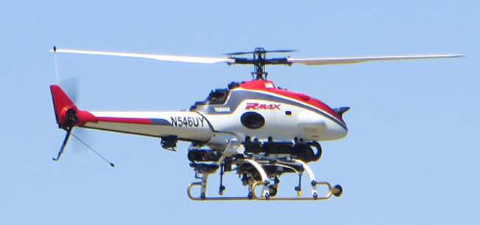
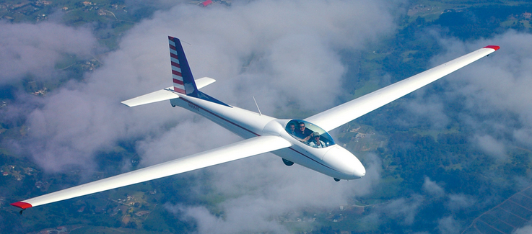
Why do aircraft fly?

Slide 4
Four Aircraft Forces
Lift (L)
Drag (D)
Thrust (T)
Weight (W)

Slide 5
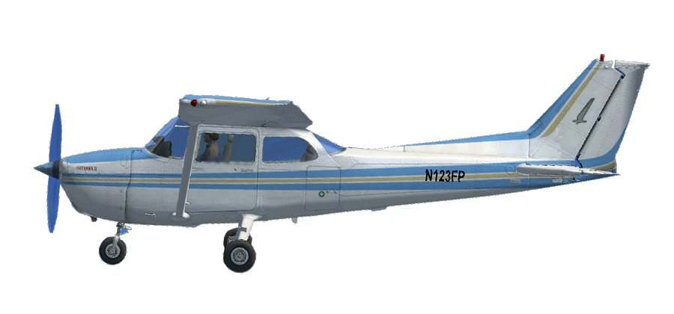
Four Forces
Lift
Thrust
Drag
Weight
5

Slide 6
Four Forces
Lift = Weight
In un-accelerated flight
6

Slide 7
Four Forces
Thrust = Drag
In un-accelerated flight
7

Slide 8
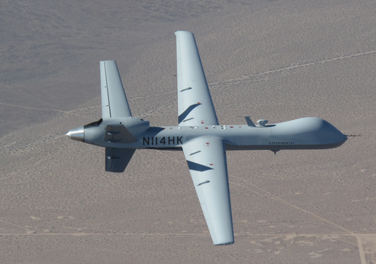
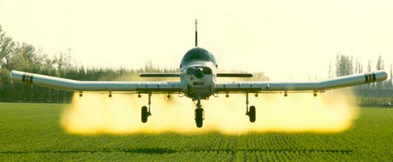
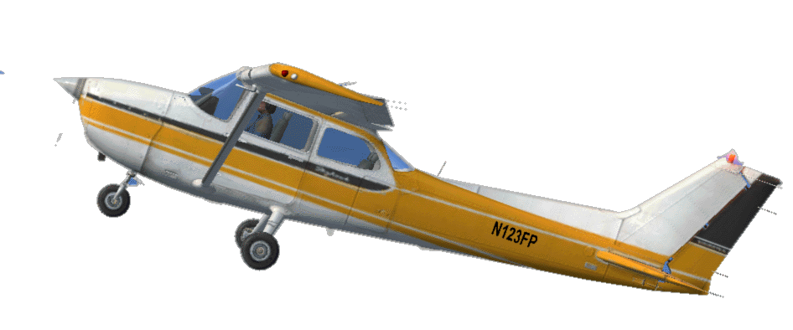
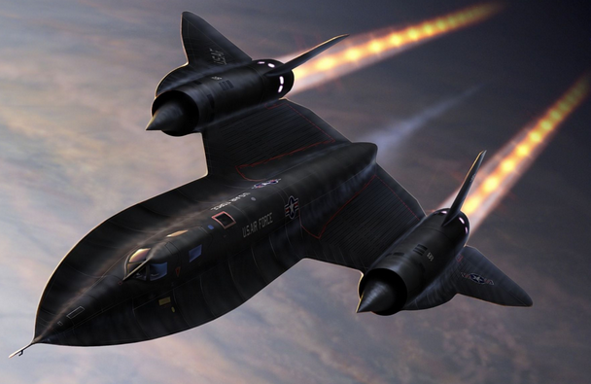
Fixed-Wing Aircraft

Slide 9
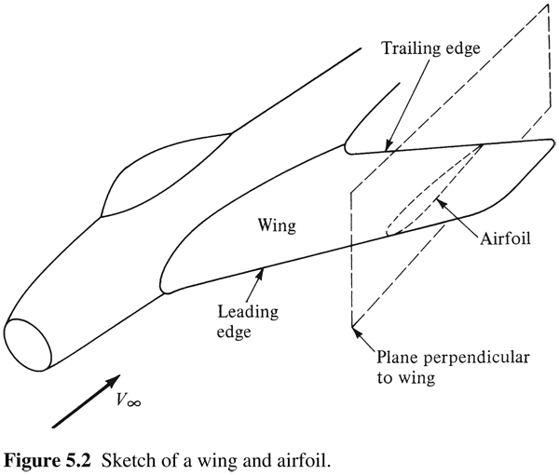
Basic Aerodynamics
Airfoil Nomenclature
Airfoil- is defined as the cross-sectional shape obtained by the intersection of the wing with the perpendicular plane as shown on the right

Slide 10
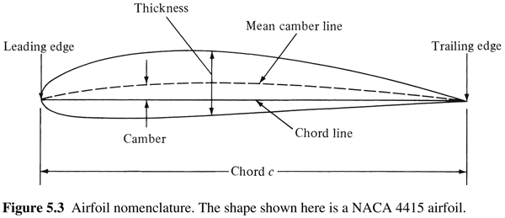
Basic Aerodynamics
Airfoil Nomenclature (continued)
Mean Camber Line – locus of the points halfway between the upper and lower surfaces as measure perpendicular to the mean camber line itself
Leading and trailing edges – most forward and rearward points, respectively, of the mean camber line
Chord line – straight line connecting the leading and trailing edges, also known as “c”
Camber - maximum distance between the mean camber line and the chord line, measured perpendicular to the chord line
Camber, shape of the camber, and to some extent the thickness, control the lift and moment characteristics of the airfoil

Slide 11
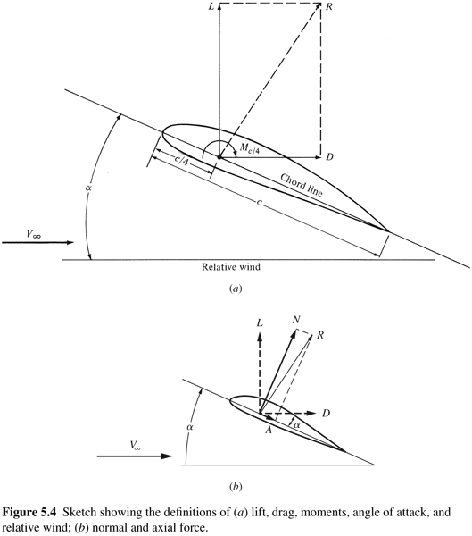
Basic Aerodynamics
Lift, Drag, and Moment
Figure on the right illustrates the definition of lift, drag, moment, and the angle of attack (α)
Lift is defined as the component of aerodynamic force perpendicular to the relative wind
Drag is always defined as the component of aerodynamic force parallel to the relative wind

Slide 12
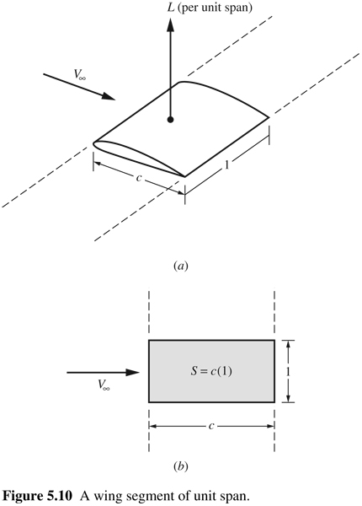
Lift, Drag, and Moment Coefficients
We can define the performance characteristics of airfoils in terms of sectional coefficients (i.e., lift/unit span).
Lift
Drag
Moment
Note that these are dimensionless, scalable, and values per unit span
A more complete discussion on the development of these coefficients can be found in most textbooks on aerodynamics

Slide 13
Lift, Drag, and Moment Coefficients
Note that the coefficients depend on:
  Free stream velocity,
  Free stream density,
    Which in turn is dependent on altitude, temperature, and pressure
  Size of the aerodynamic surface, c and S (wing area for finite wing)
  Angle of attack,
  Airfoil shape
  And other parameters such as viscosity and compressibility

Slide 14
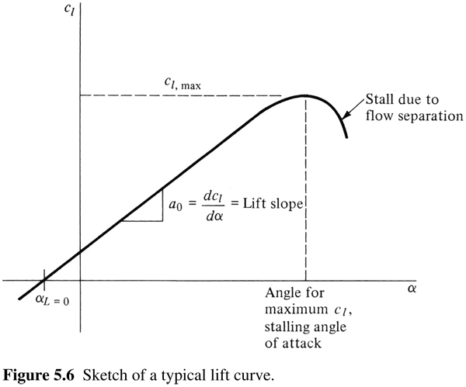
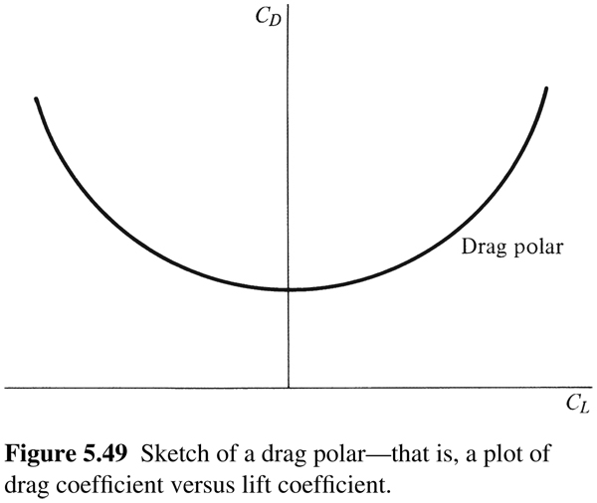
C_{l} - α Curves & Drag Polars
The aerodynamic coefficients are measured experimentally and some are documented in reports published by the National Advisory Committee for Aeronautics (NACA), which was reclassified as the National Aeronautics and Space Administration (NASA) in 1958
This and other curves are determined for you in the analysis tools
The variation of C_{D} with respect to C_{L} is typically plotted as a graph called a drag polar as shown on the right
Sketch of a Typical Lift Curve

Slide 15
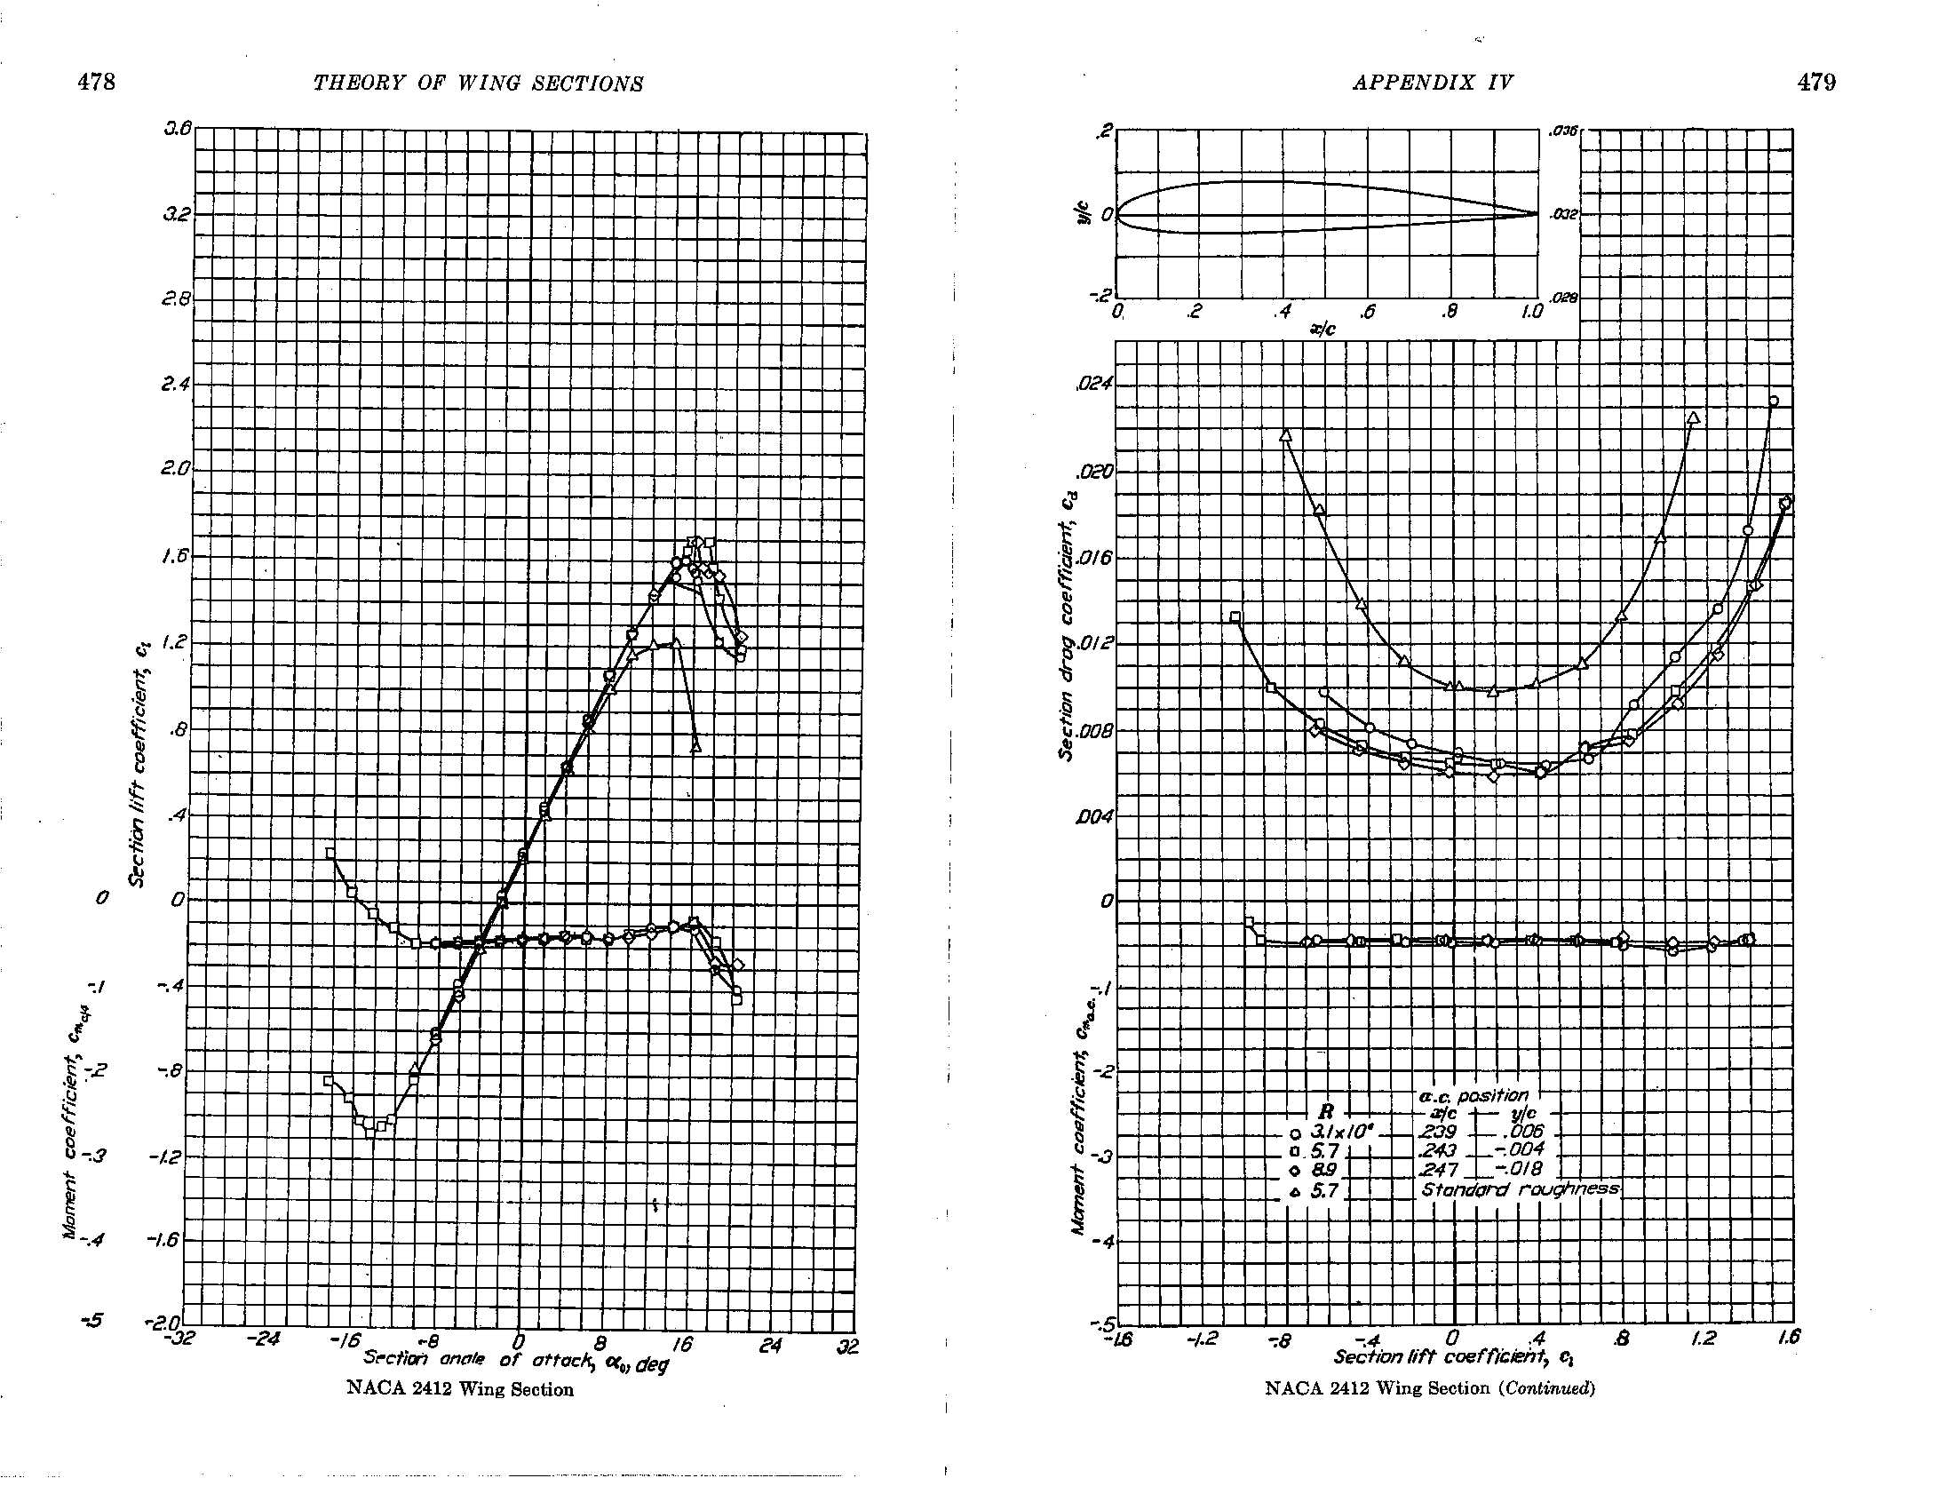
Example – Airfoil Data
These plots are available on the internet
The analysis tools calculate this for you, but it never hurts to double check

Slide 16
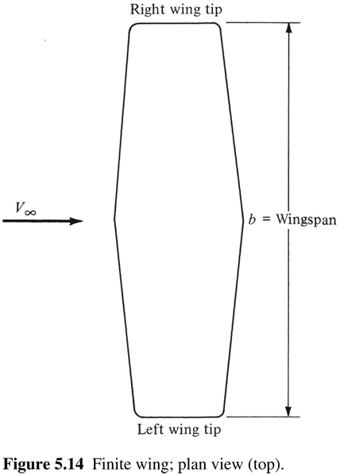
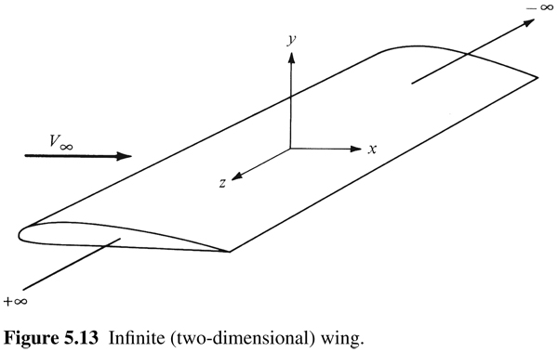
Infinite versus Finite Wings
So far we discussed wings that span the test section of the wind tunnel as shown by the figure bottom left, so there are no wing-tip effects and we can describe the aerodynamic performance by the 2-D airfoil section. In reality wings have a finite span as shown bottom right

Slide 17
Infinite versus Finite Wings
    Finite wing coefficients based on wing area (S)

Slide 18
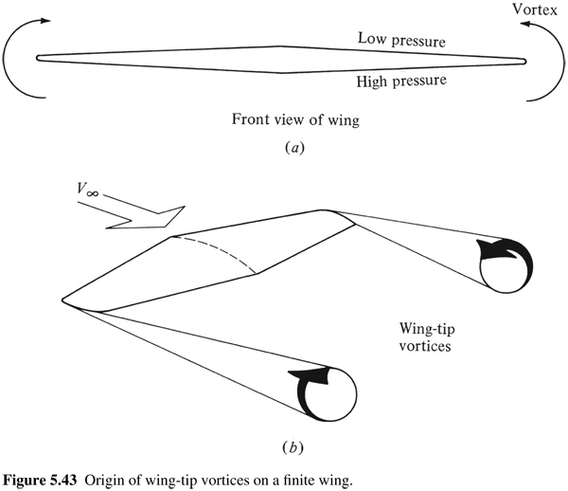
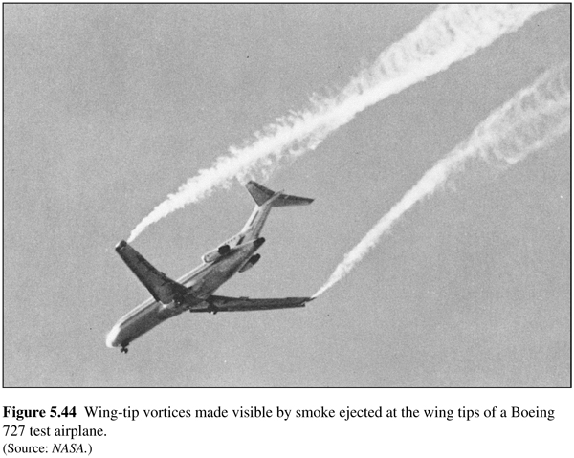
Infinite versus Finite Wings
Finite wings have a different aerodynamic effect that does not occur for infinite wings
The 2-D approximation of airfoil data is ok for preliminary performance calculations and some wing designs such as very high aspect ratio (i.e., large span)

Slide 19
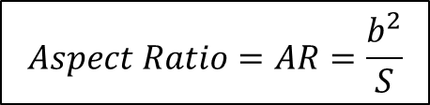
Infinite versus Finite Wings
A key parameter in describing the aerodynamic performance of a wing is the Aspect Ratio
The 2-D approximation of airfoil data is ok for preliminary performance calculations and some wing designs such as very high aspect ratio (i.e., large span)
You will need to determine this for some of your calculations

Slide 20
Range & Endurance
Range is defined as the total distance traversed by an airplane on a tank of fuel
  Maximum range for a propeller driven aircraft occurs when the airplane is flying at a velocity such that C_{L}/C_{D} is at a maximum
Endurance is defined as the total time that an airplane stays in the air on a tank of fuel
  Maximum endurance for a propeller driven aircraft occurs when the airplane is flying at minimum required power

Slide 21
Range & Endurance
Breguet Range Equation - Propeller Driven Airplane
To maximize the range of a propeller driven aircraft, we want:
Largest possible propeller efficiency, η
Lowest possible fuel consumption, c
Largest fuel to weight ration (W_{o}/W₁)
Flight at maximum L/D

Slide 22
Range & Endurance
Endurance Equation - Propeller Driven Airplane
To maximize the endurance of a propeller driven aircraft, we want:
Largest possible propeller efficiency, η
Lowest possible fuel consumption, c
Flight at maximum C_{L}^{3/2}/C_{D}
Flight at sea-level because E is proportional to density, which is highest at sea level. Note that range is independent of altitude

Slide 23
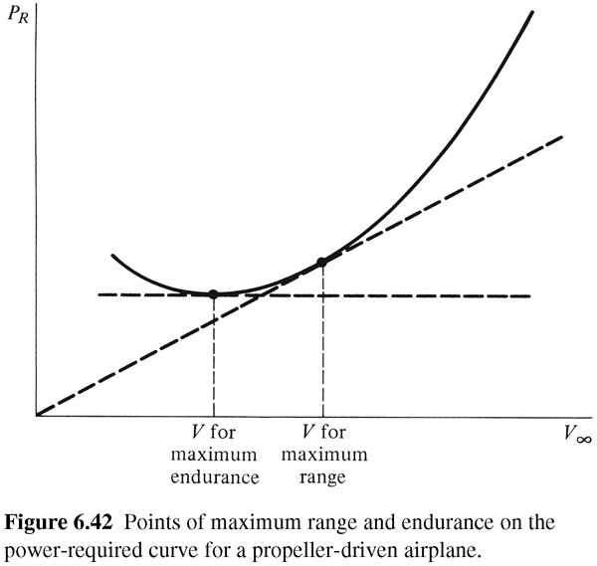
Velocities for Range and Endurance
Velocities for range and endurance can be observed by studying the relationship between power and velocity as shown in the figure on the right
As previously stated the velocity for max endurance occurs at min required power for flight while the velocity for max range occurs at best L/D, which can be shown to be the tangent point as shown on the right
These velocities can be determined using the analysis tools provided

Slide 24
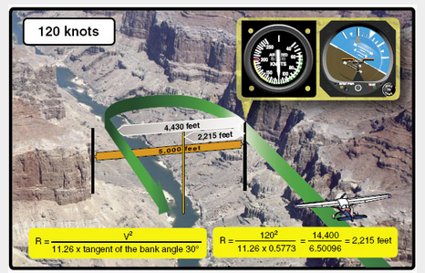
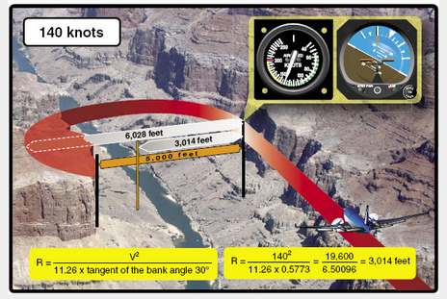
Turn Radius
http://code7700.com/aero_turn_performance.htm

Slide 25
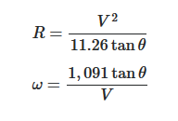
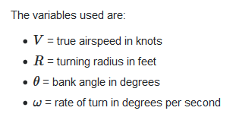
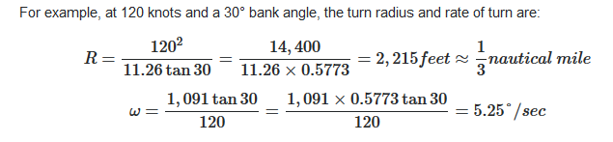
Turn Radius
https://aviation.stackexchange.com/questions/2871/how-to-calculate-angular-velocity-and-radius-of-a-turn

Slide 26
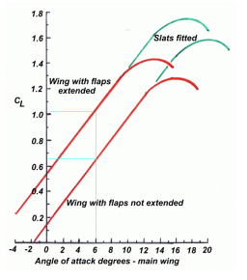
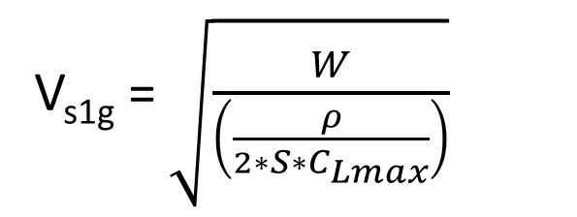
Stall Speed
V_{s1g} = $\sqrt{\frac{W}{\left(\frac{ρ}{2∗S∗C_{Lmax}}\right)}}$
W = aircraft weight = Mass * Acceleration (N)
Ρ = Atmospheric Density (1.225 kg/m^3)
S = Wing Surface Area (m^2)
Clmax = Maximum Lift Coefficient based on Polar
Example: Radio Controlled sailplane with:
Weight of the airplane W = 0,5kg*9,81m/s^2=4.905 kgm/s^2 =4.905 N
Atmospheric Density Ρ = 1.225 kg/m^3
Wing Surface Area S=1.3m*0.18m=0.234m^2
Maximum Lift Coefficient Clmax=1.4
Vs1g = sqrt[4.905 N / (1.225/2*.234m^2*1.4)]=4.944 m/s=17.8km/h

Slide 27
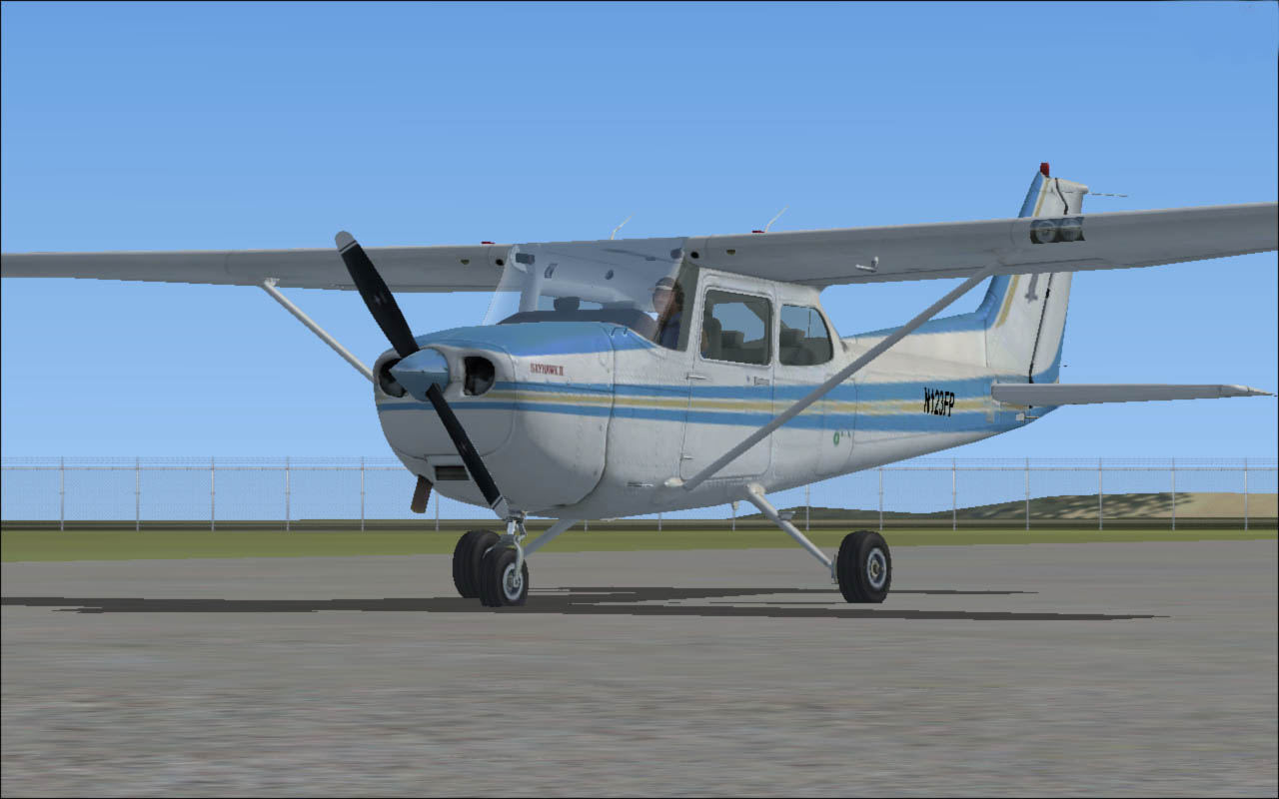

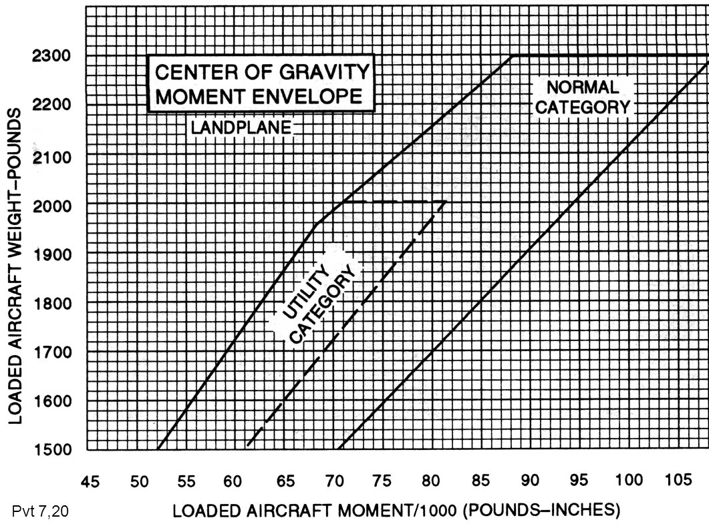
Weight & Balance
An aircraft at a specified maximum gross weight may not be safe with that load under all conditions.
High altitude, high temperature, and high humidity may limit gross weight.
The aircraft must be loaded in balance.
The balance point, or center of gravity is referred to as CG.
The CG must fall within specified limits.
27

Slide 28

Weight & Balance – What is a Moment
Datum
CG
Arm
Weight
Arm
Moment

Slide 29
Weight & Balance – What is a Moment
120 inch lbs
Counterweight
Arm 24”
1”
5
lbs
5
lbs
5
lbs
5”lbs

Slide 30
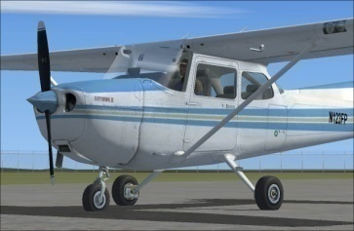
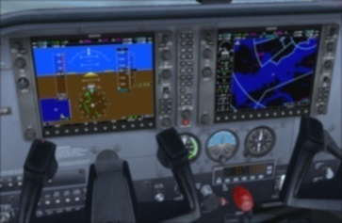
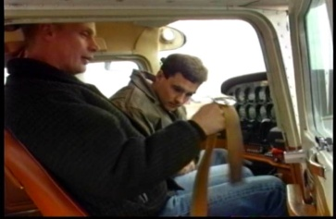
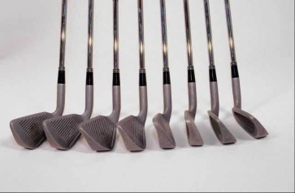
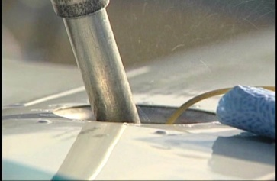
Weight & Balance – Gross Weight
Empty weight is the aircraft weight plus installed components
Airplane
Plus installed items
Gross weight (or total take off weight) includes:
Empty Weight
Plus pilot and passengers
Baggage
Fuel & Oil

Slide 31
Weight & Balance – CG of an Aircraft
WAM
Weight
Arm
Moment
Sum of the Moments
Sum of the weights
Center of
Gravity
(CG)

Slide 32
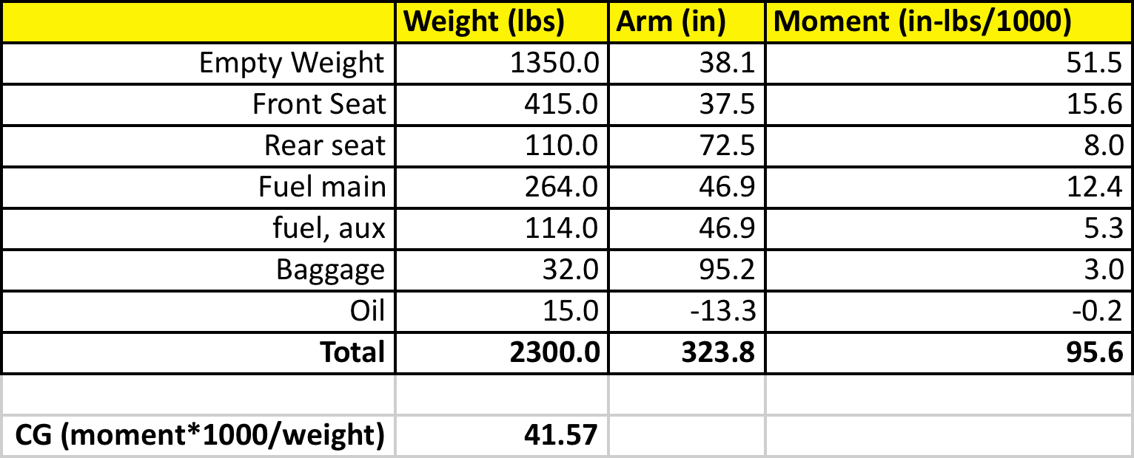
Weight & Balance – CG of an Aircraft
Example
The center of gravity (CG) of a vehicle can be computed using a spreadsheet as shown in the example below
Spreadsheets related to the RWDC challenge are provided in the tool set

Slide 33
Rotary Wing Aircraft

Slide 34
Rotary Wings – Complex Machines

Slide 35
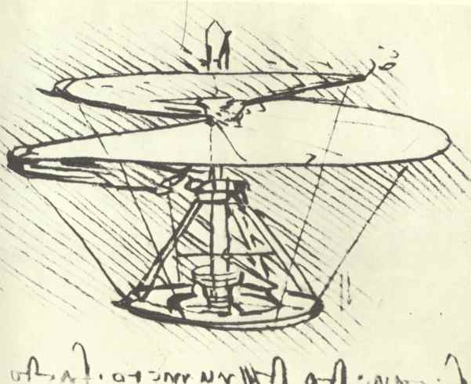
Leonardo da Vinci

Slide 36
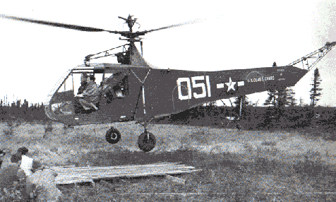
First Production Helicopter
Igor Sikorsky
Started work in 1907, Patent in 1935
Used tail rotor to counter-act the reactive torque exerted by the rotor on the vehicle.

Slide 37
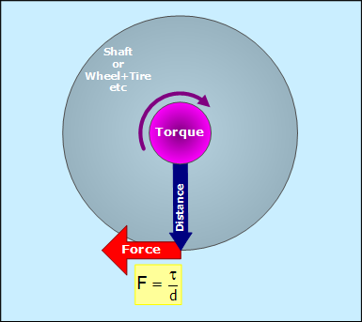
Countering Torque
What is Torque?
Torque = Force x Distance

Slide 38
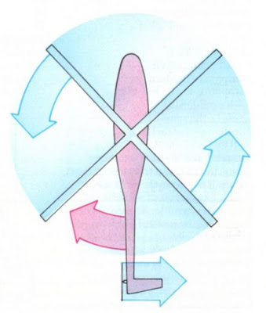
Countering Torque
Why counter torque?
  In a rotorcraft, we need to counter the torque to keep the fuselage from turning in the opposite direction of the rotation of the main rotor

Slide 39
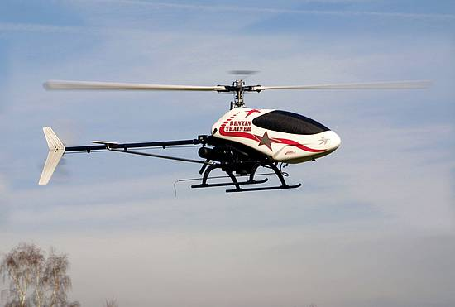
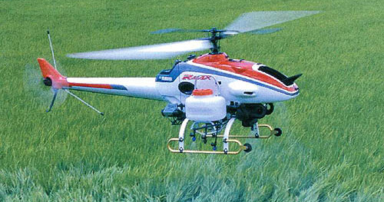
Countering Torque
Single Main Rotor Configuration

Slide 40
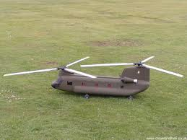
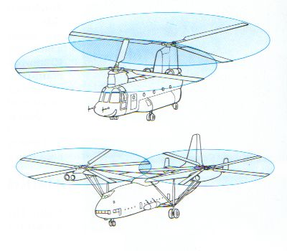
Countering Torque
Tandem Rotor Configuration

Slide 41
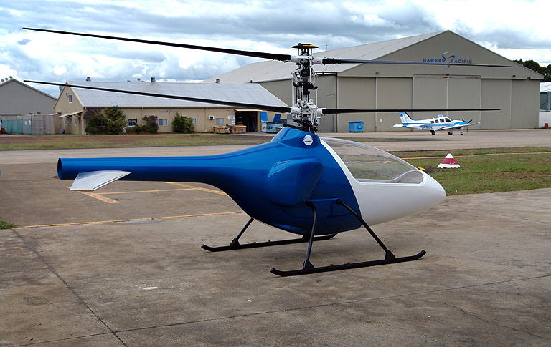
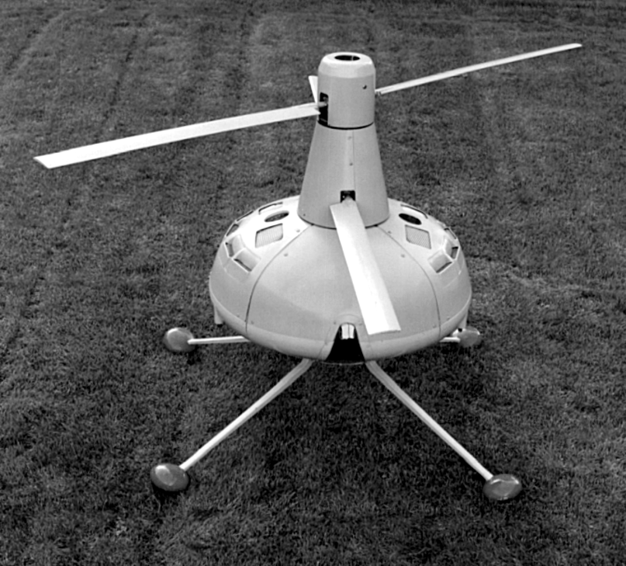
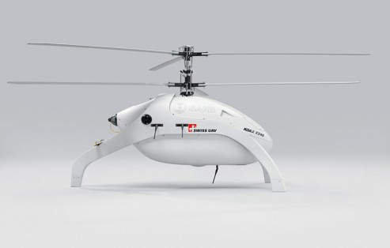
Countering Torque
Co-axial Rotor Configuration

Slide 42
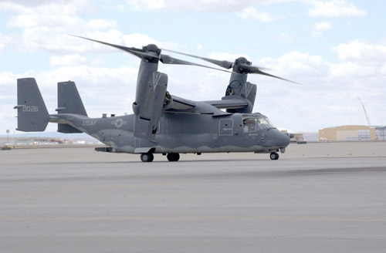
Countering Torque
Side-by-Side Rotor Configuration

Slide 43


Countering Torque
NOTAR – No Tail Rotor

Slide 44



Countering Torque
Multi-Rotor Configuration

Slide 45

Fixed Pitch Props

Slide 46


Multi-Rotor Systems
Opposing Rotors Motions

Slide 47

Multi-Rotor Systems

Slide 48

Multi-Rotor Systems

Slide 49


Multi-Rotor Systems
RPM Changes for maneuverability

Slide 50

Multi-Rotor Systems
RPM Changes for maneuverability

Slide 51

Articulated Rotor System

Slide 52

Rotor Hinges

Slide 53



Articulated Rotor System

Slide 54



Performance Prediction
V = Climb Velocity
v = Induced Velocity
T = Thrust
w = 2v

Slide 55

Performance Prediction
Ideal Power Consumed by Rotor
ρ = Density of Air
A = Area of Rotor Disk

Slide 56

Performance Prediction
Ideal Power Consumed by Rotor
In hover, Ideal Power
In Hover T = W

Slide 57

Figure of Merit
Figure of merit is defined as the ratio of ideal power for a rotor in hover obtained from momentum theory and the actual power consumed by the rotor.
For most rotors, it is between 0.7 and 0.8.

Slide 58

Sample Calculations
How to calculate power consumption
Example Problem
A side-by-side rotor aircraft has a gross weight of 60,500 lb. (27500 kg).
The rotor diameter is 38 feet (11.58 m).
Assume FM=0.75, Transmission losses=5%
Compute power needed to hover at sea level on a hot day.

Slide 59

(3070 kW)
(4090 kW)
(8190 kW)
(8600 kW)

Slide 60


Forward Flight

Slide 61

Power Calculations in Forward Flight
Total Power Required =
Induced Power (Power required to generate lift)
+
Parasite Power (Power required to overcome fuselage drag)
+
Profile Power (Power required to overcome drag of rotor blades)

Slide 62

Power Calculations in Forward Flight
Induced Power =
Parasite Power =
Profile Power =

Slide 63

Power Calculations in Forward Flight
Rotorcraft Power Curve
Power
Forward Speed

Slide 64

Quadcopter Power Requirement
$$Payload Capacity F=\left(T∗n∗D\right)−W$$
T = Motor Thrust
n = # of Motors
D = Hover Throttle
W = Aircraft Weight
F = Payload Capacity
$$Thrust=\frac{ \left(\left(\frac{1}{D}\right)∗\left(F+W\right)\right)}{n}$$
For an agile aircraft you generally you want it to hover at 50% throttle or lower

Slide 65

Quadcopter Battery Requirement
Flight Time$=\left(\frac{Capacity∗Discharge}{Average Amp Draw}\right)∗60$
For example:
If you know each motor draws 1 amps to produce 100g of thrust.
If your quadcopter take 2000g to flight, each motor will have to produce 500g (500g = 2000g / 4 motors) of thrust in order to hover.
Then your quadcopter Average Amp Draw is 20AMPS ( 20AMPS =4motors * 500g/100g per 1amps)
Quadcopter flight times = (3300mAh/1000) * 80% / 20 amps *60 minutes = 7.92 minutes

Slide 66
Weight & Balance – Gross Weight
Empty weight is the aircraft weight plus installed components
Airplane
Plus installed items
Gross weight (or total take off weight) includes:
Empty Weight
Plus pilot and passengers
Baggage
Fuel & Oil

Slide 67
Questions ???

