Slide 1

The Innovation Engine
Introduction to Unmanned Aerial System (UAS)
Design Philosophy
Dr. Florian Hafner, Embry-Riddle Aeronautical University
Thanks to Florian Hafner, Dr. Brent A. Terwilliger & Dr. Robert Deters, Embry-Riddle Aeronautical University
Thanks to Dr. Brent A. Terwilliger & Dr. Robert Deters, Embry-Riddle Aeronautical University

Slide 2
Overview Engineering Design Process
Engineering Design Process
The Engineering Design Process is used during each Design Phase.
Design Phases
Conceptual Design (Many designs at least eight per team member)
Preliminary Design (Narrow down to three designs per team)
Detailed Design (One design per team)
1
Define Problem
2
Research
3
Create Solutions
4
Test & Analyze
5
Select Solutions & optimize

Slide 3
Typical Design Phases
The design of most systems is traditionally accomplished in three phases:
Conceptual design – when the “gap” in the market or means of producing an improved (i.e., better) product offering are determined or when a new product is thought up (i.e., invented)
  Many concepts are considered
  Early research and testing activities are performed (to expedite design later in process)
  Identify dependencies of designs (i.e., what is necessary to make this work?)
Preliminary design – outline of original design need is expanded in more detail
  Design possibilities are further narrowed down
  Mock-ups or models (i.e., CAD) may be constructed
  Design vs buy (i.e., purchase COTS) considerations made
  Costs re-examined
Detailed design – when work expands to focus on the final design of the system
  Detailed analysis of the systems (e.g., aerodynamics, structures, ancillary systems)
  Layout/connection of components
  Detailed design drawings and documentation created
NOTE: Other phases my follow after initial manufacture of a design

Slide 4
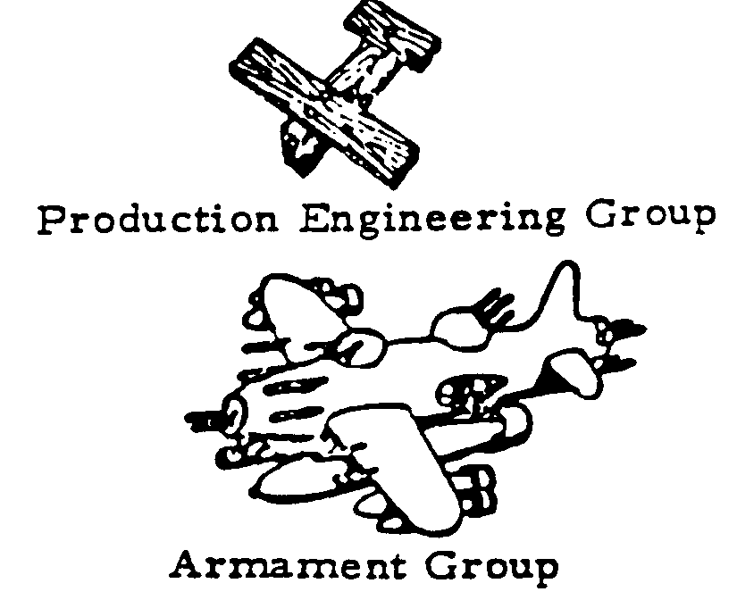
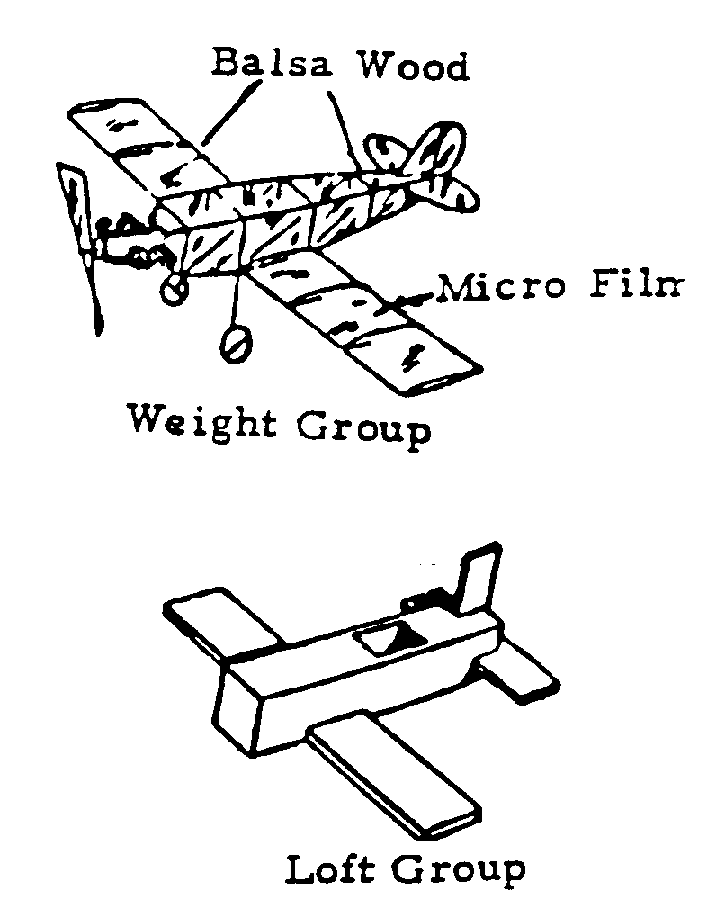
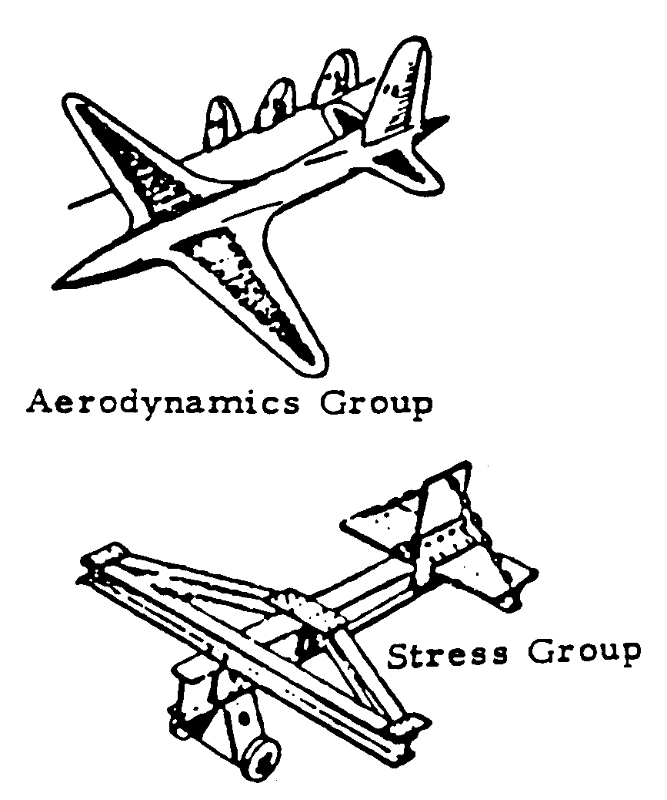
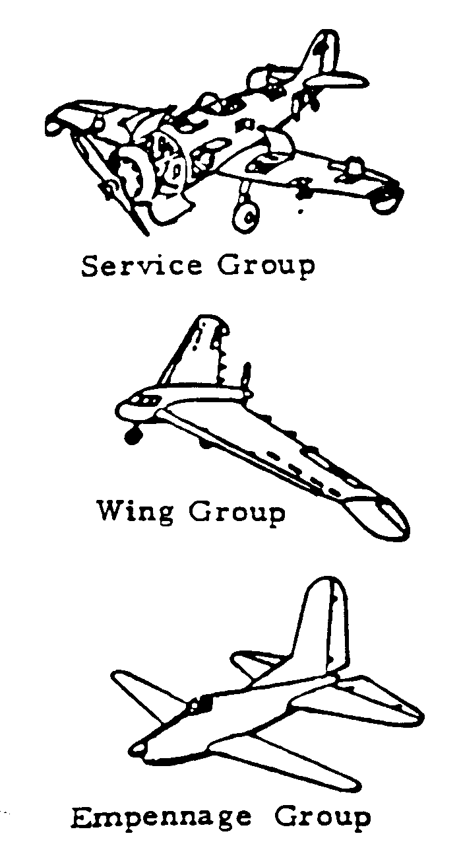
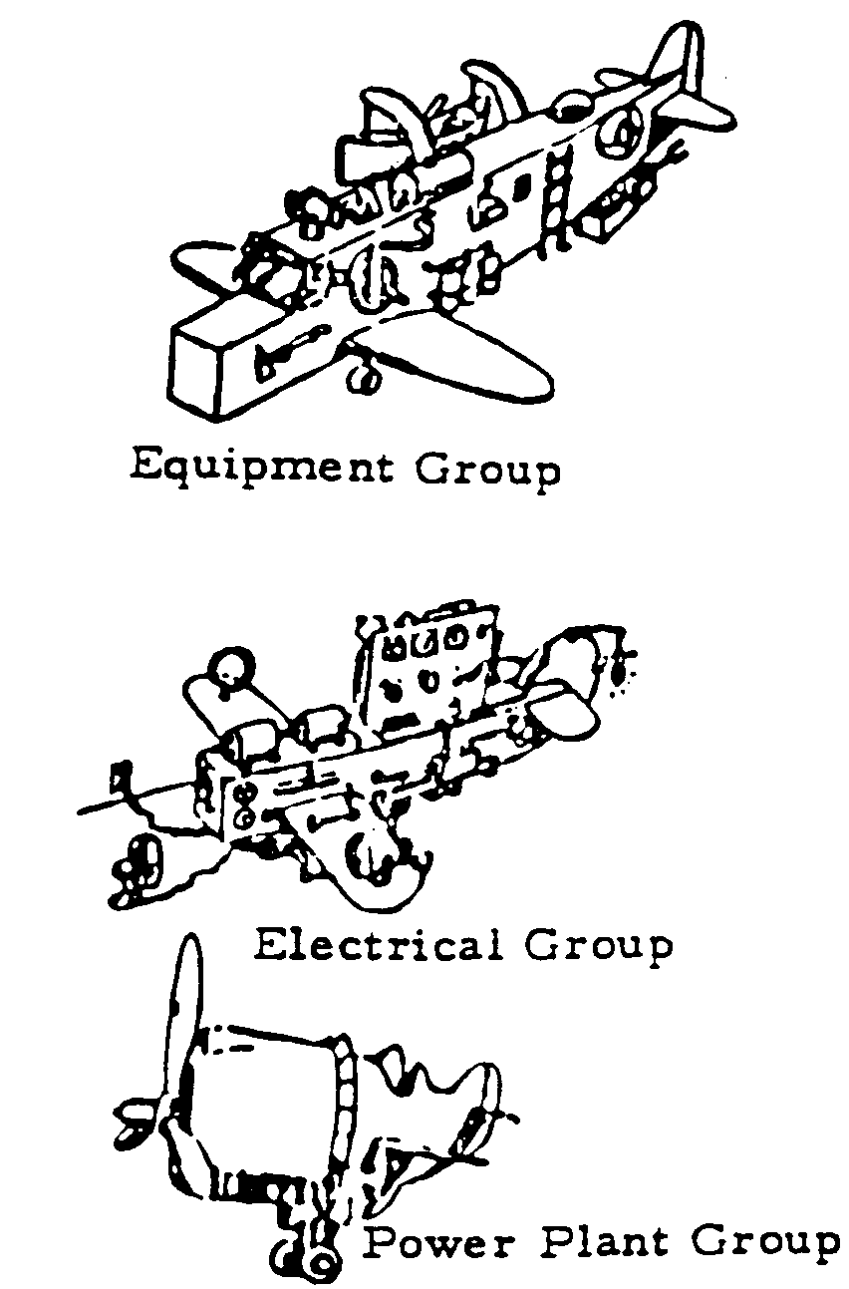
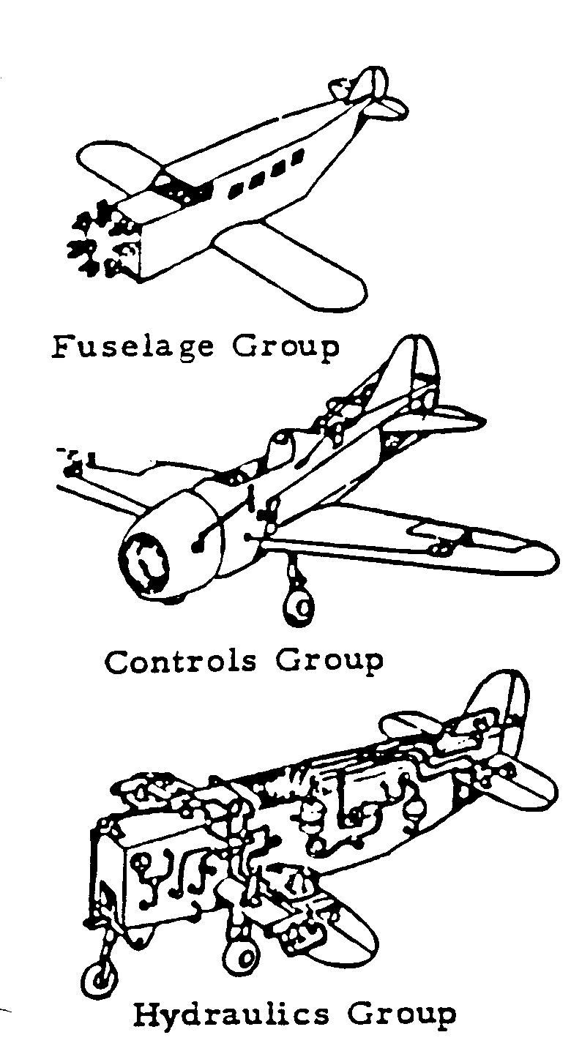
Engineering Design Process
Design of a complex system like an aircraft or UAS requires many groups to work together to form a complete design
Aircraft through the eyes of only one group

Slide 5
Mission Requirements
The first step in design is the definition of the requirements. Often the requirements are at odds with each other.
These requirements can be designated by the user or supplier.
Some possible mission requirements include
  Range
  Purpose
  Endurance
  Speed
  Cost
  Maintainability
  Payload

Slide 6
Some Engineering Design Tools…

Slide 7
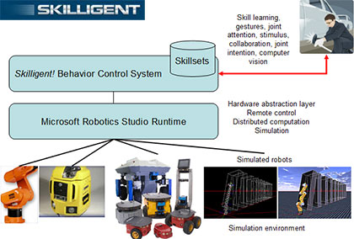
High Level Operational Views
  Provides high level overview of the system
  Depicts major subsystems/ classes
  Hierarchal depiction of design

Slide 8
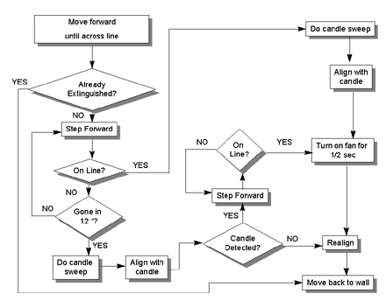
Information/Process Flows
Symbolic representations of actions/ processes
Shows WHAT the job to be performed is

Slide 9
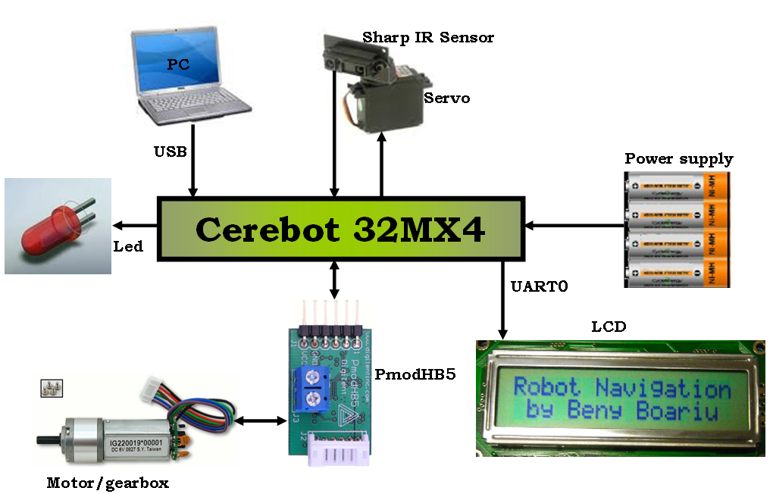
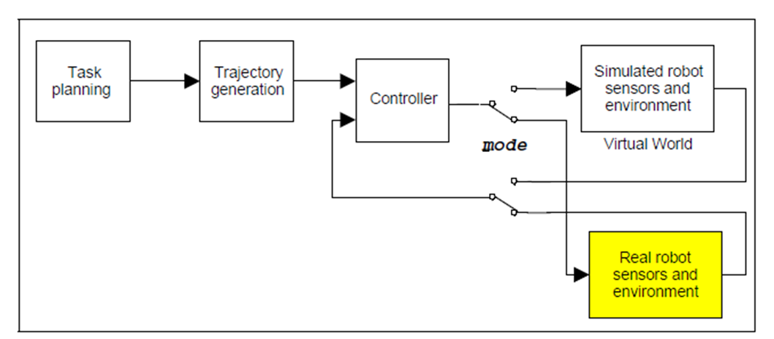
System Component Diagrams
Example shows pictographic representations of components
Shows HOW the job is to be done
Example shows block representations of components
Shows HOW the job is to be done

Slide 10
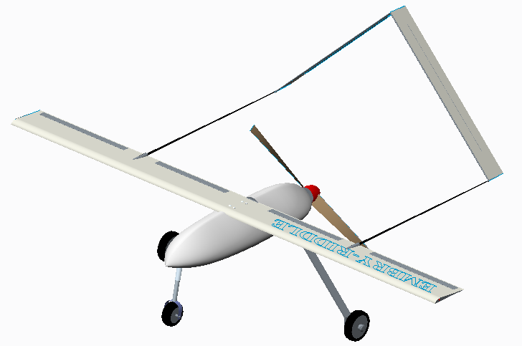
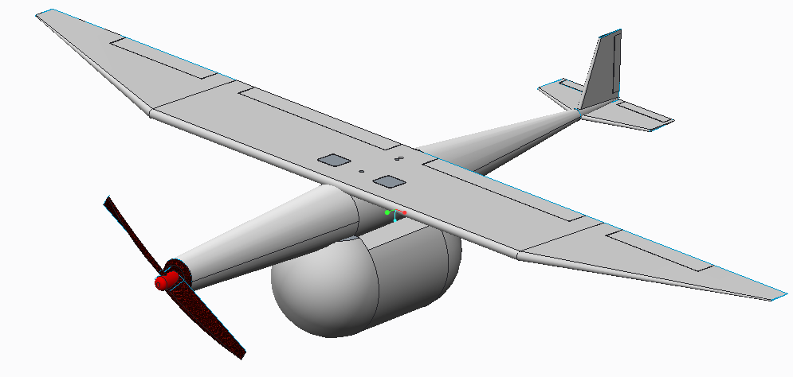
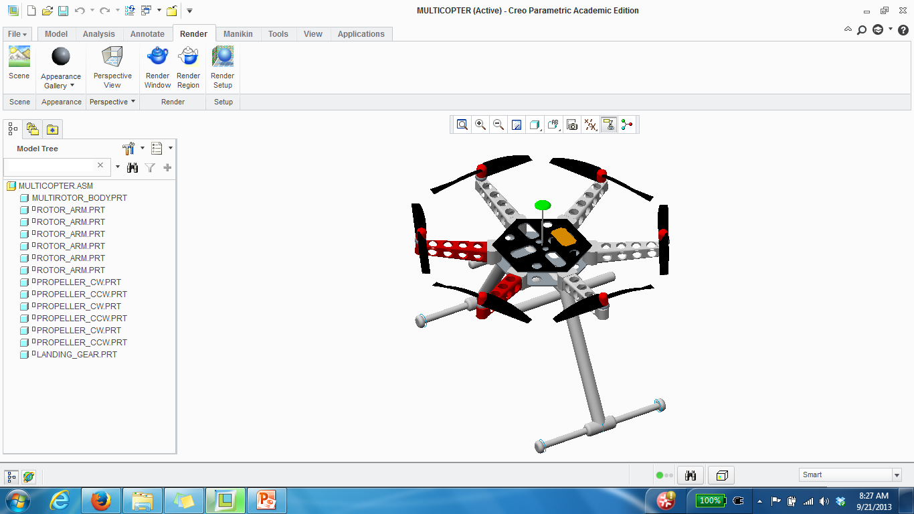
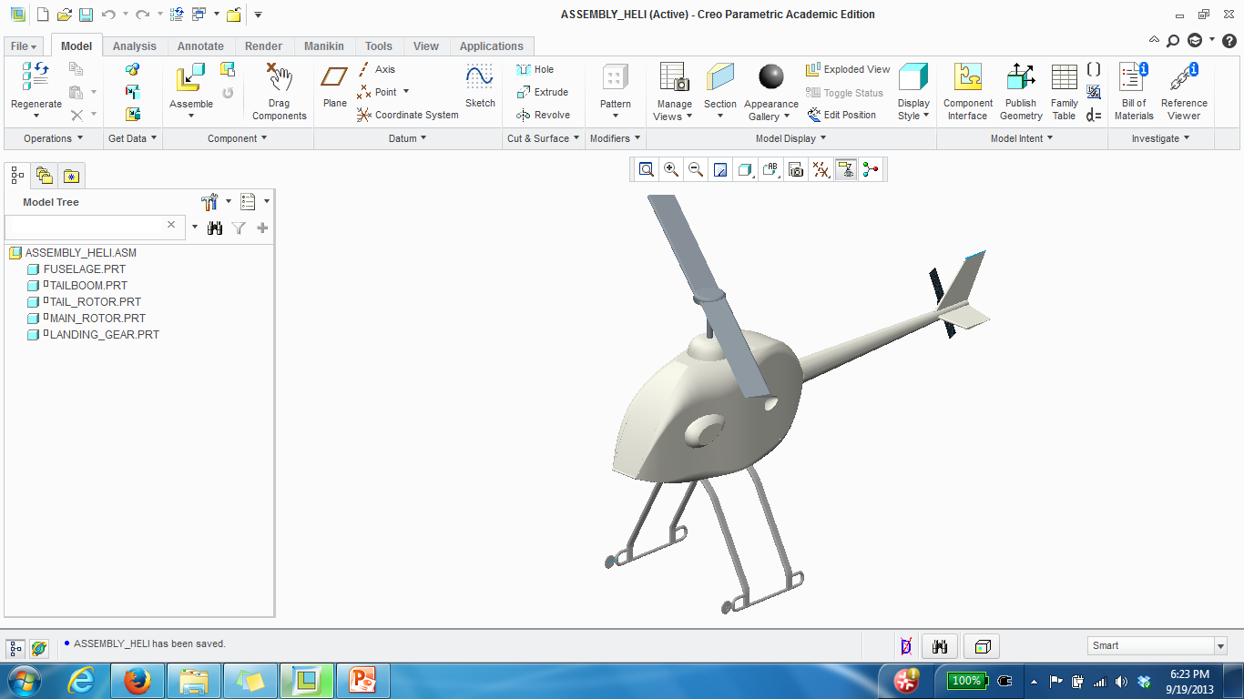
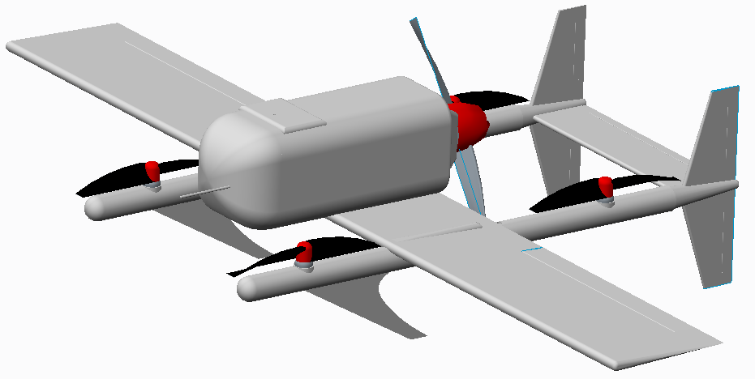
Engineering Design Tools
Increase the productivity of the designer
Improve the quality of design
Improve documentation of the design

Slide 11
Questions ???

