Slide 1

The Innovation Engine
Introduction to Unmanned Aerial System (UAS)
Ground Station Design
Dr. Florian Hafner, Embry-Riddle Aeronautical University
Thanks to Dr. Florian Hafner, Dr. Brent A. Terwilliger & Dr. Robert Deters, Embry-Riddle Aeronautical University
Thanks to Dr. Brent A. Terwilliger & Dr. Robert Deters, Embry-Riddle Aeronautical University

Slide 2
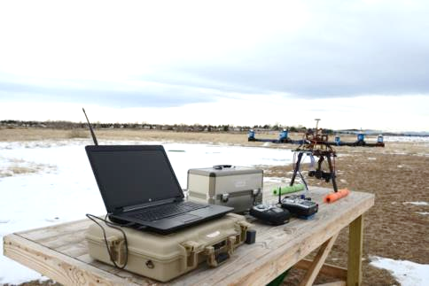
Ground Station Components (GCS)
Components needed
  Laptop/Computer for Flight Monitoring/Management
  Visual Display for Status or Real-Time Sensor Data Display
  Network/Communications Equipment
  Flight Controls for Non-Autonomous Flight
  Power Station
  Facility (Fixed Base, Mobile Trailer/Vehicle, Mobile Setup)

Slide 3
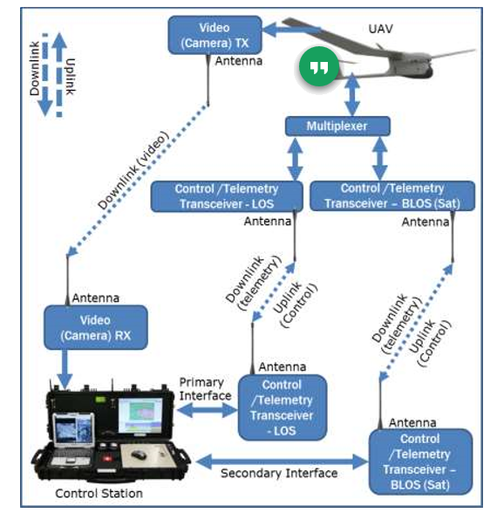
Sample C2 Configuration
Generally there are 2 types of data links
  Command & Control
  Payload Data
C2 data links are bi-directional and usually have redundancy
  Can have multiple paths
Payload data is generally a downlink only
GCS manages all data links to/from UAS

Slide 4
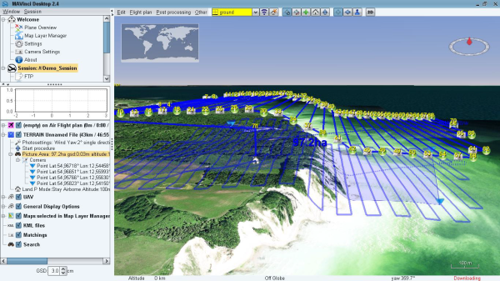
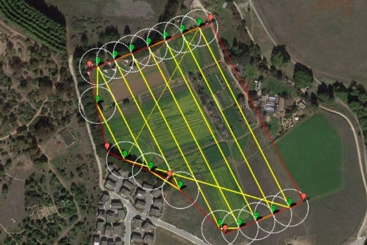
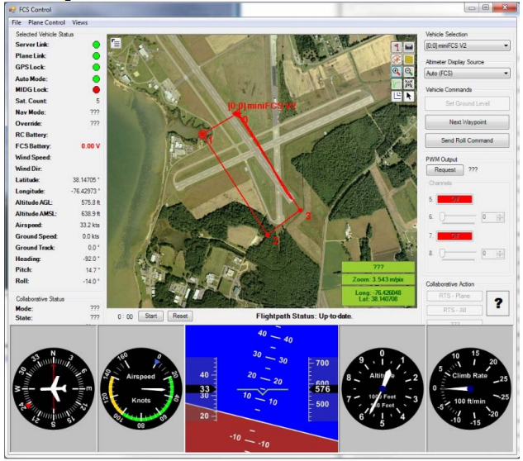
Flight Management
Manual Control is an Option but you lack flight tracking, precision, and monitoring capabilities
Lots of Flight Planning Software is available including Free/Open Source
  Develop fix-to-fix flight plans
Can incorporate several functions
  Flight/Trajectory Planning
  Display of No-Fly Zones
  Flight plan filing with Regulatory Agency
  Flight Tracking (from UAS GPS)
  Sense and Avoid (GBSAA)
Available on various platforms
  PC, Mobile

Slide 5
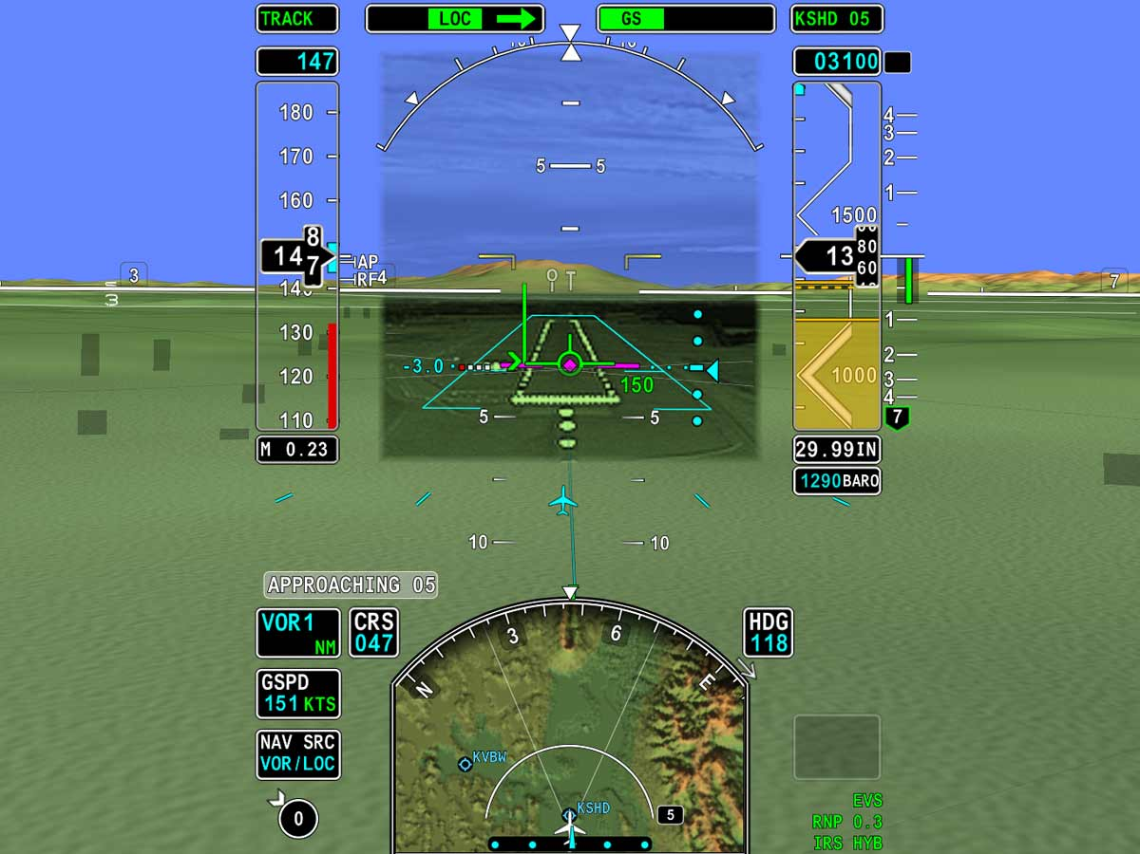
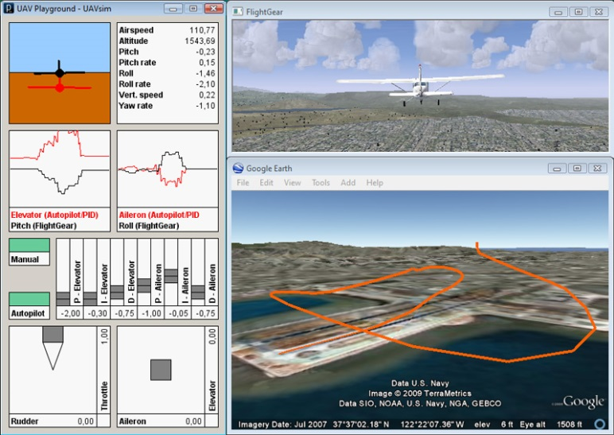
Flight Situation Displays
Egocentric – view originates from within the vehicle (i.e., being in the aircraft; also called first person view [FPV])
  Increased capability to determine orientation of aircraft relative to affected control actuation (e.g., effects of commanded pitch, roll, yaw)
  Decreased situational awareness of operating environment (e.g., soda straw effect)
  Can be supplemented with onscreen display (OSD)
Exocentric – view originates outside the vehicle (e.g., operating an RC aircraft)
  Greater situational awareness of vehicle relative to other objects in the environment
  Reduced capability to determine orientation of aircraft relative to affected control actuation
  Can also be used to artificially visualize UAV in path planning/navigation

Slide 6
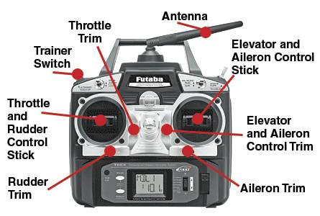
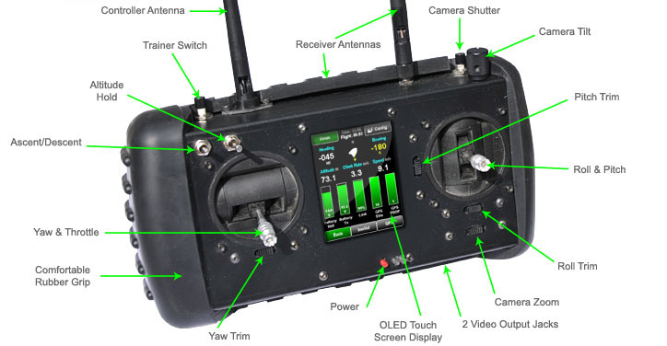
Flight Controls
Handheld Flight Controls
Do not provide the same level of interaction as conventional flight controls
Portable and easy to use
RC hobby radio system
  Typically four to 10(+) channels (i.e., servos)
  Limited to visual line of sight (VLOS) operation
  Radio frequency (RF) communication
  Two omni-direction joysticks (X-Y axes) and multiple push button or toggle switches
Custom designed - to meet specified need

Slide 7
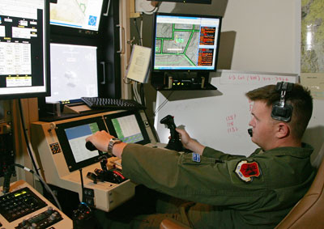

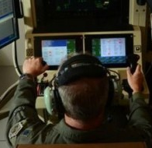
Flight Controls
Conventional Flight Controls
Provides an interface similar and familiar to manned flight pilots
  Pitch/Roll: Flight stick, yoke, or cyclic (pitch and roll)
  Yaw: Pedals
  Engine/rotor: Throttle (and collective)
  Flaps, trim, landing gear retraction, communications
May provide capability to switch between manual control and autopilot (semi-autonomous) operation– for redundant (backup) flight control

Slide 8
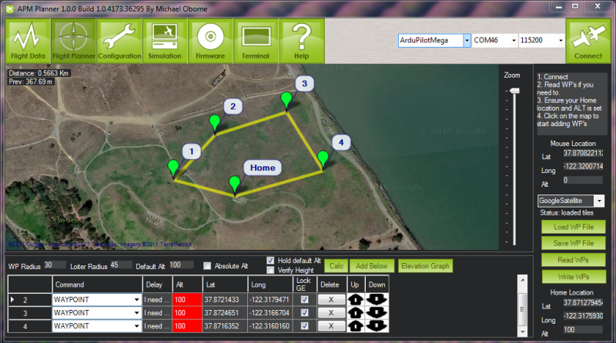
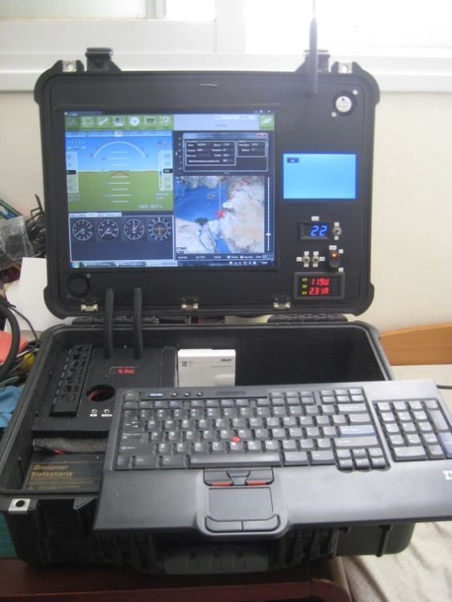
Flight Controls
Autonomous Flight Controls
Provides an graphical user interface (GUI) that
  Depicts state/status of aircraft
  Provides method to upload control/operational parameters (e.g., min/max altitude, min/max airspeed, duration, waypoints)
May provide capability to switch between manual control and autopilot (semi-autonomous) operation – for redundant (backup) flight control

Slide 9
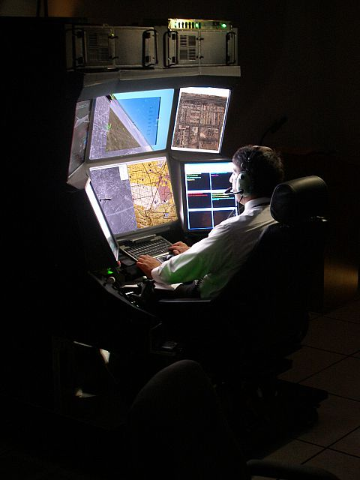
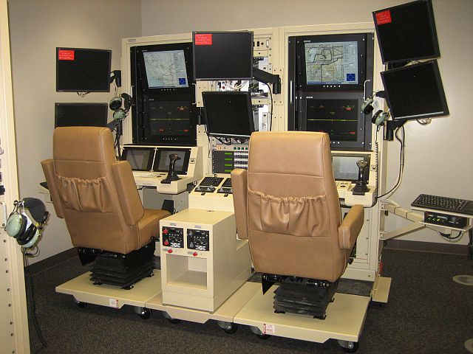
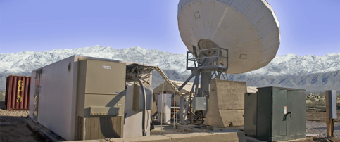
Fixed-based Ground Control Station (GCS)

Slide 10
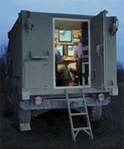
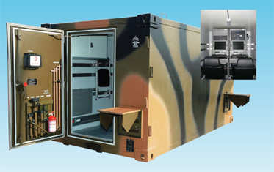
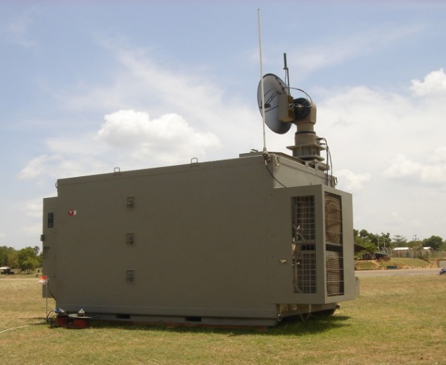
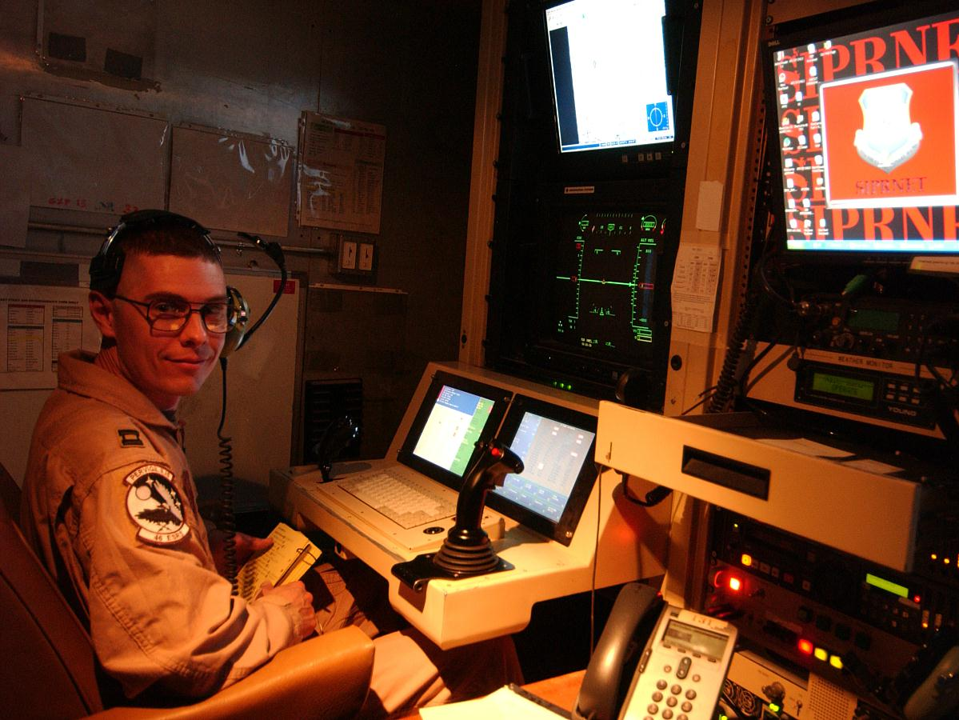
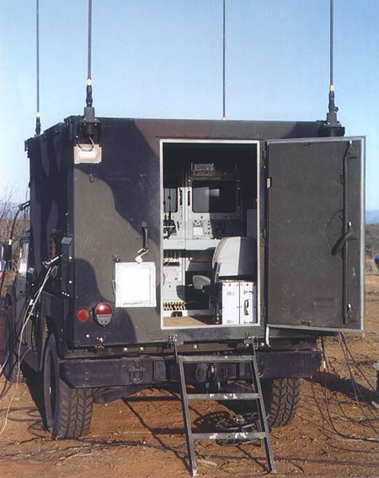
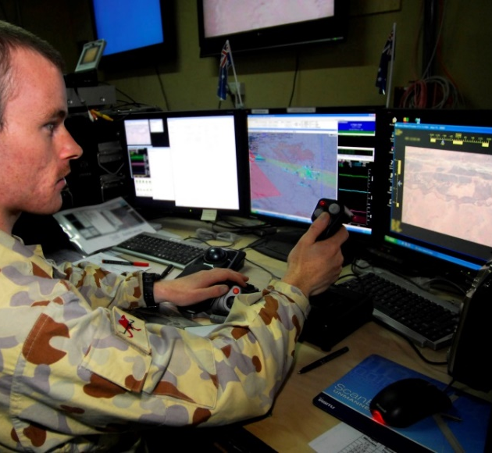
Trailer/Vehicle-Based GCS

Slide 11
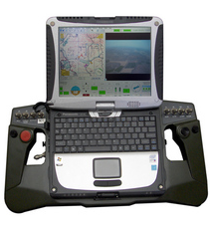
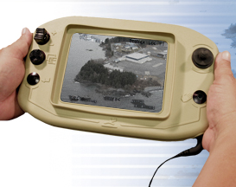
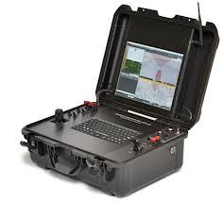
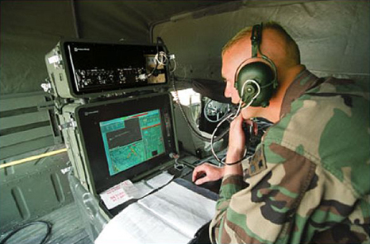
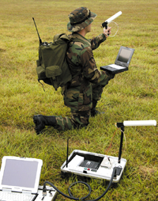
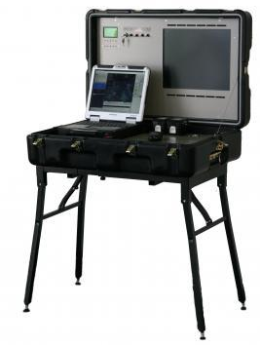
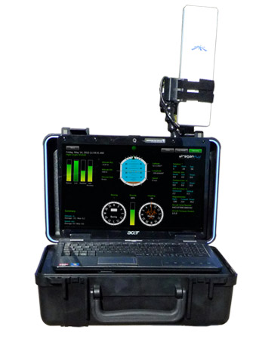
Back-packable/Portable GCS

Slide 12
Questions ???

