Slide 1
FY16 NATIONAL UNMANNED AIRCRAFT SYSTEM CHALLENGE
THE XAVERIAN ENGINEERS X181-KMR
XAVIER HIGH SCHOOL, CONNECTICUT

Slide 2
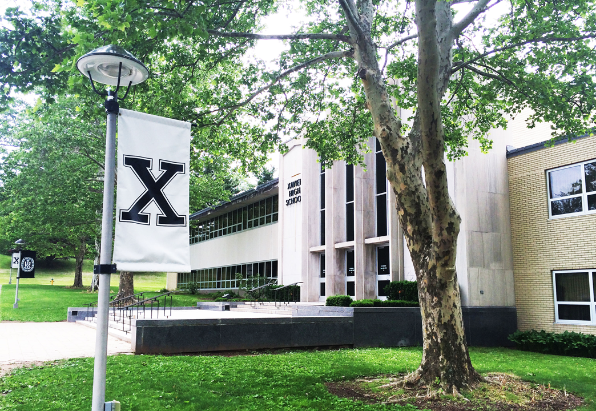
Team Formation
Shannon Copeland - Coach
Keith Cestaro ’17
Roham Hussain ’18
Mihir Khunte ‘17
Robert Larese ‘17
Noah McGuinness ‘18
Vincent Salabarria ‘18
Anthony Tedeschi ‘18
Pratt and Whitney Mentors
Andrew Burdick
Frances M. Figueroa-Rodriguez
Arthur Salve
Melanie Tibbetts
Kevin Zacchera
Notes:
Anthony

Slide 3
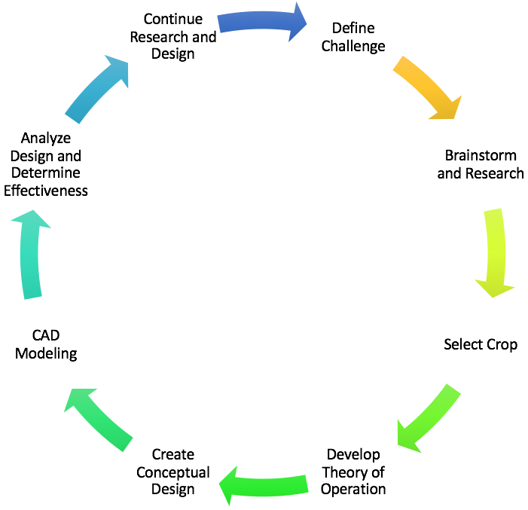
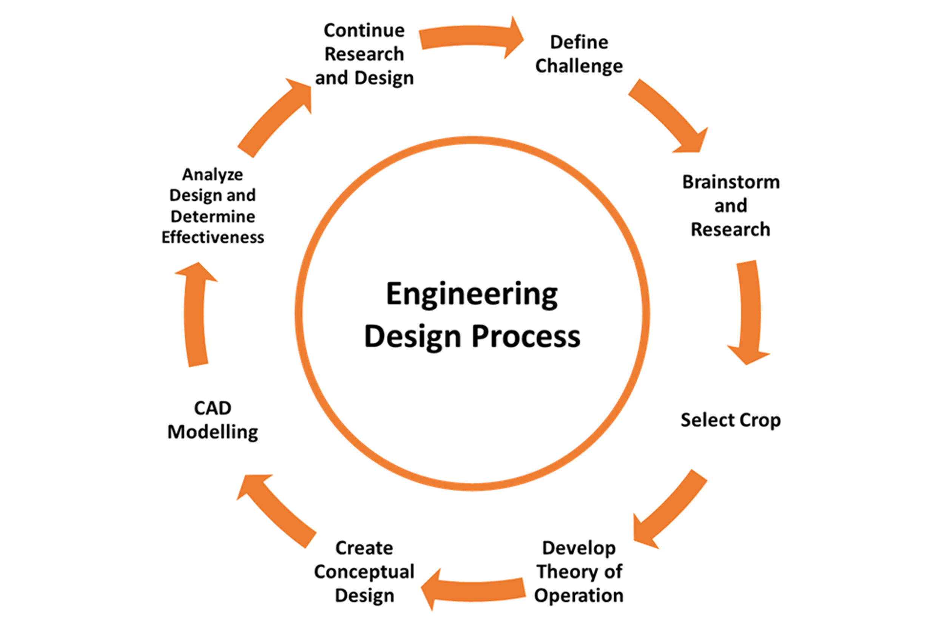
Engineering Design Process
ENGINEERING DESIGN PROCESS
Notes:
Keith

Slide 4
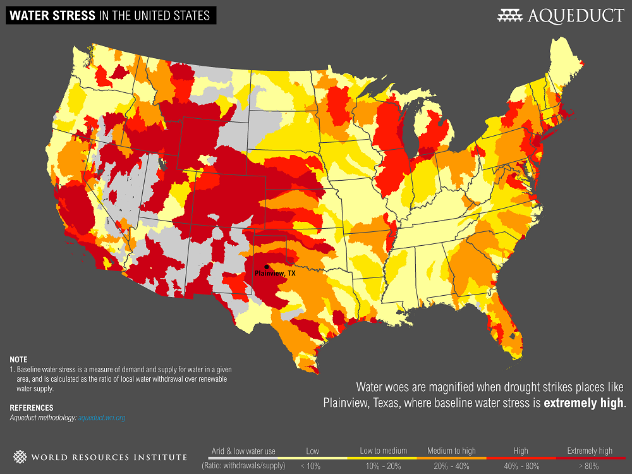
Challenge
Challenge Design Theory of Operation Business Case
Project Goal: Effectively utilize an Unmanned Aerial System for the detection of moisture content in order to combat water stress. .
Notes:
Mihir
Conserve agricultural water use by utilizing advanced techniques in order to combat water stress.

Slide 5
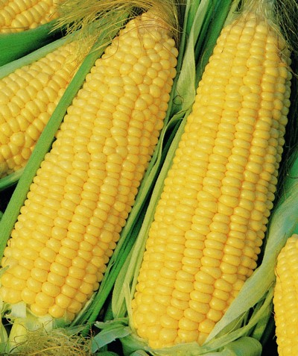
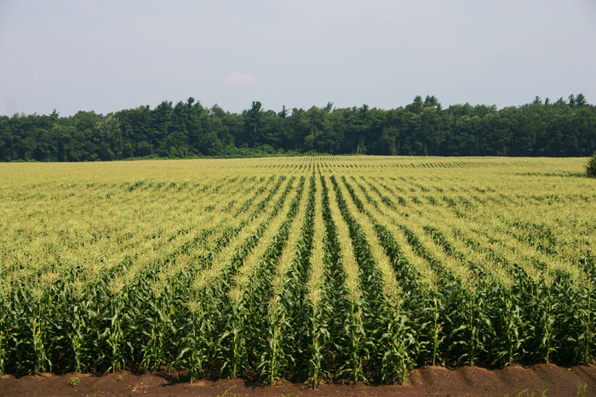
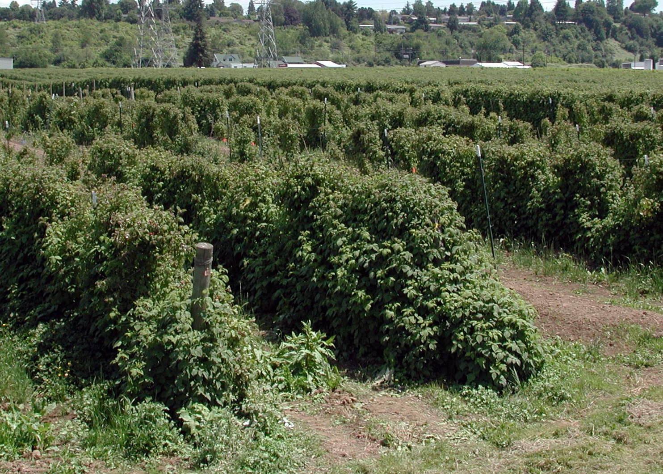
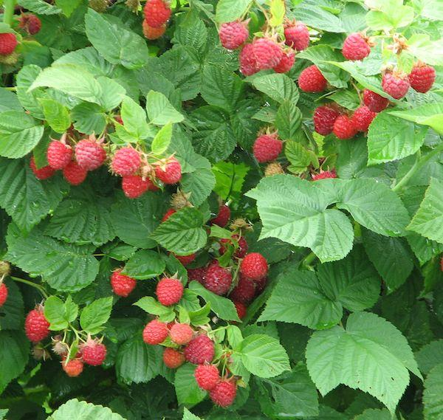
Crop
Challenge Design Theory of Operation Business Case
Sweet Corn
2012 profits - $67.3 billion
17% of agricultural sales in the U.S.
369,332 farms
Harvest: August 1-September 20
Organized rows
Raspberries
Yearly production 64,773 metric tonnes
U.S. number four in production worldwide
Average retail price per pound is $6.98 fresh
Harvest: July 5-September 30
Bushes
Notes:
Anthony

Slide 6
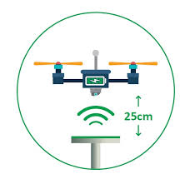
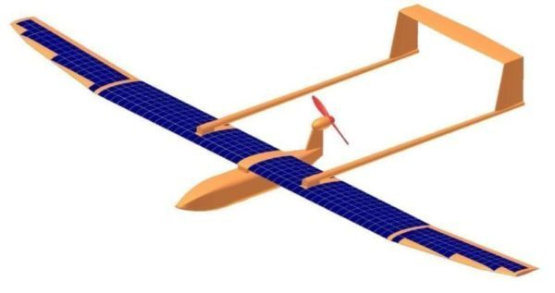
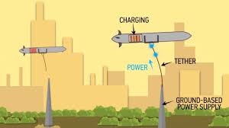
Conceptual Design & Research
Challenge Design Theory of Operation Business Case
Solar panels
Energy production
Costly (custom-made and short flight)
Wireless charging
Charging midflight
Inefficient (loss of energy)
Wired charged
Charging midflight
Unrealistic and unpractical
Types of aircraft
Hybrid: costly
Pusher: propeller inefficient and powerplant management
Tractor: camera placement and airflow disruption
Wireless Charging
Solar Panel Design
Wired Charging
Notes:
Roham

Slide 7
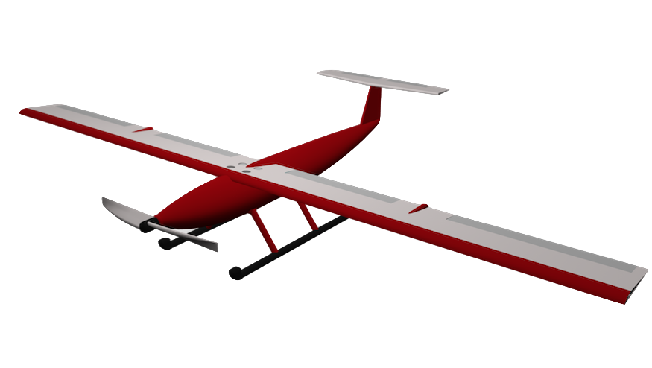
Conceptual Design
Challenge Design Theory of Operation Business Case
Fixed-Wing, High-Wing UAV
T-Tail
Carbon fiber frame and shell
Powerplant:
Electric, brushless motor
Two Lithium Polymer batteries
No onboard solar panels
Skids for landing

Slide 8
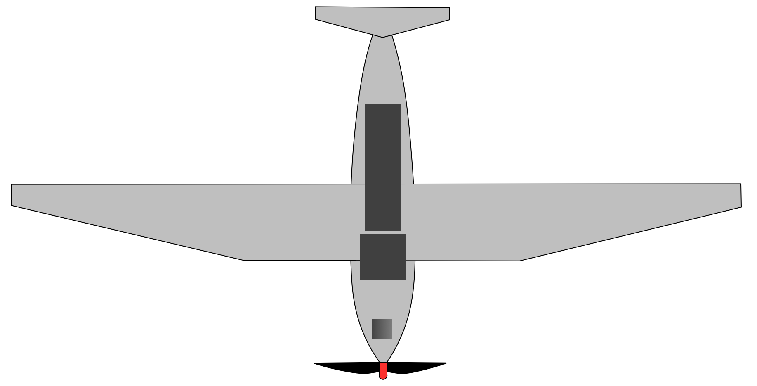
Preliminary Design
Challenge Design Theory of Operation Business Case
Initial design defined by payload dimensions
Incorporate conceptual elements
Redefine baseline components
Develop new parts
Analyze preliminary design to begin refining
Payload Distribution (side)
Preliminary model of conceptual design and Payload distribution (top)
First Model of Conceptual Design (front)
Notes:
Noah

Slide 9
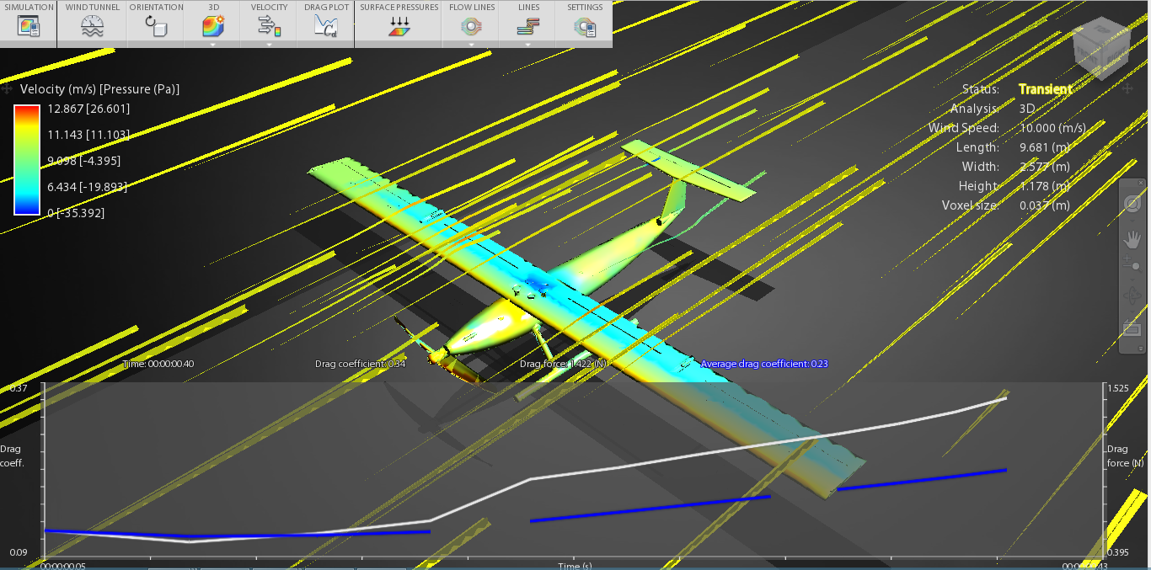
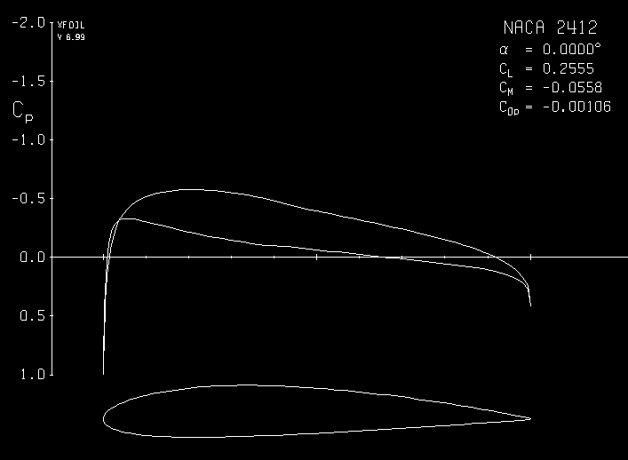
Aerodynamic Considerations
Challenge Design Theory of Operation Business Case
Wind-Tunnel Testing
Refined the airframe
Forces of drag on the UAV
Guided design process
X-Foil
Choosing airfoil - NACA 2412
Pitching Moment and AoA
Coefficients of Flight
Lift Calculations
Wind-Tunnel Analysis (Autodesk)
X-Foil (MIT)

Slide 10
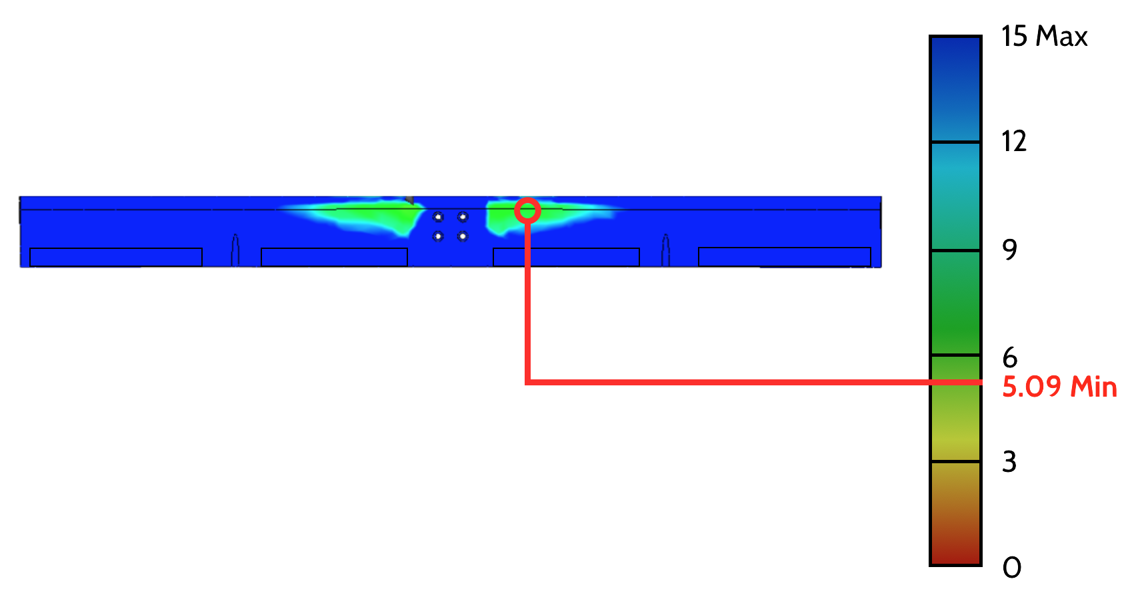
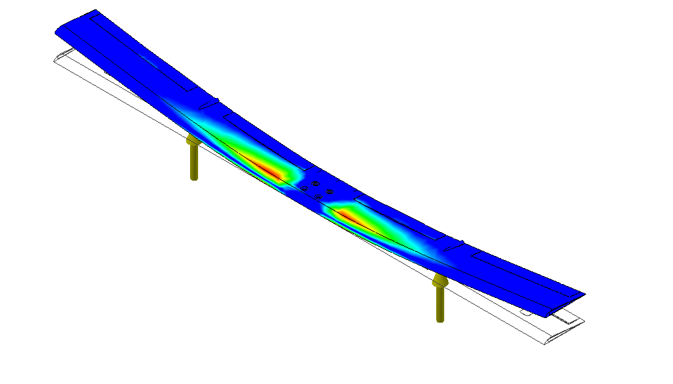
Structural Analysis
Challenge Design Theory of Operation Business Case
Design must withstand 6 G’s of force
4 high stress locations
Analysis demonstrates the material yields of the wings and stabilizers are not exceeded, safety factor of 5.09
Wings (front)
Wings (top)
Stress Distribution (Isometric)
Horizontal Stabilizer (top) (SF:4.49)
Notes:
Noah and Roham

Slide 11
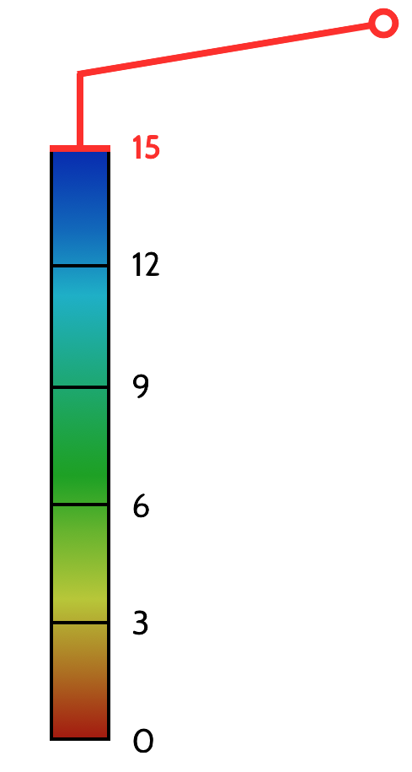
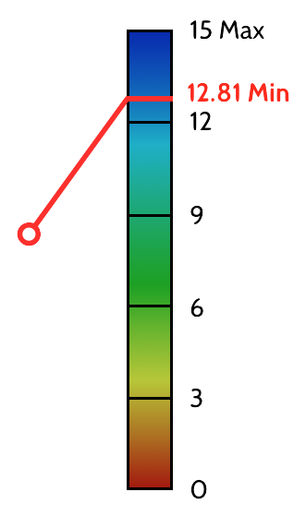
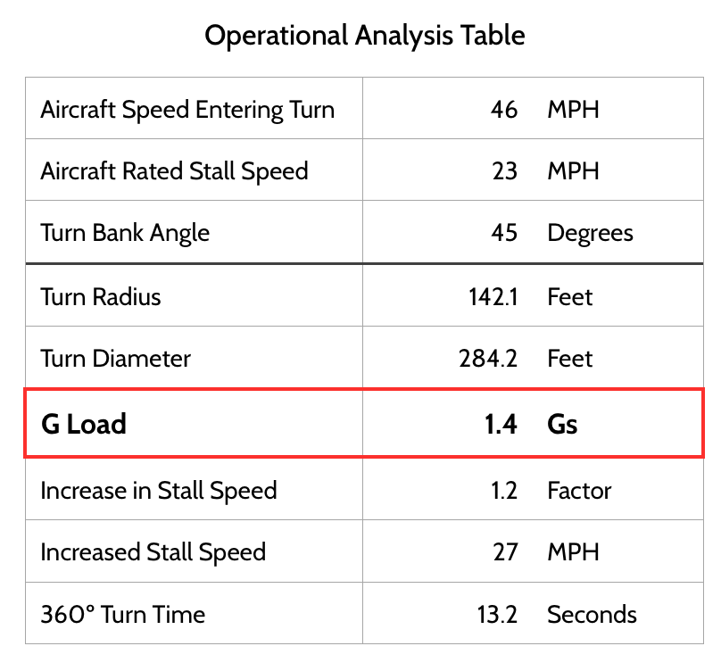
Operational Analysis
Challenge Design Theory of Operation Business Case
Safety Factor Wing (15)
Safety Factor Tail (12.81)

Slide 12
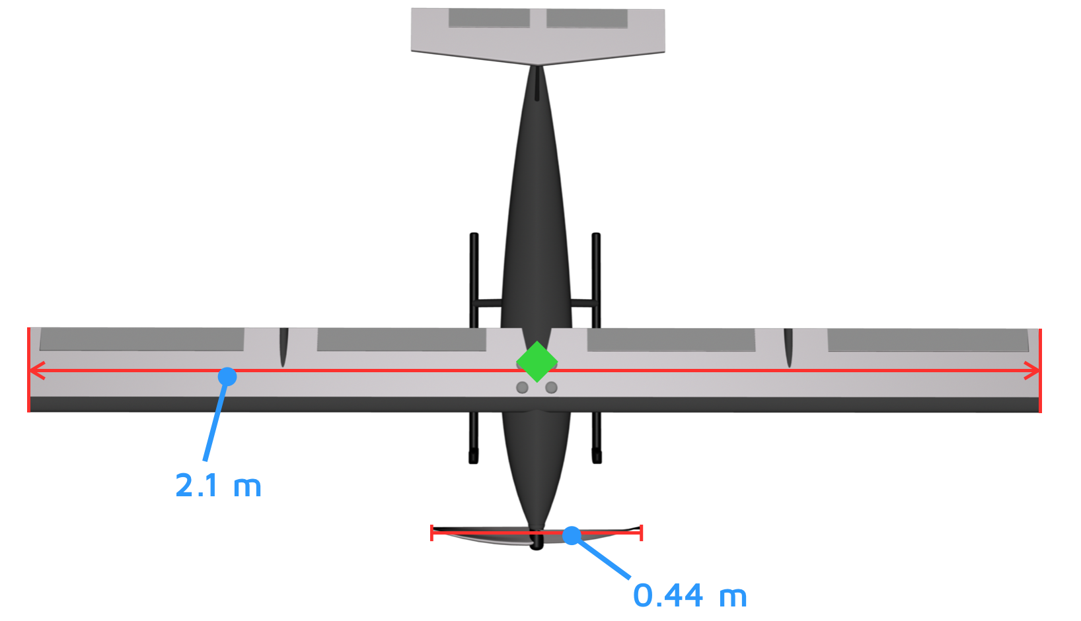
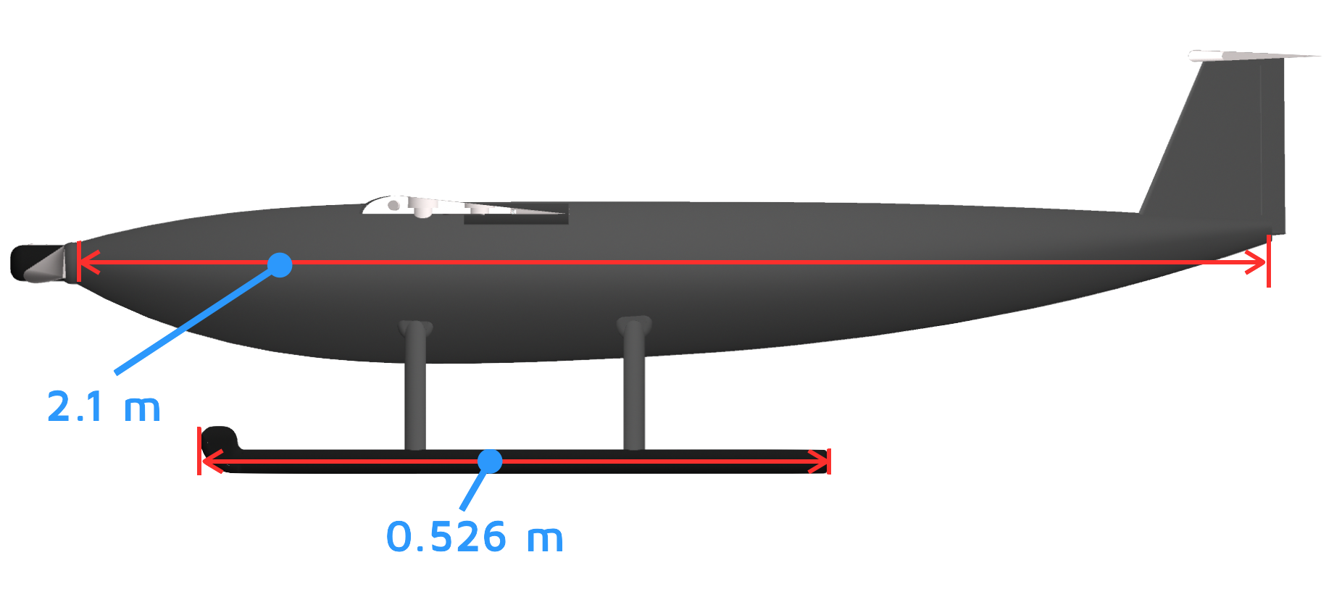
Final Design
Challenge Design Theory of Operation Business Case
Propeller Diameter: 0.44 m
Horizontal Stabilizer Span: 0.50 m
Dimensions
Wingspan: 2.1 m
Fuselage Length: 2.1 m
Vehicle Height: 0.205 m
Weight
Empty: 9.36 lbs
Total: 20.18
Maximum Capacity: 30.0 lbs

Slide 13
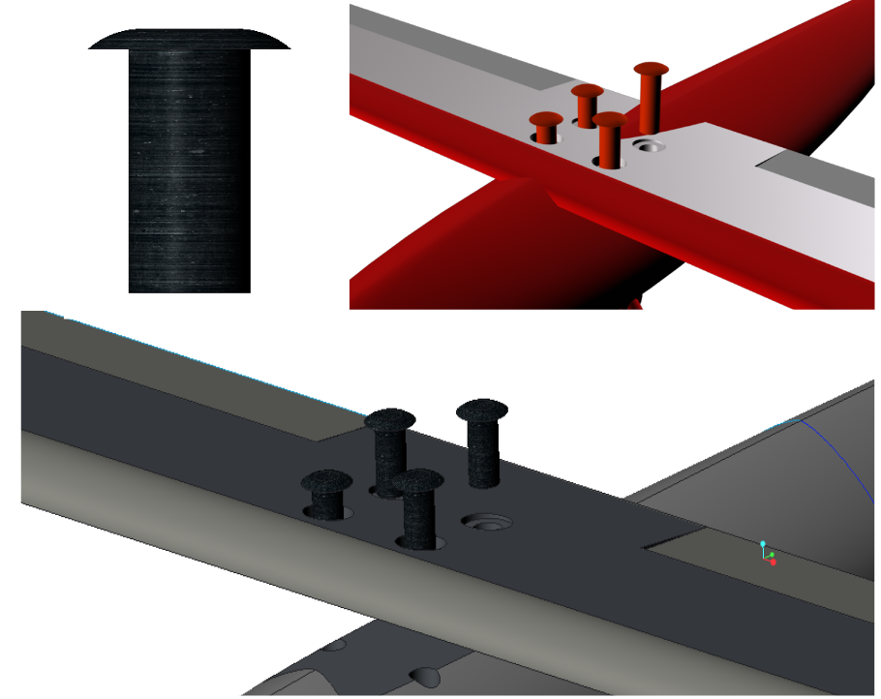
Theory of Operation
Challenge Design Theory of Operation Business Case
Mission Phases:
Setup and Launch
Data Collection
UAV Landing/Breakdown
Post Processing
Notes:
Robert

Slide 14
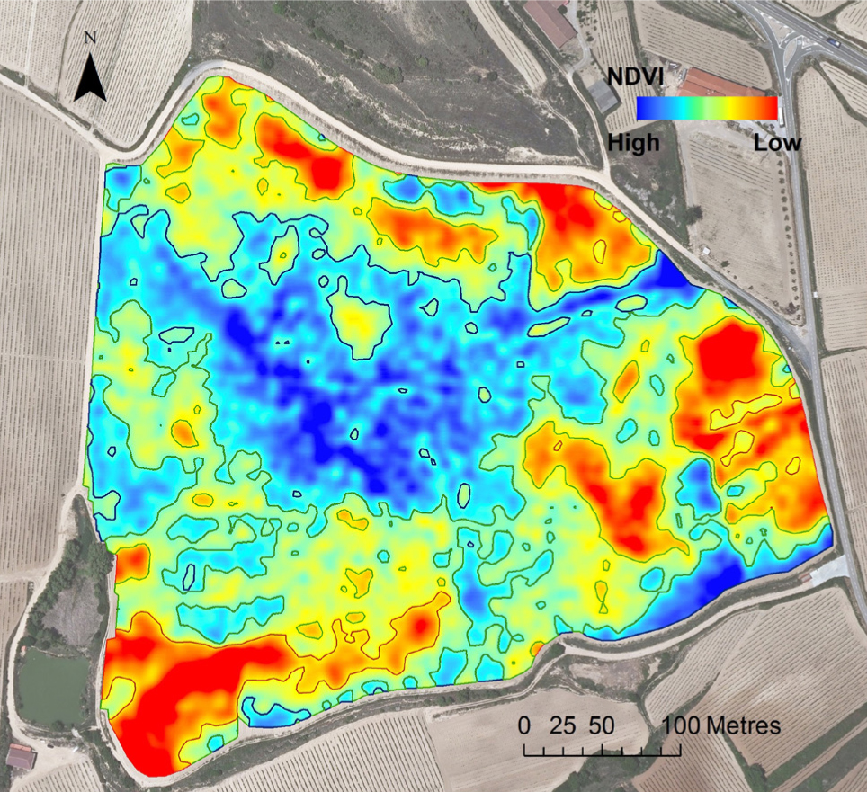
Operational Personnel
Challenge Design Theory of Operation Business Case
Operational Pilot
Monitors aircraft state
Aircraft Mechanic Technician
Performs required UAV maintenance
Safety/Redundancy Pilot
Maintains VLOS with the aircraft and recovery pilot
Data Analyst
Processes infrared images by stitching images according to their geolocation
Sample Map from Data Analyst
Notes:
Robert

Slide 15
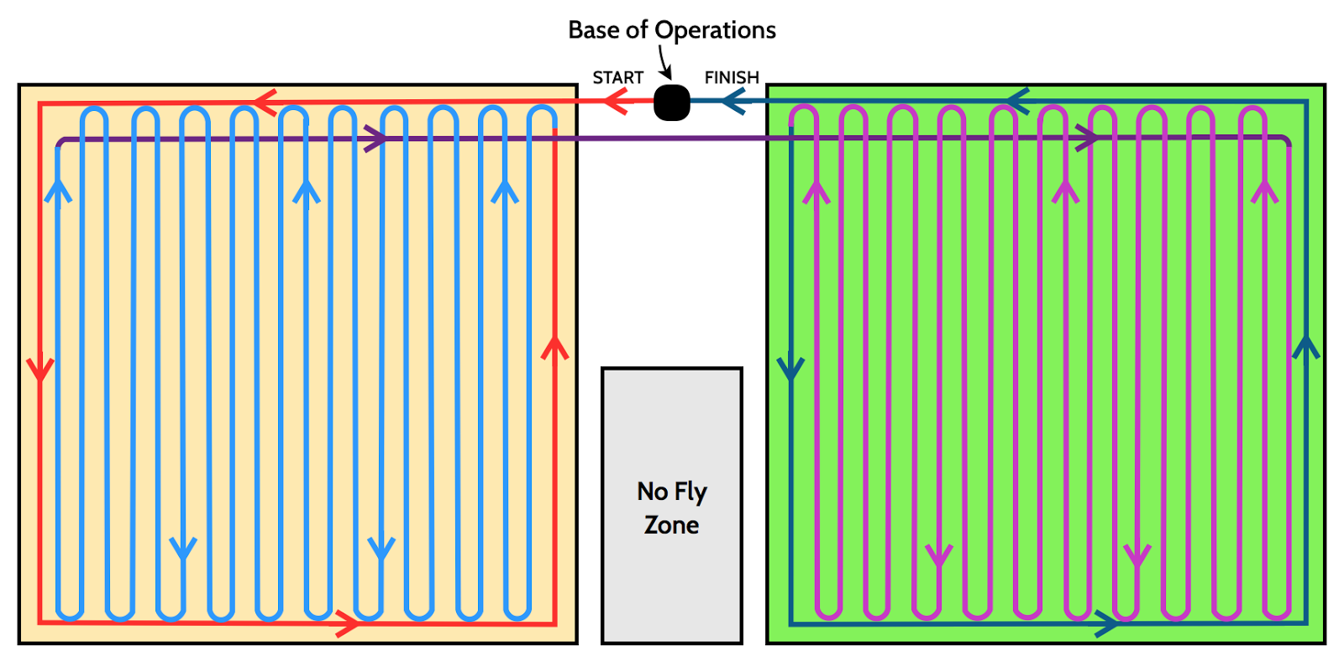
Detection Methodology
Challenge Design Theory of Operation Business Case
Notes:
Robert/Keith

Slide 16
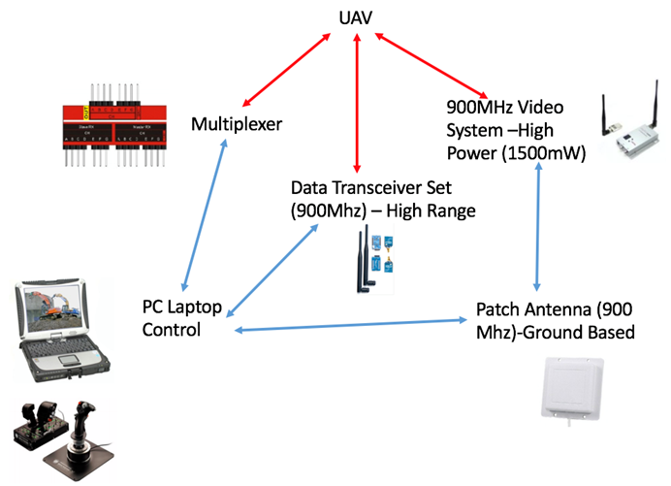
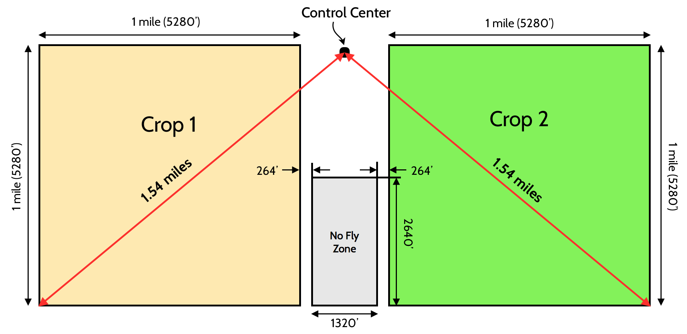
Communication System
Challenge Design Theory of Operation Business Case
Maximum Communication Distance: 1.54 miles
System Capability: 3.60 miles
Notes:
Mihir

Slide 17
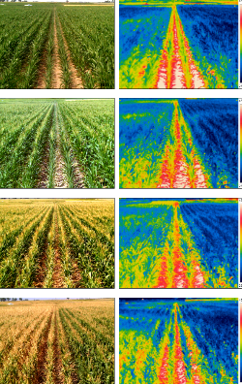
Infrared Imaging
Challenge Design Theory of Operation Business Case
Basics of moisture detection through thermal infrared imaging:
Water evaporates and cools air around crop
Cooler, moist air is detected through the camera as blue and green
Warmer, drier air is detected through the camera as red and orange
Sample Infrared Image
Notes:
Keith

Slide 18
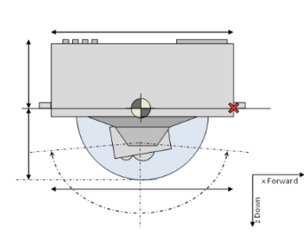
X3000 Camera
Challenge Design Theory of Operation Business Case
The X3000 camera provides
Low cost
Good field of view
Large zoom variation
Option of visual Spectrum camera
Onboard data storage
X3000 Camera

Slide 19
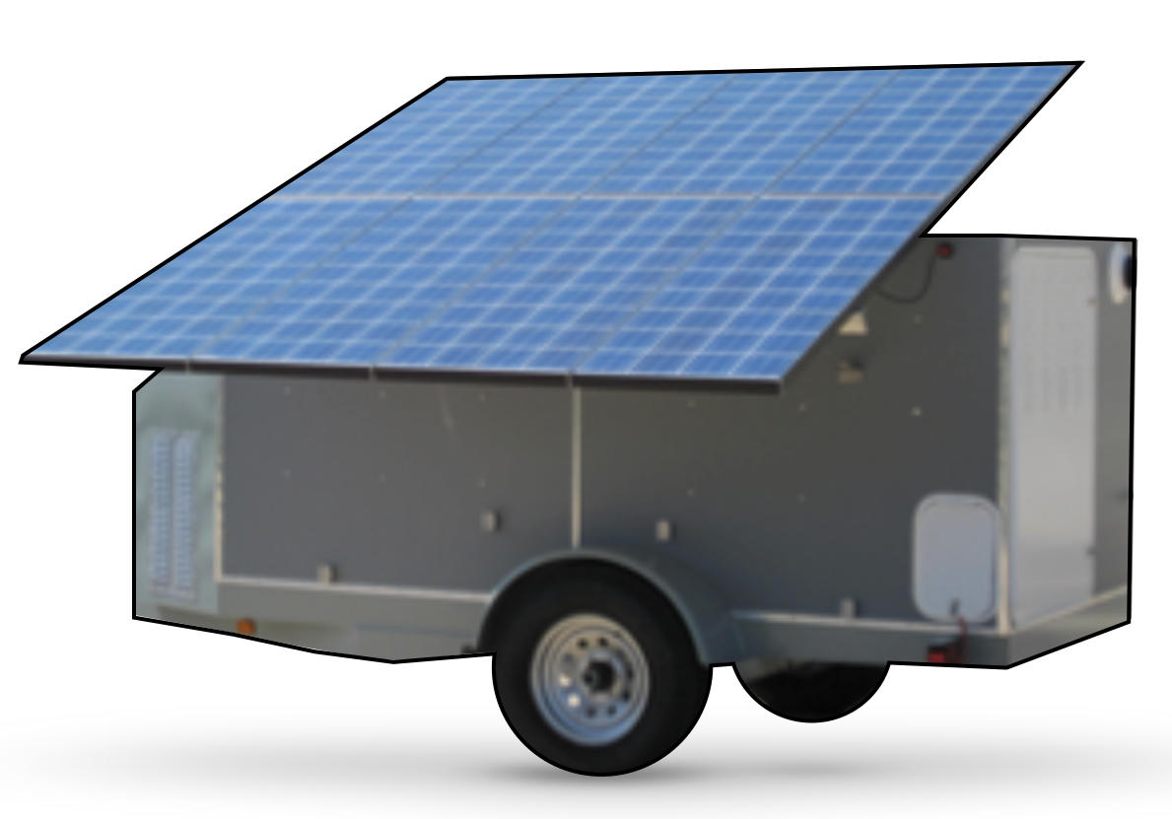
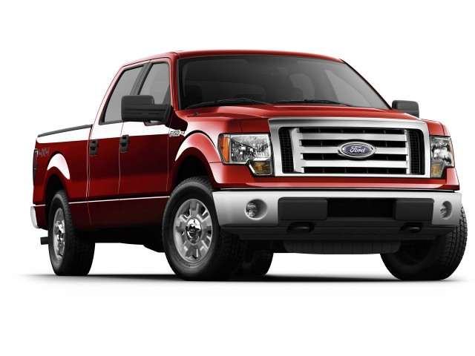
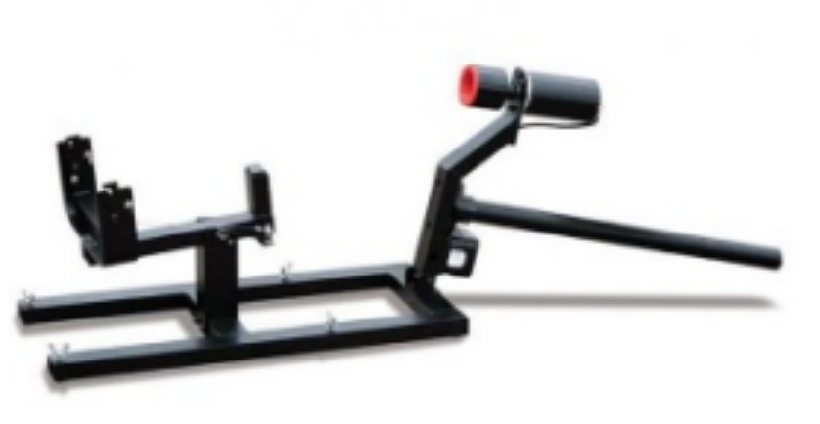
Support Equipment
Challenge Design Theory of Operation Business Case
Trailer to transport work station including all equipment and UAV
Used Ford F-150 truck to transport trailer
Solar panels to power work station.
Car top launcher to launch the UAV into the air
Notes:
Mihir

Slide 20
Business Case: Final Profitability
Challenge Design Theory of Operation Business Case
Business profitability
Difference between revenue and expenses
Maximized by increasing revenue and decreasing expense

Slide 21
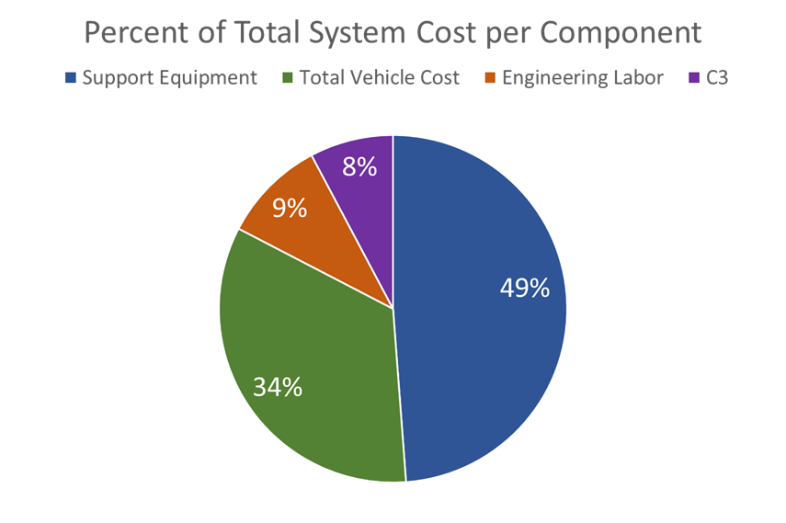
Initial Costs
Challenge Design Theory of Operation Business Case

Slide 22
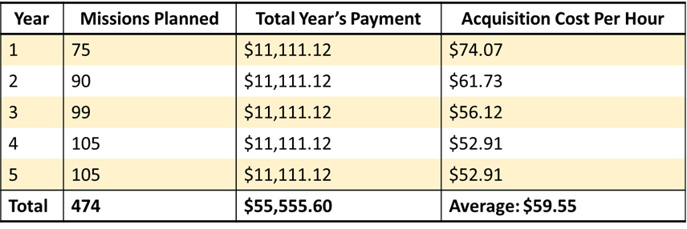
Acquisition Cost
Challenge Design Theory of Operation Business Case
Acquisition cost per hour is incumbent upon:
Number of mission-hours flown
Total payment in a year
More hours flown and smaller payment in a year, results in lower acquisition cost per hour

Slide 23
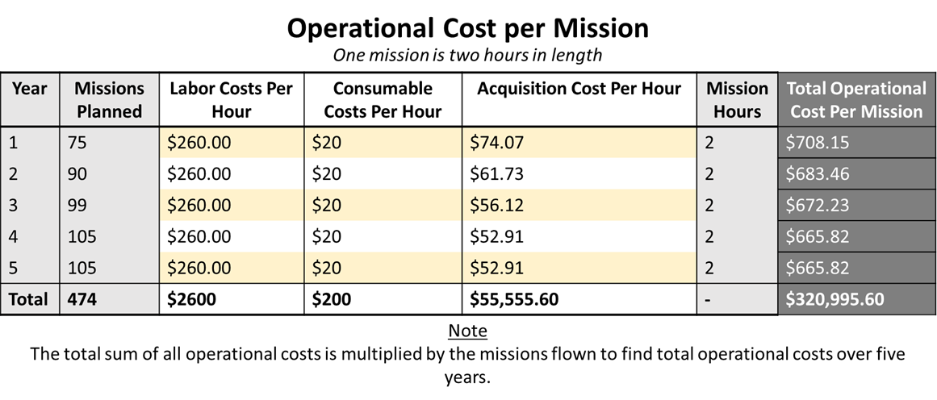
Mission Cost
Challenge Design Theory of Operation Business Case

Slide 24
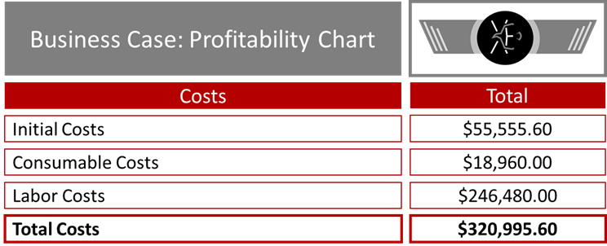
Business Case: Final Profitability
Challenge Design Theory of Operation Business Case

Slide 25
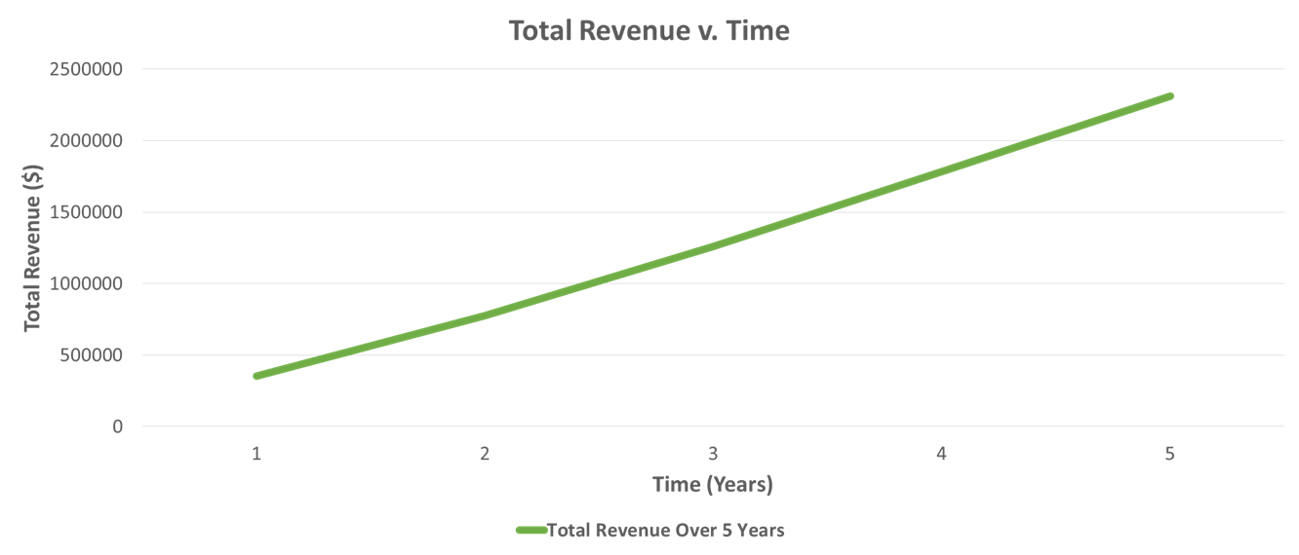
Revenue per Mission
Challenge Design Theory of Operation Business Case

Slide 26
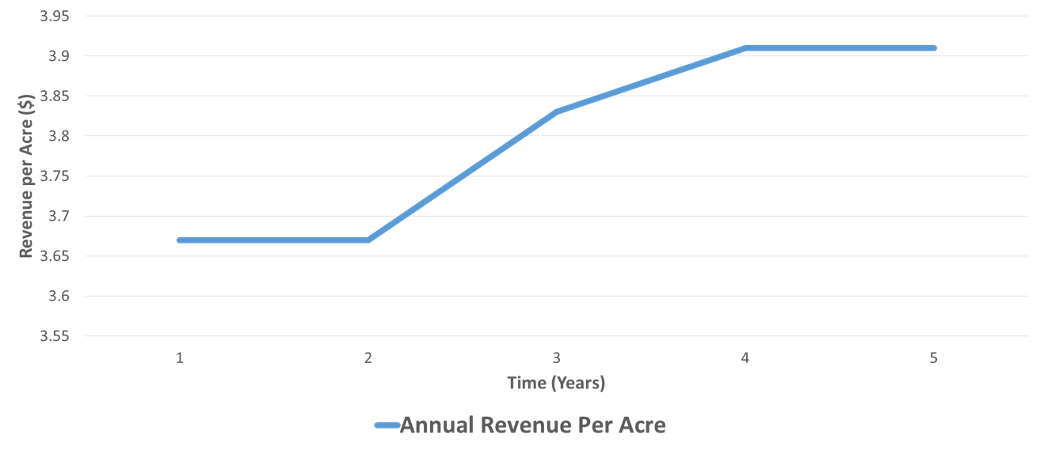
Revenue per Acre
Challenge Design Theory of Operation Business Case

Slide 27
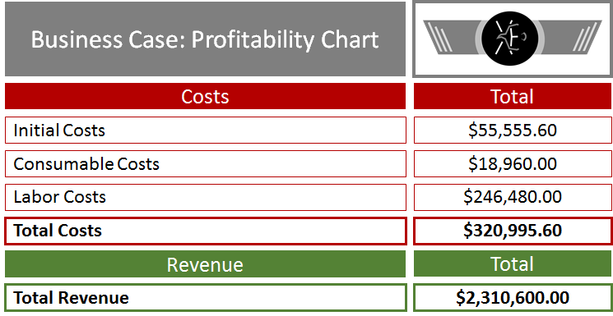
Business Case: Final Profitability
Challenge Design Theory of Operation Business Case

Slide 28
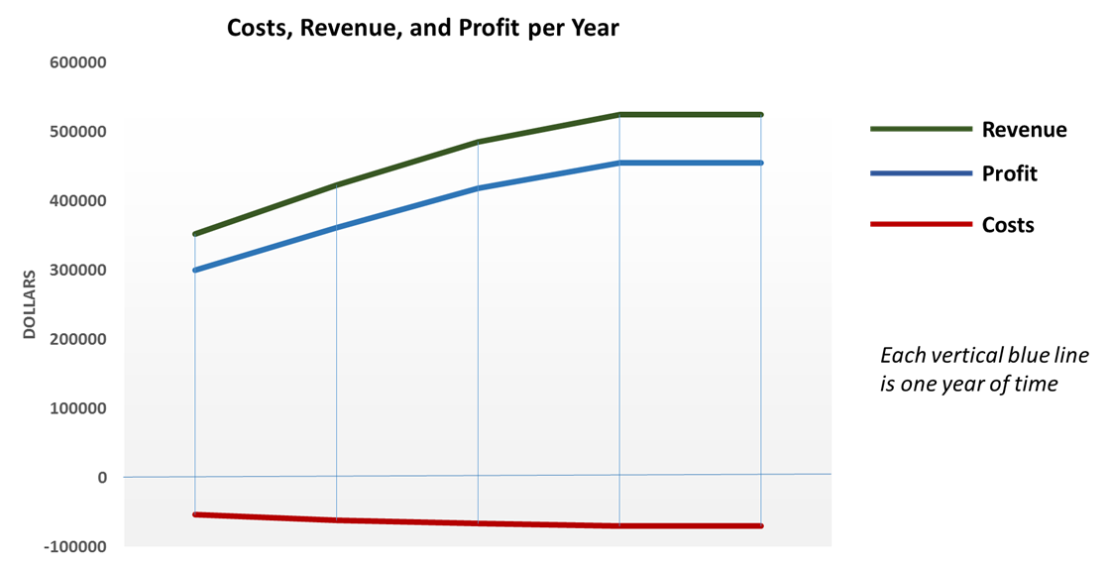
Costs, Revenue, and Profit
Challenge Design Theory of Operation Business Case

Slide 29
Profitability
Challenge Design Theory of Operation Business Case

Slide 30
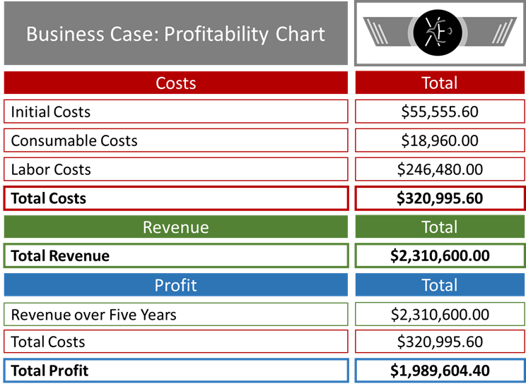
Business Case: Final Profitability
Challenge Design Theory of Operation Business Case

Slide 31
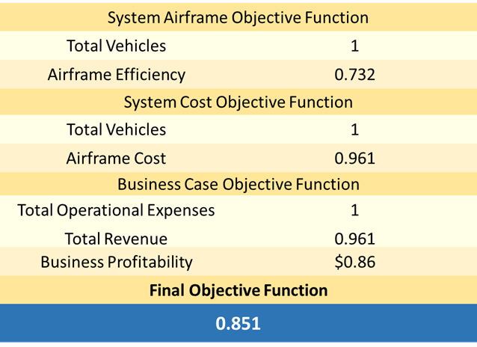
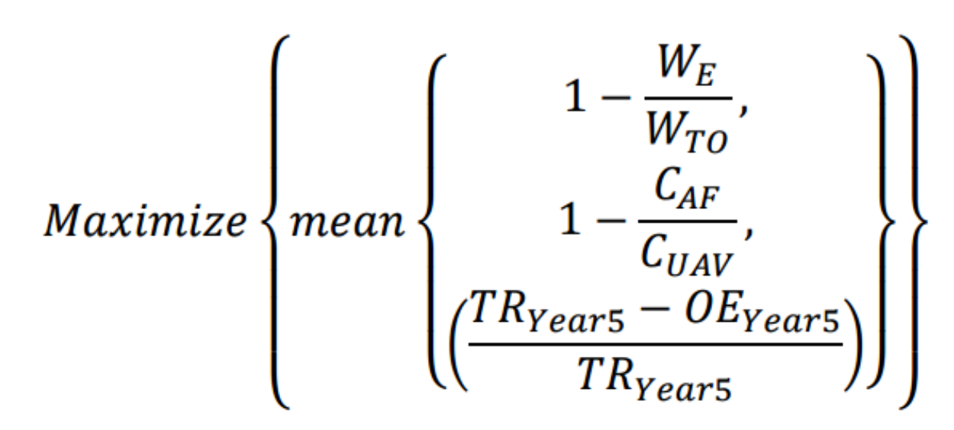
Objective Function: 0.851
Challenge Design Theory of Operation Business Case

Slide 32
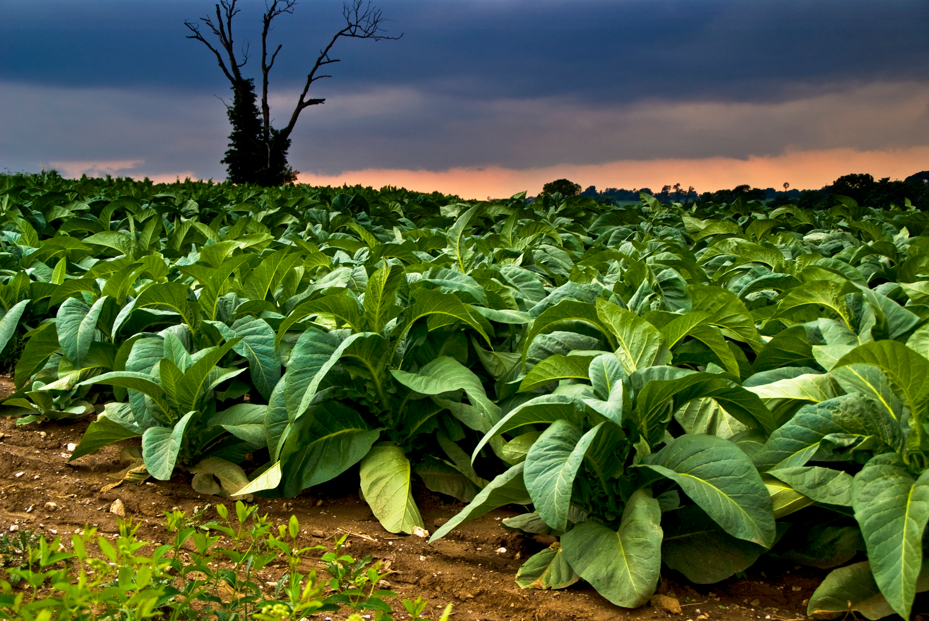
Future Applications
Challenge Design Theory of Operation Business Case
Tobacco
$30 million industry in Connecticut.
Over 25% of it is damaged from mold.
Golf Courses
45% of the water wasted
$2835 loss per year.
Soil Erosion
One foot rise in sea level led to $94 billion of damage in Boston, Massachusetts.
Tobacco Field
Soil Erosion Map
Golf Course
Notes:
Mihir
The X181-KMR can detect changes in crop or tree success and patterns, in order to predict/indicate sea level rise.

Slide 33
Thank You!
The Xavier High School Engineering Team would like to thank:
Judges
Coach
Mentors
RWDC Sponsors
Volunteers
Other Competitors
Notes:
Mihir

Slide 34
Questions?
Notes:
Mihir

Slide 35
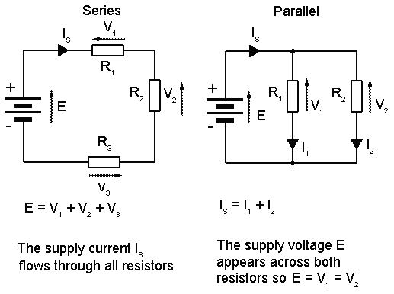
Electrical Configuration
Challenge Design Theory of Operation Business Case
The batteries are wired in parallel with the electrical components of the UAV
No danger of complete system failure with one malfunction
More constant supply of energy to each component
Wings and Stabilizers
Port attaches to underside of wings to supply energy to control surface servos
Direct connection threaded through tail

Slide 36
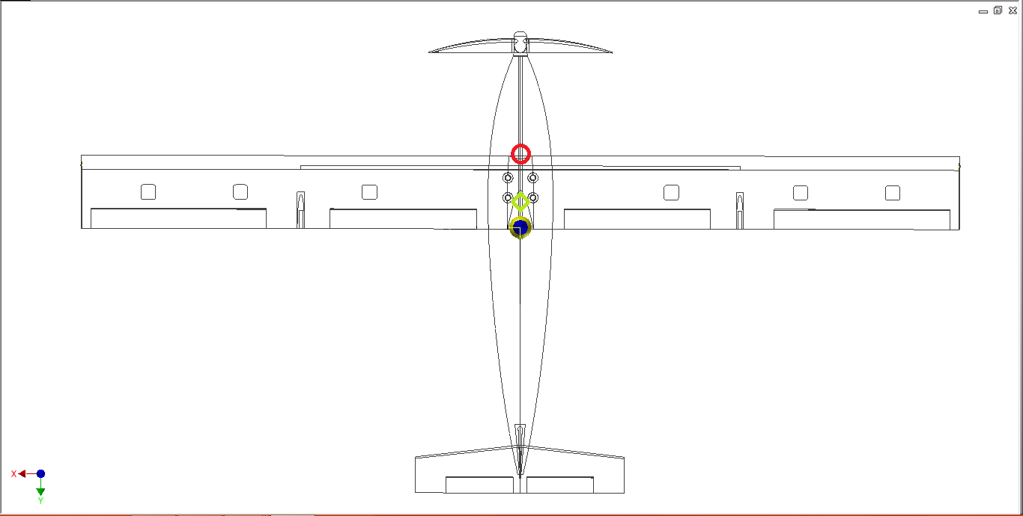
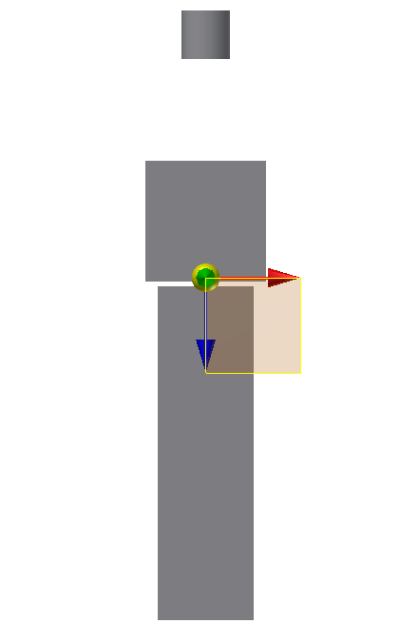
Center of Gravity Analysis
Challenge Design Theory of Operation Business Case
2 Components
Body
Payload
Both determined experimentally
Assigned to a distance scale along the fuselage
Weighted average taken and mapped on diagram (green rhombus)

Slide 37
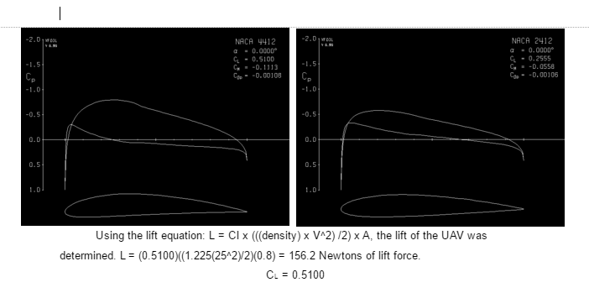
Calculating Lift
Challenge Design Theory of Operation Business Case

Slide 38
Additional Drag Information
Challenge Design Theory of Operation Business Case
Experimentally obtained in wind-tunnel software
Average Drag Coefficient: 0.23
Drag Force: 1.422 N
CD = 0.23

Slide 39
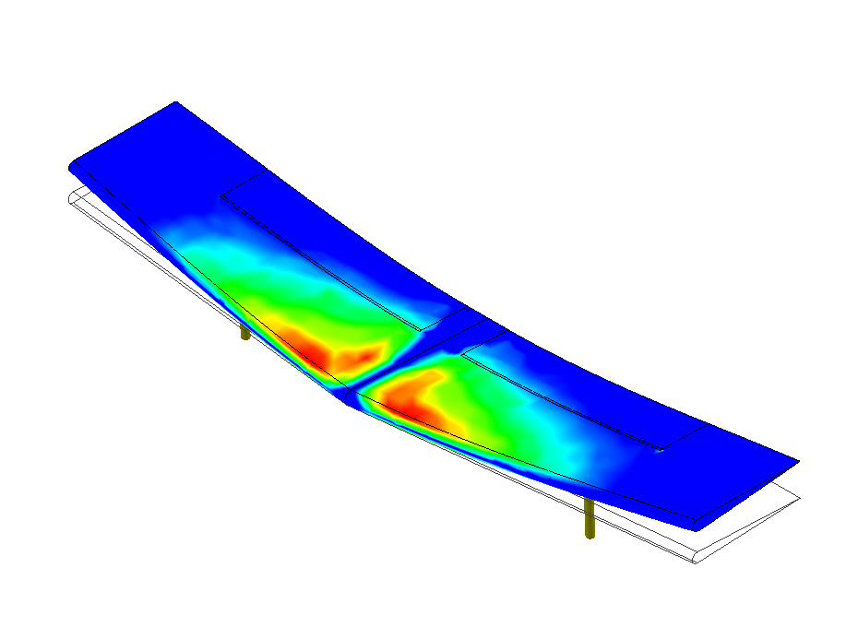
Stress Distribution
Challenge Design Theory of Operation Business Case
Distribution of stress is shown on a relative color scale
Not dependent on force applied
Designed to show only distribution of Von Mises Stress
Software: Inventor Professional (Autodesk)

Slide 40
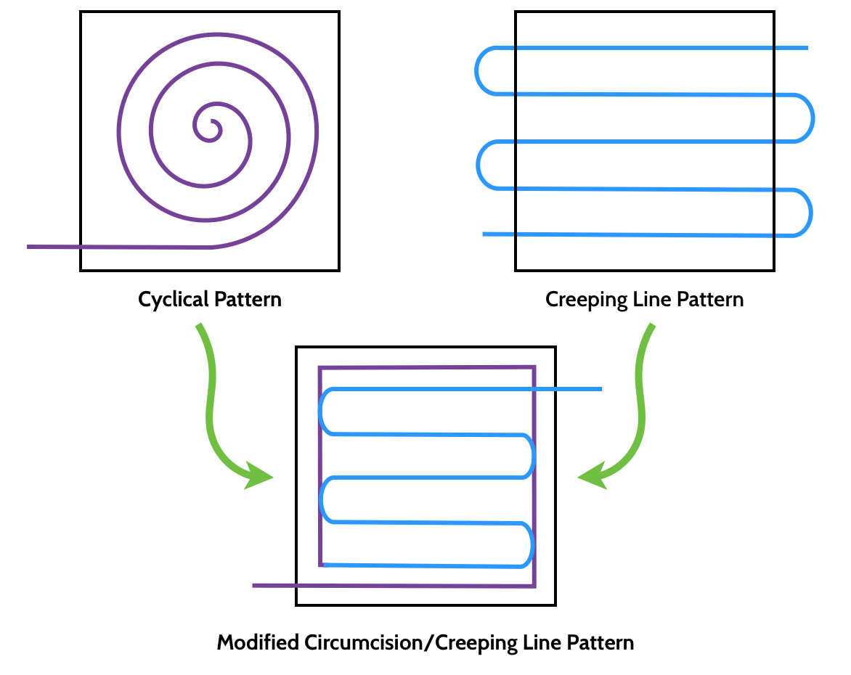
Flight Path
Challenge Design Theory of Operation Business Case
46 miles per hour
301 feet altitude
51.05 miles
1.1098 hour flight time
Notes:
Robert/Keith

Slide 41
Altitude Calculation
Challenge Design Theory of Operation Business Case
301 feet altitude, as calculated through a pixel analysis spreadsheet
Notes:
Robert/Keith

