Slide 2
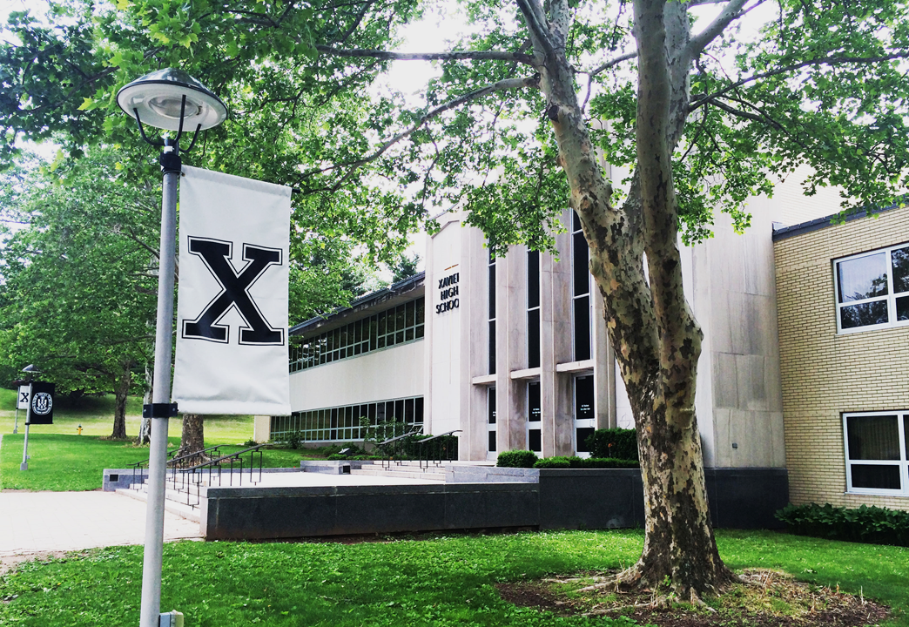
Team Formation
The Team
Shannon Copeland – Coach
Roham Hussain ‘18 PM
Noah McGuinness ‘18 PM
Vincent Salabarria ‘18
Anthony Tedeschi ‘18
Carter Chase ‘20
Akshay Khunte ‘20
Alex Pralea ‘20
Pratt & Whitney Mentors
Frances Figueroa-Rodriguez
Ruthanne Szumski
Joseph Walker

Slide 3
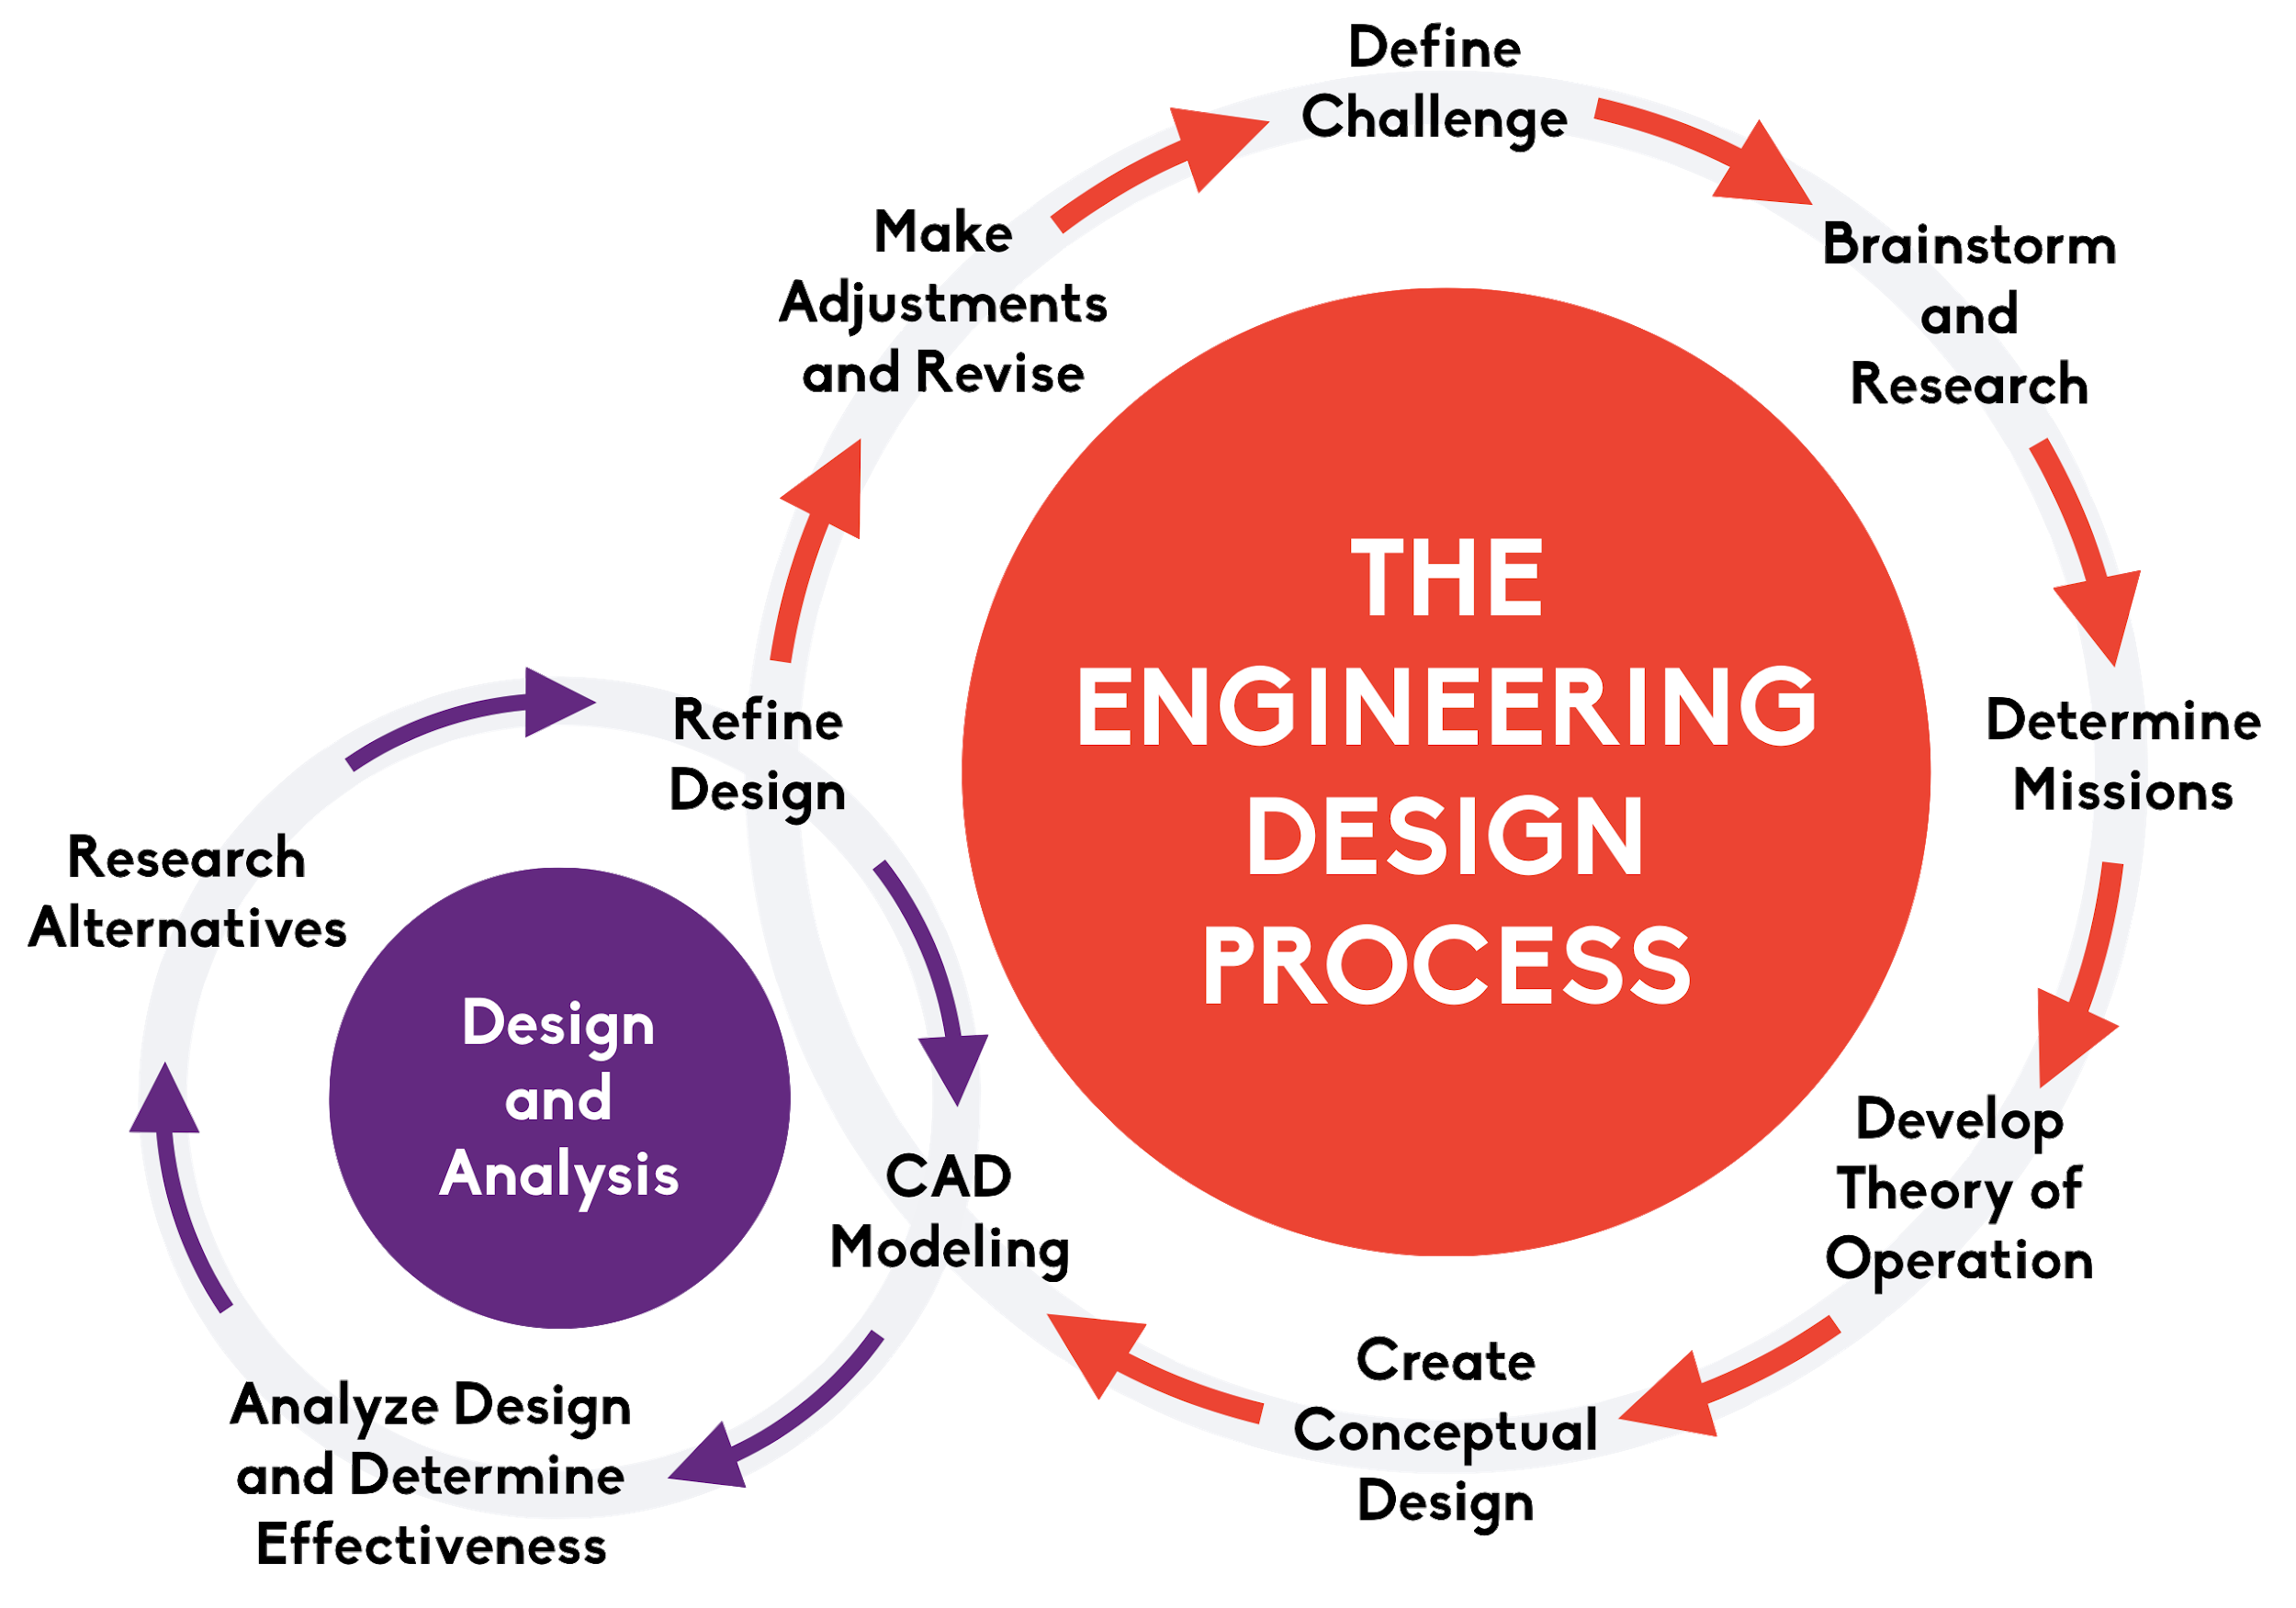
Engineering Design Process

Slide 4
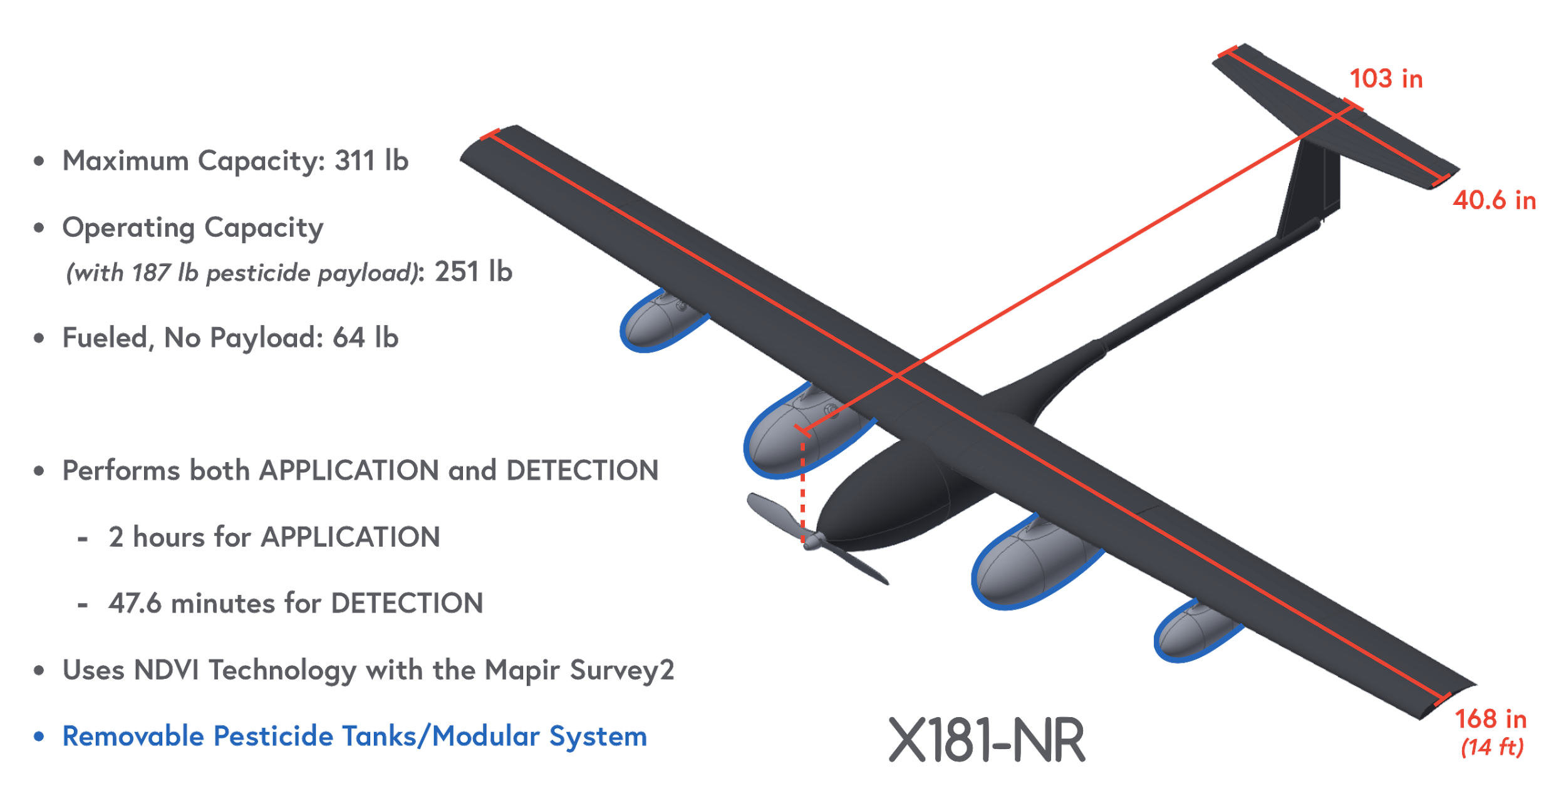
Our Solution

Slide 5
Part 107 Regulations
Vehicle must...
Operate only in daylight or twilight
Stay within 400 ft of ground
Not exceed an airspeed of 100 mph (87 knots)
Not be flown over anyone not participating in operation
Remain in visual line of sight
Vehicle and payload must...
Not exceed 55 lbs in total weight

Slide 6
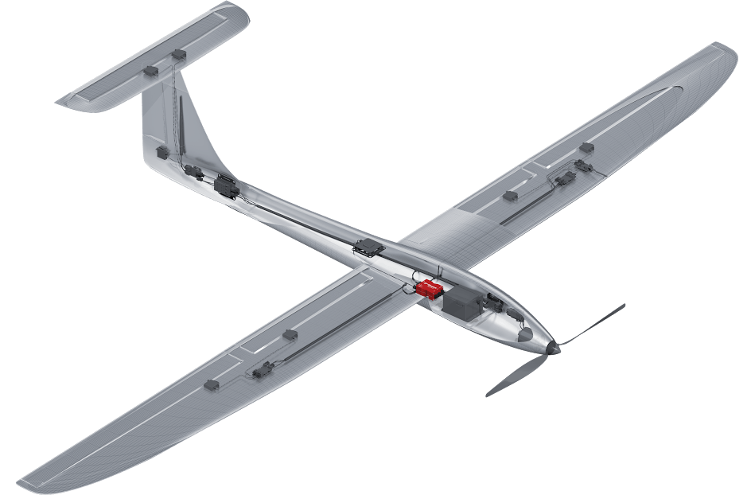
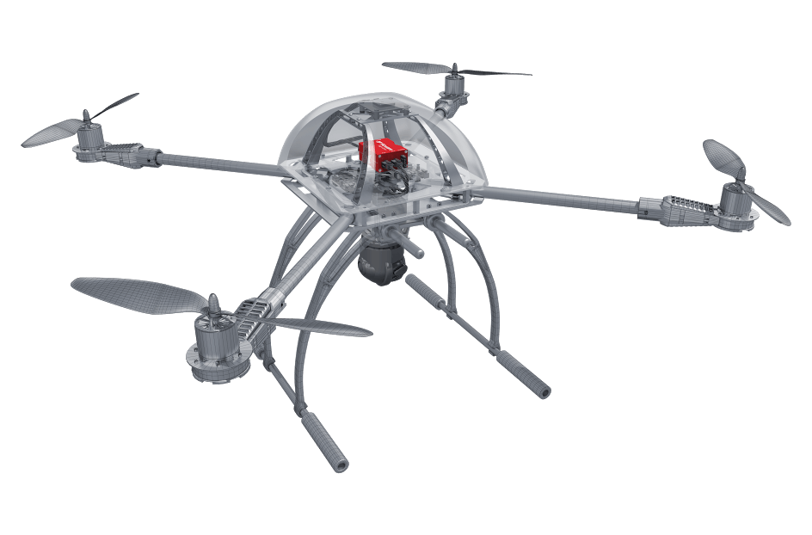
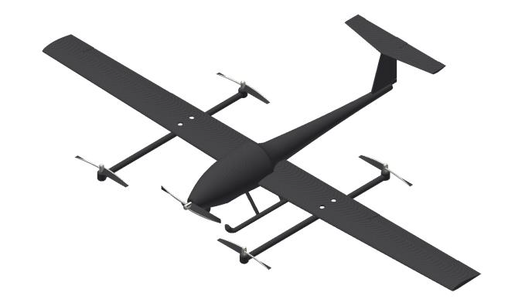
Design Considerations – Spraying Vehicle
Part 107 Regulations
55 lb limit – approximately 28 trips
Requirements
Heavy-lifting capabilities
Goal: 4-6 trips -> approx. 250-300 lbs lift
14-foot wingspan limitation
Types of aircraft
Fixed Wing Pusher/Tractor
Multi-rotor
Hybrid (VTOL)
Tractor
Multi-rotor
Hybrid (VTOL)

Slide 7
Design Considerations – Detection Vehicle
THE UAV
Two Separate UAVs for Spraying and Detection
Specifically designed UAVs
More efficient spraying vehicle
High cost
One, Modular UAV
Not as efficient as a dedicated drone
Low cost
DETECTION TECHNOLOGY
Machine Learning Technology
Frame-by-frame analysis
Low FOV
Accuracy potentially limited to test field
Reliance on visual indicators of infestation
Normalized Difference Vegetation Index (NDVI) Camera Technology
Little post-processing required
High FOV possible
Accuracy in all fields regardless of conditions

Slide 8
Preliminary Design
SPRAYING VEHICLE
Fixed-Wing Design - 14 ft
Carbon Fiber Reinforced Plastic (CFRP) Airframe
High Wing for increased payload capacity
Propulsion Configuration: Tractor
Fuel Injected Engine
DETECTION VEHICLE
Modularized Design
Spraying Components are removable from UAV - Boom tubing, pumps, etc.
NDVI Camera Technology

Slide 9
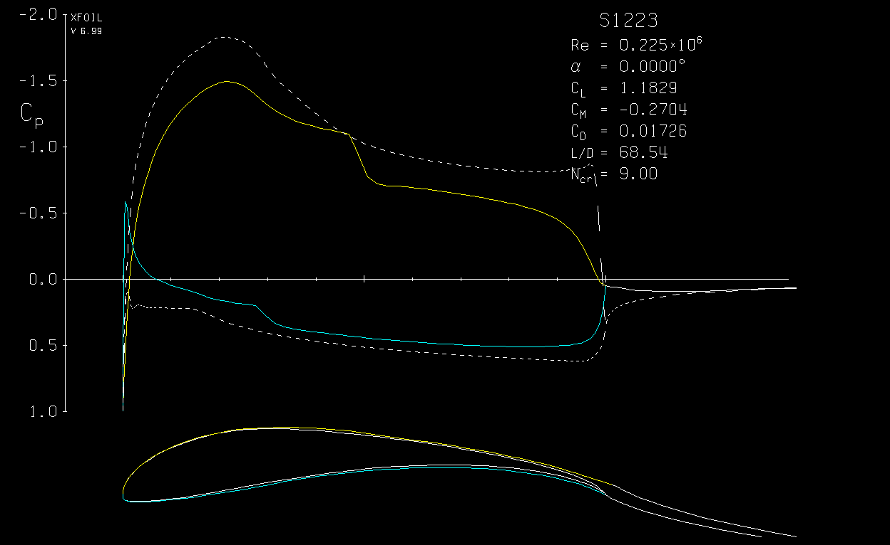
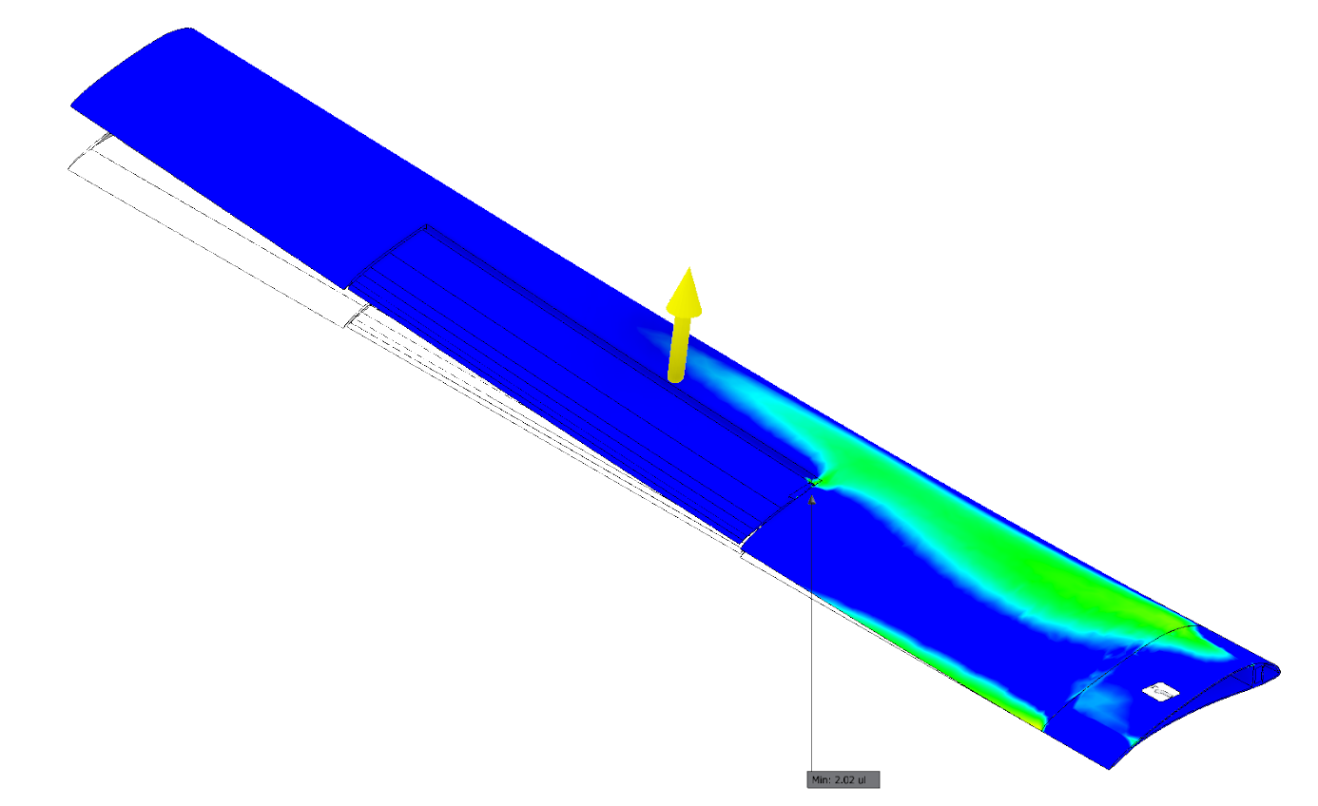
Design Process – Spraying Vehicle
OVERVIEW OF SYSTEM DESIGN
Wings and Lift
Airfoil
Wing Configuration
Lift Equation
Propulsion and Power
Max Airspeed
Electric vs Fuel Injected
Flight Time
Propeller Loading
Thrust:Weight
Control and Electronics
Autopilot and Servos
Data
Fuselage and Structure
Weight optimization
Maneuver Stress

Slide 10
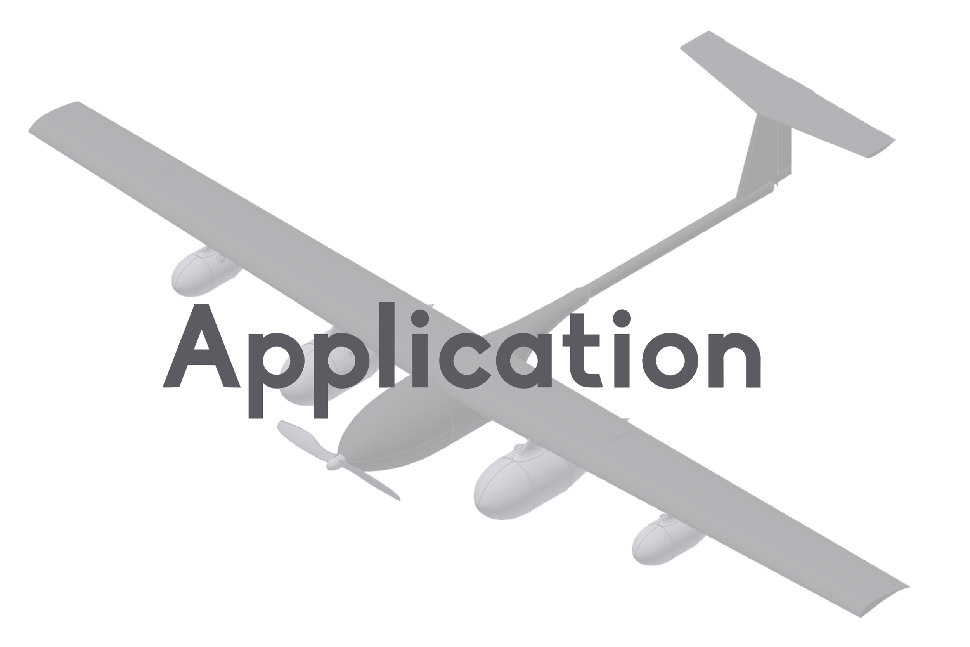

Slide 11
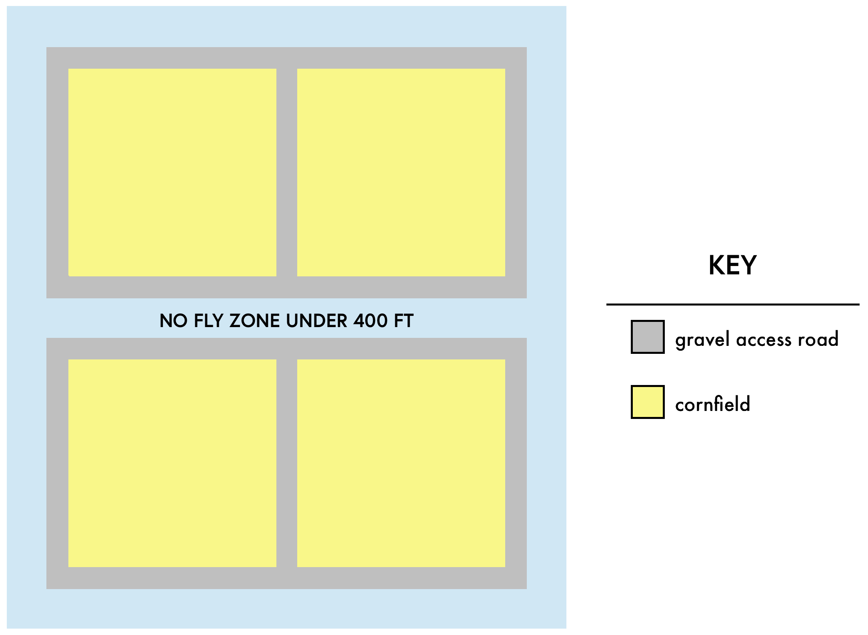
Problem Overview
Field
2560 total acres
640 acres per field
Infestation
10% of each field infested
64 infested acres per field
256 total infested acres
SOLVITAL
0.35 gallons required per infested acre
22.4 gallons required per 1x1 field
8.36 lbs / gallon of Solvital
749 gallons for all four fields
187 gallons per single field

Slide 12
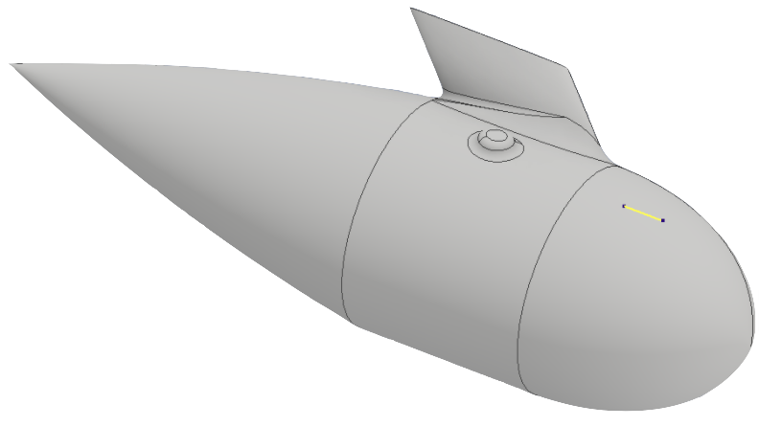
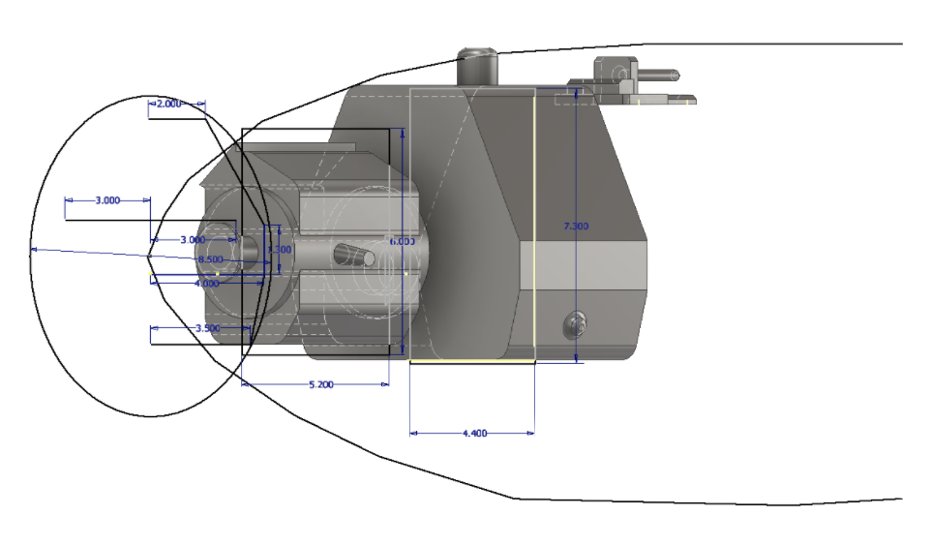
X181-NR – Capabilities
Total Payload Capacity
23 Gallons of Solvitol
187+ lbs of payload
Only 64 lb empty weight (fueled)
Maximum Flight Duration
2.0 hours - Full Throttle
Spraying
25 foot altitude
87 foot swath width
2.98 gal/minute flow rate
7.1 acres/minute coverage

Slide 13
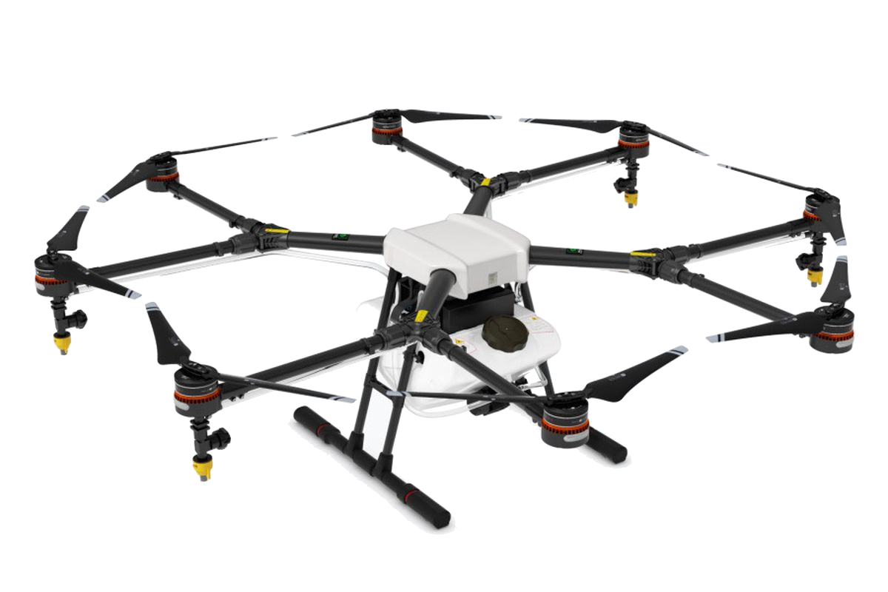
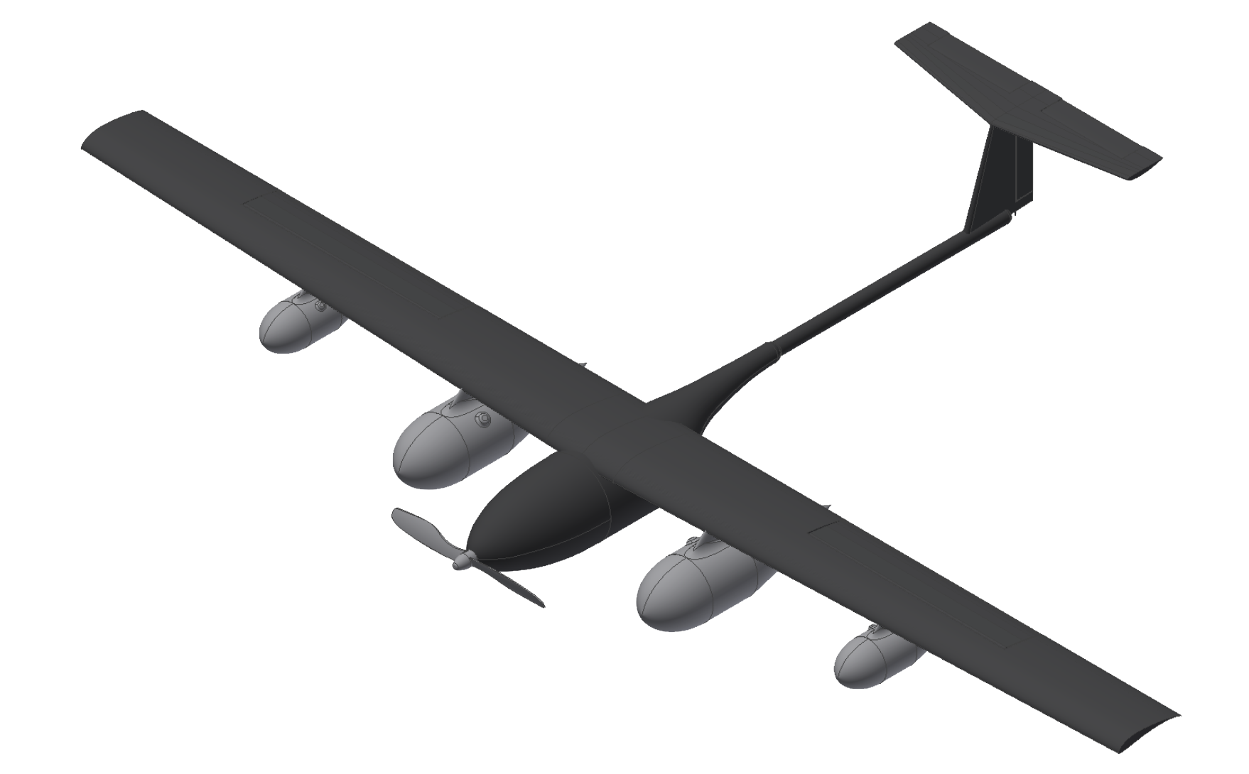
DJI Agras MG-1 and X181-NR Comparison
2.64 gallons (22 lbs) | total payload capacity | 23 gallons (187 lbs)
18 mph | operating speed | 41 mph (max 45)
0.17 acres/min (max) | spray coverage rate | 7.1 acres/min
36.6 hours | time for spraying 4, 1x1 mi fields | 2 hours

Slide 14
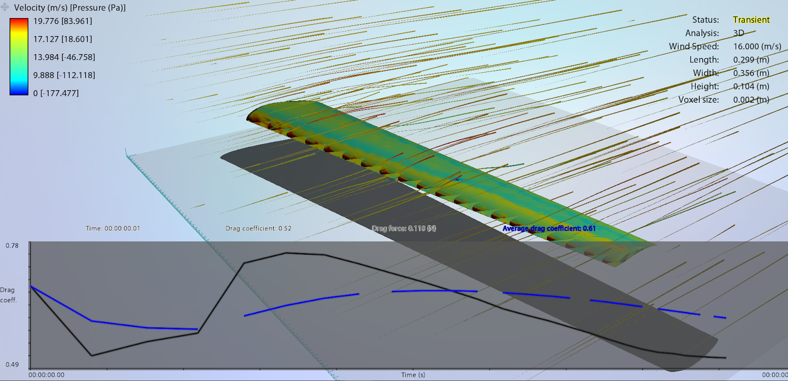
Design Details – Lift
Coefficient of Lift
XFoil
Selig 1223
A trimmed approach
Wing Area
Maximize area
Minimie drag
Autodesk CFD
Velocity
Optimization of engine and propeller

Slide 15
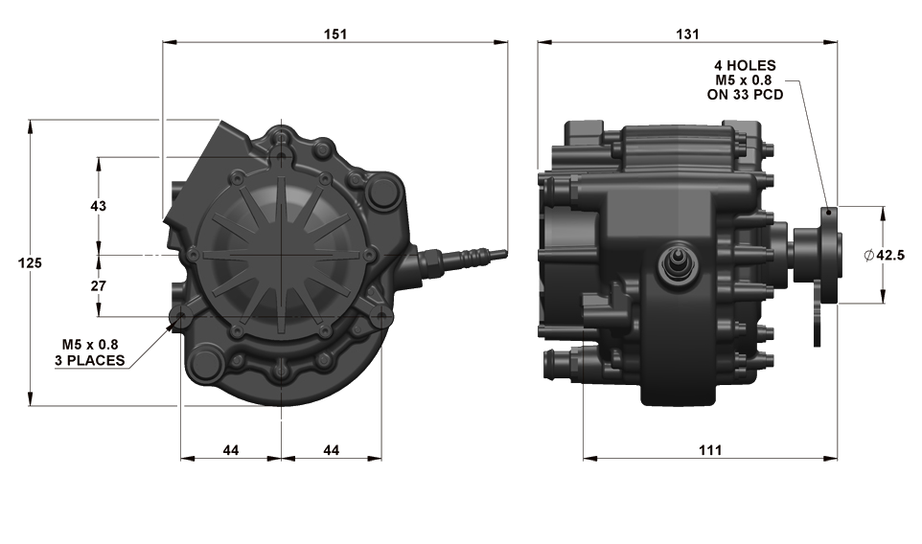
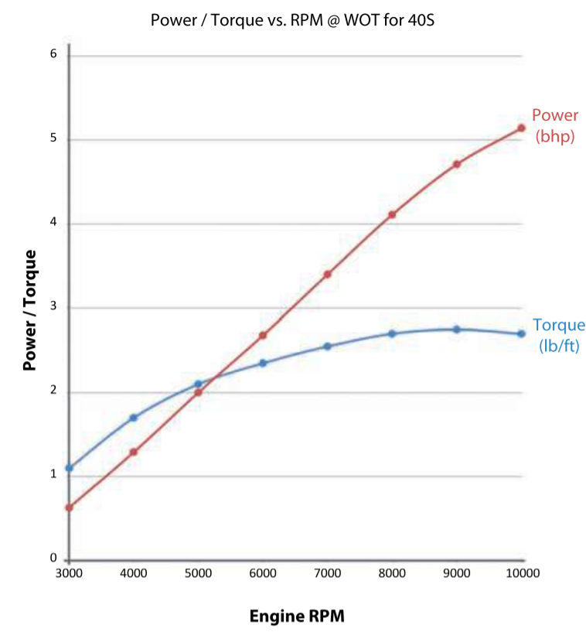
Design Details – Propulsion
Ruling out electric
AIE 40S 5BPh Wankel Rotary with 24x7 prop
0.52 - 0.57 lb/hp/hr
Standard Ethanol Mixture
2.87 lb/hr at full throttle
Full Throttle RPM = 6818
Max Airspeed - ~45 mph
GoddolAirport Static Thrust Calculator

Slide 16
Design Details – Application Mission
Application plan varies based on distribution of pests
(ArduPilot) software accounts for:
630 feet required for full-payload liftoff
High stall speed of the loaded vehicle
Flight Progression = maneuverability increase
Evasion of no fly zones
Software maintains:
Altitude of 25 ft. above crops
87 ft. application span
Droplet size that supports 0.35 gallons per acre
Calculated Statistics
Spraying Speed: 18.1 m/s
Swath Width at 25 feet: 87 feet
Flow Rate: 2.49 Gallons/min
Time Spraying per 1x1 mi field: 8.98 minutes
Time Spraying Total: 35.92 minutes
Spray Tank Considerations
5 spray tanks (4 external, 1 internal)
Complements streamlined model of the system
Provides largest amount of payload storage
Cost and Time
Application time: 2 hours
Operational cost of mission: $4,242

Slide 17
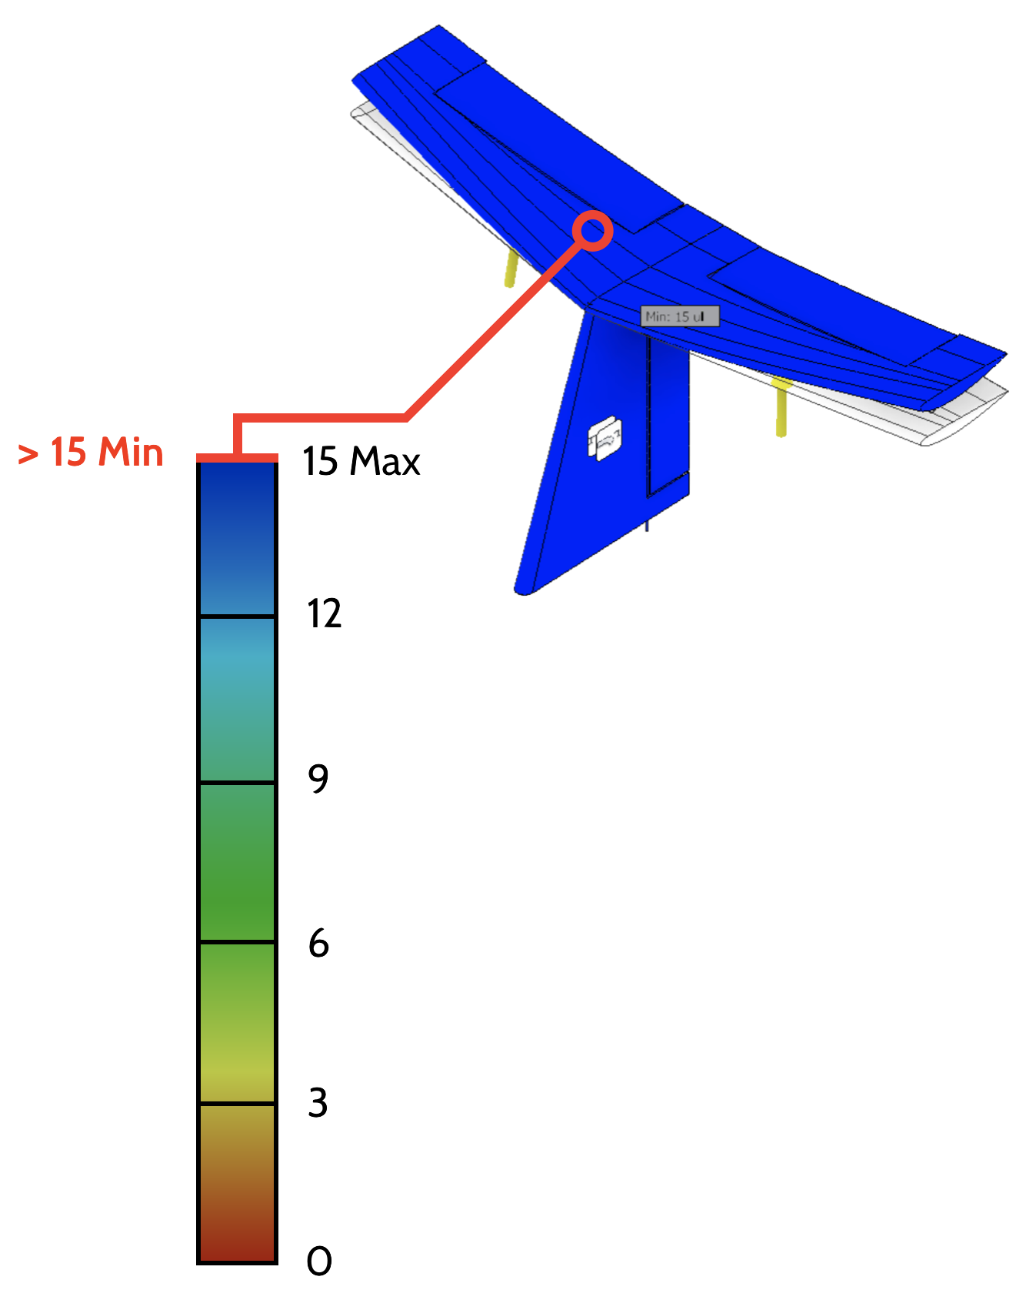
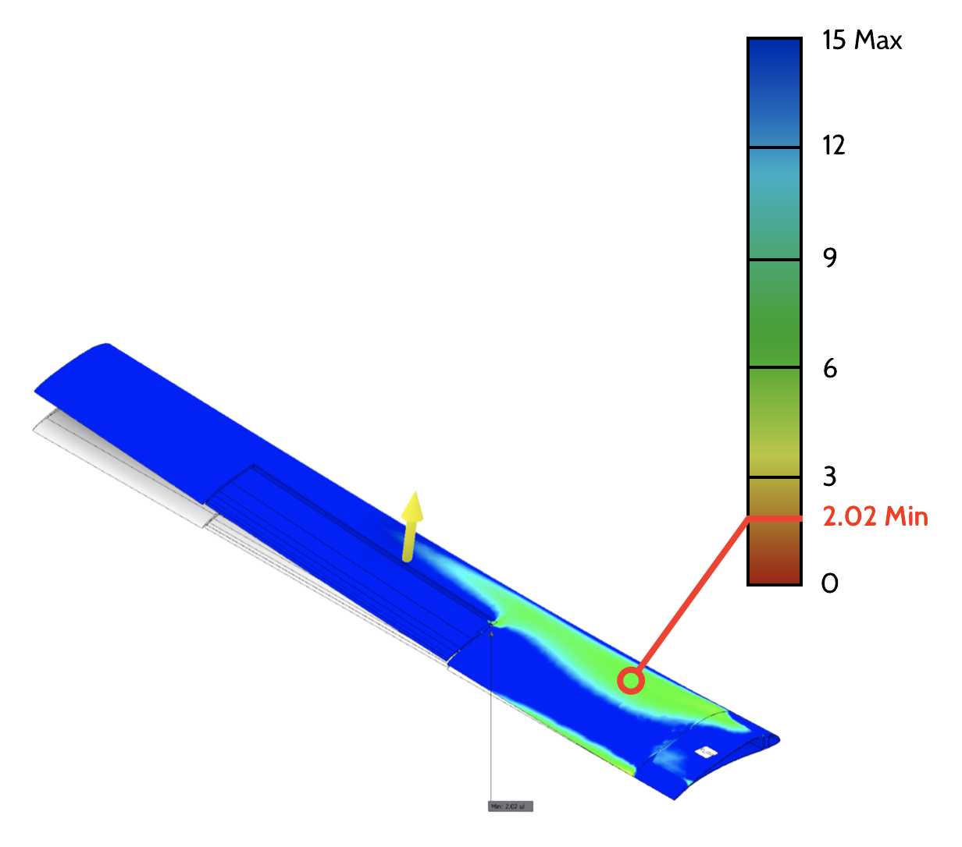
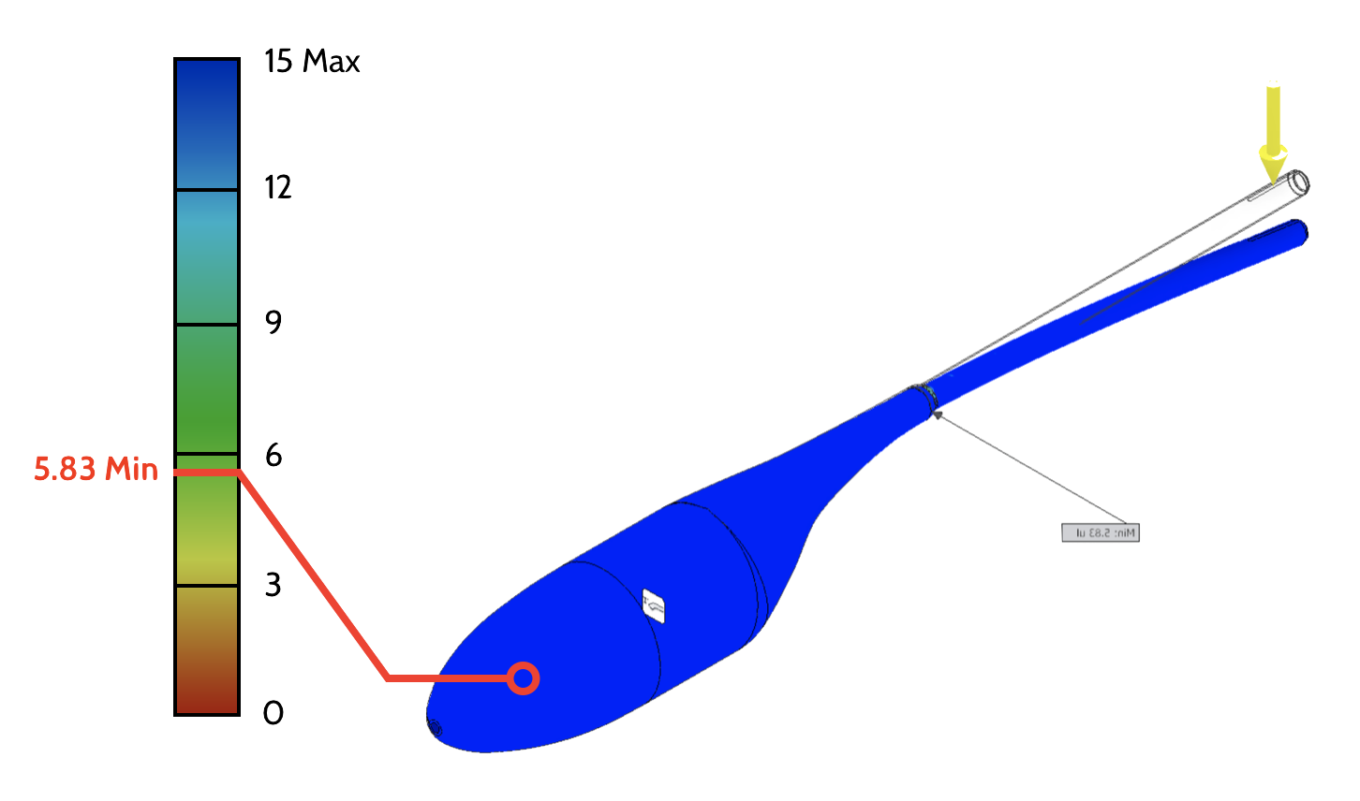
Design Details – Structural Analysis
Stabilizer (>15 Min)
Wings (2.02 Min)
Tail Boom (5.83 Min)

Slide 18
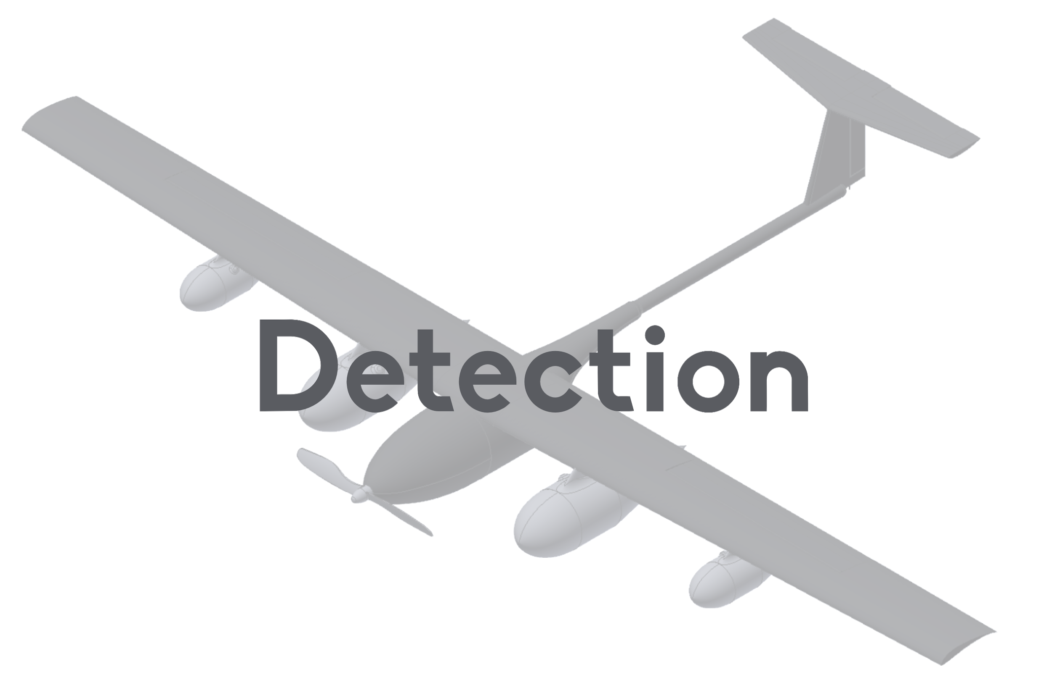

Slide 19
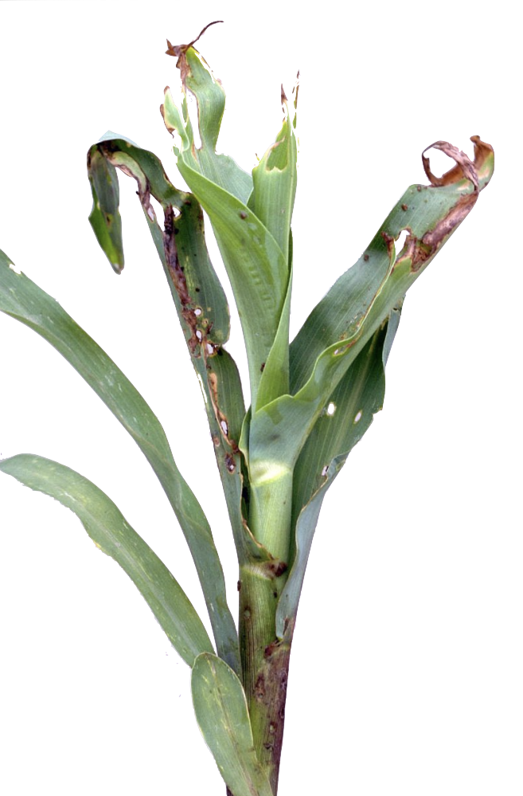
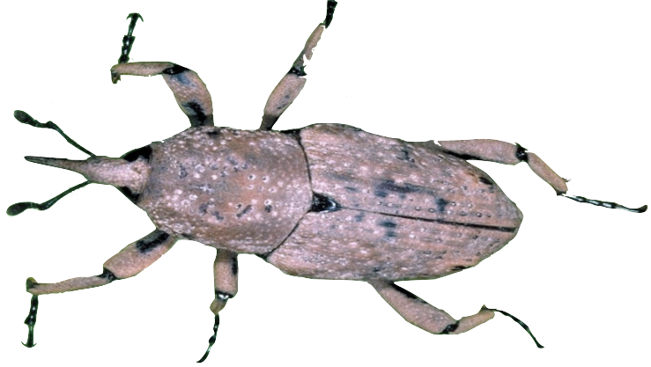
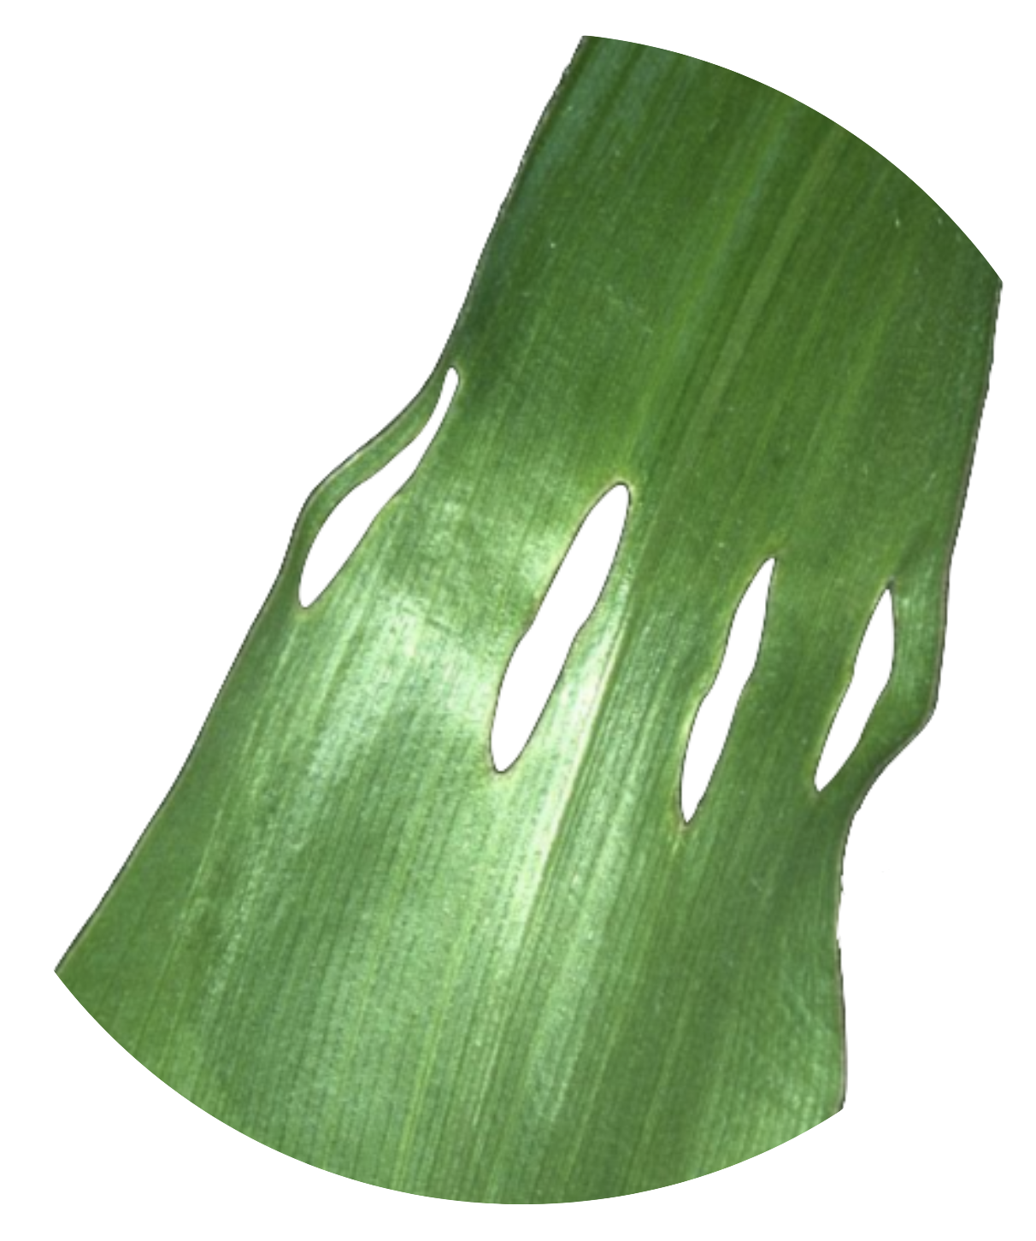
Problem Overview
Field
Four 640-acre fields
2560 total acres
Billbug Infestation
Marked by small holes in plant stem
Damages health of plant
Stunts growth
Can be detected with NDVI Camera Technology
UAS must scan entire field from the air and detect if individual acres are infested

Slide 20
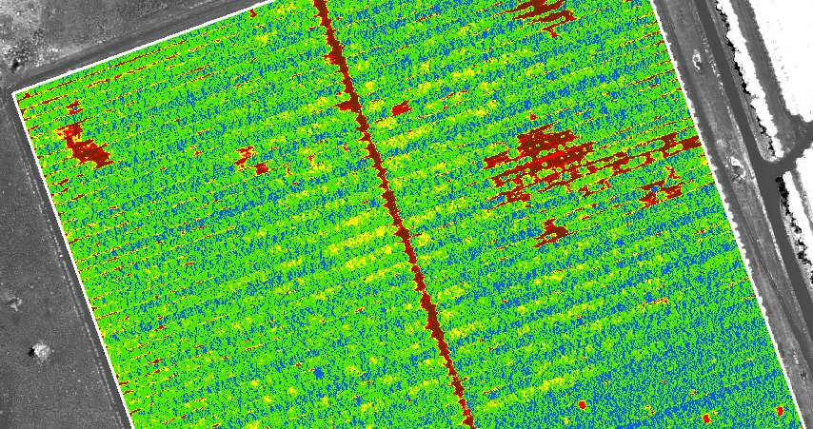
Mission Details – Camera and Data
Normalized Difference Vegetation Index (NDVI) Technology
Utilizes Near Infrared and Red light absorbed/reflected by a plant
Detects level of each plant’s health
Low overall health: infested
Little post-processing required
Completely non-invasive for the plant
Modularization of Spraying UAV
Substantial Decrease in Cost
Spraying Vehicle maneuverability maximized
Real-Time Data Analysis
No cost in attaining vitality maps after scanning field

Slide 21
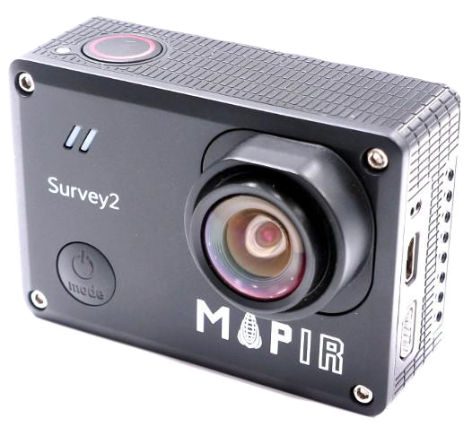
Detection Mission Component: The Mapir Survey2
The Mapir Survey2 NDVI Red + NIR Camera Provides:
Low Cost: $280
Compact Size & Lightweight: 47g
NDVI Technology Support
No post-processing required for
High Resolution: 16 MP; 1440p 30fps, 1080p 60fps
High FOV: 82° - Four acres captured per frame @ 400 feet
Mapir Survey2 Camera – NDVI Red+NIR

Slide 22
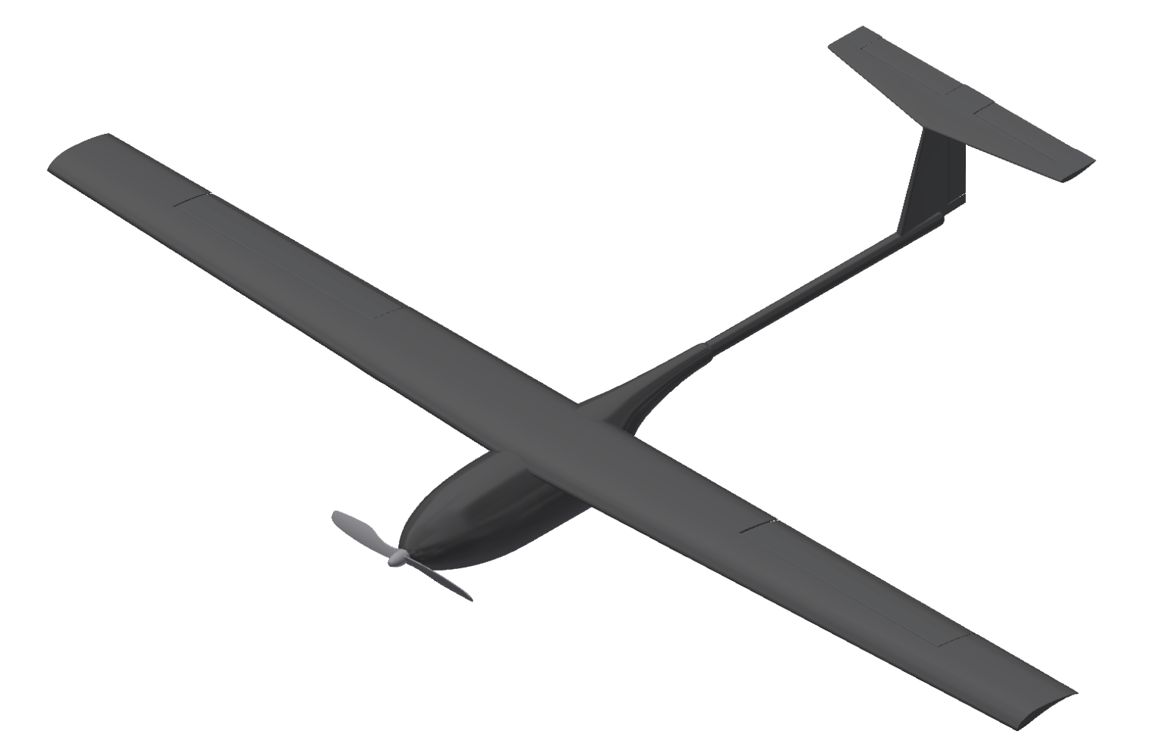
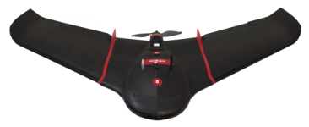
eBee SQ Compared to the X181-NR
300 min (5 hrs) | time needed for full detection | 47.6 min
$2,395.50 per mission | cost for farmer | $162.54 per mission
Parrot Sequoia | camera | Mapir Survey2 NDVI Red+NIR

Slide 24
Module

Slide 25
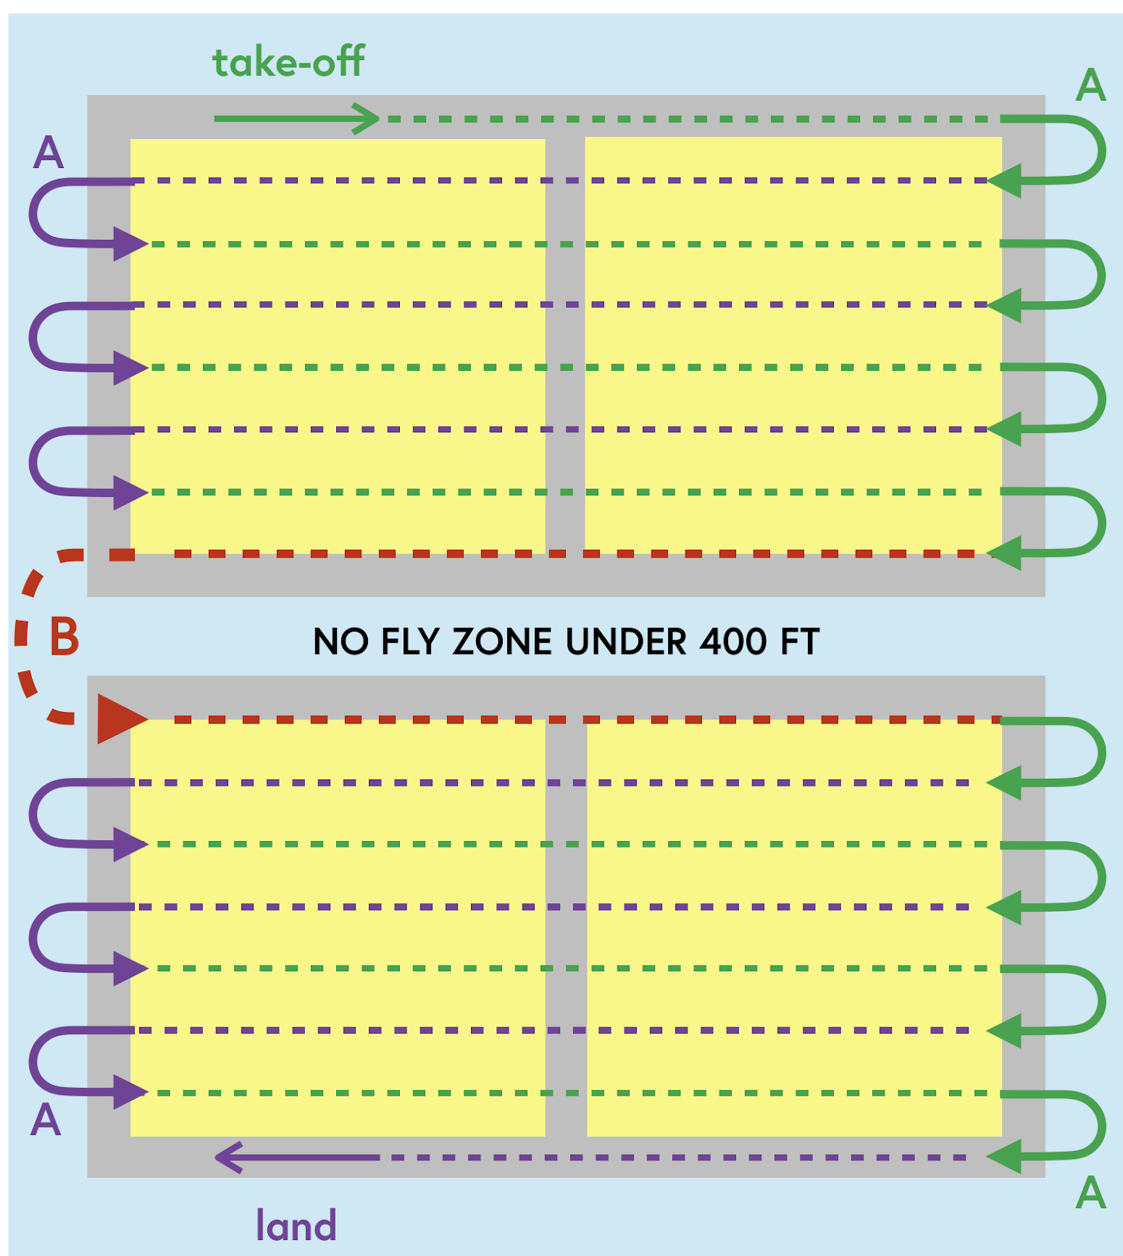
Mission Details – Flight Plan
DETECTION MISSION
Pre-determined Flight Path - 400 feet
Maneuvers A & B
A - 10º Bank; 348 ft radius
B - 45º Bank; 143 ft radius
Straight and Level Flight
-3.0º AoA
Footprint Width - 695 ft
14 Passes
Flight Plan for Detection
(not to scale)

Slide 26
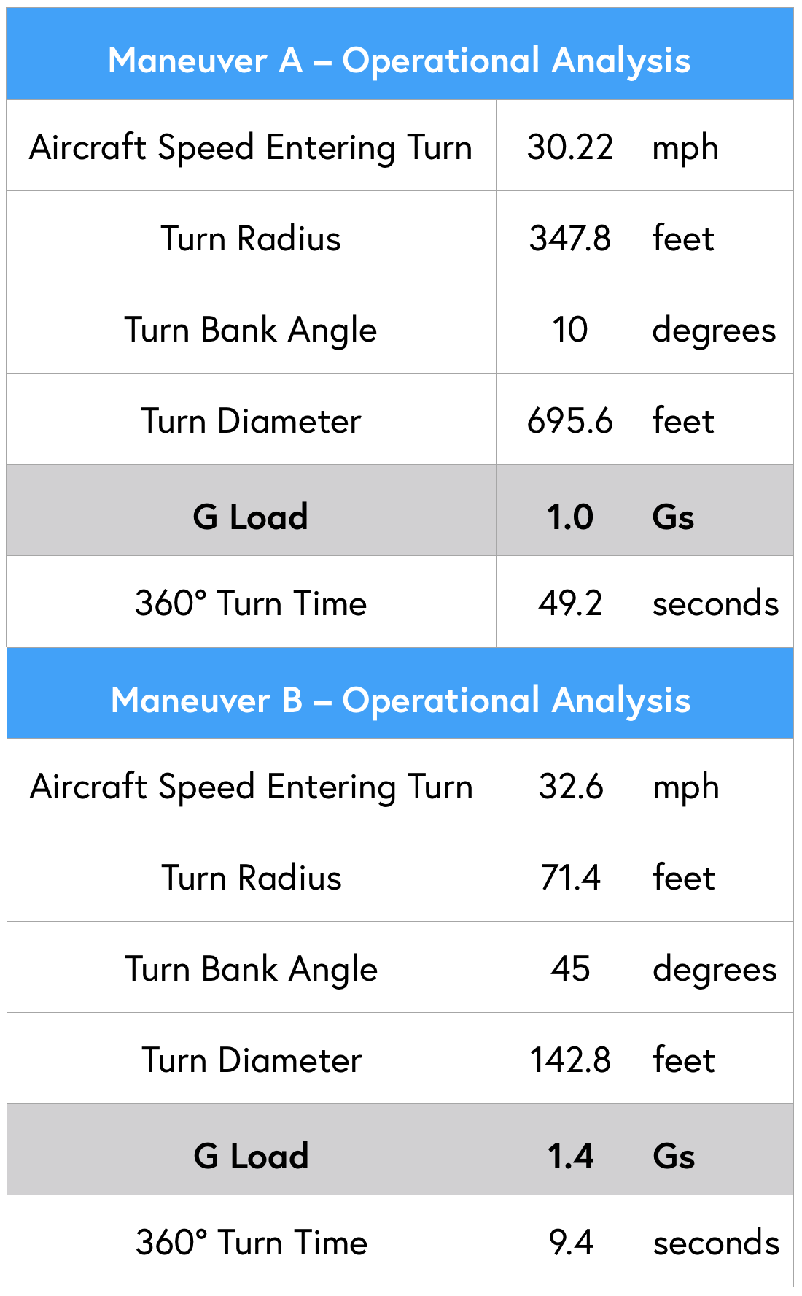
Mission Details – Flight Plan
APPLICATION MISSION
Varies for every field’s infestation
Ardupilot software
Allows for optimized waypoint targeting
Accounts for design limitations
Determines...
Best position for takeoff
Turns and maneuvers
Overall course of flight
Landing
Operational Analysis for Detection

Slide 27
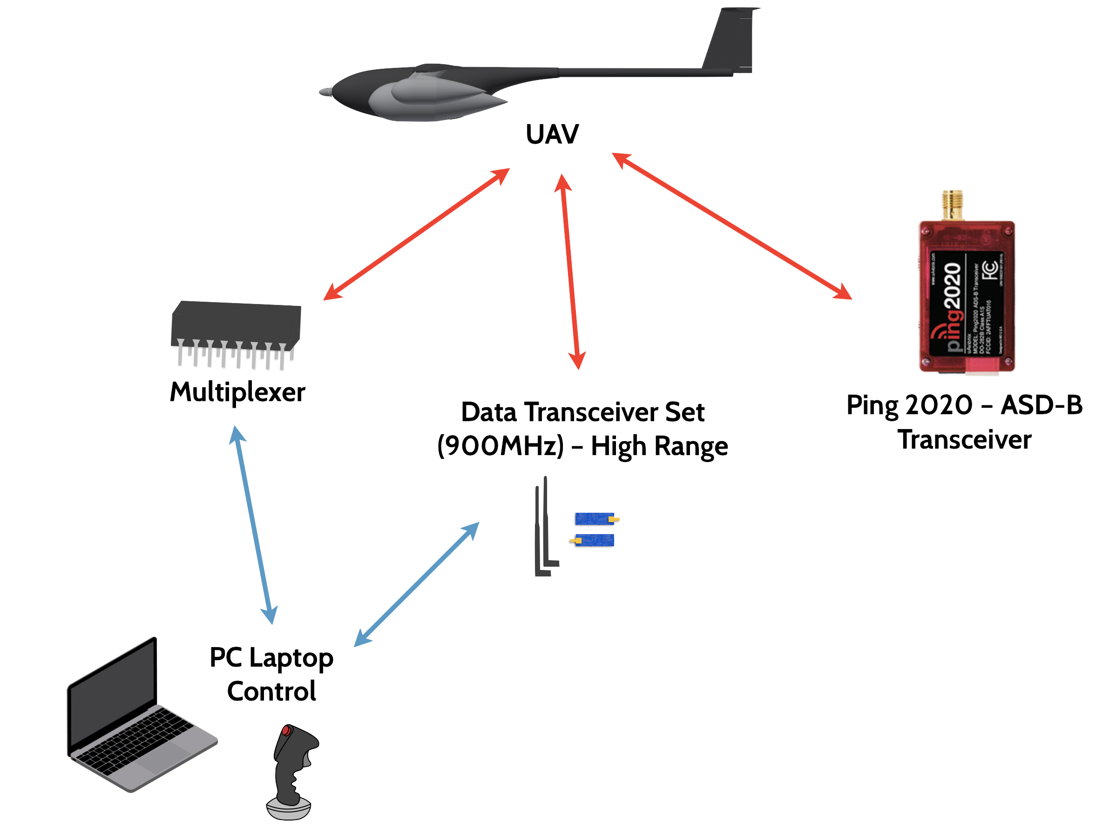
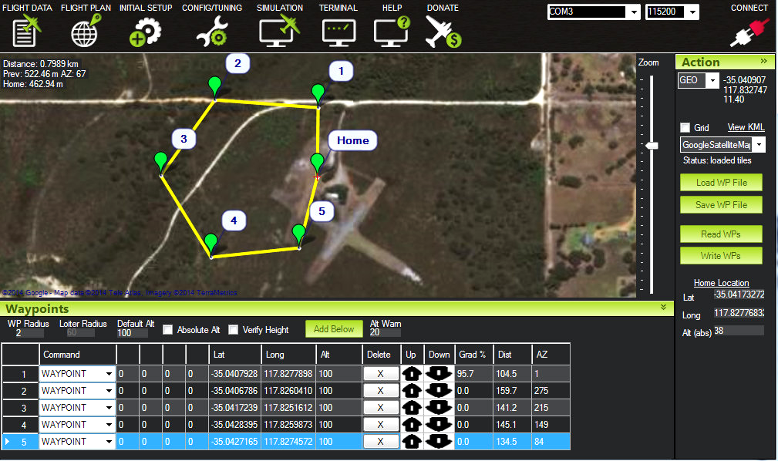
Communication Integration
Maximum Communication Distance: 6.63 miles
Line of Sight: 3 miles
Software: ArduPilot

Slide 28
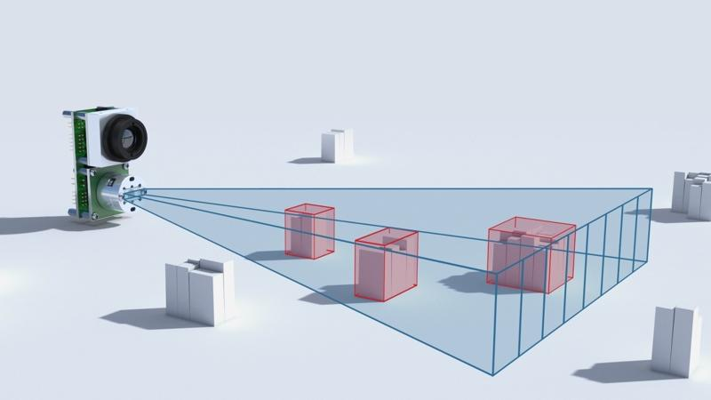
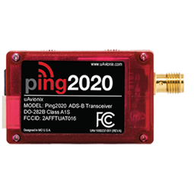
Safety Systems
LiDAR (Light Detection and Ranging)
Distance measurement
Autonomous object avoidance
Even when no signal
GPS Integration
ADS-B satellite system triangulation
Traffic avoidance capabilities
LeddarVu Solid State LiDAR Platform
Ping2020 ADS-B Transceiver

Slide 30
Compared to the DJI Agras MG-1 & SenseFly eBee SQ

Slide 31
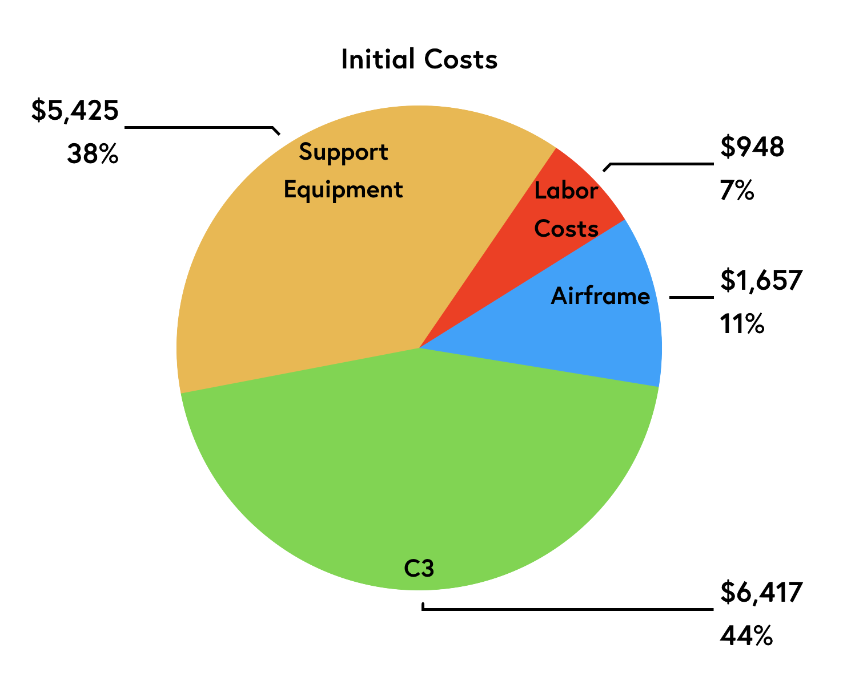
Initial Costs
Total Acquisition Cost: $14,447

Slide 32
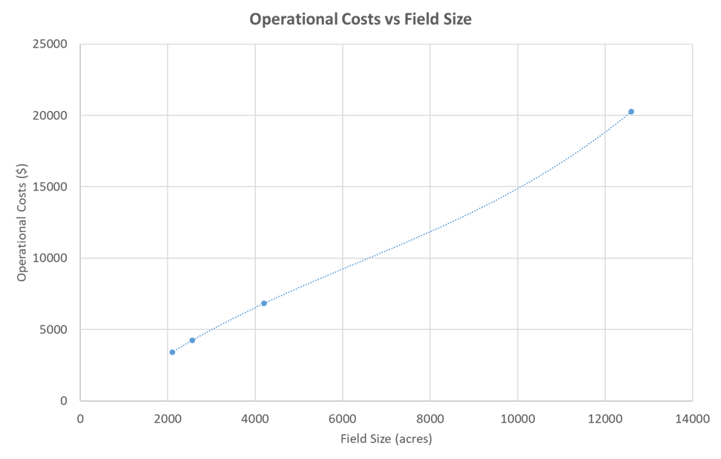
Field Size: Operational Cost Analysis (1/3)

Slide 33
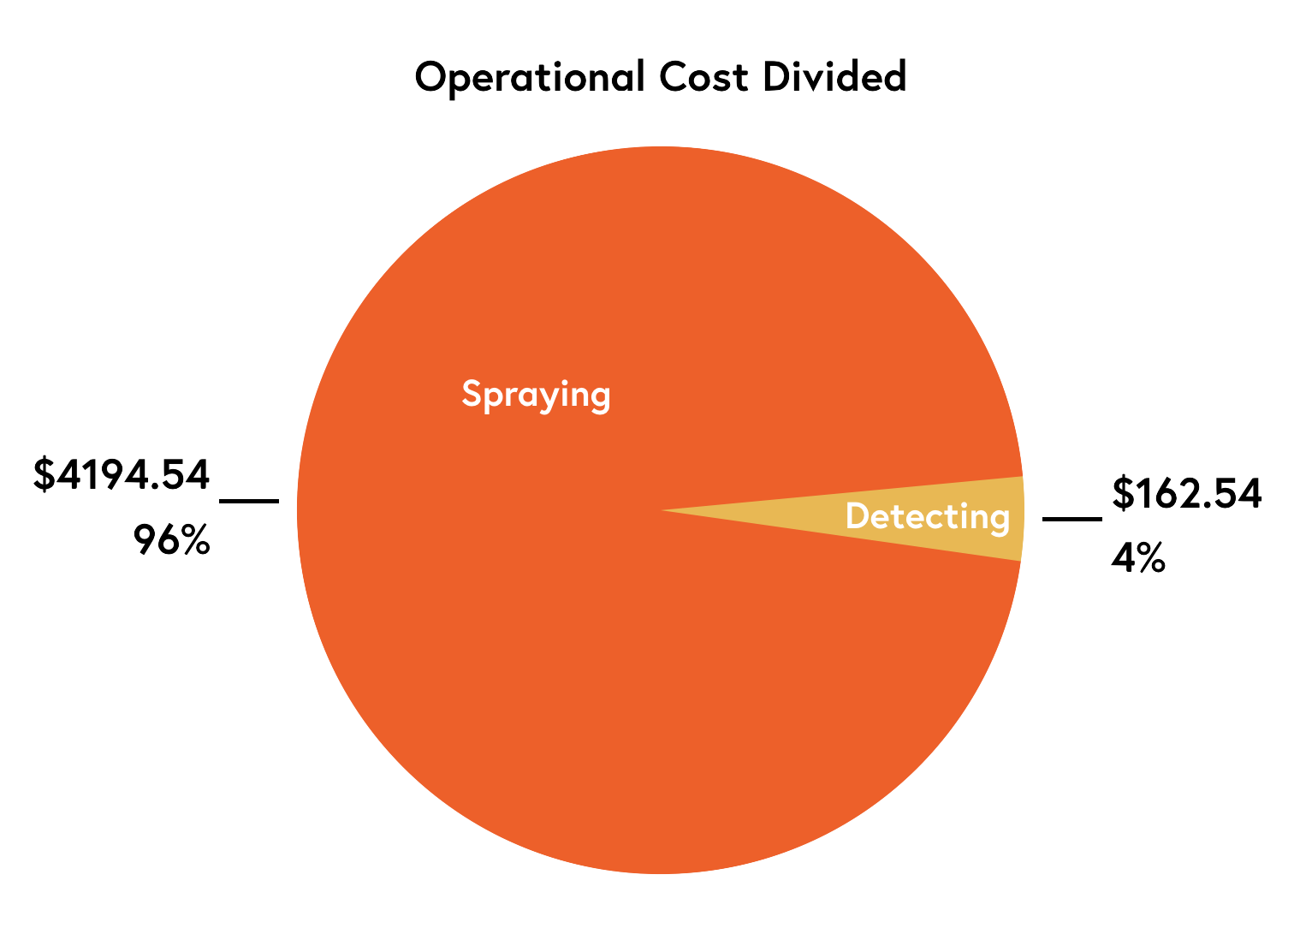
Field Size: Operational Cost Analysis (2/3)

Slide 34
Field Size: Operational Cost Analysis (3/3)

Slide 35
Company Plan: Annual Detections

Slide 36
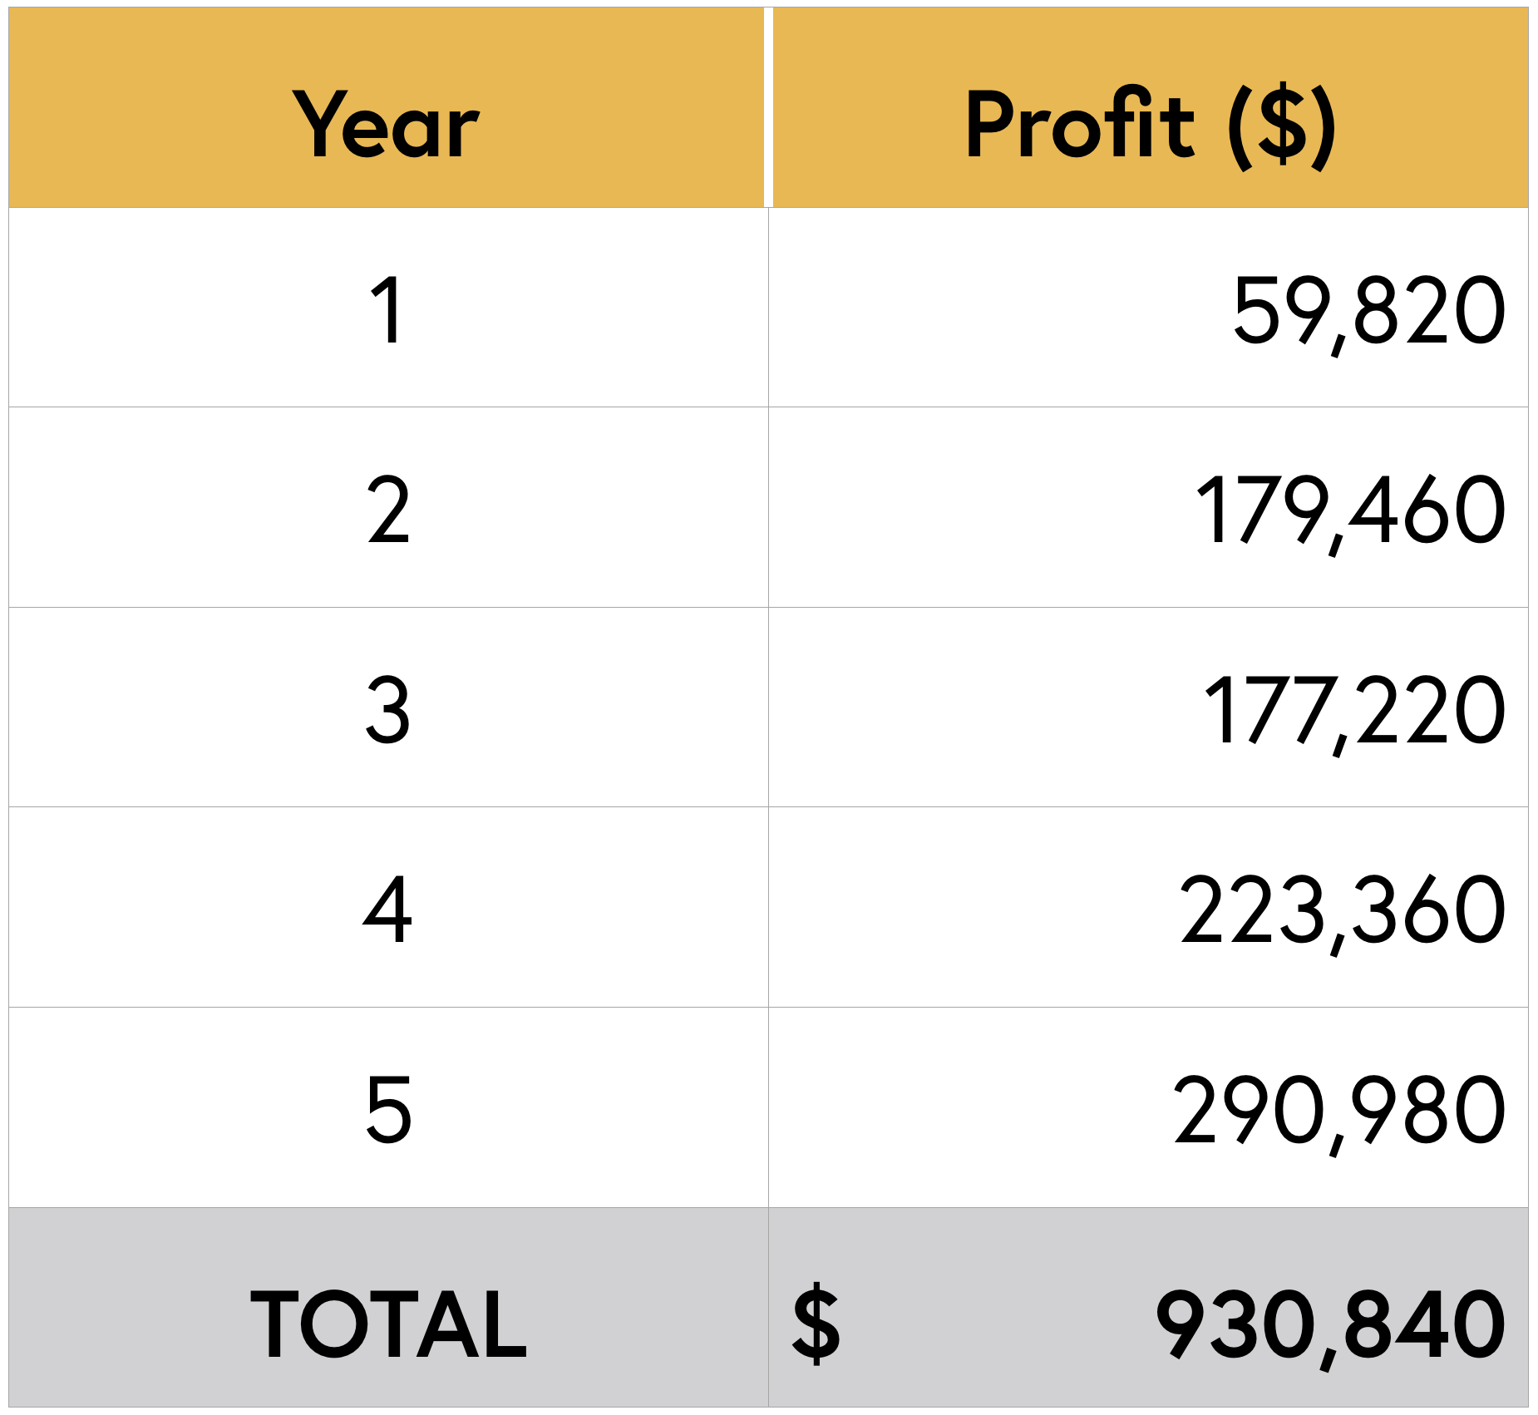
Company Plan: Profitability Over Five Years

Slide 37
Summary
Exceeded weight constraint of the FAA’s part 107 regulations
Reduces cost (3.5x lower)
Improves efficiency (18x lower mission run-time)
Allows for more pesticide transport (9x more)
Modularity – the X181-NR aircraft can perform both APPLICATION and DETECTION
Result is a significantly more effective aircraft than those currently on the market (DJI Agras MG-1 and eBee SQ)

Slide 38
Thank You!
The Xaverian Engineers would like to thank:
Judges
Coach
Mentors
RWDC Sponsors
Volunteers

Slide 39
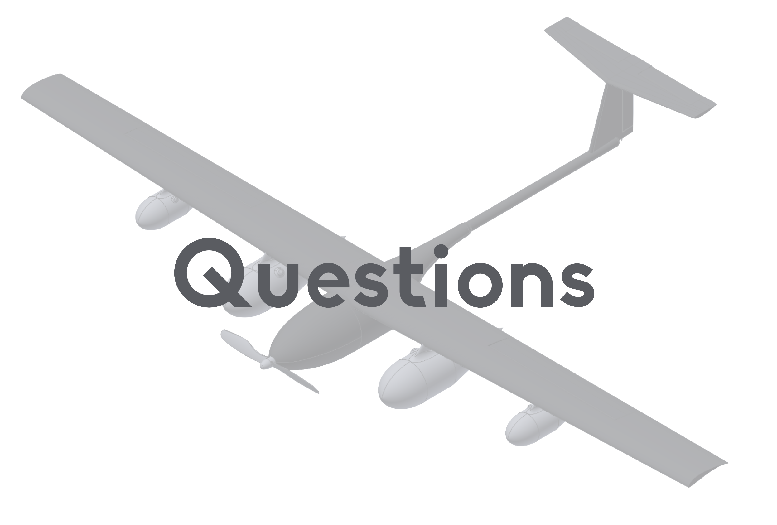

Slide 40
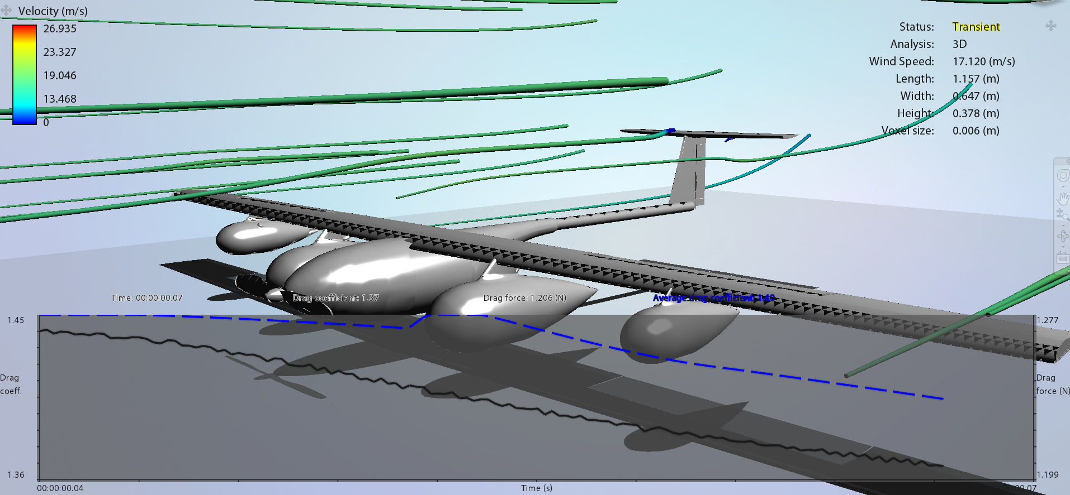
Design Details – Maximizing Lift
X-Foil
Chosen Airfoil: Selig 1223
Coefficient of Lift
Wing Design
Lift Calculations
Wind Tunnel Testing
Refined the airframe
Force of drag on the UAV
Guided Design Process

Slide 41
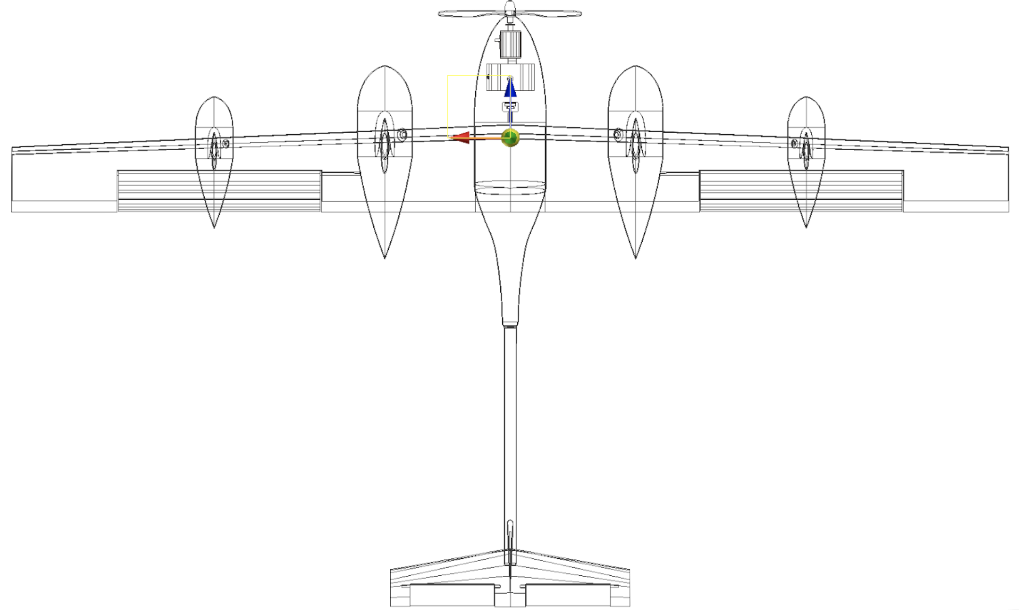
Design Details - Balance
Center of lift: 4.6” behind CM
Tail Center of lift: 75” behind CM

Slide 42
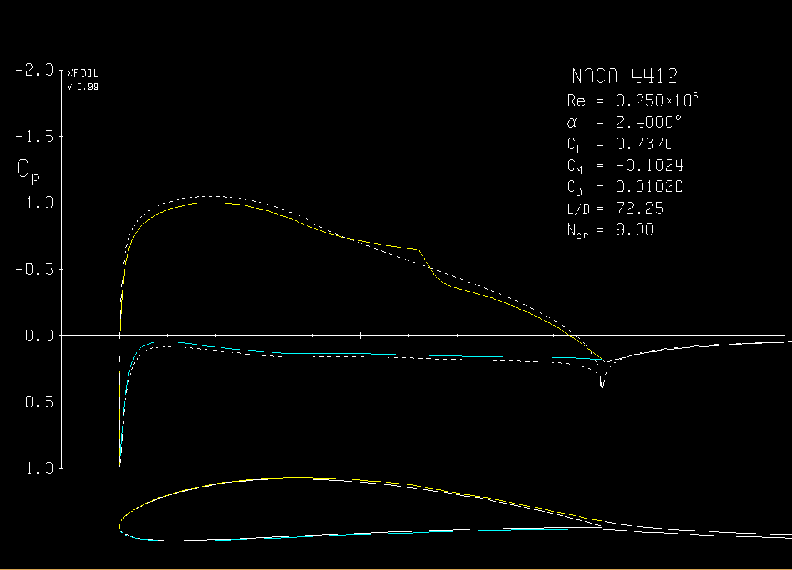
Design Details - Balance (2): Stabilizer

Slide 43
Additional Final Operational Information
Total Runway Required for Full Payload: 630 ft
-With an acceleration of 1.67 m/s² from the 42.8 lbs of thrust on the 251 lb loaded UAV
Total Runway Required for Empty Payload/Detection: 66 ft
-With an acceleration of 6.58 m/s² from the 42.8 lbs of thrust on the 64 lb unloaded UAV
Thrust (100% Throttle): 42.8 lbs
Top Speed: 45.2 mph (20.20 m/s)
Operational Weight (no payload): 64 lbs
Maximum Lift: 311 lbs at 45.2 mph
Fuel Capacity: 0.93 gal
Flight Time (full payload): 2.0 hours*
Flight Time (no payload): 10.0 hours**
Stall Speed (full payload): 40.1 mph (decreases exponentially as pesticide is released)
Stall Speed (no payload): 20.4 mph
Stall Angle: 13.2°
*To err on the side of caution, the 100% throttle value was used to calculate the full payload flight time.
**The speed required to keep the empty craft aloft at 0.0 degree angle of attack is 25 mph, which according to the Godolloairport Static Thrust calculator requires an RPM of 3922 which strains the engine approximately 1 HP. This yields a lb/hr rate of (0.57 lb/hp/hr)(1 hp) = 0.57 lb/hr. With 5.7 pounds of fuel, this results in a 10 hour flight time.

Slide 44
Detection Plan - Detailed
1.) Launch from the long outside access road with camera and gimbal payload
-66 feet required at an acceleration of 6.58 m/s^2 (see 2.2.4 thrust analysis)
-1.7 seconds until liftoff
-2.8 seconds to climb to 400 feet cruising altitude with a net upward thrust of 104 lbs at a 0.0 degree angle of attack, 40 mph airspeed
2.) Maneuver A
-Decrease airspeed to 30.22 mph to conduct Maneuver A (10 degree bank, 347.7 ft turn radius)
-Turn takes 24 seconds to complete. See section 2.5.
3.) Scanning Pass
-Increase airspeed to 42.5 mph and trim nose down to -3.0 degree angle of attack to decrease coefficient of lift to 0.402, creating a lift equal to the UAV weight
-Adjust camera gimbal by 3 degrees to be perpendicular with the ground
-Single pass time = 2.82 minutes at 42.5 mph (2 mile strip)
4.) Repeat Maneuver A and Scanning Pass (7 additional times)
-Total time for 8 Maneuver A’s and Scanning Passes = 25.7 minutes.
5.) Maneuver B
-Decrease airspeed to 32.6 mph to conduct Maneuver B (45 degree bank, 71.3 ft turn radius)
-Turn takes 4.7 seconds to complete and crosses above the restricted area of the no-fly zone. See section 2.5 for analysis.
6.) Scanning Pass
7.) Maneuver A + Scanning Pass
9.) Repeat Maneuver A and Scanning Pass (7 additional times)
-Total time for second half of the field (8 maneuver A’s and passes) is 25.7 minutes
10.) Maneuver A
-Land on access road.

Slide 45
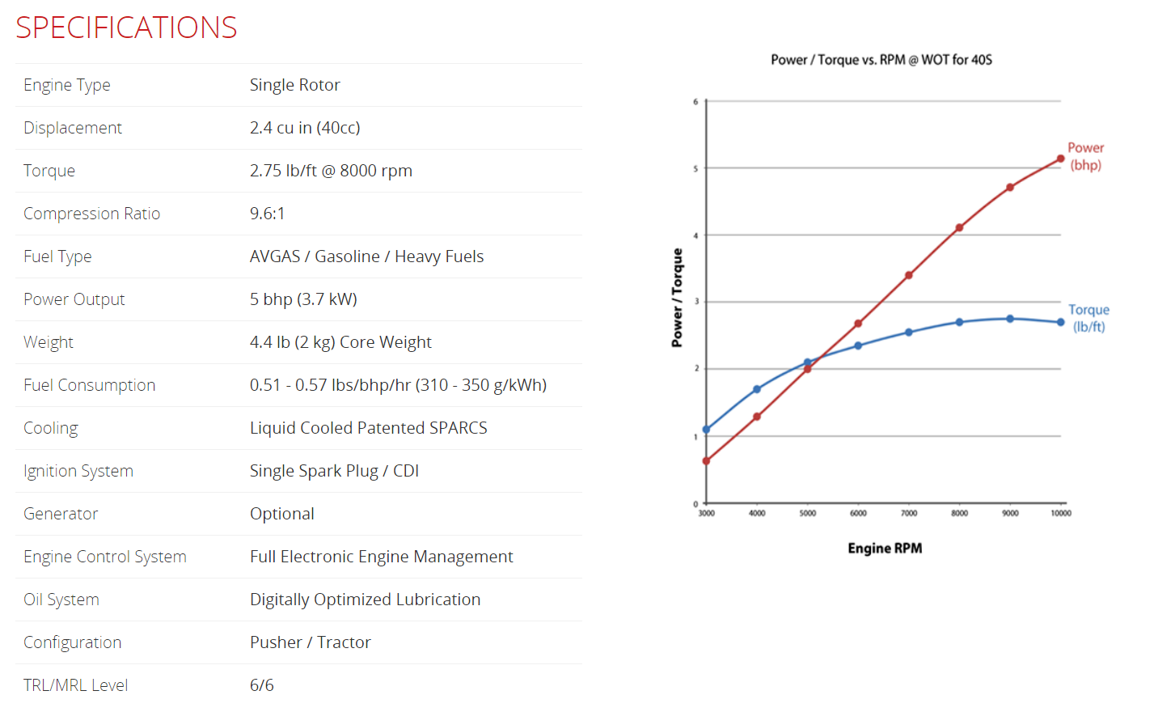
Engine

Slide 46
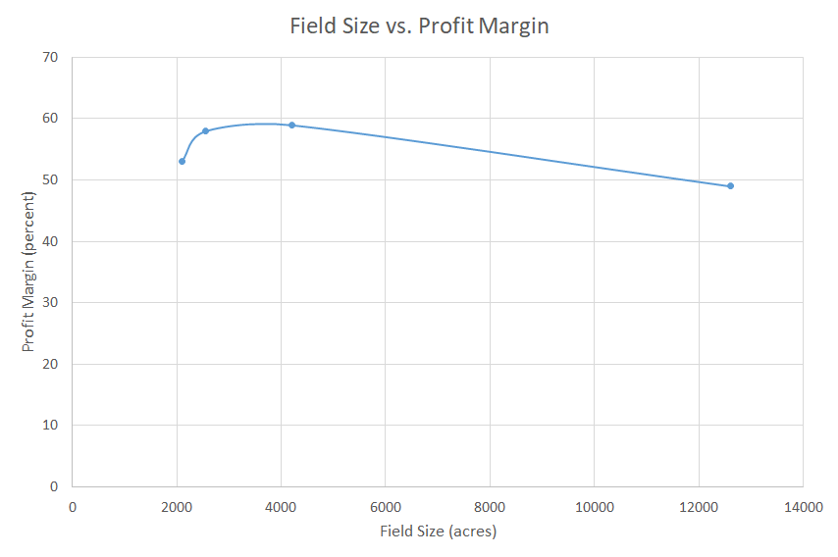
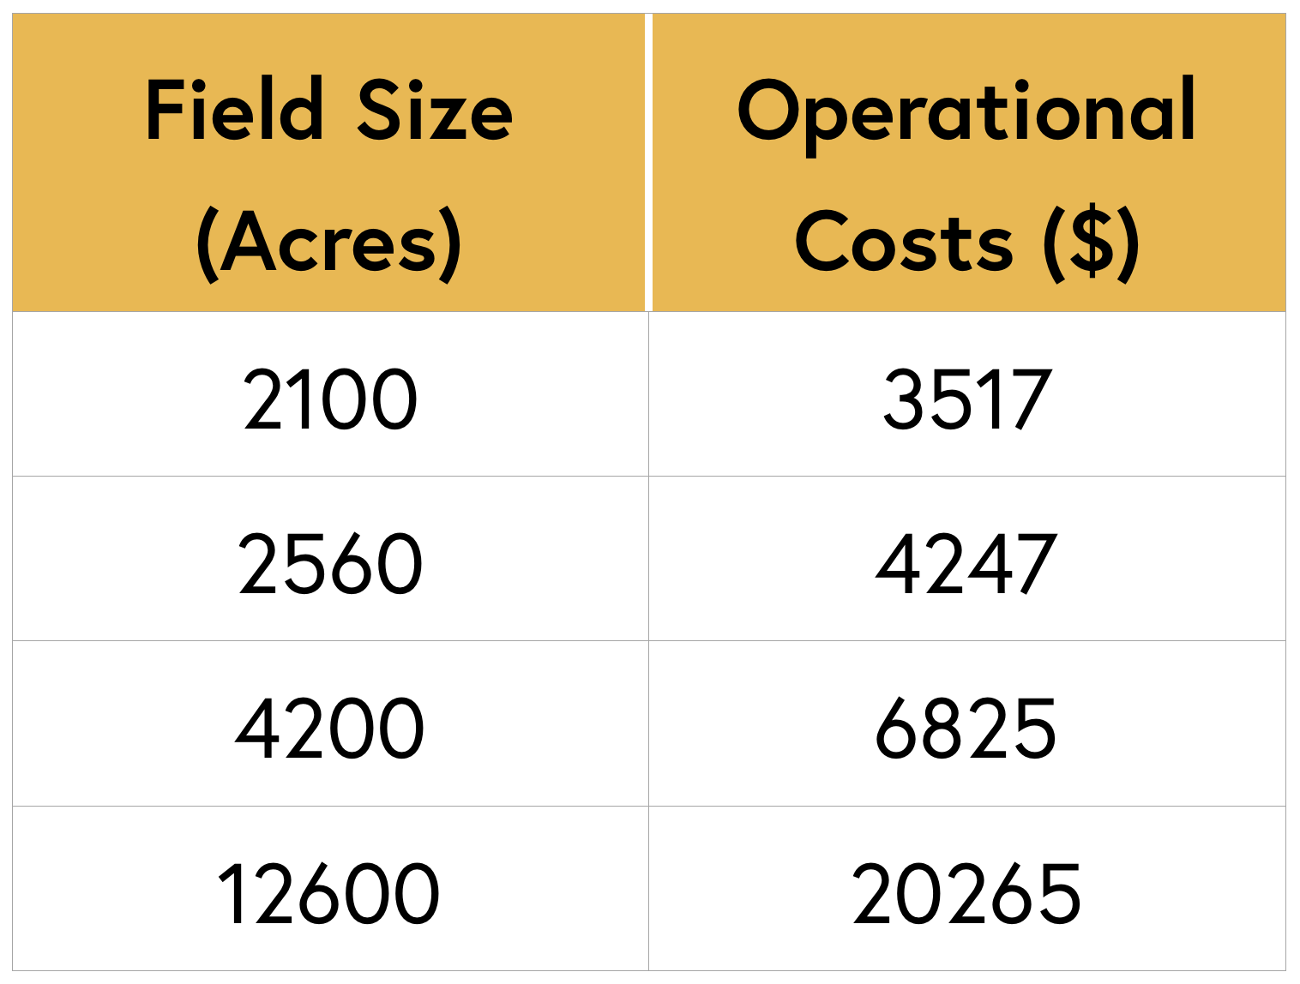
Field Size: Operational Costs & Profit

Slide 47
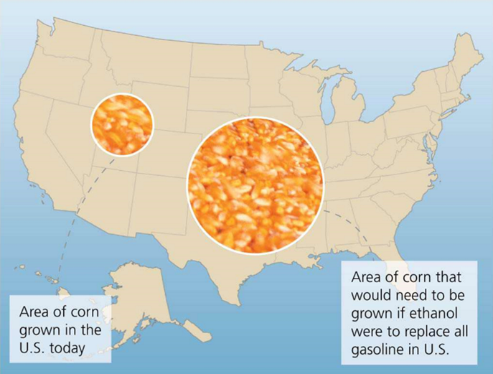
Corn as Ethanol

Slide 48
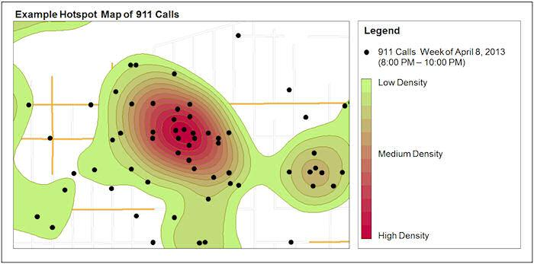
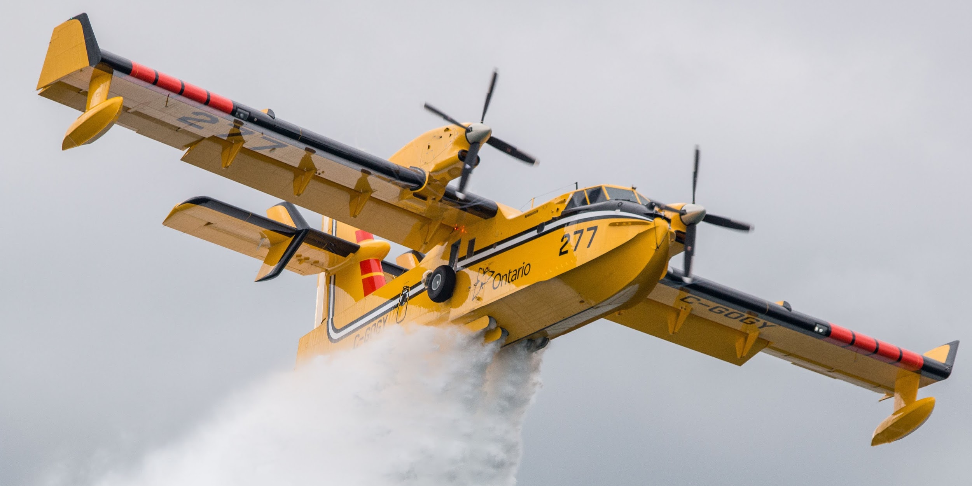
Additional Applications
DETECTION
Striping for Parking
Hotspot Detection
APPLICATION
Wildfire Fighting in Hard-to-Reach Areas

