Slide 1
The Innovation Engine
Introduction to Unmanned Aerial System (UAS)
Creo: Computer Aided Design
Dr. Florian Hafner, Embry-Riddle Aeronautical University
Thanks to Dr. Florian Hafner, Dr. Brent A. Terwilliger & Dr. Robert Deters, Embry-Riddle Aeronautical University
Thanks to Dr. Brent A. Terwilliger & Dr. Robert Deters, Embry-Riddle Aeronautical University

Slide 2
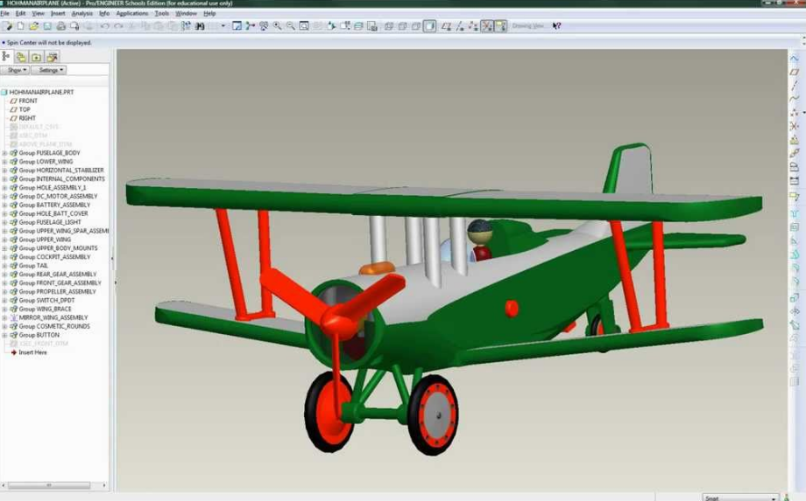
Creo Parametric Introduction
CAD Application for your 3D airframe model designs
Structured Design-through-Manufacturing Process Tool

Slide 3
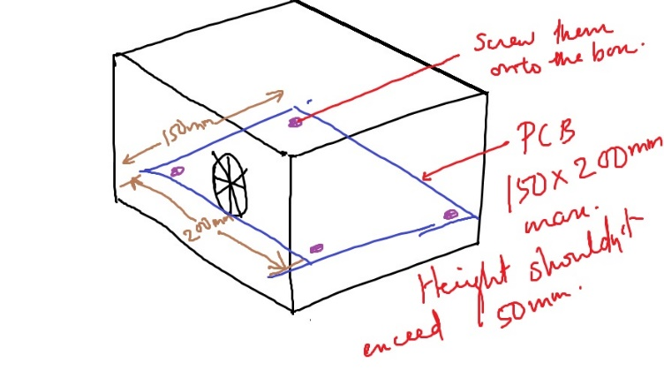
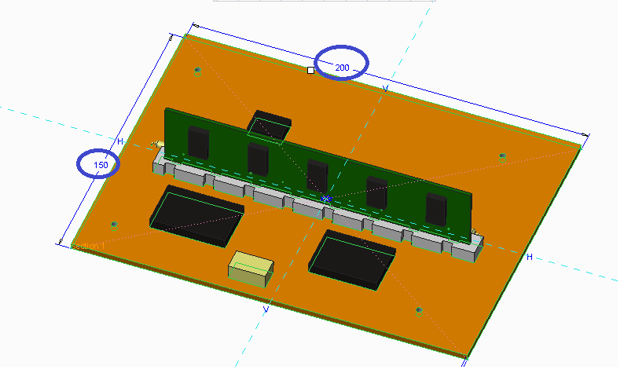
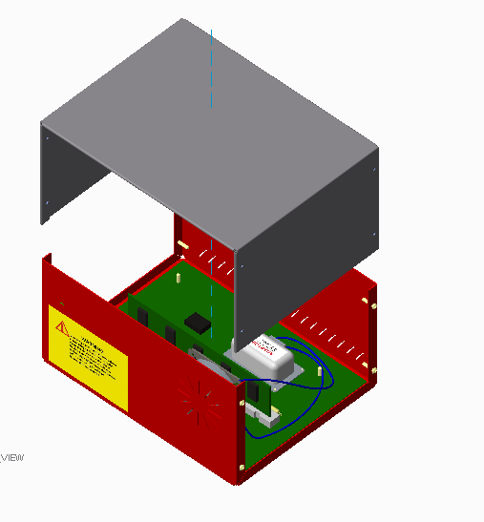
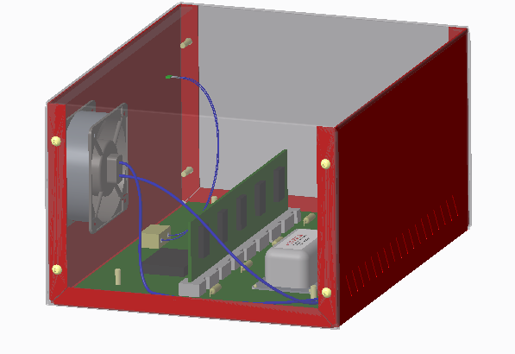
Creo Parametric Process
Designs
Parts
Assembled Components

Slide 4
3 Creo Exercises in Exercises Folder 1. Construct a Die 2. Variable Sweep (Fuselage) 3. Wings and Assemblies

Slide 5
Creo Parametric Exercise ‘Construction of a Die’

Slide 6
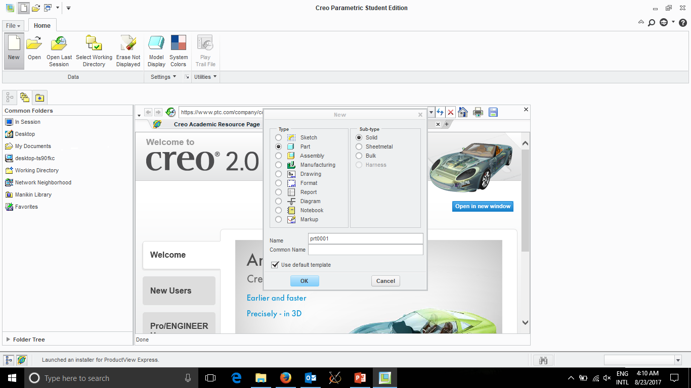

Slide 7
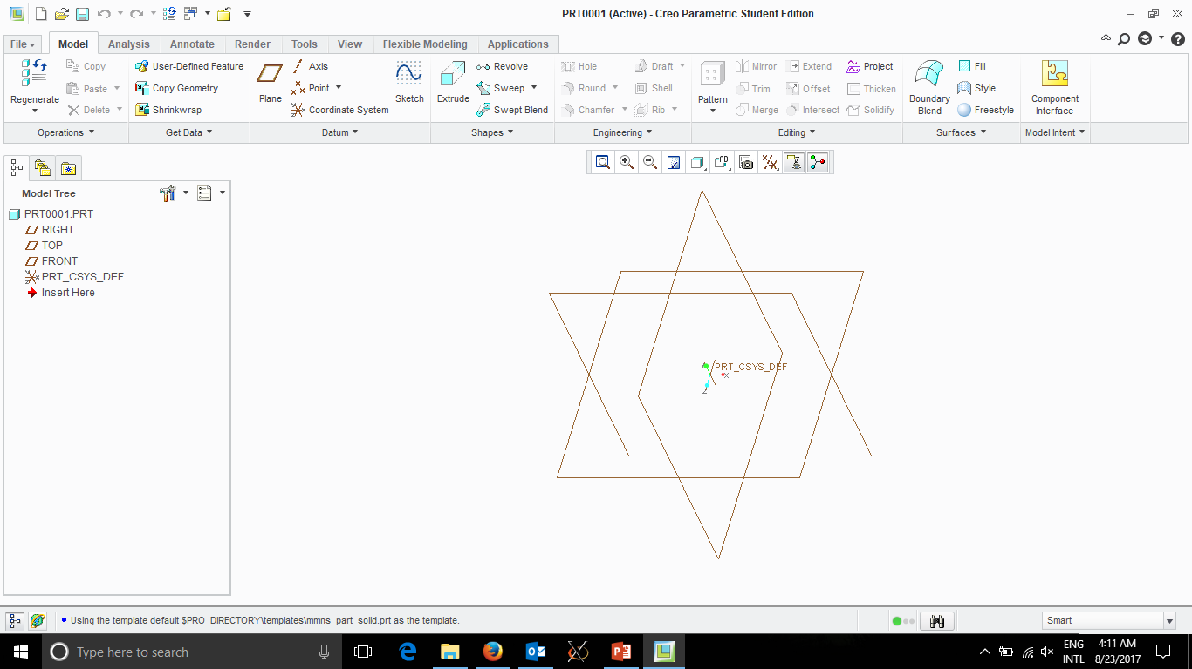
Draw
Controls
Views

Slide 8
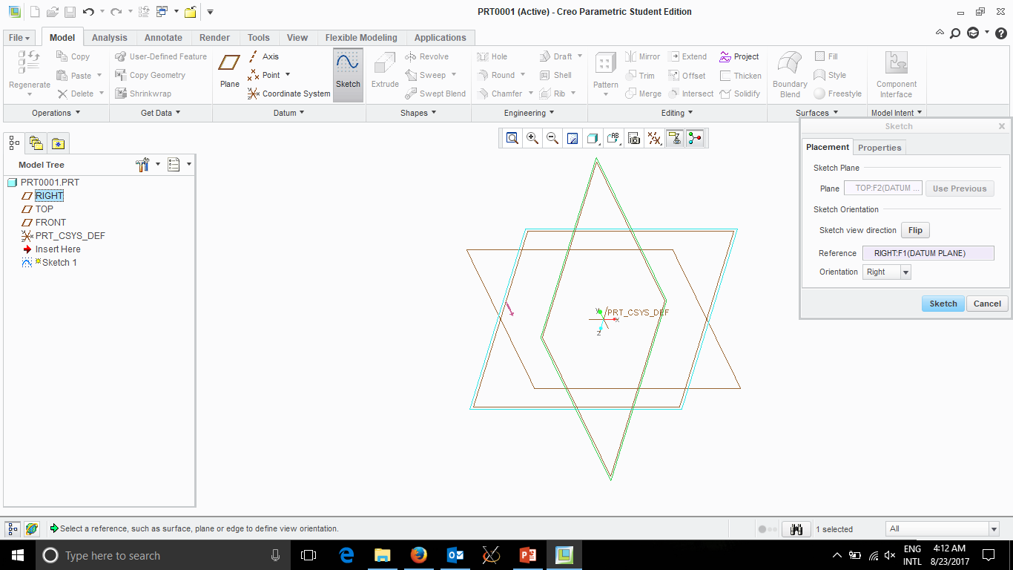
Draw SKETCH
Pick Plane

Slide 9
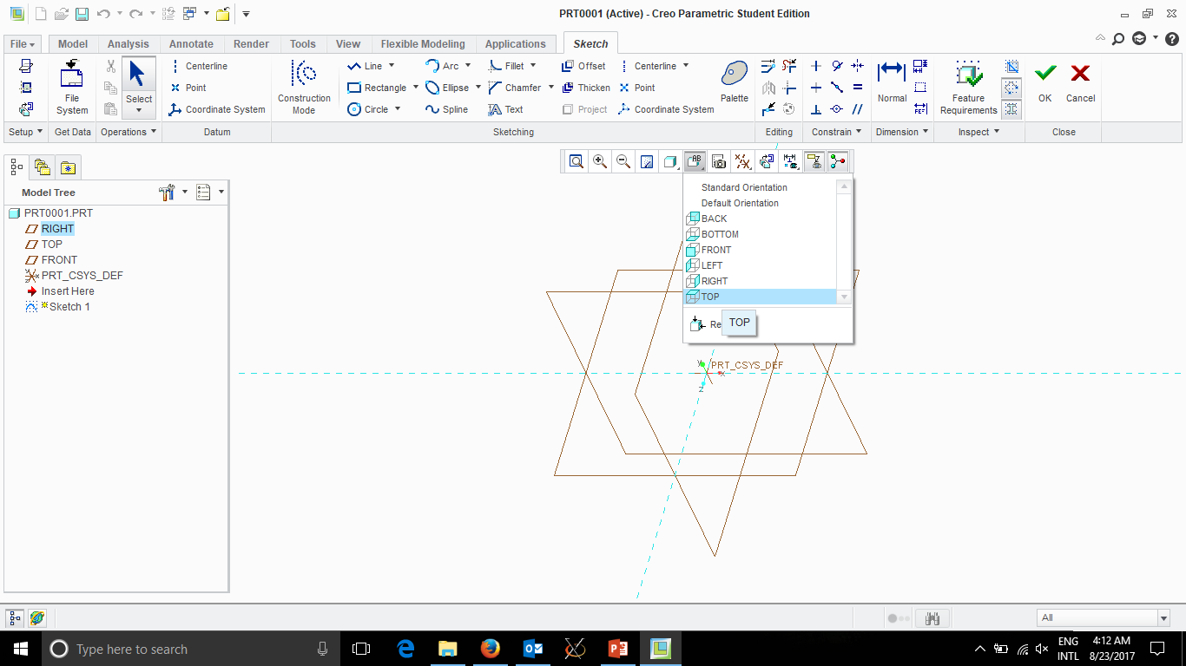
Change View
To Drawing Plane

Slide 10
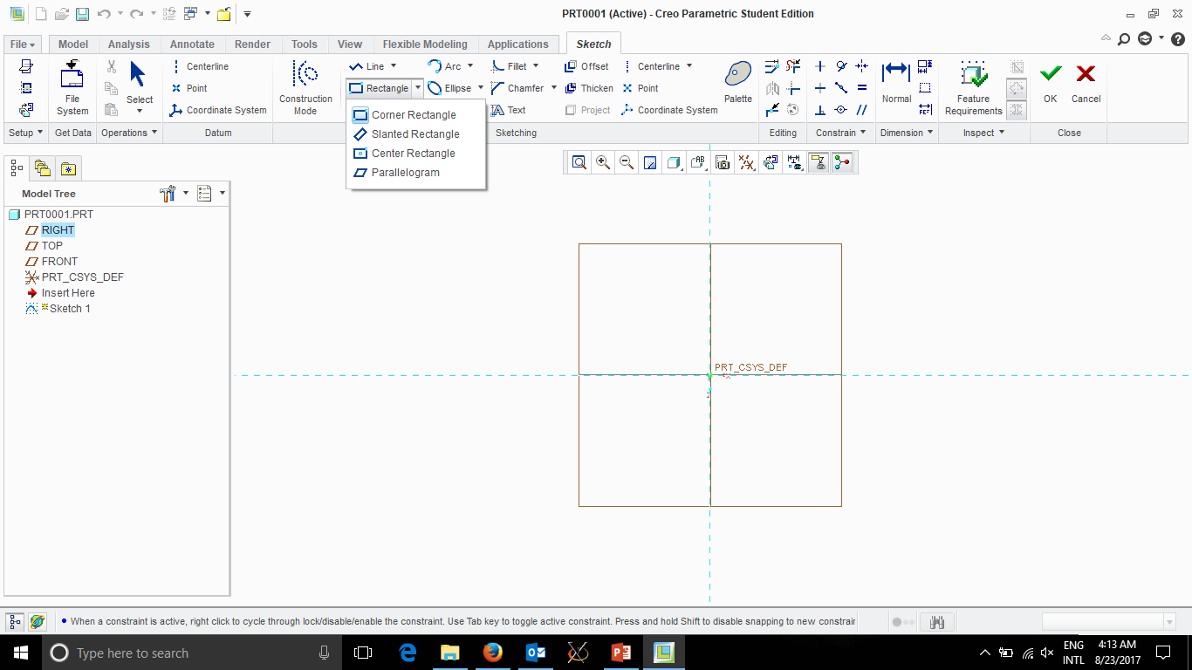
Draw a Rectangle

Slide 11
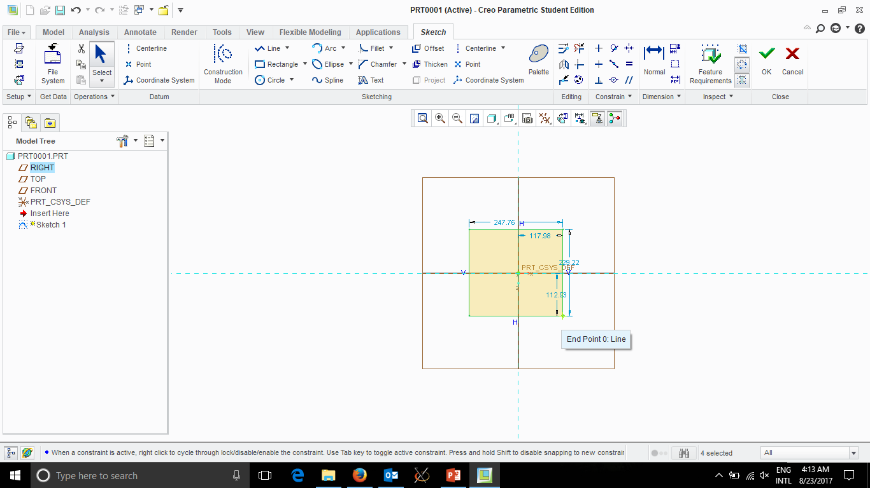
Left Click
Left Click
Middle Click to Finnish

Slide 12
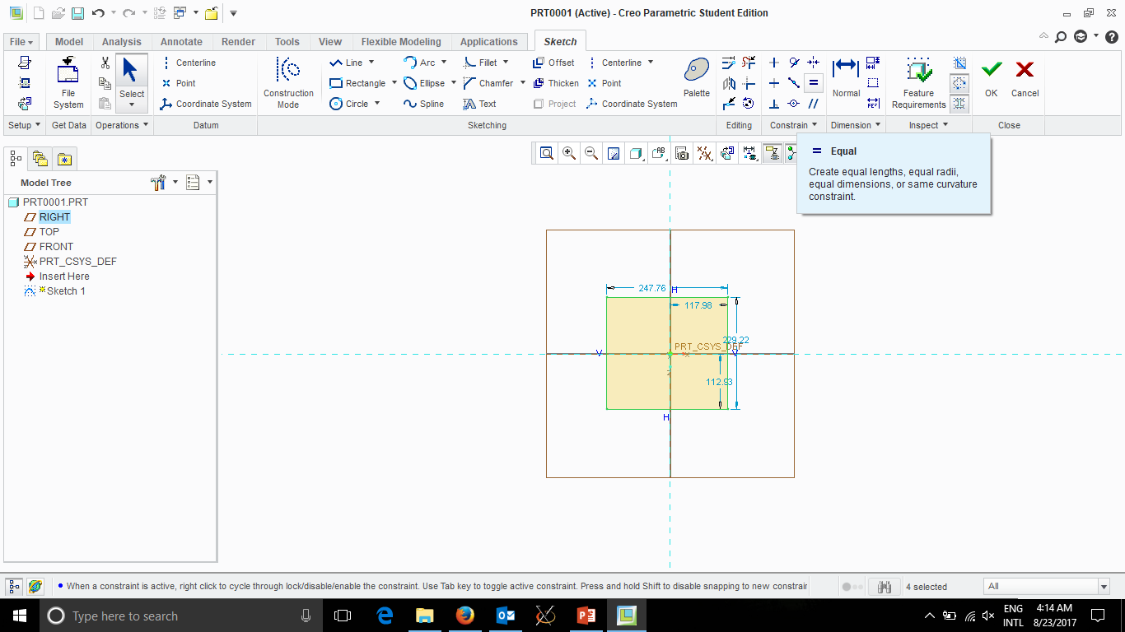
Need to make sides
equal

Slide 13
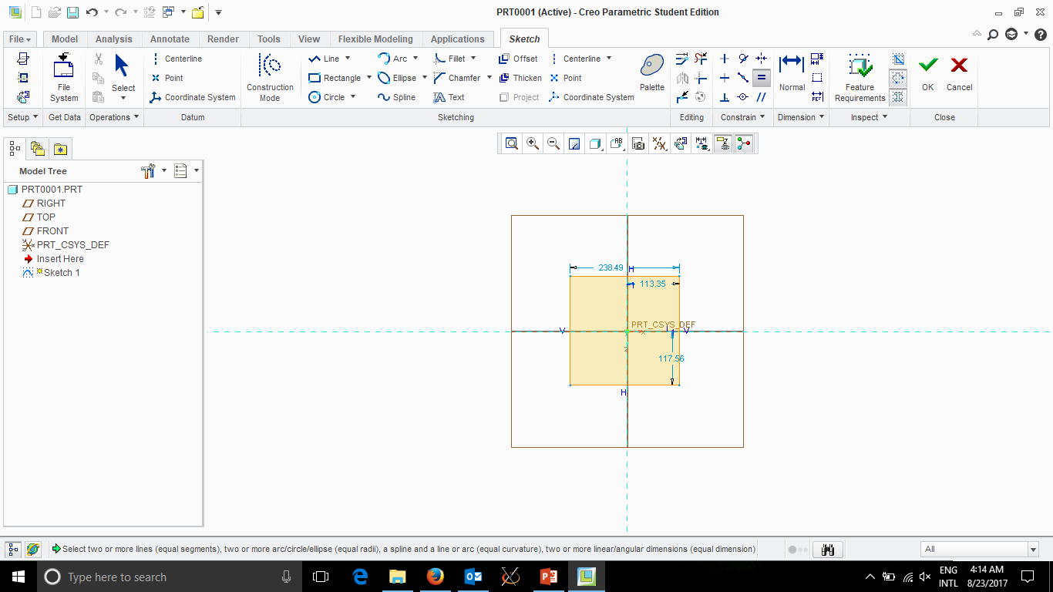
Need to make sides
equal

Slide 14
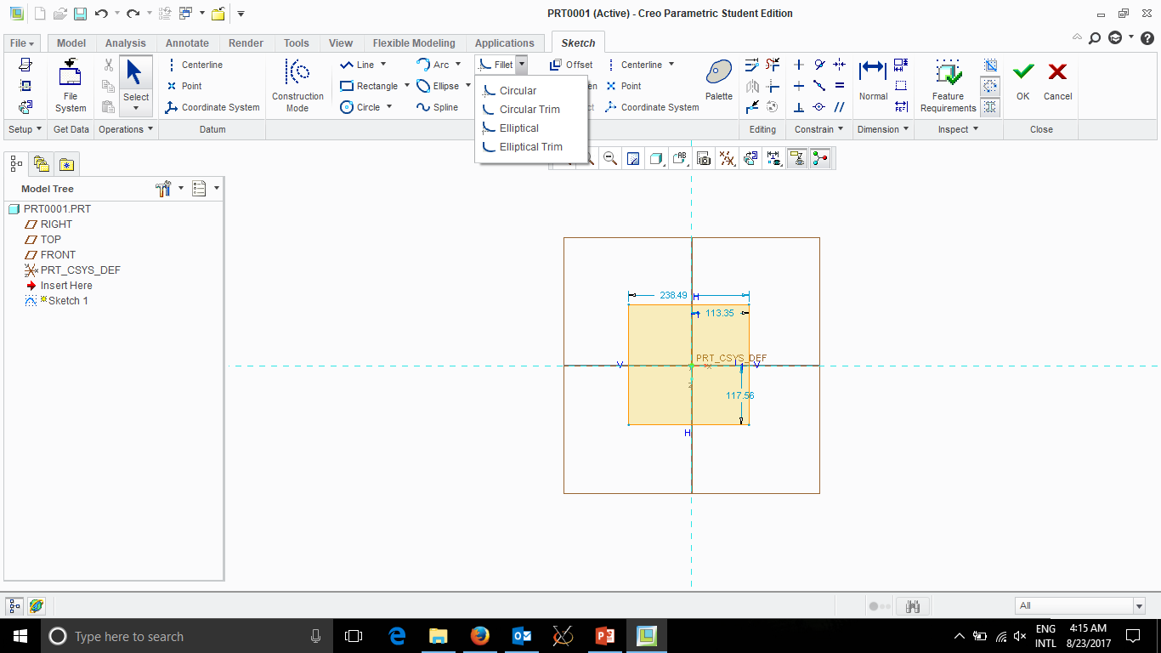
Fillet – Round Corners

Slide 15
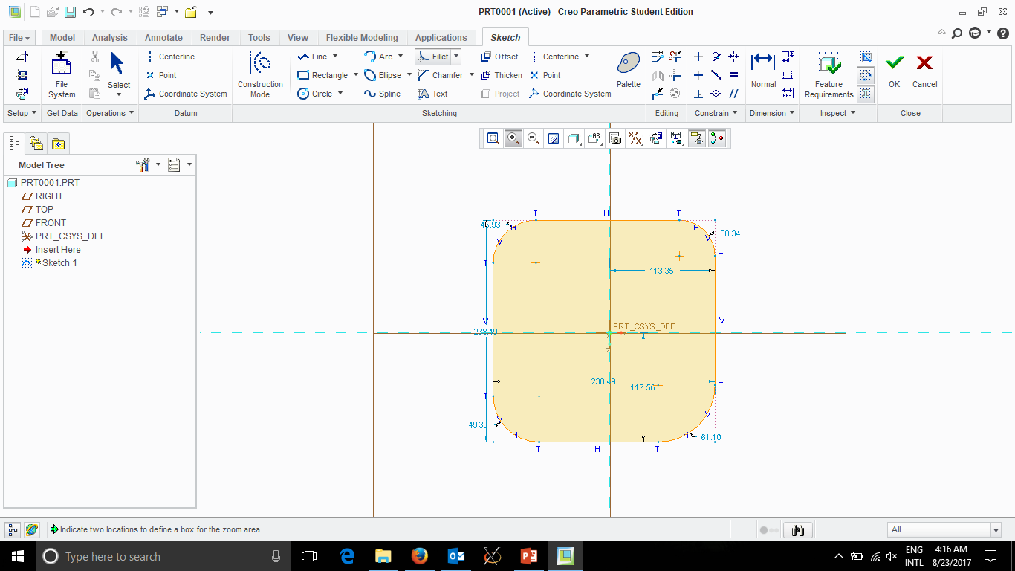
Click on 2 adjacent
Sides for each
Corner

Slide 16
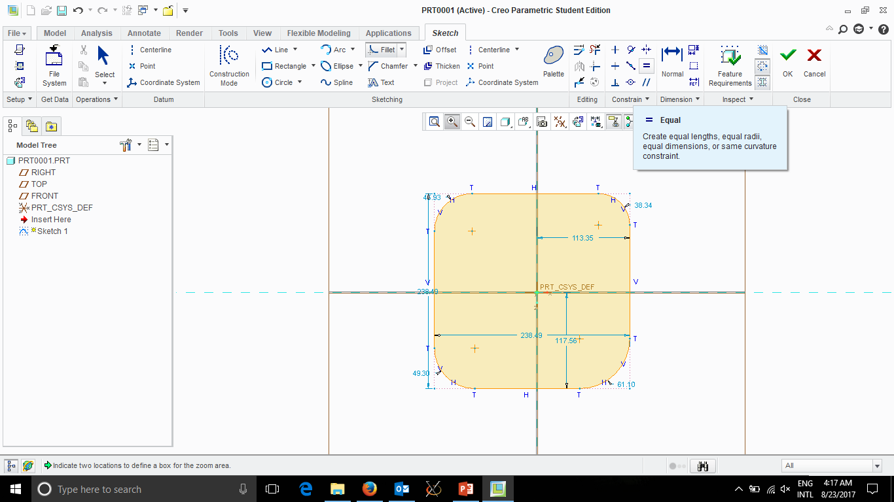
But corner Radii
No equal
So Click Equal
Then Click all
4 Corner Radii

Slide 17
Click ‘OK’ when done

Slide 18
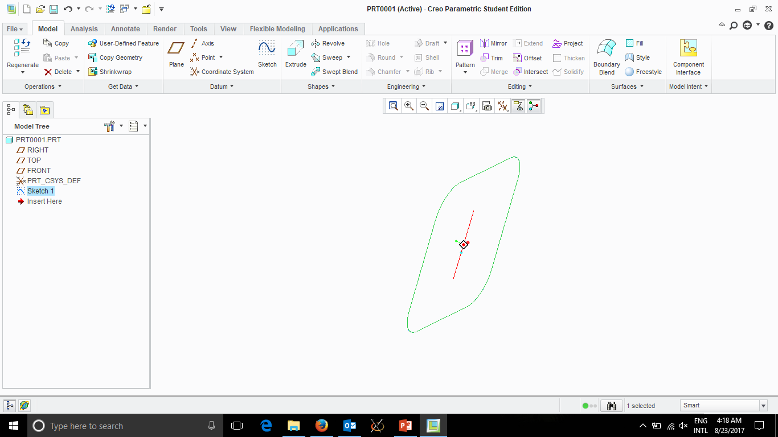
Middle Click-Drag to Rotate

Slide 19
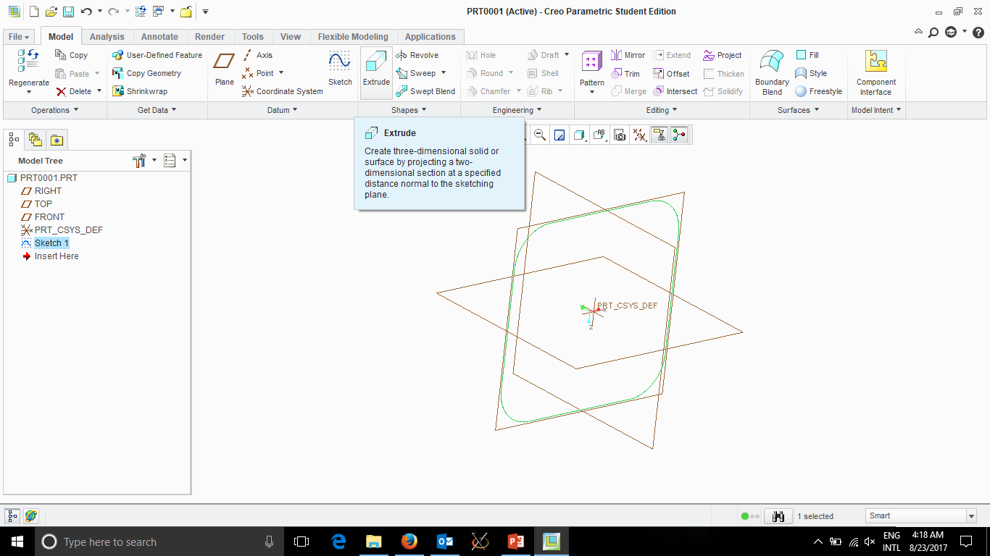
Now click ‘Extrude’
To add 3rd Dimension

Slide 20
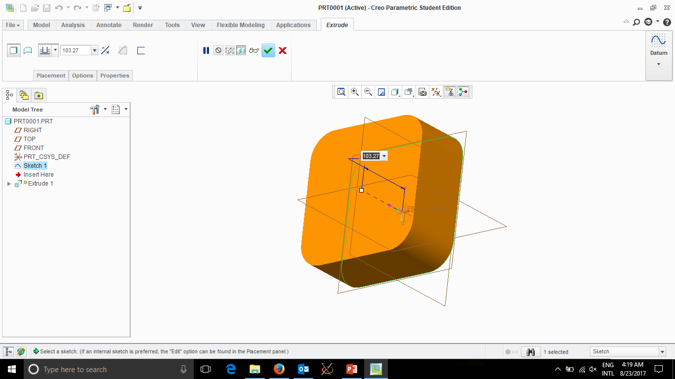
Remember your Reactangle Width/Length

Slide 21
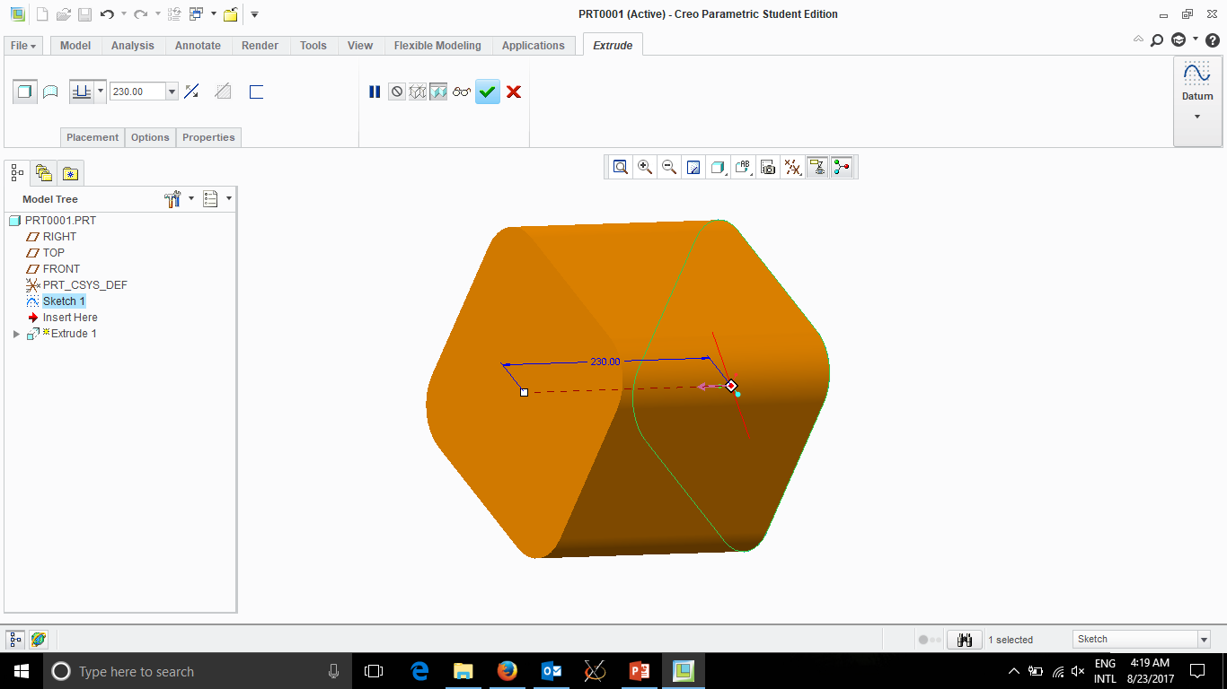

Slide 22
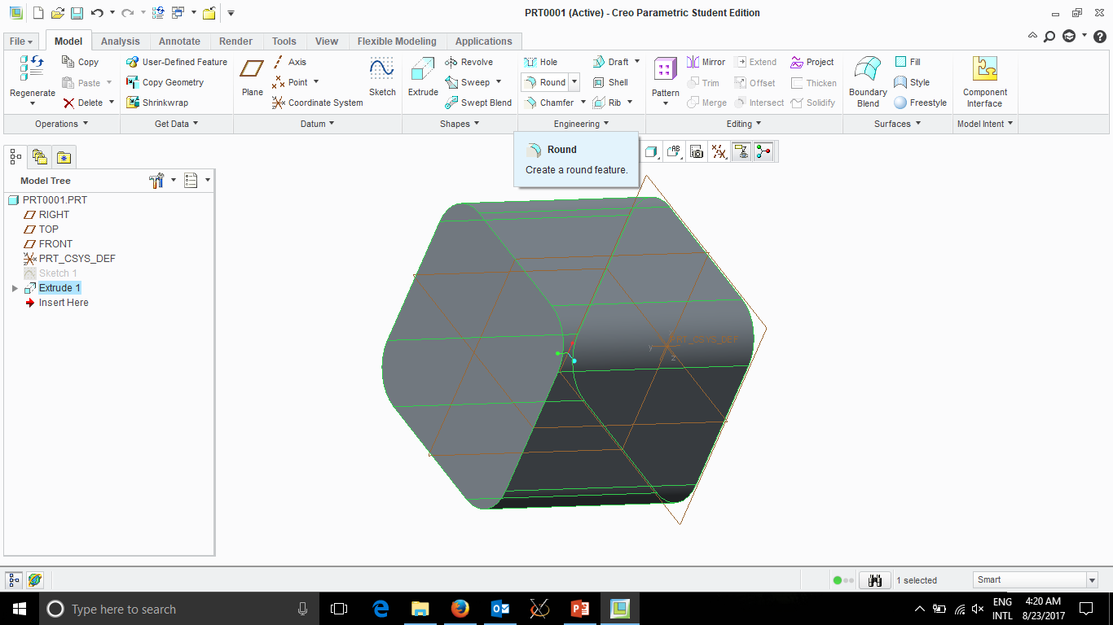
Round Corners

Slide 23
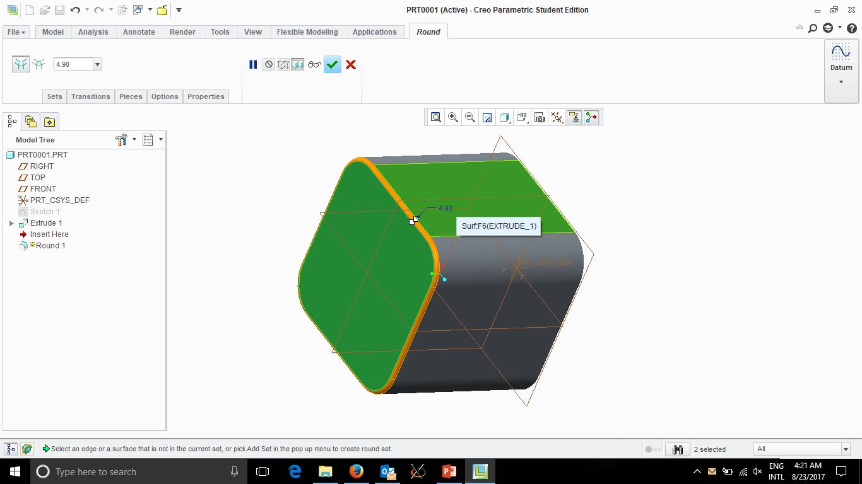
Hold ‘Ctrl’ key down and
Click on 2 adjacent sides
Then click Middle Button
Also select Radius
Then Rotate Cube (Middle Button Drag)
And do the same on the other side

Slide 24
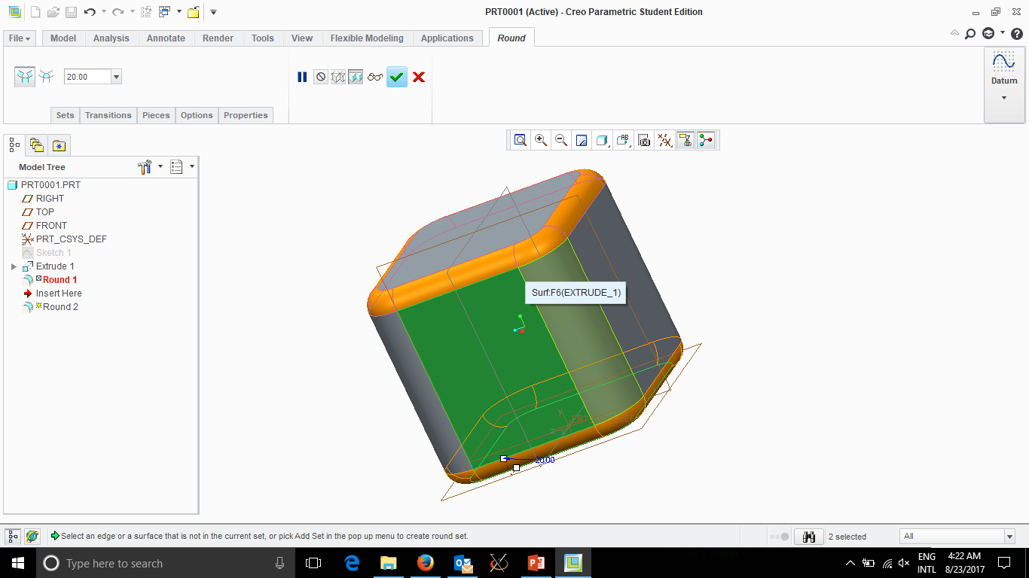
Then Rotate Cube (Middle Button Drag)
And do the same on the other side

Slide 25
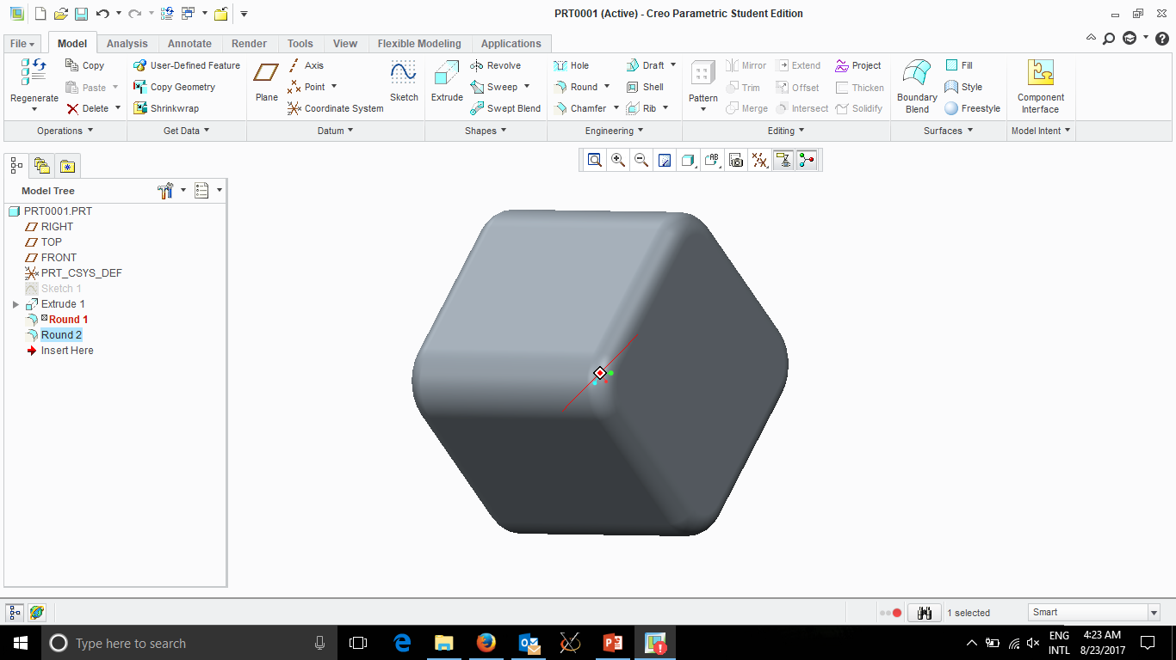

Slide 26
Creo Parametric Exercise ‘Variable Section Sweep’

Slide 28
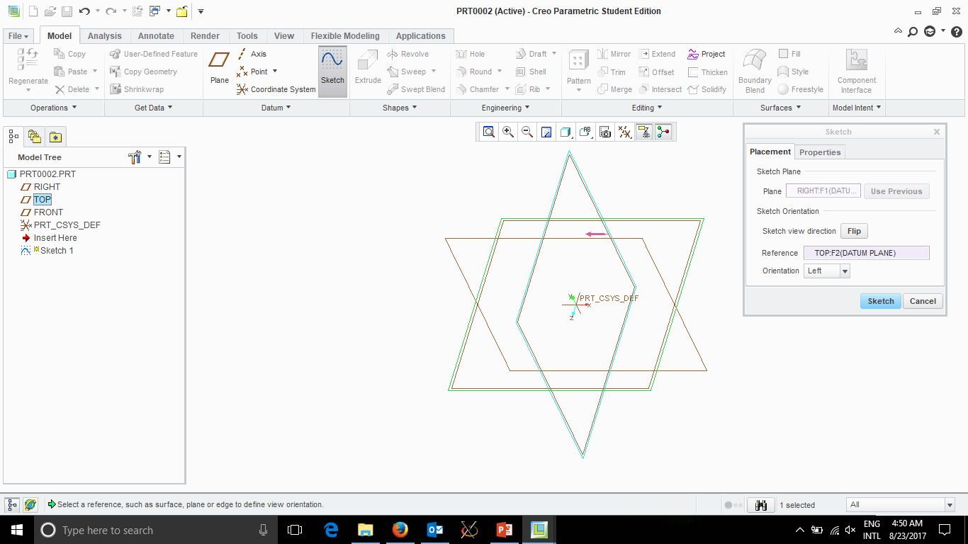
New Sketch
RIGHT Plane

Slide 29
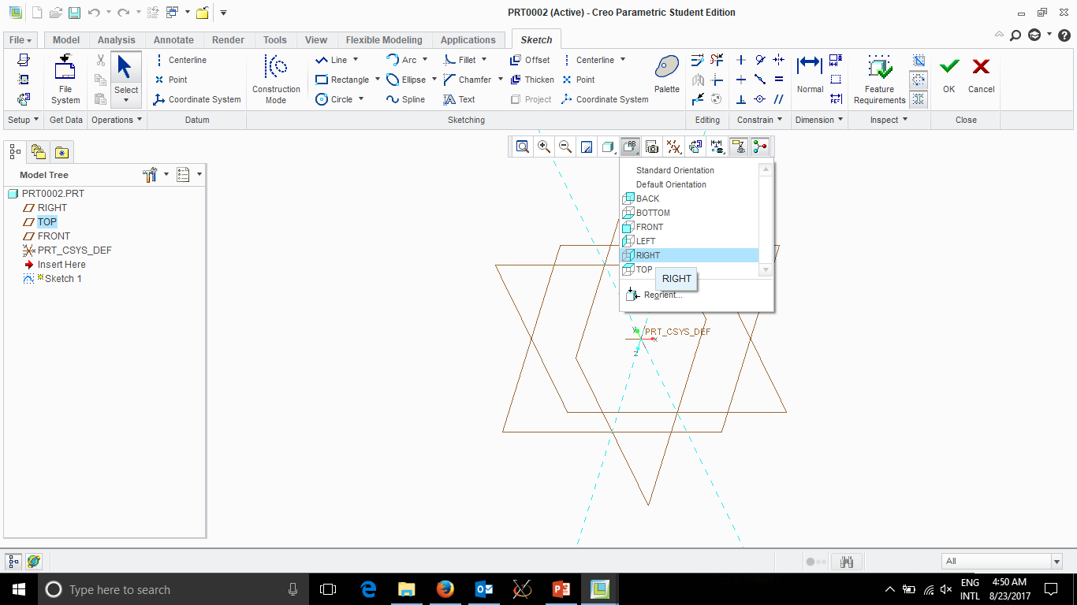
Change View to
RIGHT

Slide 30
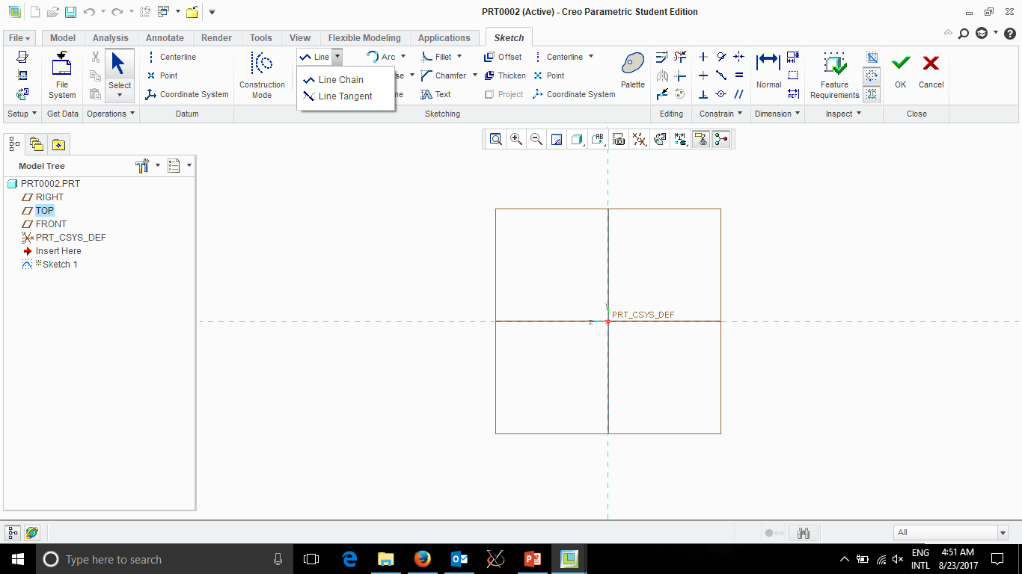
Draw Line on
X-Axis

Slide 31
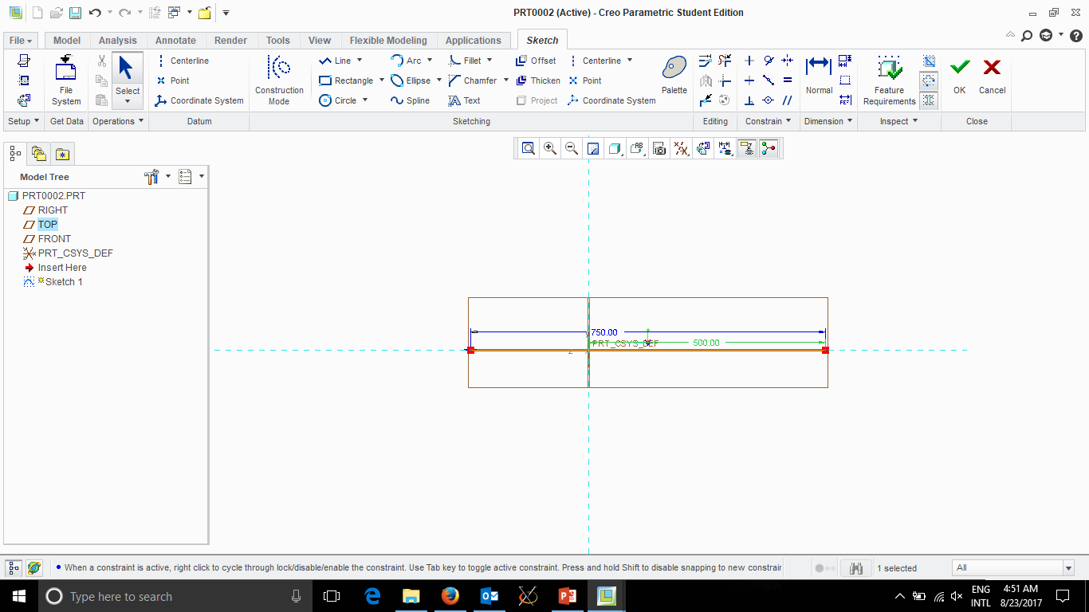
Change Dimensions to 750.00 Total and
250 front (or 500 back)

Slide 32
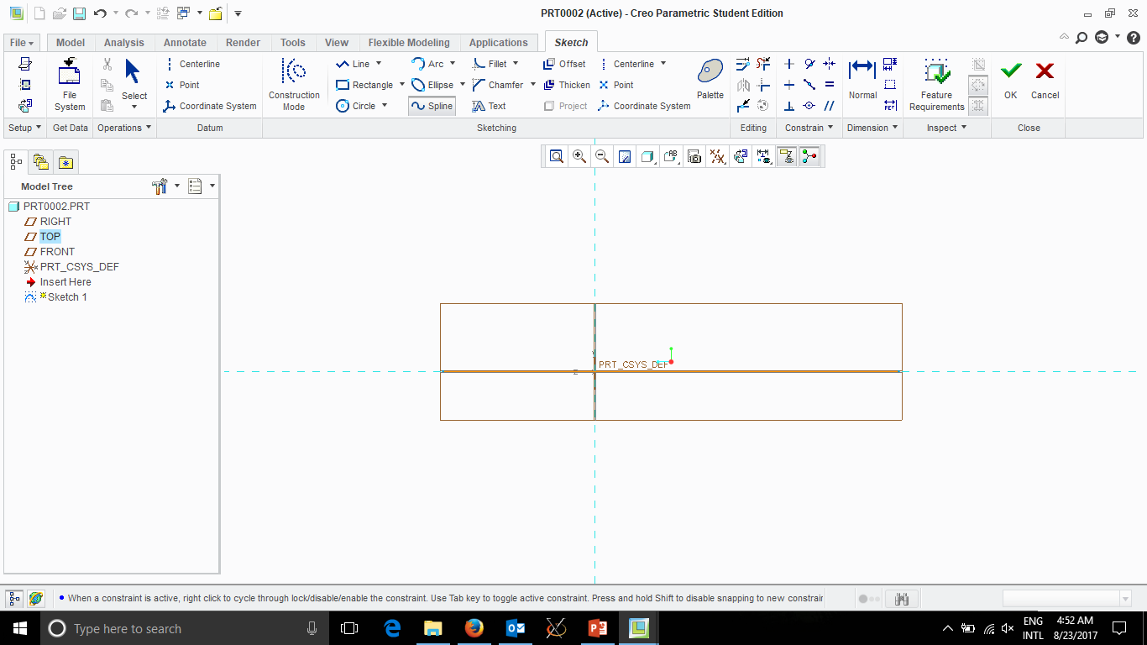
Draw 2 Splines for
TOP and BOTTOM of
airplane

Slide 33
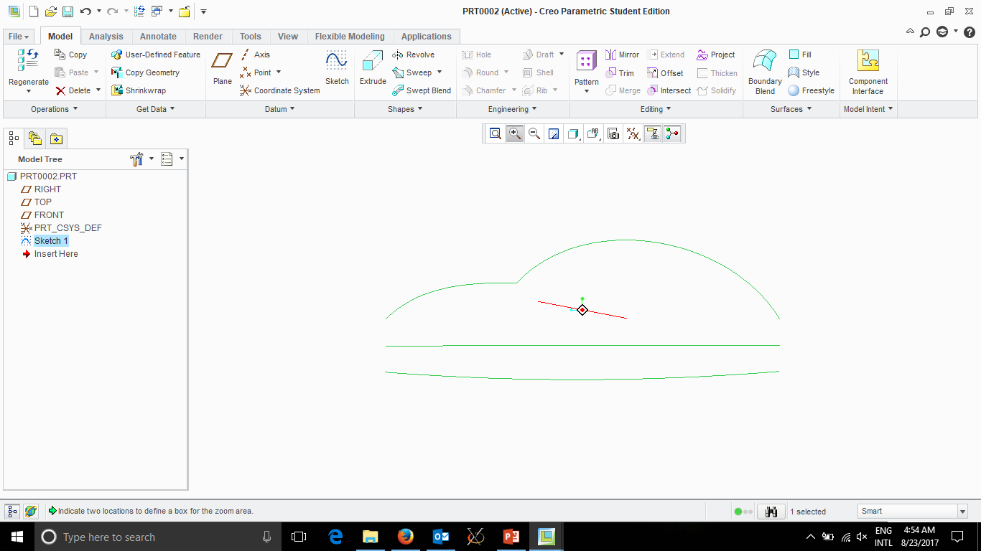
Bottom is singe Spline
Top is first part (then Middle click once)
Then add second part
Click ‘OK’ top right when done

Slide 34
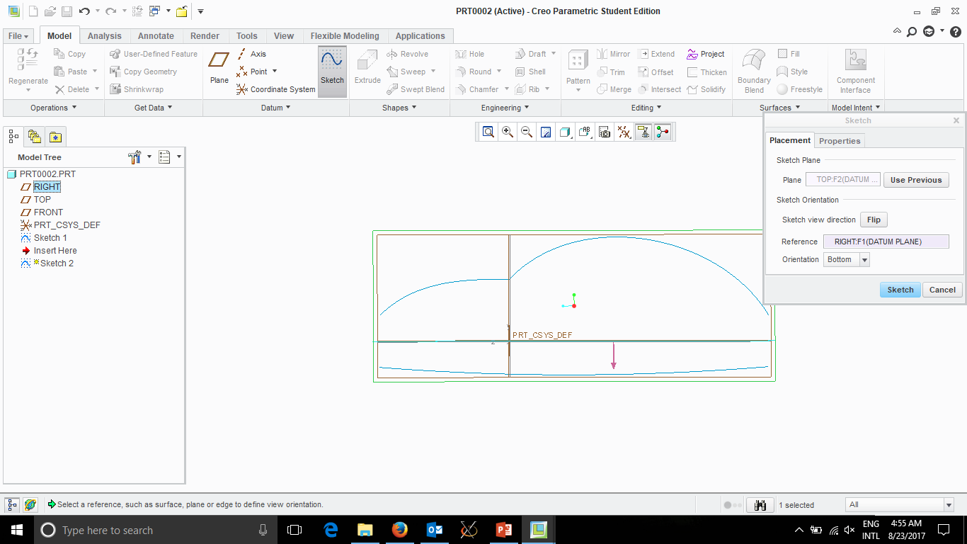
New Sketch
TOP Plane

Slide 35
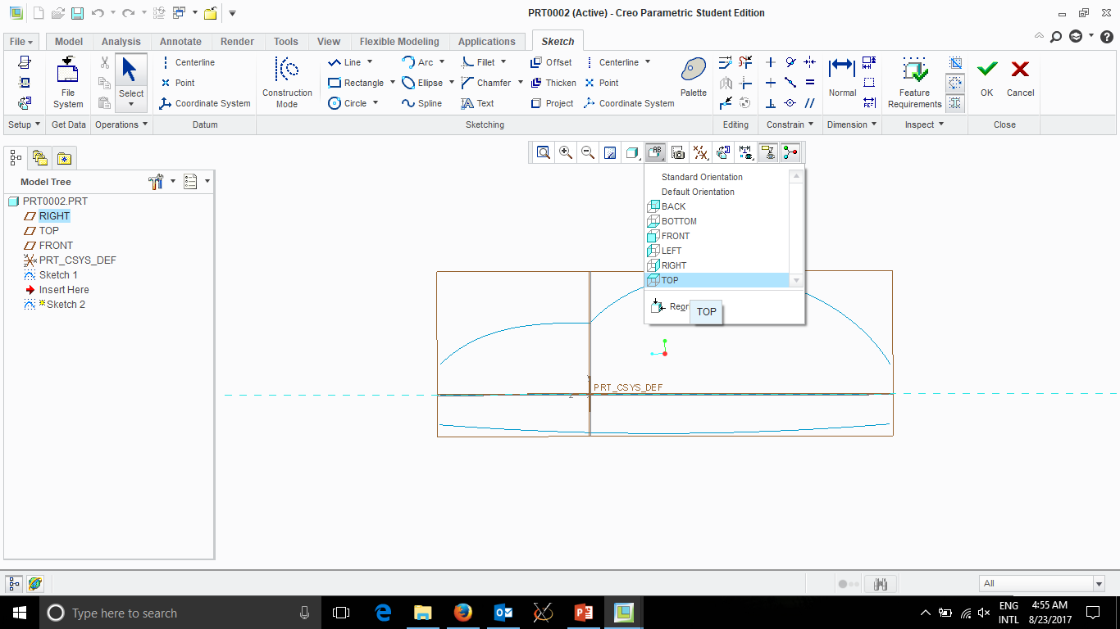

Slide 36
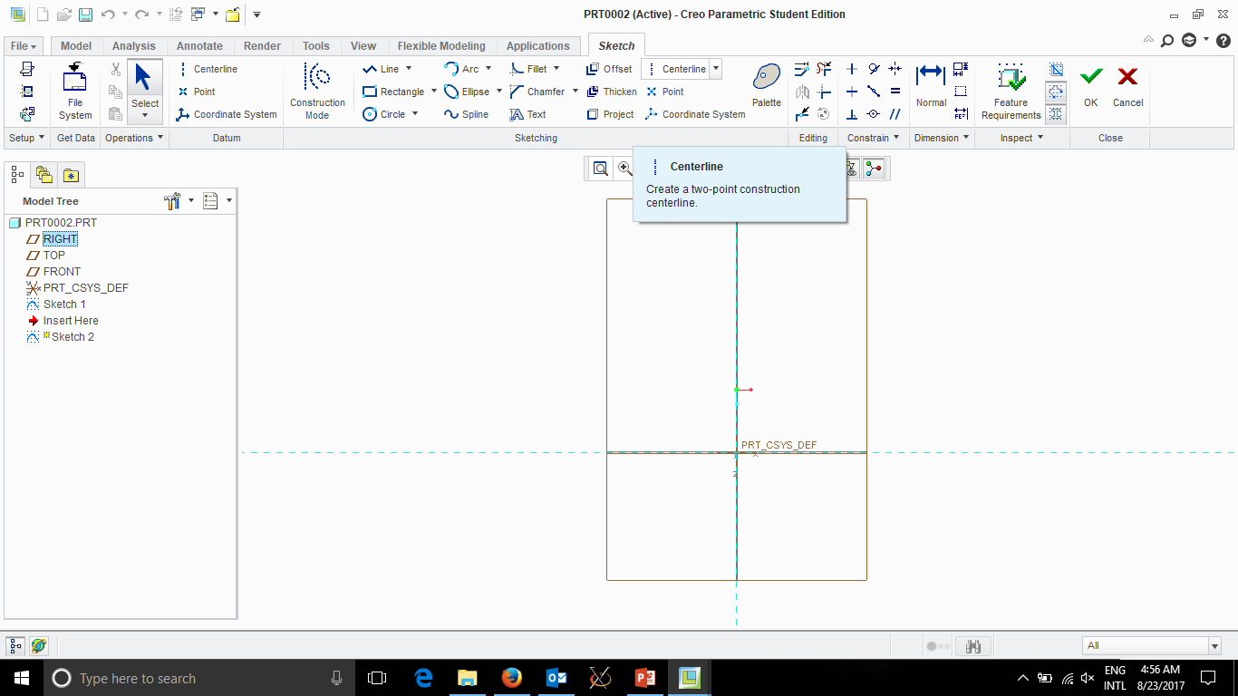
Draw CENTERINE
Down middle

Slide 37
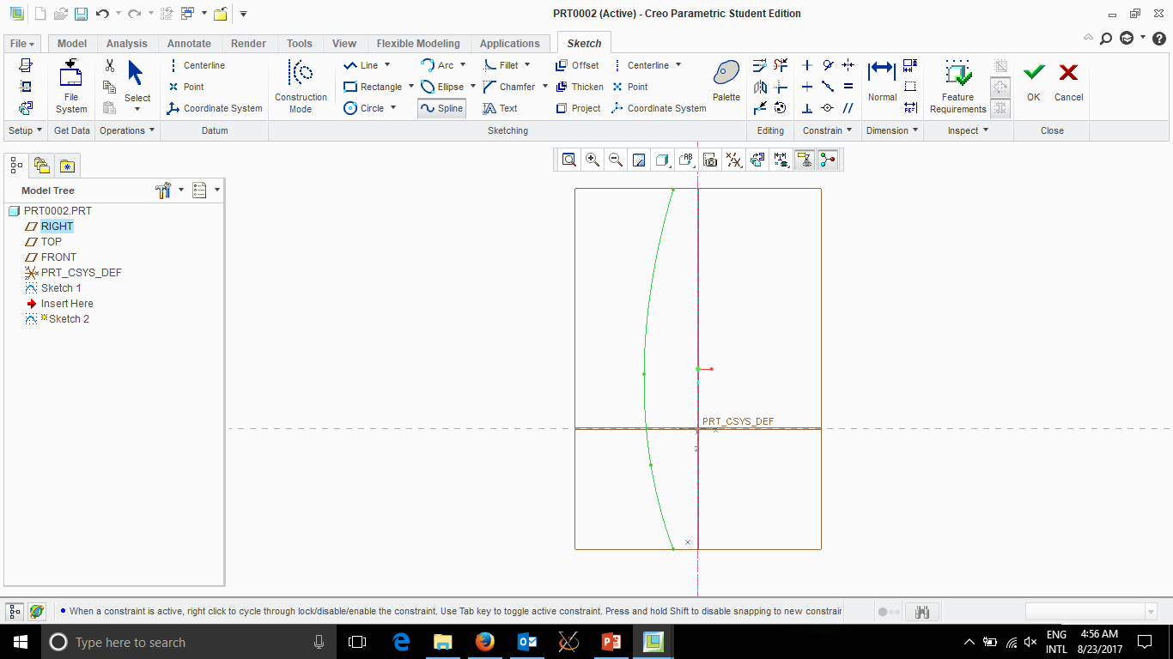
Use Spline to
Draw left side
When done click
Middle Button
Once

Slide 38
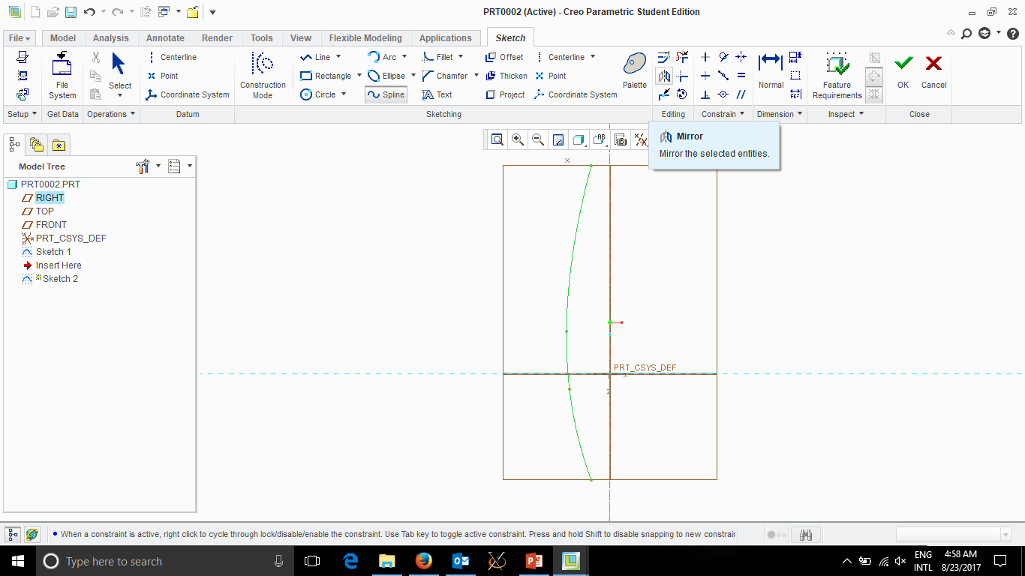
Click Mirror
And Select
Centerline

Slide 39
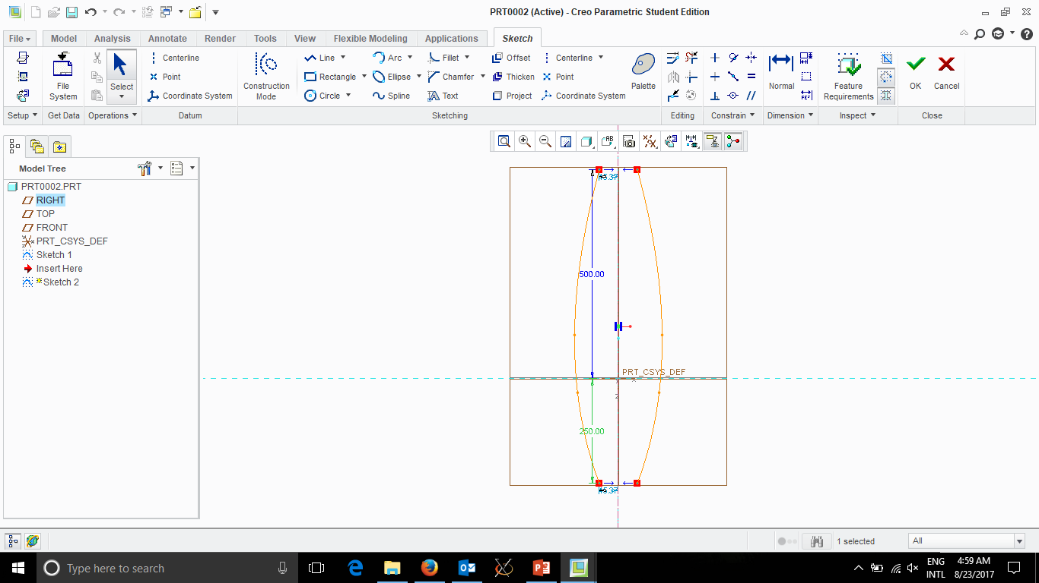
Click Middle Button
Adjust Dimensions to
500.00 and 250.00

Slide 40
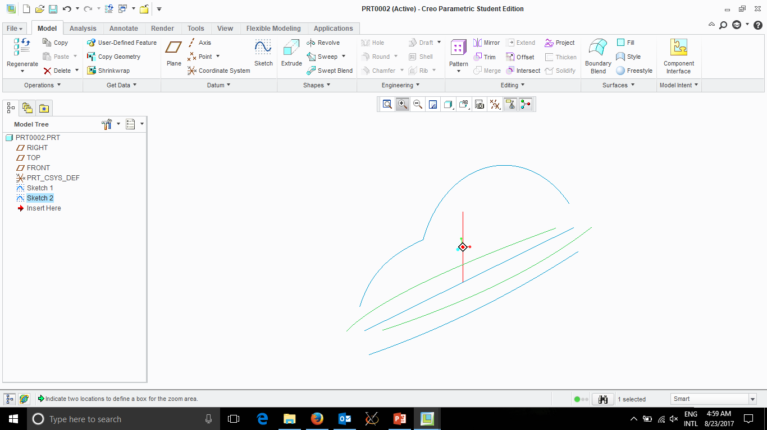

Slide 41
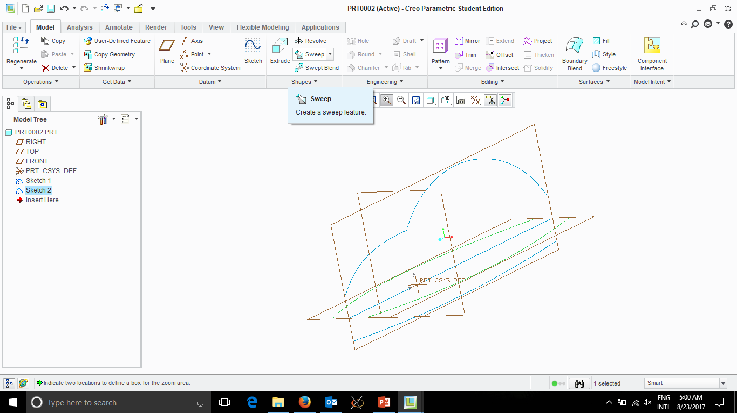
Select SWEEP

Slide 42
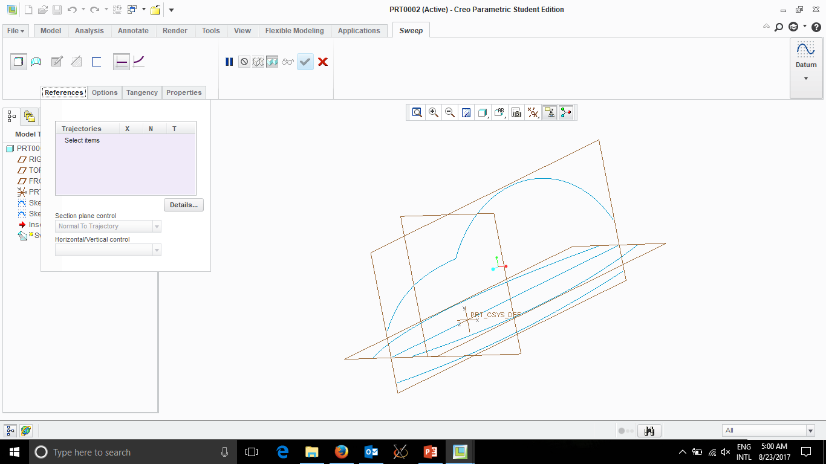

Slide 43
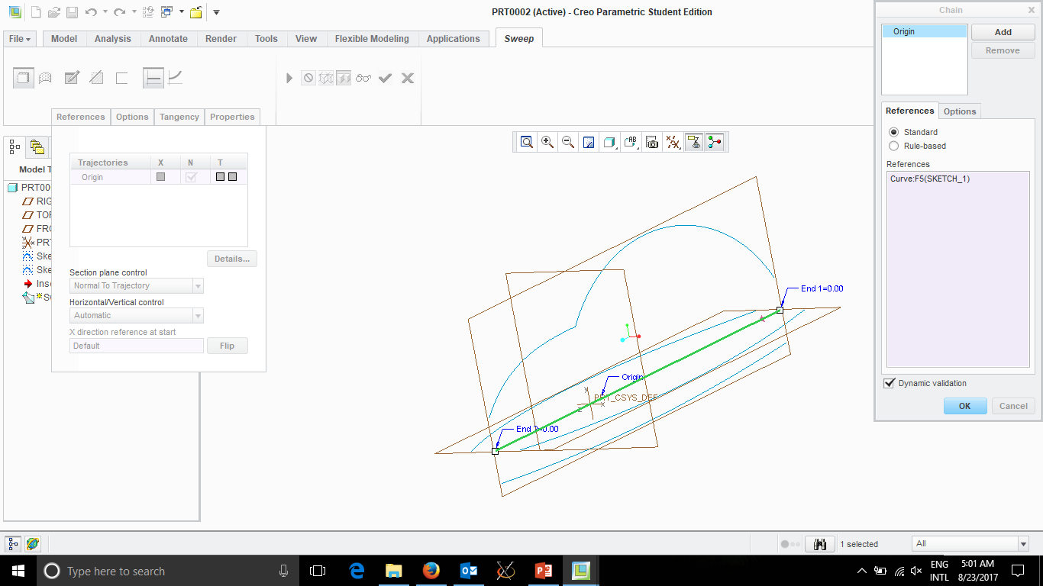
Select Centerline First
Then click Add for each other line like
BOTTOM
LEFT
TOP
RIGHT
BOTTOM
(Bottom 2X because 1st is X-Reference)

Slide 44
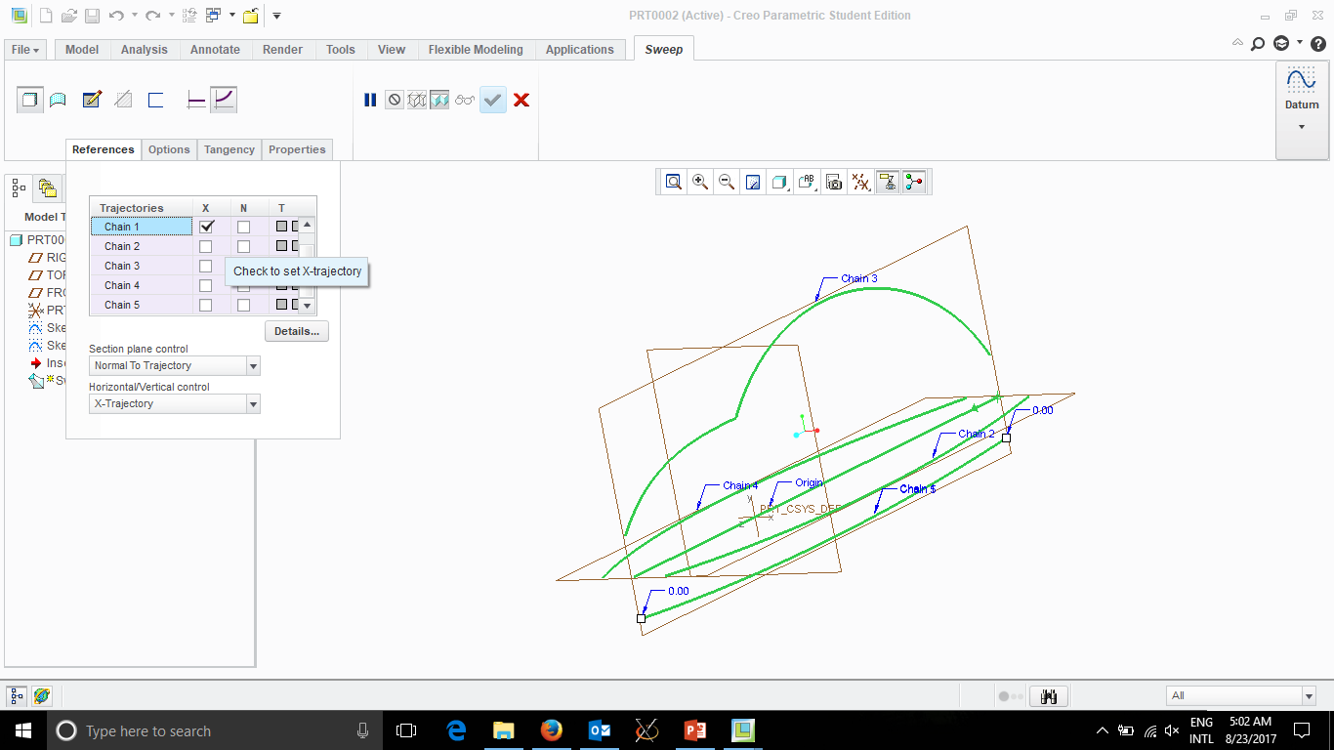
2. Enter sketch mode
1. Select Chain 1 to be X-Reference

Slide 45
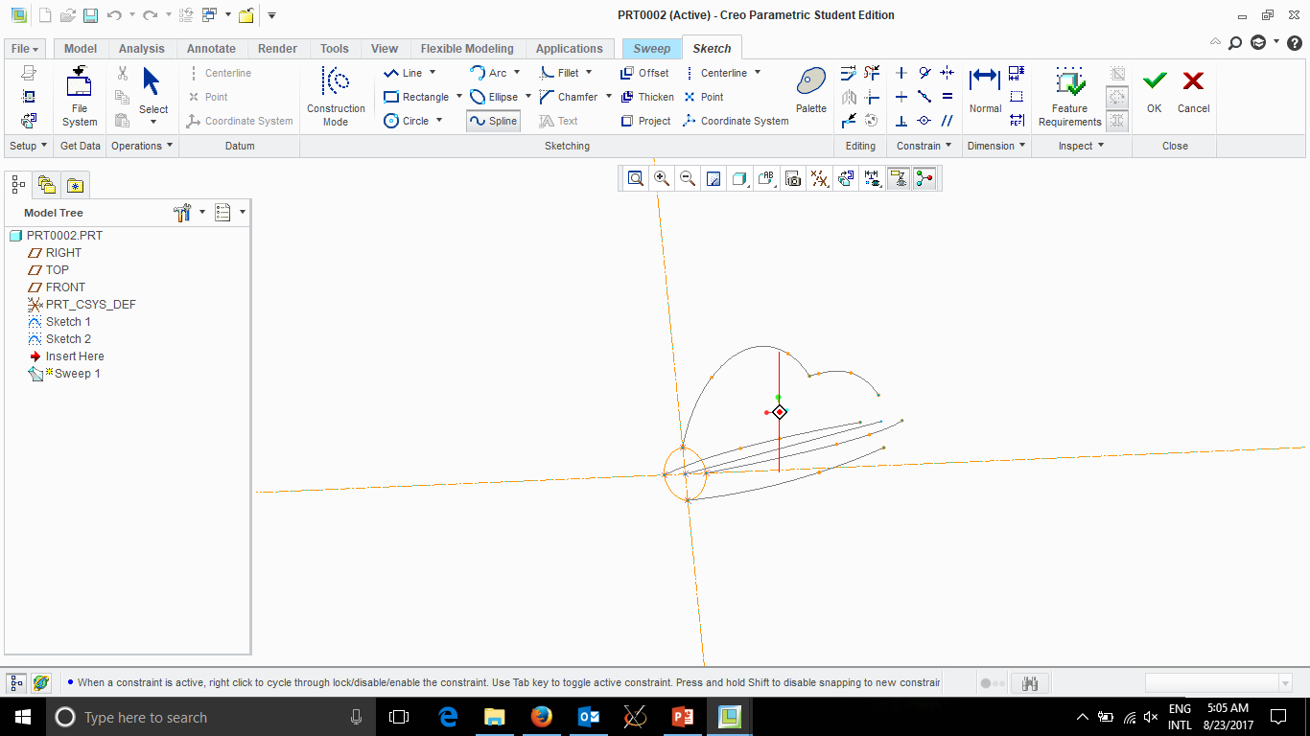
Use Spline to connect the front (or end)
4 pieces of your plane
(Hint: They are shown as ‘X’’s in Creo
When done middle click 1 or 2 times

Slide 46
