Slide 1
ਸਵਾਗਤ ਹੈ
ഹലോ
வரவேற்பு
ಹಲೋ
B-IRYANI!
హలో
سلام
ନମସ୍କାର
बिरयानी!
வணக்கம்
സ്വാഗതം
Notes:
Greetings! Biryani is a very popular food item in India, and so for no good reason, that’s where we are going to begin. (8 seconds)

Slide 2
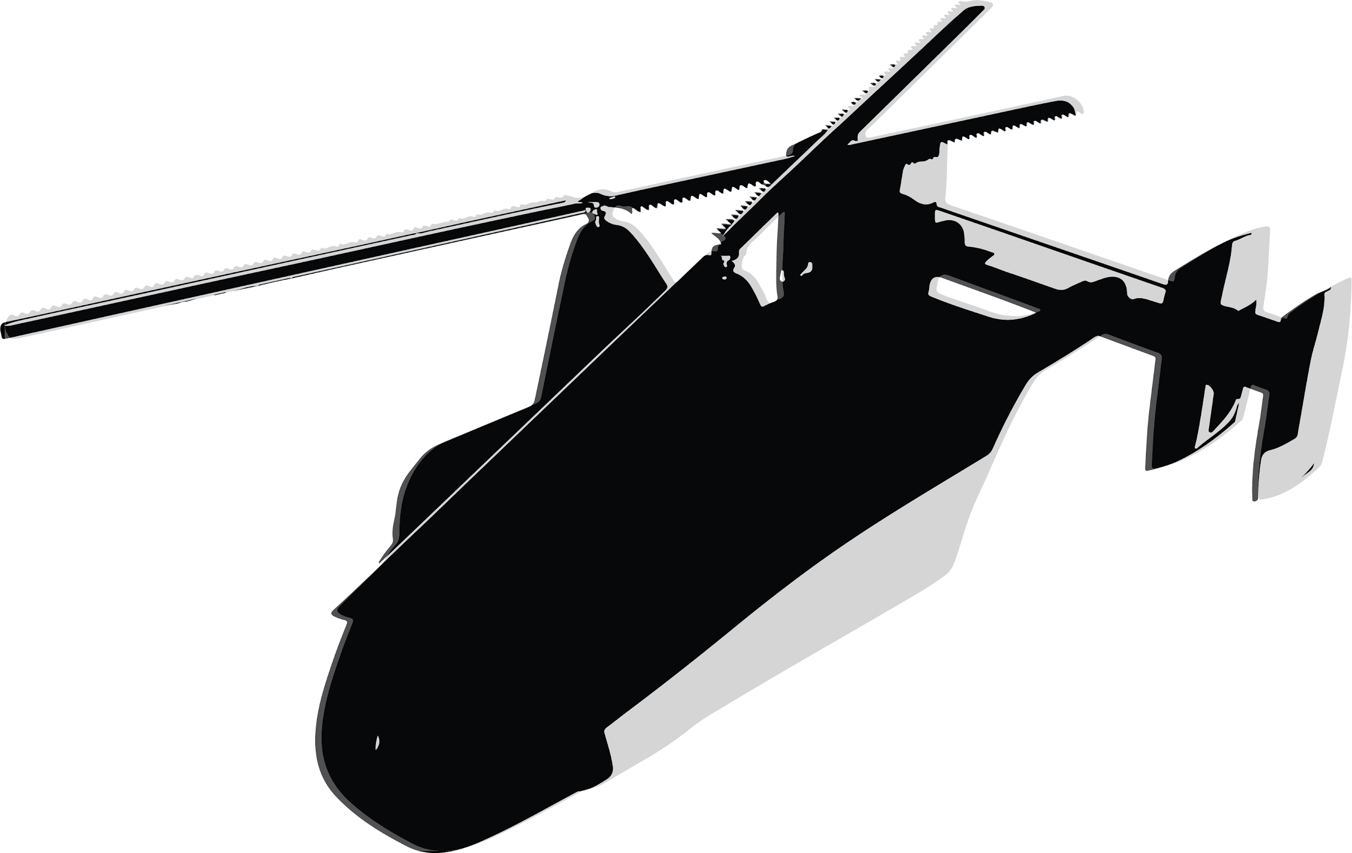
DRONE-ACHARYA
SAMARITAN AEROSPACE Inc.
Delhi Public School, R.K Puram, India
FY20 RWDC International Challenge
Q.S.I. International School
of Dushanbe, Tajikistan
Notes:
Welcome to this presentation. We are Samaritan Aerospace, and for this 2020 RWDC International Challenge, we present to you, Drone-Acharya! (9 seconds)

Slide 3
Team Formation
We also thank the following for their unwavering support:
Team
Aditya Swaminathan
Vinamr Loomba Sachdeva
Advitya Singhal
Aditya Rohan Sengupta
Ashvin Verma
Kushagra Gupta
Karan Handa
Anhad Singh Chawla
Om Gupta
Anhad Singh
Siddhansh Narang
Coach
Zohaib Ehtesham
Mr. Ajay Goel
Notes:
Our team consists of Aditya Swaminathan, project manager and scientist, Advitya Singhal, CAD specialist Ashvin Verma, systems engineer Karan Handa, scientist Om Gupta, researcher Siddhansh Narang and Business and Costs Analyst Zohaib Ehtesham. We were also assisted by several senior members of Aeross, the Aerospace Society. We had no mentors. Our coach is Mr. Ajay Goel.

Slide 4
Overview
Problems with existing delivery systems.
Key design features of the solution.
Design process and rationale.
Systems components.
Design analysis.
Concept of operations.
The business case.
Notes:
This is an overview of our presentation. As you can see, we will be covering all aspects of the challenge from engineering to business, justifying every decision we made and trying to convince you that ours is the solution you need. (12 sec)

Slide 5
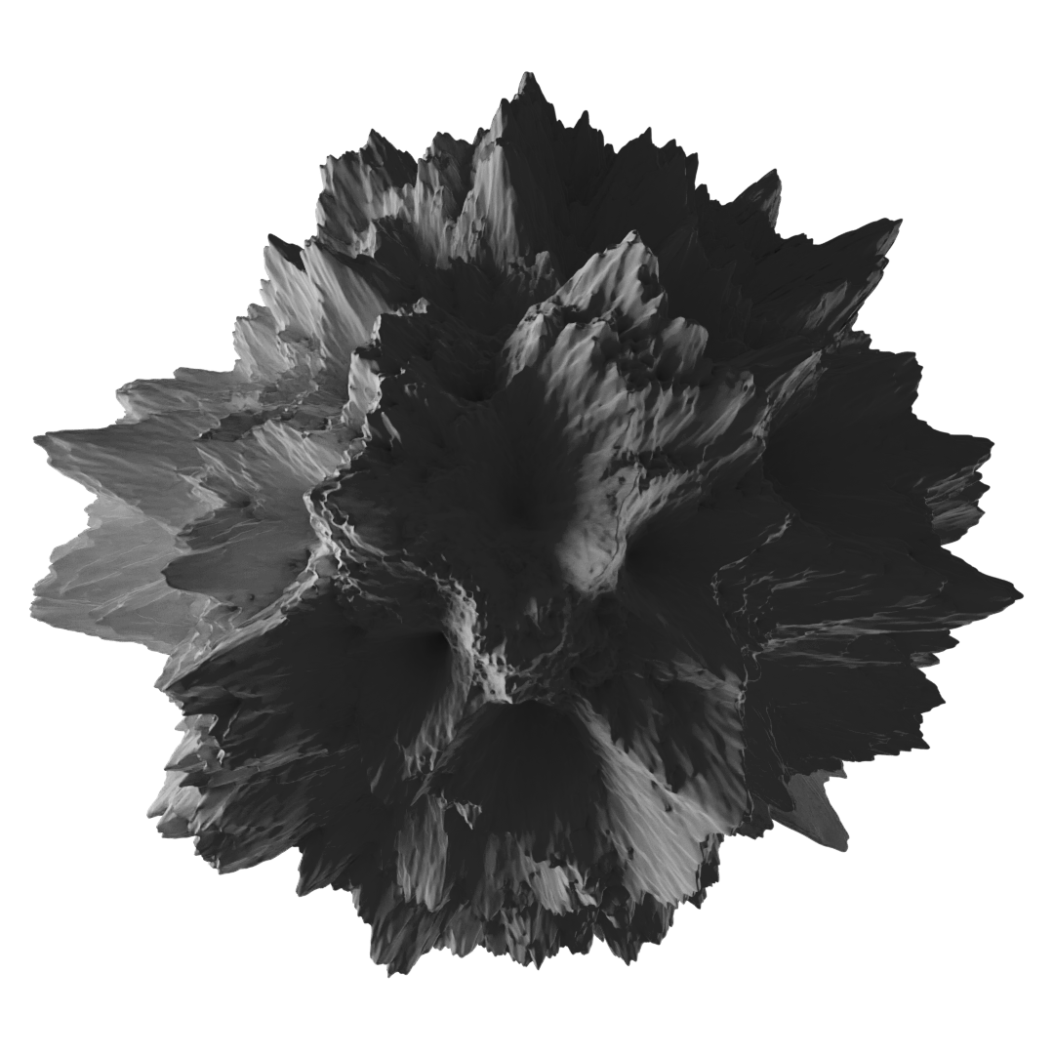
Background
Notes:
We will start by shedding some light on the overlying metropolitan situation.

Slide 6
Most companies rely on a manual delivery system to deliver their products to customers.
[1]
Notes:
Most companies employ, directly or indirectly, individuals on 2-wheelers or delivery trucks or vans, to provide services at home.

Slide 7
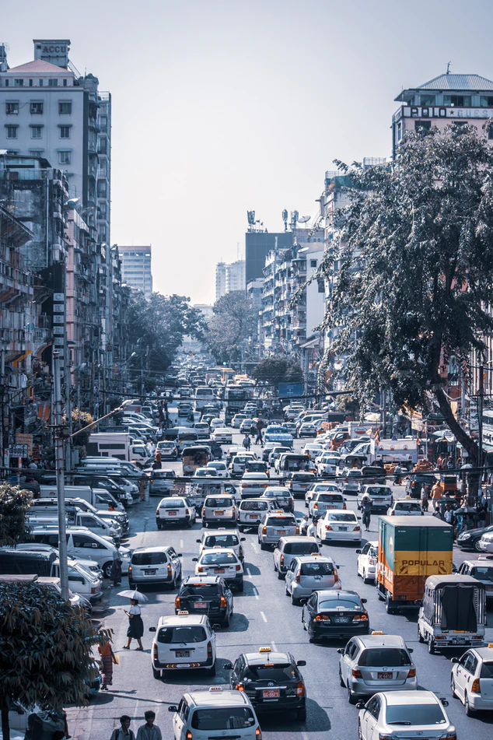
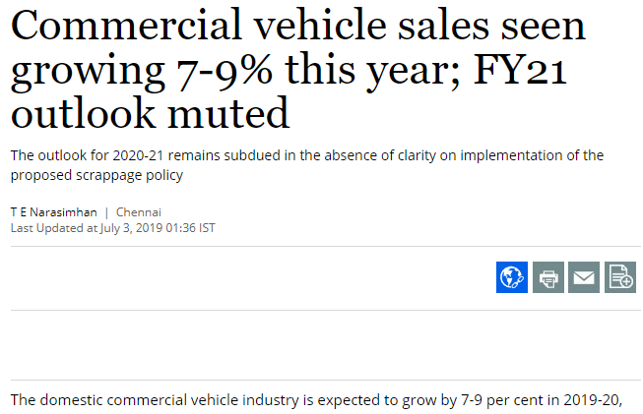
[2]
[3]
Increase in commercial vehicle sales has led to rise in traffic in metropolitan areas.
Notes:
The sale, and hence traffic, of commercial vehicles has been on the rise in recent times.

Slide 8
[4]
This commercial traffic causes widespread pollution in public areas of cities, reducing quality of life.
[5]
Notes:
A part of this traffic is delivery vehicles. With e-commerce and the delivery business on the rise, this is likely to soon become a serious problem.

Slide 9
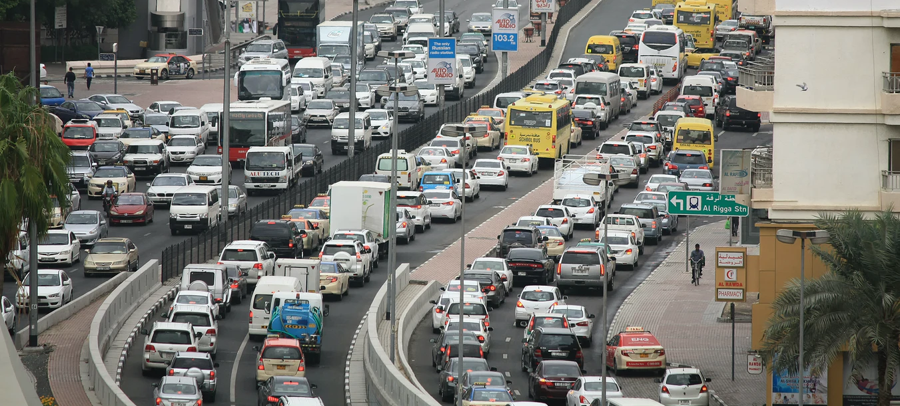
[6]
This increase in traffic, also increases the number of jams and slows the pace of traffic, further contributing to pollution.
Notes:
The increasing traffic congestion causes inconvenience and adds to air and noise pollution.

Slide 10
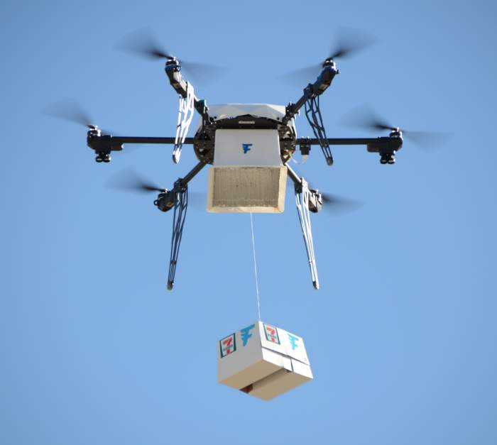
This Year’s Challenge
[7]
This year’s challenge the development of a UAS (Unmanned Aerial System) for package delivery.
It requires careful designing of aerial and ground elements that account for the challenges of delivering in an urban area.
The business case is an important aspect of the challenge.
Notes:
This year’s challenge has put us up to solving this very problem. The aim is to take to the skies and shift the delivery business to unmanned aerial systems. These are to be be sent from a central hub to deliver in a 8*8 km area. We are not required to meet FAA regulations, but instead a set of rules including a 25 kg total mass limit and the requirement of having the capacity for an extra 15 minutes of flight.

Slide 11
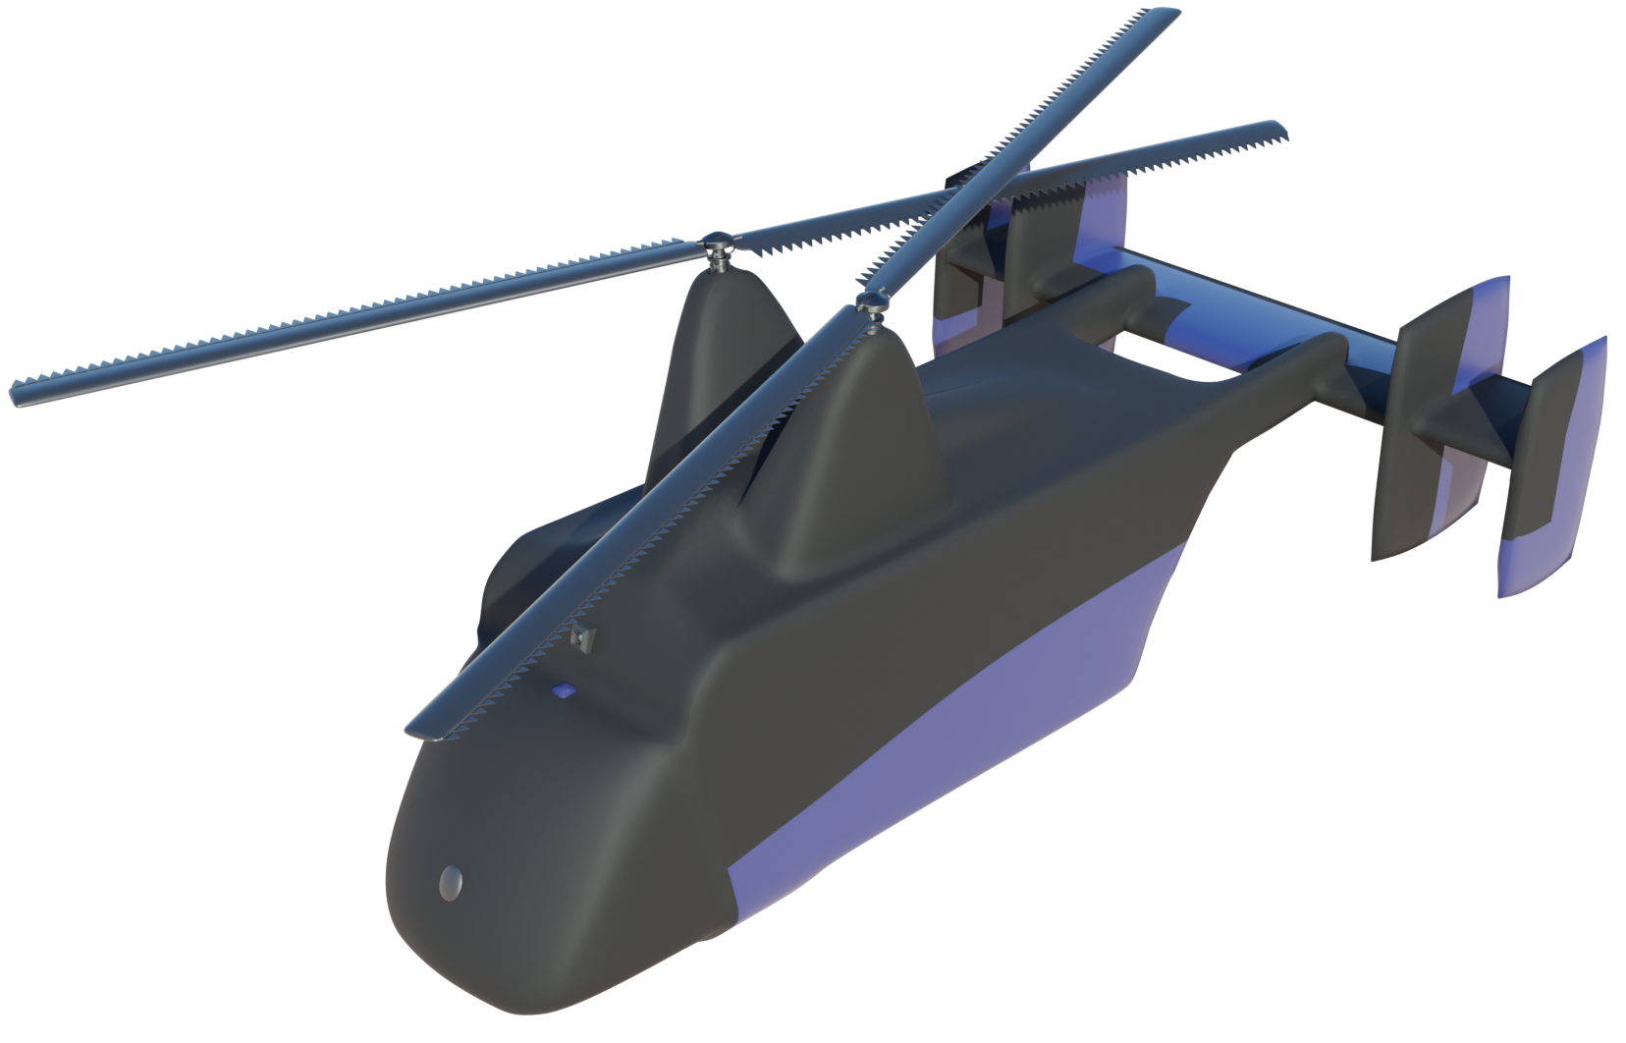
Our Solution
Intermeshing rotors provide high efficiency and, along with rotor blade spoilers, unparalleled noise reduction.
Capable of carrying three packages (a total of 15 kg) as payload.
Excellent navigation and obstacle avoidance systems for urban operations.
Quiet and safe- can be accepted by city residents.
Notes:
Our solution, Drone-acharya, is a system based on heavy-lifting to increase efficiency by the employment of intermeshing rotors. It has excellent subsystems designed specifically for urban operations. It has several features that will eventually result in acceptance and assimilation into urban life.

Slide 12
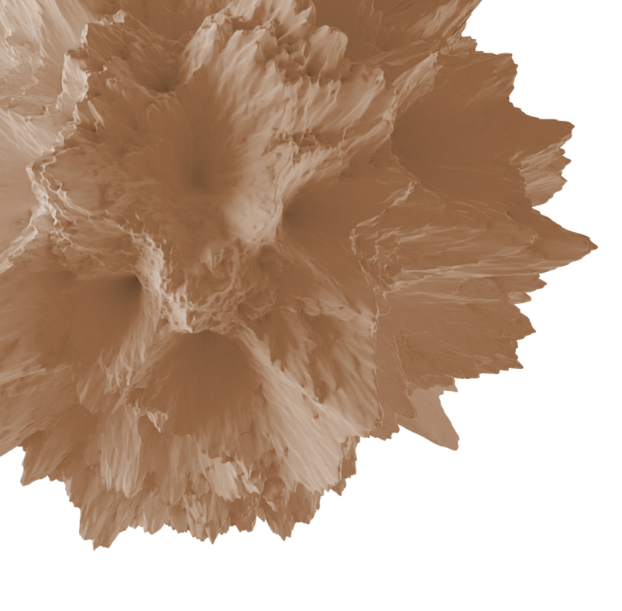
Design Rationale
Notes:
Here, we will attempt to provide rationale for the design choices we have made and demonstrate the effectiveness of the system.

Slide 13
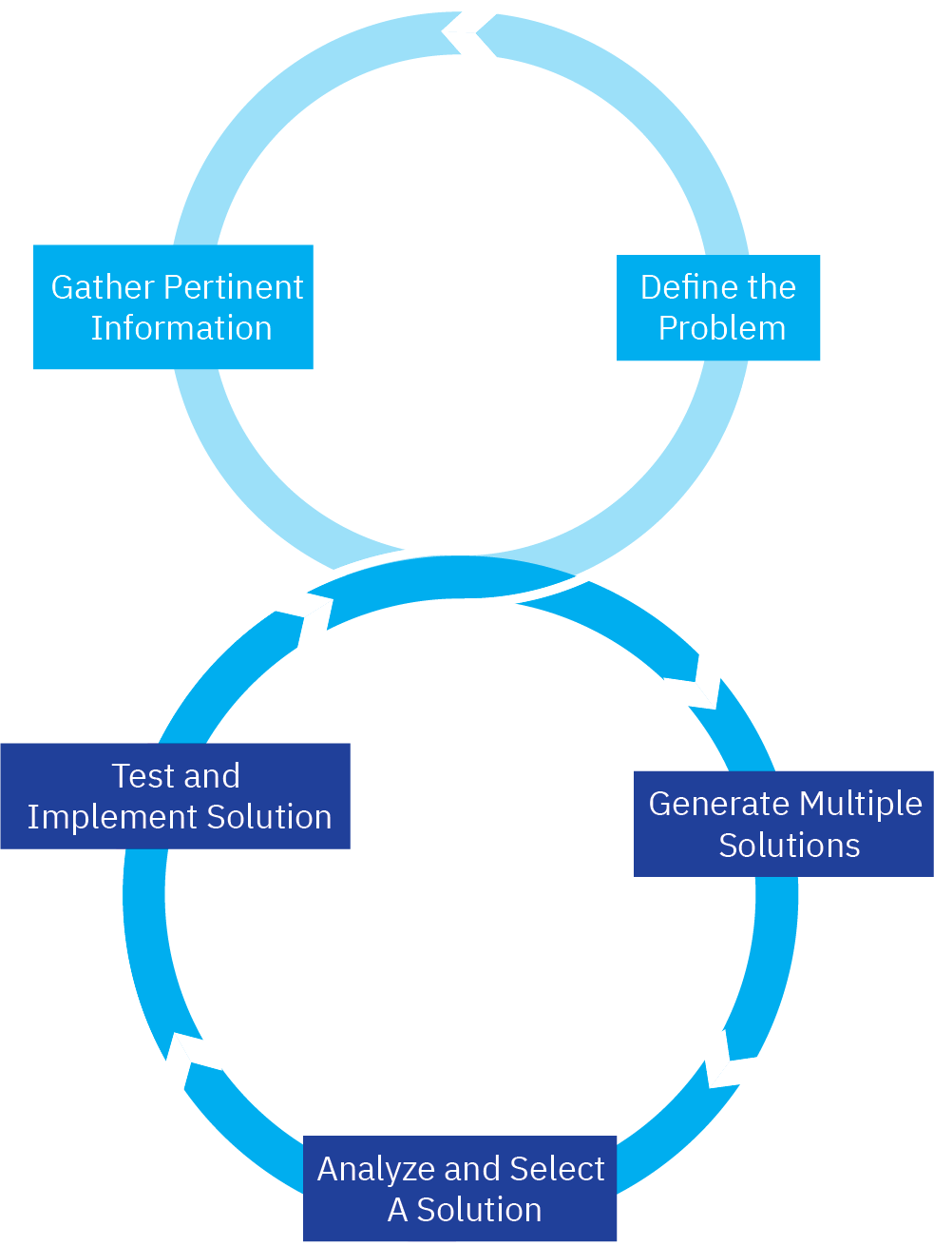
Engineering Design Process
Phase 1: Conceptual Design
Understanding the challenge,
consideration of designs
Phase 2: Preliminary Design
Further design considerations and research on proposed designs, and entire project
Phase 3: Detailed Design
Finalising aspects of designs, and project as a whole
Notes:
To start with, we would like to show the design process that we followed. We understand the problem, research and find solutions and finally narrow down the choices. This we repeat at all levels of detail for solving each problem. The biggest strength of this process is its simplicity and yet great effectivity.

Slide 14
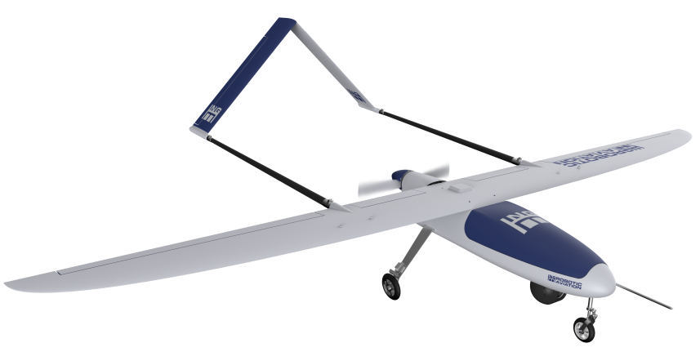
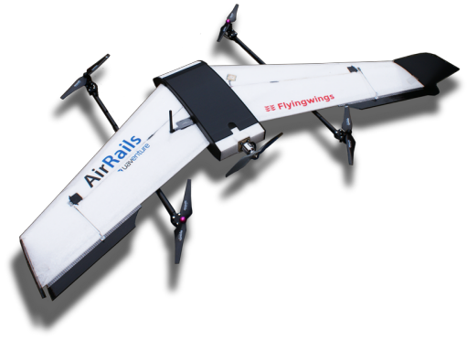
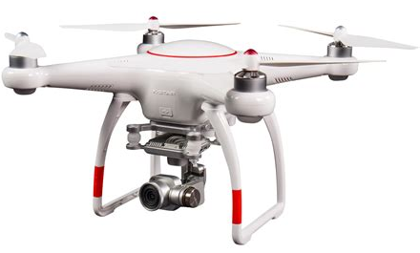
Designs Considered (Conceptual)
[8]
[9]
[10]
[11]
Notes:
We considered all the main common basic designs. Firstly, kinetic energy is half mass times velocity squared, which means that increasing the velocity costs more energy than increasing mass, and thus slow and heavy is the way to go. The fixed wing is extremely effective, but loses out on its lack of maneuverability and the problem with landing in small areas (the alternative being dropping which needs additional equipment). The common multirotor lacks on weight carrying capacity, efficiency and stability. Hybrids have the advantages of both fixed wings and multirotors, but also the disadvantages of both, along with greater complexity. Another original design was proposed, which involved a single rotor whose thrust was vectored from four points, but abandoned due to a lack of real world testing. Finally, the single rotor with variable blade pitch was chosen. It is stable, can lift heavy weights, is maneuverable, is capable of VTOL, and can safely land using autorotation in case of motor failure.

Slide 15
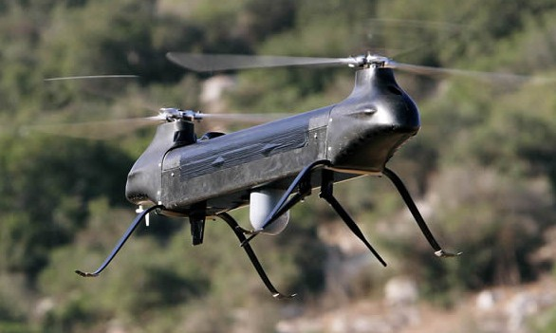
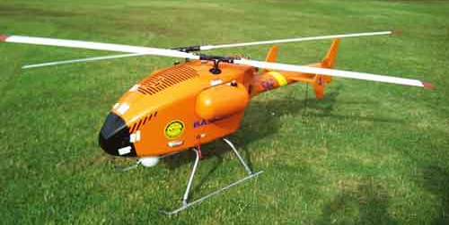
Designs Considered (Preliminary)
[12]
[13]
Notes:
Later, we realised that the though the single rotor was better than the designs considered during conceptual design, it was still not ideal. We realised that the aim, by the ½ mv^2 argument was lifting larger weights. In a single rotor, a tail rotor is required. This reduces lift efficiency compared to power consumption, adds additional mass, and required more wiring and strengthening on the tail. Twin rotors like in the chinook solve part of this problem but increase the size of the UAV and the risk due to the larger areas swept by the blades. The solution to this is to bring the rotors close together and tilt them in an intermeshing rotor design like in the Kaman Kmax. The rotors are tilted and synchronised to prevent collision. The system also has other advantages such as lower noise emission.

Slide 16
Design Refined
[14]
Notes:
Over time, as we developed the design, we realised it bore a remarkable similarity to the Kaman Huskie. In fact, other than a few modifications, the Huskie fits perfectly. In fact, a UAV version of the Huskie, called the QH 43, has been built. All this provides a lot of verification for the design choice. In fact, aerodynamically, the design has been tested theoretically and over years of service to an extent beyond the scope of this challenge. However, nothing scales down perfectly, so a lot of calculations and simulations were done, and changes made. Mostly, though, the design is a scaled-down version of the Huskie.

Slide 17
Final Design
Notes:
This is the final design of the UAV. It differs from the Huskie in terms of the shape of the rear and a hole in the bottom through with packages are dropped. Its rotor blades have the same airfoil as the Huskie, though shosen not for purely that reason and put through a detailed analysis. The rotor blades also have spoilers to reduce noise. It can carry three 5 kg packages, and cruises at 26 m/s. It runs on an electric motor.

Slide 18
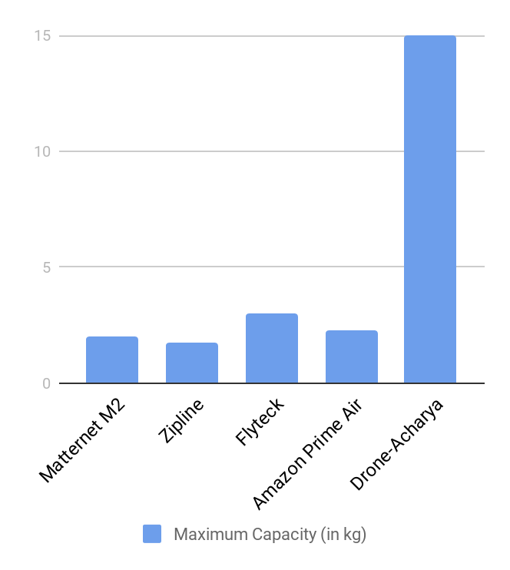
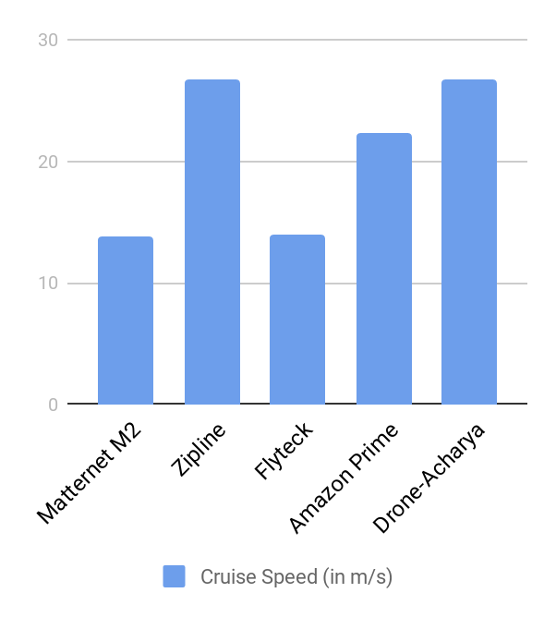
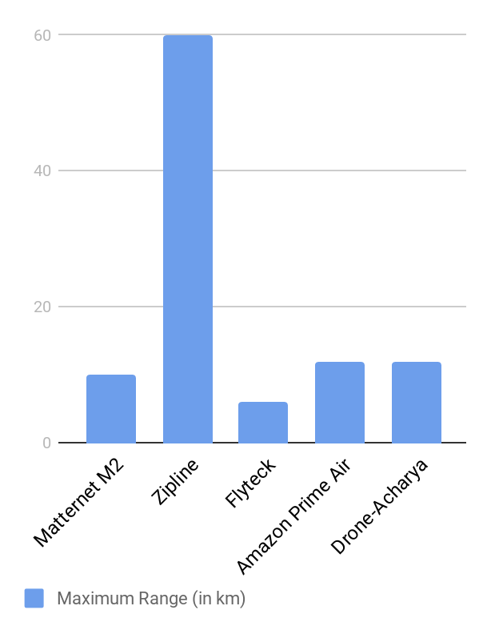
Comparison with other air-based delivery services
Notes:
Here, we have compared the design to other aerial package delivery services. As we can see, it completely wins out on maximum capacity, because that was a design aim. In terms of speed, it keeps up and has a close cut with zipline. It lags behind in range, but that is because it was designed to function within limited surroundings. Otherwise, though, it can be observed that it it is an excellent system relative to others based on UAV performance.

Slide 19
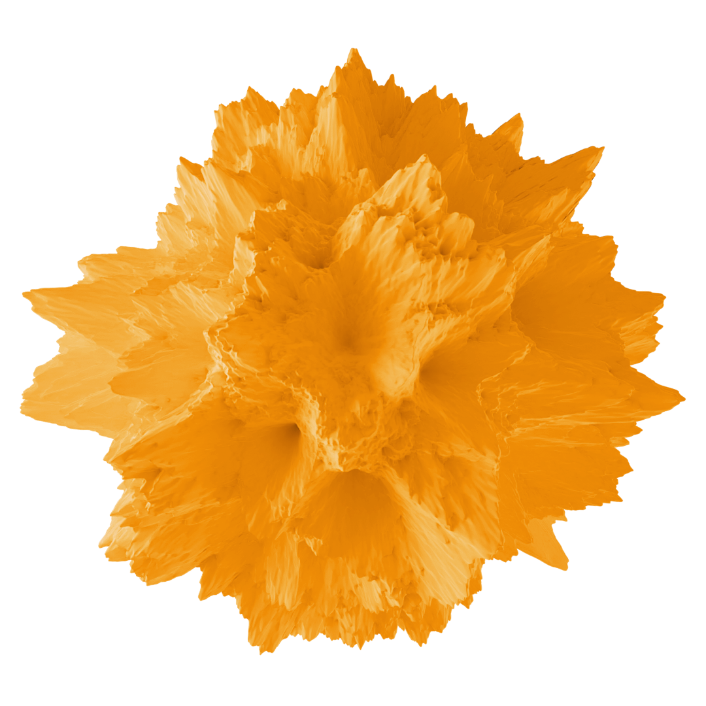
System Components
Notes:
Here, we will describe the capabilities of the various system components, the role they play in the design, and why they have been chosen.

Slide 20
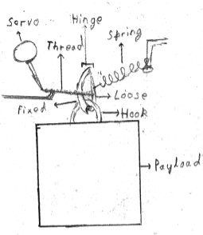
Payload
Three packages suspended sides by side from release mechanisms.
Connected via hook on top to hinge
Hinge connected to loose part connected to thread
With anticlockwise movement of servo, the thread is released, thus opening the hinged part and releasing the package.
Notes:
Three packages are suspended side by side, each from a payload release mechanism. The mechanism has a hook with one loose hinged side. The hinged side is held by a spring, but the spring is stretched due to a thread pulling the mechanism from the other side. The thread has a metal end like a tape measure’s end, which is held back by a ledge. As soon as a servo releases this end, the thread goes loose, allowing the spring to pull back the hinged side of the hook, and the package is released.

Slide 21
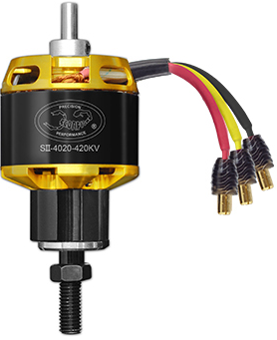
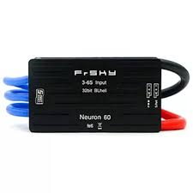
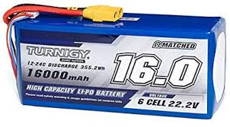
Motor, Battery, ESC and battery charger
[16]
[15]
Scorpion SII-4020-420KV motor provides the required 1.5 kW peak continuous power output and the necessary torque, but is also very light.
Turnigy High with capacity 16,000mAh battery is used. It can provide enough power to run for 30 mins*.
The FrSky Neuron 60 BL-32 will be used to because of the versatile UBEC capability.
The The ISDT T6 BattGo ,with it’s 30A output,it can charge a fully discharged battery in 40 mins.
[17]
*All the electronic calculations are done considering dissipation of energy as heat.
Notes:
The motor has been chosen to fit power and torque requirements, and the battery to power the motor and electronics. The ESC also also provides a configurable battery elimination circuit. The The ISDT T6 BattGo can charge a fully discharged battery within 40 minutes.

Slide 22
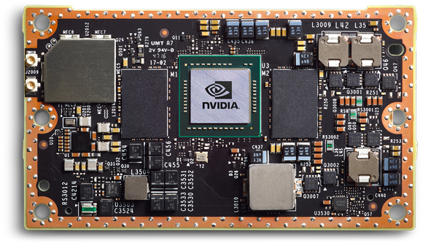
Main Computer- nVidia Jetson TX2
Fast and power-efficient, rated at 7.5W
8 GB RAM, 256 CUDA cores with NVIDIA Pascal™ GPU architecture.
Quad-Core ARM® Cortex®-A57 MPCore and 32 GB Storage
Firmware is supported by Linux.
It has very versatile peripheral interface options including 8 I²C | 5 x UART | 3 x SPI |2 x CAN |3 x USB 3.0, 3 x USB 2.0.
It can decode videos at over 500MP/sec and encode at over 1000MP/sec.
[18]
Notes:
The main computer is very powerful and versatile, suitable for processing large amounts of data and and running the neural networks used by the videogrammetry navigation systems.

Slide 23
WiFi Trilateration
The UAVs systems measure signal strength to various nearby WiFi networks with known locations.
It does not need to connect.
WiFi networks are better for trilateration that other means because their ubiquity in a city.
The accuracy increases with more available networks checked against at any moment.
Notes:
WiFi trilateration was chosen over other methods due to the omnipresence of WiFi networks. This allows several nearby measurements and thus high accuracy. Of course, backup systems are maintained.

Slide 24
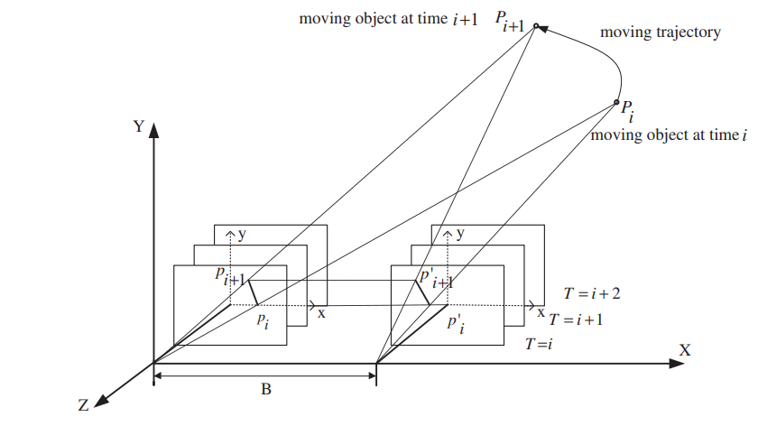
Videogrammetry
Real-time video feed from multiple cameras is the input.
Used to form a virtual 3D map of the environment.
The map is used to navigate and for close range obstacle detection.
Combines the sensor data and motion tracking
using neural networks for interpolation.
Proved to work very effectively in Skydio
drones.
[19]
Notes:
3D videogrammetry is combination of photo scanning and motion tracking that make it very effective for verification and emergency navigation. It us based on neural networks and has been successfully tested on Skydio drones.

Slide 25
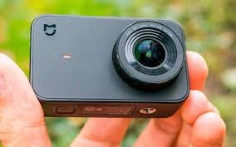
Cameras
The cameras cover all view around the UAV, which is important for the functioning of videogrammetry and for manual control by pilot.
The front view is the most important at high speeds, so there is a high resolution front camera: the Mi 4k Action Camera. It has a very low power consumption.
Other views are covered by 7 smaller highly efficient wide-field-of-view IMX 258 based cameras HD cameras.The footage from these cameras can also be demanded by the pilot.
[21]
[22]
Notes:
The high resolution front camera and the other smaller cameras provide a full view around for manual flying and videogrammetry.

Slide 26
Radars
Range of 160 m. Allows 7 seconds for reaction to stationary objects and 5 seconds for a bird flying head-on, considering the UAV is operating at the maximum speed.
Doppler shift analysis allows determination of the speed very accurately.
Five radars mounted at various locations on the UAV along with servos to increase the angular range of the UAV.
[23]
1.04 cm
1.04cm
Notes:
The radars detect both moving and stationary obstacles from a rage of 160 m. The minimum reaction time available is as high as 5 seconds, even for a bird flying head on.

Slide 27
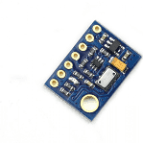
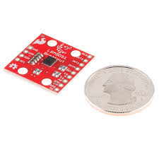
Integrated Navigation components
GPS, inertial measurement and barometric sensors have negligible weight and power consumption, yet it can lend high accuracy to the system. The I²C interface will be used for data transfer.
The GPS chip can also access GLONASS, Beidou, Galileo, etc which makes is much more versatile and accurate.
The GPS sensor, NEO-M8N u-blox can connect to 3 such radionavigation systems concurrently increasing accuracy.
The SparkFun IMU LSM9DS1 and 9250 are the 2 IMU which provide 9 DOF and high accuracy.
Digikey MS5611-01BA will be used as the barometric sensor.
All the sensors are the respective latest editions.
[24]
[25]
[26]
Notes:
Integration of electronics has allowed the incorporation of a GPS module that can concurrently connect to 3 satellite systems, 2 inertial measurement units and a barometric sensor for almost no cost of mass.

Slide 28
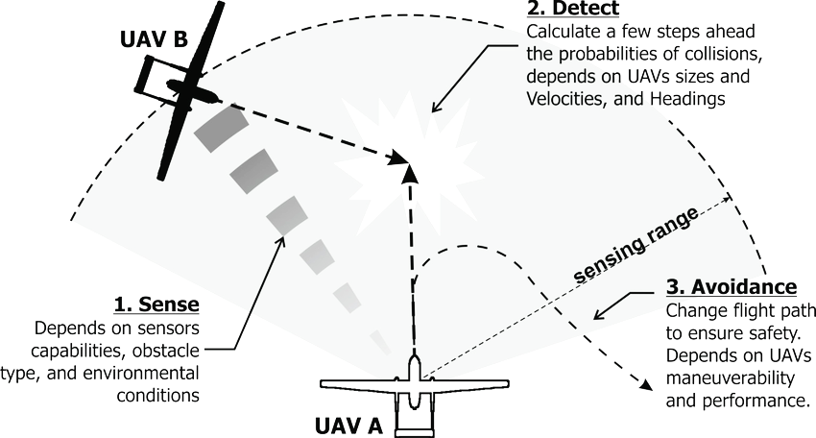
Obstacle Avoidance
[20]
Major fixed obstacles are recorded and included on a 2D map.
UAV is informed of nearby UAVs by the ATC.
Other obstacles are dealt with by the obstacle avoidance systems, a combination of multiple radars and camera systems along with sophisticated processing software that allow detection of any obstacle.
UAV follows one of a series of pre-decided maneuvers depending on the surroundings.
Notes:
Major fixed obstacles are pre-mapped. Larger ones are detected using radars. Birds are prominent moving obstacles. Since birds when afraid have a tendency to do one of a specific set of maneuvers, the UAV may be programmed to move up or hold altitude depending on the situation. Most maneuvers are programmed along with selection criteria based on the surroundings.

Slide 29
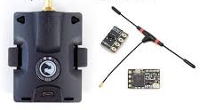
Radio
[27]
Due to high speed and high reliability radio is primary means of communication.
Internet systems have been maintained as a backup, in case of bad signal reception or interference.
The following are used:
Eachine TS832 Boscam
RC832 48CH FPV AV Receiver
Turnigy T6A-V2 AFHDS with TBS Crossfire Micro Rx Tx
[28]
Notes:
The radio devices give quick and solid correspondence between the hub and the UAVs.

Slide 30
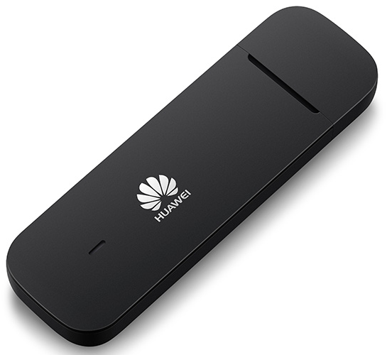
Internet
[29]
Available as a backup due to the slight unreliability of radio.
Sprint 5GB/month plans will be used.
Notes:
Internet systems are a great backup if the radio communication suffers problems. A 5GB per month plan will be used.

Slide 31
Safety Features
Emergency landing components ensure that the UAV lands safely with minimum damage to itself and its surroundings.
Backups are kept for the main navigation and communications components.
The UAV can be monitored and flown using its internet capabilities.
Location determination using 3D videogrammetry and inertial navigation.
The UAV is constantly monitored by a pilot, who can take over if there are any problems.
Notes:
The UAV has excellent safety features. It has backups for all its major systems including videogrammetry and inertial measurements for navigation and obstacle avoidance and internet for communication. It is constantly monitored by a pilot. It is capable of landing safely if required. The UAV is mostly made up of foam, which can reduce impacts.

Slide 32
Emergency Landings- Battery Failure
The battery’s temperature is constantly monitored.
In the event of a temperature spike, the UAV will use NASA’s Safe2ditch software to find a suitable spot to land by autorotation without collateral damage damage.
Notes:
The battery is always monitored. If there are any problems, the other battery is used to land as soon as possible, preferably at the Hub, but if necessary, in other locations, maybe even by autorotation.

Slide 33
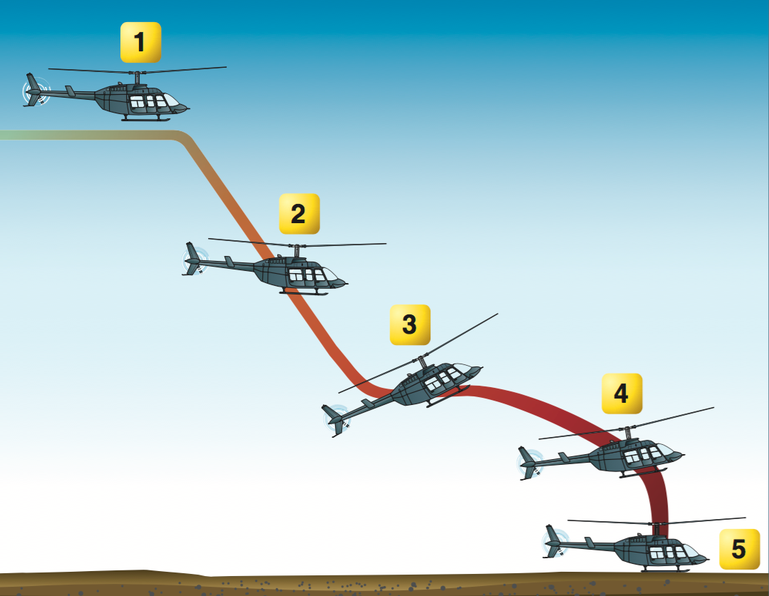
Emergency Landings- Motor/Rotor Blade Problems
If the motor fails, a pilot will take control and perform autorotation.
A safe landing spot is determined using Safe2Ditch.
If rotor blades are damaged, they will be stopped using the motor brakes and the UAV will descend using a parachute.
[30]
Notes:
In case of motor failure, autorotation will be used. The pilot will take control, with software stabilising the craft for the milliseconds of gap. The pilot will ease the collective and allow the craft to descent. As it goes down, the air passing through the rotor blades gives them kinetic energy, which is utilised in the end to provide a safe landing at the nearest safe spot as determined by NASA’s Safe2Ditch software. The rotor blades will be stopped and the parachute deployed if the blades are damaged. Since the UAV has no landing legs, there are some carbon fibre rods driven through the hull to support it. Rooftops are preferred landing spots but streets and parks are also an option.

Slide 34
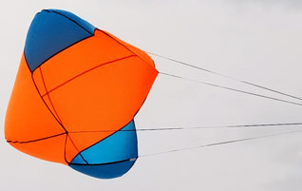
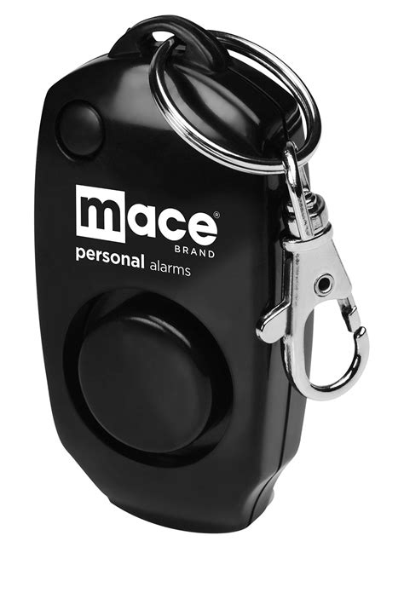
Emergency Components
[31]
The 180 dB buzzer alerts surrounding pedestrians. It has its own battery and is long lasting.
The parachute has been chosen for very low weight despite its high cost.
The parachute is released by a servo .
[32]
[33]
Notes:
The UAV is equipped with a parachute for descending in case rotor blades are damaged. There is a servo to open the parachute. A 180 decibel buzzer is used to alert pedestrians in case of an emergency landing.

Slide 35
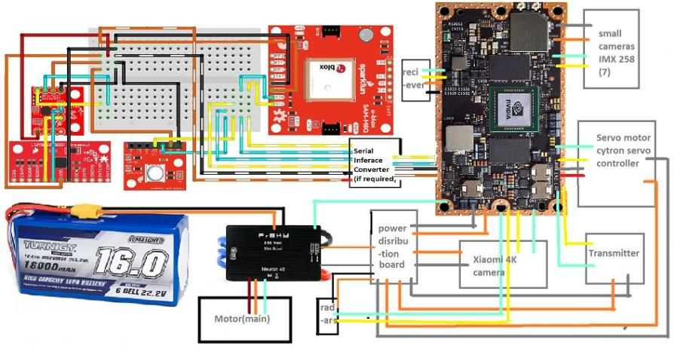
Overall Electrical Configuration
Notes:
The computer will be connected to all the sensors using I²C interface will be used for the sensors. All the electronics will be powered using the UBEC on the ESC. The breadboard is only for representation, a PCB will be used in the UAV.

Slide 36
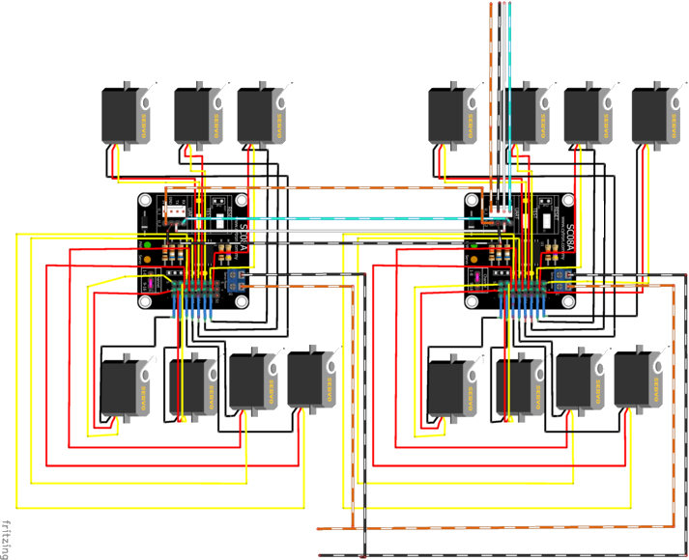
Electrical Configuration of Servos
Controller input
The Cytron SC08A will be used as the servo controller.
2 of them will be daisy chained to control 15 servos.
The UART interface will be used for data transfer between the servo controller and the Jetson TX2.
Servo power
vcc
gnd
Notes:
The servo controller,Cytron SC08A will be daisy chained. This can power upto 16 servos using one UART port, thus, saving on the GPIO pins.

Slide 37
Design Analysis

Slide 38
Front View of UAV
Notes:
This is the front view of UAV.

Slide 39
Side View of UAV
Notes:
This is the side view of the UAV.

Slide 40
Top View of UAV
Notes:
This is the top view of the UAV.

Slide 41
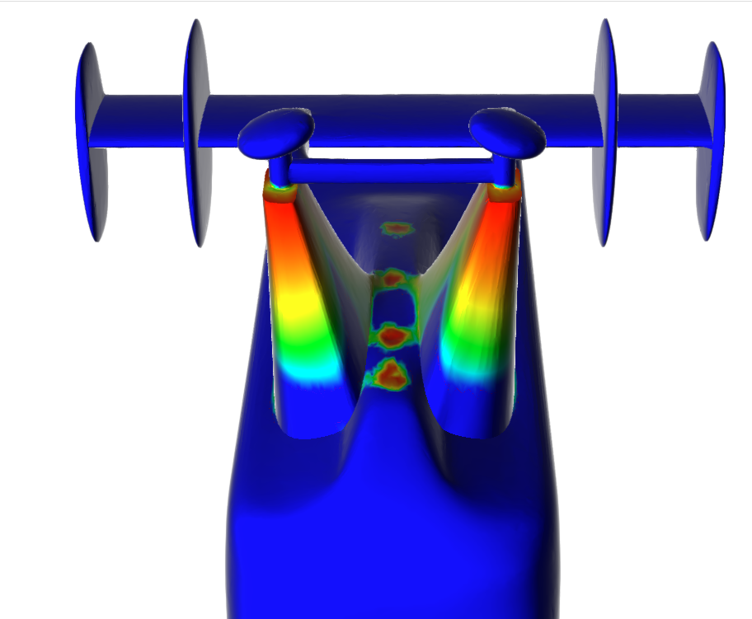
Materials
High
Low
Carbon Fiber
Static-stress simulation was run to gather data.
Carbon fiber is only used at high-stress areas.
EPP Foam is used otherwise.
There are some vertical carbon fibre rods driven through the hull to support in in an emergency landing, since there are no landing legs.
EPP Foam
Notes:
Due to its higher strength-to-weight ratio than other materials often considered for UAVs, carbon fibre will be used for the critical components. The usage of EPP foam for other components will reduce their weight and their influence in shifting the CoM.

Slide 42
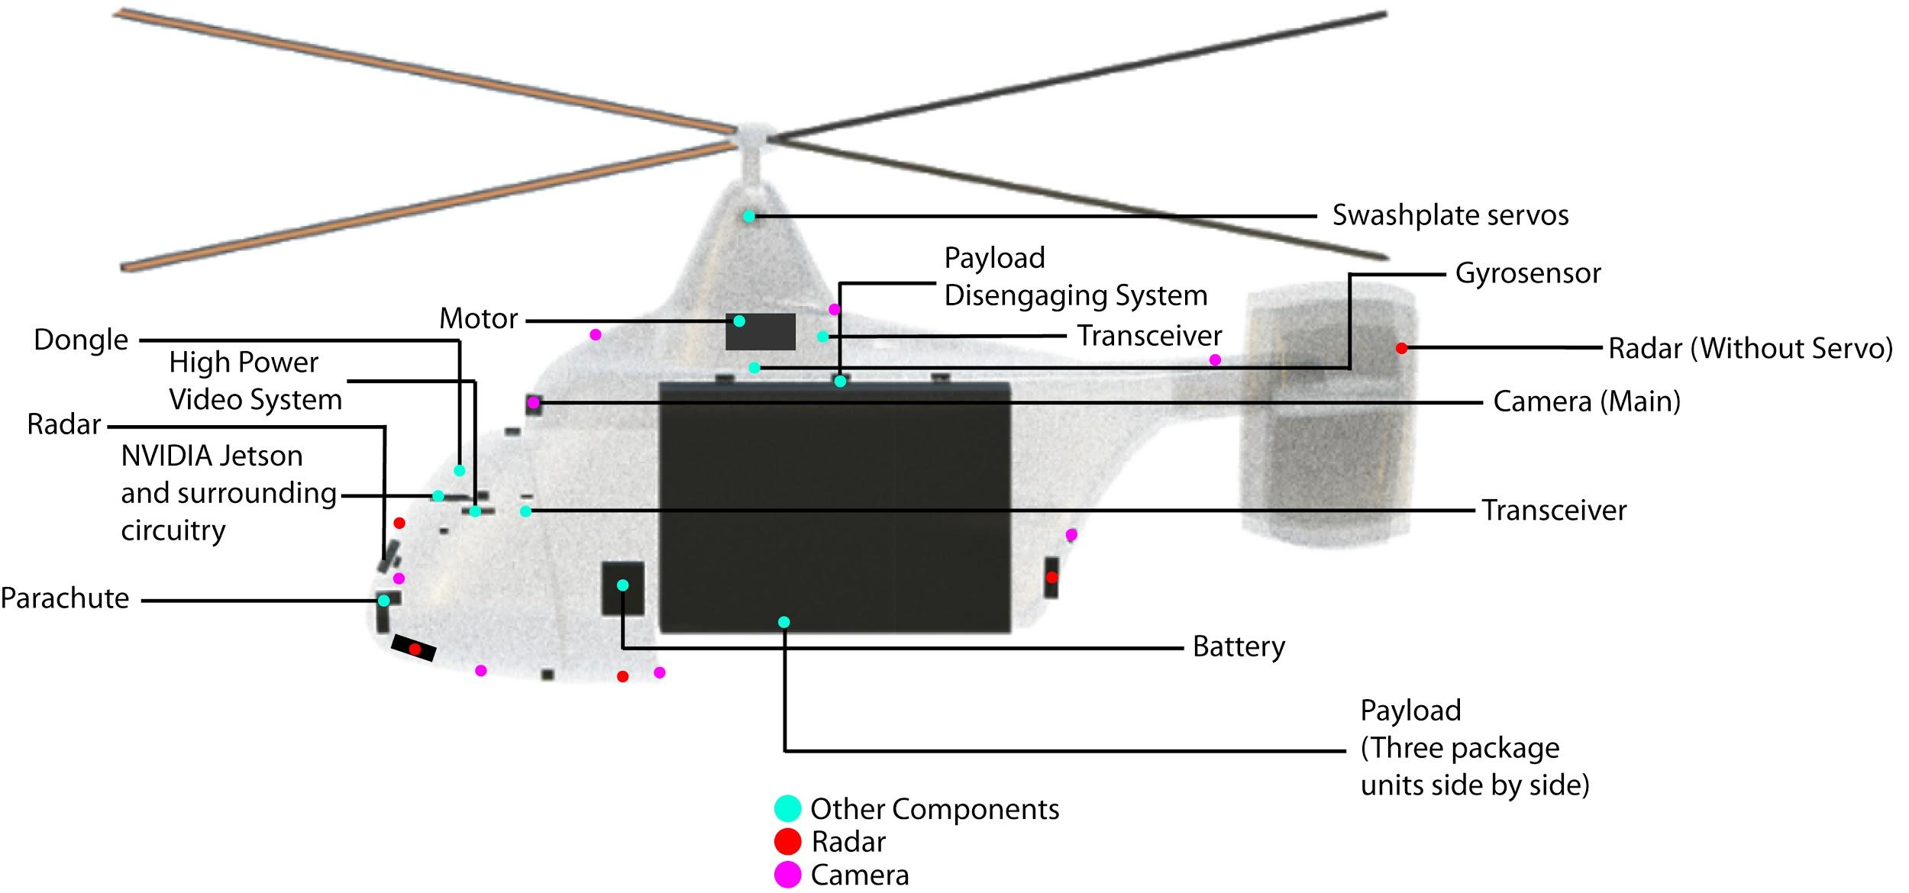
Component Placement

Slide 43
Rotor Airfoil
Asymmetric airfoil was chosen because the tensile strength of carbon fibre was being used.
The NACA 23012 was used as the airfoil.
Reynolds number calculated was approx 1,000,000.
Notes:
Rotor blade airfoil analysis was tricky because all software was intended for fixed-wing airfoil analysis. We stumbled upon the Blade element theory, which described how rotor airfoil activity is different across different sections of the blade. Our choice of an asymmetric airfoil was due to the fact that we had carbon fibre at our disposal. Since we didn’t have the ability to experimentally test different airfoils in an intermeshing environment, we looked at all intermeshing helicopters and discovered that most went for the NACA 230xx series. We chose 23012 because it was the most appropriate with the 1,000,000 reynolds number.

Slide 44
Some Major Calculation Results
Hover power requirement 1.4 kW at maximum weight.
Cruise power at 25 kg, 20 kg, 15 kg, and 10 kg gross weight calculated to be 0.75 kW, 0.54 kW, 0.36 kW, and 0.21 kW respectively.
Average flight time is estimated to be 12 minutes, with the maximum flight time for the farthest deliveries being 15 minutes.
Total battery capacity required for longest flight plan including 15 minute backup flight capacity, requirement is 16 Ah.

Slide 45
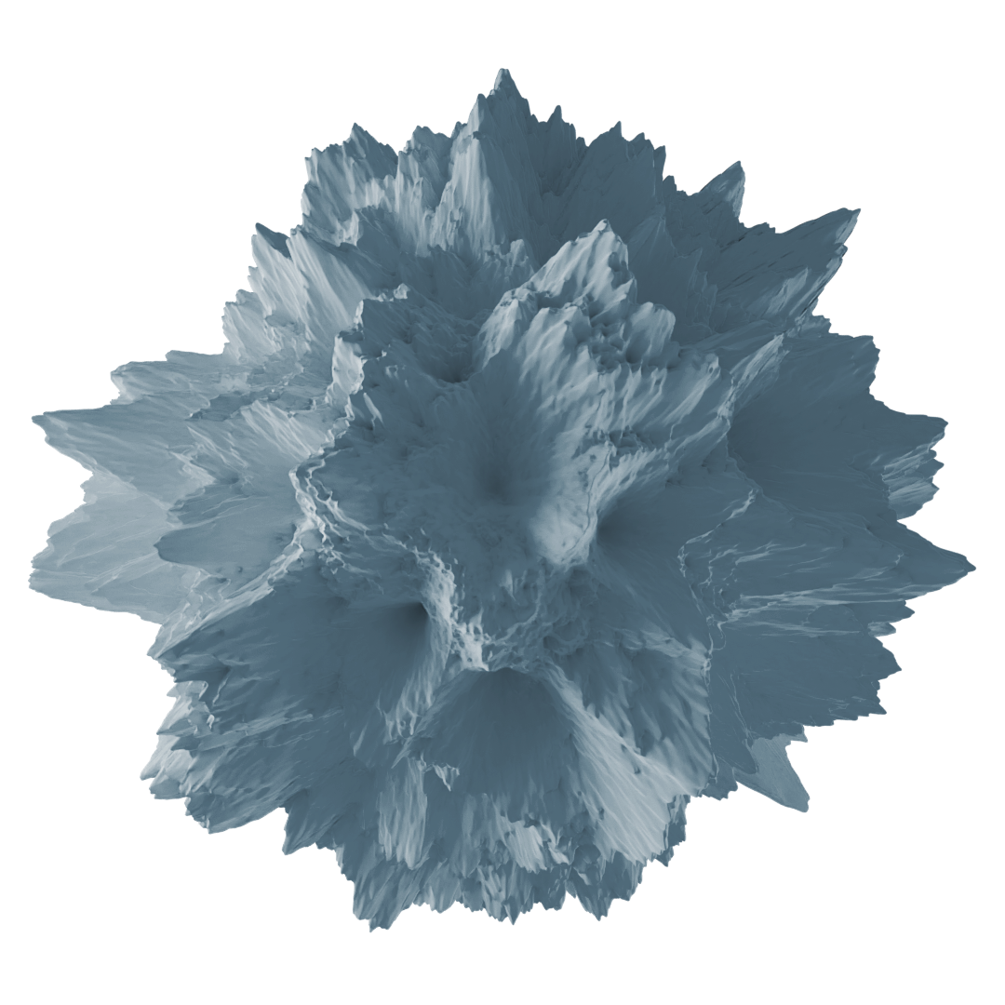
Concept Of Operations

Slide 46
Preparations
Operations are from 0800-1700 hrs local time.
Every morning, flight plans are prepared, considering METAR reports and NOTAMs/TFRs for the local airspace, with software such as ForeFlight, Garmin Pilot and Next Generation Flight Management System (NGFMS) by Honeywell.
Prior planning includes elimination of possible collisions between UAVs and optimisation of the schedule to ensure a uniform take-off and landing rate at the Hub.
Notes:
Before operations begin at 8 AM local time each day, the crew will prepare flight plans for the day taking into account weather and flight restrictions. Plans are prepared such that UAVs arrive at and depart from the Hub at regular intervals, thus maximizing efficiency.

Slide 47
Pre-mission
Packages are prepared and loaded in.
UAV Systems, as well as flight control surfaces, are checked with a tablet connected to the main onboard computer.
The battery is replaced.
Flight plan is loaded in.
UAV loaded onto special launch apparatus.
The radio is connected and and tested.
ATC clearance and departure vectors requested.
Notes:
Before departure from the Hub, each UAV undergoes a human assisted pre-flight routine to prepare it for the mission that is outlined above. This serves as both a check to ensure all systems are functional as well as an undertaking of all necessary tasks required for the mission.

Slide 48
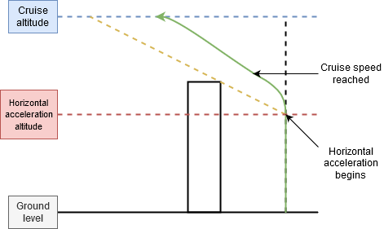
Vertical Navigation
Upon take-off, the UAV first ascends vertically to clear surrounding obstacles (if required).
Once the designated acceleration altitude is reached, the UAV pitches over in the direction of the next target and accelerates to a cruise speed of 26 m/s while climbing.
The acceleration altitude is determined on the basis of the UAV’s minimum climb rate at cruise speed, thus ensuring minimum time is spent in the inefficient vertical ascent phase.
Nominal cruise altitude is 200 ft, though it may be lower for shorter intra-neighbourhood hops.
Notes:
The UAV can dynamically generate a vertical flight profile on the basis of its current load and the height of surrounding obstacles for every individual drop off through an iterative process shown above. This ensures that it reaches its cruise speed of 26 m/s and nominal cruise altitude of 200 ft using as little energy as possible.

Slide 49
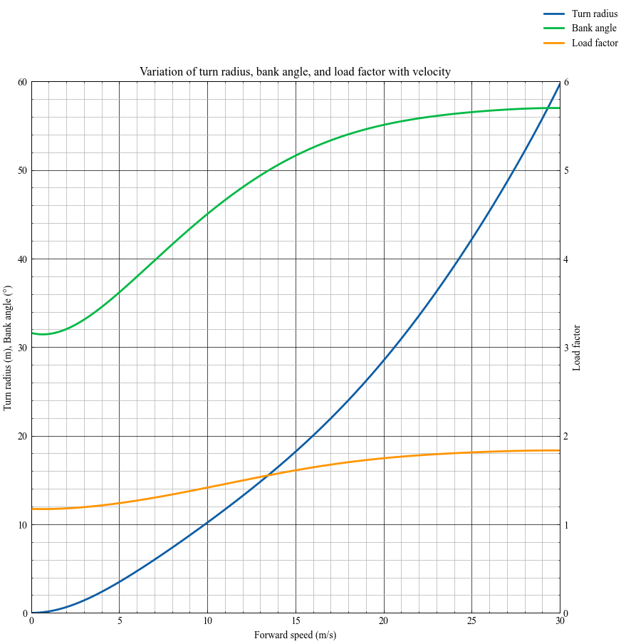
Maneuver Analysis
Plotting the bank angle and load factor for an altitude preserving turn at various speeds shows that the UAV remains under a load factor of 2 and bank angle of 60° in and beyond its operating regime of up to 26 m/s.
Hence, maneuvering capability is usually restricted not by structural or aerodynamic considerations, but by the available turn radius.
Inside the city, the UAV may have to slow to less than 10 m/s during turns, but can perform evasive maneuvers safely even at cruise speed.
Notes:
Given the motor’s peak power output of 1.5 kW and the relatively negligible drag at these low speeds, it is not possible for the UAV to structurally overload itself during maneuvers under normal operating circumstances, as the above plot of load factor with forward speed demonstrates. So, the UAV can safely undertake maneuvers at cruise speed, and need only decelerate if there is not enough space for a turn at cruise speed, which may often be the case inside a city.

Slide 50
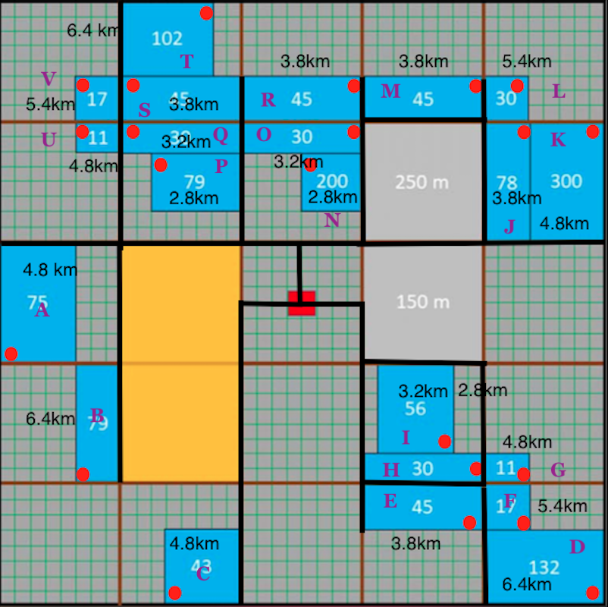
Flight to Delivery Location
Pre-decided flight corridors (shown by thick lines in the figure) along major roads are adhered to reduce public nuisance.
The flight corridors allow different ways to reach each neighbourhood (as can be seen in the figure showing three ways of reaching neighbourhood R ). Enables flexibility in planning.
Notes:
Outside of neighbourhoods, the UAVs will follow predesignated flight corridors to minimize disturbance to residents and commuters. As there are multiple possible routes to a single neighbourhood, traffic conflicts can be minimized and planning is more flexible.

Slide 51
Flight Inside Neighbourhood
The neighbourhood will be entered from the point nearest to first location to minimize time taken within neighbourhood.
Within neighbourhoods, UAVs will fly at lower altitudes at half the cruise speed to reduce noise and power consumption.
This is the only time noise levels are concerning; the presence of spoilers on the rotors helps to mitigate this problem in addition to increasing overall flight efficiency.
Overall, the UAV will follow roads within the neighbourhood.
Due to higher chances of collision between UAVs, the ATC will closely monitor UAV flight paths in delivery neighbourhoods and manually vector the UAVs if needed.
Notes:
Within neighbourhoods, UAVs fly along roads at reduced speeds and altitudes to alleviate noise and energy wastage from climbing. Due to proximity with other UAVs as well as other obstacles in this flight phase, ATC will specifically monitor UAVs in these regions and intervene with manual vectoring if required.

Slide 52
Delivery
UAV will drop the package from <1 m above the designated spot to avoid landing. Packages will be adequately wrapped to protect the contents.
To avoid theft, the customer will be required to be present, as guaranteed by multiple confirmations requested from them at various times.
A minimum safe distance will be marked. Any breach will cause the UAV to abort the delivery and move away for safety of the UAV as well as the people. Intentional breach will result in fines and legal action against violators.
Notes:
During delivery, two conditions must be met: the customer must be present at the site, and there must nothing within the marked safe zone. If these conditions are met, the UAV will descend to its drop height of just under a metre, and deploy the package. The package will be encased in protective wrapping to ensure no damage occurs.

Slide 53
Return Flight to Hub
During the return flight back to hub the energy consumption by the UAV will be significantly reduced due the absence of the payload.
UAV will approach its assigned landing pad, which is equipped to receive it.
Flight planning and specific assignment of UAVs to stations ensures the availability of that landing pad at the time the UAV returns.
If due to problems landing space is not available, the UAV will be instructed by the ATC to remain in a designated holding pattern around the hub (as this is more efficient than hovering) until a bay is vacated.
Notes:
Once all packages have been delivered, the UAV will fly back to the Hub and land on its assigned landing pad. If for some reason there are deviations from the schedule and a pad is not available, the UAV will hold in a predesignated holding pattern until space frees up for it to land.

Slide 54
Post Mission
After the UAV safely lands on the bay and the rotors come to a full stop, the UAV is removed from the pad by technicians.
The battery is removed and taken to be charged, and electronics are allowed to cool down. If the UAV has more missions in its schedule for the day, it goes through the pre-mission routine once again and is readied for departure.
Once all the missions for the day are over, the UAV is taken below the flight deck and is thoroughly cleaned and stored for the night.
Notes:
After landing, the battery is removed from the UAV and it is allowed to cool down before preparations for the next flight begin. After its last flight, the UAV is cleaned and taken inside to prepare it for storage during the night.

Slide 55
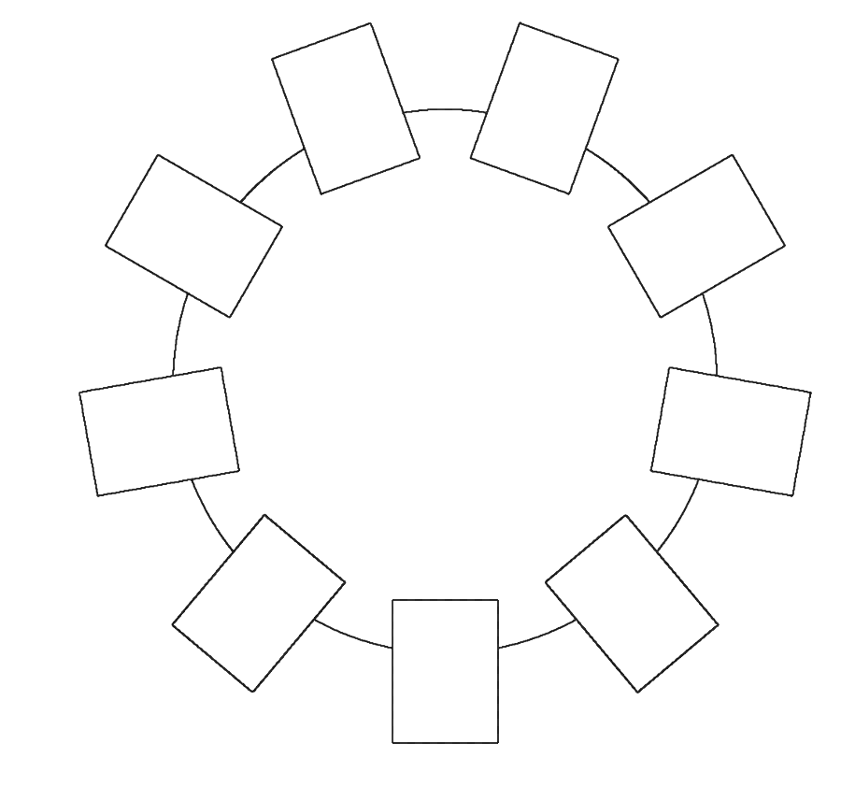
Hub Design
2 m
ATC
2.7 m
Packages prepared and sorted in ground floor.
Each top floor launch station has a preparation station below it.
In the middle is the room for pilots and the planning crew. Packages pass through with dumbwaiter system.
A storage warehouse is attached to the main structure.
Launch Deck
Planning and Monitoring
Package Preparation and Sorting
2.7 m
Launching/Receiving Station
5 m
Repair and Maintenance Station
Notes:
The Hub consists of three distinct floors. The ground floor is used for package preparation and sorting, and has a connected warehouse for temporary storage. The central floor houses the pilots, management and planning crew, and the top floor is the launch deck which holds the 9 launch and landing pads for the UAVs, as well as the ATC building.

Slide 56
Human Resource
Category | Number of Personnel
Safety Pilots | 9
Maintenance/ Aircraft Launch and Recovery | 9
Payload Operators | 9
Package Handlers | 8
Package Collectors | 2
Air Traffic Managers | 7
Emergency and Response Teams | 6 (3 teams)
Two shifts of workers.
Work seven days a week.
1.25 × normal wages.
Notes:
We will utilise the same 57 crew members throughout the week. The workers will be paid higher than normal wages to compensate them for the extra hours. According to our analysis, this option is still cheaper than hiring more crew, especially due to the added cost associated with adequately training them to operate the equipment safely.

Slide 57
Business Case
Notes:
Now, after all, we are a company that will conduct these operations. Therefore, the business side of the design has a lot of importance too.

Slide 58
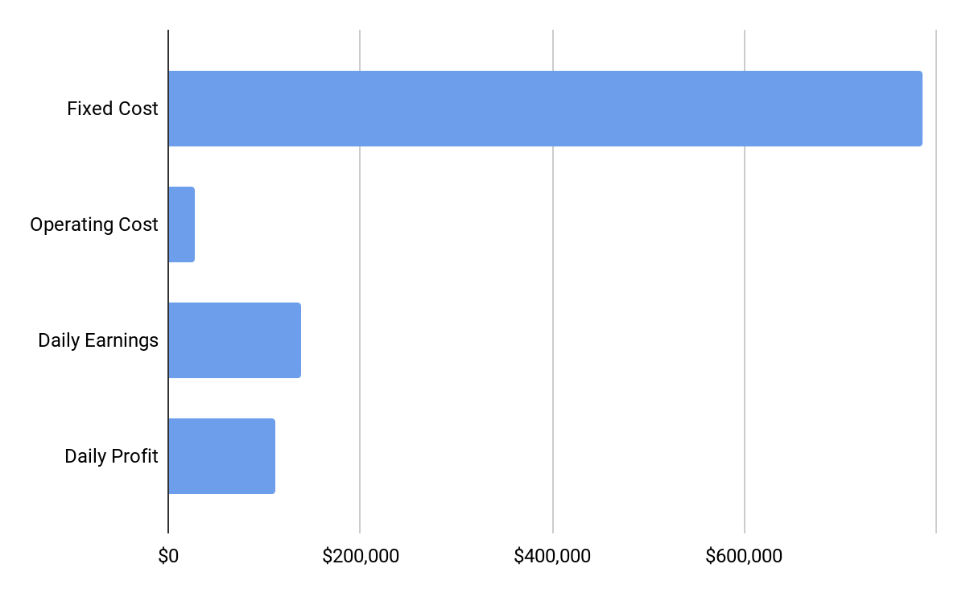
Summary of Costs

Slide 59
Revenue and Operating Costs*
Revenue
Delivery Revenue | $75,000
Volume Bonus | $37,000
Distance Bonus | $26,875
Total | $138,875
Operating Costs
Personnel | $16,087.5
Maintenance | $98.2
Packaging Material | $3535
Insurance Premium | $6943.75
Batteries | $261.4
Sprint 4G Communication | $25
inFlow Software | $2.63
Electricity | $28.1
Miscellaneous | $300
Total | $27,272
Net Daily Profit
$111,603
*Per day
Notes:
The net daily profit was calculated to be $111,603. The profit was calculated considering the operating costs and the revenue which included Daily revenue, Volume Bonus and Distance bonus and resulted to be $138,875. We considered as many practical aspects to calculate the operating costs which includes the personnel, maintenance, packaging material, insurance premium, batteries, 4G communication ,WMS software, electricity, miscellaneous cost which resulted in $27,272.

Slide 60
Fixed Costs and Breakeven
Fixed Costs
Cost of UAVs | $106,870
Construction Cost | $447,740
Solar Panels and Inverters | $192,890
Other Components | $21,000
Miscellaneous | $16,500
Total | $785,000
Break-even achieved within 8 days
Net Daily Profit: $111,600
Notes:
The fixed cost was calculated considering the cost of UAVs, construction cost, solar panels and inverters and other components which also includes miscellaneous cost which includes shelves and other electronic needs. The daily profit was already calculated to be $111,600. The estimated break-even point was found to be 8 days.

Slide 61
Future Expansion
The high revenue obtained by neighbourhood completion bonus will be utilised in future expansion and further development of the UAV network. This revenue will also be used to buy out competition.
Additionally, the money may go into scholarships and sponsorships such as into RWDC, to other branches the company establishes, and shareholder dividends. It will also be used in advertising campaigns.
In any case, this money is not discussed much here since it will not be directly involved with the UAV operations.

Slide 62
Benefits
Safe
Designed for urban environment
160m obstacle avoidance
Multiple back-ups for each system.
Well-prepared with myriad of contingencies
Well-designed emergency landing procedures.
Sustainable
Runs on electricity
Majority of the electricity will be generated by solar panels
Convenient
Low noise levels
App for easy customer interaction
Fast delivery
Minimal human interaction (appropriate for current COVID-19 pandemic)
Profitable
Three packages per UAV
Quick break-even
Notes:
Drone-acharya was designed to be a safe, convenient solution for customers and for the environment. These benefits were made after taking cost minimization into consideration.

Slide 63
Unique Selling Propositions
Replacement of operating costs by recoverable fixed costs, by reducing working hours and increasing the number of UAVs.
High volume operations: Delivery to all neighbourhoods due to high revenue generation of 50$ per package and bonuses.
Carrying three packages per UAV makes the system highly efficient.
Large margins for emergencies and large-scale future expansion.
Employment of two shifts of workers.

Slide 64
Image Credits
Lucian Alexe. Retrieved from https://unsplash.com/.
Rebekah Blocker. Retrieved from https://unsplash.com/.
Top Drone Package Delivery Projects Around the World. Retrieved from https://dronesonvideo.com/drone-delivery-around-world/
Alexander Popov. Retrieved from https://unsplash.com/
Road Traffic. Retrieved from http://www.environmentlaw.org.uk/rte.asp?id=38
Iwona Castiello d'Antonio. Retrieved from https://unsplash.com/
Drone Delivery. Retrieved from https://dronesonvideo.com/drone-delivery-around-world/
Fixed-Wing UAV. Retrieved from http://vespadrones.com/2015/11/29/flir-consolidates-its-leading-position-in-aerial-thermography/
Single Rotor UAV. Retrieved from https://buybestquadcopter.com/drone-types/.
Hybrid UAV. Retrieved from https://www.uasvision.com/2017/02/22/affordable-ready-to-fly-hybrid-vtol-drone/.
Multirotor UAV. Retrieved from https://shop.autelrobotics.com/.
Twin rotors UAV. Retrieved from https://defense-update.com/20110808_ghost.html.
Intermeshing rotors UAV. Retrieved from http://www.indomiliter.com/sdo-50v2-ini-dia-drone-copter-andalan-basarnas/comment-page-1/.
Kaman HH-43 Huskie. Retrieved from http://shelbs2.deviantart.com/art/Kaman-HH-43-Huskie-168425214.
Motor. Retrieved from http://www.scorpionsystem.com/catalog/aeroplane/motors_1/sii-40/SII_4020-420/.

Slide 65
Image Credits
FrSky Neuron 60. Retrieved from https://www.frsky-rc.com/product/neuron-60/
Battery. Retrieved from https://www.amazon.com/Turnigy-High-Capacity-20000mAh-Multi-Rotor/dp/B07DRDG7V8.
nVidia Jetson TX2. Retrieved from https://techcrunch.com/2017/03/07/nvidias-jetson-tx2-makes-ai-computing-possible-within-cameras-sensors-and-more/
Videogrammetry. Retrieved from https://www.researchgate.net/publication/264563727_Global_calibration_for_muti-camera_videogrammetric_system_with_large-scale_field-of-view.
Obstacle Avoidance. Retrieved from https://www.researchgate.net/figure/Sense-Detect-Avoid-definition-12_fig3_266327376
Main camera. Retrieved from https://www.xiaomitoday.com/get-xiaomi-mijia-camera-mini-4k-action-camera-for-just-87-99-at-gearbes/
Camera sensor.
AWR1843. Retrieved from https://www.ti.com/product/AWR1843
GPS. Retrieved from https://www.u-blox.com/en/product/neo-m8-series

Slide 66
Image Credits
Inertial Measurement Unit. Retrieved from https://www.robotgear.com.au/Product.aspx/Details/3222-SparkFun-9-Degrees-of-Freedom-IMU-Breakout-LSM9DS1
TBS Crossfire. Retrieved from https://www.visionfpv.com/products/tbs-crossfire-micro-tx-nano-rx-bundle
Eachine TS832 Boscam. Retrieved from https://www.banggood.in/Eachine-TS832-FPV-5_8G-32CH-600mW-Wireless-AV-Transmitter-p-975425.html?cur_warehouse=CN
Huawei dongle. Retrieved from https://www.alibaba.com/product-detail/Huawei-Unlocked-E3372h-153-Hi-Link_60575276806.html
Autorotation. Retrieved from https://www.danubewings.com/straight-in-autorotation/
Parachute. Retrieved from https://the-rocketman.com/
Mace personal lock. Retrieved from https://www.vigilantpps.com/products/mace-80457-black
Servo motor. Retrieved from https://robu.in/product/towerpro-sg90-9gm-1-2kg-180-degree-rotation-servo-motor-good-quality/

Slide 67
THANK YOU!

