Slide 1

The Innovation Engine
Overview
Dr. Ralph K. Coppola, Founder & Executive Director

Slide 2


The Real World Design Challenge
An annual program that provides students with the opportunity to apply the lessons of the classroom to the technical problems currently faced in the engineering field.
Real Problems
Real Tools
Real Roles
Real Contributions
INDUSTRY, GOVERNEMENT & EDUCATION

Slide 3
RWDC Overview
Develops STEM and professional skills through an annual program.
Applies lessons learned in the classroom to engineering problems faced in industry and applies business skills.
Teaches innovation and problem solving.
Prepares students for the aerospace workforce.
Challenges high school student teams of 3-7 students to optimize the design of an unmanned aircraft system (UAS).
State Level Program runs from September through December. State Teams that do well are invited to participate in the National/International Level, which runs from January through April.

Slide 4
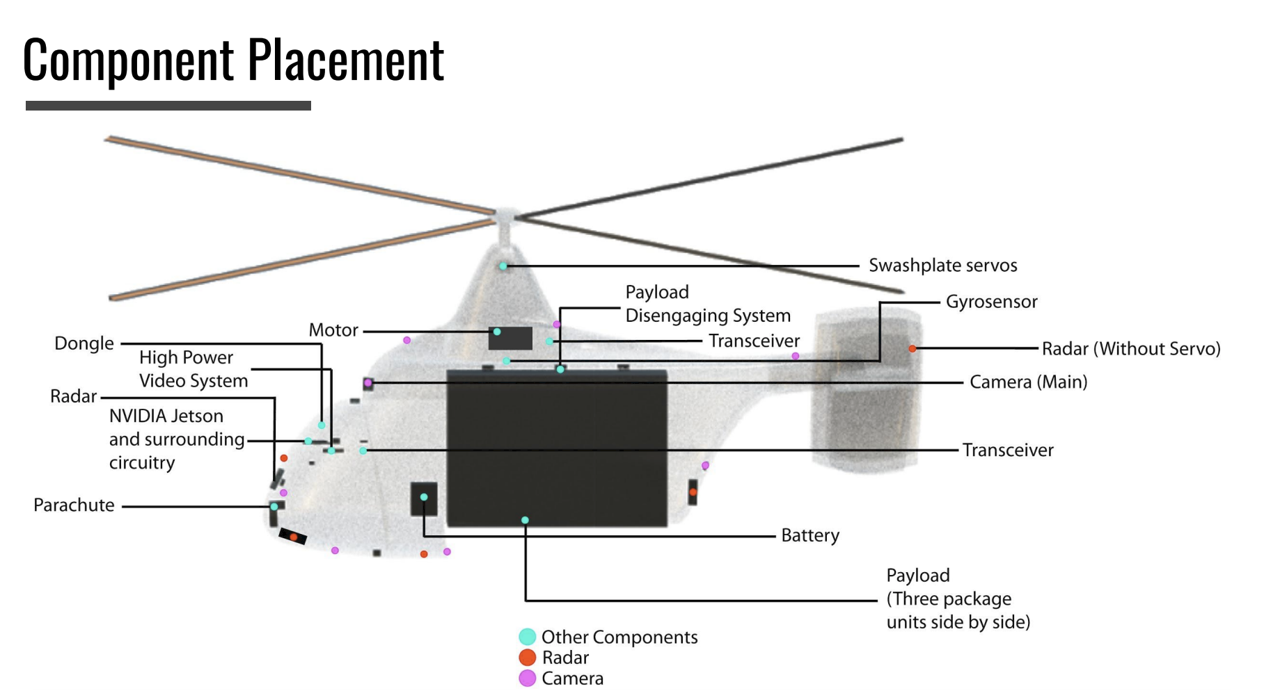
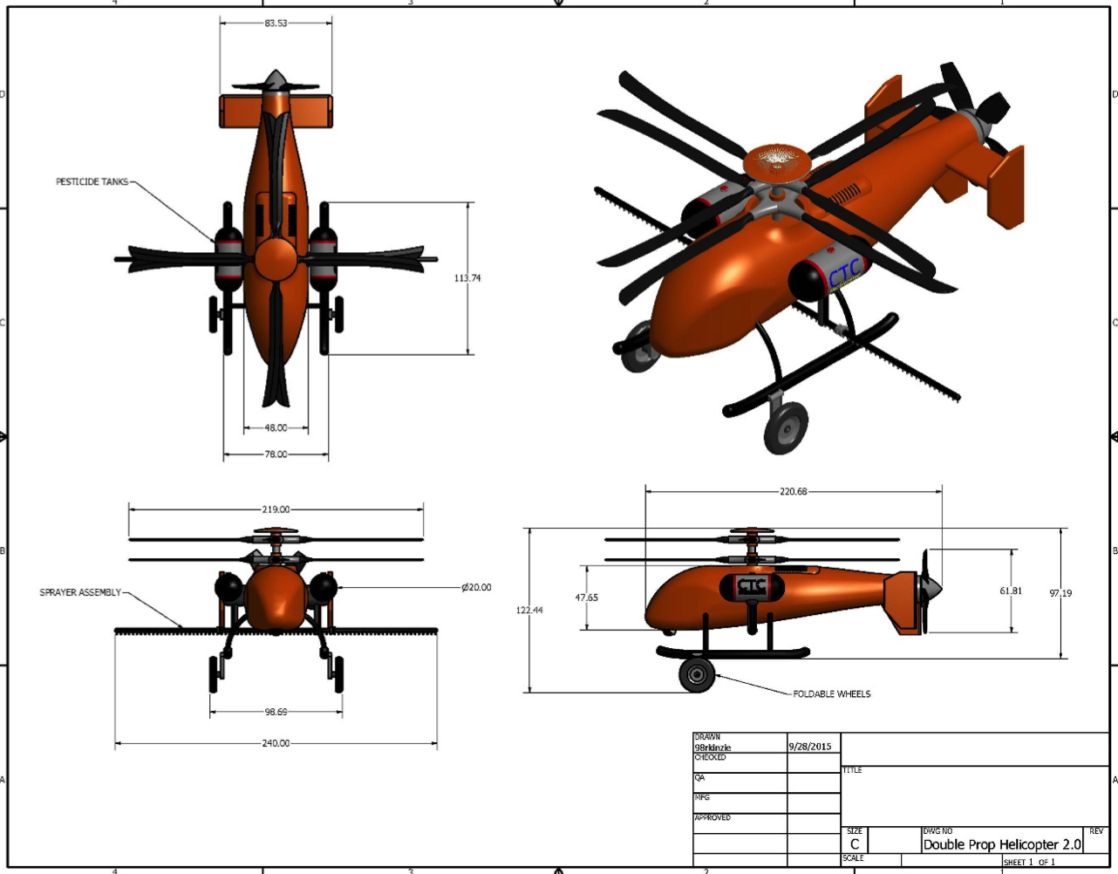
What Teams Get
Professional engineering software
Access to professional mentors
Each student on the top International Team gets a $50,000 scholarship to Embry-Riddle Aeronautical University in the U.S.
Free State Level Challenge for all teams.
Free STEM curriculum materials.

Slide 5
RWDC Process
State Challenge, October - January
National Challenge/International Challenge, February - April

Slide 6

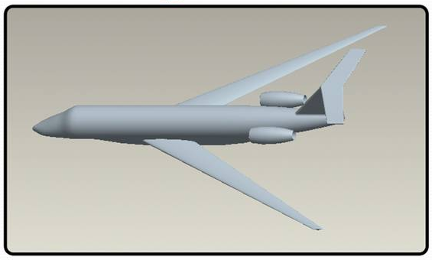
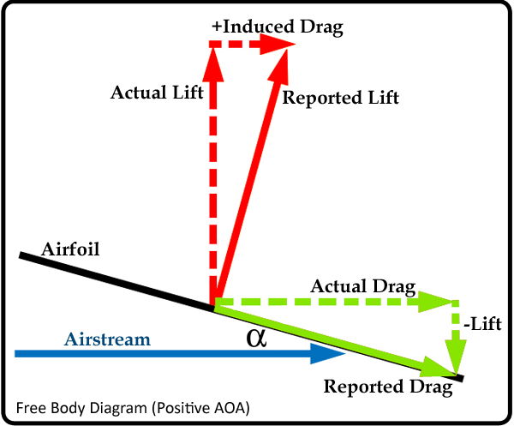
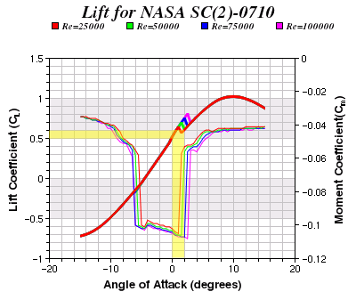
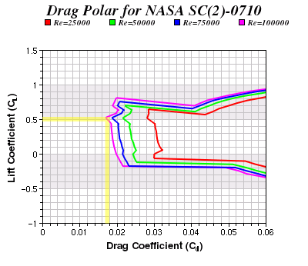
The Students Solve Real Aerospace Problems
Teams of 3-7 high school students design a plane looking at the forces of flight, lift, weight, thrust & drag with the goal of enhancing performance.
Free Body Diagram
Airfoil Selection Method
Minimum Lift Coefficient = 0.3-0.5
Total Drag = Actual Drag + Induced Drag
Total Lift = Actual Lift – Reported Drag(sin α)

Slide 7
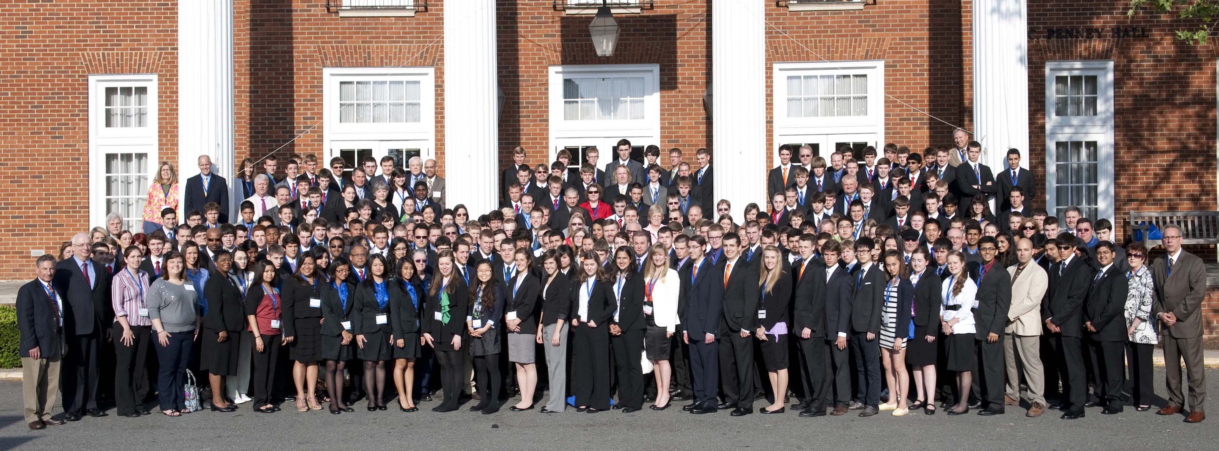
The Real World Design Challenge is the largest aviation education program in the World
Top State Level Teams
We have had 35,000 students participate over 17 years.

Slide 8
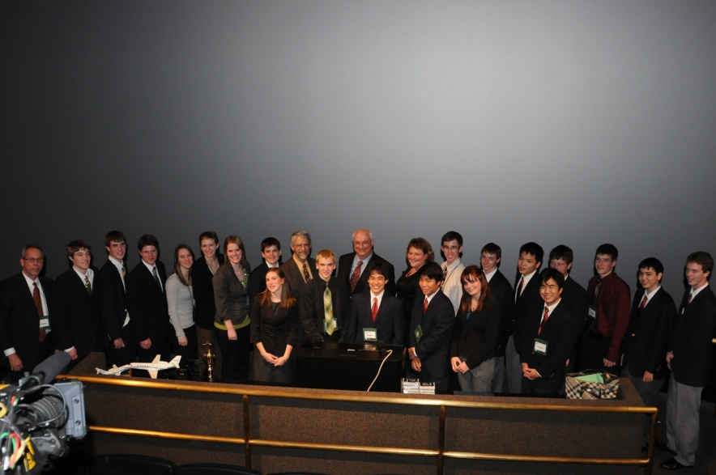
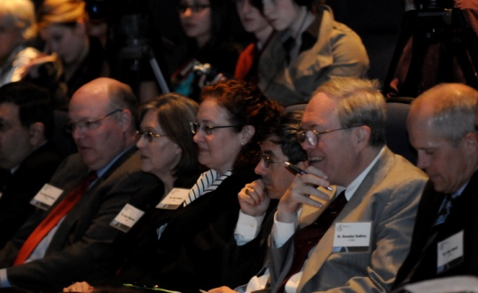
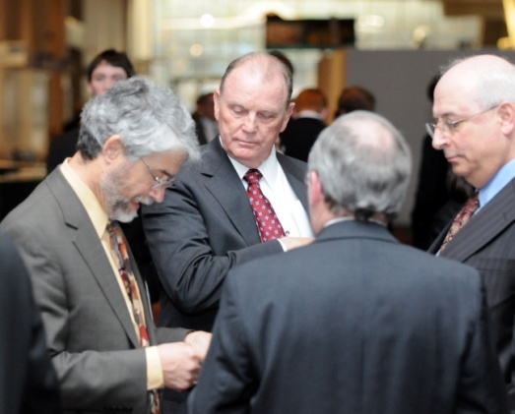
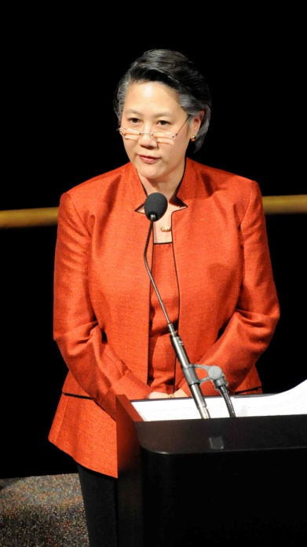
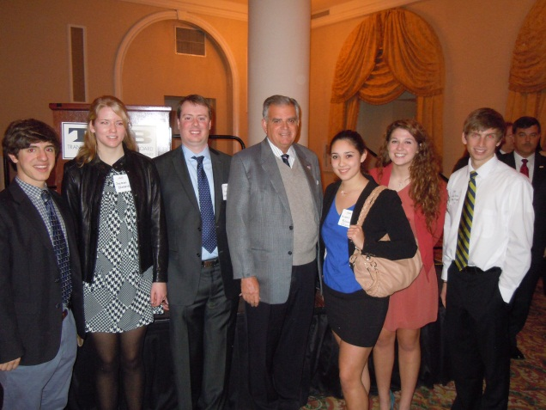
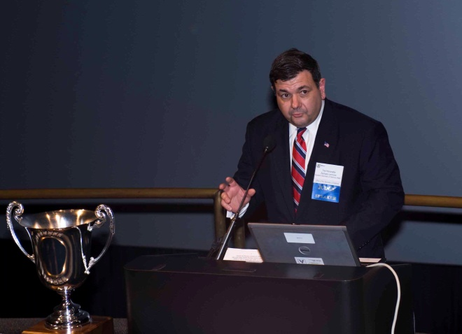
Dignitaries Speak at the RWDC International Program
Blue Ribbon Judges evaluate student presentations
Dr. John Holdren President Obama’s Science & Technology Advisor reviews the Challenge
Three top teams honored with Dr. John Holdren
Department of Transportation Secretary Ray LaHood with RWDC Students
The Honorable Zachary Lemnios, Assistant Secretary of Department of Defense Research & Engineering, presents
KC Yanamura, Deputy Director FAA Aircraft Certification Services

Slide 9
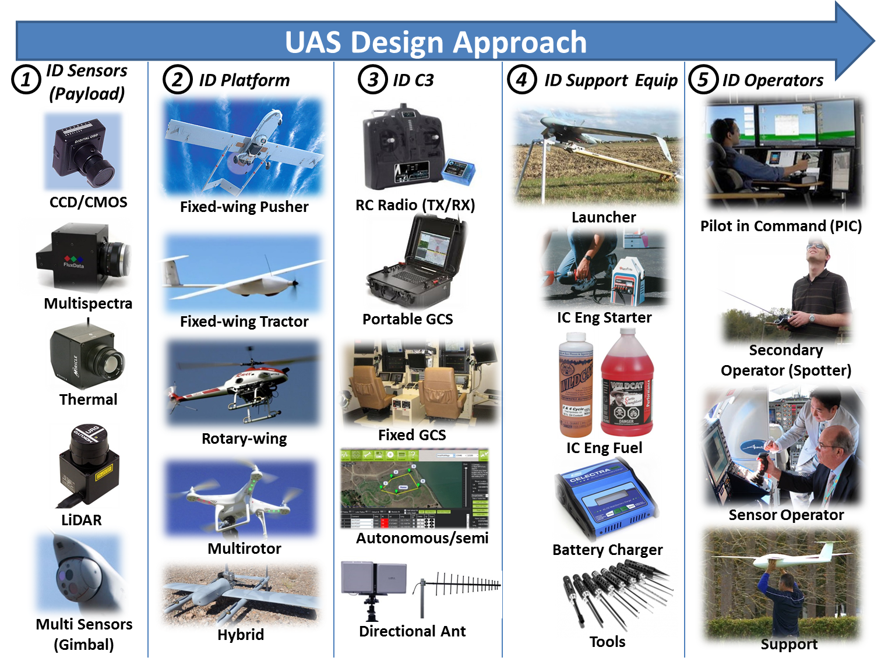

Slide 10
Overview Engineering Design Process
Engineering Design Process
The Engineering Design Process is used during each Design Phase.
Design Phases
Conceptual Design (Many designs at least eight per team member)
Preliminary Design (Narrow down to three designs per team)
Detailed Design (One design per team)
1
Define Problem
2
Research
3
Create Solutions
4
Analyze & Select
5
Test

Slide 11
Teams Develop A Business Plan
The RWDC Blue Ribbon Judges, from industry, suggested that teams add a business plan to the Challenge to make it “more real world”. All engineers need to learn to make a case for their product to customers.
Teams:
Maximize Profitability by taking into account costs and revenue.
Amortize costs, spreading fixed costs over missions flown.
Account for variable costs involved with performing a mission.
Develop a communications plan to communicate the importance of the mission to policymakers and the public.

Slide 12
Teams Develop a Public Affairs Plan
NASA suggested that teams add a Public Affairs Plan the Challenge to make it “more real world”. All engineers need to learn to make a case for their product to non-technical policy makers and the public.

Slide 13
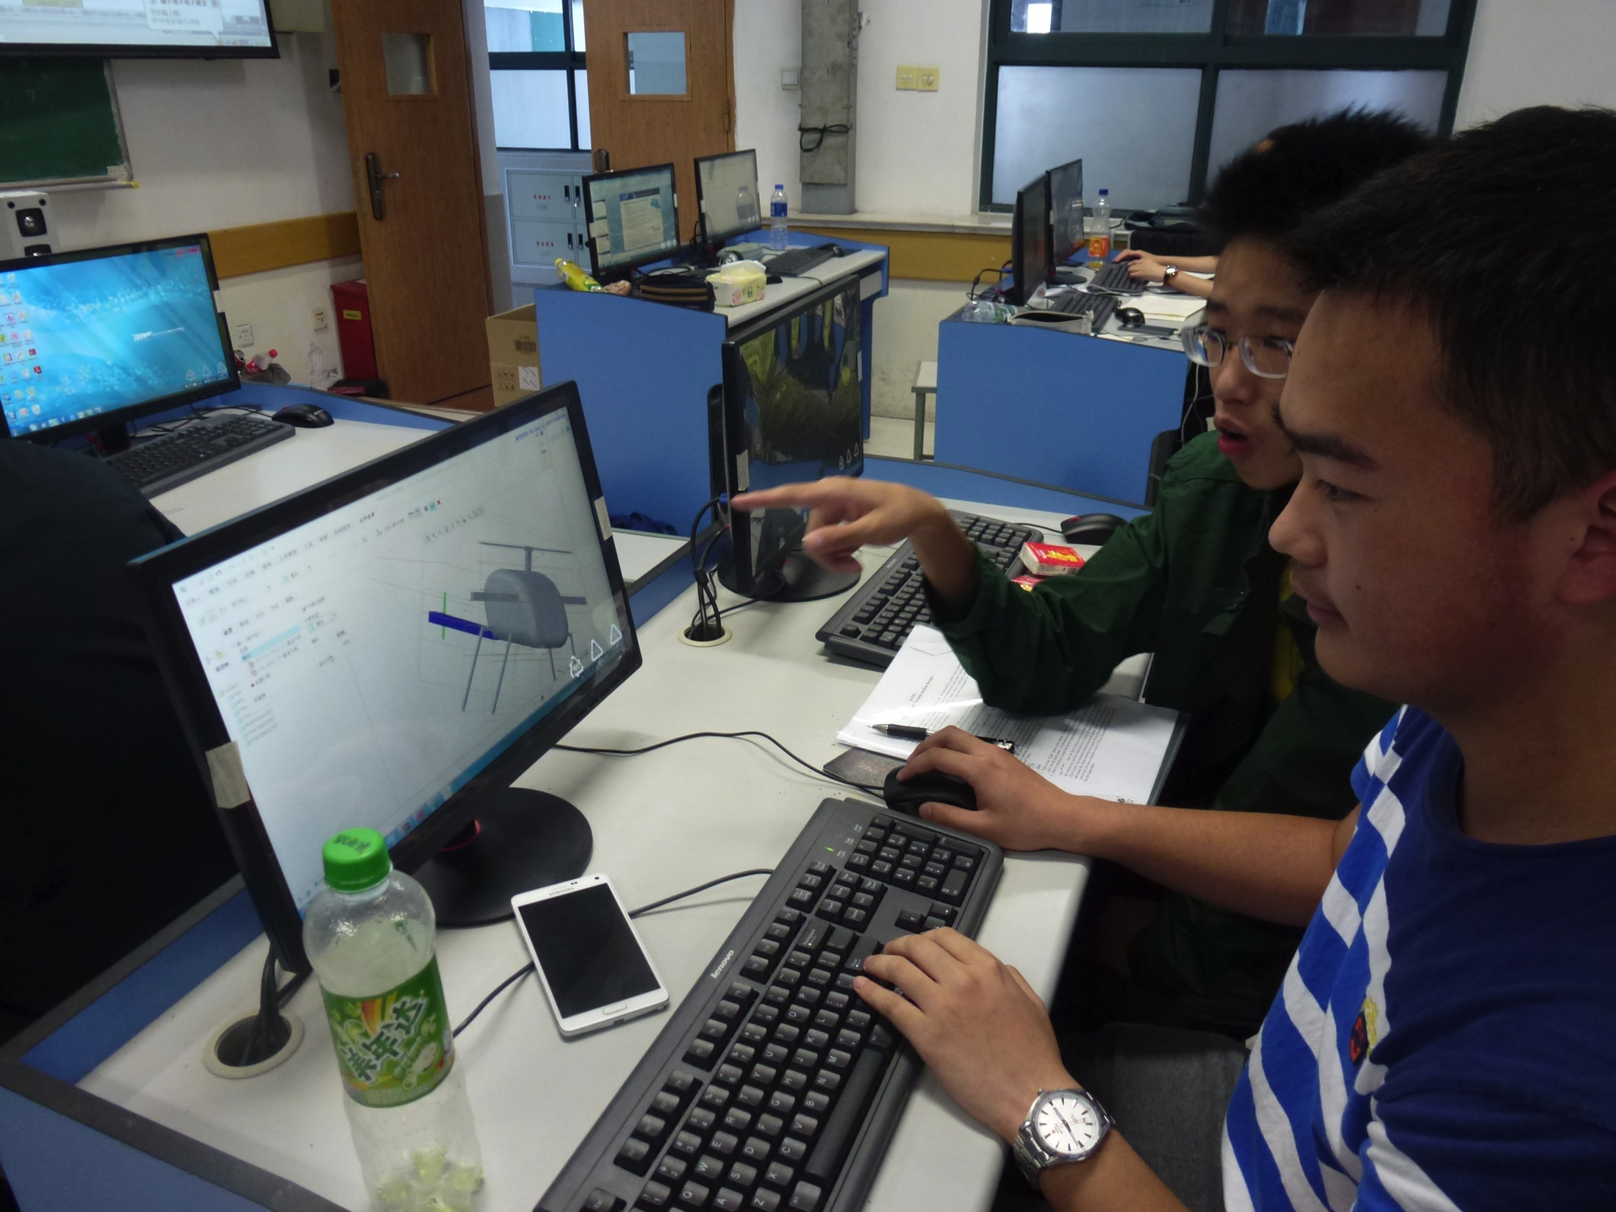
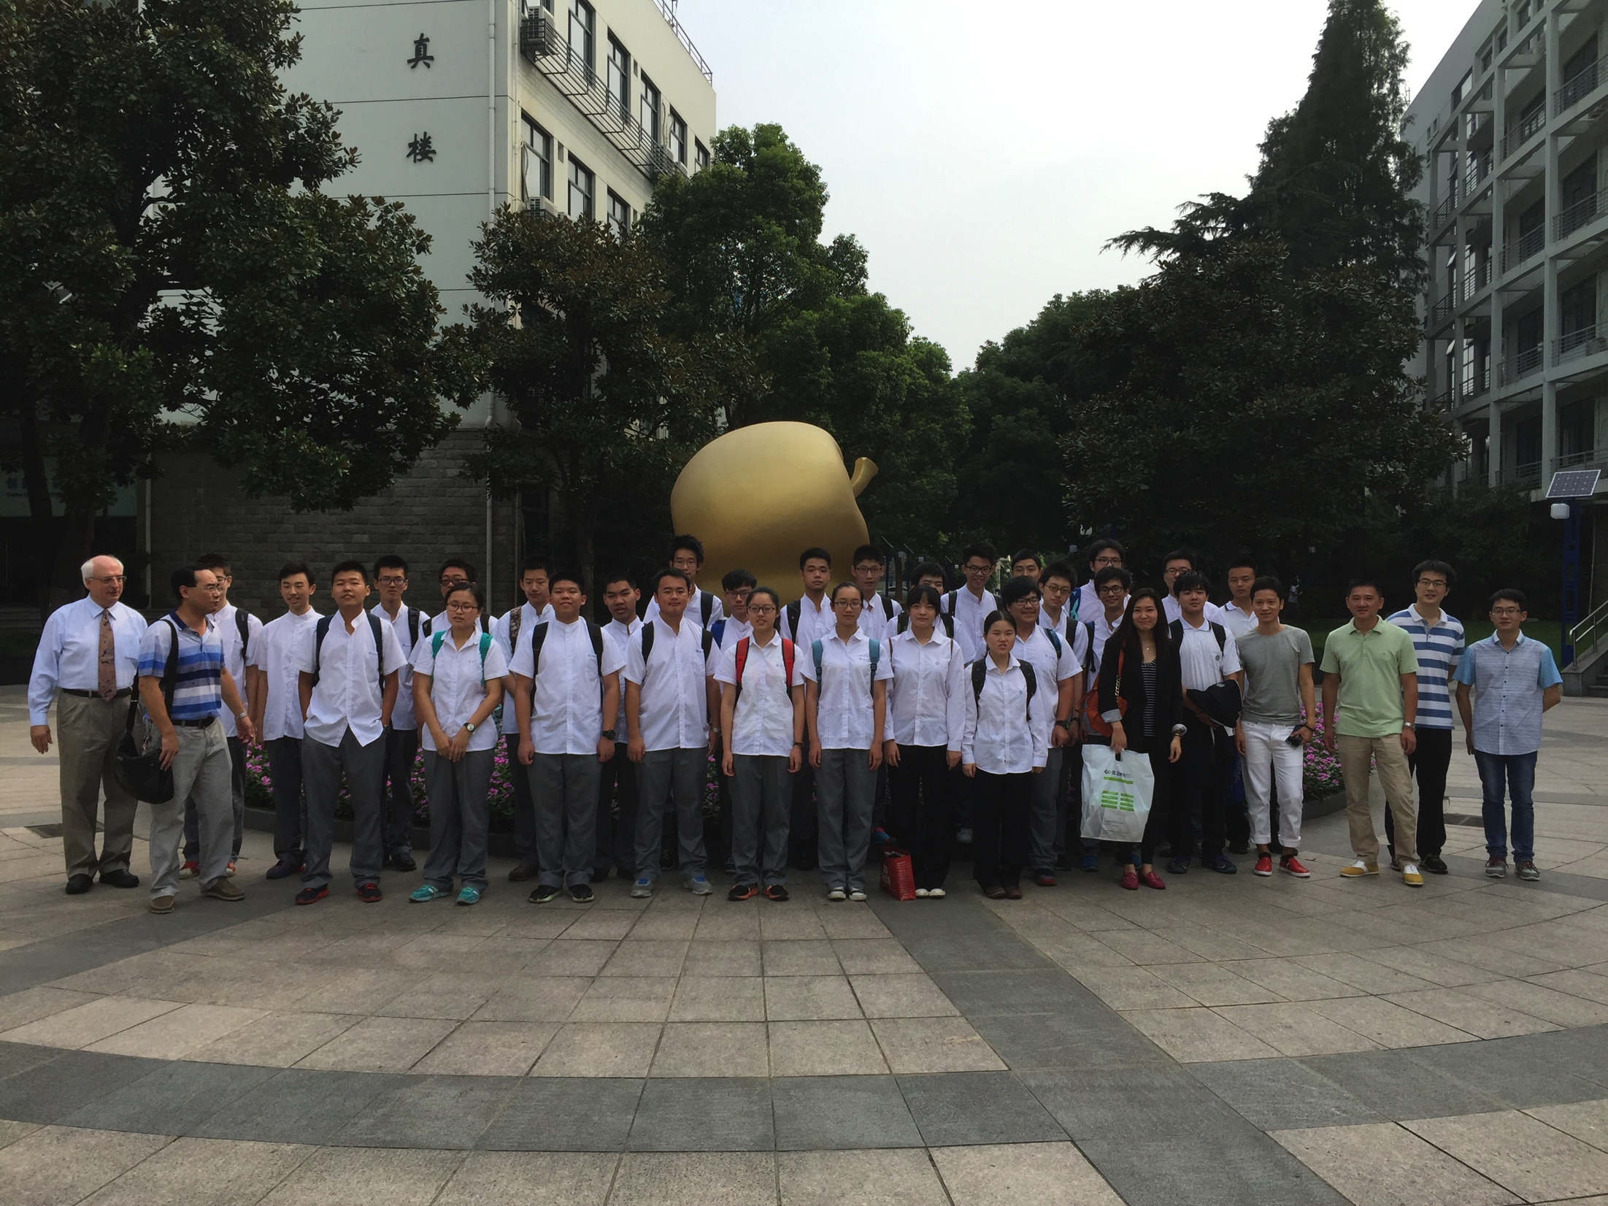
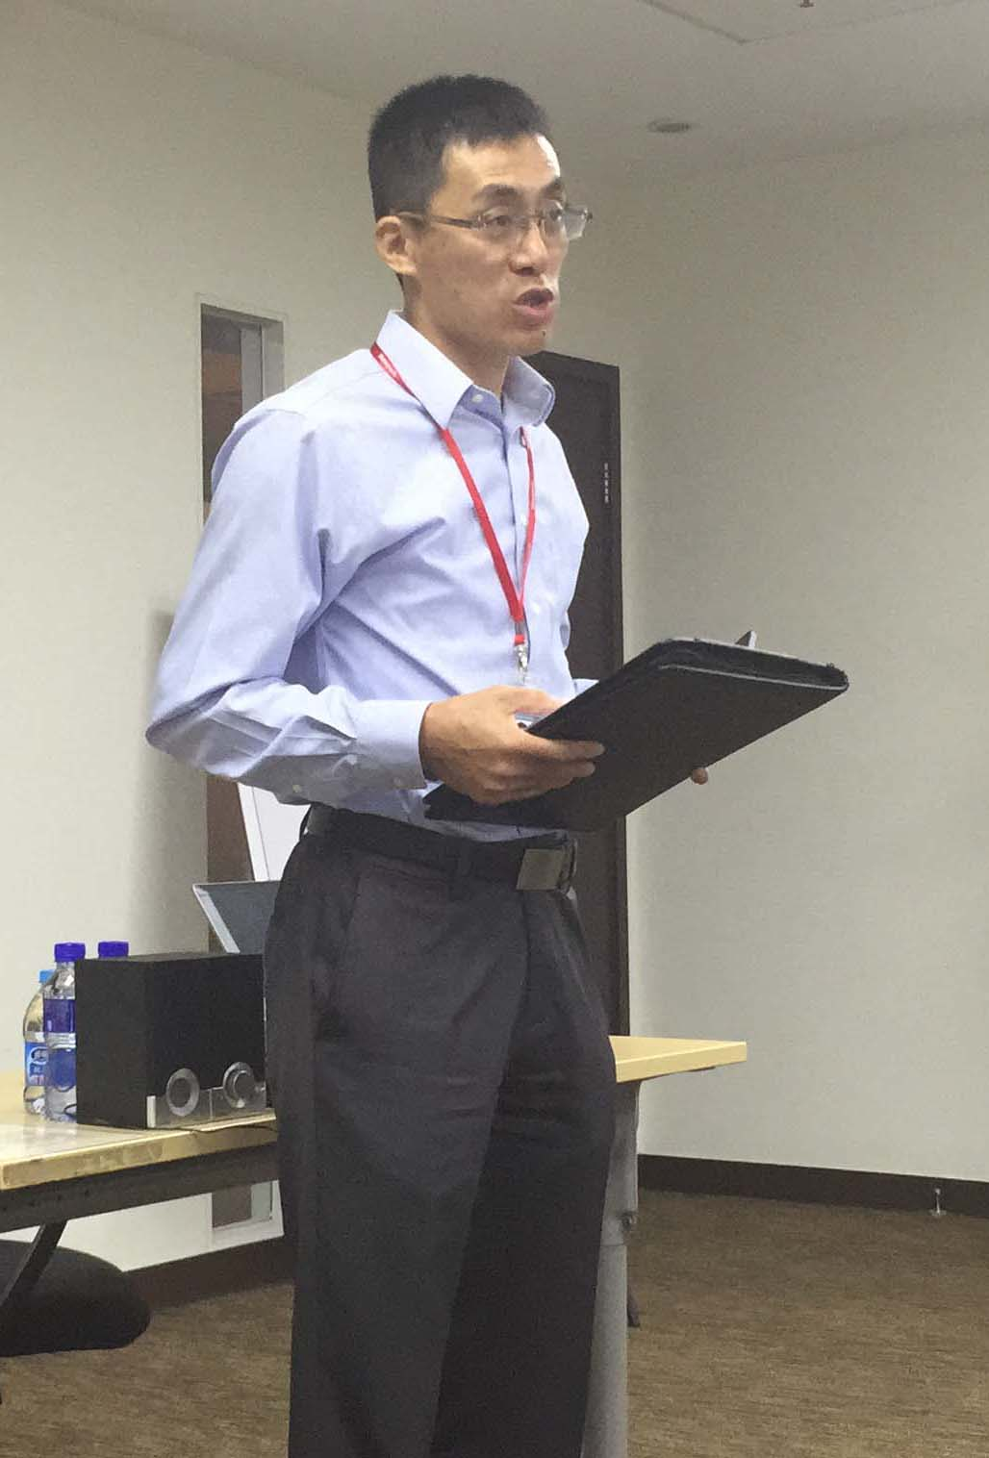
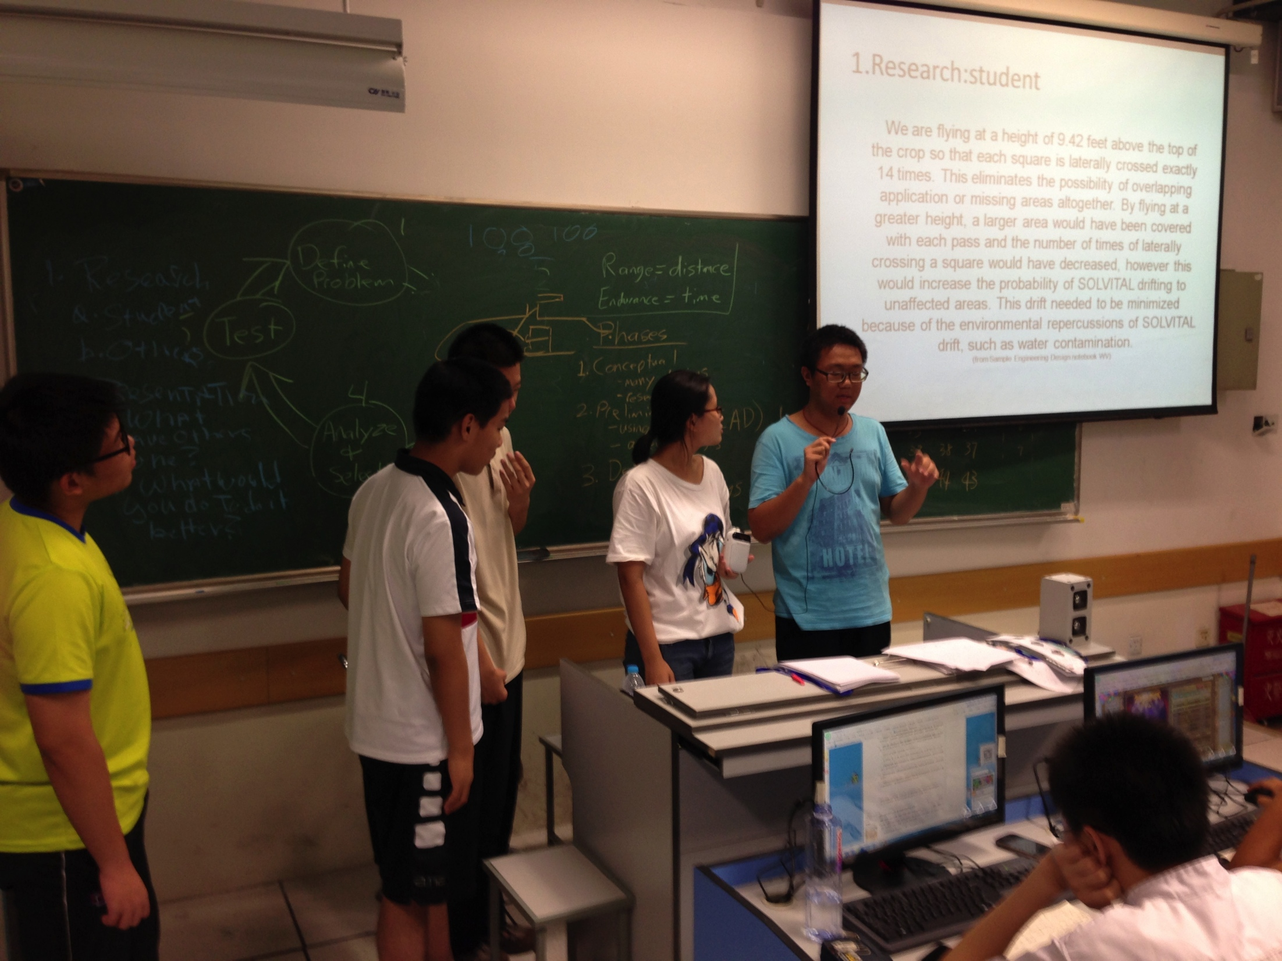
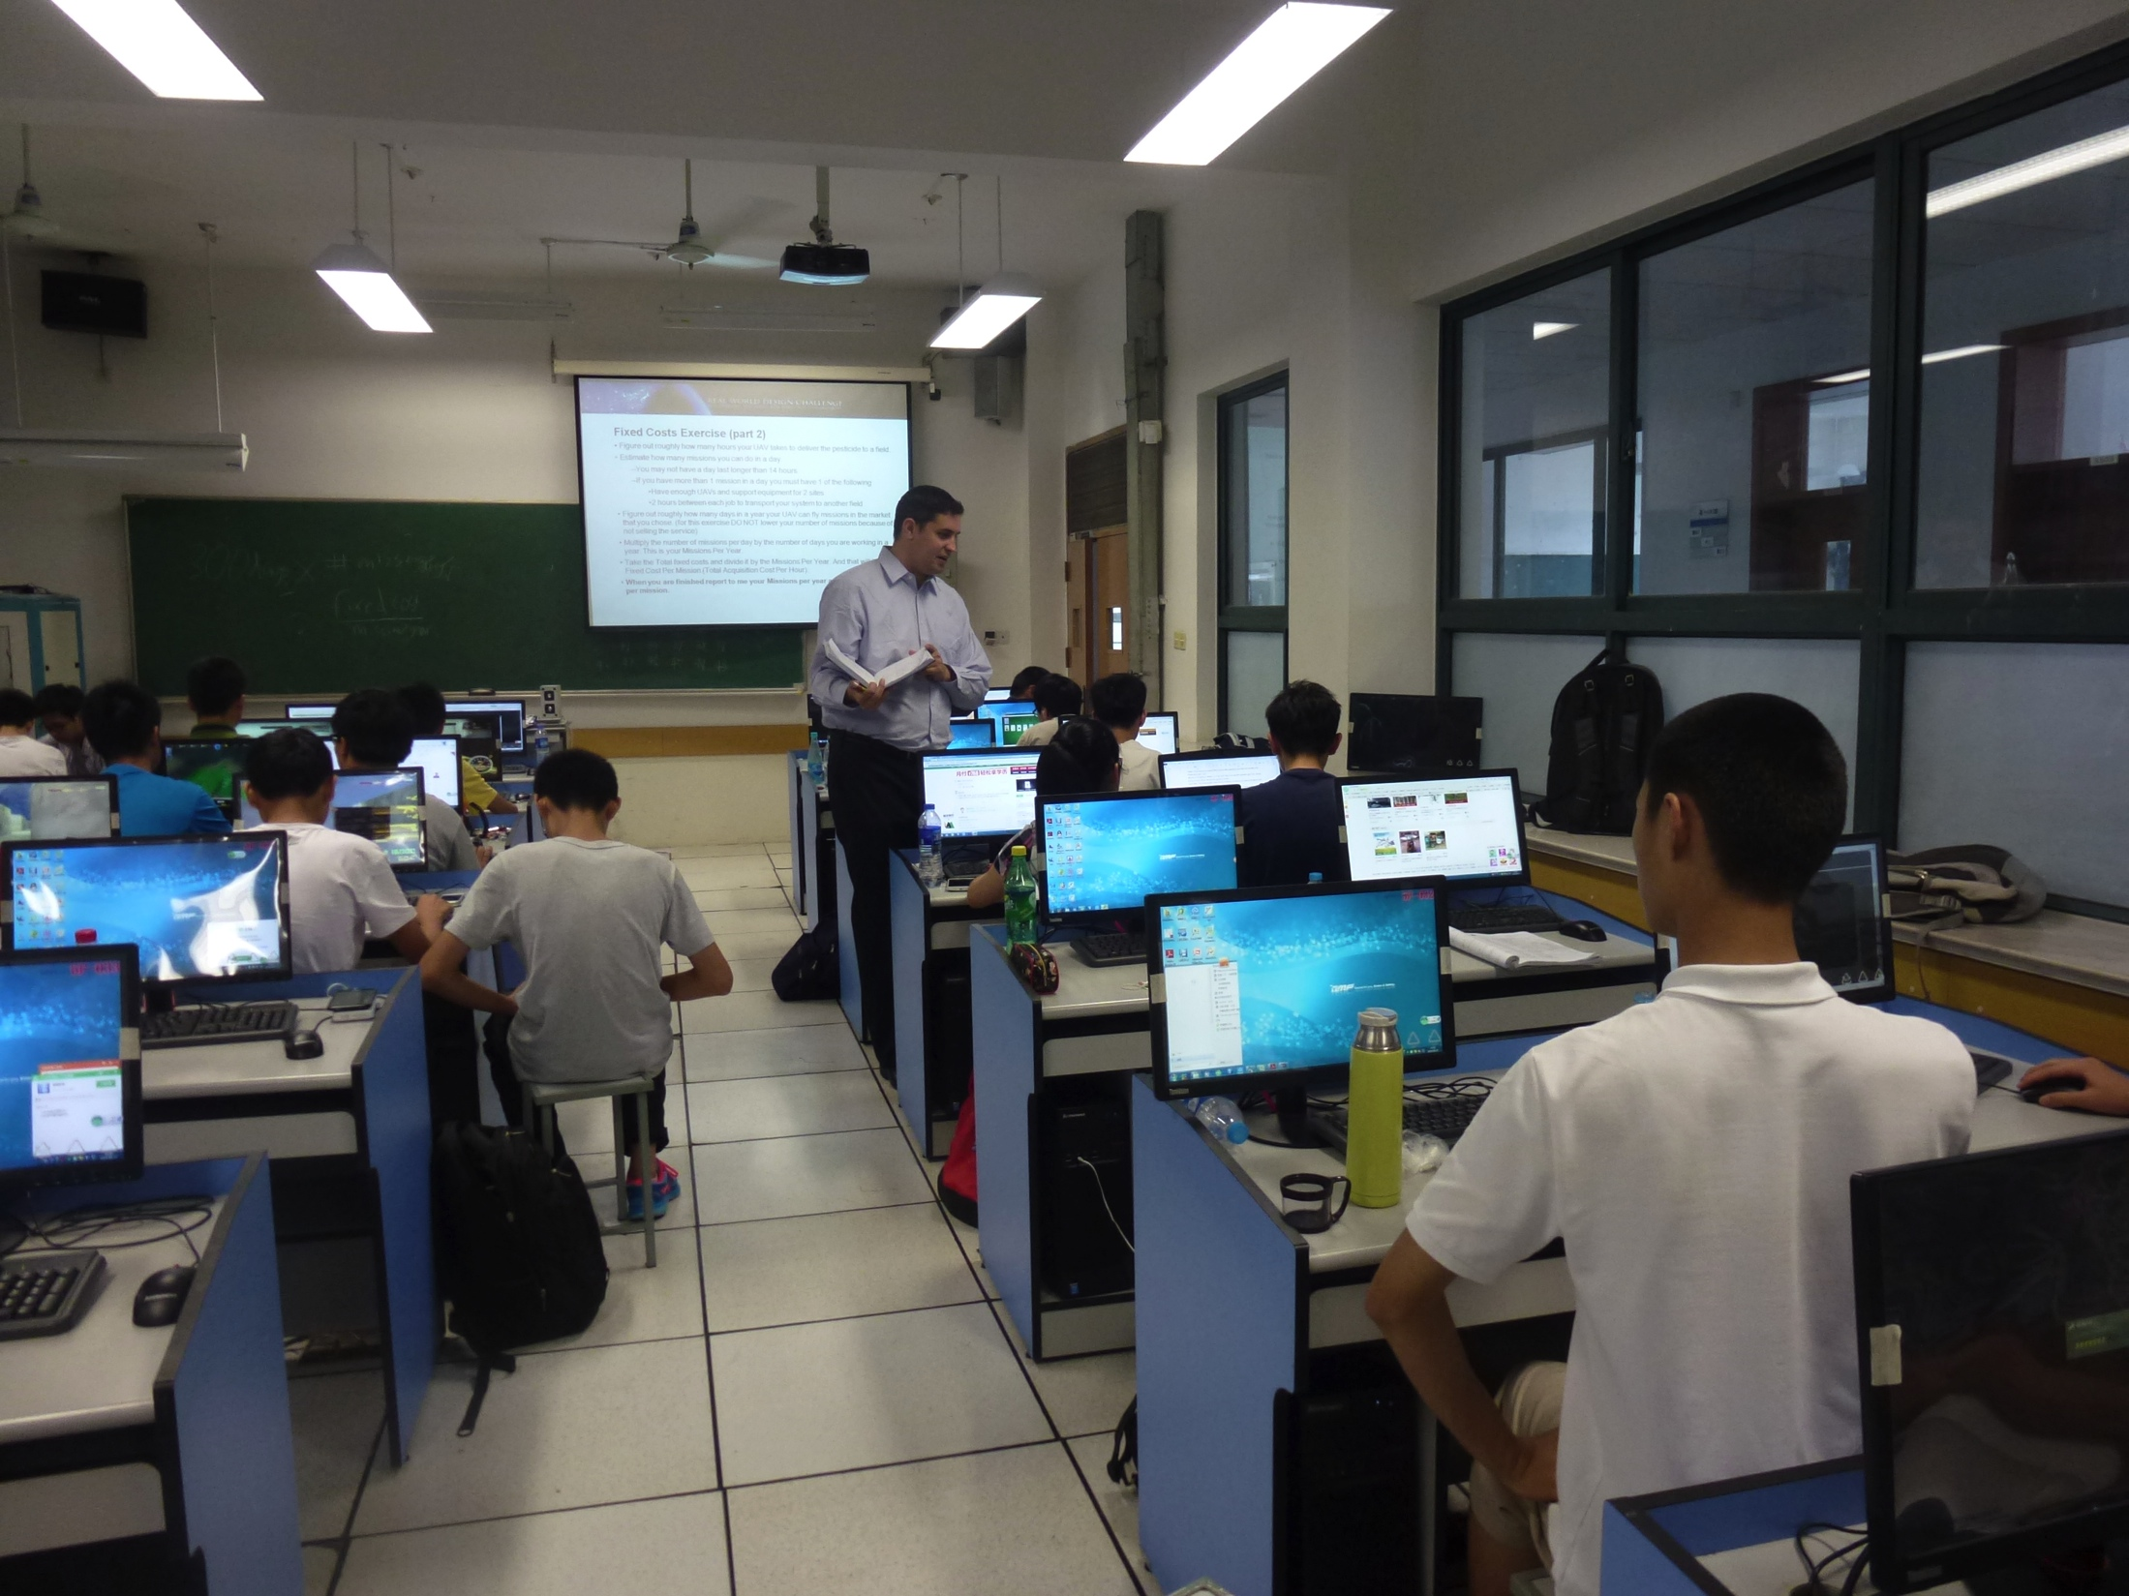
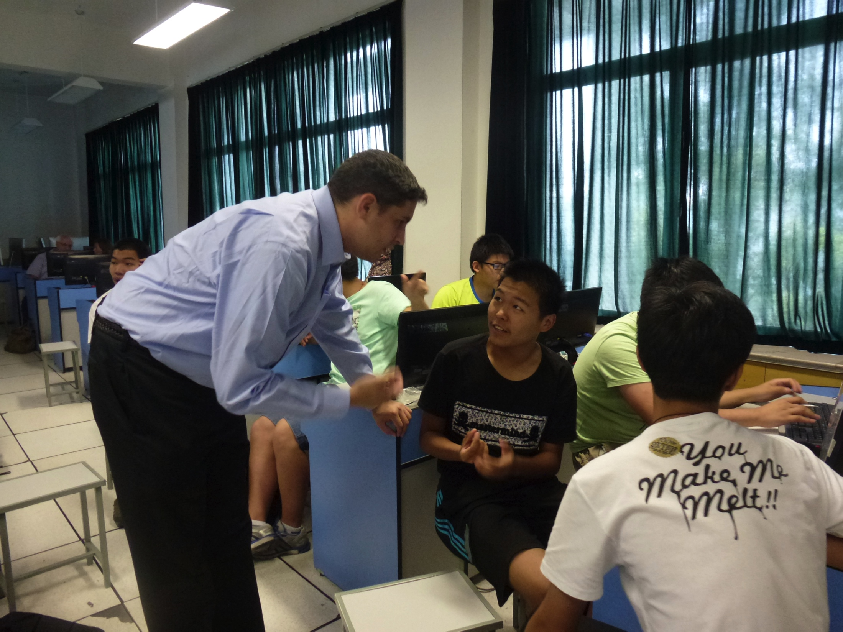
First RWDC International Workshop Shanghai China 2015
Shanghai JainPing High School
Dr. Jun Xu, Leader Engineering & Technology Honeywell

Slide 14
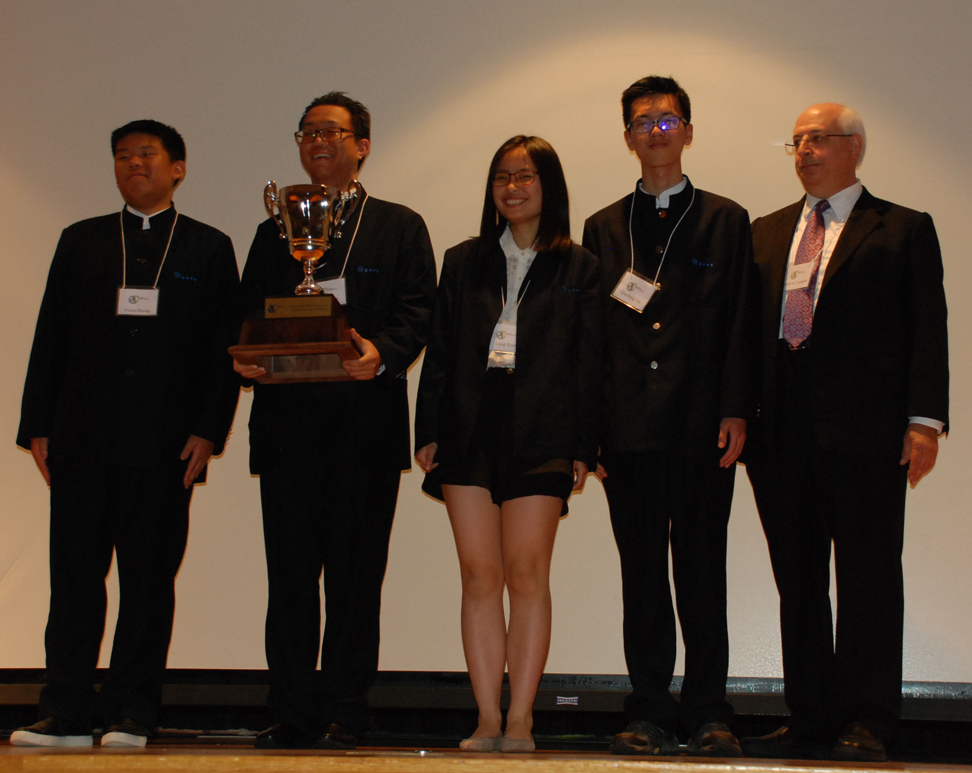
Team Zero, 2016 Top Chinese National Team
Jianping High School, Shanghai, P.R. China

Slide 15
RWDC IMPACT
Results Based on a Ten-Year Longitudinal Study in the U.S.
RWDC students perform at higher rates when compared with all U.S. students.
More than 99% of the RWDC students purse or obtained a bachelor’s degree while 70% of all U.S. students enroll in higher education.
RWDC students purse STEM fields at a rate of 89% versus 34% of all U.S. students.
More than 62% of RWDC students purse engineering versus a U.S. average of 5%.
More than 18% of RWDC students go on to pursue graduate degrees while only 4% of all U.S. students pursue graduate degrees.
We have seen similar results in China.

Slide 16
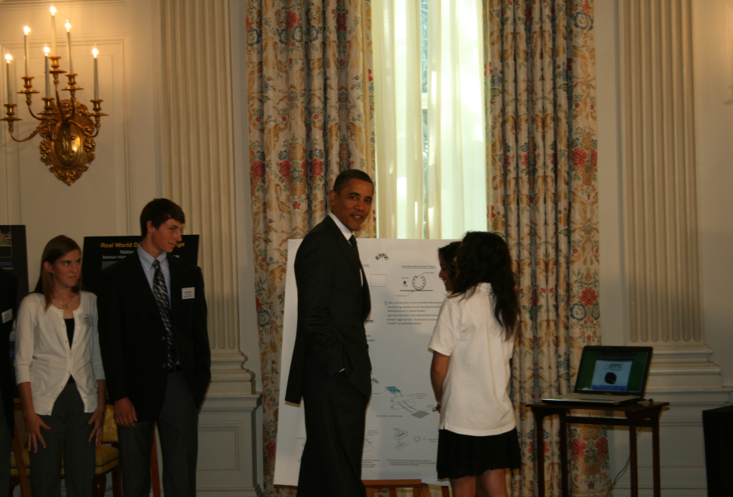
President Obama reviews the work of RWDC Students at the White House

Slide 17

RWDC Awards & Recognition
National Coalition for Aviation Education Presented on July 24th, 2012
Crown Circle Award to the Real World Design Challenge for “Extraordinary accomplishment and outreach in a leadership role in Aerospace Design Education”
National Lt. Governors’ Association
Unanimously past a resolution supporting the Real World Design Challenge
on the 24th day of June, 2011
WHEREAS, the Real World Design Challenge provides real world STEM experience for secondary students by providing a real problem, real tools and resources, real roles for students, and an opportunity for students to make real contributions;
NOW LET IT BE RESOLVED, that the NLGA encourages member states to investigate partnership with the Real World Design Challenge;
NOW LET IT BE FURTHER RESOLVED, that the NLGA encourages interested states to publicize the Real World Design Challenge, encouraging educators to take advantage of this partnership;
NOW LET IT BE FURTHER RESOLVED, that the NLGA would support, as possible, members and their state departments of education in involving teachers in the Real World Design Challenge.

Slide 18
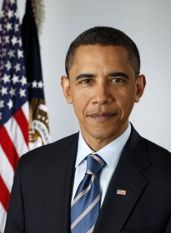
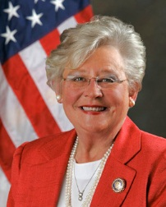



RWDC Recognized as a Driver of Economic Development & Job Preparation
“Our future depends on reaffirming America’s role as the world’s engine of scientific discovery and technological innovation, and that leadership will come from young Americans Like you. The experience gained at competitions like the RWDC will help you drive our economy as tomorrow’s entrepreneurs, innovators; and guide our Nation as our future educators, policy makers, and parents.” President Barack Obama
“The Real World Design Challenge helps recruit manufacturers to Alabama.” Alabama Governor Kay Ivy
“RWDC is a jewel in the U.S. STEM Crown. Keep it up!
Dr. Jeffrey Weld, Senior Policy Advisor & Assistant Director STEM Education, Office of Science & Technology Policy, Executive Office of President Trump
“The Real World Design Challenge is the best engineering education program in the world!” Dr. Keith Hanna, Marketing Director, Mentor Graphics Mechanical Analysis Division, United Kingdom
“…both parents and students describe the experience as ‘life changing’. In the past three years, a total of six team members have graduated from [our] high school, all have selected engineering related fields of study at their respective universities. RWDC has extended their education outside of the classroom and given them the confidence to tackle challenging engineering fields of study and helped them develop a passion for learning.” Sandy Barnes, parent of an RWDC student on the Baldwin High School Kansas Team

Slide 19
Getting Started with the Challenge
Step 1: Register your team for the RWDC Program.
Step 2: Prepare for the challenge by reviewing Challenge materials on the Getting Started Website www.realworlddesignchallenge.org. Be sure to review the following documents: State Challenge Statement; Scoring Rubric, Detailed Background; Student, Teachers, Coaches & Mentors Guide.
Step 3: Contact a mentor as soon as possible.
Step 4: Build networks with fellow team members and review documents and videos on the RWDC Getting Started Page.
Step 5: Download the software applications that will be used for this year’s challenge.

Slide 20
Getting Started with the Challenge Continued
Step 6: Participate in the RWDC Training
Step 7: Complete Formative Surveys
Step 8: Download and monitor RWDC Challenge Resources on the Getting Started Page
New Resources are added frequently – Keep checking to see what is new!

