Slide 1

The Innovation Engine
Systems Engineering
Thanks to Dr. Florian Hafner, Dr. Brent A. Terwilliger & Dr. Robert Deters, Embry-Riddle Aeronautical University

Slide 2
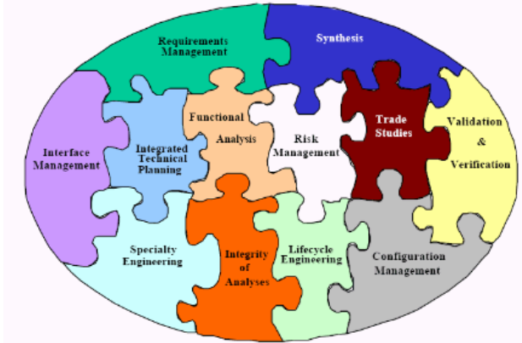
What is Systems Engineering?

Slide 3
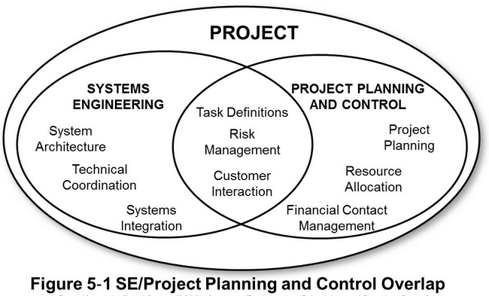
What is Systems Engineering?

Slide 4
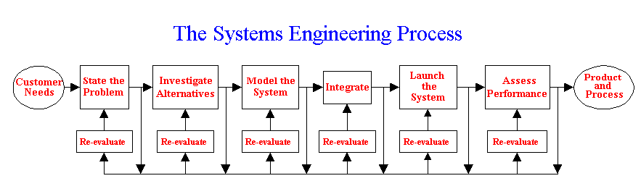
What is Systems Engineering?
Interdisciplinary approach and means to enable the realization of successful systems
Integrates all the disciplines and specialty groups into a team effort forming a structured development process that proceeds from concept to production to operation
Considers both the business and the technical needs of all customers with the goal of providing a quality product that meets the user needs.
Bahill and Gissing (1998)

Slide 5
Systems Engineering Process
State the problem. Stating the problem is the most important systems engineering task. It entails identifying customers, understanding customer needs, establishing the need for change, discovering requirements and defining system functions.
Investigate alternatives. Alternatives are investigated and evaluated based on performance, cost and risk.
Model the system. Running models clarifies requirements, reveals bottlenecks and fragmented activities, reduces cost and exposes duplication of efforts.
Integrate. Integration means designing interfaces and bringing system elements together so they work as a whole. This requires extensive communication and coordination.
Launch the system. Launching the system means running the system and producing outputs -- making the system do what it was intended to do.
Assess performance. Performance is assessed using evaluation criteria, technical performance measures and measures -- measurement is the key. If you cannot measure it, you cannot control it. If you cannot control it, you cannot improve it.
Re-evaluation. Re-evaluation should be a continual and iterative process with many parallel loops.

Slide 6
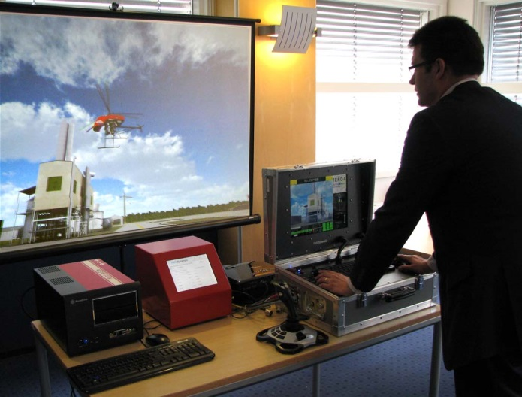
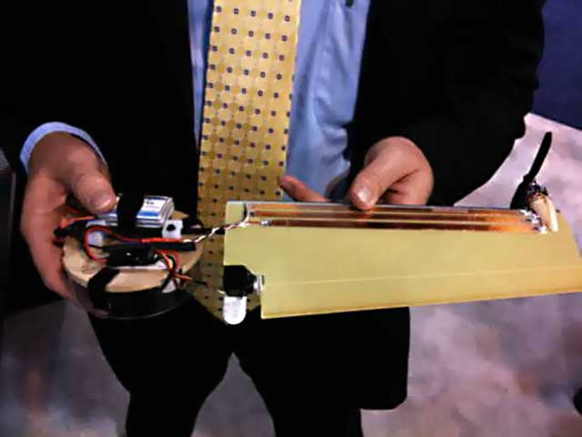
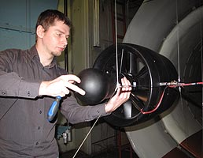
Requirements Analysis
The Systems Engineer performs functional analysis, based on requirements, and defines an overarching System architecture, structure, interrelationships, and creates derived requirements
  Do not originate with the customer, but are implied by the needs of the customer and the architecture chosen to meet those needs
Systems Engineers conduct or facilitate trade-off studies pertaining to the best approach in responding to the functional requirements
Partitions or groups similar functions into logical subdivisions
  Identifying major subsystems, configuration items, units, assemblies, modules, and so forth

Slide 7
Requirements to Product
CUSTOMER DESIRES OR
PERCEIVED CAPABILITY NEED
MARKET OPPORTUNITY
/
SUB
-
SYSTEM
#
N
THE “WHAT
?
FUNCTIONAL
SYSTEM
”
...
FUNCTIONAL
REQUIREMENTS
REQUIREMENTS
SUB
-
SYSTEM
#
2
Allocation to Disciplines
SUB
FUNCTIONAL
ARE WE GIVING THE
-
SYSTEM
#
1
REQUIREMENTS
CUSTOMER WHAT THEY
FUNCTIONAL
ELECTRICAL
SOFTWARE
. . .
MECHANICAL
REQUIREMENTS
WANT
/
NEED
REQUIREMENTS
REQUIREMENTS
REQUIREMENTS
?
Disciplines take
IS THIS PRODUCT GOOD
FOR THE COMPANY
ownership and define
?
S
(
MARKET
/
OPPORTUNITY
E
E
R
specifications
/
N
,
MARGIN
I
e
)
G
r
N
a
w
s
E
t
r
ELECTRICAL
SOFTWARE
. . .
MECHANICAL
f
e
E
o
e
N
S
n
SW
,
i
I
l
g
SPECIFICATIONS
SPECIFICATIONS
SPECIFICATIONS
L
a
n
P
c
E
i
I
r
C
t
…
S
c
I
e
l
l
a
D
E
c
i
>
a
n
=
h
c
e
M
DID WE MAKE WHAT WE SAID
DESIGN AND IMPLEMENTATION
WE WERE GOING TO MAKE
?
THE “HOW
?
HOW DO WE DO IT BETTER
”
,
FASTER
,
CHEAPER
?
ELECTRICAL TEST
SOFTWARE TEST
. . .
MECHANICAL TEST
(
Unit
/
Module Testing
-
(
Module “Desktop”
(
Unit
/
Module Testing
Quantitative
-
)
Testing
-
Quantitative
)
Quantitative
)
SYSTEM FUNCTIONAL TEST

Slide 8
Requirements & Specifications Terminology
Requirements – The “What” => What MUST the System consist of, be, functionally do? “Shall’s list”
Specifications – The “How” => How will this particular System implement the Requirements?
  Ex., Apple Macintosh vs. Windows PC => both are personal computers, but the IMPLEMENTATIONS are quite different methods of meeting often similar Requirements
  The “How” should not be spelled out in the Requirements, unless the customer is demanding a certain implementation. Limiting the “how” so early in the design process is very often detrimental to cost, performance, and System flexibility.

Slide 9
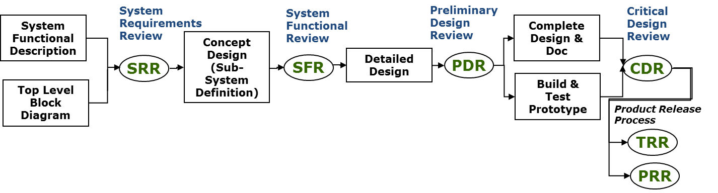
Technical Review – Phases & Control Gates
It is standard process to use a phase-gate approach to System Development, not allowing design/manufacture to continue past a certain point/degree unless the corresponding review has been satisfactorily completed
Formal Program Reviews/Phase-Gates establish relevant criteria to review with specific stakeholders (ex. Requirements, make/buy decisions design for manufacturability, bill-of-material vs. profit margin)
Informal Peer reviews – usually independent of the rigid phase-gate structure – are for checking that “things are on the right track”, as opposed analysis of far-reaching ramifications

Slide 10
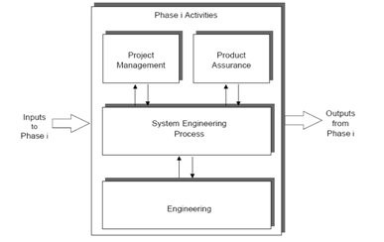
An Example Design Process – multiple different disciplines operate in parallel (i.e., multi-disciplinary)

Slide 11
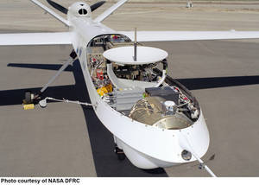
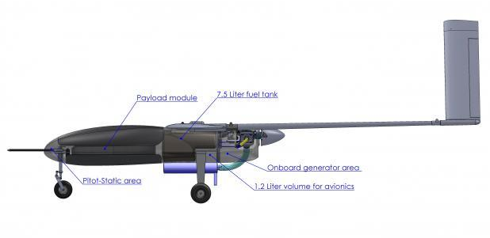
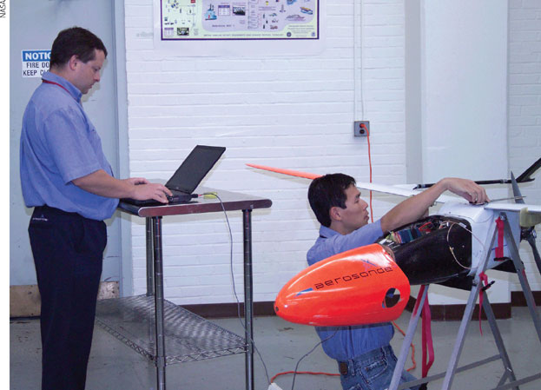
System Development
System designers, developers, and manufacturers depend on design processes
  Some use unstructured (ad-hoc) processes (unsophisticated designs; trial and error) –
  Highly-structured and organized processes (complex and detailed designs with improved reliability)
Robust and structured design processes
  Incorporate basic science, math, and engineering systems into a formal design plan
  Establish a project/program life cycle
  Provide capability to evidence the safety, reliability, and capability of systems (required for certification)

Slide 12
Why force a formal process?
Why do organizations establish such detailed frameworks? Why infringe on the “freedom” and “creativity” of the design teams?
Accomplish more work in less time with fewer people
  Identify the tasks, phases, review criteria, and documentation required
  Clarify the roles and interfaces of participants (reduce power struggles)
  Clarify the types and content of deliverables (tailored for each project)
Provide better control over scope changes
Increase quality
Increase profitability
Improve relationship with customers
Encourage good decision-making and organizational behavior (e.g., Program Gates/Checklists)

Slide 13
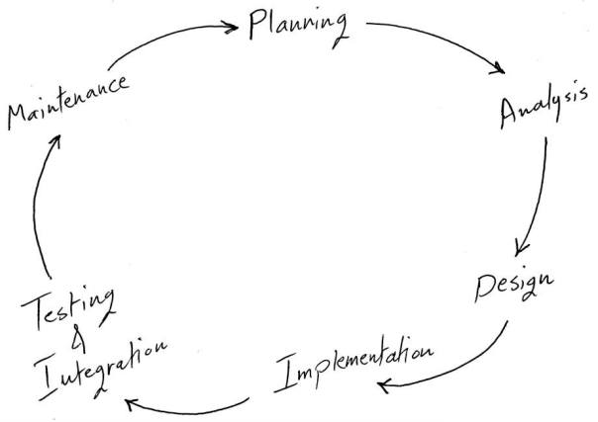
High-level Development Process

Slide 14
Life Cycle
Multiple phases compose the “life cycle” of a UAS program
  A significant program is comparable in cost to manned aircraft development (up to several hundred million dollars)
  Smaller, less complex systems require less time for each phase with lower investment cost
  In some instances the various phases may overlap
System development methodology is the framework used to structure, plan, and control process of developing a system
Multiple examples of system development life cycle models/methodologies
  Each is best suited to specific kinds of projects (based on technical, organization, project, and team considerations)
  Used to meet all requirements (functional and user), goals, and objectives
  Customizable based on project needs

Slide 15
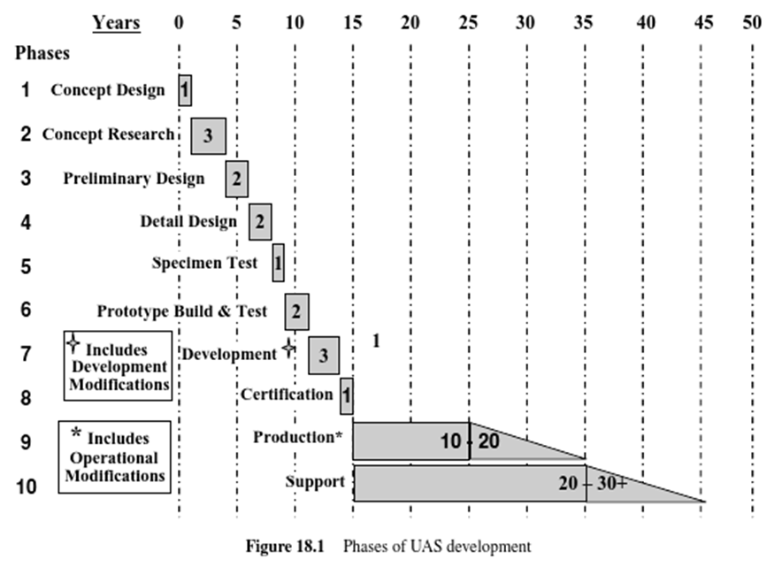
Example: 10-Phase (Waterfall) Method
Project divided into 10 sequential phases
Emphasis placed on planning, time schedules, target dates, budgets, and implementation of an entire system at one time
Tight control maintained through use of extensive written documentation and formal reviews

Slide 16
System Design
Research & Observe
Form a Point of View
Ideate
Prototype & Test
Evaluate & Iterate
How system functions/capabilities are achieved through a structured design process
Ideate – Process of forming, relating, and communicating ideas

Slide 17
UAS System Design
You will be asked to follow a Structured Systems Engineering and Design Process for RWDC
  Conceptual Design
  Preliminary Design
  Detailed Design
You will be asked to conceptualize and develop a model UAS – it is different from typical systems
Many details of System operation and interaction do not scale proportionately when compared to large aircraft

Slide 18
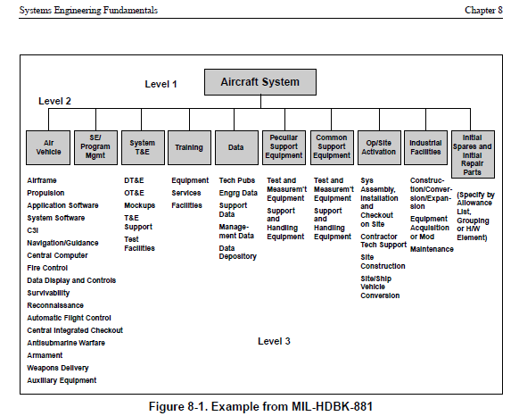
Designing the System is about more than just vehicles

Slide 19
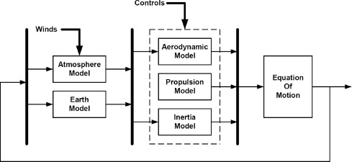
Matters of Scale
Consider all the various components comprising the mathematical model of a flying vehicle. How many of the parameters are different for a scaled-down Unmanned System?
Aerodynamics
Propulsion
Inertia (mass)
Time lag in controls (if remote; i.e., latency)

Slide 20
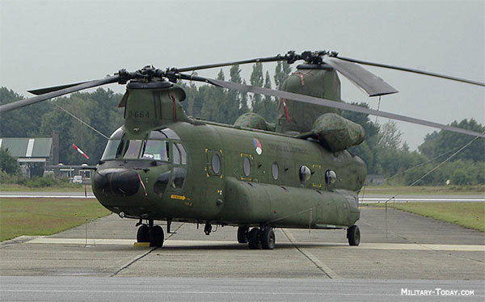
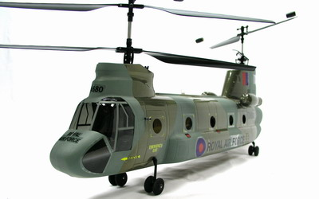
Example: Consider a full-sized, manned helicopter rotor vs. that of a small unmanned remote control helicopters that are common for hobbyists; the smaller rotorcraft exhibit
  a much higher ratio of the main rotor mass to the fuselage mass;
  the rotation speed of the main rotor of toy helicopters is generally higher than that of most full-sized helicopters
  toy helicopters have very stiff main rotors without flapping hinges and the complexity/articulation of a full-sized helicopter

Slide 21
UAS Design is a Different
Unmanned Systems change nature of design options, operational limits
Concept/Model => can differ drastically between UAS & comparable manned system
BIG MISTAKE: Do not assume “safety” does not come into play
UNDERSTAND THE REQUIREMENTS AND CONSTRAINTS

Slide 22
Questions ???

