Slide 1

The Innovation Engine
Introduction to Unmanned Aerial System (UAS)
Types of Unmanned Planes
Dr. Florian Hafner, Embry-Riddle Aeronautical University
Thanks to Dr. Florian Hafner, Dr. Brent A. Terwilliger & Dr. Robert Deters, Embry-Riddle Aeronautical University
Thanks to Dr. Brent A. Terwilliger & Dr. Robert Deters, Embry-Riddle Aeronautical University

Slide 2
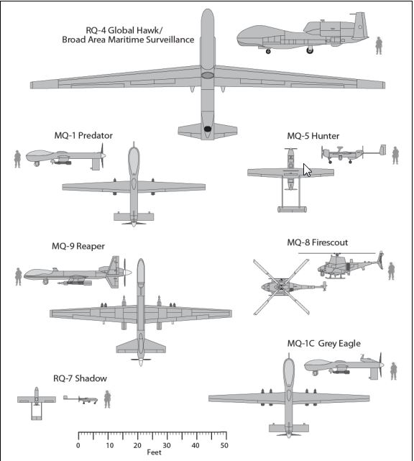
UAS Classification by Size
*Source: : Congressional Budget Office, Policy Options for Unmanned Aircraft Systems, Publication 4083, Washington,
DC, June 2011

Slide 3
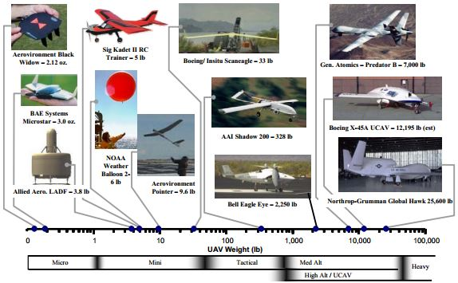
UAS Classification by Weight
*Source: : Weibel and Hansman, 2004. Safety considerations for operation of different classes of UAVs in the NAS. Chicago, IL.

Slide 4
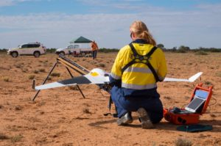
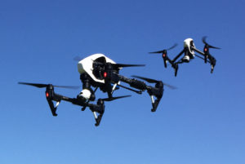
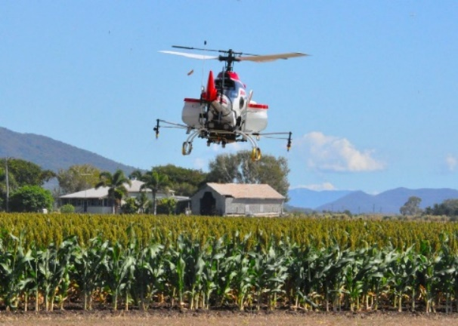
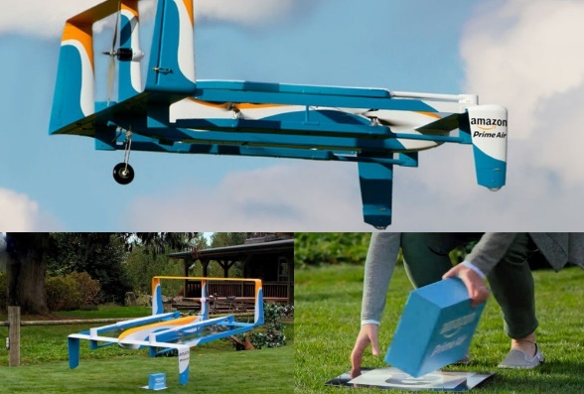
Types of Drones you may Consider
Fixed Wing
Multi Rotor
Single Rotor Helicopter
Fixed Wing Hybrid VTOL

Slide 5
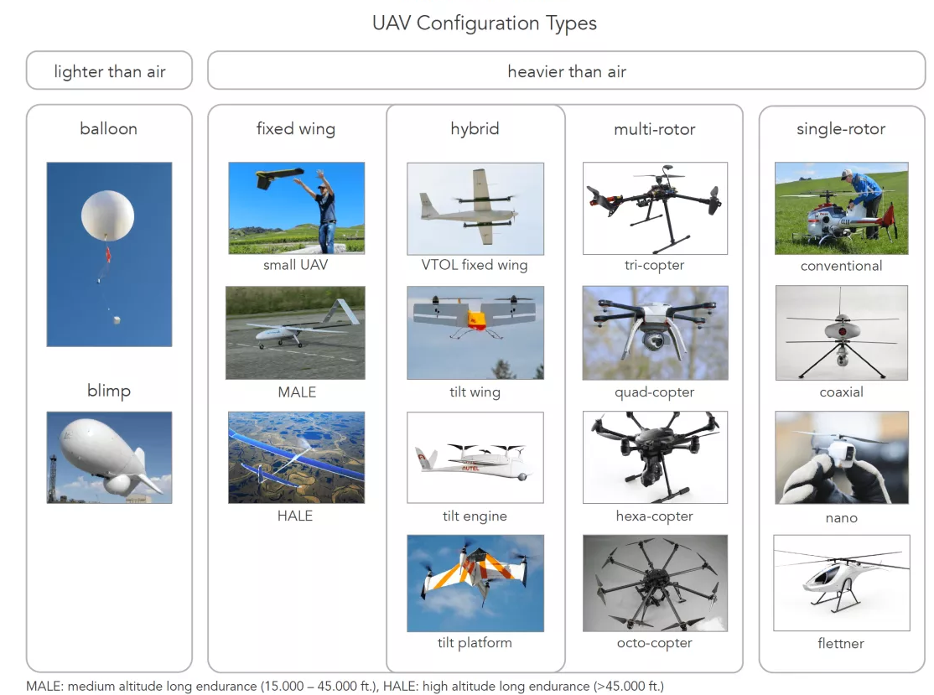
Types of Drones you may Consider
*Source: Drone Industry Insights, 2016

Slide 6
Pros & Cons
 | Pros | Cons | Typical Uses
Multi-Rotor | Accessibility Ease of use VTOL and hover flight Good camera control Can operate in a confined area | Short flight times Small payload capacity | Aerial Photography and Video Aerial Inspection
Fixed-Wing | Long endurance Large area coverage Fast flight speed | Launch and recovery needs a lot of space no VTOL/hover Harder to fly, more training needed Expensive | Aerial Mapping, Pipeline and Power line inspection
Single-Rotor | VTOL and hover flight Long endurance (with gas power) Heavier payload capability | More dangerous Harder to fly, more training needed Expensive | Aerial LIDAR laser scanning
Fixed-Wing Hybrid | VTOL and long-endurance flight | Not perfect at either hovering or forward flight Still in development | Drone Delivery
*Source: Australian UAV, 2016

Slide 7
You will design your own !!!
But here are some basic commercial ones that are available

Slide 8
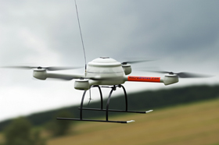
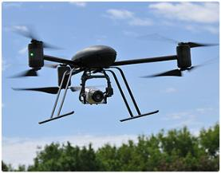
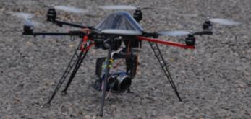
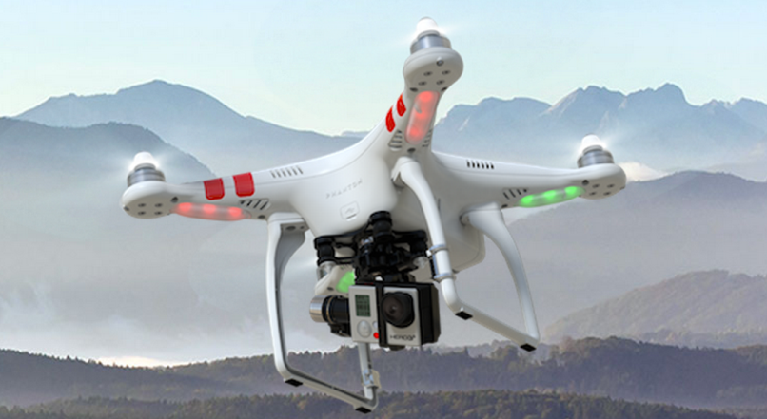
Rotary Drones
MicroDrone MD4-200
€ 25,000 +
DraganFly X6
http://www.microdrones.com
Mikrokopter
$2K +
$ 3- $15k
http://www.draganfly.com
http://www.mikrokopter.us/
DJI Phantom (<$1000)
http://www.dji.com/product/phantom-2/

Slide 9
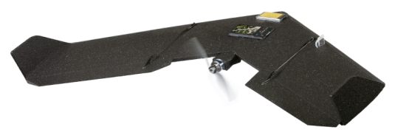
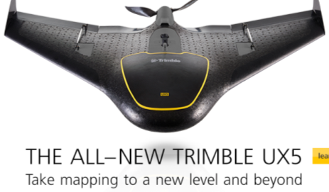
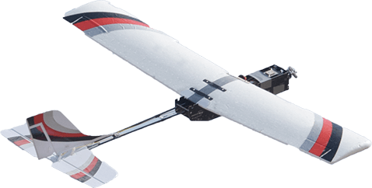
Fixed Wing
Swinglet CAM
http://www.sensefly.com
Trimble-Gatewing
http://uas.trimble.com/
Precision Hawk

Slide 10
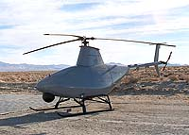
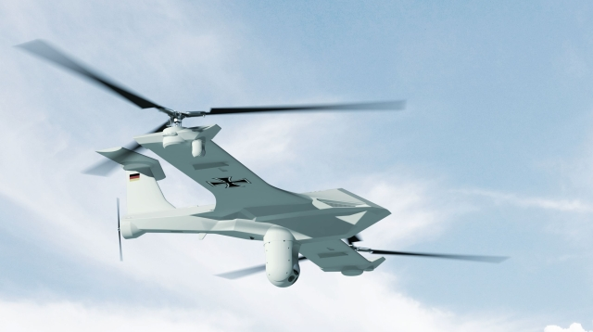
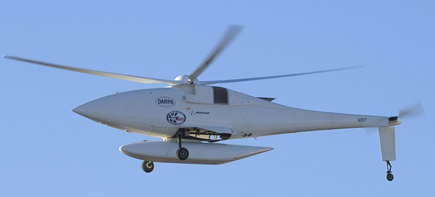
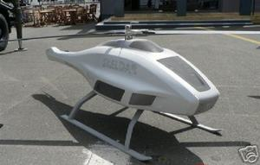
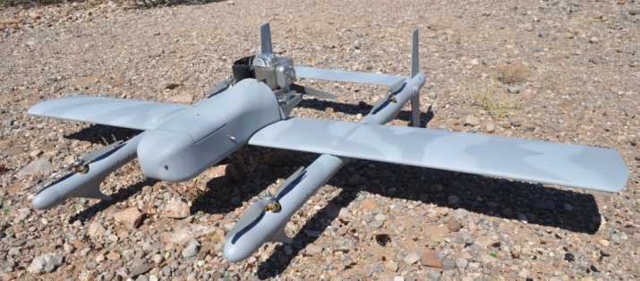
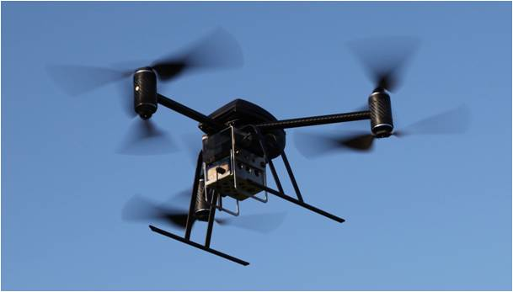
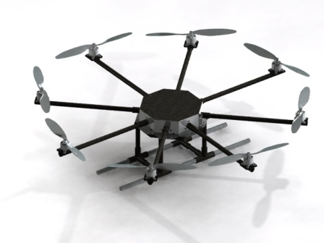
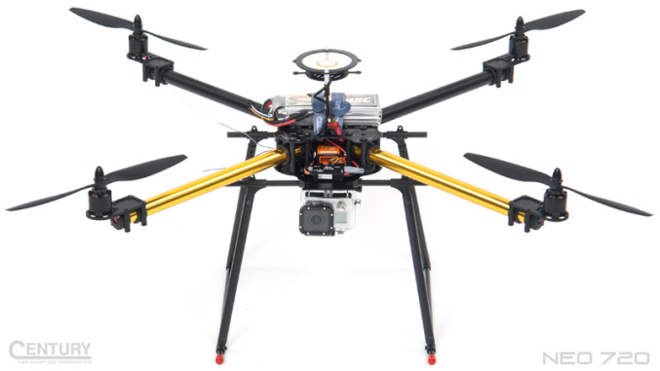
Questions ???

