Slide 1
Expert Systems
Dr. Chuck West
Thursday 11 October 2024

Slide 2
Introductions
Dr. Chuck West

Slide 3
Introductions
What you want me to call you
Programming experience
Discipline or business
What you want to learn tonight

Slide 4
Expert Systems
Expert systems is a branch of Artificial Intelligence
Simulate the judgment and behavior of a human
Narrow AI in that expertise and experience in a particular field.
Expert systems are usually intended to complement, not replace, human experts but…
Numerous applications

Slide 5
Expert System Advantage
… the most intriguing and powerful characteristic of ES’s, and that which distinguish them from more traditional computer applications is
their capability to deal with challenging real-world problems through the application of processes that reflect human judgement and intuition.
David Rolston

Slide 6
Expert Systems
The concept of expert systems was developed in the 1970s by computer scientist Edward Feigenbaum, a computer science professor at Stanford University.
Feigenbaum stated the world was moving from data processing to knowledge processing.
That meant computers had the potential to do more than basic calculations capable of solving complex problems.
In 1970s the U.S. Navy was developing weapon systems using this technology.
This change was due to enhanced processor technology, cheaper and smaller memory, and advanced computer architectures.

Slide 7
Expert Systems
Solve complicated problems that would otherwise require extensive human expertise.
To do so, it simulates human reasoning process by applying specific knowledge and inferences.
Initially intended to assist humans in decision making, not to replace them but has migrated to the realm of replacing them.
Autonomous vehicles
Robotics

Slide 8
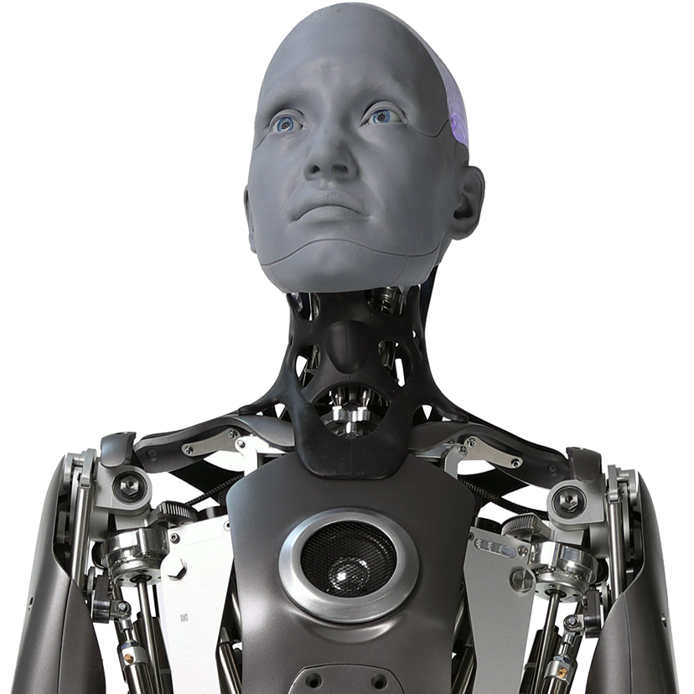
Expert Systems
A mechanical device or system, which can think contemplate, observe, listen, walk, speak, and sense like a human.
Expert system can be integrated with robotics to merge human intelligence with machines, so as to achieve smart work like that of humans by embedding features such as reasoning, knowledge/intelligence, and problem-solving capabilities.
Ajay K. S. Singholi & Divya Agarwal

Slide 9
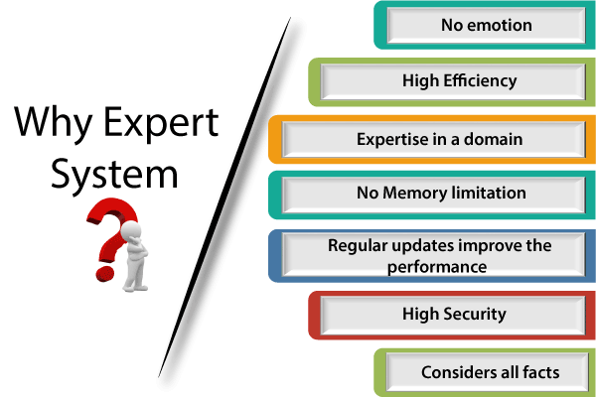
Why Expert System

Slide 10
Why Expert System
Cheaper!

Slide 11
Why Expert System
More dependable

Slide 12

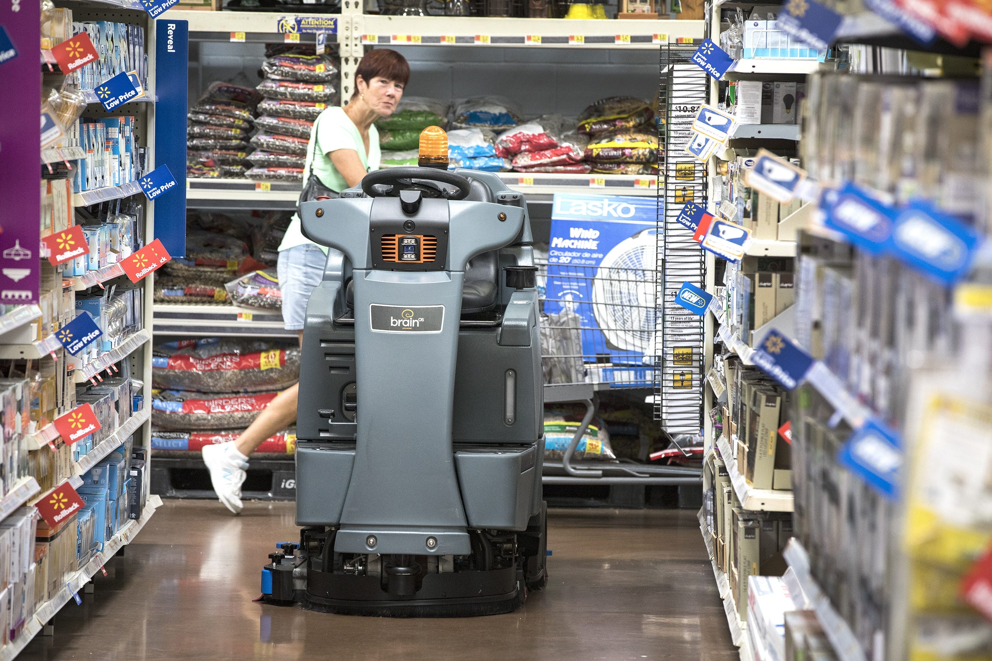
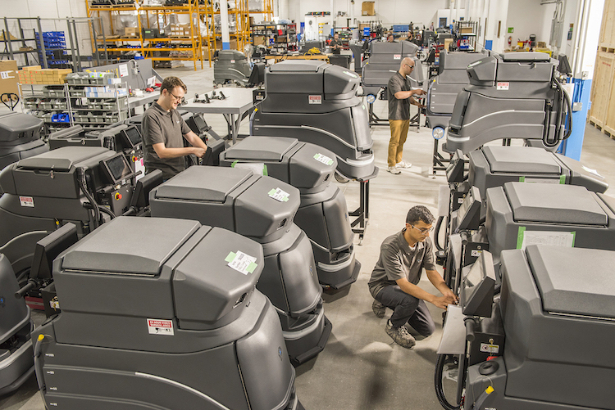
Walmart – Menards Robots

Slide 14
Expert Systems Characteristics
Extensive specific knowledge from the domain of interest
Application of search techniques
Support for heuristic analysis
Capacity to infer knowledge from existing knowledge
Symbolic processing
An ability to explain its own reasoning

Slide 15
Symbolic Logic

Slide 16
Heuristic Analysis
Approach to discovery, learning and problem solving
Usability testing
UX design
Auto industry
Military
Medicine
…

Slide 17
Heuristic Analysis

Slide 18
Examples
Dendral (predict molecular structure from chemical analysis data)
Macsyma (computer algebra system)
Prospector (decision making in mining)
Dxplain (suggests potential diseases based on a doctor’s findings)
MYCIN(identify various bacteria that can cause severe infections)
Teiresias (knowledge tool – can be used in conjunction with MYCIN)
R1/XCON (developing computer systems)
CaDet (identify cancer at early stages)
PXDES (cancer diagnosis pneumoconiosis X-Ray)

Slide 19
How do we feed Expert Systems?

Slide 20

Gathering and Analyzing Knowledge
Art form
Scientific in nature
Multiple sources
Gentle approach
Systematic approach
Interpreting human expert
Written procedures or processes
Facts
Heuristic rules (general rule or rules of thumb)

Slide 21
Gathering Knowledge
Where would you go in your discipline?
Accounting (NetSuite)
Law (Westlaw)
Purchasing (procurify)
Tax preparation (…)

Slide 22
How would you insure…
Consistency
Usability
Validation
…

Slide 23
Knowledge Storage
Knowledge base (primitives)
Knowledge scheme is critical to success
Knowledge engineer’s domain

Slide 24
Primitive
Conceptualization (form an idea or principle in your mind)
Action (key element)
Objects
Modifiers of actions
Modifiers of objects
Analyzing a sentence at the conceptual level

Slide 26
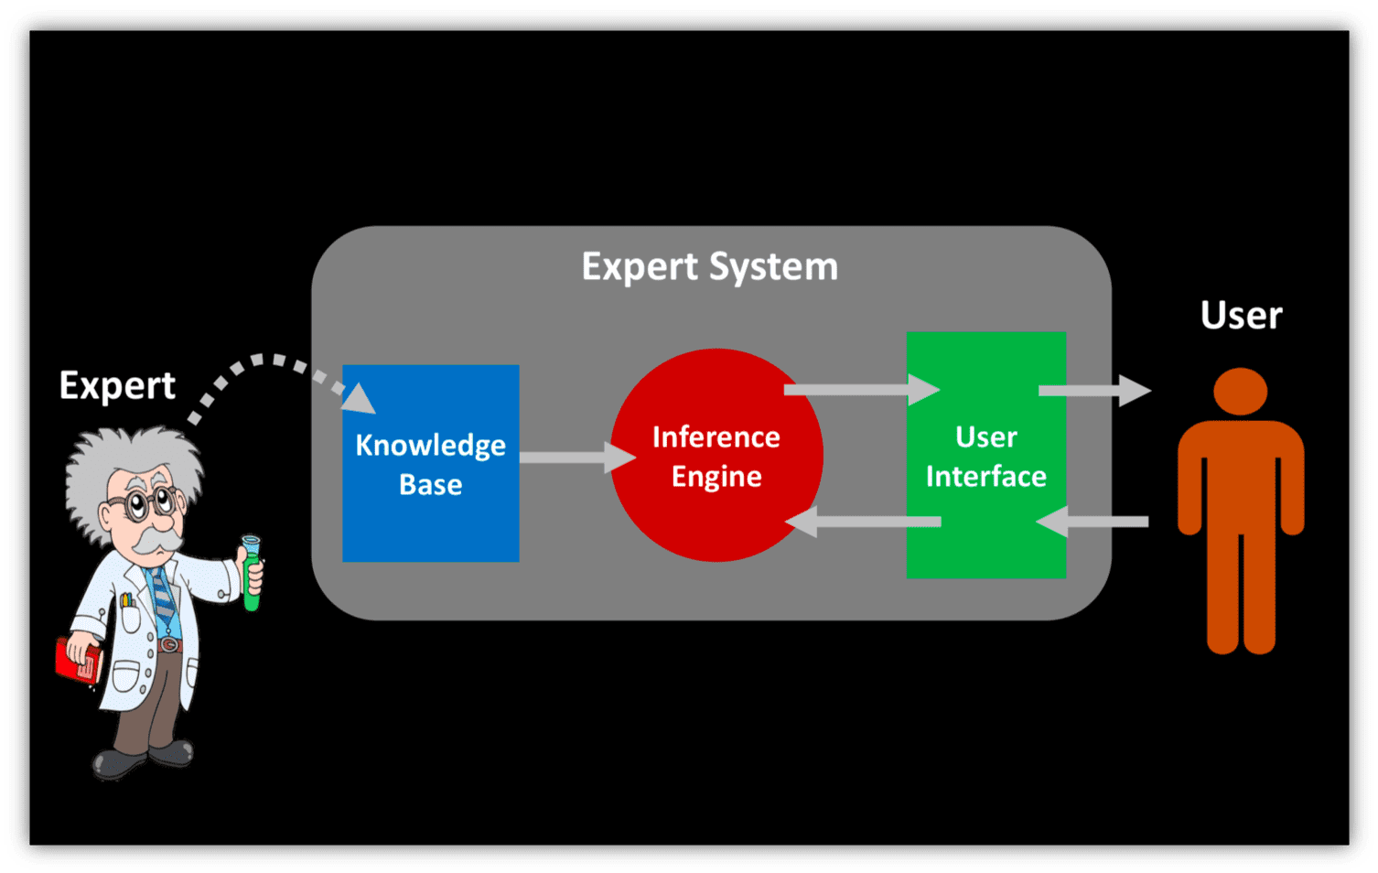
Inference Engine

Slide 27
Inference Engine
Software component of an intelligent system that applies rules to the knowledge base to deduce new information.
All mammals breathe oxygen
Dogs are mammals
Therefore …

Slide 28
Inference Engine

Slide 29
Knowledge Representation
Extremely important
Experience necessary

Slide 30
Who or what am I?
I can be dangerous

Slide 31
Who or what am I?
I can be dangerous
I can be hot

Slide 32
Who or what am I?
I can be dangerous
I can be hot
I am part of the earth

Slide 33
Who or what am I?
I can be dangerous
I can be hot
I am part of the earth
I create lava

Slide 34
Types of ESs
Assistant
Small knowledge-base
Limited subset of a task
PC based
Colleague
Medium sized knowledge-base
Significant subset of a task
PC based, mainframes, specialized workstations
Expert
Large knowledge-base
Approaches experts' level of knowledge
Sophisticated development tools

Slide 35
Typical System
Knowledge acquired from a “limited” number of human experts
Written knowledge
Verbal knowledge
Experiential knowledge
Application limited to a specific domain
Domain has little need for spatial or temporal reasoning

Slide 36
A.I. Problem Solving
Two-pail problem
Calculating taxes
HR hiring
Routing deliveries
Making change
Teaching?

Slide 37

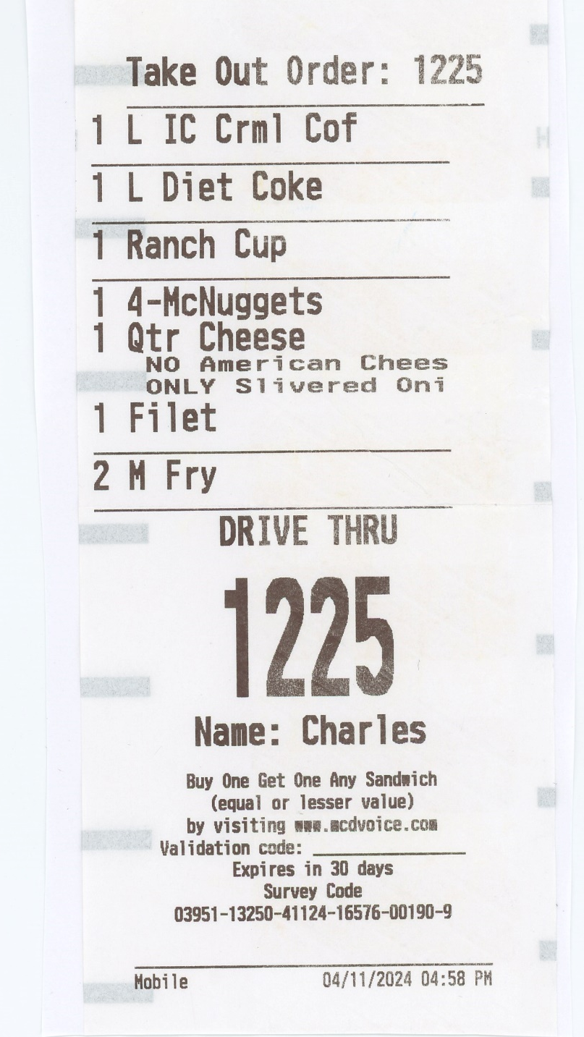
Customer Satisfaction: Getting the Order Right
Errors Made
Order taker did not follow guidelines when conversing with customer X2
Iced Carmel Coffee was never delivered
Ranch cup never delivered
Deliver person delivered one item thinking order was for only one item
Server made three trips to customer
Medium drink delivered instead of Large drink
Meal was cold after 17-minute fast-food experience

Slide 38

How can an YOU smooth the process?
Education

Slide 39

How can an YOU smooth the process?
Education
Experience

Slide 40

How can an YOU smooth the process?
Education
Experience
Expert System

Slide 41


How can an YOU smooth the process?

Slide 42

Could an ES robotic replace … ?
Robot costs have declined
The time and energy needed to program them and get them online has diminished greatly
The cost of the human has increased and will continue to do so

Slide 43

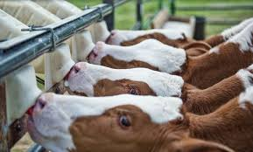
Expert System Reusability

Slide 44
Chaining
Forward chaining: Forward chaining is a form of reasoning for an AI expert system that starts with simple facts and applies inference rules to extract more data until the goal is reached.
Backward chaining: Backward chaining is another strategy used to shape an AI expert system that starts with the end goal and works backward through the AI’s rules to find facts that support the goal.

Slide 45
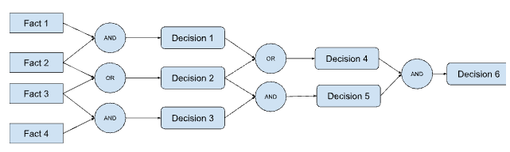
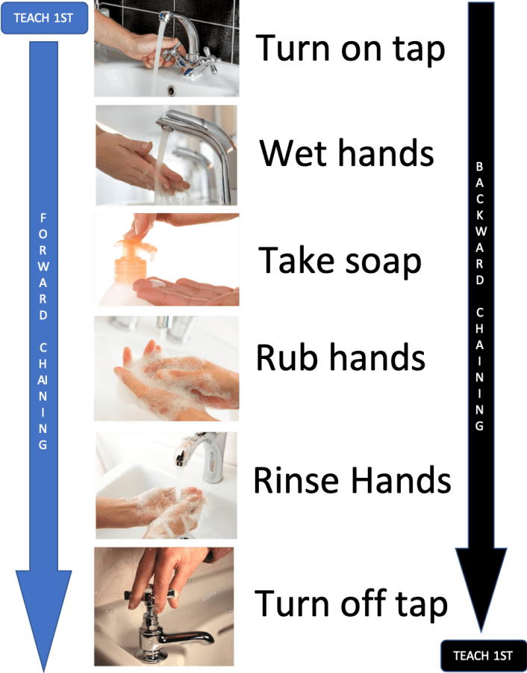
Forward Chaining

Slide 46
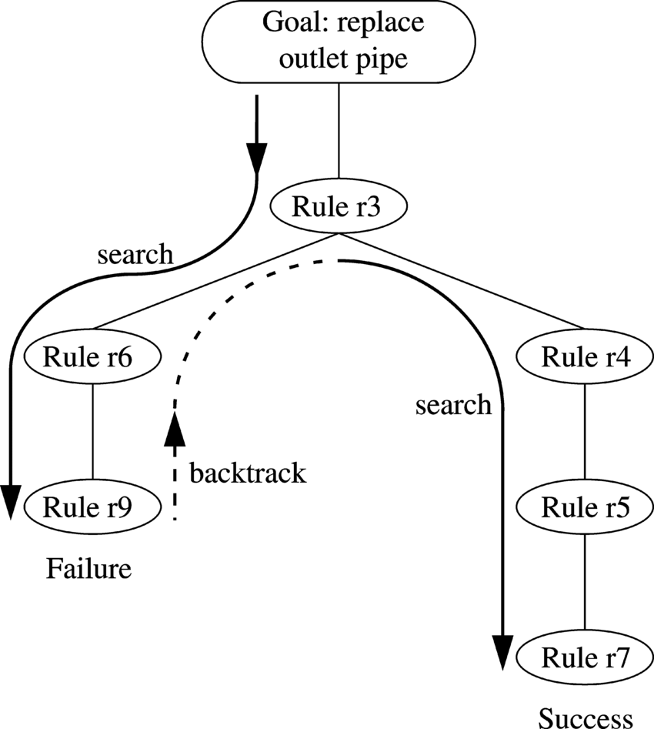
Backward Chaining

Slide 47
How to build Expert System

Slide 48

Communicating
What did you mean?

Slide 49
Symbolic Logic
AND
OR
EXCLUSIVE
OR
IF THEN
IMPLIES
NOT
EQUALS
EQUALS

Slide 50
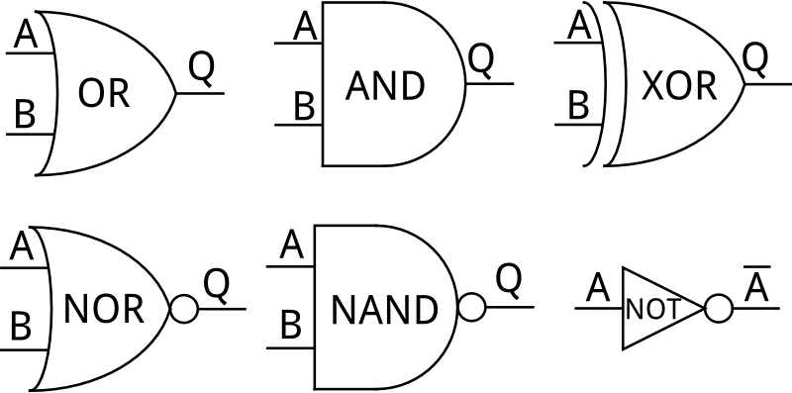

Slide 51
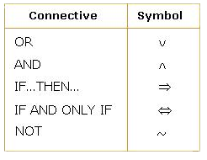

Slide 52
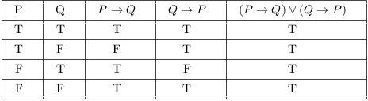
Truth Table

Slide 53
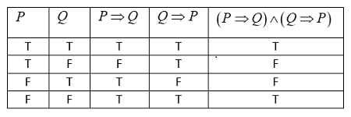

Slide 54


Slide 55
Expert System Overview

Slide 56

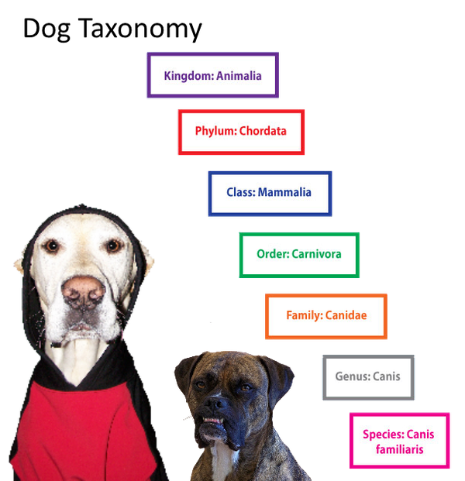






EXTERNAL DATABSE
KNOWLEDGE BASE
FACTS
RULE: IF-THEN-ELSE
RULE: IF-THEN-ELSE
RULE: IF-THEN-ELSE
RULE: IF-THEN-ELSE
RULE: IF-THEN-ELSE
INFERENCE ENGINE
USER INTERFACE
EXPLANATION FACILITY

Slide 57
Prolog
Line by line procedural language
Expert System Shells
An expert system shell can be considered as a expert system with the knowledge removed. Therefore, all the user has to do is to add the knowledge in the form of rules and provide relevant data to solve a problem.
Notes:
Procedural Language is also known as 3GL which means third generation language. It is a type of programming language that follows a procedure; set of commands or guidelines that must be followed for smooth execution of the program. It works on step by step basis. It requires the user to tell not only What to do but also How to do it. Its basic idea is to have a program specify the sequence of steps that implements a particular algorithm. Hence, Procedural languages are based on algorithms.
In this developers use variables, loops, and functions to create a program performing a specific task which does calculations and displays a desired output.
It follows a top-down approach. It is carried out in a fixed sequence with a start and end point. The entire program is divided into functions and its main focus is on functions only. The program’s code executes linearly with logical steps. In this, the code is written first and executed with some conditions. The procedure calls to decide the conditions.
There are no data-hiding features in procedural language. It is command command-driven language. It is operated by means of commands keyed in by the user or issued by the program. In procedural language, both iterative and recursive calls are used. It works through the state of the machine. It returns only restricted data types and allowed values. It is highly efficient despite the fact the size of the program is quite large and is not suitable for critical applications with complex code. It takes a lot of time but it needs very less memory.

Slide 58

Prolog
Line by line procedural language
Expert System Shells
An expert system shell can be considered as a expert system with the knowledge removed. Therefore, all the user has to do is to add the knowledge in the form of rules and provide relevant data to solve a problem.
Notes:
Procedural Language is also known as 3GL which means third generation language. It is a type of programming language that follows a procedure; set of commands or guidelines that must be followed for smooth execution of the program. It works on step by step basis. It requires the user to tell not only What to do but also How to do it. Its basic idea is to have a program specify the sequence of steps that implements a particular algorithm. Hence, Procedural languages are based on algorithms.
In this developers use variables, loops, and functions to create a program performing a specific task which does calculations and displays a desired output.
It follows a top-down approach. It is carried out in a fixed sequence with a start and end point. The entire program is divided into functions and its main focus is on functions only. The program’s code executes linearly with logical steps. In this, the code is written first and executed with some conditions. The procedure calls to decide the conditions.
There are no data-hiding features in procedural language. It is command command-driven language. It is operated by means of commands keyed in by the user or issued by the program. In procedural language, both iterative and recursive calls are used. It works through the state of the machine. It returns only restricted data types and allowed values. It is highly efficient despite the fact the size of the program is quite large and is not suitable for critical applications with complex code. It takes a lot of time but it needs very less memory.

Slide 59
Python
Python: Python stands out as one of the leading AI programming languages.
Simplicity
Extensive libraries (such as NumPy, Pandas, and TensorFlow)
Community

Slide 60
Prolog Python
Prolog
Python
prolog_while(0) : !
prolog_while(N, A) :
N1 is N -1,
A1 is A + 1,
prolog_while(N1, A1).
my_set = {'apple', 'banana', 'cherry'}
for x in my_set:
print(x)

Slide 61
Prolog Python
calMedian(X,Y,Z) :-
X > Y ->
(
Temp is X, X is Y, Y is Temp
; X is X, Y is Y
),
Y > Z ->
(
Temp is Y, Y is Z, Z is Temp
; Y is Y, Z is Z
),
X > Z -> (
Temp is X, X is Z, Z is Temp
; X is X, Z is Z
),
write('Median is : '),writeln(Y).
age = 27
if age >= 60:
print('Senior Discount')
elif 18 <= age < 60:
print('No Discount')
else:
print('Junior Discount')

Slide 62
Prolog
Prolog is a logic programming language.
It has important role in artificial intelligence.
Unlike many other programming languages, Prolog is intended primarily as a declarative programming language.
In prolog, logic is expressed as relations (called Facts and Rules).
Core heart of prolog lies at the logic being applied.
Formulation or Computation is carried out by running a query over these relations.

Slide 63
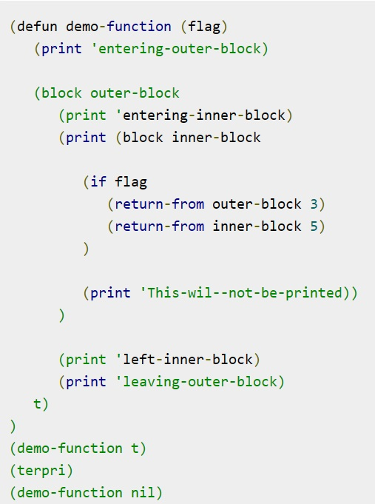
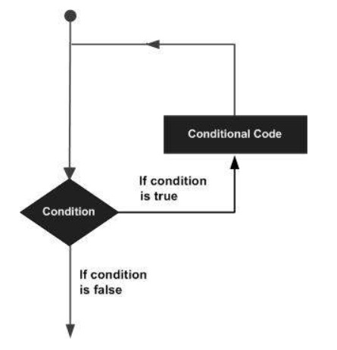
LISP

Slide 64
Recursion

Slide 65
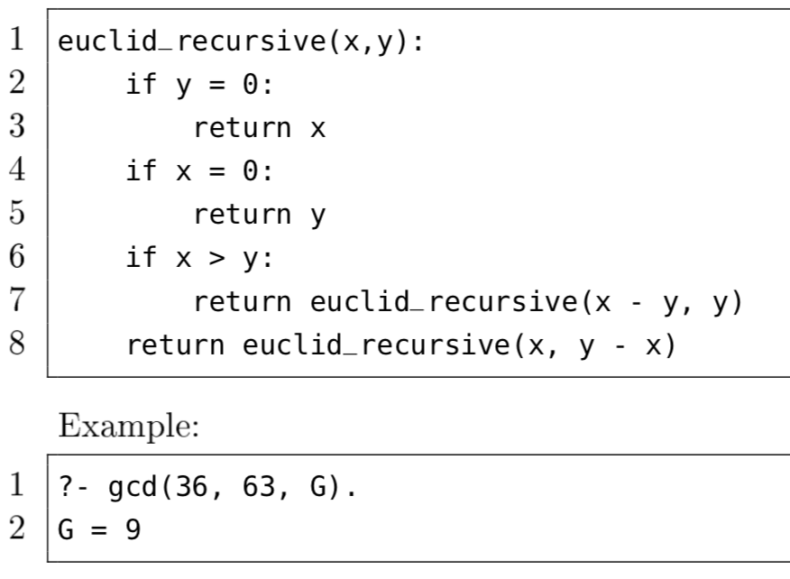
Prolog (A.I. rule based)

Slide 66
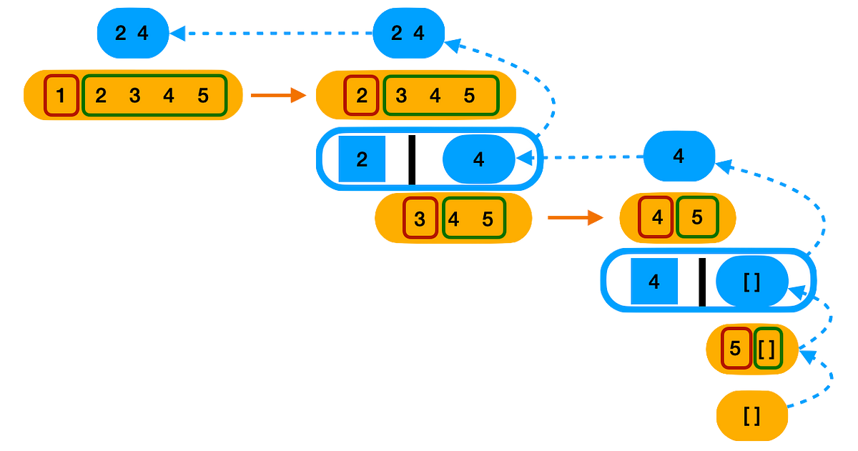
Prolog (A.I. rule based)

Slide 67
Expert System Shells
1. Knowledge engineer’s development aids.
2. Knowledge acquisition aids.
3. User-system interfaces
5. Explanation facilities
6. Language interfaces
BootPoot

Slide 68
Knowledge engineer’s development aids:
The knowledge engineer’s development aids assist the knowledge engineer in the development of expert systems.
These aids provide the capabilities necessary to build effective systems that are not provided by the other components.
They include screen formatters, graphic development aids, and multipurpose editors.

Slide 69
Knowledge Acquisition Aids
The knowledge acquisition subsystem controls the flow of new knowledge from the human experts to the knowledge base.
It determines what new knowledge is needed or whether the received knowledge is indeed new, i.e. whether or not it is included in the knowledge base and if necessary, transmits them to the knowledge base.

Slide 70
Reasoning or Inference engines
Inference mechanisms that are used for manipulating the symbolic information and knowledge contained in the knowledge base in order to form a reasoning path towards the solution of a problem.
The inference engine component of the expert system shell is the foundation of the inference engine
The control logic for the expert system is based on the inference engine component. Normally, this component contains all the control logic required by the expert system.

Slide 71
User-system Interfaces
The most important component is the user-system interface.
This represents the means of communication with the user.
Many components involved in expert system shells are designed to make the user-system interaction more flexible and friendly. Common features include graphic interfaces, menus, windows, explanation features and natural language dialogue.

Slide 72
User-system Interfaces
It is important to ensure that the expert system shell provides complete user-system interface functionality for two reasons.
First, without a comprehensive user-system interface, the developed system will be more difficult for a user to learn and use.
Second, the knowledge engineer will have to develop the requisite user-system interface functionality, and this can take up a great deal of time and effort.

Slide 73
Explanation Facilities
This is a subsystem that explains the system’s actions by trying to give reasons why a certain cause of action or a certain conclusion was chosen by an Expert System.
The explanation can range from how the final or intermediate solutions were arrived at to justifying the need for additional data.
Can anyone say IRS AUDIT?

Slide 74
Language Interfaces
Language interfaces are important when the expert system design calls for the system to perform data manipulation, which is not included in the ES technology.
The language interface functions provided with most expert system shells allow the expert system builder to interface the expert system with programs external to it.

Slide 75


Simulates judgement and behavior of humans

Slide 76

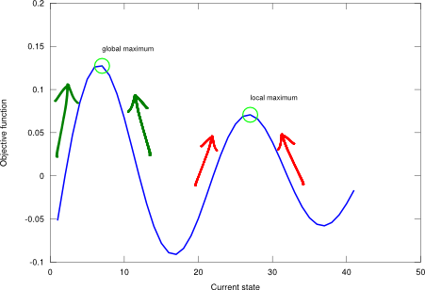
Heuristic Strategies
Generate and test
Best first search
Hill Climbing – Greedy local search

Slide 77
Interface Function
The language interface functions provided with most expert system shells allow the expert system builder to interface the expert system with programs external to it.

Slide 78
Working storage
Database
Tables
Arrays
Potentially external sources

Slide 79
Inference Engine
Key component
Applies logic rules to knowledge base
Deduces new information

Slide 80
Conflicting Rules
Major issue
Typically resolved in testing phase

Slide 81
Advantages of Expert System
Roll-you-own for your own discipline or problem
Outsourcing knowledge base is not required
Emulates how humans think and solve problems
Known AI mechanism
Ability to obtain a considerable amount of knowledge within a domain
Minimal reaction time
Can handle complex problems

Slide 82
Scalability
Knowledge base
Inference engin
User interface

Slide 83
Disadvantages
Time required to initially set up Expert Systems
Limited number of Expert System engineers for design and development
Not effective in all environments - limited domain
Lack of common sense and creativity features
Potentially High implementation and maintenance cost
Lack of experience in creating inference rules

Slide 84
User Interface

Slide 85


Slide 86
SUDOKU

Slide 87
Possible Solvable Unique Grids
6,670,903,752,021,072,936,960
6 sextillion
670 quintillion
903 quadrillion
752 trillion
21 billion
72 million
936 thousand

Slide 88
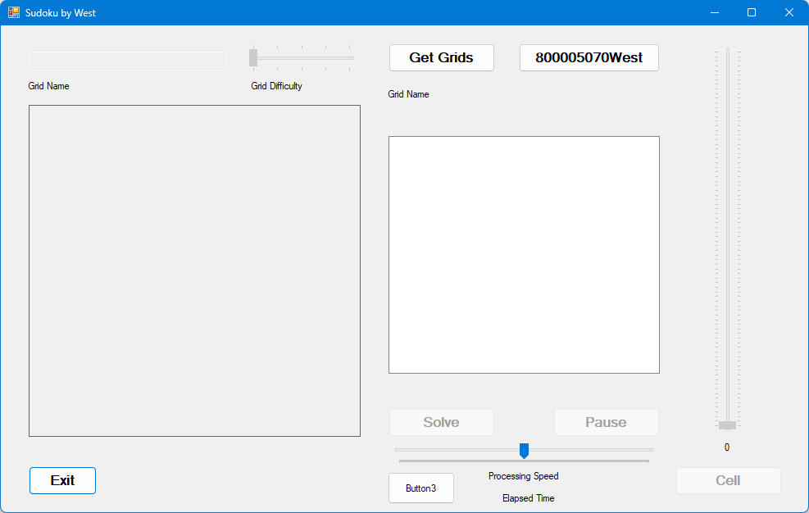
Sudoku Explanation Facility
Get Grids
Click on
Select desired Grid file
Grid Name will appear
Grid difficulty will
Grid files will display
Click on desired Grid
Click on
Grid will be processed
Click to pause processing
Click to continue processing
Solve
Pause
Resume

Slide 90
Sudoku Explanation Facility

Slide 91
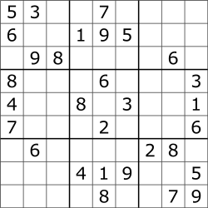
Knowledge Representation
Cell Values
Numeric
1 through 9
Null
Given or Guess
Concept of Row
Concept of Column
Concept of playing field
Concept of ERROR
Concept of winning

Slide 92
Inference Engine

Slide 93


Slide 94


Slide 95
Teams of two or three
Design an Expert System
Determine symbolic logic to use
Where are you getting the knowledge
Populate the Knowledge Base
Populate the Rules Engine

