Slide 1
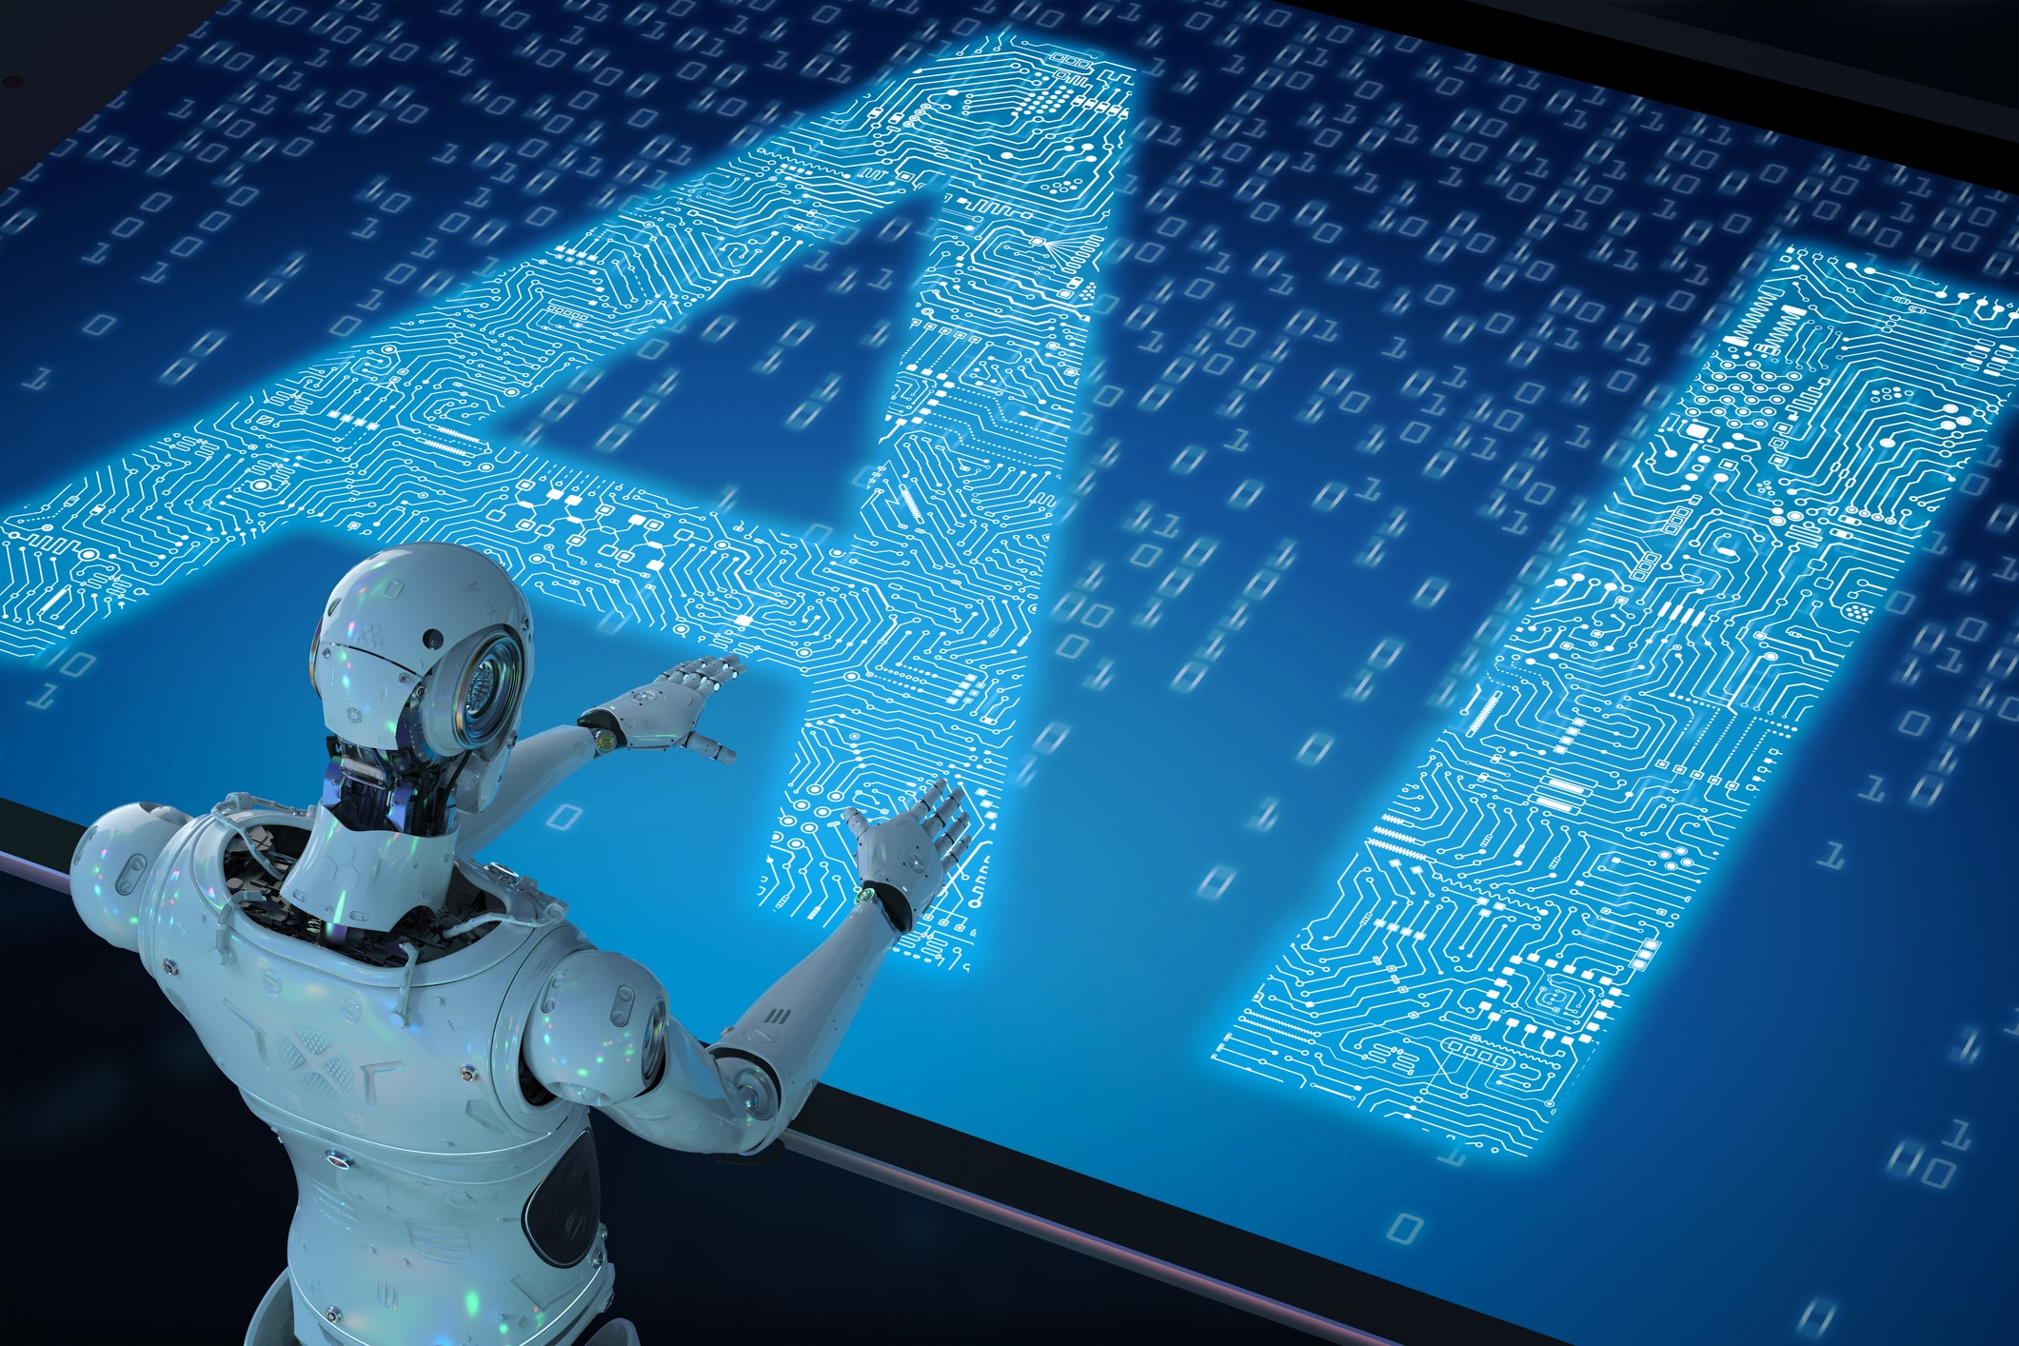

Slide 2

Artificial Intelligence: and YOU
Dr. Chuck West

Slide 3
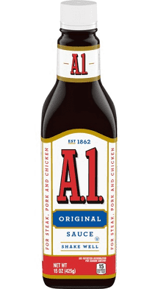
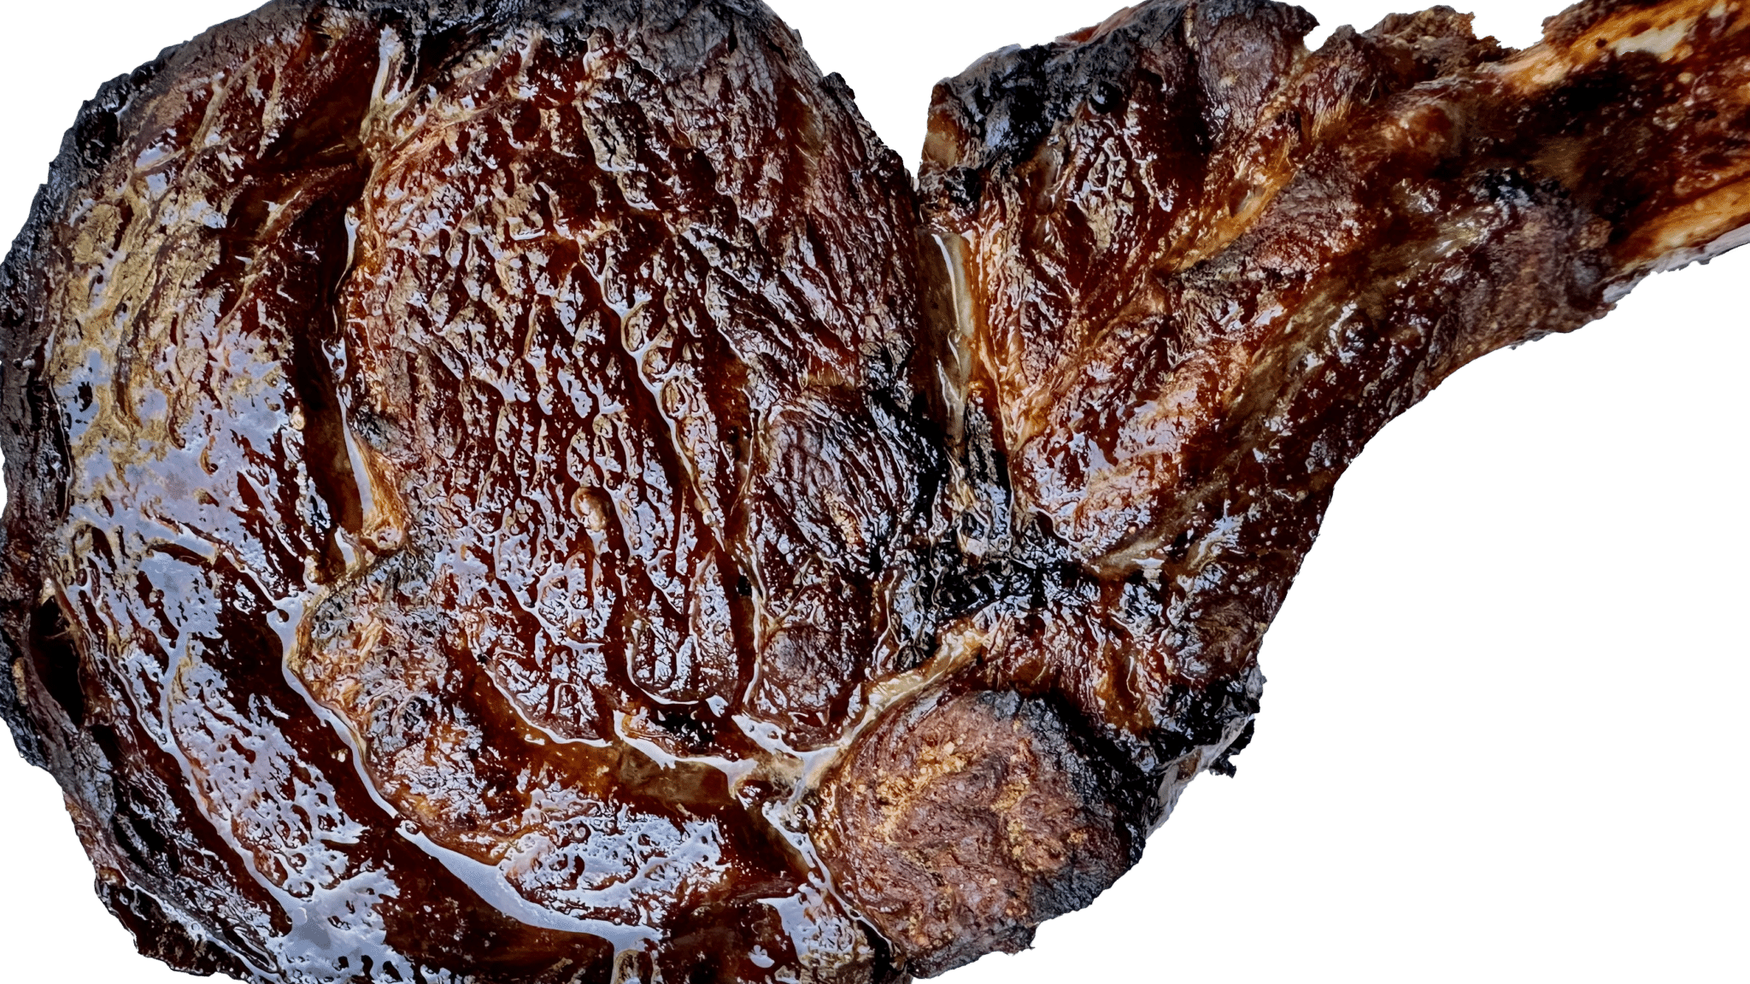
Topic for Discussion

Slide 4
Artificial Intelligence ~ A.I. ~ AI

Slide 5
What is A.I. ?

Slide 6
What is A.I.?
A.I. Exceeding or matching the capabilities of a human

Slide 7


Slide 8
What can AI do?
Discover
Infer
Reason

Slide 9
What can AI do?
Discover
Infer
Reason
Learn

Slide 10
Objectives
Identify scope of the various types of AI
Carry on a rudimentary conversation about AII
Identify where each type of AI can/should be applied
Understand the value of AI
Identify the ethical issues AI creates
To fear or NOT

Slide 11
Scope of Artificial Intelligence
Changing the face of everything
Impacts billions now and many billions more in the not-so-distant future
Jobs will be lost, jobs will be created
Lives will be made easier as we live longer
Notes:
Personal opinion

Slide 12
Topics for tonight
Ethics and AI
History of AI
Types AI
What AI is doing TODAY and TOMORROW
  Augmentation
  Farming
  Education
  Autonomous transportation
  Business
  Health/Medicine
  Athletics
  Military
  Space – the final frontier
  NLP

Slide 13
What can AI do?
NLP
Vision
Audio
Text to speech
Move autonomously
General research
Explore Space

Slide 14
Any Ethical Thoughts or Comments?

Slide 15
24 January 1968

Slide 16

24 January 1968

Slide 17
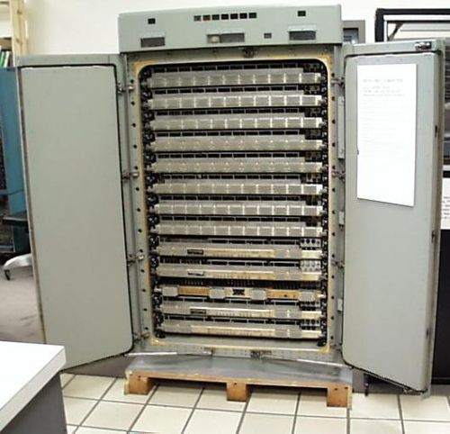

AI is the future and the past
Algorithms
Digital World
Programming
Value of Data
Notes:
Instill drive to succeed
Building blocks for A.I.
Expert Systems

Slide 18
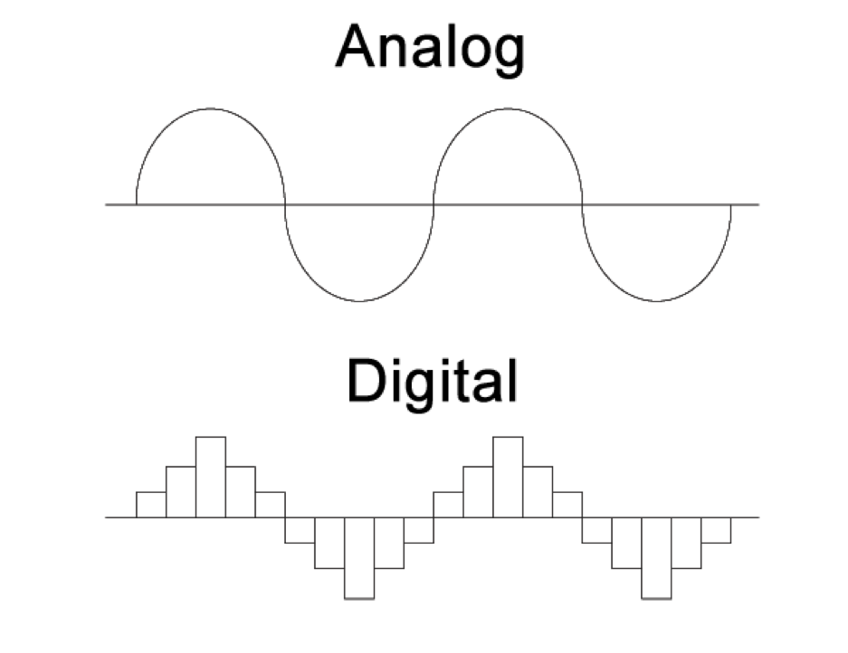

Slide 19
Special Projects Group

Slide 20

Evolution of Pong
Pong for 1 - Wall
Pong for 2
Pong for 1 + AI
Pong for 4

Slide 21





Introduction: Dr. Chuck West
Algorithms
+
Data
+
Theory
Notes:
Pattern recognition

Slide 22

Who are you?
What should we call you?
What is your discipline?
What do YOU want to do with what you learn in this workshop?

Slide 23
Where do YOU get your news?
Notes:
Journalism
Communications
Law
…

Slide 24









Slide 25
Algorithms

Slide 26

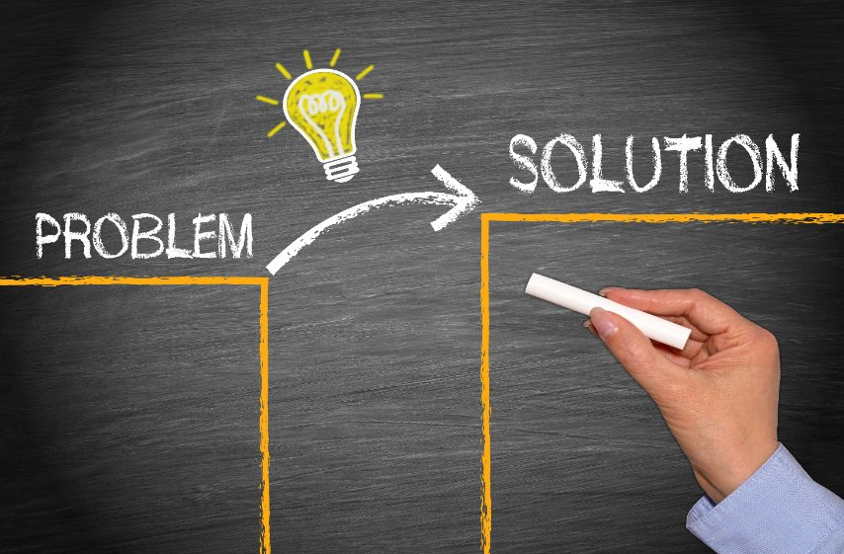
Figure out how to use it!

Slide 27
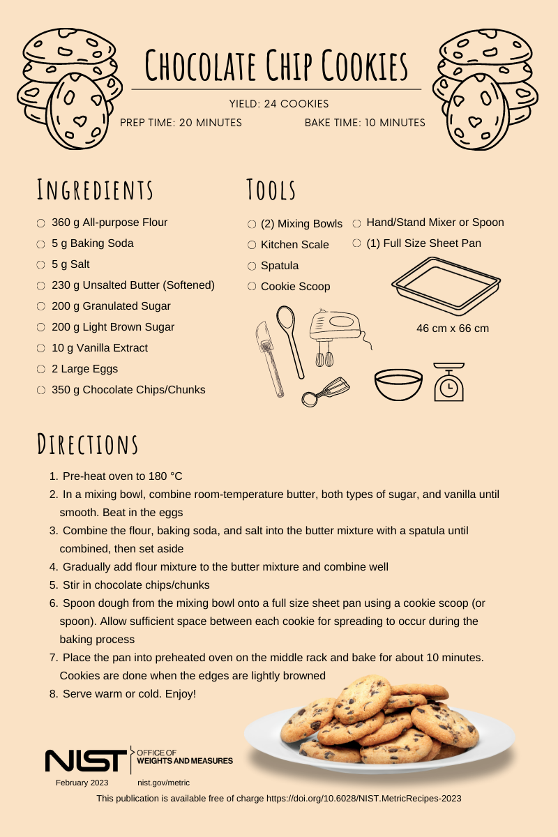
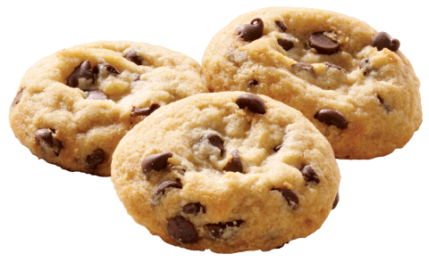
What is an ALGORITHM
An algorithm is a sequence of instructions
Mini program
Solves a specific problem

Slide 28

Defining A.I.

Slide 29

Turing Test
To be “intelligent” the system must exhibit intelligent behavior equivalent to, or indistinguishable from, that of a human.

Slide 30
History

Slide 31
Mainstream Events – Early Years
1950: Alan Turing - Turing Test
1952: Claud Shannon – Programming a computer to play chess
1955: John McCarthy - Dartmouth College workshop
1955: Herbert Simon – Logic Theorist program

Slide 32
Mainstream Events – Early Years
1958: John McCarthy – Developed LISP
1958: US Department of Defense - DARPA
1959: Arthur Samuel – Machine Learning

Slide 33
Mainstream Media 1970
Colossus: The Forbin Project
Thinking this will prevent war, the US government
gives an impenetrable supercomputer total control
over launching nuclear missiles.
But what the computer does with the power is
unimaginable to its creators.

Slide 34
Mainstream Events - Innovation
1961: GM – Umimate robot
1964: Daniel Bobrow - STUDENT
1966: Joseph Weizenbaum
1968: Alex Ivakhnenko: Deep Learning

Slide 35
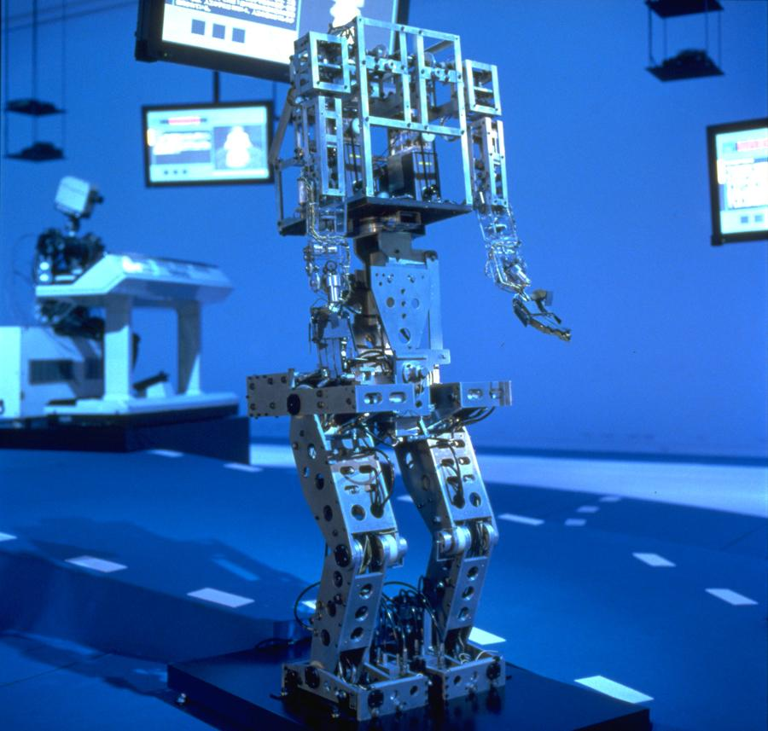
Mainstream Events
1970: Waseda University – WABOT (anthropometric robot)
1973: James Lighthill - &^$&*^%$^&
1979: Hans Moravec – Stanford Cart camera
1979: Association for the Advancement of Artificial Intelligence

Slide 36
Mainstream Events – Government Funding
1980: DEC – XCON First Expert System in commercial use
1981: Japanese Ministry of International Trade: $850M/$3Billion
1984: Ernst Dickmanns – First self-driving car
1986: Geoffrey Hinton, David Rumelhart & Ronald Williams – Back Machine propagation learning algorithm that trains Neural Networks
Notes:
Computer scientist and cognitive psychologist Geoffrey Hinton, psychologist David Rumelhart, and computer scientist Ronald J. Williams released a paper that explored backpropagation

Slide 37
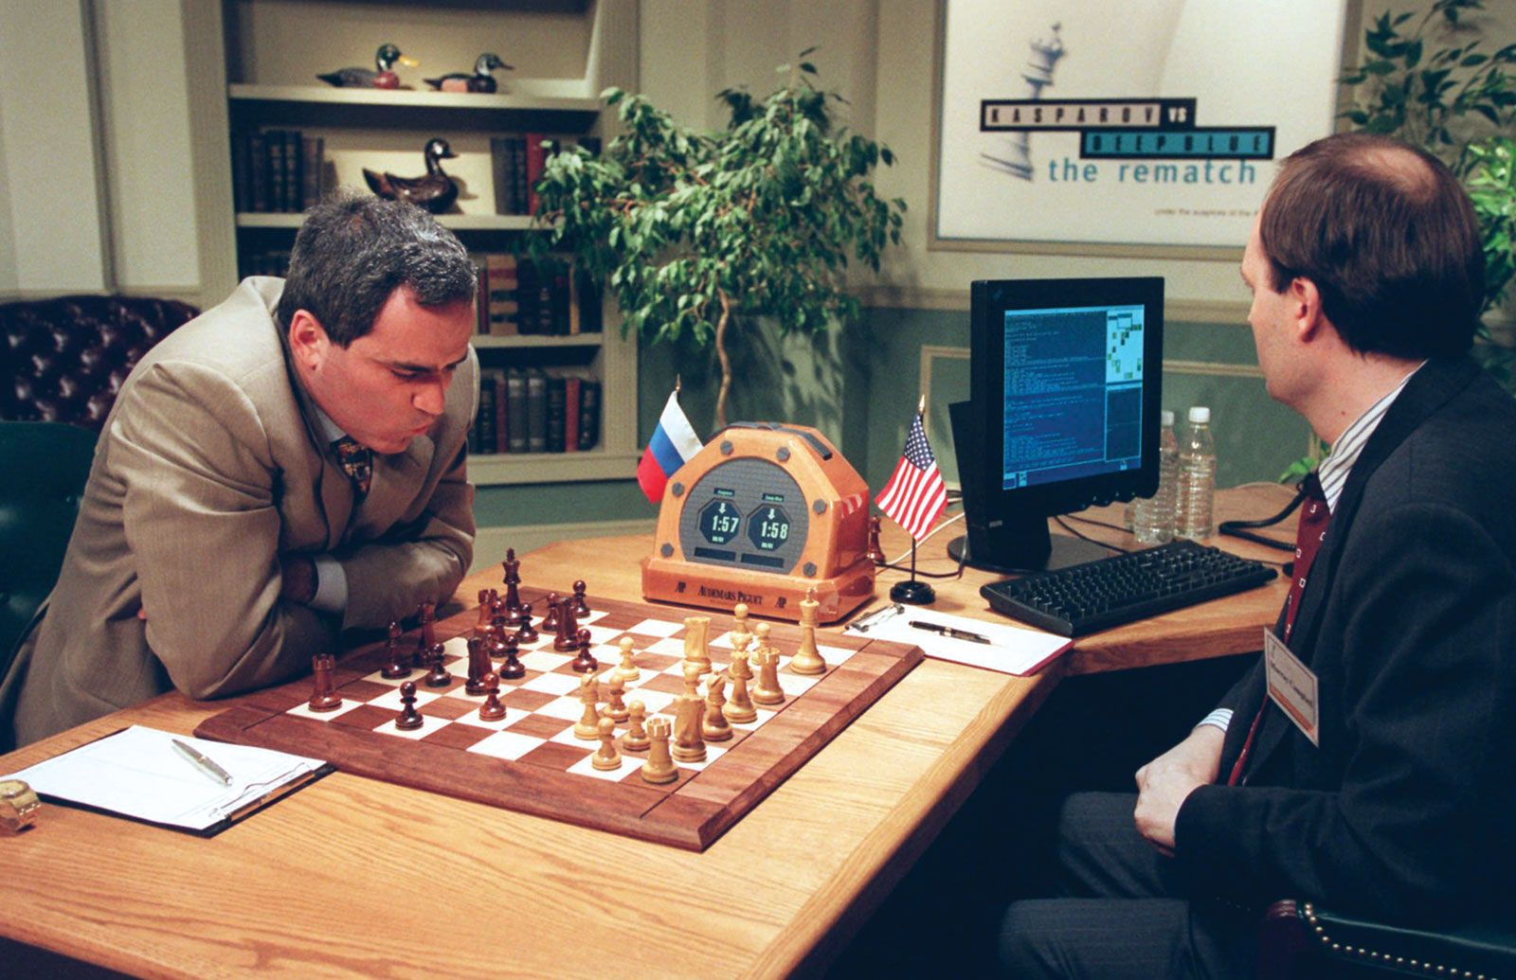
Mainstream Events
1991: DARPA – Military Logistics
1997: IBM – Deep Blue
1997: Dragon Systems – Dragon Naturally Speaking
1998: Furby the domestic robot
Notes:
Kasparov

Slide 38
Mainstream Events – Common Use
2000: Cynthia Breazeal – Kismet Robot that mimicked human emotions
2001: Steven Spielberg – A.I. Artificial Intelligence(coexistence)
2002: iRobot - Romba
2003: NASA – Spirit & Opportunity

Slide 39
Mainstream Events – Common Use
2006: Facebook, Twitter,… - Develop social media algorithms

Slide 40
AI becomes part of everyday life
2010: Microsoft - Xbox 360 Kinect began growth of IoT
2011: Apple - Siri
2015: 3,000 people – Letter calling for a ban on AI weapons
2016: Hanson Robotics – Sophia worlds first “robot citizen:

Slide 41
Sophia

Slide 42
AI becomes part of everyday life
2016: Google – AlphaGo shows computers can solve problems on their own - defeats Lee Sedol
2017: Facebook – 2 chatbots communicate one another and develop their own language
2021: Open AI - GPT-3
2022: OpenAI – ChatGTP3

Slide 43
AI Becomes part of everyday life
2022: AI-job-related postings soar
2023: Geoffrey Hinton - Warns how AI can spread misinformation
2023: Bidnen – Puts VP Harris in charge of AI strategy
2024: European Union - Guidelines for ethical development of AI

Slide 44
Enablers of AI

Slide 45
What enablers are impacting your future?

Slide 46
Enablers of A.I.
Faster processors
Parallel processing
Networks
Faster communications
Cloud storage and computing
Government
Inflation
Lack of work ethic
Needs of mankind
Notes:
AI help feed the world
Live longer
Make life more enjoyable

Slide 47
Faster Processors
Moore’s Law
Moore's Law refers to Gordon Moore's perception that the number of transistors on a microchip doubles every two years, though the cost of computers is halved.
Moore's Law states that we can expect the speed and capability of our computers to increase every couple of years, and we will pay less for them.
Another tenet of Moore's Law asserts that this growth is exponential.
Physical limitations
SPEED
Cost

Slide 48
Faster Communications
X2

Slide 49

Enablers of A.I.
Faster processors
Parallel processing
Networks
Faster communications
Cloud storage and computing
Government
Inflation
Lack of work ethic
Needs of mankind
Notes:
AI help feed the world
Live longer
Make life more enjoyable

Slide 50
Enablers of A.I.
Faster processors
Parallel processing
Networks
Faster communications
Cloud storage and computing
Government
Inflation
Lack of work ethic
Needs of mankind
Notes:
AI help feed the world
Live longer
Make life more enjoyable

Slide 51

Cloud Storage and Cloud Computing
Cloud storage. Cloud storage is a model of computer data storage in which the digital data is stored in logical pools.
The physical storage spans multiple servers (sometimes in multiple locations), and the physical environment is typically owned and managed by a hosting company.

Slide 52
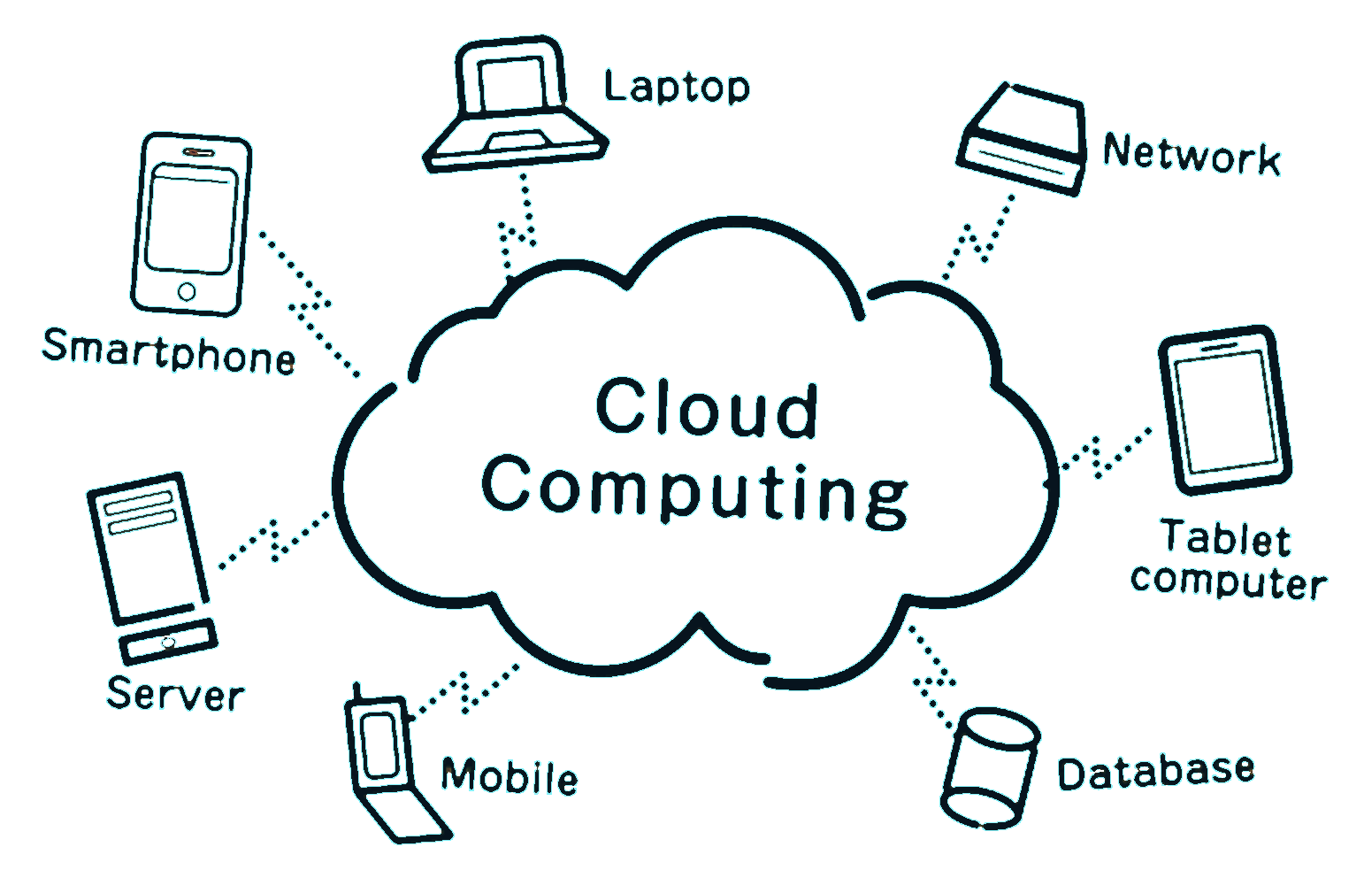
Cloud Storage and Cloud Computing
Cloud computing is the delivery of computing services including servers, storage, databases, networking, software, analytics, and artificial intelligence over the Internet to offer faster innovation, flexible resources, and economies of scale.

Slide 53
Types of AI

Slide 54
Scope of A.I.
Narrow A.I.
General A.I.

Slide 55
Scope of A.I.
Narrow A.I.
examples
General A.I.
exampl4s

Slide 56

Expert Systems
Artificial Intelligence
Artificial General Intelligence
Expert Systems
Natural Language Processing
Autonomous Vehicles
Deep Learning
Cognitive Computing
Neural Networks
Machine Learning
Fuzzy Logic
Robotics
Computer Vision
Generative

Slide 57
Machine Learning
Artificial Intelligence
Artificial General Intelligence
Expert Systems
Natural Language Processing
Autonomous Vehicles
Deep Learning
Cognitive Computing
Neural Networks
Machine Learning
Fuzzy Logic
Robotics
Computer Vision
Generative

Slide 58
Deep Learning
Artificial Intelligence
Artificial General Intelligence
Expert Systems
Natural Language Processing
Autonomous Vehicles
Deep Learning
Cognitive Computing
Neural Networks
Machine Learning
Fuzzy Logic
Robotics
Computer Vision
Generative

Slide 59
Neural Networks
Artificial Intelligence
Artificial General Intelligence
Expert Systems
Natural Language Processing
Autonomous Vehicles
Deep Learning
Cognitive Computing
Neural Networks
Machine Learning
Fuzzy Logic
Robotics
Computer Vision
Generative

Slide 60
Generative AI
Artificial Intelligence
Artificial General Intelligence
Expert Systems
Natural Language Processing
Autonomous Vehicles
Deep Learning
Cognitive Computing
Neural Networks
Machine Learning
Fuzzy Logic
Robotics
Computer Vision
Generative

Slide 61

Artificial Intelligence
Artificial General Intelligence
Expert Systems
Natural Language Processing
Autonomous Vehicles
Deep Learning
Cognitive Computing
Neural Networks
Machine Learning
Fuzzy Logic
Robotics
Computer Vision
Generative

Slide 63


How Humans vs Computers Think

Slide 64
Compare two pictures

Slide 65
Expert Systems

Slide 66
Sudoku
Human
  Many rules or strategies
  Complex programming
  Time consuming
Computer
  Three rules
Possible puzzles: 6,670,903,752,921,072,936,960

Slide 67
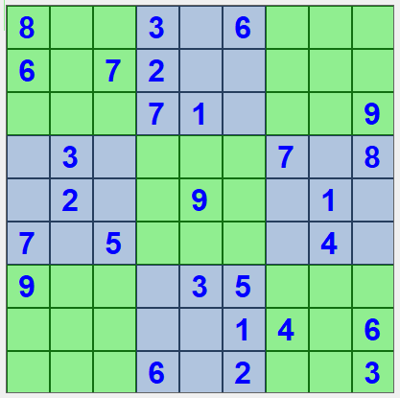
Expert System - Sudoku
Rule based
Simple rules

Slide 68
Simplicity – Rule #1
Cannot repeat a number within a row
Do not repeat a number within a column
Do not repeat a number within a grid (9 3x3)

Slide 69
Simplicity – Rule #2
Cannot repeat a number within a row
Do not repeat a number within a column
Do not repeat a number within a grid (9 3x3)

Slide 70
Simplicity – Rule #3
Cannot repeat a number within a row
Do not repeat a number within a column
Do not repeat a number within a grid (9 3x3)

Slide 71
Simplicity
6,670,903,752,021,072,936,960 puzzles

Slide 72
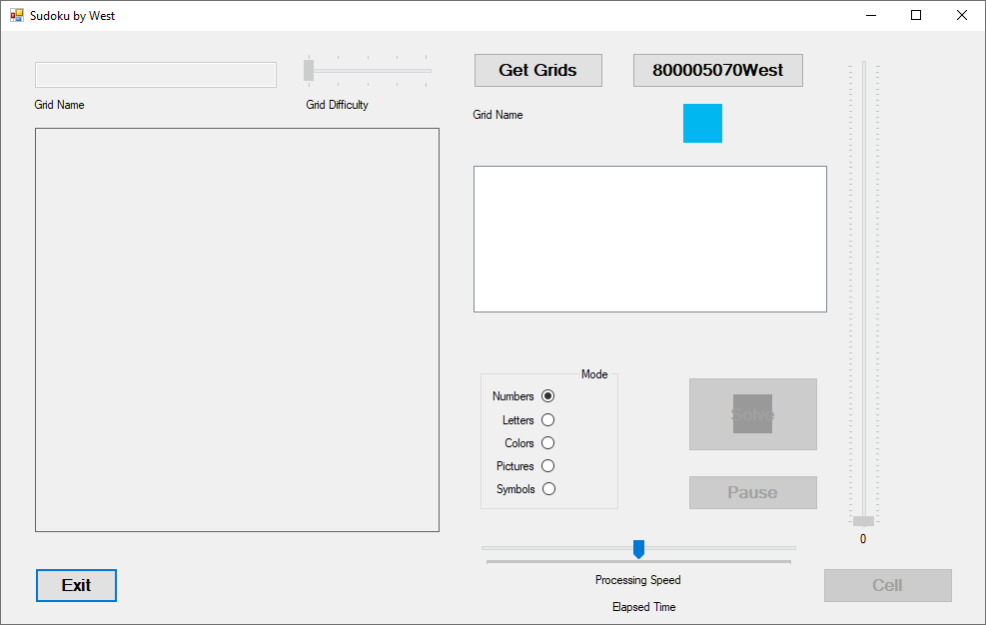
Expert System
Sudoku
6,670,903,752,021,072,936,960
Only 3 rules
  Expert System
Very basic learning
Never makes the same mistake twice

Slide 73
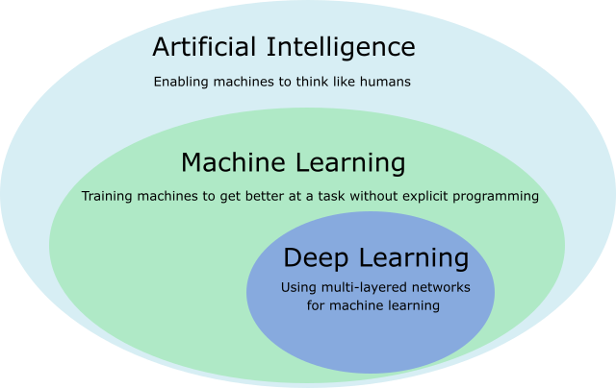
Expert System VS Machine Learning
Expert System
Deep Learning
Rule based
Based on a select group of subject matter experts
As reality changes so do the rules

Slide 74
Thank you for participating

