Slide 1
Autoencoder Neural Networks
ANNs are a type of neural network that is used for unsupervised learning, which means that they do not require labeled data to make predictions. They are primarily used for data compression and feature extraction.
Autoencoder neural networks work by compressing the input data into a lower-dimensional representation and then reconstructing it back into the original format. This allows them to identify the most important features of the input data.
Autoencoder neural networks are commonly used in applications such as data compression, image denoising, and anomaly detection. For example, NASA uses an autoencoder algorithm to detect anomalies in spacecraft sensor data.

Slide 2
Autoencoder Neural Networks
ANNs are a type of neural network that is used for unsupervised learning, which means that they do not require labeled data to make predictions. They are primarily used for data compression and feature extraction.
Autoencoder neural networks work by compressing the input data into a lower-dimensional representation and then reconstructing it back into the original format. This allows them to identify the most important features of the input data.

Slide 3
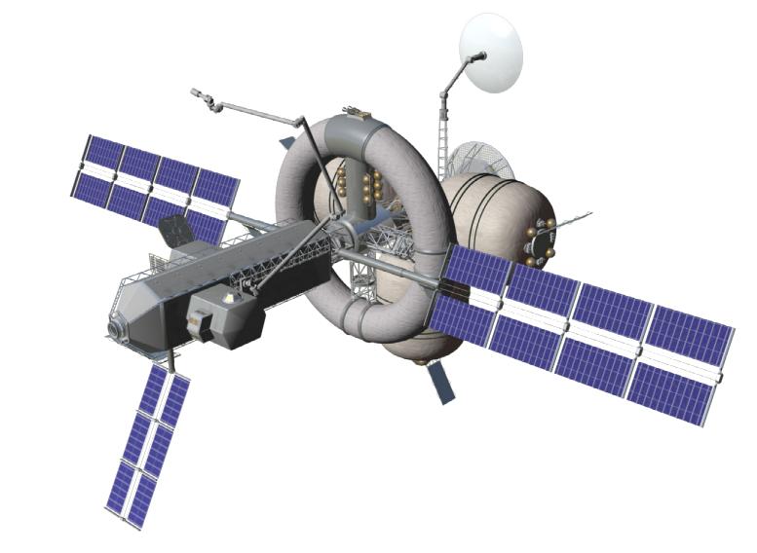
Autoencoder Neural Networks
Autoencoder neural networks are commonly used in applications such as data compression, image denoising, and anomaly detection. For example, NASA uses an autoencoder algorithm to detect anomalies in spacecraft sensor data.

Slide 4
Sequence to Sequence Models
Seq2Seq models are a type of neural network that uses deep learning techniques to enable machines to understand and generate natural language. They consist of an encoder and a decoder, which convert one sequence of data into another. This type of network is often used in machine translation, summarization, and conversation systems.
One of the most common applications of Seq2Seq models is machine translation, where the encoder takes the source language and converts it into a vector representation, which the decoder then uses to generate the corresponding text in the target language. Seq2Seq models have been used to develop state-of-the-art machine translation systems, such as Google Translate and DeepL.
Another application of Seq2Seq models is in summarization, where the encoder takes a long document and generates a shorter summary. These models have also been used in chatbots and other conversational agents to generate responses to user input.
Seq2Seq models work by first encoding the input sequence into a fixed-length vector representation, which captures the meaning of the sequence. The decoder then uses this vector to generate the output sequence one element at a time, predicting the next element based on the previous one and the context vector.

Slide 5
Modular networks
The team player of neural networks

Slide 6
Modular Neural Network
MNN are a type of neural network that allows multiple networks to be combined and work together to solve complex problems. In a modular network, each module is a separate network that is designed to solve a specific subproblem. The outputs from each module are then combined to provide a final output.

Slide 7
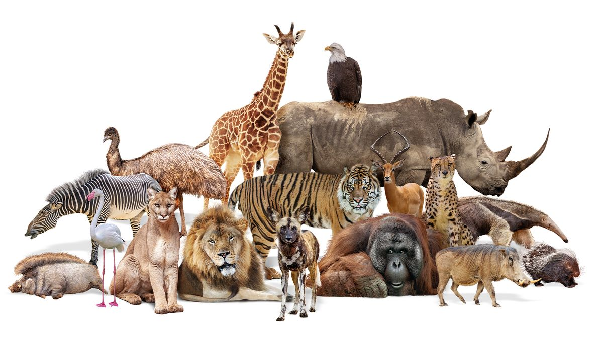
Modular Neural Network
MNNs have been used to solve a wide range of complex problems, including computer vision, speech recognition, and robotics. For example, in computer vision, a modular network may be used to detect different objects in an image, with each module responsible for detecting a specific type of object. The outputs from each module are then combined to provide a final classification of the image.

Slide 8
Modular Neural Network
One advantage of MNNs is that they allow for flexibility and modularity in the design of neural networks, making it easier to build complex systems by combining simpler modules. This makes it possible to develop large-scale systems with multiple modules, each solving a specific subproblem.
Another advantage of MNNs is that they can be more robust than traditional neural networks, as each module can be designed to handle a specific type of input or noise. This means that even if one module fails, the overall system can still function, as other networks fail.

Slide 9
Convolutional Neural Networks
CNNs are a type of neural network that are designed for processing grid-like data, such as images. They are made up of multiple layers, including convolutional layers, pooling layers, and fully-connected layers, which each playing a different and interconnected part in processing data and simplifying outputs.
CNNs are commonly used for image and video recognition tasks, such as object detection, facial recognition, and self-driving cars. For example, a CNN could be used to classify images of cats and dogs based on their features.
In a CNN, the input data is processed through multiple convolutional layers, which apply filters to the input and extract features. The output of the convolutional layers is then passed through pooling layers, which downsample the data and reduce its dimensionality. Finally, the output is passed through fully connected layers, which perform the final classification or prediction.

Slide 10
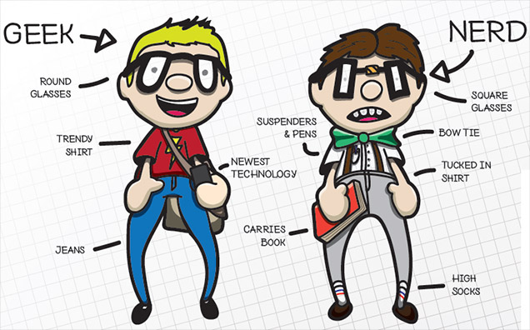
Really Geek

Slide 12
Applications
Predictive modeling
Social Media
Aerospace
Defense
Healthcare
Handwriting analysis (fraud detecti0n)
Adaptive control
Facial recognition
Handwriting recognition
Marketing
Education
Generative AI
Data compression
Logistics
Weather forecasting
Farming
Speech and voice recognition
Cybersecurity
Stock Market prediction
Autonomous vehicles
Text Classification and Categorization
Creative writing
Writing assistance
Film colorization
Farming
General game playing

Slide 13
Recognizing Handwritten Characters

Slide 14
Neural Networks Agriculture Report

Slide 15
Neural Networks Agriculture Report
Abstract: Artificial neural networks are one of the most important elements of machine learning and artificial intelligence. They are inspired by the human brain structure and function as if they are based on interconnected nodes in which simple processing operations take place. The spectrum of neural networks application is very wide, and it also includes agriculture. Artificial neural networks are increasingly used by food producers at every stage of agricultural production and in efficient farm management. Examples of their applications include: forecasting of production effects in agriculture on the basis of a wide range of independent variables, verification of diseases and pests, intelligent weed control, and classification of the quality of harvested crops. Artificial intelligence methods support decision-making systems in agriculture, help optimize storage and transport processes, and make it possible to predict the costs incurred depending on the chosen direction of management. The inclusion of machine learning methods in the “life cycle of a farm” requires handling large amounts of data collected during the entire growing season and having the appropriate software. Currently, the visible development of precision farming and digital agriculture is causing more and more farms to turn to tools based on artificial intelligence. The purpose of this Special Issue was to publish high-quality research and review papers that cover the application of various types of artificial neural networks in solving relevant tasks and problems of widely defined agriculture.

Slide 16
Neural Networks in Predictive Modeling

Slide 17
Neural Networks in Predictive Modeling
Highlights
•Review of neural network model approaches.
•Training and parameter estimation of neural network models.
•Neural network model performance evaluation and improvement.
•Implementation in MPC and evaluation of closed-loop performance.

Slide 18
Neural Networks in Predictive Modeling
An overview of the recent developments of time-series neural network modeling is presented along with its use in model predictive control (MPC). A tutorial on the construction of a neural network-based model is provided and key practical implementation issues are discussed. A nonlinear process example is introduced to demonstrate the application of different neural network-based modeling approaches and evaluate their performance in terms of closed-loop stability and prediction accuracy. Finally, the paper concludes with a brief discussion of future research directions on neural network modeling and its integration with MPC.

Slide 19
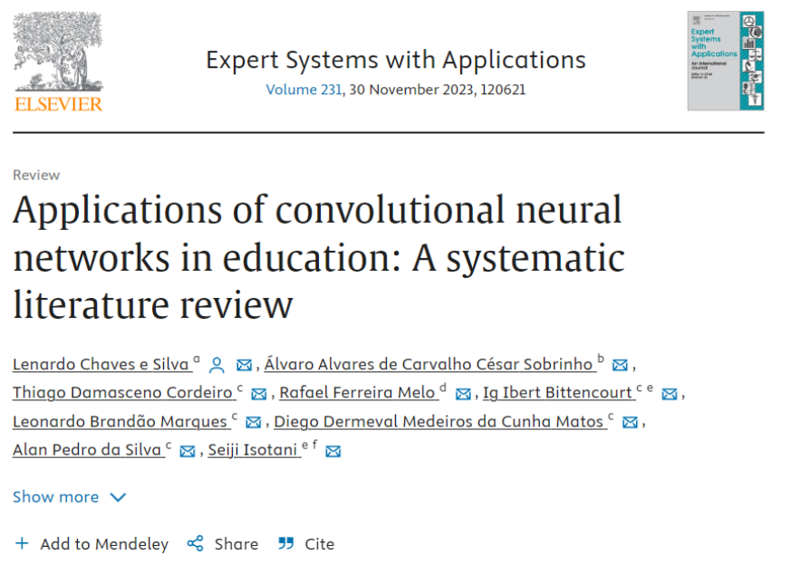
Neural Networks in Education

Slide 20
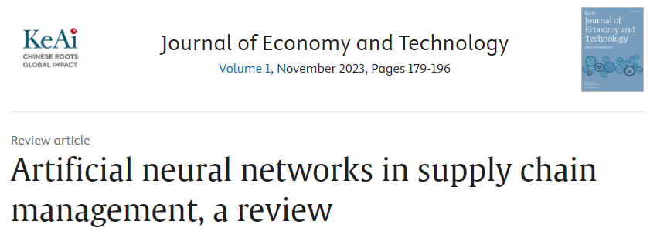
Neural Networks in Logistics

Slide 21
Neural Networks in Logistics
Highlights
•Artificial neural networks in supply chain management is studied to enhance performances of part manufacturing process.
•New ideas of future research works in applications of artificial neural networks in supply chain management are presented.
•So, productivity of part manufacturing can be enhanced using the supply chain management in artificial neural networks.

Slide 22
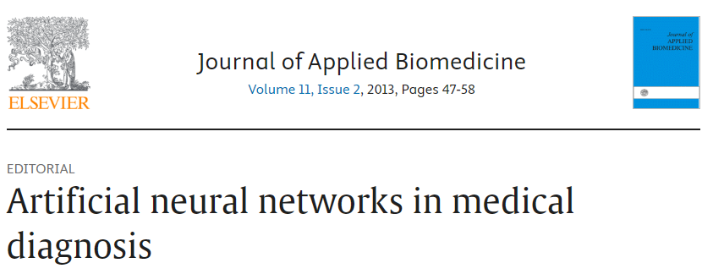
Neural Networks in Healthcare

Slide 23
Neural Networks in Healthcare
An extensive amount of information is currently available to clinical specialists, ranging from details of clinical symptoms to various types of biochemical data and outputs of imaging devices. Each type of data provides information that must be evaluated and assigned to a particular pathology during the diagnostic process. To streamline the diagnostic process in daily routine and avoid misdiagnosis, artificial intelligence methods (especially computer aided diagnosis and artificial neural networks) can be employed. These adaptive learning algorithms can handle diverse types of medical data and integrate them into categorized outputs. In this paper, we briefly review and discuss the philosophy, capabilities, and limitations of artificial neural networks in medical diagnosis through selected examples.

Slide 24
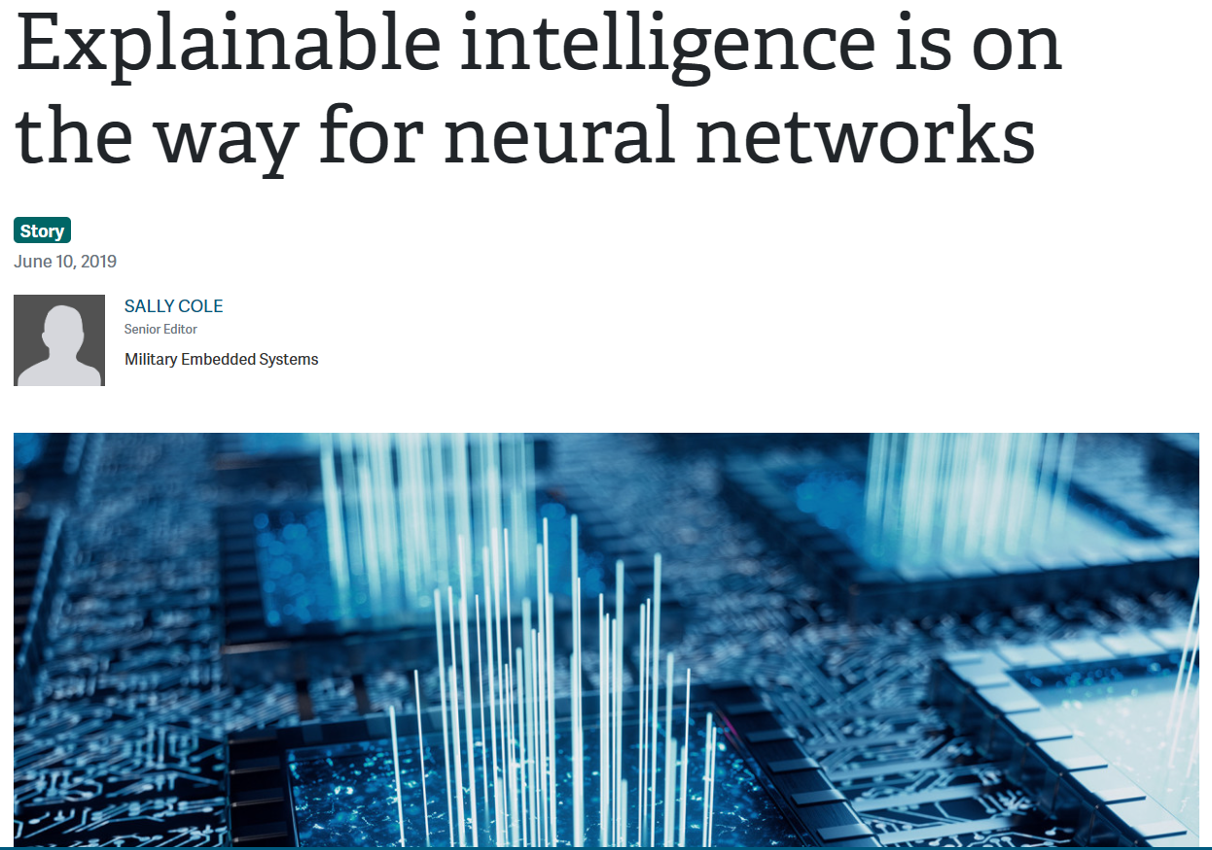
Neural Networks and the Military

Slide 25
Neural Networks and the Military
Neural networks are one realm of AI actively being explored for future DoD use; the Defense Advanced Research Projects Agency (DARPA) is working on a program called Explainable Artificial Intelligence (XAI), which has as its goal the development of neural networks capable of explaining why they make their decisions and showing users the data that plays the most important role in its decision-making process.

Slide 26
Voice recognition
Image recognition
Speech recognition
Language translation
Pattern recognition
Anomaly detection

Slide 27
Music Creation
4 min
10 instruments
Muse Net

Slide 28
Convolutional Neural Network

Slide 29
Mathematics

Slide 30
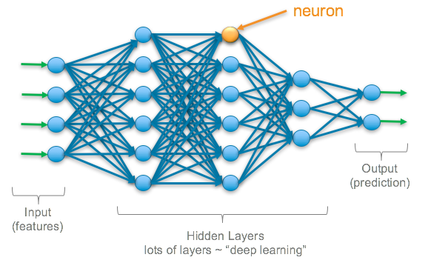
Where is all the math happening?

Slide 32
Why do we call them neurons?

Slide 33
What are Neurons?
Container or box
One piece of information
Holds gray scale value of each of the pixel (1024)
Activation
The brighter the pixel, the Higher number

Slide 34
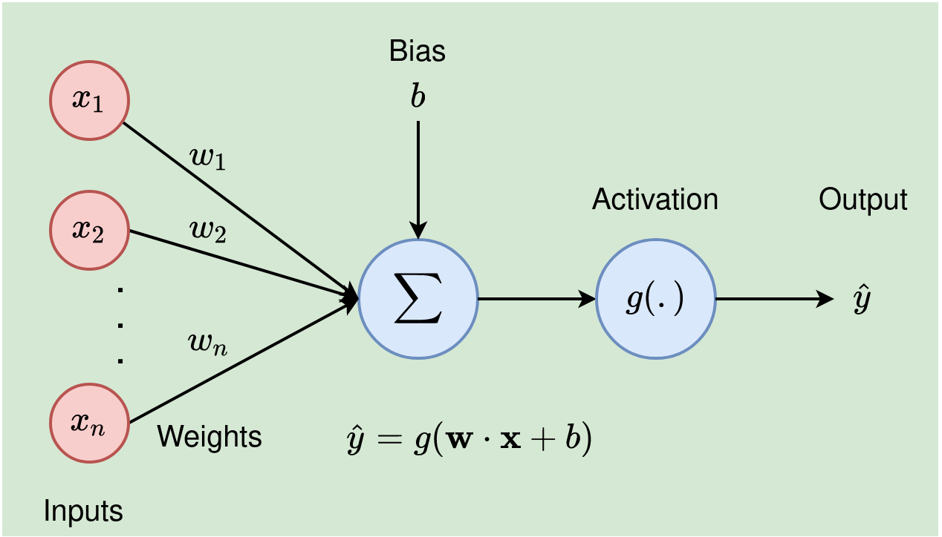

Slide 35
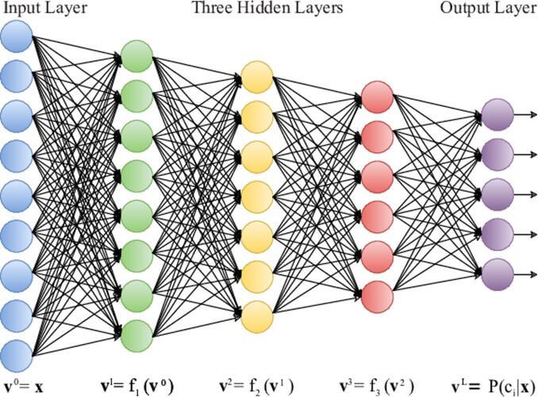

Slide 37
Think of writing a program to implement this!

Slide 39
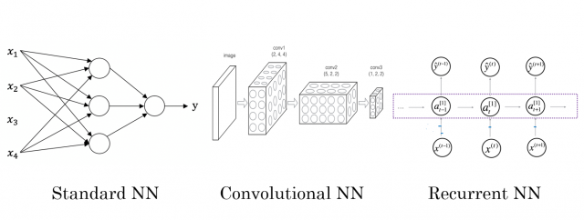
Bye

