Slide 1
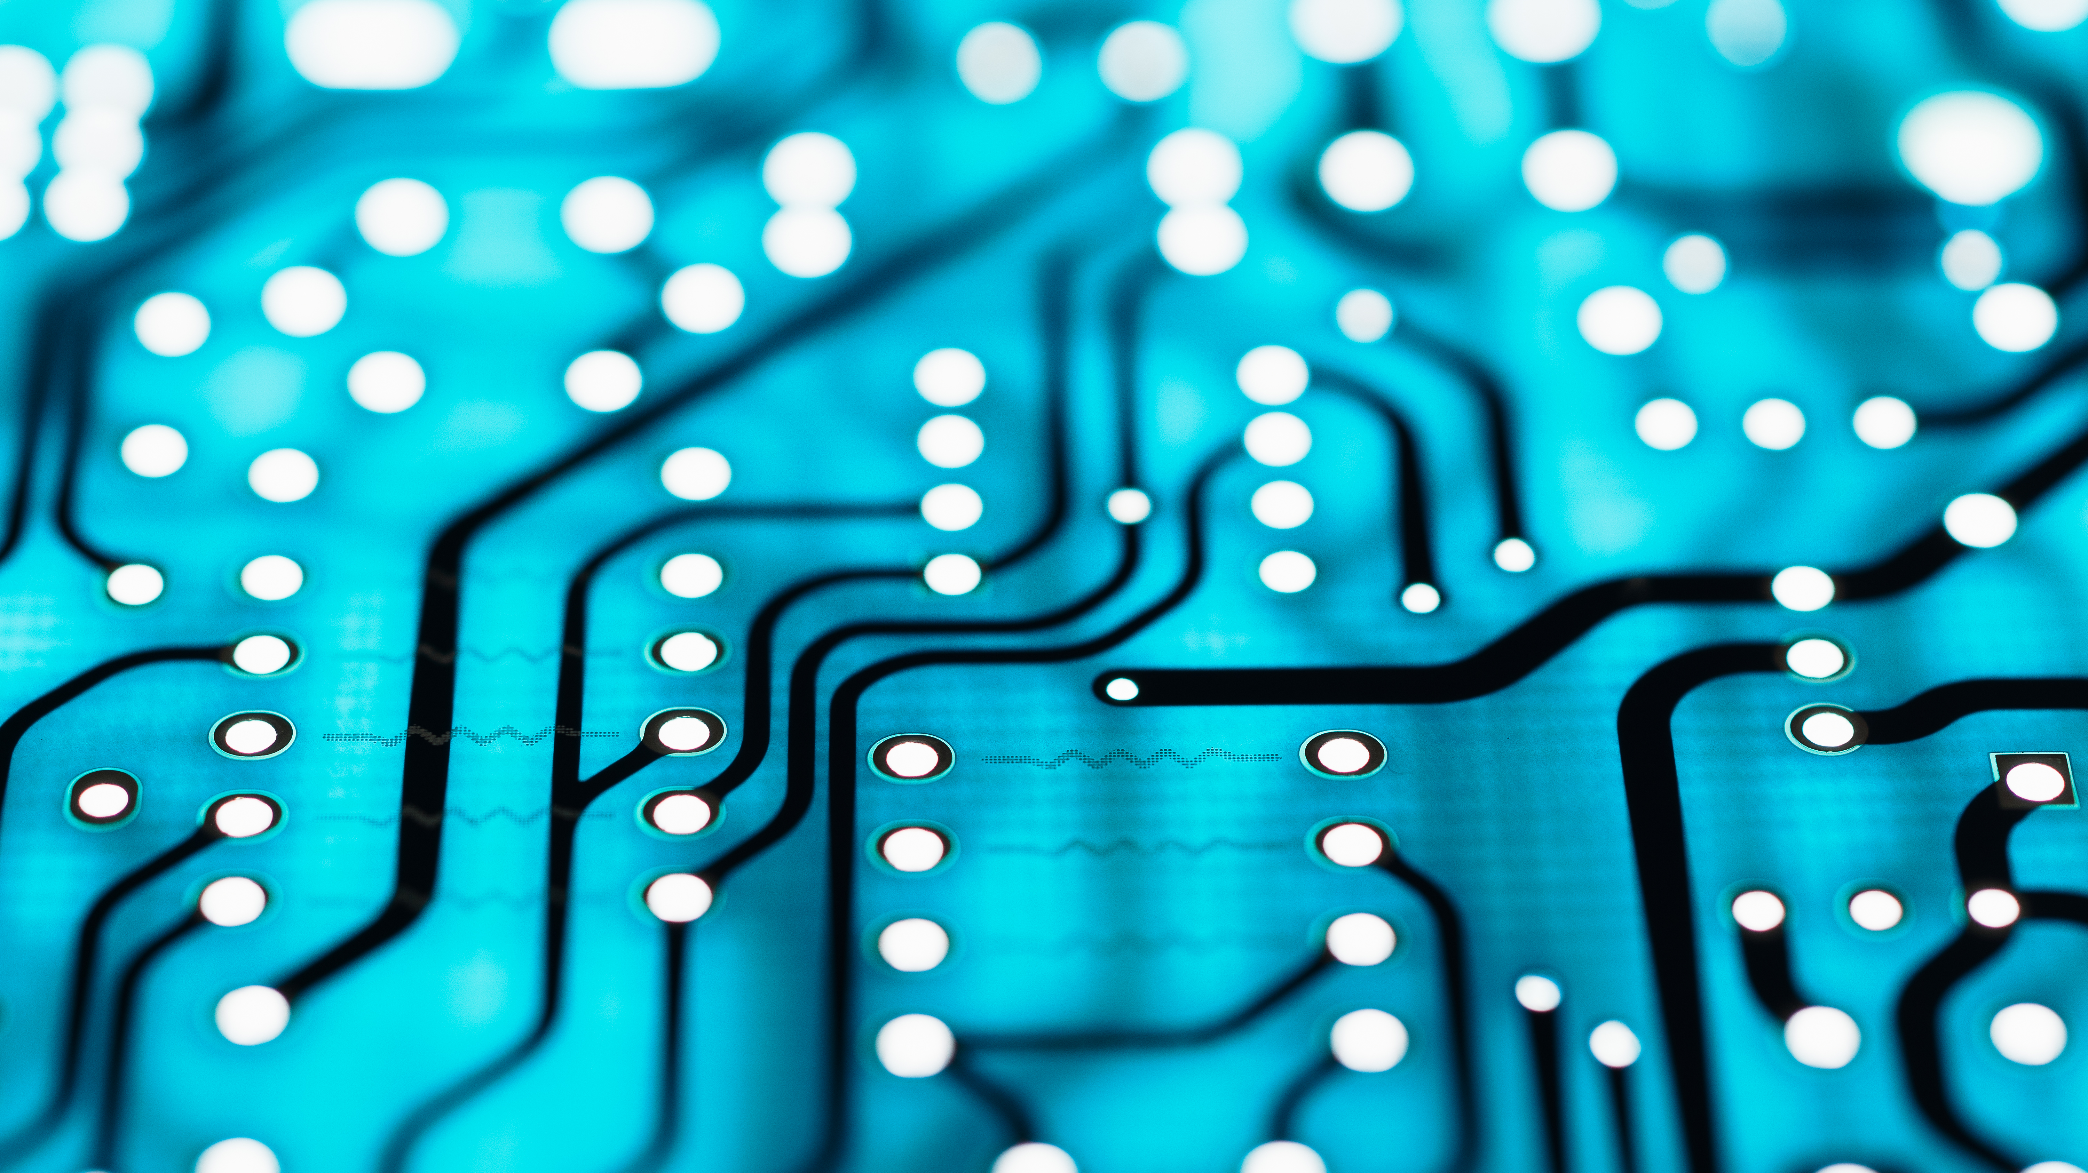
Deep Learning Neural Networks
Dr. Chuck West

Slide 2
Topics
Machine Learning
Deep Learning
Neural Networks

Slide 3
Artificial Intelligence
Machine Learning
Deep Learning
Neural Networks

Slide 4
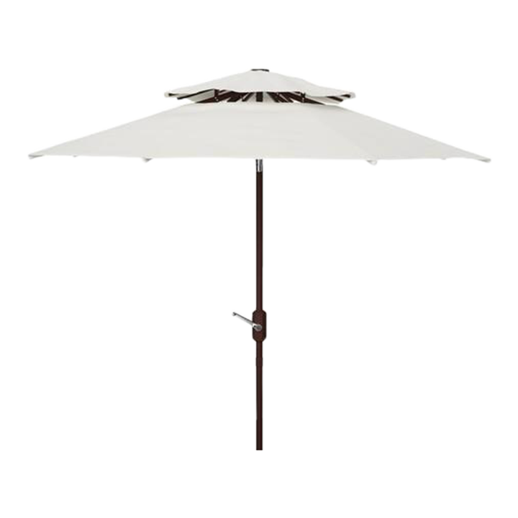
Artificial Intelligence
Artificial General Intelligence
Expert Systems
Natural Language Processing
Autonomous Vehicles
Deep Learning
Cognitive Computing
Neural Networks
Machine Learning
Fuzzy Logic
Robotics
Computer Vision

Slide 5
How do you know?

Slide 6
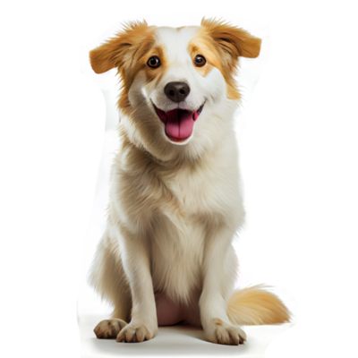

Slide 7
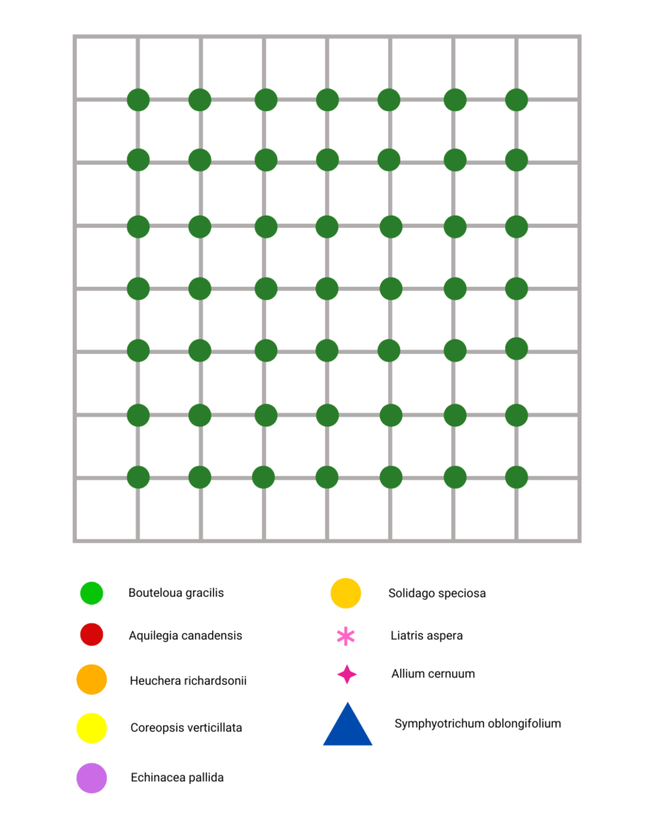

Slide 8
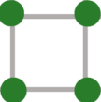

Slide 10
Color
Texture
Shape
…

Slide 11
Color #
Texture #
Shape #
… #

Slide 12
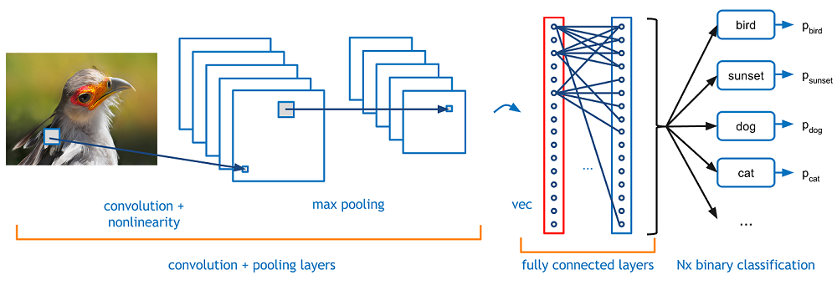
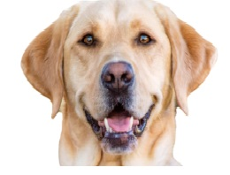
Characteristics

Slide 13
Machine Learning
Process to learn new things from patterns and make decisions without explicit programming.
Computers learn from data - information.

Slide 14
Machine Learning
Supervised Learning
Features and label data
Unsupervised Learning
Autonomously
Not labeled
Reinforcement Learning
Feedback

Slide 15
Supervised Learning
Predicting the unknown from the labeled known
Features, such as weight, color, number of legs,… are known

Slide 16
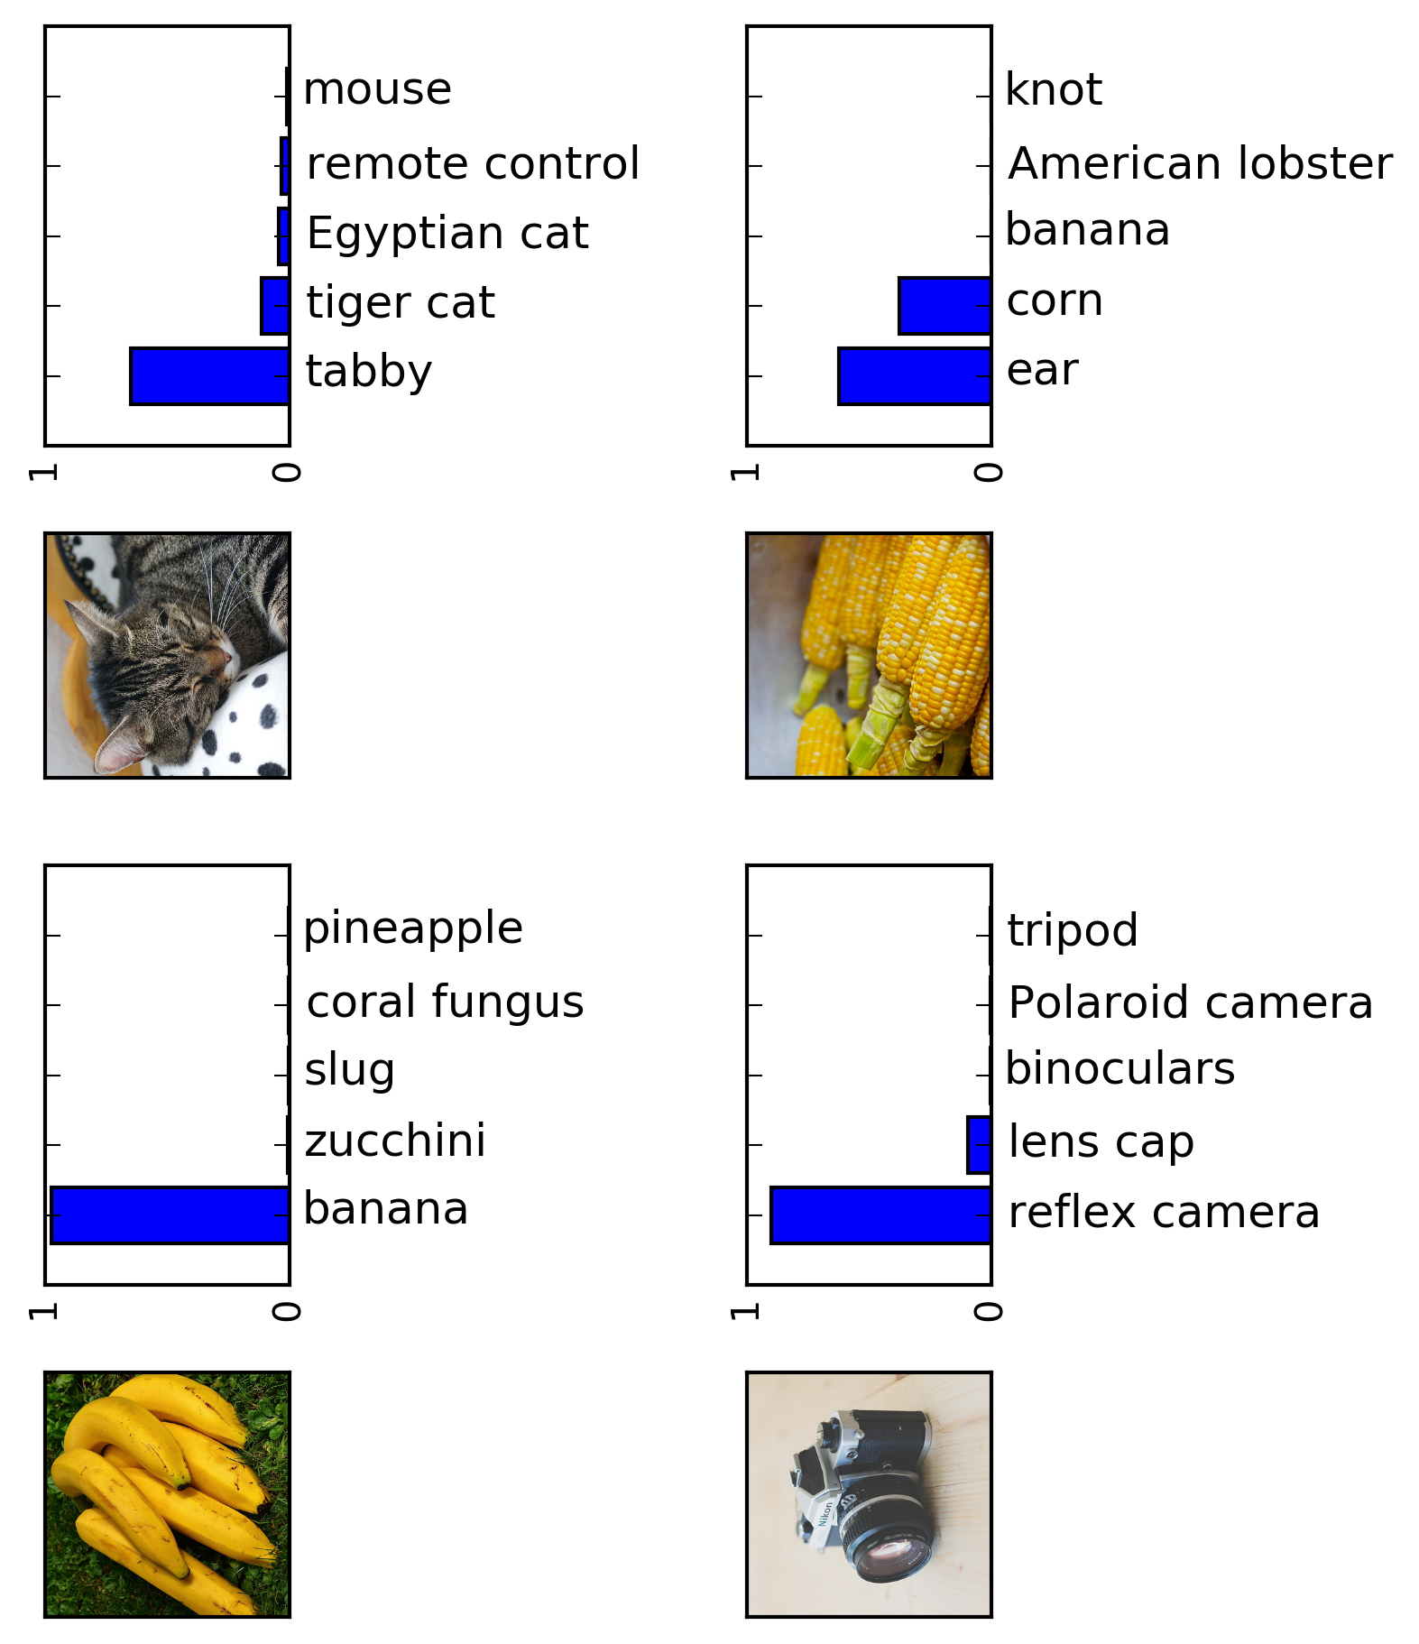
Supervised Learning

Slide 17
Unsupervised Learning
Predicting the unknown without labels

Slide 18
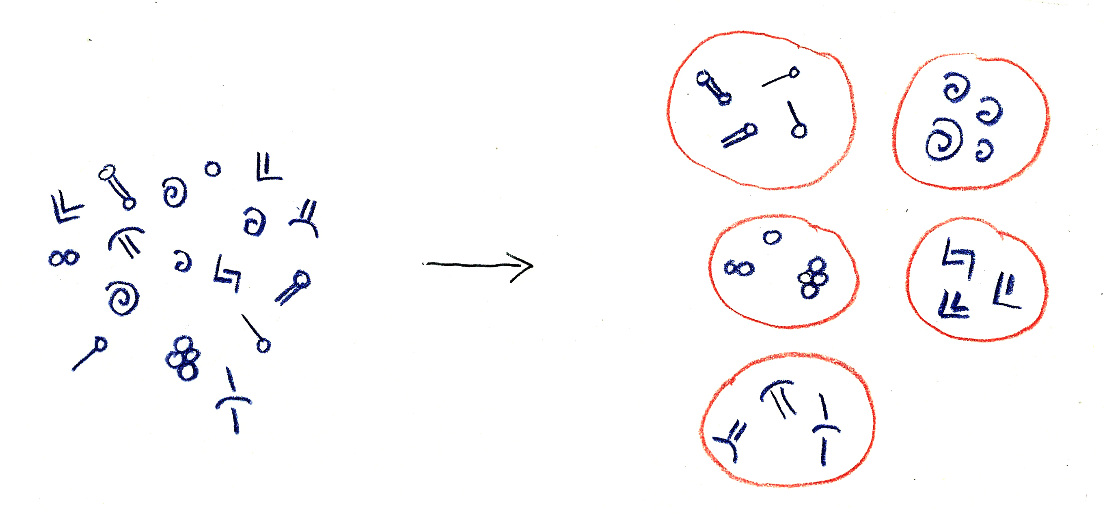
Unsupervised Learning

Slide 19
Reinforcement Learning
Correcting mistakes

Slide 20
Reinforcement Learning
DOG

Slide 21
Reinforcement Learning
DOG

Slide 22
Reinforcement Learning
DOG

Slide 23
Reinforcement Learning
CAT

Slide 24
Machine Learning

Slide 25
Deep Learning Neural Networks

Slide 27
Neural Networks

Slide 28
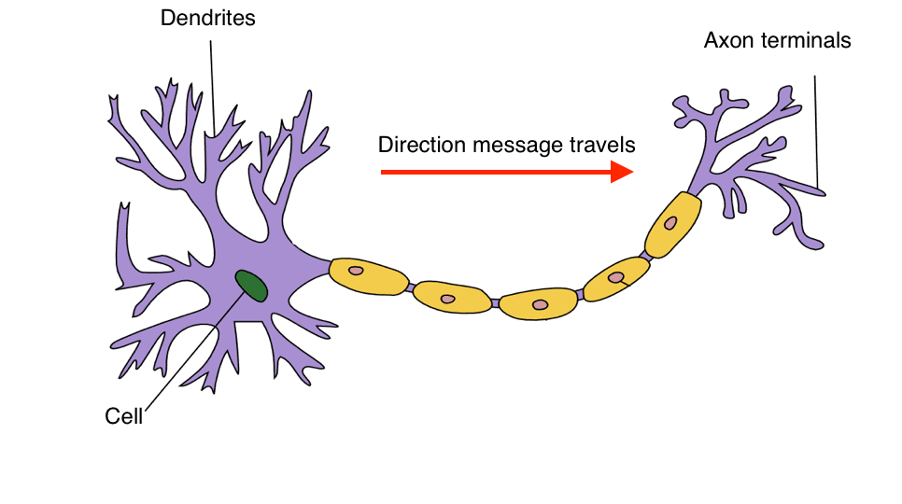
Axon

Slide 29
Axon

Slide 30
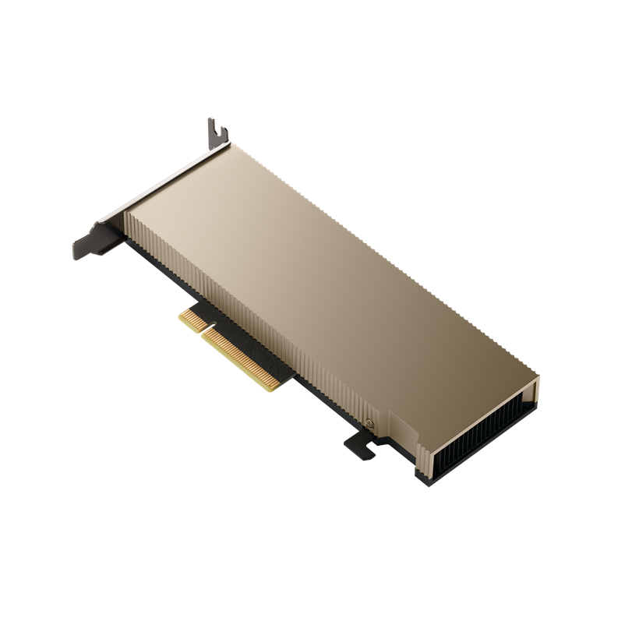
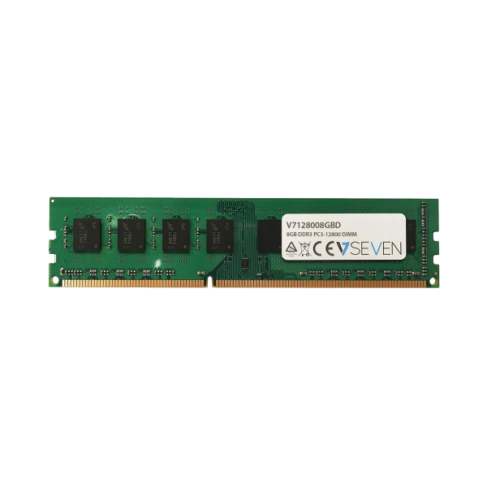

Slide 31
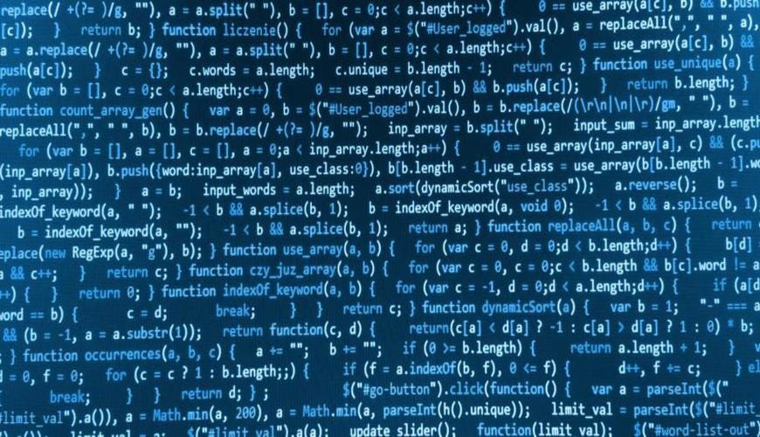
Very sophisticated programs

Slide 32
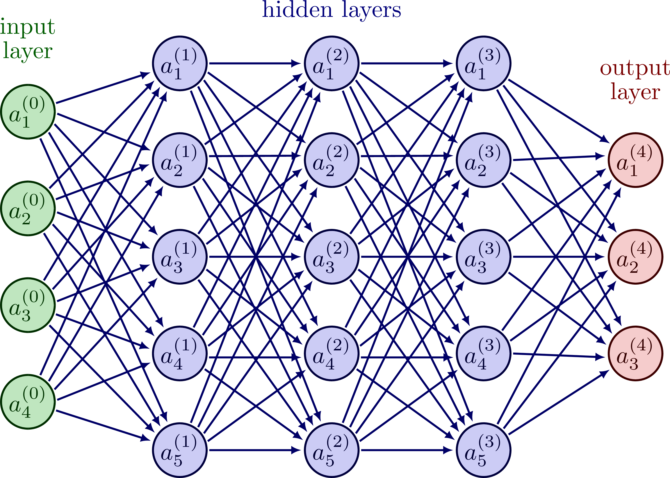
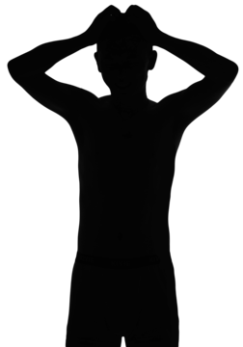
Very sophisticated programs
Notes:
Layers learn more than better more complexity to handle

Slide 33
Ability to learn

Slide 34
Gain insight

Slide 35
Feedforward Neural Networks
FNN is he most basic type of neural network.
They consist of an input layer, one or more hidden layers, and an output layer.
The data flows through the network in a forward direction, from the input layer to the output layer.
.

Slide 36
Feedforward Neural Networks
Feedforward neural networks are widely used for a variety of tasks, including image and speech recognition, natural language processing, and predictive modeling.
For example, a feedforward neural network could be used to predict the likelihood of a customer churning based on their past behavior.

Slide 37
Feedforward Neural Networks
In a feedforward neural network, the input data is passed through the network, and each neuron in the hidden layer(s) performs a weighted sum of the inputs, applies an activation function, and passes the output to the next layer.
The weights and biases of the neurons are adjusted during training to minimize the error between the predicted output and the actual output.

Slide 38
What is a perceptron
Perceptron is one of the simplest Artificial neural network architectures.
It was introduced by Frank Rosenblatt in 1957s.
It is the simplest type of feedforward neural network, consisting of a single layer of input nodes that are fully connected to a layer of output nodes.
It can learn the linearly separable patterns. it uses slightly different types of artificial neurons known as threshold logic units (TLU).
It was first introduced by McCulloch and Walter Pitts in the 1940s.

Slide 39
Perceptron
Single-Layer Perceptron (of input nodes):
This type of perceptron is limited to learning linearly separable patterns. effective for tasks where the data can be divided into distinct categories through a straight line.
Multilayer Perceptron:
Multilayer perceptrons possess enhanced processing capabilities as they consist of two or more layers, adept at handling more complex patterns and relationships within the data.

Slide 40
Multilayer Perceptron
MLP is a type of neural network that contains multiple layers of perceptrons. MLPs are a type of feedforward neural network and are commonly used for classification tasks.
Each layer in an MLP consists of multiple perceptrons, and the output of one layer is fed into the next layer as input. The input layer receives the raw data, and the output layer produces the final prediction. The hidden layers in between are responsible for transforming the input into a form that is suitable for the output layer.
Some applications of MLPs include image recognition, speech recognition, time series analysis, and natural language processing.

Slide 41
Recurrent Neural Networks
RNNs are commonly used for natural language processing tasks, such as language translation and text generation.
They can also be used for speech recognition and time series prediction. For example, an RNN could be used to generate a new sentence based on a given input sentence.

Slide 42
Recurrent Neural Networks
In an RNN, the input data is processed through a series of recurrent neurons, which take the current input and the output from the previous time step as input.
This allows the network to maintain a memory of previous inputs and context. The weights and biases of the neurons are adjusted during training to minimize the error between the predicted output and the actual output — a process called backpropagation.

Slide 43
Long Short-Term Memory
LSTM is a type of recurrent neural network (RNN) that is designed to handle long-term dependencies. It is composed of memory cells, input gates, output gates, and forget gates.

Slide 44
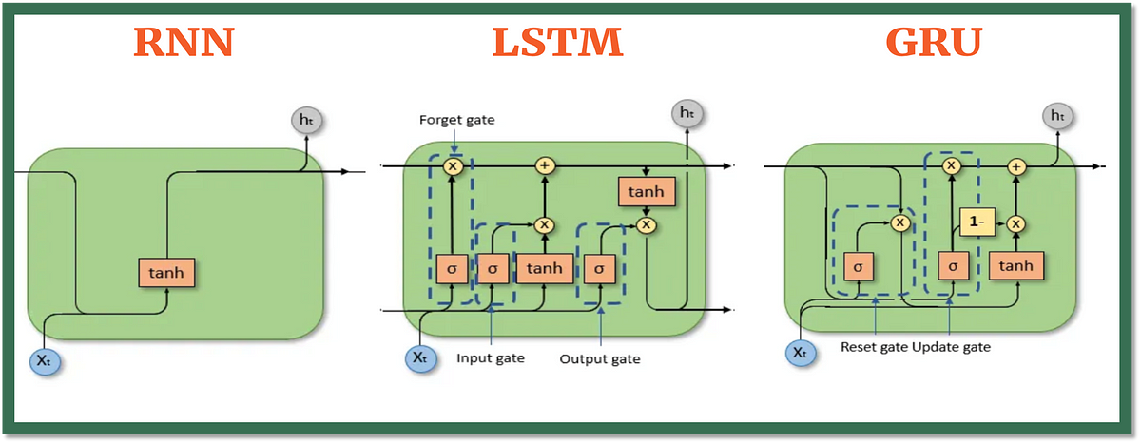
Long Short-Term Memory
LSTM networks are used in natural language processing tasks, such as speech recognition, text translation, and sentiment analysis. They are also used in the field of image recognition, where they are used to recognize objects and scenes within an image.

Slide 45
Long Short-Term Memory All
LSTM networks work by allowing information to flow through the memory cells over time.
The input gate determines which information should be stored in the memory cells, while the forget gate determines which information should be removed.
The output gate then determines which information should be passed on to the next layer.
This allows the network to remember important information over long periods of time and to selectively forget irrelevant information.

Slide 46
Long Short-Term Memory
LSTM networks have proven to be very effective in solving problems with long-term dependencies and are widely used in the field of natural language processing.
They are also used in speech recognition, handwriting recognition, and other applications where long-term memory is important.

Slide 47
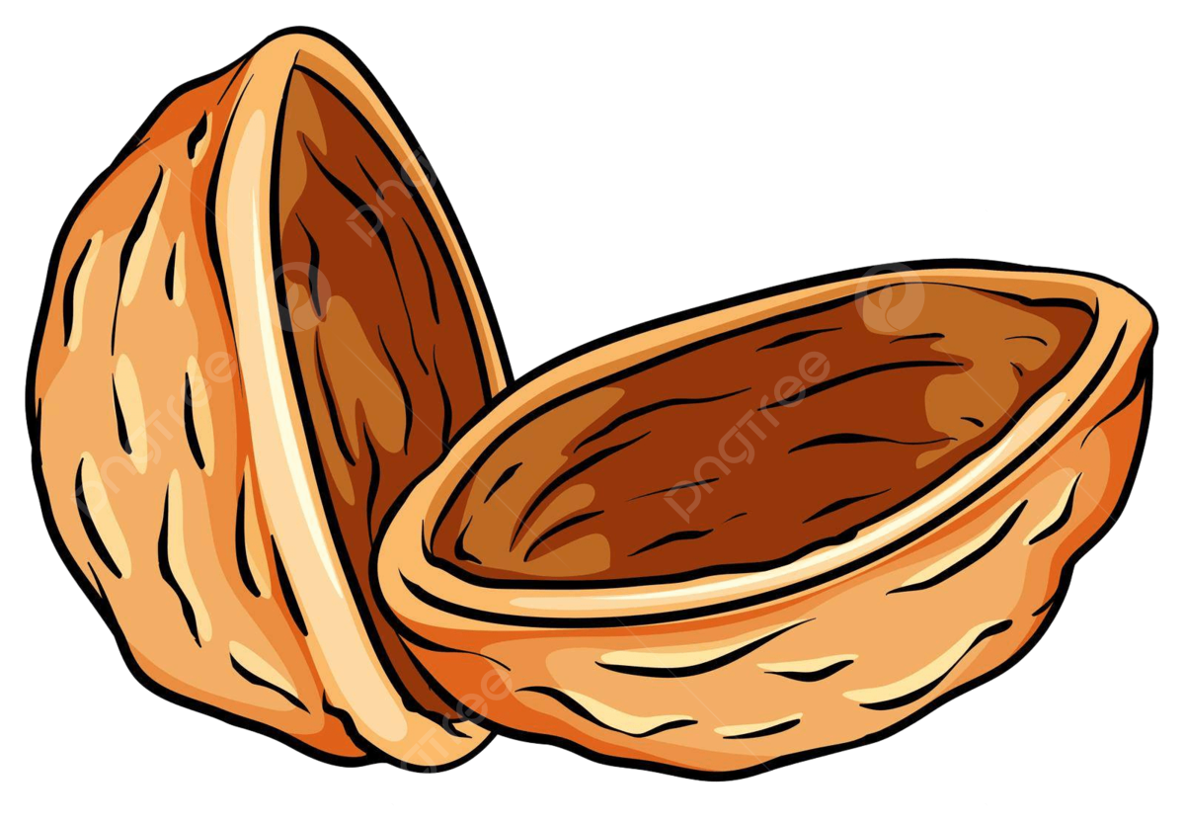
Long Short-Term Memory
LSTM is a type of recurrent neural network (RNN) that is designed to handle long-term dependencies. It is composed of memory cells, input gates, output gates, and forget gates.
LSTM networks are used in natural language processing tasks, such as speech recognition, text translation, and sentiment analysis. They are also used in the field of image recognition, where they are used to recognize objects and scenes within an image.
LSTM networks work by allowing information to flow through the memory cells over time. The input gate determines which information should be stored in the memory cells, while the forget gate determines which information should be removed.
The output gate then determines which information should be passed on to the next layer. This allows the network to remember important information over long periods of time and to selectively forget irrelevant information.
LSTM networks have proven to be very effective in solving problems with long-term dependencies and are widely used in the field of natural language processing. They are also used in speech recognition, handwriting recognition, and other applications where long-term memory is important.

Slide 48
Radial Basis Functional Neural Network
A RBF neural network is another type of feedforward neural network that uses a set of radial basis functions to transform its inputs into outputs. Like many neural networks, it is composed of three layers: the input layer, the hidden layer, and the output layer.

Slide 49
Radial Basis Functional Neural Network
RBF networks are commonly used for pattern recognition, classification, and control tasks. One of the most popular applications of RBF networks is in the field of image recognition, where they are used to identify objects within an image.

Slide 50
Radial Basis Functional Neural Network
The RBF network works by first transforming the input data using a set of radial basis functions. These functions calculate the distance between the input and a set of predefined centers in the hidden layer. The outputs from the hidden layer are then combined linearly to produce the final output. The weights of the connections between the hidden layer and the output layer are trained using a supervised learning algorithm, such as backpropagation.
RBF networks are often used for problems with large datasets because they can learn to generalize well and provide good predictions. They are also used for time-series analysis and prediction, as well as financial forecasting.

