Slide 1
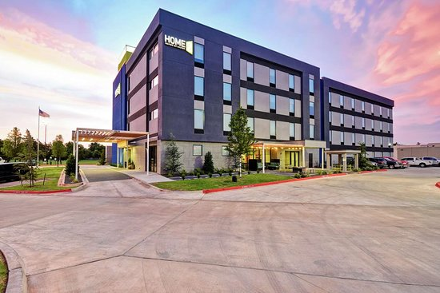
THE HOSPITALITY GROUP INVESTMENT OPPORTUNITY
Home 2 Suites
El Reno, Oklahoma (Oklahoma City)

Slide 2
Home 2 Suites EL RENO, OKLAHOMA (OKC)
1. Executive Summary
2. Location Overview
3. Sponsor
4. Case Study

Slide 3
Executive Summary
Sponsor is under contract to purchase the fee-simple interest in the institutional-quality Home 2 Suites , located in El Reno, OKC . This Hotel is an off-market acquisition in which the Hospitality group is offering the opportunity to invest with select investors. Sponsor’s business plan is to stabilize the subject property during COVID , reposition operations of the value add asset to drive revenue and increase profit margins gradually through COVID recovery. This subject property is projected to close by October 2020.
BUILDING OVERVIEW
Property Name | Home2 Suites by Hilton El Reno
Address | 1528 SW 27th St
City | El Reno, OK 73036
Brand | Home2 Suites
Acreage | 1.9
Keys | 85
PROJECT RETURNS
Hold Period | 5 Years
Levered IRR | 42.22%
Equity Multiple | 5.20x
PROJECT BASIS
Purchase Price | $8.3M
Closing Cost | $962.5k
Total CapEx | $0.00
Financing | $8.3M
Equity | $962.5k
TEAM
Sponsor | The Hospitality Group
Hotel Operator | Commonwealth Hotels

Slide 4
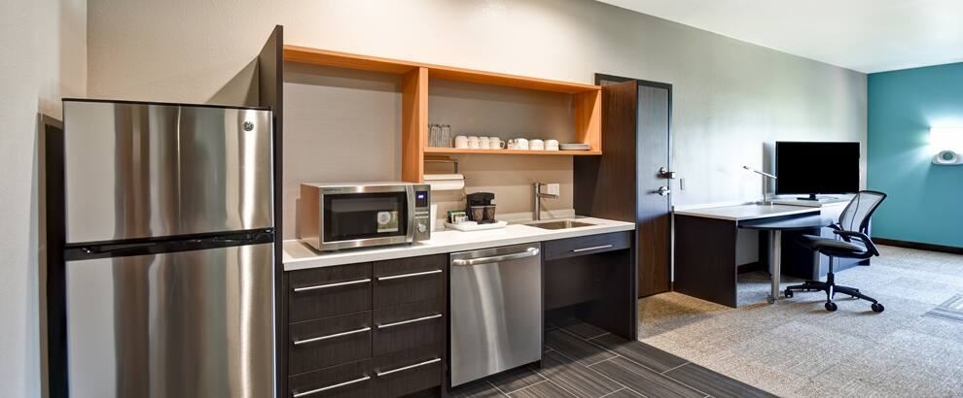
Investment Highlights
PREFERRED EQUITY POSITON
Participating investors will receive 50% of all net cash flow and disposition proceeds.
VALUE ADD INVESTMENT
This hotel is currently underperforming significantly due to COVID 19 and the reduction of oil pricing. This subject property is only three (3) years old and there are no renovations/PIP requirements needed to be addressed. Upon distribution of the vaccine for COVID globally we believe that subject property within 3 years will stabilize and return to its pre-COVID performance. Therefore this Home2 Suites will experience significant upside in margins.
BRAND AFFILIATION
Home2 Suites by Hilton is one of the fastest-growing brands in Hilton’s history, is a fresh take on the mid-tier, all-suite, award-winning extended-stay hotel concept designed to offer stylish accommodations with flexible guest room configurations and inspired amenities for the cost-conscious extended-stay traveler. The brand’s innovative prototype combined with our sustainable practices and products ensures cost-effective development and operation. Currently, Hilton has over 411 hotels in 2 countries of this brand

Slide 5
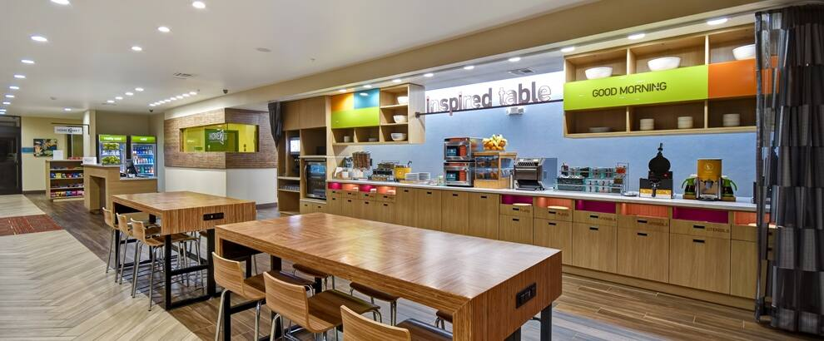
Business Plan
Sponsor’s business plan highlighted below is focused on funding the deficit for 6 – 8 months, operate and stabilize hotel as the market returns back to pre-covid. We will replace existing operations with quality efficiencies, and utilize local and national demand drivers to increase market share, profitability and value.
Action Steps
Reposition existing operations group
Fund interest reserve and operations reserve account for 10 -18 month for projected deficit
Return investors capital via refinance or exit investment
If Sponsors refinance, investors will receive initial capital and will retain ownership

Slide 6
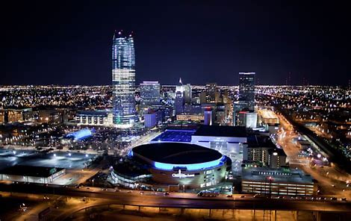
Sources & Uses
USES | Cost | Cost Per Key 85 | % of Total
Purchase Price | 8,300,000 | 97,647.06 | 89.61%
Closing Cost | 962,500 | 11,323.53 | 10.39%
Total CapEx |  | - | 0.00%
Total Uses | 9,262,500 | 108,971 | 100.00%
SOURCES | Cost | Cost Per Key 85 | % of Total
Equity | 962,500 | 11,323.53 | 10.39%
Financing
Debt | 8,300,000 | 97,647.06 | 89.61%
Total Sources | 9,262,500 | 108,971 | 100.00%
3 Year Projection | Project | Investor
Targeted Avg Cash Return | 16.7% | 8.35%
Target IRR | 54.49% | 32.25%
Equity Multiple | 3.56X | 2.28X
5 Year Projection | Project | Investor
Targeted Avg Cash Return | 22.41% | 11.20%
Target IRR | 44% | 27.80%
Equity Multiple | 5.32X | 3.16X

Slide 7
Stabilized Underwriting Comparison
To evaluate Home2 Suite operations, sponsor will leverage its experience in similarly situated properties such as those previously underwritten. TTM 2019 Summary as listed below. As stated due to COVID is operating at a negative deficit. By 2023 we expect to be back at 2019 TTM numbers. (See addendums)
3 Year
Room Revnue | $2,582,218
Expenses | $1,564,072
NOI | $1,018,146
Debt | $359,619
Cash Flow | $658,527

Slide 8
Stabilized Underwriting Comparison
To evaluate Home2 Suite operations, sponsor will leverage its experience in similarly situated properties such as those previously underwritten. TTM 2019 Summary as listed below. As stated due to COVID is operating at a negative deficit. By 2023 we expect to be back at 2019 TTM numbers. (See addendums)
5 Year

Slide 9
Investments Terms
Deal Terms
Investment | $962,500
Hotel Mgmt. Fee | 3.0% of Total Revenues
Hotel Incentive Mgmt. Fee | 10% of NOI excess of Budget
Acquisition Fee | 1.5% of Purchase Price
Asset Mgmt. Fee | 1% of Total Revenues
Project Cashflow 5 year
Project Cashflow
 | Close | Year 1 | Year 2 | Year 3 | Year 4 | Year 5 | Total Funds
Initial Investment | $ (962,500) |  |  |  |  | $962,500
Project Cashflow |  | $0 | $216,494 | $265,860 | $289,080 | $306,850
Net Sell Proceeds |  |  |  |  |  | $4,038,873
Total | $ (962,500) | $0 | $216,494 | $265,860 | $289,080 | $4,345,723 | $5,117,157
Targeted Cash Return |  | 0.00% | 22.49% | 27.62% | 30.03% | 31.88%
Targeted Avg Cash Return | 22.41%
Target Investor IRR | 44.00%
Equity Mutiplier | 5.32

Slide 10
Investments Terms
Deal Terms
Investment | $962,500
Hotel Mgmt. Fee | 3.0% of Total Revenues
Hotel Incentive Mgmt. Fee | 10% of NOI excess of Budget
Acquisition Fee | 1.5% of Purchase Price
Asset Mgmt. Fee | 1% of Total Revenues
Investor Cashflow 5 year
Investor Cashflow
 | Close | Year 1 | Year 2 | Year 3 | Year 4 | Year 5 | Total Funds
Initial Investment | $ (962,500) |  |  |  |  | $962,500
Project Cashflow |  | $0 | $ 108,246.83 | $ 132,929.98 | $ 144,539.81 | $153,425
Net Sell Proceeds |  |  |  |  |  | $1,538,187
Total | $ (962,500) | $0 | $108,247 | $132,930 | $144,540 | $2,654,112 | $3,039,828
Targeted Cash Return |  | 0.00% | 11.25% | 13.81% | 15.02% | 15.94%
Targeted Avg Cash Return | 11.20%
Target Investor IRR | 27.80%
Equity Mutiplier | 3.16

Slide 11
Investments Terms
Deal Terms
Illustrative Equity Table
The following table reflects a $50,000 investment made by an investor into the project
Investment | $962,500
Hotel Mgmt. Fee | 3.0% of Total Revenues
Hotel Incentive Mgmt. Fee | 10% of NOI excess of Budget
Acquisition Fee | 1.5% of Purchase Price
Asset Mgmt. Fee | 1% of Total Revenues
 | Purchase
Total Equity Required | $962,500
Illustrative Investment | $50,000
Illustrative LP % of Total | 5.19%
Net Distributions of a $50,000 Initial Investment
 | Close | Year 1 | Year 2 | Year 3 | Year 4 | Year 5 | Total Funds
Initial Investment | $ (50,000) |  |  |  |  | $50,000
Project Cashflow |  | $0 | $5,623 | $6,905 | $7,509 | $7,970
Net Sell Proceeds |  |  |  |  |  | $79,906
Total | $ (50,000) | $0 | $5,623 | $6,905 | $7,509 | $137,876 | $157,913
% of Total Equity | 5.195%
Targeted Cash Return |  | 0.00% | 11.25% | 13.81% | 15.02% | 15.94%
Targeted Avg Cash Return | 11.20%
Target Investor IRR | 27.80%
Equity Mutiplier | 3.16

Slide 12
Investments Terms
Deal Terms
Illustrative Equity Table
The following table reflects a $100,000 investment made by an investor into the project
Investment | $962,500
Hotel Mgmt. Fee | 3.0% of Total Revenues
Hotel Incentive Mgmt. Fee | 10% of NOI excess of Budget
Acquisition Fee | 1.5% of Purchase Price
Asset Mgmt. Fee | 1% of Total Revenues
 | Purchase
Total Equity Required | $962,500
Illustrative Investment | $100,00
Illustrative LP % of Total | 10.39%
Net Distributions of a $100,000 Initial Investment
 | Close | Year 1 | Year 2 | Year 3 | Year 4 | Year 5 | Total Funds
Initial Investment | $ (100,000) |  |  |  |  | $100,000
Project Cashflow |  | $0 | $11,246 | $13,811 | $15,017 | $15,940
Net Sell Proceeds |  |  |  |  |  | $159,812
Total | $ (100,000) | $0 | $11,246 | $13,811 | $15,017 | $275,752 | $315,826.32
% of Total Equity | 10.39%
Targeted Cash Return |  | 0.00% | 11.25% | 13.81% | 15.02% | 15.94%
Targeted Avg Cash Return | 11.20%
Target Investor IRR | 27.80%
Equity Mutiplier | 3.16

Slide 13
Investments Terms
Deal Terms
Illustrative Equity Table
The following table reflects a $250,000 investment made by an investor into the project
Investment | $962,500
Hotel Mgmt. Fee | 3.0% of Total Revenues
Hotel Incentive Mgmt. Fee | 10% of NOI excess of Budget
Acquisition Fee | 1.5% of Purchase Price
Asset Mgmt. Fee | 1% of Total Revenues
 | Purchase
Total Equity Required | $962,500
Illustrative Investment | $250,000
Illustrative LP % of Total | 25.97%
Net Distributions of a $250,000 Initial Investment
 | Close | Year 1 | Year 2 | Year 3 | Year 4 | Year 5 | Total Funds
Initial Investment | $ (250,000) |  |  |  |  | $250,000
Project Cashflow |  | $0 | $28,116 | $34,527 | $37,543 | $39,851
Net Sell Proceeds |  |  |  |  |  | $399,529
Total | $ (250,000) | $0 | $28,116 | $34,527 | $37,543 | $689,380 | $789,566
% of Total Equity | 25.97%
Targeted Cash Return |  | 0.00% | 11.25% | 13.81% | 15.02% | 15.94%
Targeted Avg Cash Return | 11.20%
Target Investor IRR | 27.80%
Equity Mutiplier | 3.16

Slide 14
Ownership Structure
Hospitality Group OKC –Portfolio
The Hospitality Group
(Developers)
Investors, LP
(Investor Capital)
Commonwealth
Hotels
(Management)
HG Management
Hotels
(Asset Management)

Slide 15
`
1. Executive Summary
2. Location Overview
3. Sponsor
4. Case Study

Slide 16
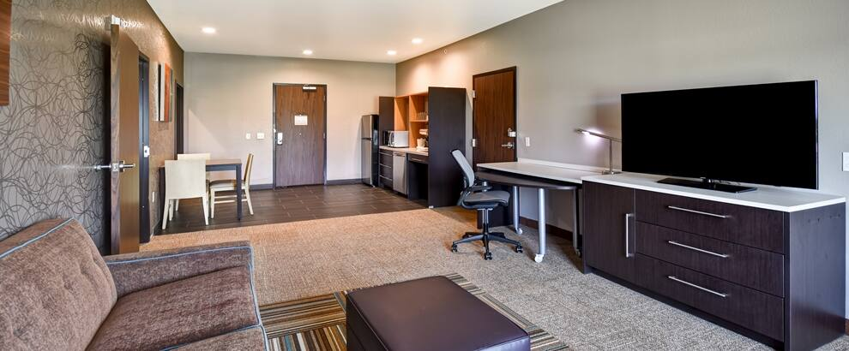
Property Description
LOCATION
El Reno is a city in and county seat of Canadian County, Oklahoma, United States. As of the 2010 census, the city population was 16,729. The city was begun shortly after the 1889 land rush and named for the nearby Fort Reno. It is located in Central Oklahoma, about 25 miles (40 km) west of downtown Oklahoma City and is part of the Oklahoma City Metropolitan Statistical Area, which is a tier 2 city with a total population of over 1.2 Million (2010 census).
PROPERTY DETAILS
Address | 1528 SW 27th St El Reno, OK 73036
Year Built/Converted | 2017
Number of Rooms | 85
Number of Floors | 4-story
Food & Beverage | The Market
Meeting Space
Other Amenities | 24/7 Fitness center, indoor pool, outdoor patio/fireplace
Interest | Fee Simple
Affiliation | Hilton
Management | Unencumbered
Site Size | 1.92
Building Size | 54,600

Slide 17
1. Executive Summary
2. Location Overview
3. Sponsor
4. Case Study

Slide 18
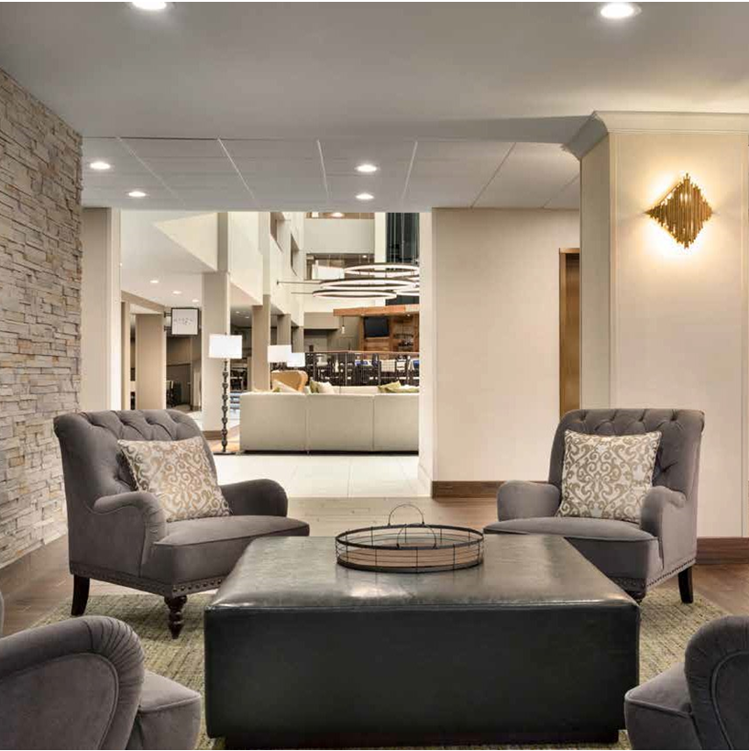
Sponsor & Execution Leadership
The Hospitality Group and Commonwealth Hotels have come together to partner on this project, bringing a strong breadth of experience in vertically integrated real estate investment, development, and hotel management.
The Hospitality Group is a vertically integrated real estate investment, development, construction and management group that focuses on ground up, value add hotel opportunities and real estate projects.
Commonwealth is a full service hotel management company which successfully operates a wide variety of premium hotel brands nationally A world class hospitality company, they are sought after for their exceptional guest and associate satisfaction, market premiums and superior return on investment. Commonwealth achieves exceptional performance, outperforming industry average operating profit by over 10%, resulting in superior hotel values for investors.
Platform Overview:
238 Ground Up Hotels
6,081 keys under management, 48 hotels, representing $1.5 billion in real estate value
67 hotel renovation projects
Over 1.7k employees

Slide 19
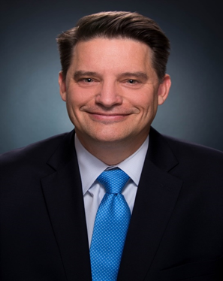
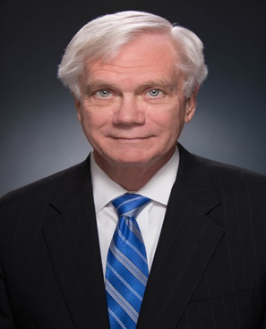
Project Execution / Management
Brian Fry
Dan Fay
19 Years in Real Estate
Construction Management
Nate Barger
30 years in Hospitality & Development
Hilton, GE Capital, Winston Hotels
35 years in Hospitality & Development
Stouffer, Hilton, Hyatt and Marriott
Paul Stanton
Michael Ealy
Daniel Nguyen
25 years in Hospitality & Development
International operations, Disney Hilton, Marriott Choice Brands
20 years in Real Estate
Senior Analyst
10 years in Real Estate
Investor Relations

Slide 20
1. Executive Summary
2. Location Overview
3. Sponsor
4. Case Study

Slide 21
Competitive Analysis Competitive Set
Another key factor is designated in the occupancy index. Prior to COVID this HOME2 Suites was leading the comp set.
Occupancy (%) |  |  |  |  | ADR |  |  |  |  | RevPAR
 | My Prop | Comp Set | Index (MPI) |  |  | My Prop | Comp Set | Index (ARI) |  |  | My Prop | Comp Set | Index (RGI)
 | 77.4 | 71.6 | 108.1 |  |  | 92.79 | 91.07 | 101.9 |  |  | 71.85 | 65.22 | 110.2
Name | City, State | Rooms | Open Date
Home2 Suites by Hilton El Reno | El Reno, OK | 85 | 2017
Best Western Plus Yukon | Yukon, OK | 69 | 2000
La Quinta Inns & Suites Oklahoma City Yukon | Yukon, OK | 80 | 2008
Fairfield Inn & Suites Oklahoma City Yukon | Yukon, OK | 94 | 2014
Home2 Suites by Hilton Oklahoma City Yukon | Yukon, OK | 89 | 2016
 |  | 417

Slide 22
Addendum
This presentation contains select information about The Hospitality Group, LLC (“HG”) and its affiliates, and about the assets that HG manages. This presentation has been prepared and is being furnished solely for informational purposes. In particular, this presentation is not, and is not intended to be, an offer to sell, or a solicitation of an offer to purchase, any securities or any other interest in HG or in any account or other investment product or assets managed by HG or to offer any services. Any such offering and sale would be made only on the basis of certain transaction documents and, as the case may be, a final private placement memorandum and related governing and subscription document (together, “Transaction Documents”) pertaining to such offering and sale and is qualified in all respects and in its entirety by any such final Transaction Documents.
The views and statements expressed herein are those solely of HG. This presentation contains preliminary information only, is subject to change at any time and is not, and should not be assumed to be, complete or to constitute all the information necessary to adequately make an investment decision. No representation is made as to the accuracy or completeness of the information set for herein.
The information contained in this presentation is based in part on past performance and certain assumptions, particularly about future growth. These assumptions have certain inherent limitations, and will be affected by any changes in the structure, criteria or assets involved in particular transactions. The assumptions identified in this presentation do not represent all of the assumptions used to try to determine future growth. Actual performance may differ, and may differ substantially, from that set forth in this presentation. The terms and characteristics of any investment with HG or in any account or other investment product or assets managed by HG may change based on economic and market conditions. Past performance is no guarantee of future results. HG assumes no obligation to update or otherwise revise any projections, forecasts or estimates contained in this presentation, including any revisions to reflect changes in economic or market conditions or other circumstances arising after the date of this presentation or to reflect the occurrence of unanticipated event.
This presentation is provided to you on the understanding that, as a sophisticated investor, you will understand and accept its inherent limitations, will not rely on it in making any decision to invest with HG, in any account or other investment product or assets managed by HG. In making any investment decision, you should conduct, and must rely on your own investigation and analysis of the data and descriptions set forth in this presentation, including the merits and risks involved.
As will be provided in any applicable Transaction Documents, any investment in HG or in any account or other investment product or assets managed by HG, is suitable only as an investment for, and will be offered only to, persons who have, directly or through qualified representatives, the ability to evaluate the merits and risks of any such investment and the ability to assume the economic risks involved in any such an investment. Certain information contained herein constitutes “forward-looking statements,” which can be identified by use of forward-looking terminology such as “may,” ‘’will,” “should,” “expect,” “attempt,” “anticipate,” “project,” “estimate,” “intend,” “seek,” “target,” “continue,” or “believe,” or the negatives thereof or other variations thereon or comparable terminology. Due to the various risks and uncertainties, actual events or results in the actual performance of investments may differ materially from those reflected or contemplated in such forward-looking statements.
The contents of this presentation are not to be construed as legal, regulatory, business, accounting or tax advice. You should consult your own attorney, business advisor, accountant and tax advisor as to legal, regulatory, business, accounting and tax advice.
This presentation is confidential. Any reproduction or distribution of this presentation, in whole or in part, or the disclosure of the contents hereof, without the prior written consent of HG, is prohibited.
By receiving the presentation, you acknowledge and represent to HG that you have read, understood and accept the terms of this presentation and acknowledge and agree that the presentation is confidential, non-public and/or proprietary information.
The distribution of this presentation in certain jurisdictions may be restricted by law. You should inform yourself as to the legal requirements and tax consequences of an investment within the countries of your citizenship, residence, domicile and place of business.
RETURNS
Target and estimated equity returns are derived by HG from analyses based upon market experience, including data related to leasing and operating expenses, market expectations and historical averages related to the risk/return profile and generally accepted criteria for making investments in the type of anticipated investments. HG’s targets are based on the expected cumulative returns generated by a series of real estate investments across a multi-year investment period. HG’s estimates are based on the expected cumulative returns generated across a multi-year investment period. Target and estimated returns are also based on certain assumptions including, but not limited to, anticipated hold period, market conditions, default rates, tenant credit stability and turnover, exit strategies and availability and cost of financing. Targets, estimates or other forecasts contained herein are based upon subjective estimates and assumptions about circumstances and events that may not yet have taken place and may never take place. If any of the assumptions used do not prove to be true, results may vary substantially from the target return. Target and estimate returns shown are pre-tax and represent possible returns that may be achieved only for the period of time expressly identified. HG makes no guarantee that targeted or estimated returns will be achieved. Targets and estimates are objectives and should not be construed as providing any assurance as to the results that may be realized in the future from investments. Many factors affect performance including changes in market conditions and interest rates and changes in response to other economic, political or financial developments. Any targets and estimates are being shown for information purposes only and should not be relied upon to make predictions of actual future performances. The information underlying any forecasts has been obtained from or is based upon sources believed to be reliable, but HG assumes no responsibility for, and makes no representation or warranty, expressed or implied as to the adequacy, accuracy or completeness of any such information.
Past performance is no guarantee of future results, and there can be no assurance that future investments offered by HG will achieve comparable results to any of the prior performance information contained herein or that targeted returns or other measuring standards will be met.
All financial projections presented herein, and all forward-looking statements (identified by use of words such as “expects,” “anticipates,” “intends,” “may,” and similar expressions), should be considered speculative and are qualified in their entirety by the assumptions, information and risks is closed in the Private Placement Memorandum. The assumptions and facts upon which the financial projections are based are subject to variations that may arise as future events actually occur and are based on assumptions made by HG regarding future events. Prospective investors are advised to consult with their financial and business advisors concerning the validity and reasonableness of the factual and accounting assumptions

